Slide 1
The Harriet Lane Pediatric Residency Program Health Equity Track

Slide 2
What is Health Equity? Why does it matter?

Slide 3
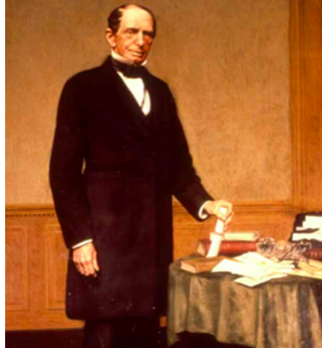
It is my wish that the plan...shall provide for a hospital, which shall, in construction and arrangement, compare favorably with any institution of like character in this country or in Europe...
The indigent sick of this city and its environs, without regard to sex, age, or color, who may require surgical or medical treatment, and who can be received into the hospital…and the poor of this city and state, of all races, who are stricken down by any casualty, shall be received into the hospital, without charge.
- Johns Hopkins, 1876

Slide 4
Hopkins Pediatric Health Equity Track
We envision a world where every child, regardless of their background, has the opportunity to reach their full potential.
We aim to train pediatric leaders who will work to eliminate health disparities through advocacy, research, community partnership, education, and clinical care.
The program will leverage resources across Johns Hopkins to provide graduates with a unique skill set that will equip them to make an impact for children affected by health disparities.

Slide 5
Hopkins Pediatric Health Equity Track
Overarching goal is to train pediatric leaders who will work to promote health equity through advocacy, research, community partnership, education, and clinical care.
To increase knowledge related to social determinants of health and health disparities in pediatric populations
To learn about the role of community partnership and advocacy in promoting health equity
To develop skills in culturally competent clinical care
To engage in scholarship related to health equity

Slide 6
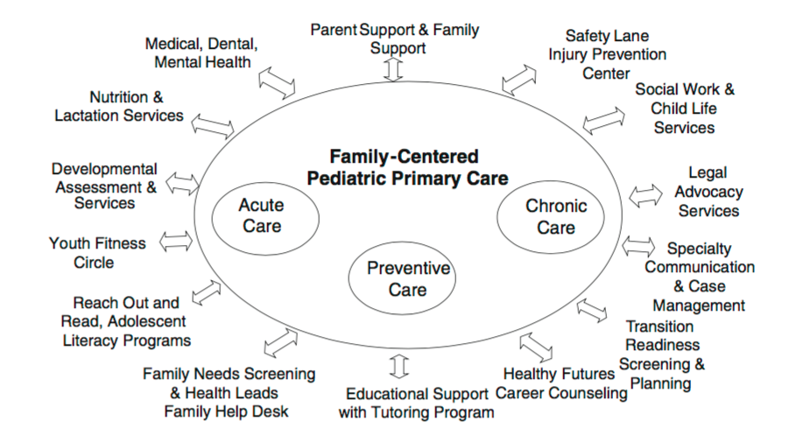
Harriet Lane Clinic
Continuous
Comprehensive
Coordinated
Compassionate
Culturally Effective
Cheng T & Solomon B. Mat Child Health J Feb 2014

Slide 7
Capstone project in coordination with mentors with dedicated time
Facilitate presentation at regional/national meetings
Scholarship
Courses at JHBSPH
Advocacy rotations
Community experiences
Electives with health equity focus
Advocacy & Skill Building
Longitudinal track mentor(s) from Hopkins Faculty
Linking to institutional resources
Individualized learning plan
Mentorship

Slide 8
1-2 months of elective time dedicated to Health Equity individualized learning plan
Complete capstone project
Attend national meeting
PGY3
1-2 months of elective time dedicated to Health Equity individualized learning plan
Begin capstone project
PGY2
Health Equity selective – 1 mo Spring
Online Course at JHBSPH Local and Global Best Practices in Health Equity Research Methods
Choose capstone project topic
PGY1
Throughout residency:
Scholarship
Half-days
Elec, ED
Avg 6 per 6 mo starting after Jan
Center for Equity
Longitudinal Social Determinants
of Health Curriculum
Urban Health
Academic Half Days
Noon Conf Once/Month
JC and Book Club
Serve on Health Equity Track Advisory Board
Meetings with
Content Experts

Slide 9
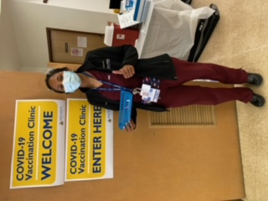
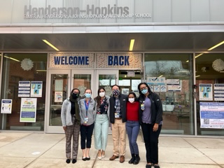
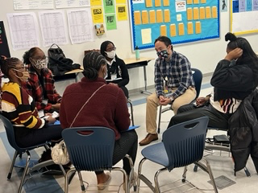
Community Engagement Experiences

Slide 10
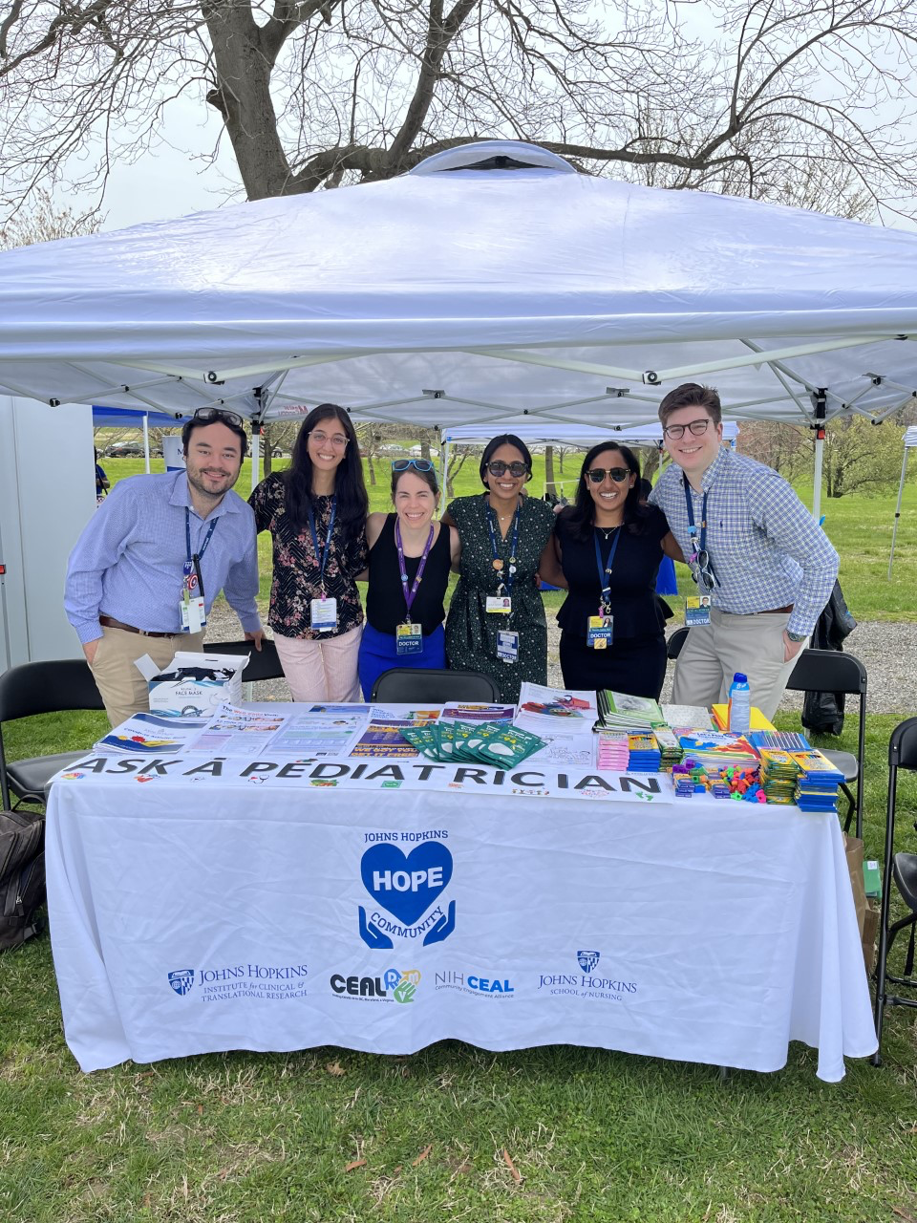
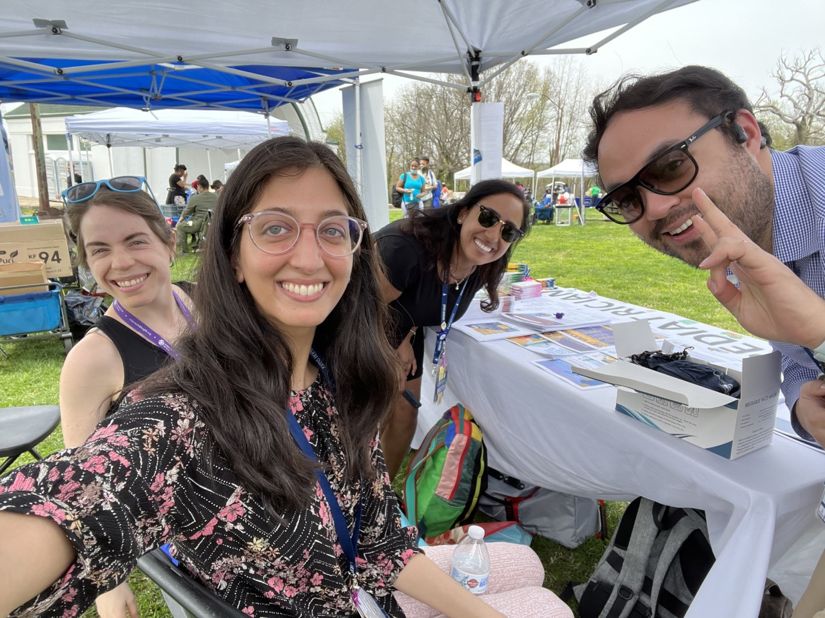
Community Engagement Experiences

Slide 11
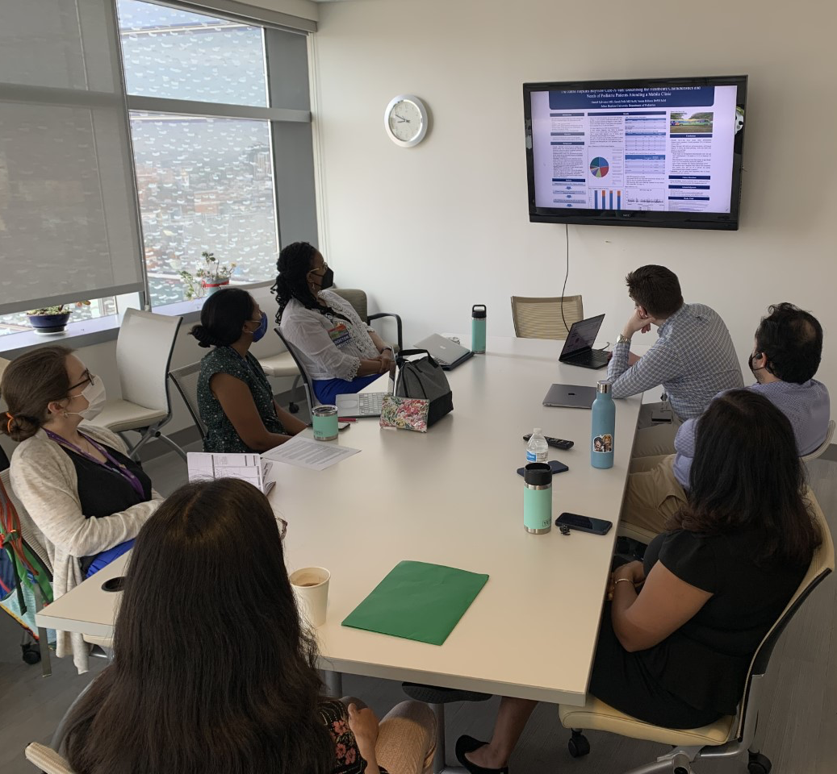
Research In Progress

Slide 12
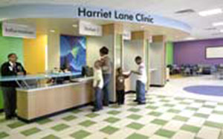
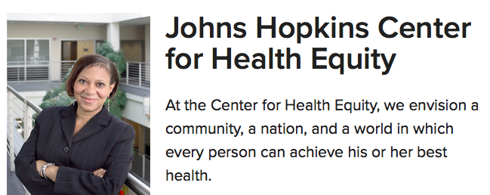

Slide 13
Hopkins Pediatric Health Equity Track
The track will leverage relationships and collaborations across the department and the institution including:
Johns Hopkins School of Medicine
The Center for Child and Community Health Research
Centro Sol – Center for Salud Health & Opportunities for Latinos
Center for Transgender Health
Rales Center for the Integration of Health and Education
Johns Hopkins University
Center for Health Equity
Urban Health Institute
Bloomberg School of Public Health
Bloomberg American Health Initiative
Center for Adolescent Health
Center for Gun Policy and Research
Center for Injury Research and Policy
Center for Prevention of Youth Violence
The Child and Adolescent Health Measurement Initiative
Department of Population, Family, and Reproductive Health

Slide 14
Pediatric Residency Health Equity Track Advisory Board
Maria Trent, MD MPH
Adolescent Medicine
Fellowship Director
Lisa A. Cooper, MD MPH
General Internal Medicine
Director, Center for Health Equity
Joshua M. Sharfstein, MD
Director, Bloomberg American Health Initiative
Sara B. Johnson, PhD
Division of General Pediatrics
Rales Center
Deidra Crews MD, ScM
Vice Chair for Diversity and Inclusion
Associate Director of Research Development, Center for Health Equity
Megan M. Tschudy, MD MPH
Division of General Pediatrics
Sara Polk, MD, ScM
Centro SOL
Medical Director, Children’s Medical Practice, Bayview
Barry S. Solomon, MD MPH
Interim Division Chair
General Pediatrics
Lenny Feldman, MD
Director, Medicine-Pediatrics Urban Health Residency Program
Amaris Keiser, MD
Division of Neonatology
Jacky Jennings, MPH, PhD
Director, Center for Child & Community Health Research (CCHR)

Slide 15
Meet Our Residents

Slide 16
PGY-1 HE Resident
Hometown: Nova Friburgo, Brazil & Deerfield Beach, Florida
Med School: UNC Chapel Hill
Why Hopkins HE: To me, being a great pediatrician means knowing everything I can about addressing health inequities and understanding how to apply that knowledge in a practical way in my day-to-day life as a physician. I wanted a program where Health Equity was built into the structure of the program itself as well as the hospital system. There are so many resources to address inequities built into the way we learn to care for patients here and learning to make those connections in residency is invaluable.
Health Equity Interests: Food insecurity (especially the availability of healthy foods), Hispanic/latino healthcare, disparities in kidney transplants/chronic kidney disease
Rafi Faria MD

Slide 17
PGY-1 HE Resident
Hometown: Minneapolis, MN
Medical School: University of Minnesota Medical School
Relevant Experiences: AmeriCorps City Year, SNAP-Ed Community Educator, MPH in Public Health Nutrition
Why Hopkins HE- I was looking for a program that would allow me to have dedicated time to engage in health equity work and learn from incredible mentors in the field. I am not sure what I want to do after residency, so I was grateful to find a program that was not specifically tied to primary care, and would allow me to apply my interests in health equity to whatever career path I end up choosing.
HE interests: Reproductive Justice and social determinants of health
Cecilia Di Caprio MD, MPH

Slide 18
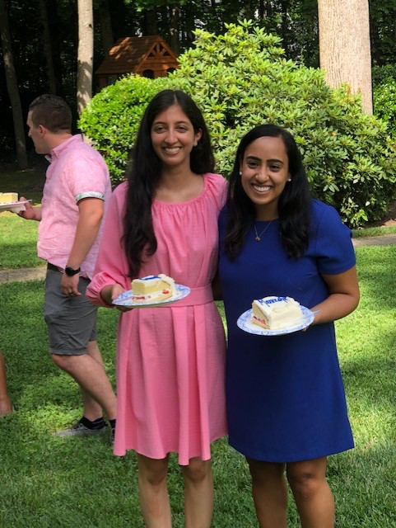
PGY-2 HE Residents
Devki Gami MD, MA
Medical School: Temple University
Additional Training: Master's in Urban Bioethics
Relevant Experience: City Year AmeriCorps
Health Equity Interest: School-based health centers
Maneesha Sakhuja MD, MPH
Medical School: University of Nevada
Additional Training: Masters Johns Hopkins Bloomberg School of Public Health.
Relevant Experience: Staff member on a federal advisory committee on bioethics.
Health Equity Interest: Intersection of public health, ethics, and policy

Slide 19
PGY-3 HE Resident
Medical School: George Washington University School of Medicine
Relevant Life Experiences: Teacher and New York Center for Childhood Development
Health Equity Interest: Barriers to care management among teens with chronic kidney disease
Why Hopkins: Dedicated time and space to think about and work towards addressing issues related to health equity. The HE track creates a home base for me that continues to remind me of my broader interests and helps me maintain perspective. I also like that the track is non-binding in terms of career choices (eg, it is not a strictly primary care track).
Amali Gunawardana MD

Slide 20
PGY-3 HE Resident
Medical School: Johns Hopkins School of Medicine
Health Equity Interest:
- High acuity trauma during the COVID19 era compared to previous years, especially looking at child abuse and assaults in lower SES zip codes of Baltimore.
- Neonatal Abstinence Syndrome- Increasing parental engagement
Why Hopkins: “I truly found a 'home' in the Pediatrics Department at Johns Hopkins as a medical student. Many attendings and residents I had a chance to work with not only taught me the skill of observation needed in pediatric medicine but also how to identify and combat the social determinants of health in the children we cared for
Tai Hairston MD

Slide 21
Alumni
Medical School: SUNY Downstate
Additional Training: MPH Health Policy and Management
Health Equity Interest: Legislative advocacy - qualitative research project interviewing youth to elucidate perspectives surrounding voting.
Why Health Equity: I'd love to combine my work as a pediatrician with community advocacy and non-fiction writing, like composing op-eds for newspapers and elevating patient voices to catalyze policy change.
Where are they now? Pediatric EM Physician at Howard County Hospital
Melissa Hirsch MD, MPH

Slide 22
Alumni
Medical School: Boston University
Health Equity Interest: immigrant and refugee health and medical education. I am working on a retrospective analysis of patients who attend the Mobile Care-a-Van Clinic.
Why Hopkins: I was impressed by the track leadership and their vision for the program, the chance get support and protected time for advocacy and whatever my eventual project direction would be, and the flexibility the track offered me to pursue a variety of career interest during residency.
Where are they now? Pediatric Hospitalist at CHOP
Dan Sylvester MD

Slide 23
Residents Making Waves in Health Disparities and Inequities Research
Amali- PGY-3
- Best Research Project Johns Hopkins Scholarly Achievement Day 2022. Baltimore MD
- Abstract acceptance- American Academy of Pediatrics Experience National Conference 2022, Anaheim, CA
Tai- PGY-3
-Renae Jenkins Research Symposium Award, National Medical Association 2021
- Platform Presentation," COVID-10 Trauma and Health Disparities" National Medical Association Convention 2021
- Platform Presentation," COVID-10 Trauma and Health Disparities" Society for Academic Emergency Medicine 2021
Poster Presentation. " COVID-10 Trauma and Health Disparities". Pediatric Academic Society 2021

Slide 24
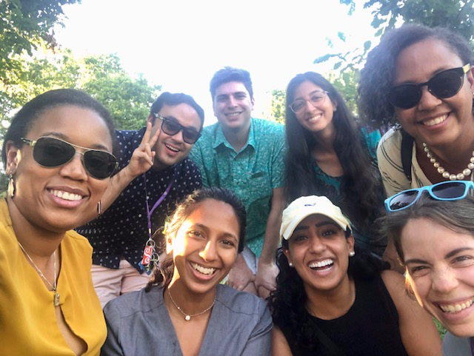
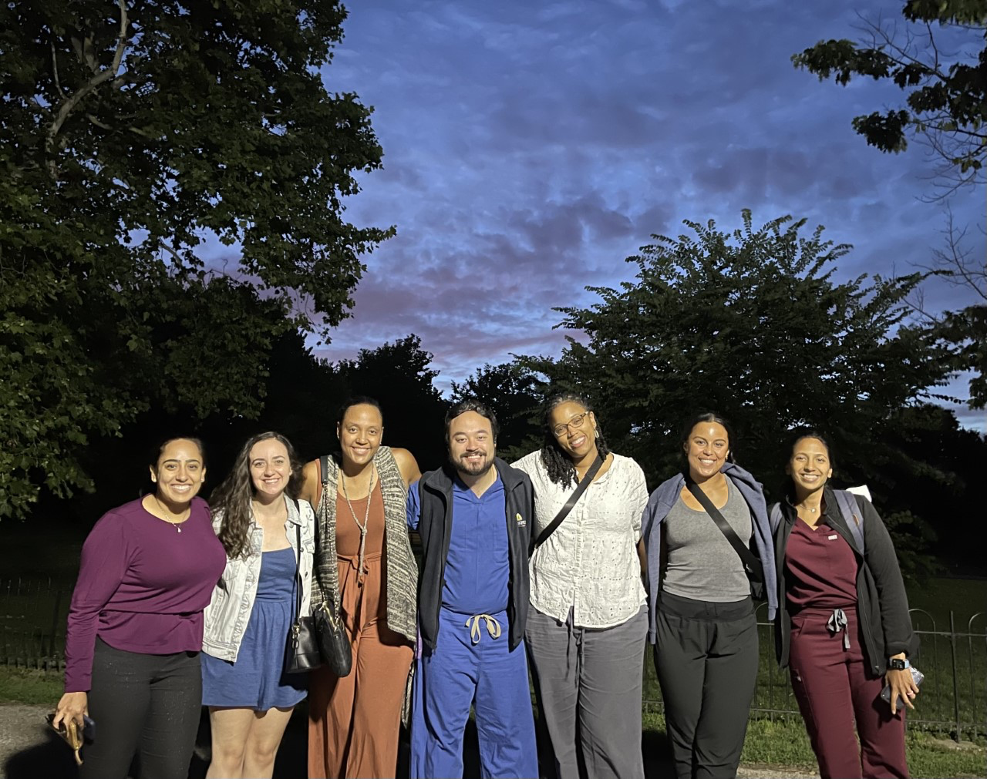
The Harriet Lane Pediatric Residency Program Health Equity Track- Join Us!

Slide 25
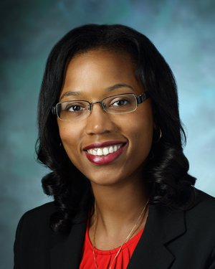
Questions?
Marquita Genies, MD MPH
APD, Pediatric Residency Training
Health Equity Track Co-Director
Assistant Professor of Pediatrics
Associate Vice Chair of Faculty Development, Diversity, Equity and Inclusion
Division of Pediatric Hospital Medicine
Johns Hopkins University School of Medicine
Email: MGenies1@jhmi.edu
Nakiya Showell, MD MPH
APD, Pediatric Residency Training
Health Equity Track Co-Director
Assistant Professor of Pediatrics
Division of General Pediatrics
Johns Hopkins University School of Medicine
Email: NShowel1@jhmi.edu

