Slide 1

The Harriet Lane Pediatric Residency Program
Global Health Track
Notes:
We have created a structure that overview that we’re very excited about.
We are looking for applicants with a passion for global health who not only want to participate in the track, but also to help us refine the program in the upcoming years.

Slide 2
Overview
Why global health?
Institutional resources
Track structure overview
Mentorship and advisory board
Notes:
Informal, please interrupt with questions.
Overview of institutional resources that would be available to you as a global health track resident.
Discuss our vision for the structure of this new track
And highlight some of the amazing mentors who are committed to working with you making this track a really unique and important program nationally.

Slide 3

Hopkins Pediatric Global Health Track
We envision a world where every child, regardless of their background, has the opportunity to reach their full potential.
We aim to train pediatric leaders who will work in the field of global health to eliminate health disparities through advocacy, research, community partnership, education, and clinical care.
The program will leverage world-renown resources across Johns Hopkins to provide graduates with a unique skill set that will equip them to make an impact for children both domestically and in limited resource settings.
Notes:
Our mission/vision

Slide 4
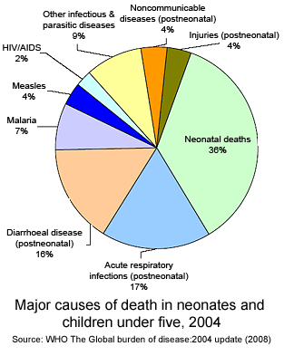
Global Health Threats to Children
9.2 Million Children < 5 yrs of age die every year
  99% of these deaths are in developing countries
  8.4 million are avoidable
  Shann, PCCM 2009
Notes:
80% of these are estimated to be avoidable (Jones et al, 2003)
Improvement in education surrounding emergency management of pediatric patients is key factor
Currently, few programs exist to address this need or remediate the existing educational deficits
Programs must take into account cultural and resource specific considerations if they will be effective

Slide 5
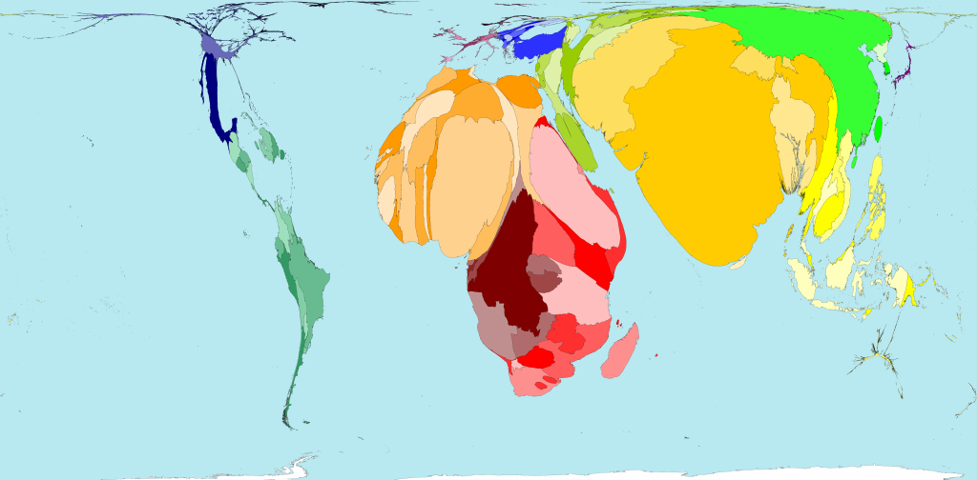
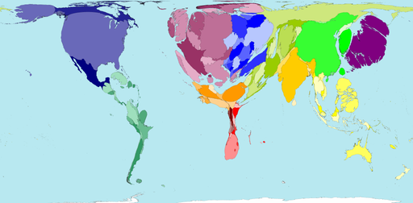
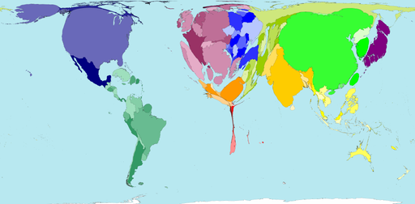
Nurses Working
Under 5 Mortality
Doctors Working
www.worldmapper.com

Slide 6
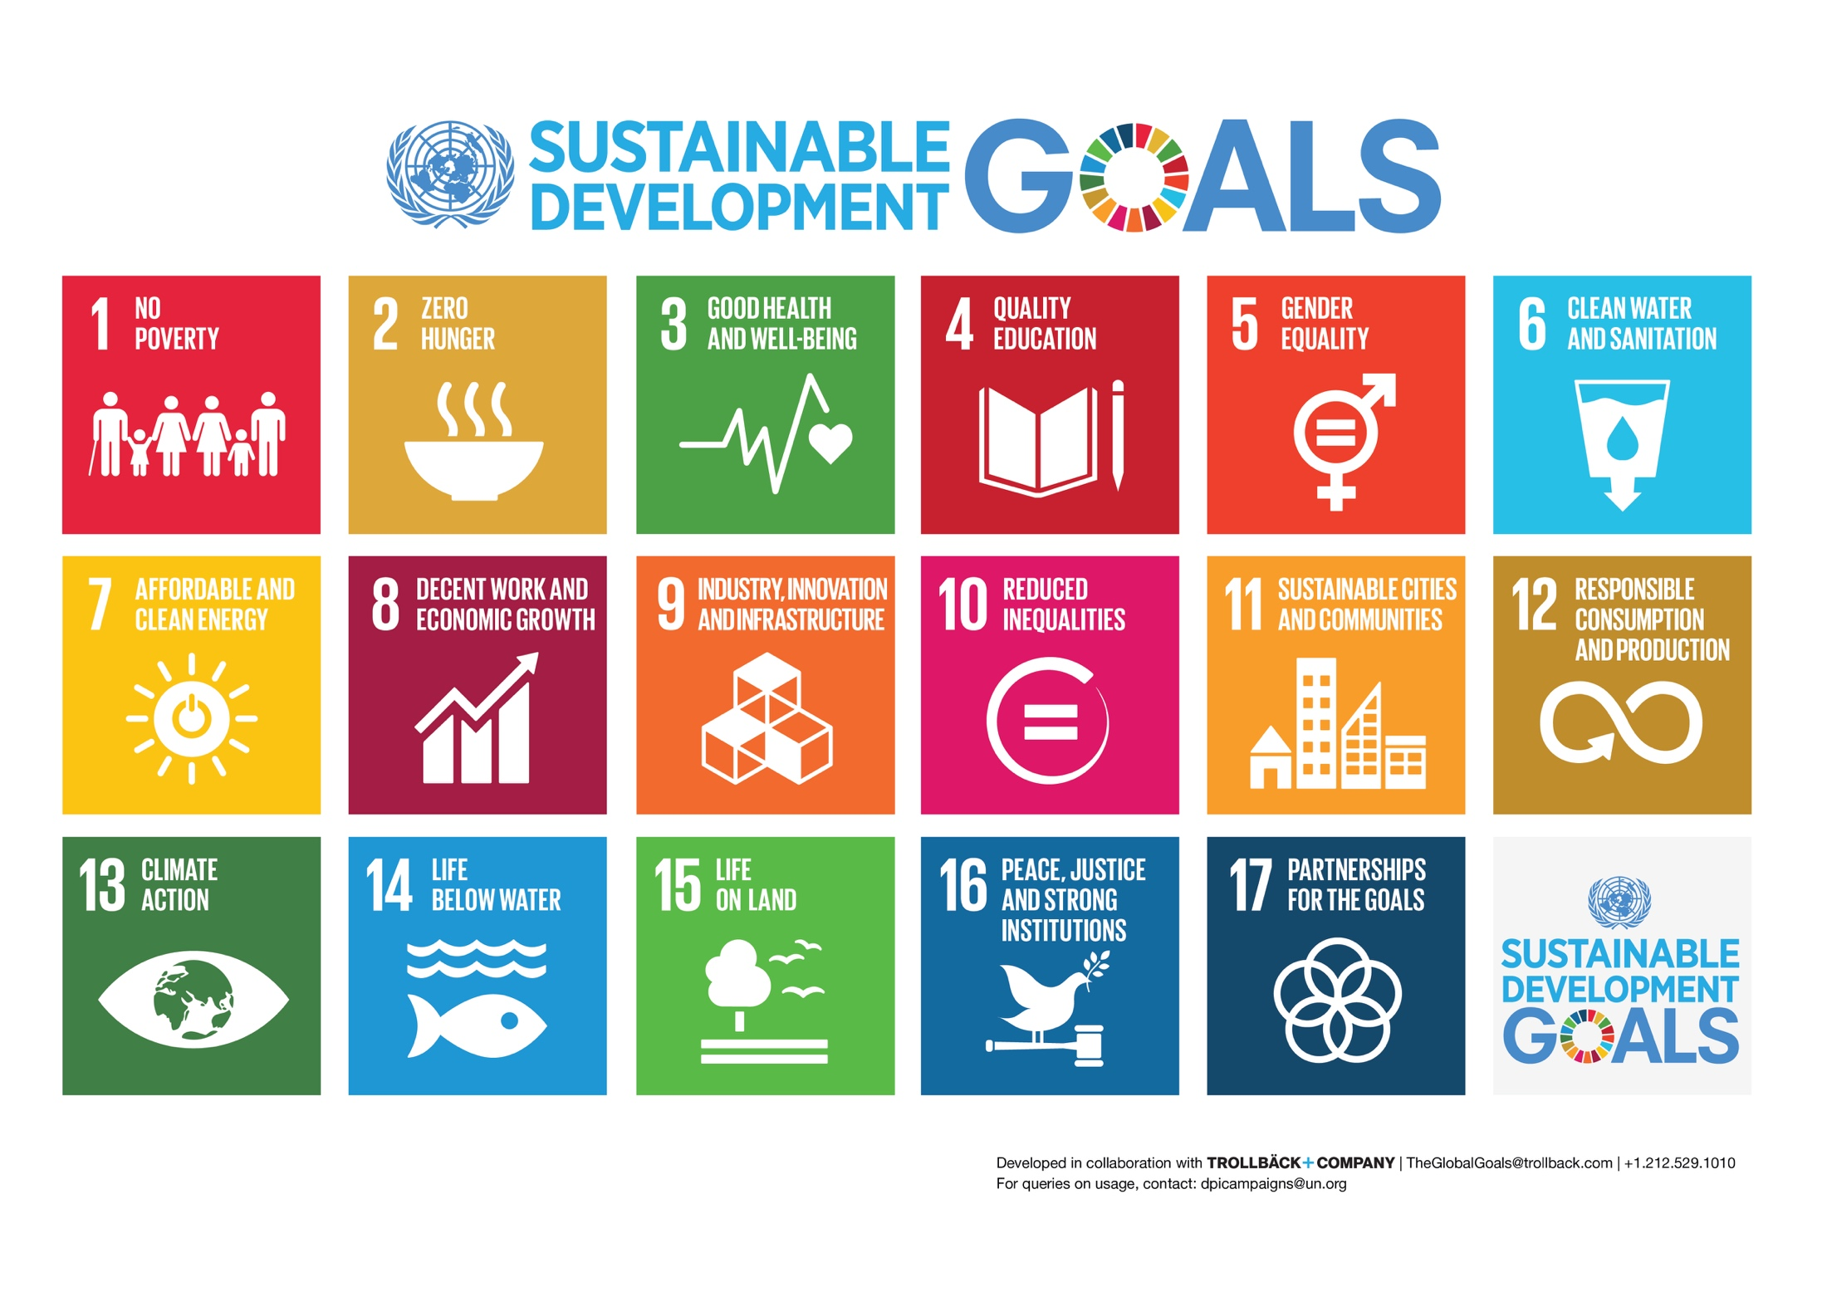
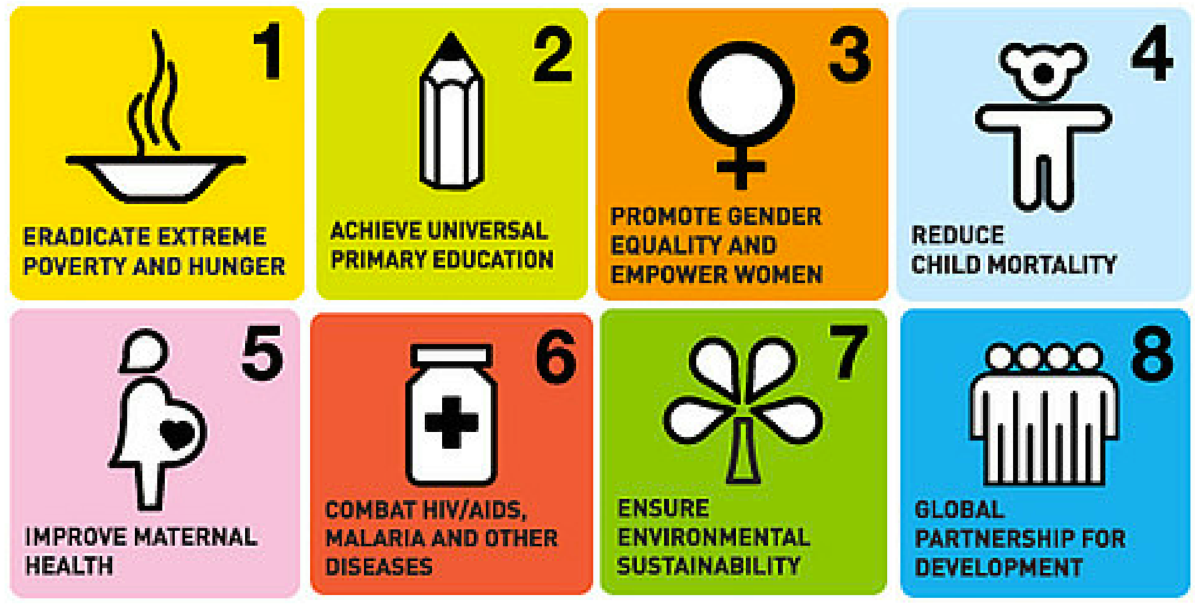
United Nations Millennium and Sustainable Development Goals

Slide 7
Global Health
Research
Education
Policy
Service

Slide 8

Global Health for the 21st Century
Technology and
Innovation
Politics, Culture
and Behavior
Women
and
Children
Chronic Diseases
and
Injuries
Infectious
Diseases
Nutrition
Ethics and Values
Education, Economics
and Development

Slide 9
Institutional Resources

Slide 10







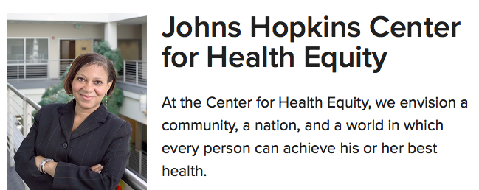

Notes:
The program will leverage world-renown resources across Johns Hopkins to provide graduates with a unique skill set that will equip them to make an impact for children affected by health disparities with experts in global and public health

Slide 11
Hopkins Pediatric Global Health Track
The track will leverage relationships and collaborations across the department and the institution including:
Johns Hopkins School of Medicine
  The Center for Child and Community Health Research
  Centro Sol – Center for Salud Health & Opportunities for Latinos
Johns Hopkins University
  Center for Health Equity
  Urban Health Institute
  Fogarty Global Health Fellowship http://hopkinsglobalhealth.org/funding-opportunities/student-and-trainee-grants/ujmt-fogarty-global-health-fellowship
  Global Health Pathway Program http://hopkinsglobalhealth.org/funding-opportunities/student-and-trainee-grants/global-health-pathway-program-ghpp/
  Alliance for a Healthier World
  https://www.ahealthierworld.jhu.edu/
  JHPIEGO
Bloomberg School of Public Health
  Paul S. Lietman Global Travel Grant for Residents & Fellows http://hopkinsglobalhealth.org/funding-opportunities/student-and-trainee-grants/housestaff-grant/
  International Center for Maternal and Newborn Health https://www.jhsph.edu/research/centers-and-institutes/international-center-for-maternal-and-newborn-health/index.html
  Center for Global Health http://hopkinsglobalhealth.org/
  Center for Clinical Global Health Education https://main.ccghe.net/
Notes:
Hyperlinks will take you to the webpage for each of the resources

Slide 12
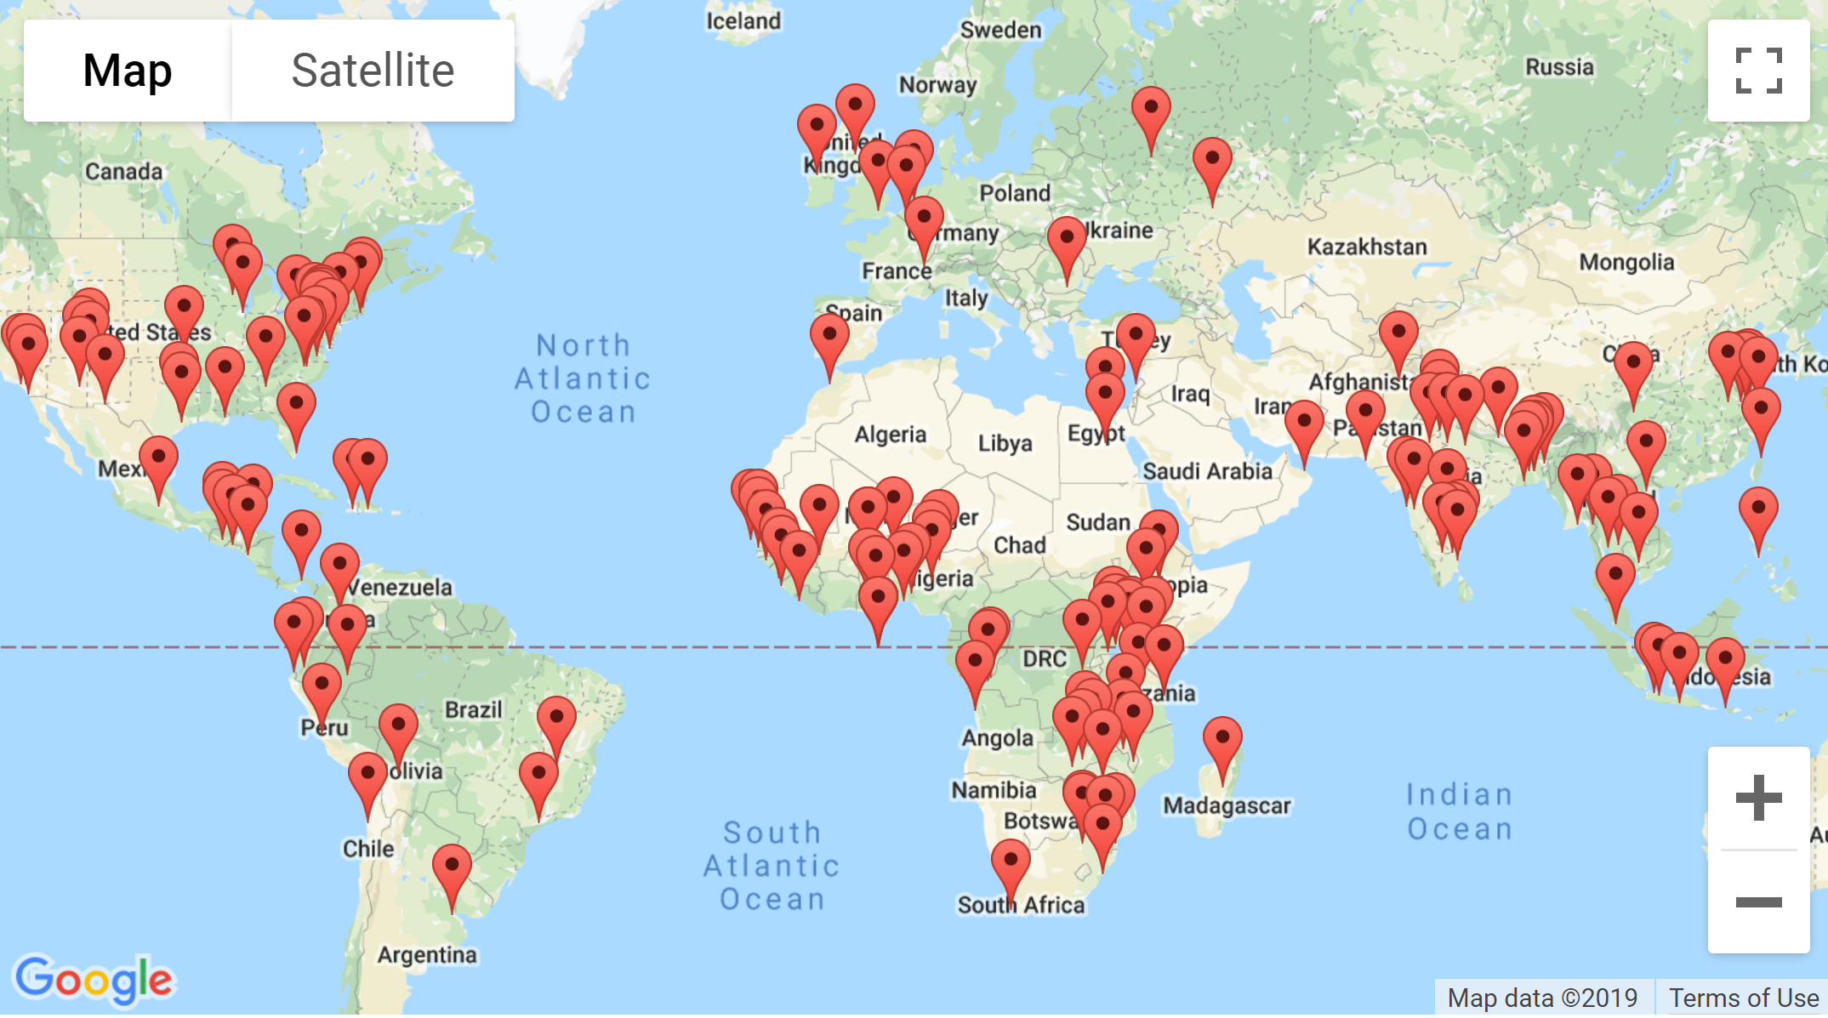
Global Health Opportunities at JHU:
Faculty Research Sites
https://www.jhsph.edu/faculty/research/map
Notes:
Capstone project needs to be achievable… appropriate scope, mentorship and preferably established research infrastructure
Map shows sites in US and abroad where current JHU faculty (SPH and SOM) currently have established research projects

Slide 13
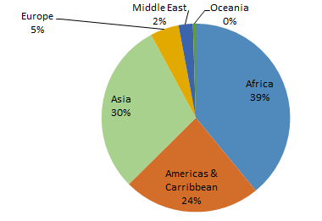
JHU Faculty Global Health Projects
Projects by Region
Topic | Number
Maternal & Child Health | 271
HIV/AIDS | 202
TB, Malaria, or Other Inf. Diseases | 179
Capacity Building/Training | 207
Population, Fam Planning, Family | 82
Chronic Diseases/Injuries | 76
Micronutrients, Nutrition, Water | 70
Behavior Change | 53
Mental Health | 24
Other | 75
434 Faculty Members
34 Centers and Institutes
915 Active Projects
101 Countries
Current Global Health Projects
Source: CGH 10-year progress report

Slide 14
Track Structure
Notes:
Want to give you a little bit more about specific details about how this track differs from the traditional categorical program.

Slide 15
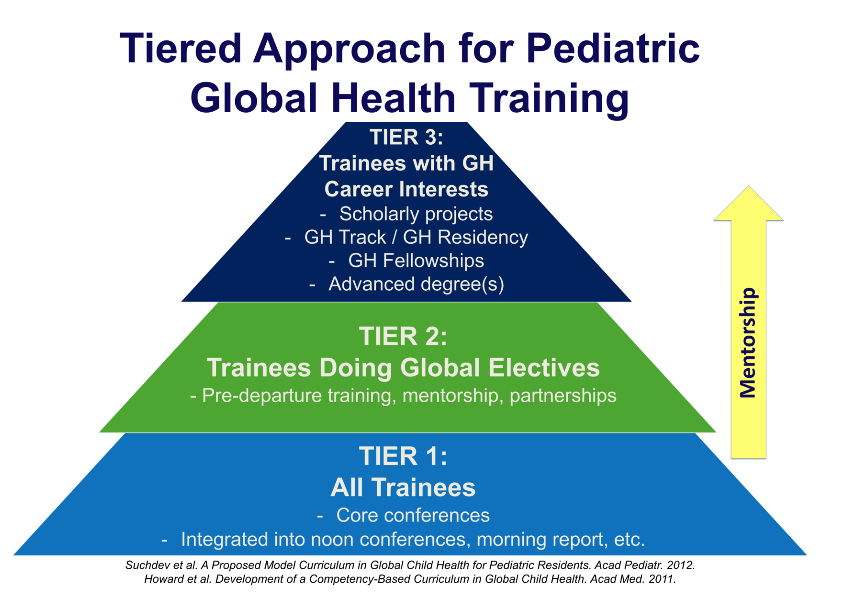
Notes:
Slide is from AAP
All residents at JH, regardless of being in track or not, have opportunities for global health electives (about 30% of all residents participate at some point during training in an overseas elective and/or Indian Health Service clinic in Tuba City, Arizona)
Track residents will be in tier 3 with dedicated mentorship

Slide 16
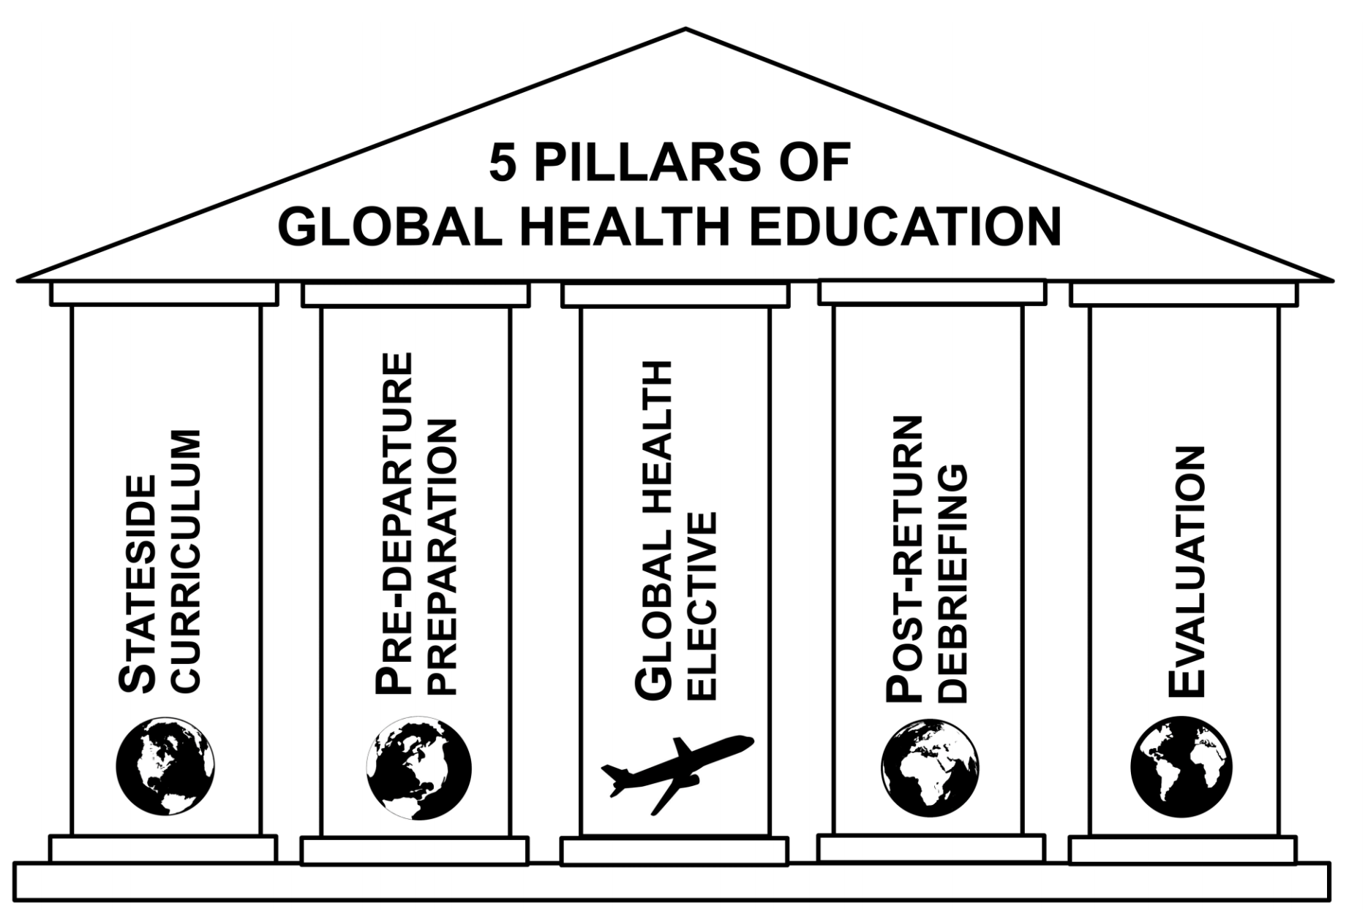

Slide 17
Elective Requirements:
AAP Section on International Child Health
  4 principles for meaningful international exchange:
    Prerequisites- field placement online coursework and pre-departure simulation curriculum
    Preceptorship- must have adequate supervision and mentorship at international site, during preparation, and for post-elective evaluation and debriefing
    Preparation- sim and ethics curriculum
    Evaluation- must be evaluated by JH faculty member and/or on site (in-country) preceptor

Slide 18
Capstone project in coordination with mentors in a global health setting
Facilitate presentation at regional/national meetings
Global health
Scholarship
Coursework at JHBSPH and CGH
International rotations (minimum 2 months in year 2 and 3)
Pre-departure simulation training
Electives and dedicated curriculum with global health focus
International exposure
Longitudinal track mentor(s) from Hopkins Faculty
Linking to institutional resources
Individualized learning plan
Mentorship/ individualized advising
Notes:
Will give you a flavor of some of these opportunities
Longitudinal track mentor is above and beyond usual advising system in the residency program
Find your niche
You have unique experiences others will find valuable!
Select a mentor
Your primary mentor does not need to be a global health researcher
Consider a mentorship committee
Make sure you can complete your project
Setting reasonable expectations for what you can get done
Consider a US-based project in a related field

Slide 19
1-2 months of elective time dedicated to Global Health individualized learning plan
Complete capstone project
Attend national meeting
PGY3
1-2 months of elective time dedicated to Global Health individualized learning plan
Online Course at JHBSPH
Begin capstone project
PGY2
PGY1
Global Health selective
Choose capstone project topic
Throughout residency:
Quarterly meetings with
Track advisory board/project mentor
Serve on Global Health Track Advisory Board
Center for Global Health Curriculum
Global Health
Journal Clubs
Notes:
Will give you a flavor of some of these opportunities
Your first rotation should be an attempt to spend time in the setting in which you wish to conduct research
Elective time, brief site visits with Hopkins groups
Get to know the local system, potential partners on the ground, and the context

Slide 20












Established Pediatric Elective Opportunities Abroad
  Malawi
  Madagascar
  Morocco
  Bangladesh
  India
  Lesotho
  Nigeria
  Kenya
  Philippines
  Peru
  Haiti
  South Africa
  Sierra Leone
  Create your own
Notes:
A small sample of possible electives for your individualized learning plan include…
These are areas with well established mentors/ peds faculty doing research

Slide 21
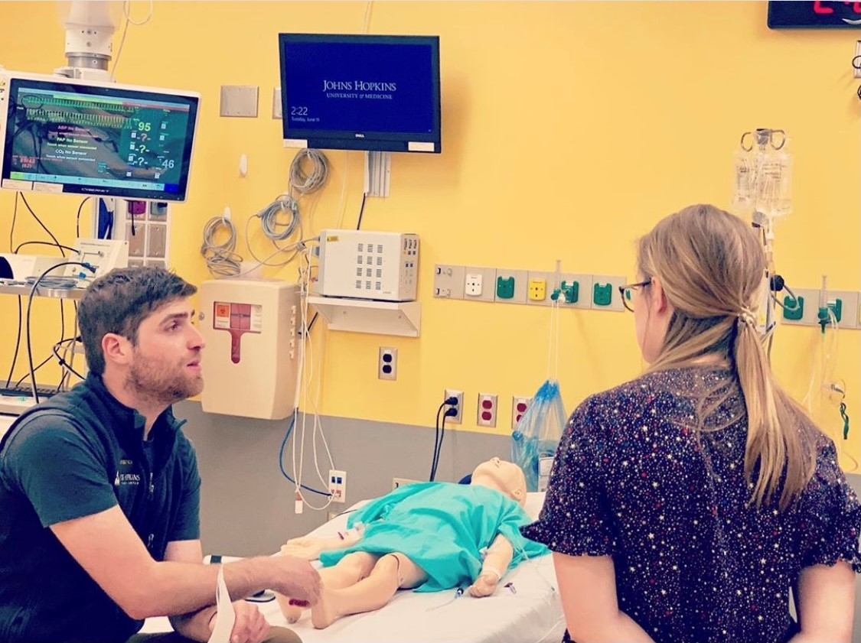
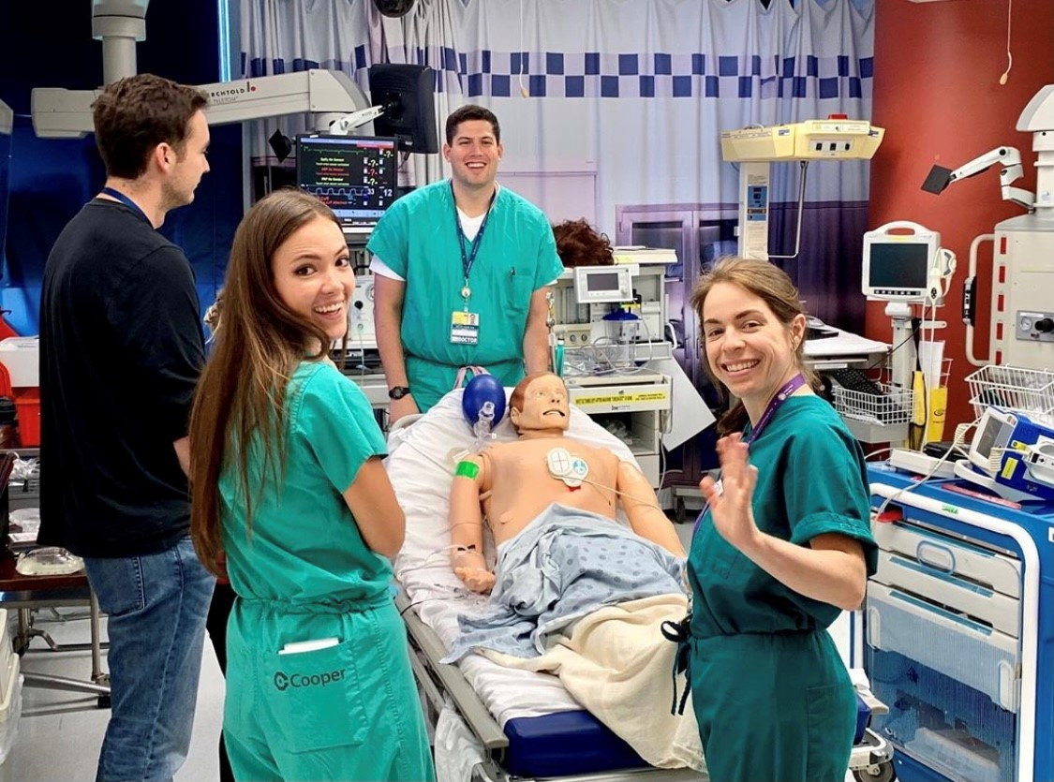
Pre-Departure Simulation Training

Slide 22
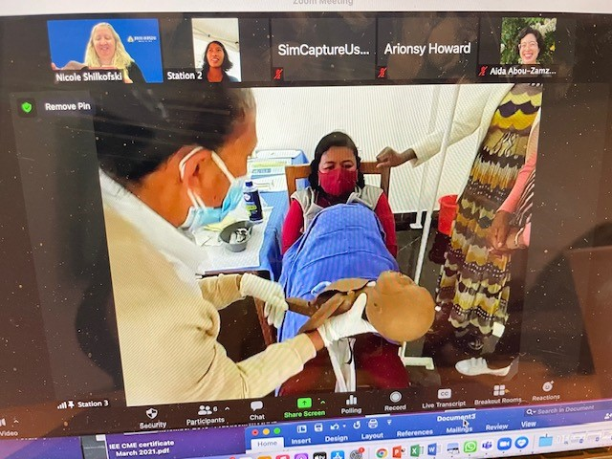
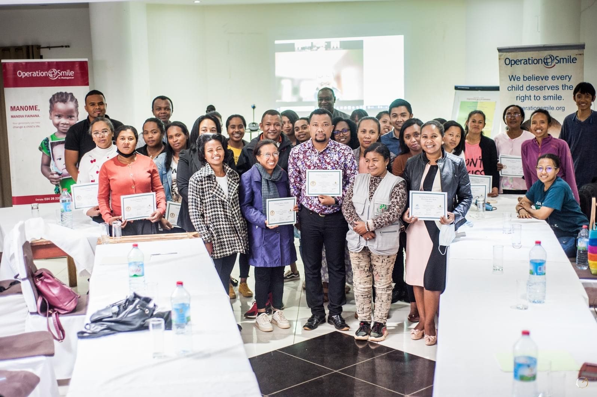
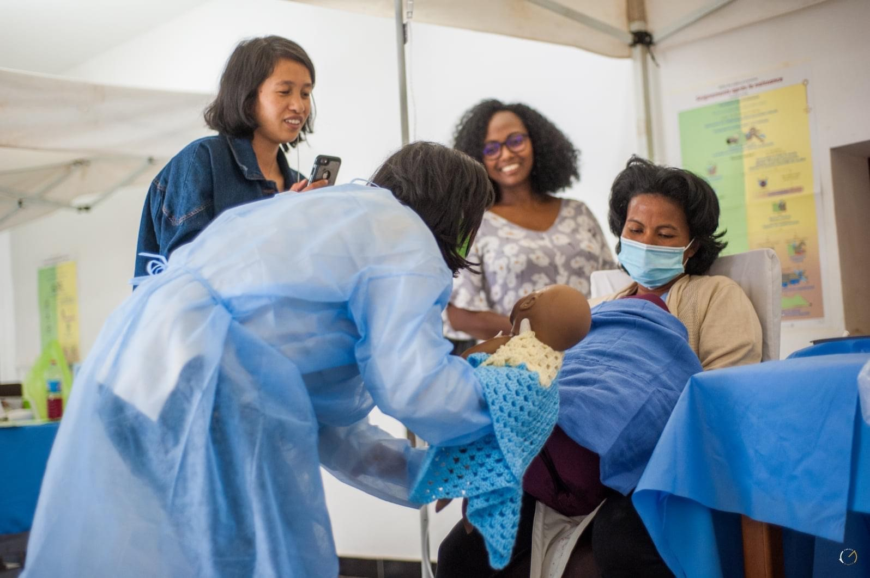
Leveraging Virtual Learning for Training in Madagascar

Slide 23
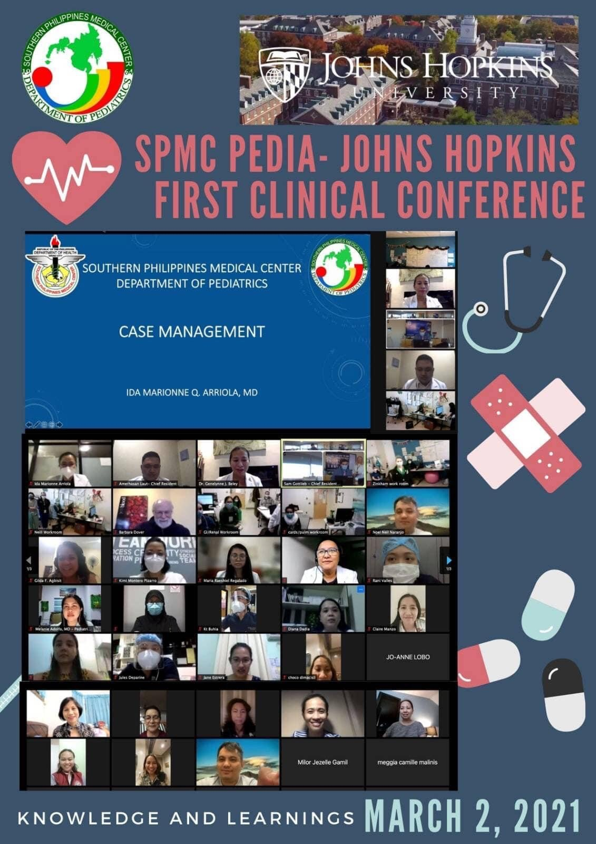
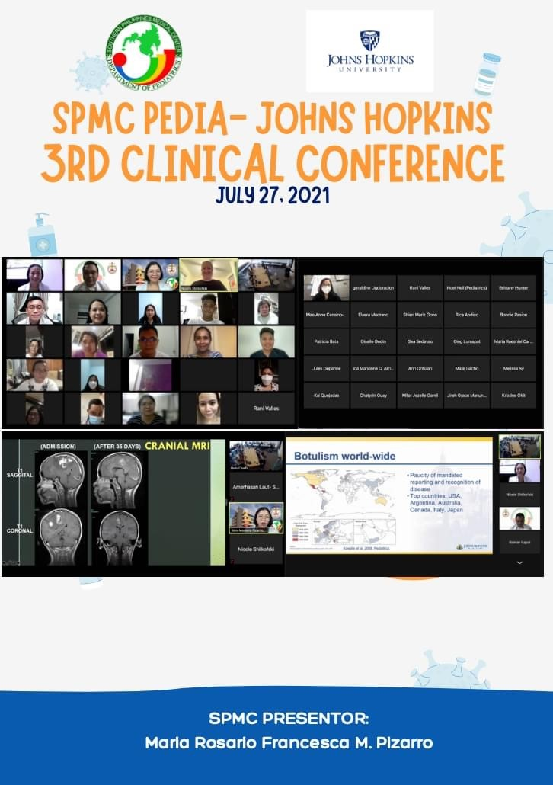
Collaborative Case Discussion Series with International Partners

Slide 24
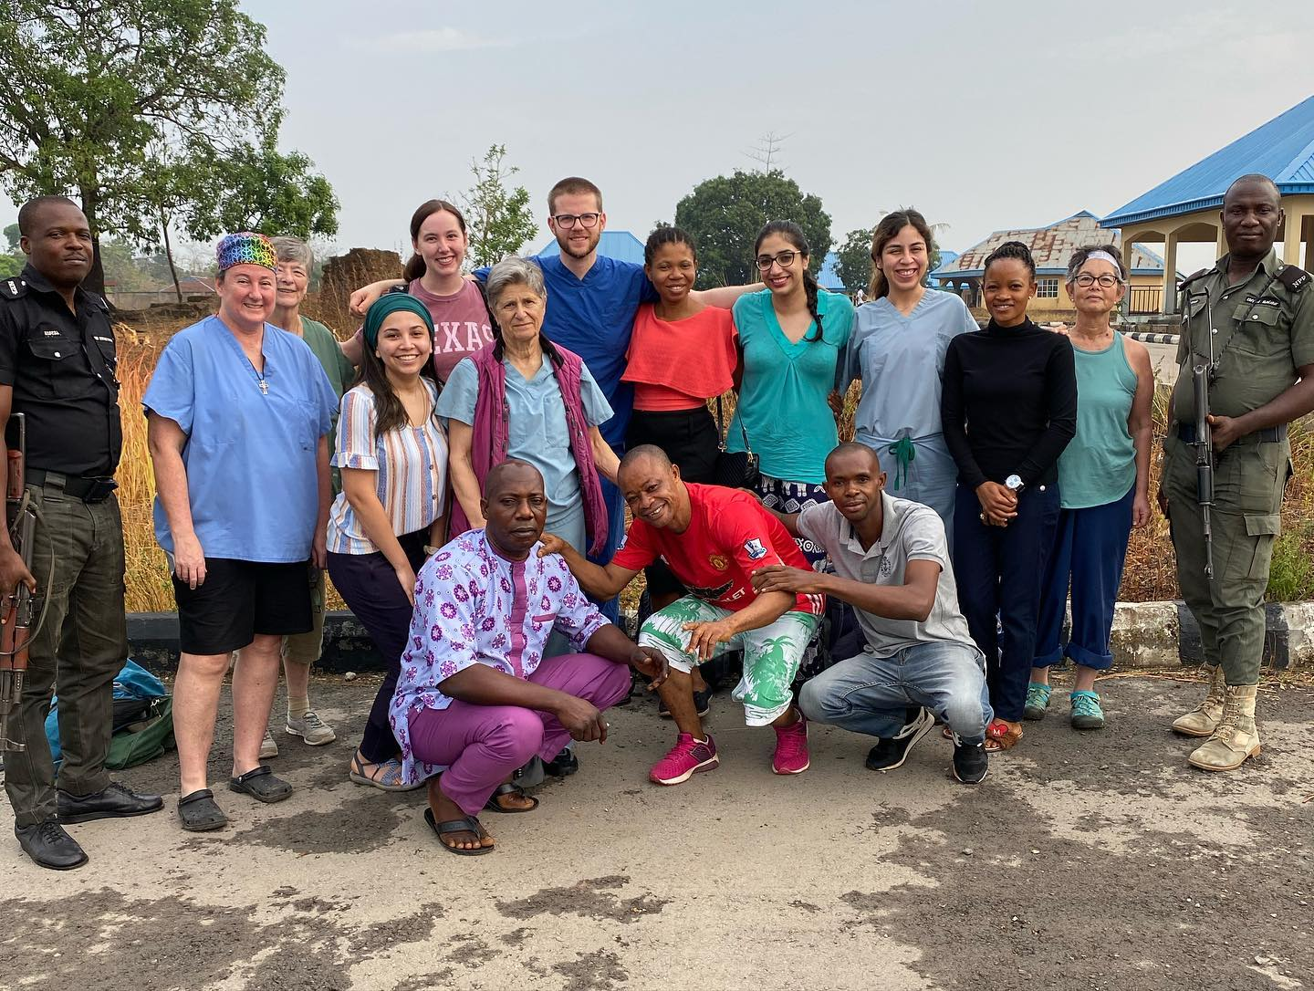
Nigeria- Perioperative Research on sedation protocols in LRS
Notes:
August 2018 Philippines trip

Slide 25
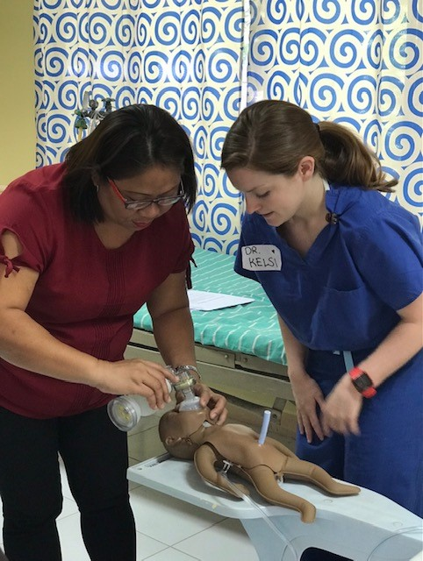
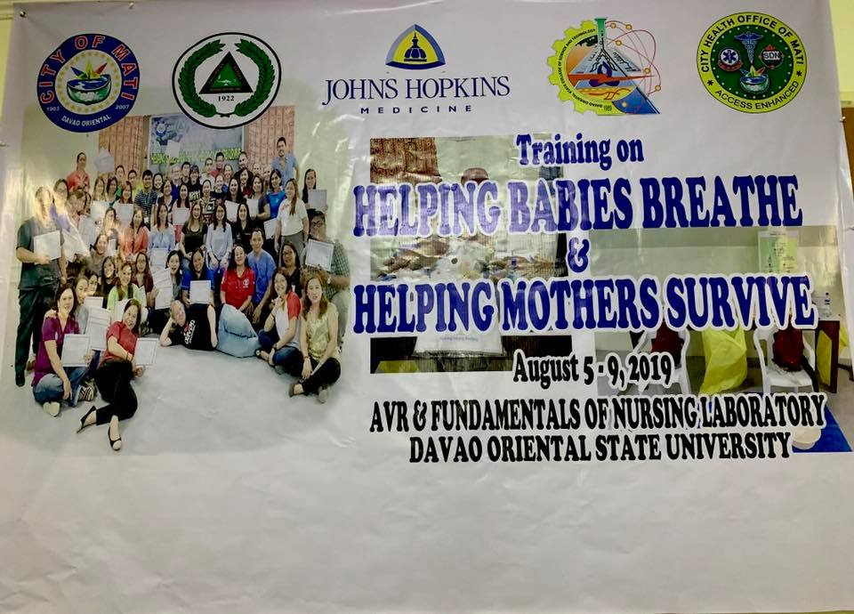
Health System Capacity Building: Creating Train the Trainer Programs

Slide 26
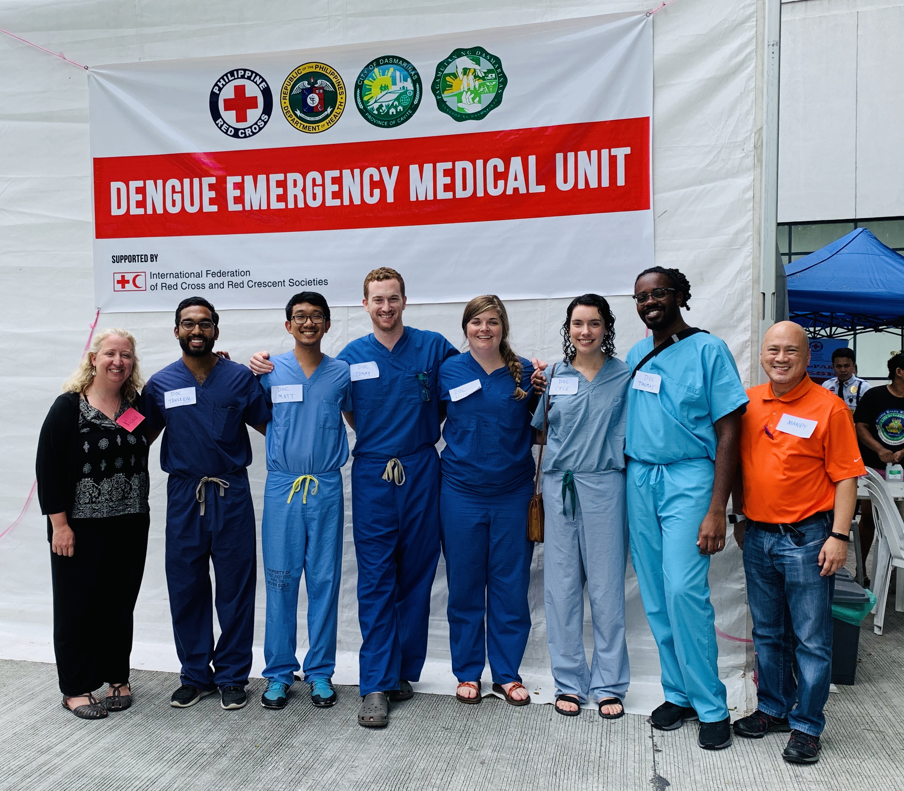
Public Health Epi Research:
Dengue Season in Philippines
Notes:
August 2019 Philippines trip

Slide 27
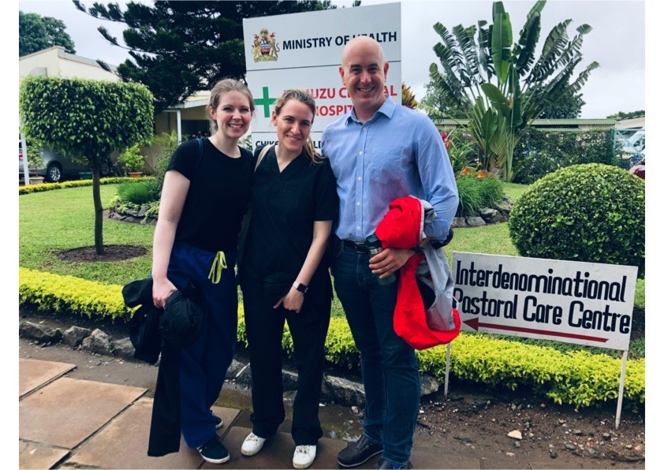
Clinical Immersion:
Kamuzu University of Health Sciences, Malawi

Slide 28
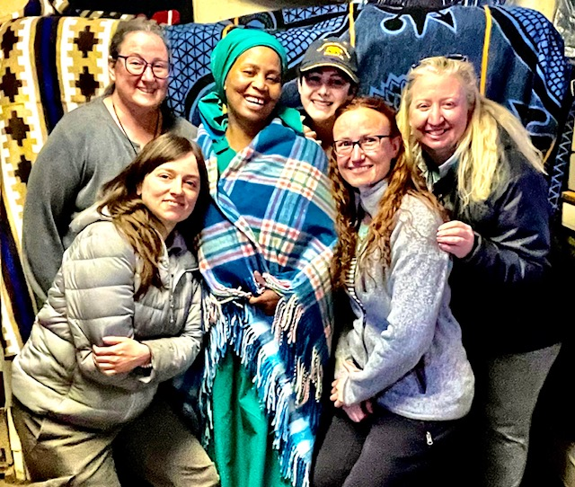
Teaching WHO ETAT courses in Lesotho

Slide 29
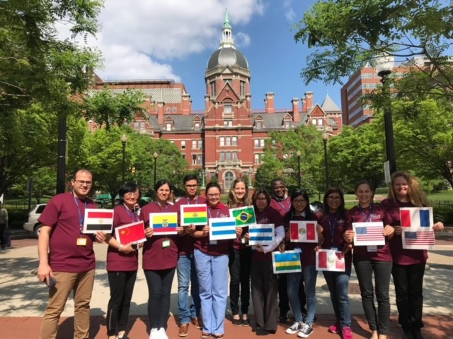
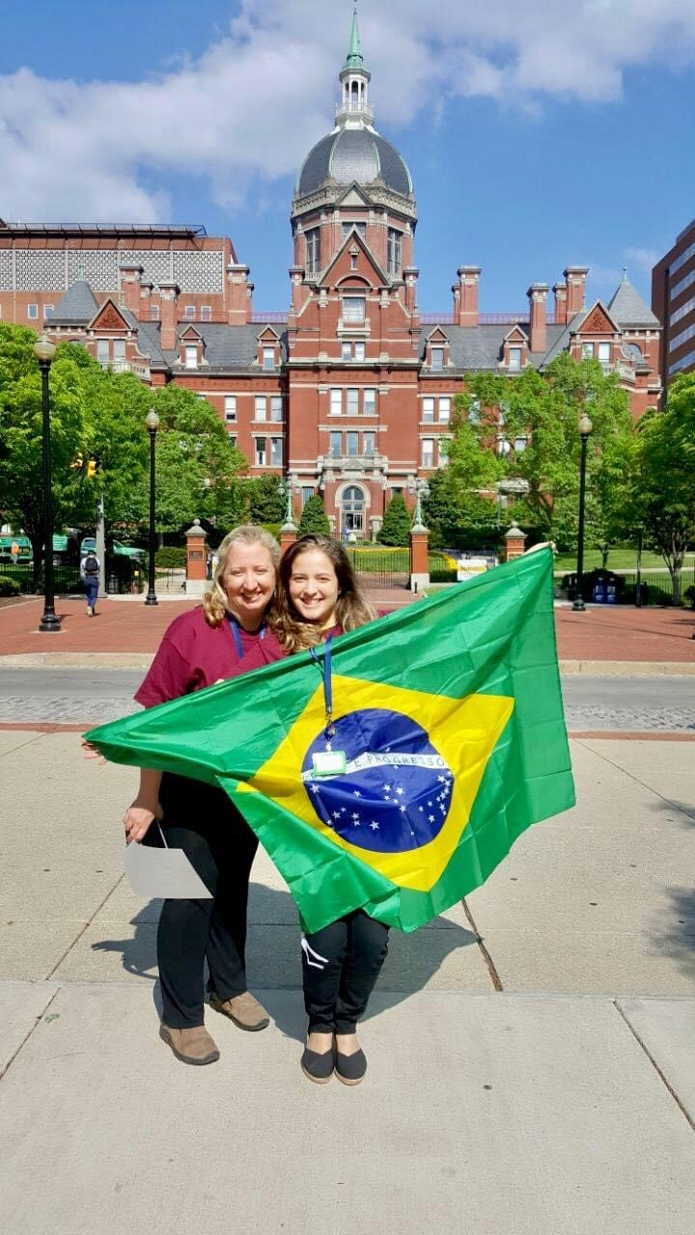
Bidirectional Longitudinal Partnerships

Slide 30
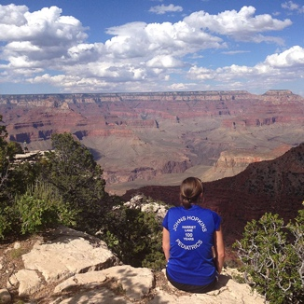
Elective Opportunities:
Domestic = “Local Global”
  Advocacy rotations
    Baltimore city health department
    Maryland state health department
    National AAP elective
  Latino Health Elective
  International Adoption Elective
  Immigrant and Refugee Health Elective
  International Rescue Committee (IRC) project
  Baltimore Child Abuse Center
  Centro Sol
  Indian Health Service – Tuba City, Arizona
  Disaster Medicine
  Pandemic local global health electives and research projects
Notes:
A small sample of possible local/domestic electives for your individualized learning plan include…

Slide 31
Local Global Health in Baltimore:
Centro Sol – Center for Salud Health & Opportunities for Latinos
Notes:
Centro Sol – Center for Salud Health & Opportunities for Latinos
The mission of Centro Sol is to promote equity in health for Latinos; This can be taken as a “local global” elective for learning about immigrant and refugee health

Slide 32
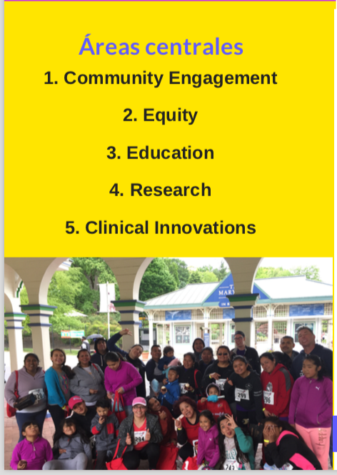
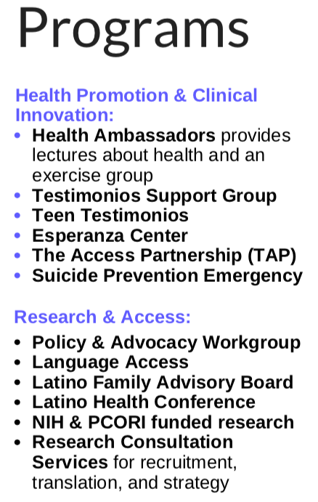
Notes:
Programs at Centro Sol in Baltimore

Slide 33
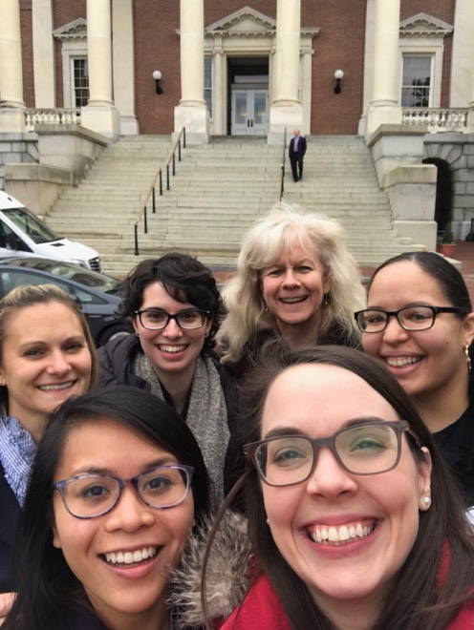
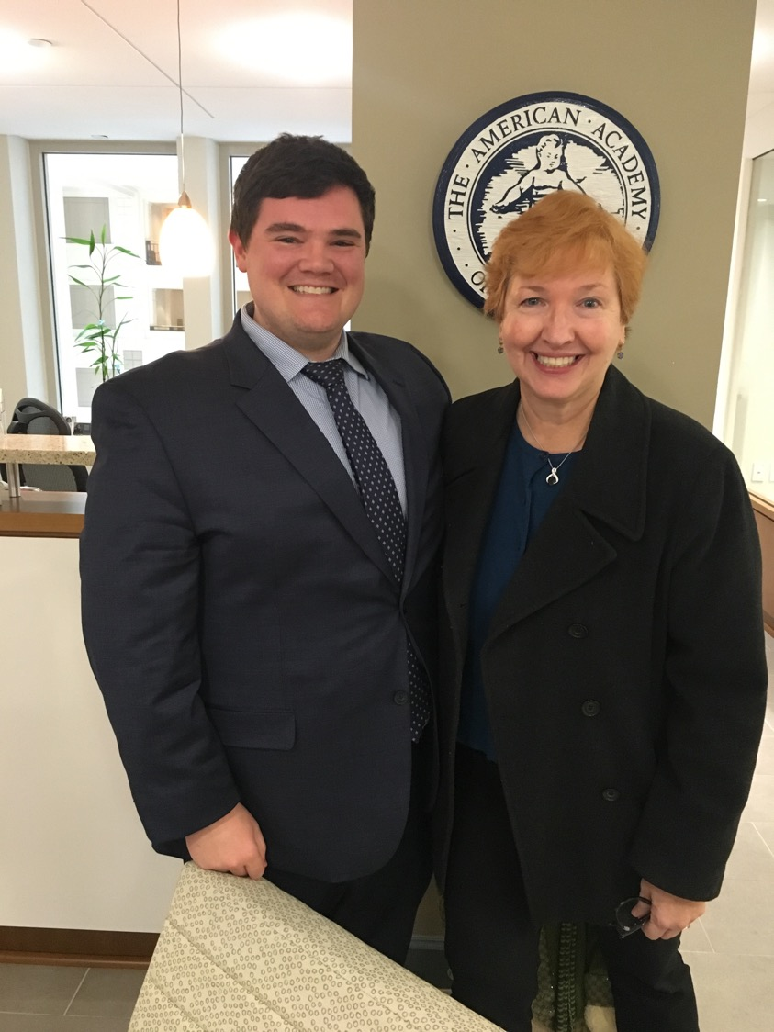
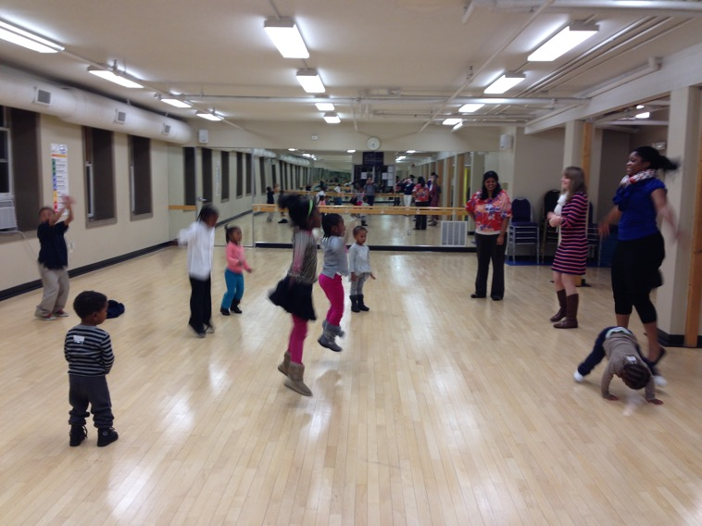
AAP Advocacy Elective in DC
Domestic Health Equity and Advocacy
Opportunities
State Capital Advocacy
B’More Fit for Kids
Notes:
Recent examples of resident advocacy and scholarship include….

Slide 34
Global Health Opportunities at
School of Public Health- Coursework
Coursework at SPH
  Residents can take up to 16 credits per year free of charge!
  Some courses are available online and can be done during elective time
  All track residents required to do Coursera (online) International Travel Preparation course
  Some examples of other courses offered at SPH:
    220.601 Foundations of International Health
    221.627 Issues in the Reduction of Maternal and Neonatal Mortality in Low Income Countries
    221.646 Health Systems in Low and Middle Income Countries
    223.663 Infectious Diseases and Child Survival
    223.686 Child and Public Health in the Tropics

Slide 35
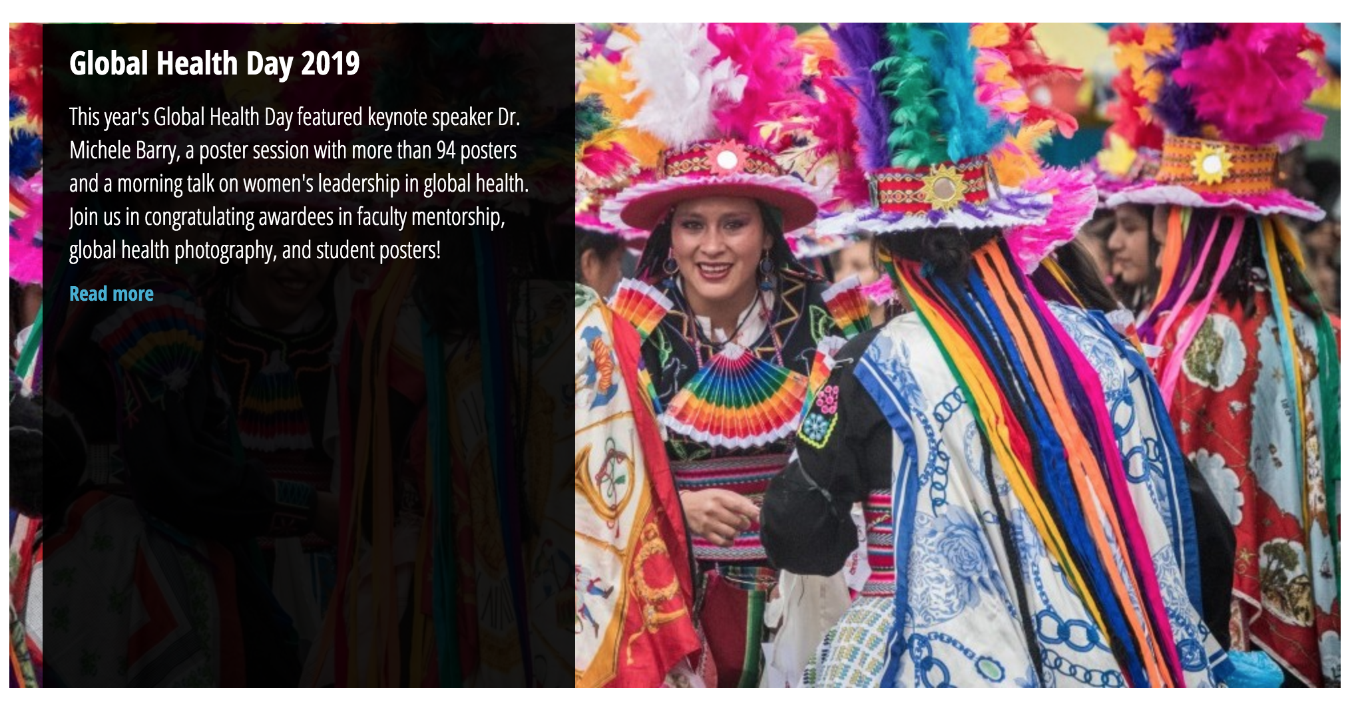
Scholarship Opportunities
Devan Jaganath presenting on “Financial
Notes:
All residents who receive funding from Center for Global Health are required to present a poster (at a minimum) at the School of Public Health’s Global Health day, held annually. Many alos present at national conferences, in particular the Consortium of Universities for Global Health conference (CUGH), of which JH is a member. All track residents will be required to present their research capstone at a national conference, with a goal to have a written manuscript or scholarly product as a result of their capstone project.

Slide 36

Notes:
An example of yearly global health scholarly conferences hosted at Johns Hopkins

Slide 37
Track Funding
Residents in track receive $5000 grant from Johns Hopkins Center for Global Health
Can be spent on travel, accommodations, research support, project needs
Often supplemented by faculty research grants
Paul S. Lietman Global Travel Grant for Residents & Fellows http://hopkinsglobalhealth.org/funding-opportunities/student-and-trainee-grants/housestaff-grant/
Alliance for Healthier World Launchpad and Impact Grants:
https://www.ahealthierworld.jhu.edu/funding

Slide 38
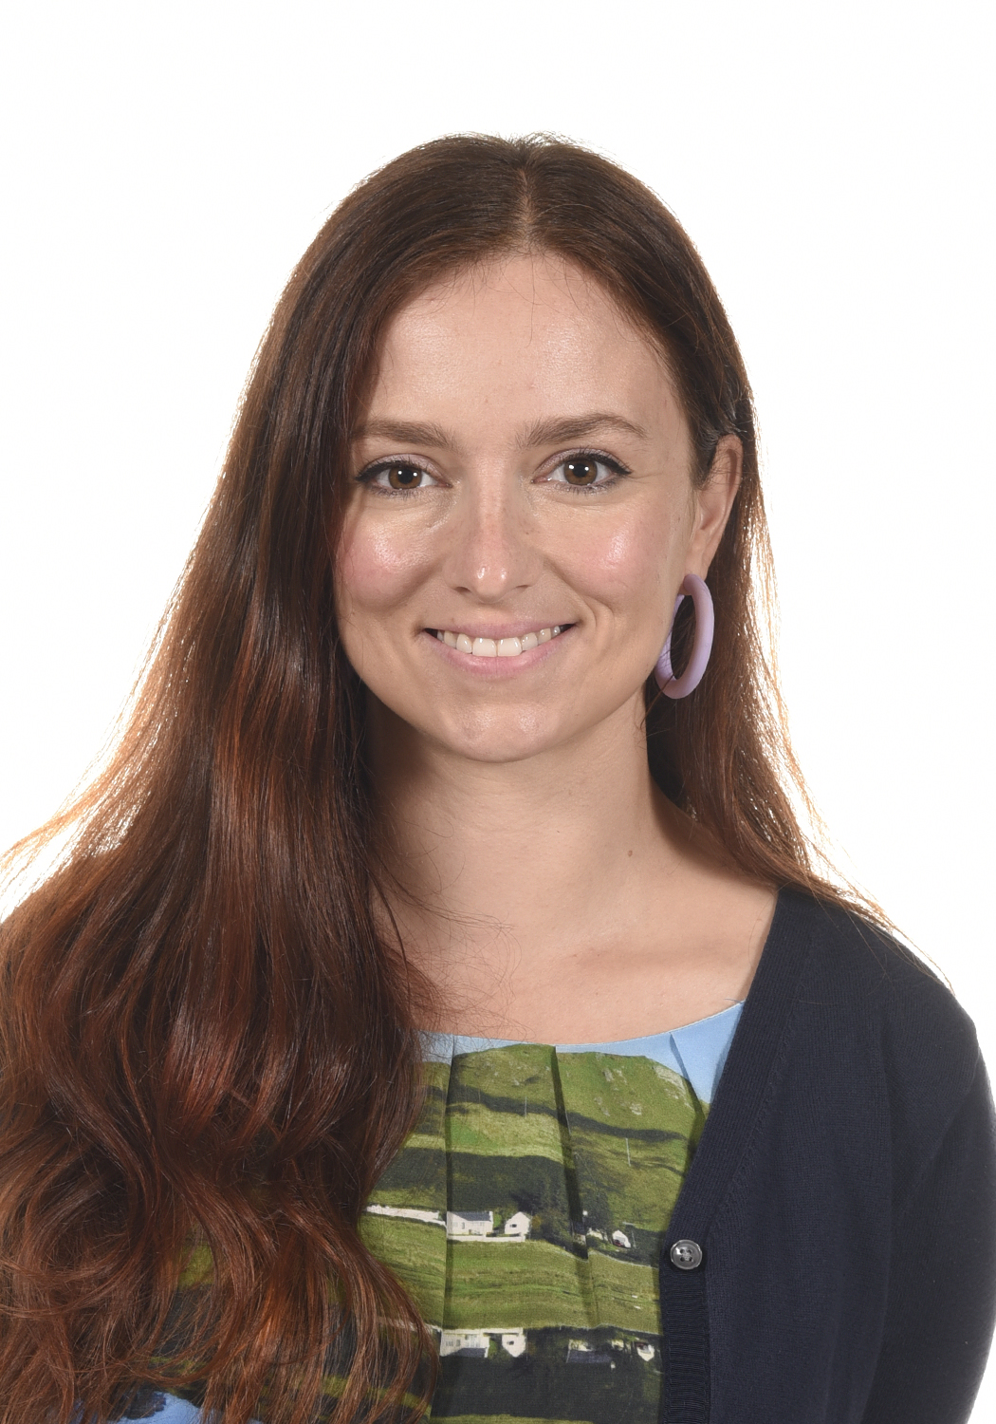
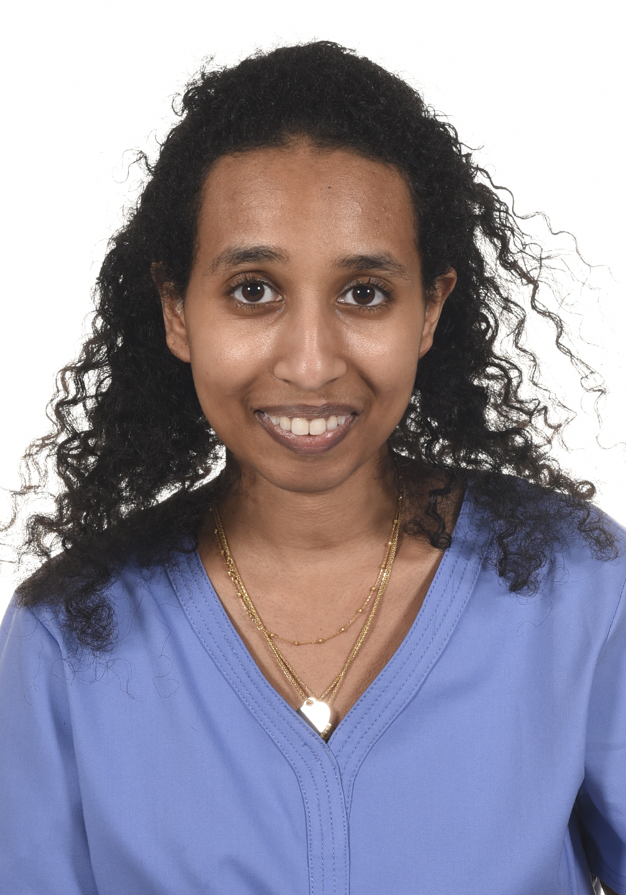
Current GH Track Residents- PGY 3
Dr. Elshaddai Ephrem
Interests: primary care
Experience: certificate in global health from Princeton
Project site: Ethiopia, newborn resuscitation and care prior to discharge
Dr. Katherine Cummings
Interests: Cross cultural communication, HIV/AIDS prevention, maternal/child health
Experience: Peace Corps Volunteer in Tanzania
Project site: Lesotho

Slide 39
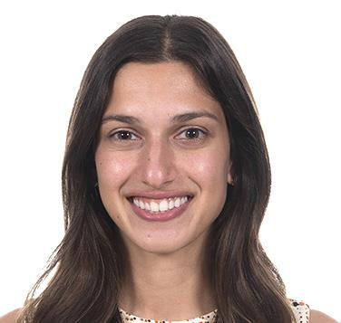
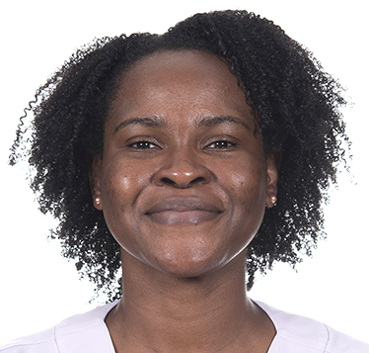
Current GH Track Residents- PGY 2
Dr. Mallika Rajamani
Interests: neonatology, cardiology
Experience: MPH in maternal and child health, work in Haiti and India
Research plans: working with mentor at Johns Hopkins International Vaccine Access Center (IVAC) in India
Dr. Kaysha Henry
Interests: adolescent health/primary care, mental health in pediatrics
Experience: MPH capstone project in Belize
Research Plans: menstrual hygiene management in low resource settings

Slide 40
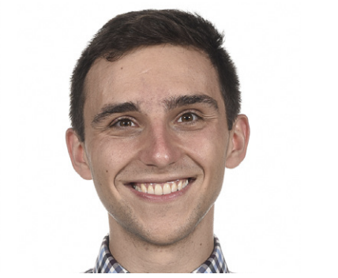
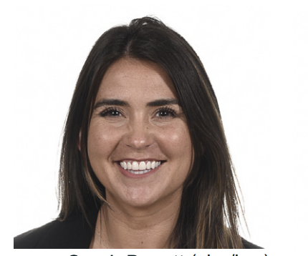
Current GH Track Residents- PGY 1
Dr. Andy Koltun
Interests: infectious diseases and equitable population health systems in LMICs
Experience: community health and redevelopment initiatives in Uganda and Columbia
Dr. Sarah Benett
Interests: Medical Education, Implementation of developmental screening in limited resource settings
Experience: Project in neurodevelopment in children in Uganda

Slide 41
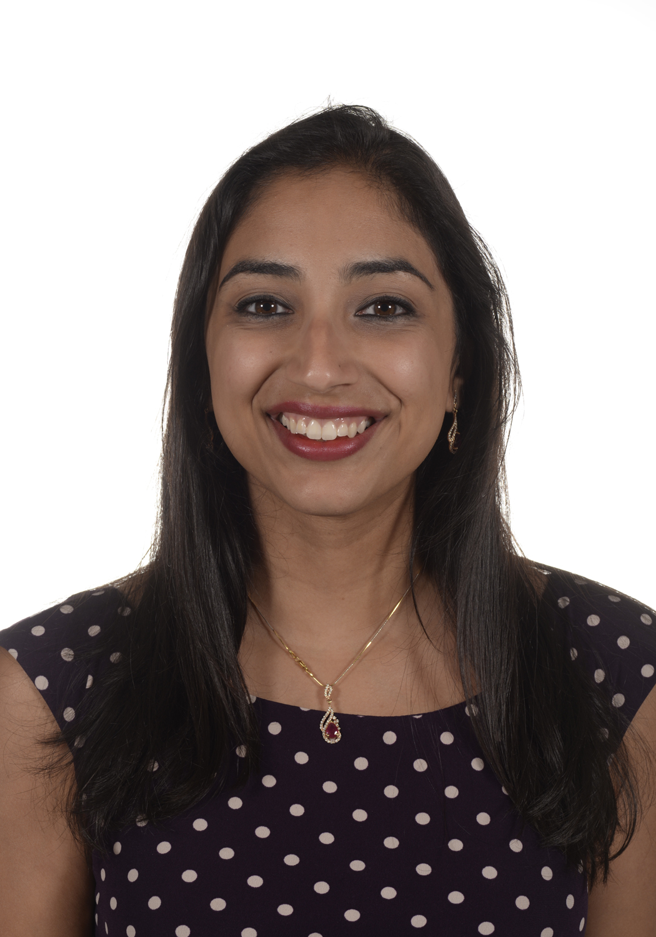

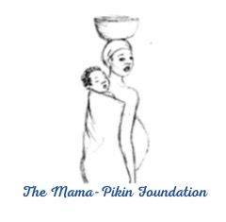
Sierra Leone Postgraduate College of Health Specialties- Residency Program Curriculum Development
Dr. Sunaina Kapoor MD, MPH
Harriet Lane Chief Resident 2022-2023

Slide 42
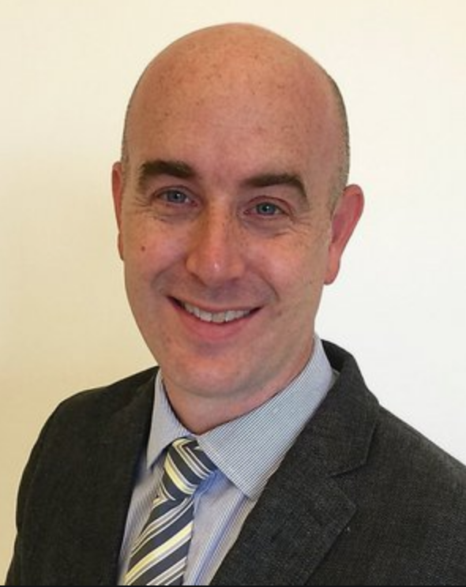
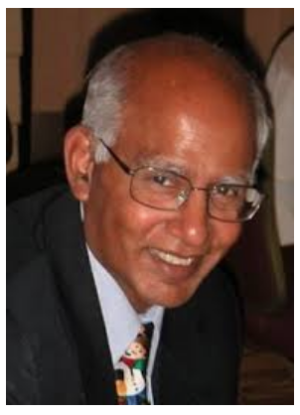
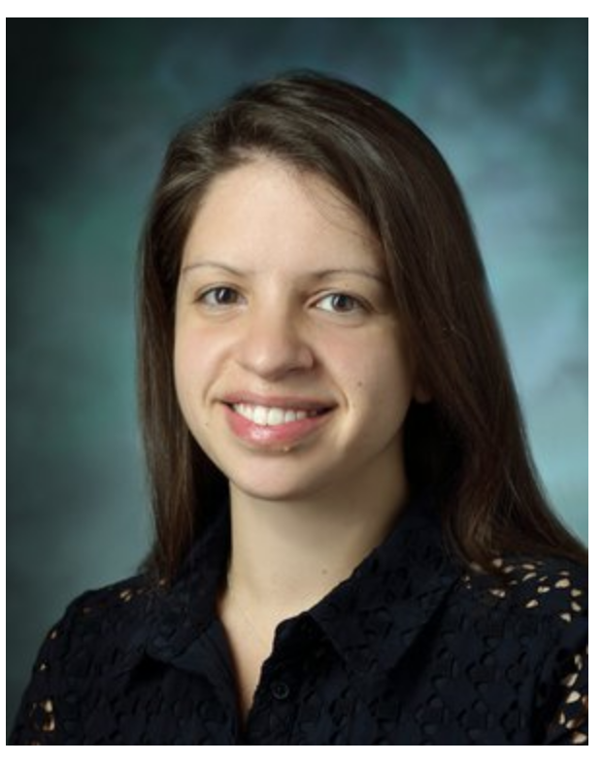

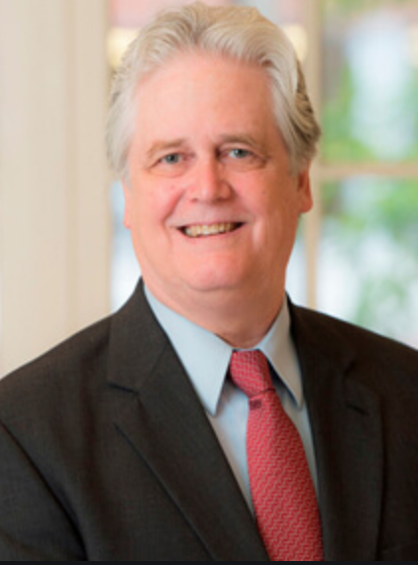
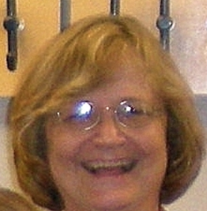
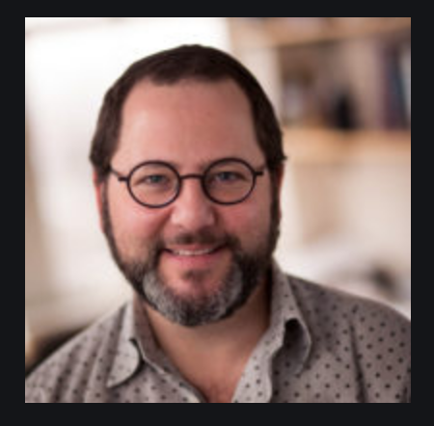
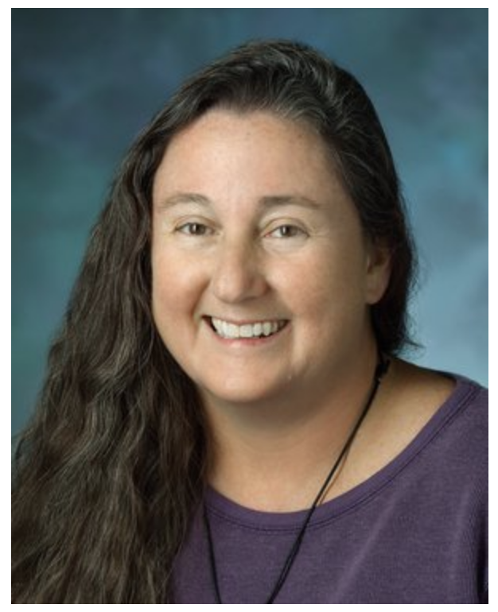
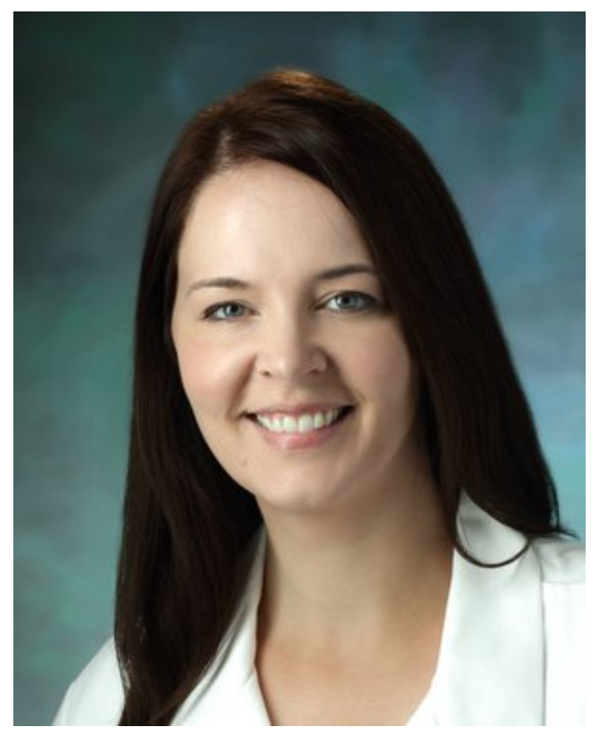
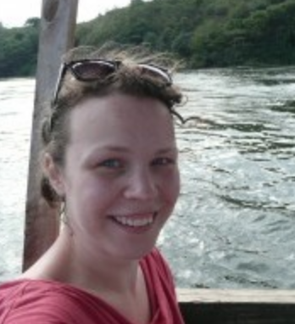


Pediatric Residency Global Health Track
Advisory Board and Mentors
Eric McCollum, MD
Division of Pediatric Pulmonology
Lesotho, Africa
South Africa, Malawi, Bangladesh
Mathuram Santosham, MD, MPH
Senior Advisor
International Vaccine
Access Center
Nicole Salazar-Austin, MD MPH
Division of Pediatric
Infectious Diseases
BPAI
Andrea Ruff, MD
Program Director,
Global Disease Epidemiology
and Control JHSPH
Bob Bollinger, MD
Director of Center for Clinical Global Health Education
Naor Bar- Zeev, MD, PhD, MPH
Director of Epidemiology
JH International Vaccine
Access Center
Karen Schneider, MD
Division of Pediatric Emerg Med
Clinical Immersion Tropical Medicine Rotations:
Haiti, Kenya, Nigeria, Guyana
Julia Johnson, MD, PhD
Division of Neonatology
Neonatal sepsis research (India)
Quality improvement research (Ethiopia)
Anna Kalbarczyk MPH
Assistant Director,
JH Center for Global Health
Anita Shet, MD PhD
IVAC and Department of
International Health
School of Public Health
Abdulla Baqui, MBBS
Director, International Center
For Maternal and Newborn Health
Notes:
In addition to program leadership, we have the commitment of many experts across the institution to make this track a success!

