Slide 1
PGY-3 CLASS
2023-2024

Slide 2
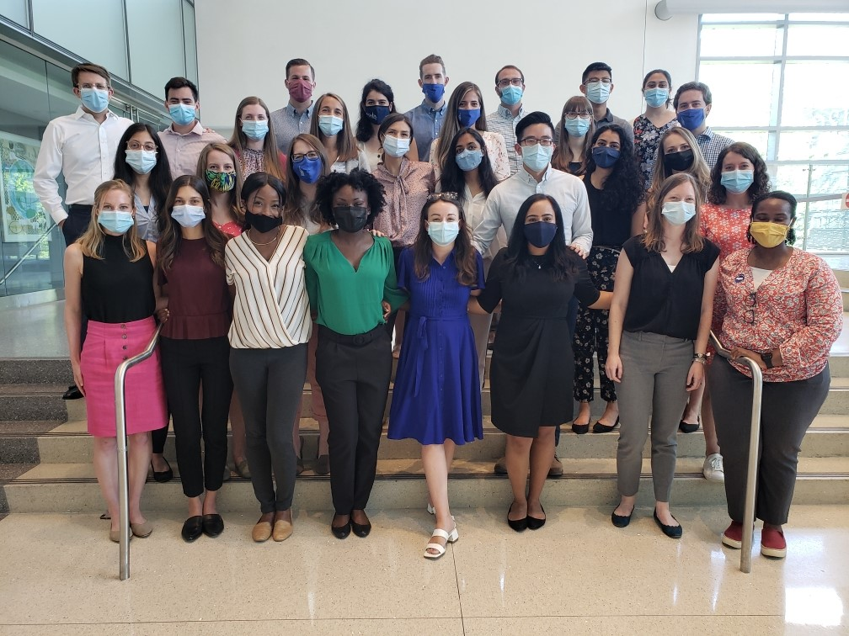
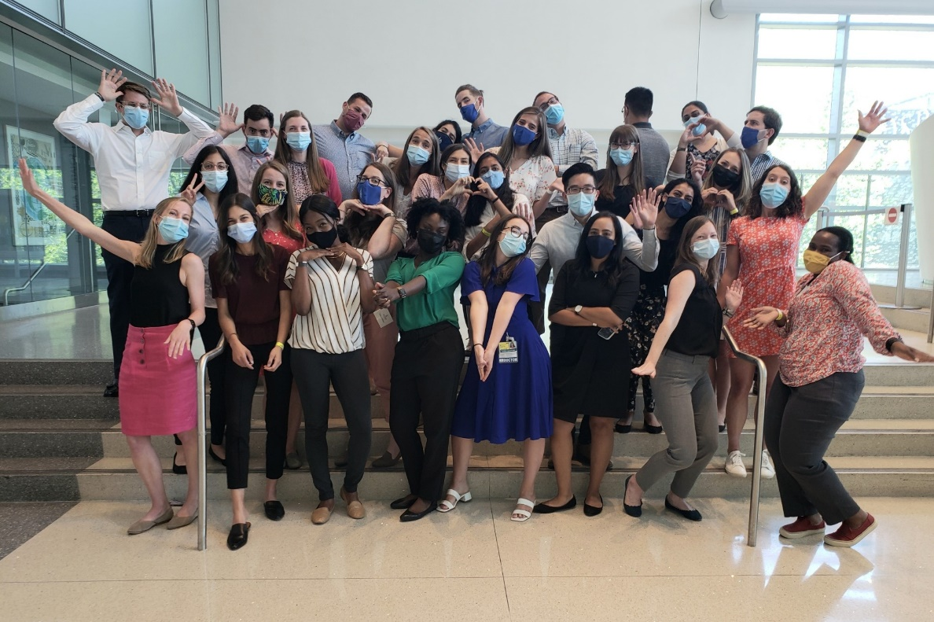

Slide 3
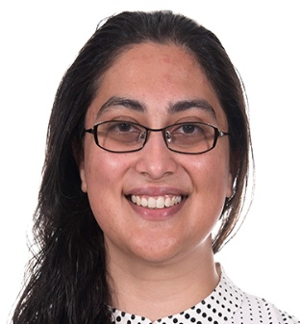
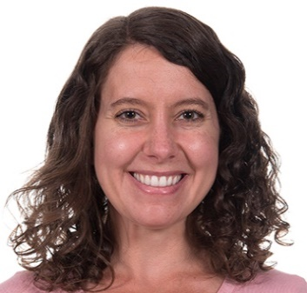
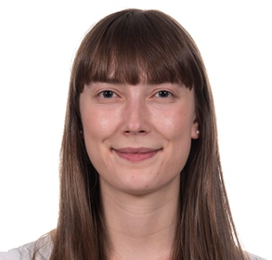
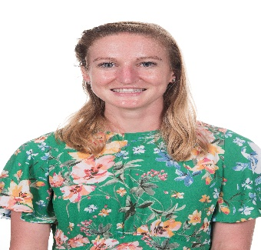
Saher Ali M.D., M.S. | Halei Benefield M.D., Ph.D. | Anna Bitners M.D. | Kyla Cordrey M.D.
Hometown: Latham, MD
Medical School: Penn State
For Fun I: Gardening/taking care of my fruit trees, cooking, volleyball and tennis, taking naps (especially in my hammock!)
Why did I choose Hopkins: Combined pediatrics-anesthesiology program, friendly and down-to-earth people, being close to my family, and the opportunities to make advocacy and service part of my training
What excites me most about Baltimore: Food scene, being by the water. Being in the DMV overall - culture, community, close to everything
She/Her
Hometown: New Smyrna Beach, FL
Medical School: University of North Carolina - Chapel Hill
For Fun I: run, hike, read (mostly fiction and journalism), bake, and sample the Baltimore food scene with my husband
Why did you choose Hopkins? Two of my favorite mentors from medical school were Harriet Lane alums, so I knew firsthand the caliber of pediatrician Hopkins produces. I loved how intentional the program is about educating its residents, and training residents to be educators. I was excited by the graduated autonomy throughout training, variety of electives, and ample opportunities to develop career interests outside of clinical medicine. What really sealed the deal, though, were the stellar interactions I had on interview day! The PDs, residents, and staff were all exceptionally warm and kind and I knew I was joining a family and not just a training program.
What excites you most about living in Baltimore? I love being able to walk everywhere! My husband and I live near Patterson Park and have easy access to the park, waterfront, and very delicious dining, not to mention I can walk to work most days. This is also my first time living outside the South and in a big city, and I was surprised at how genuinely kind everyone in Baltimore has been. I'm excited to explore this new community for the next few years!
She/Her
Hometown: Seattle, WA
Medical School: Albert Einstein
For Fun I: cook with my significant other, explore the outdoors nearby (hiking, kayaking, etc.), and try out new restaurants.
Why did you choose Hopkins: The incredible people, patient population, focus on education, impressive history, clinical exposure, and supportive leadership!
What excites you most about living in Baltimore: Getting to explore a new city filled with kind people, great food, and easy access to the outdoors.
She/Her
Hometown: Summit, NJ
Medical School: Johns Hopkins
For Fun I: cook, run along the harbor, and play/coach field hockey.
Why did you choose Hopkins?
The emphasis on education and teaching. I loved the culture of the pediatric program here as a medical student, and I wanted to be part of a program that appreciated its residents and deeply cared for its patient population.
What excites you most about living in Baltimore?
B'more Licks ice cream, Hoehn's donuts, and all the different neighborhoods in the city.
She/Her

Slide 4
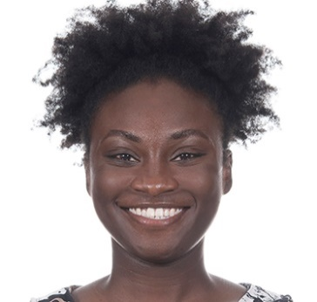
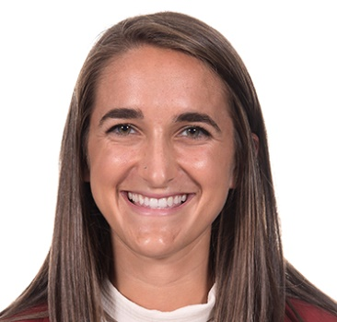
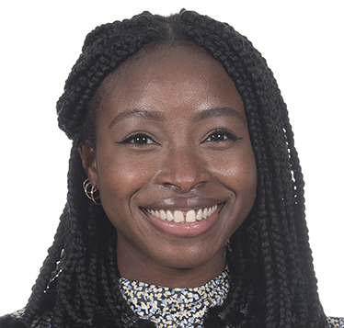
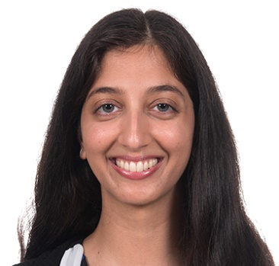
Rachel Darko M.D. | Becca Dryer M.D. | Tolulope Fatola M.D. | Devki Gami M.D.
Hometown: Silver Spring, MD
Medical School: Meharry Medical College School of Medicine
For fun I: watch reality TV, listen to podcasts, do yoga +/- peloton, and eat brunch!
Why did you choose Hopkins: I chose Hopkins because I felt like I could be myself around everyone. It is a truly welcoming environment full of genuinely kind-hearted and supportive people. I don't feel afraid to hide a particular part of my personality, background, or struggles. Here, I feel as though all parts of me are nurtured and valued. What excites you most living in Baltimore? In addition to being close to family and friends in the area, I LOVE seafood and am happy to get back into the food scene here with all of my new friends!
She/Her
Hometown: Minneapolis, MN
Medical School: Emory
For Fun I: Run, read, play soccer, do literally anything outdoors!, eat a lot of ice cream, go to concerts & sporting events
Why did you choose Hopkins?: I remember at the end of my (virtual) interview day feeling like I really KNEW the program and the people. I was so impressed with Hopkins' dedication to not only its patients, but also its residents. There is an emphasis on teaching by all members of the patient care team, a focus on leadership early on in residency, and endless opportunities available.
What excites you most about living in Baltimore? The food scene (everyone talks about it), judging for myself Bmore's best ice cream, exploring local running trails, and being on the water!
She/Her
Hometown: Toronto, Canada
Medical School: Meharry Medical College School of Medicine
For fun I: Love to try new restaurants, binge-watch shows, watch hair, fashion and makeup youtubers, blog, and eat ice cream.
Why did you choose Hopkins? I did an online virtual away rotation here and met a lot of faculty members, residents and got to listen in on rounds. I loved the learning environment, I felt it was very easy-going and non-confrontational. The residents here were very friendly and willing to further answer questions and would check in on me throughout the interview cycle!
What excites you most about living in Baltimore: The food options, Being a part of a culturally diverse city, Being able to take public transportation or walk places!
She/Her
Hometown: York, PA
Medical School: Temple
For Fun I: like to dance, try new vegan foods, watch 76ers games, watch Bollywood movies, do henna, craft, and host gatherings with my friends
Why did you choose Hopkins? the opportunity to advocate for children and their communities through the Health Equity track, the genuineness of the people, the supportive culture, and the amazing clinical training
What excites you most about living in Baltimore? being close to the water! also being only an hour away from home so my family and I can appreciate Baltimore together!
She/Her

Slide 5
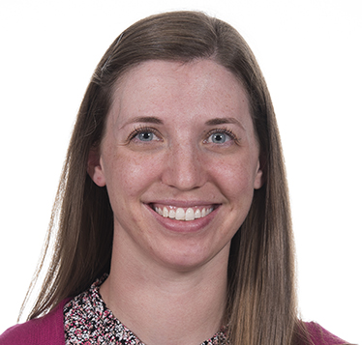
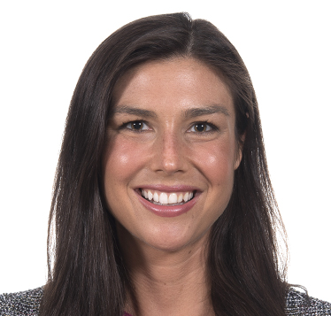
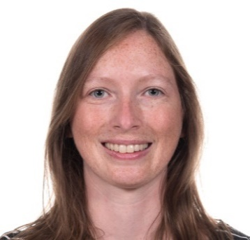
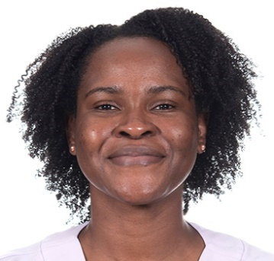
Megan Gates M.D., M.S. | Jillian Heckman M.D. | Laura Henderson M.D. | Kaysha Henry M.D., M.P.H
Hometown: Lancaster, PA
Medical School: Drexel
For Fun I: I love to spend time with my family and family and look for reasons to plan celebrations for my loved ones, which typically include a charcuterie board! I enjoy trying new places and foods, and you can typically find me at a Farmer's market most Saturday mornings. I love a good exercise spin class and have been enjoying safely getting back into group fitness classes.
Why did you choose Hopkins? I choose Hopkins because I desired a training environment that would challenge and support me, expose me to cutting-edge medical practice and complex medical conditions while staying grounded in the principle of caring for the local community. On my interview day, during virtual rounds, I saw a breadth of cases in just 30 minutes: from an international child seeking care for a rare metabolic disorder to asthma in the local child complicated by household smoking and smoking cessation support for the family. I was inspired by how children come from all over the world to receive their care from Hopkins, but how the physicians never abandoned the needs of the children in their own neighborhood. I realized that Hopkins would lay an excellent foundation for whatever path my career decided to take me, whether community general pediatrics to subspecialized care. I knew I would be surrounded by brilliant and hardworking individuals just trying to deliver the best care to their patients and do the right thing for the families and communities they serve. To be a part of this team is truly a humbling experience.
What excites you most about living in Baltimore? The waterfront! I love being able to see the docks and sailboats and be able to just grab a nice meal along the water with fresh, salty air blowing in the wind. Coming from a small town, I also find this city the PERFECT size for me - there is so much to see and do, but I already feel like I can navigate the neighborhoods well and it is super driveable - And so many FARMERS MARKETS with amazing fresh fish! Baltimore gives me the perfect balance of feeling like a local, but also the option to explore and try new things during my time off. My neighborhood and individuals I have met have also been friendly and welcoming, and it is nice to have a sense of support and belonging in a new community.
She/Her
Hometown: Concord, MA
Med School: Drexel
For fun: love running, cooking and eating food of all kinds, playing board games, and reading books (especially sci-fi, fantasy, and history)
Why did you choose Hopkins? The strong focus on education was very important to me - I am interested in Medical Education and also wanted to be in a program that prioritized resident learning. Between that, the sense of community and camaraderie, and the opportunities available in Baltimore for my spouse (who is not in a medical field), it just seemed right!
What excites me about Baltimore: I love the sense of community - people are very friendly and involved. There is also lots of great food to try and activities and neighborhoods to explore within Baltimore, but it is easy to get out of the city if you're craving more nature.
She/Her
Hometown: Antigua, West Indies and Chicago, Illinois
Medical School: University of Illinois College of Medicine
For Fun I: paint, do creative writing (mainly poems), and watch historical documentaries or fictional shows/movies. I really love Masterpiece Classics on PBS!
Why did you choose Hopkins? I absolutely enjoyed my virtual interview day and felt the warmth and camaraderie between the current residents even through the virtual environment. I was fully sold by the program when I sat through the global health second look day and learned about the amazing projects current attending faculty were working on and the diverse locations I could potentially go to for global health experiences. I was even more impressed by how humble and approachable all the faculty were throughout the entire application process, making it clear that this was the right place for me to train in pediatrics and global health.
What excites you most about living in Baltimore? Coming from the midwest it was hard to find Caribbean food and supermarkets. I've been excited to try to test out all the Caribbean restaurants that are in Baltimore and even experiment with all of the international cuisine.
She/Her
Hometown: Ashburn, VA
Medical school: Texas Tech
For fun I: Avid baseball and hockey fan, playing intramural sports, taking care of my labradoodle, Griffin, and tortoiseshell cat, Roux, hoping to one day make the perfect gumbo from scratch
She/Her

Slide 6
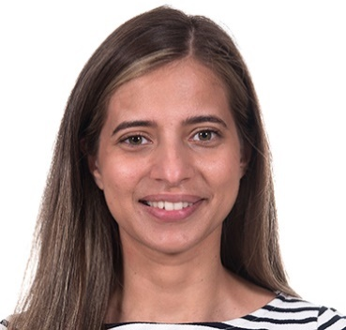

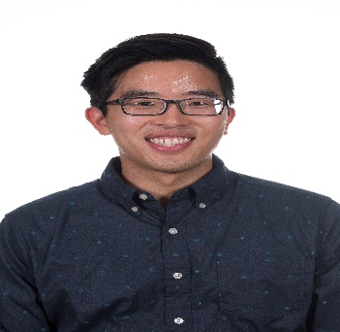
Zainab Khan M.D. | Andy Kleist M.D., Ph.D. | Matthew Kosasih M.D.
Hometown: Phoenix, AZ
Medical School: University of Arizona College of Medicine- Phoenix
For fun I: I like to travel, eat great food, and spend time in nature. Why did you choose Hopkins: I chose to come to Hopkins to pursue my training in pediatrics surrounded by great minds and kind souls. I loved the idea of having 1:1 senior to intern ratio and feel well supported in each environment.
What excited you most about living in Baltimore: Moving across country to Baltimore has given me and my husband so many local and nearby places to explore. We're excited to explore the east coast over the three years!
She/Her
Hometown: Pittsburgh, PA
Med school: Medical College of Wisconsin
For fun I: Play with our cats, go to running trails, try new breweries, play ice hockey
Why did I choose Hopkins: Great basic science research environment
What excites you the most about living in Baltimore: Surprisingly large vegan food scene, lots of breweries, close to many historical sites
He/Him
Hometown: Milwaukee, WI
Medical School: Medical College of Wisconsin
For Fun I: I love to eat out as much as I can, drink bubble tea every waking moment, and hang out with my lovely wife and two "daughters" (they're cats). Why did you choose Hopkins? Program and faculty are incredibly supportive with a superior focus on teaching and resident autonomy. Residents are kind, admirable, and down to earth.
What excites you most about living in Baltimore? THE FOOD!!!!
He/Him

Slide 7
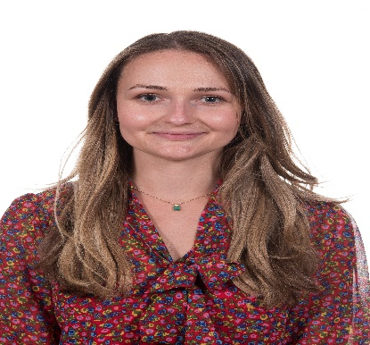
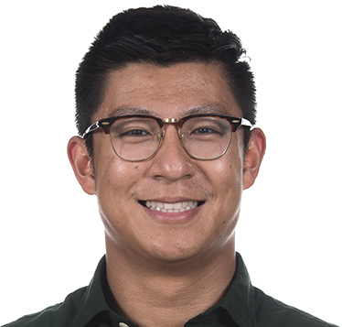
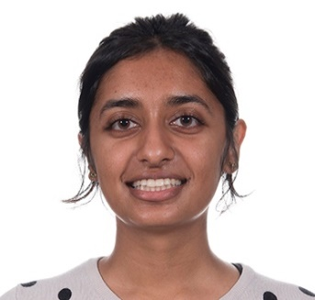
Jackie Kruglyakova M.D., M.S. | Fred Lam M.D. | Roshni Patel M.D.
Hometown: Los Angeles, CA
Medical School: Georgetown
For Fun I: like to do yoga/pilates, explore new hiking trails, watch true crime documentaries, and spend time with my boyfriend and pup, Atlas!
Why did you choose Hopkins? the people! I love how supportive and collaborative everyone is, especially the senior residents who have been so helpful during my first month of residency. I'm also excited to be at a program that offers so many incredible research and global health opportunities!
What excites you most about living in Baltimore? being so close to the water and all the delicious food spots!
She/Her
Hometown: Johnson City, TN
Medical School: East Tennessee State University
For Fun I: Powerlift, Collect comic books and sneakers, Read short stories & literature, and eat out with friends.
Why did I choose Hopkins: I chose Hopkins after how well I meshed with all of the faculty and residents I had met on interview day. The minute the day was over, I immediately got that gut feeling that this was where I needed to be. Aside from knowing that I would receive top tier training at Hopkins, I knew I would be able to do it surrounded by people that would support my ambitions and who I could end up calling family.
What excites me about living in Baltimore: The amazing food scene, the unique atmosphere and the variety of different experiences that each neighborhood here has to offer, and Ravens games.
He/Him
Hometown: Indianapolis, IN
Medical School: Indiana University
For Fun I: Cook, try new restaurants, hike in the Fall, hang with my cat Petal Patel, read sci-fi, watch reality TV
Why did you choose Hopkins?
I really liked the emphasis put on both on supporting resident education and training residents to be educators. Also, there are amazing opportunities in global health education, research and practice.
What excites you most about living in Baltimore? Trying out new restaurants, being close to DC and so many amazing places to hike.
She/Her

Slide 8
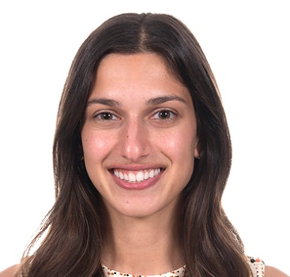
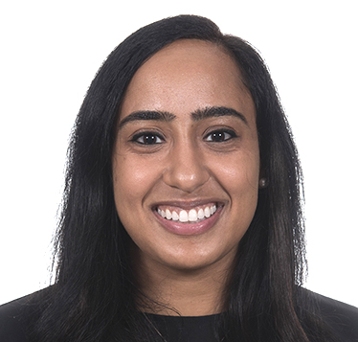
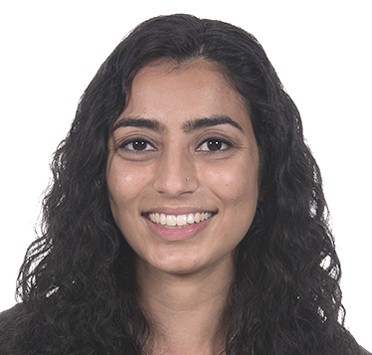
Mallika Rajamani M.D., M.P.H | Maneesha Sakhuja M.D., MHS | Nisha Shah M.D.
Hometown: Rochester, NY
Medical school: SUNY Upstate
For Fun I: Love to hang out with friends and do anything outside - running, hiking, skiing, water sports, etc. I also love trivia, musicals (Les Mis will always be my #1) and watching lots of Netflix.
Why did you choose Hopkins? Incredible faculty and staff, opportunities for global health work & research (I'm in the global health track), the clear commitment to underserved and diverse patient populations, and the truly genuine residents that I met on my interview day.
What excites you most about living in Baltimore? Being in a non-landlocked city, milder winters, and seafood!
She/Her
Hometown: Rockville, MD
Medical School: University of Nevada, Las Vegas
For Fun I: Travel, ski, play tennis, and spend time with friends and family.
Why did you choose Hopkins? The rigorous clinical training, the resident camaraderie, and the incredible breadth of academic opportunities and mentorship, including in public health, bioethics, and policy.
What excites you most about living in Baltimore? Learning about the culture of Baltimore and being close to family.
She/Her
Hometown: Bethpage, NY
Medical School:
Albert Einstein
For Fun I:
crochet, craft, cook, play board games, bike along the waterfront or Patterson Park!
Why did you choose Hopkins?
The residents are all warm, intelligent, and caring individuals that I'm grateful to work with every day. The administration is very approachable and supportive and puts a lot of emphasis on resident education. Also, the breadth of clinical exposure and patient diversity at Hopkins was very important to me.
What excites you most about living in Baltimore?
All of the neighborhoods are so unique and have tons of character! The food is AMAZING and Baltimore has a great craft beer scene!
She/Her

Slide 9
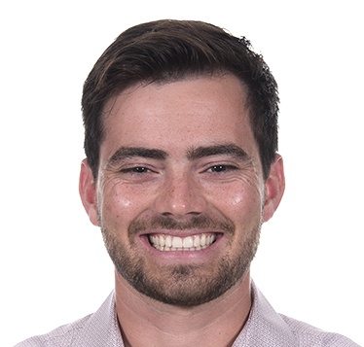
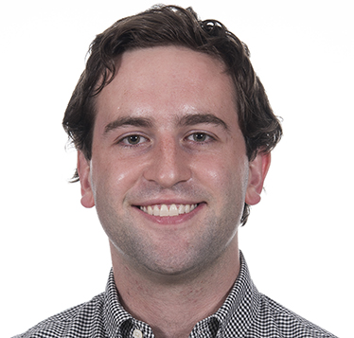
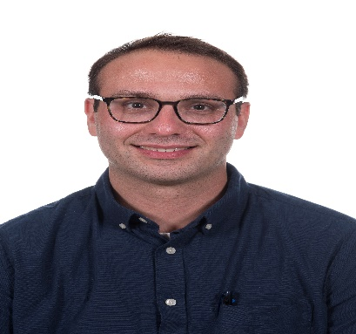
Nate Silvestri M.D. | Will Squiers M.D.
Nadav Weinstock M.D., Ph.D.
Hometown: Charleston, SC
Medical School: Medical University of South Carolina
For Fun I: Like to be outside!!! Hiking and Camping and Fishing, OH MY! We have already gone hiking as an Intern class, we have camping trips planned and we also hang out at restaurants (an outside activity for sure). You can also find me on my bike, playing golf with co-interns and their significant others or jogging the inner harbor!
Why did you choose Hopkins? It has the acuity and the crazy cases of a huge 600+ bed hospital, but our class is not huge and you can get to know everybody! It is so nice to be able to take care of the sickest kids with the rarest diseases from around the world, but to also have your bread and butter gen peds. The Children's Center is big enough to provide that experience but not so big that you don't get to know the people who work with you (like your co-interns, the nursing staff and ancillary services). I have been here for less than a month and I already find familiar places wherever I go!
What excites you most about living in Baltimore? I am excited super excited to be living in Baltimore! There is a ton to do on the weekend like O's games, farmers markets, festivals and a great restaurant scene. We are also super close to other cities to visit friends in NY, DC, Philly and you can get anywhere for your vacations from our airports in the area. I also LOVE my neighborhood and jog a different route every time so I can explore!
He/Him
Hometown: Dallas, TX
Medical School: Dell Medical School
For Fun I: Play board games, pick up sports, and watch Dallas sports teams
Why did you choose Hopkins?: The program's focus on making residents great teachers as well as physicians
What excites you most about living in Baltimore?: The food and being close to the water
He/Him
Hometown: Buffalo, NY
Medical School: Jacobs School of Medicine, SUNY Buffalo
For Fun I: Eat, travel, squash, golf, board games, escape rooms, fantasy books.
Why did you choose Hopkins?
Great research opportunities for physician scientists, robust pediatrics and genetics training programs, affordable east coast city.
What excites you most about living in Baltimore?
Affordability to buy house, explore the area, proximity to DC and outdoors.
He/Him

Slide 10

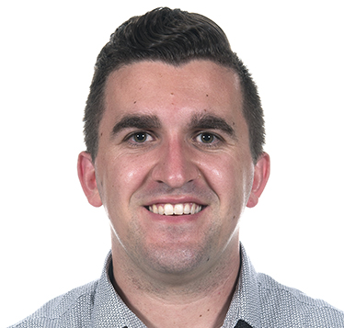
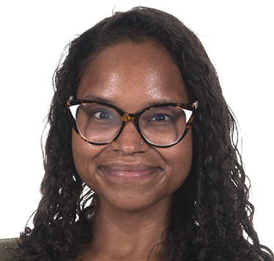
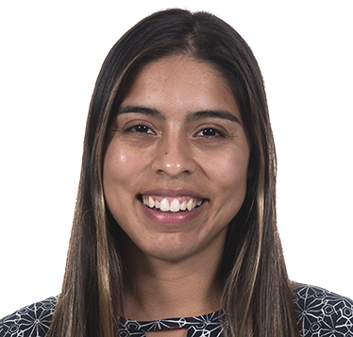
Edward Corty M.D., M.P.H. | Ross Gilbert M.D. | Vianca Masucci M.D. | Andrea Silvas M.D.
3rd- Year Med-Peds Residents!
Hometown: St. Petersburg, FL
Medical School: Florida State University
For Fun I: Read the Harriet Lane Handbook. But seriously, I enjoy jogging, taking my dog, Annie to Patterson Park, and trying new coffee shops.
Why did you choose Hopkins? Location was important to me and my fiance, Courtnee and we LOVE Baltimore. In addition, I have always found the Hopkins community to be forward thinking yet humble. I wanted to be in an environment where it was encouraged to say "I don't know" because the patient's well-being is prioritized far above pride. I have found this to be repeatedly true at Hopkins.
What excites you most about living in Baltimore? From Fell's Point to Hampden to Highlandtown, every Baltimore neighborhood has a different feel. A common thread, however, is that everyone says hello (it really is Charm City). I love being out in the city and trying the new restaurants that are always popping up. In addition, I feel immensely privileged to work in partnership with individuals and communities in Baltimore towards improved health and well being.
He/Him
Hometown: Howards Grove, WI
Medical School: University of Wisconsin
For Fun I:
Go for walks to Patterson Park and BMore Licks with my wife, daughter, and dog.
Why did you choose Hopkins?
I was so impressed by the Med-Peds program's commitment to urban underserved primary care and urban health leadership. Plus everybody I met on interview day (from IM to Med-Peds to Peds) was absolutely incredible!
What excites you most about living in Baltimore? Top 3 reasons, in no particular order: (1) Baltimore is so walkable with countless great restaurants abound. (2) Mr. Trash is an icon.(3) My daughter has a set of grandparents just 2.5 hours away!
He/Him
Hometown: Newark, NJ
Medical School: Penn State
For Fun I: Weight lifting; attending live theatrical performances; acting; writing poetry; dog training; travel; finding everyday adventures; cooking
She/Her
Hometown: El Paso, TX
Medical School: Texas Tech
For Fun I: Do lots of yoga (especially like practicing handstands), learn dance choreographies on TMilly TV or Youtube and share them videos on IG (or just record myself and never share them), take dogs on walks (mostly just Molly because Pico doesn't listen), and help my husband create guitar videos (although the majority of the time I just watch him rock out).
Why did you choose Hopkins?: I chose Hopkins because of the Urban Health Primary Care focus the Med/Peds program has. I knew it would best prepare me to one day return to my hometown and influence/improve the primary care scene there. The program also seemed incredibly family friendly and mega sensitive to resident wellbeing, all things which I desired. However, I ultimately came here because I had met Dr. Lenny Feldman and Dr. Angela Orozco before interview season formally started and I just knew I wanted them to be my bosses.
What excites you most about living in Baltimore? Being surrounded by water! As someone who has lived the majority of my life in a desert, I have already loved quick beach/river getaways and running by the harbor.
She/Her

Slide 11
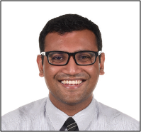
4rd Year Med-Peds Residents
Joniqua Ceasar M.D. ​ | Sophie Crinion M.D. | Christle Nwora M.D. | Urveel Shah M.D.
Medical School: Baylor College of Medicine
For Fun I: like to dance (especially bachata), practice yoga, go thrifting and take care of my plants.
Why did you choose Hopkins? As soon as I discovered the MedPeds program here, I fell in love. Its mission aligns so perfectly with my career goals of becoming a community physician committed to anti-racism and interested in public health. I had the opportunity to do an away rotation and was impressed by the brilliance, humility and passion of the housestaff and faculty.
What excites you most about living in Baltimore? I love being near the water and so much greenery!
Ask me about: moving from the "real" south/to a new place, being a Black female resident, apartment hunting in Baltimore, Jordan Peele's movies and shows.
She/Her
Hometown: San Jose, CA
Medical School: UCSF
For Fun I: Like to run, hike, do anything outside! I've also been loving caring for my growing indoor plant collection!
Why did you choose Hopkins?
I am doing MedPeds and I love the urban health, primary care focus of the MedPeds program! Both categorical programs and MedPeds attract super smart, driven residents and I'm humbled and excited to get to learn from them.
What excites you most about living in Baltimore?
My favorite Baltimore story so far is when my partner and I first moved in and bought our couch. We bought it used from someone who lived just a few blocks away. It was too big to fit in the car and I thought "we can carry it!" Big mistake. We (okay, actually just me) were struggling carrying the couch down the street and several strangers offered to help carry it for a block or two to give me a break. A group of kids even cheered us on! It was such a sweet welcome to Baltimore. I'm so excited to get to spend some time with this community over the next few years!
She/Her
Hometown: Murphy, Texas
Medical School: McGovern Medical School
For Fun I: Going to boxing and watching live performances in the park.
Why did you choose Hopkins? The Urban Health Program and the great residents I met around the interview day!
What excites you most about living in Baltimore? All the green space within city limits.
She/Her
Hometown: Morton Grove, Illinois
Medical School:
University of Illinois College of Medicine
For Fun I:
Make pizza, watch Avatar: The Last Airbender, and watch baseball
Why did you choose Hopkins?
I chose Med-Peds at Hopkins because the program has a dedicated focus on urban health and underserved populations. It was also the program with the clearest emphasis on teaching and medical education.
What excites you most about living in Baltimore?
Living close to the water and exploring the restaurant scene!
He/Him

Slide 12
Sapna Desai M.D. | Alex Jaksic M.D.
4thYear Peds- Anes Residents
Hometown: Wellesley MA
Medical School: Zucker School of Medicine and Hofstra/Northwell
For Fun I: I enjoy walking to new places, working out, peanut butter, and cooking. Big fan of dogs. I picked up drawing with charcoal in undergrad at Union College, it has been a mix of a relaxing (sometimes a novel source of stress).
Why did you choose Hopkins? I am in the Combined Pediatrics-Anesthesiology Residency Track, and the established culture of cooperative/interdisciplinary training at Hopkins allowed me to pursue my interest in pediatrics as well as anesthesia in parallel.
What excites you most about living in Baltimore? I am living in the inner harbor area and have found it to be a very lively and fun area to explore. Since arriving I started hiking in some of the surrounding areas. I have only great things about the food scene here and once restaurants open up again, I am looking forward to trying places out!
He/Him
Hometown: Melbourne, Florida
Medical School: University of Central Florida
For fun I: Hangout with friends, play board games, rock climb, travel
Why did you choose Hopkins? The leadership truly supports the residents, everyone is happy, good work life balance
What excites you most about living in Baltimore: The crab and charm of all the different neighborhoods
She/Her

Slide 13
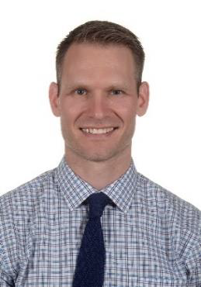
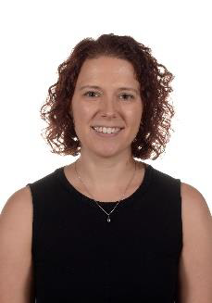
Ian Drummond M.D., M.B.A. | Kristen Penberthy M.D., Ph.D.
5thYear Peds- Anes Residents
Hometown: Del Mar, CA
Medical School: Case Western Reserve
For Fun: Play ice hockey. Think about what to make in my crockpot next week.
Favorite thing about Baltimore: I like how Baltimore is overlooked by most people. Keeps the hidden gem hidden, and the rent down, baby.
What do you like most about our residency program : By and large, the residents and attendings are kind and patient people. The residency is associated with a med school and university that’ve got it going on (amenities, research, opportunities to collaborate with the other professional and graduate schools). The Bloomberg Children’s Center is a newer building with wide hallways and lots of windows.
Call me superficial, but honestly its
awesome.
Ask me about...the Pediatrics
Anesthesia Program!
Hometown: Pelham, NY
Medical School: University of Virginia
For Fun I: enjoy spending time with my dog, Ozzie in Patterson Park, exploring the Baltimore restaurants and bars and doing aerial silks and yoga.
Favorite thing about Baltimore:I love Patterson Park and how you can forget that you're in a city while you're there. I also love how there are many small neighborhoods within Baltimore, some only spanning a few blocks, and yet they all have unique personalities that you can appreciate while walking through the city.
What do you like most about our residency program:
The people here are what make this program fantastic. I love my class and spending time with them. Everyone looks out for one another and value each other for the things they bring to the program. My co-residents make the difficult days of residency manageable and the good days excellent.

