Slide 1
Ten Minute Wellbeing Tips for Managers
Powered by the Office of Wellbeing
Vision: For our employees to leave work at the end of the day healthier than when they arrived
Carolyn J. Cumpsty-Fowler, PhD, MPH, ACC
Senior Director for Nursing Well-Being
Johns Hopkins Health System
Notes:
Good morning. We’re starting in a few seconds. Notice that this meeting will be recorded. Please keep yourself on mute.
(When ready to record, be sure all others not showing)
Speaking points
Good morning and thank you for joining our learning community for ten minutes to explore how we can support wellbeing within our teams.

Slide 2
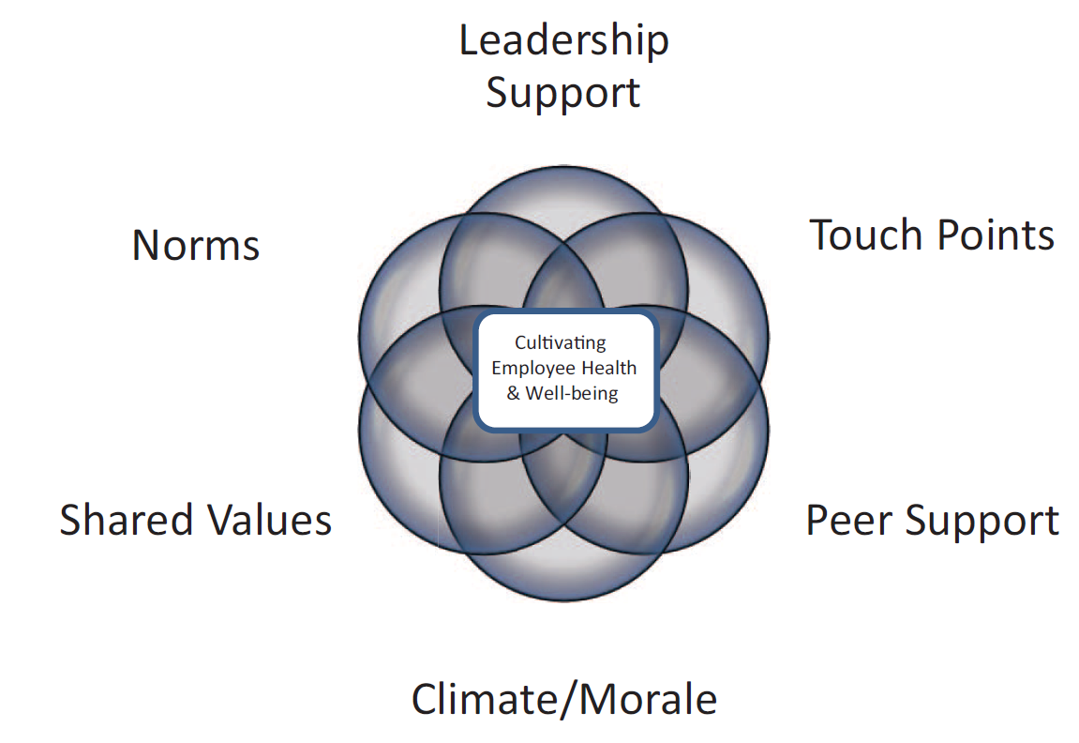
Theme: Leading with Well-being in Mind
Episode 26: Collaborative Leadership
Notes:
This morning we return to the Leadership Support building block of well-being - and an important theme: Leading with Well-Being in Mind.
Those of you who’ve worked with me, already know that collaborative leadership is something I care very deeply about. I’m grateful to be able share some of the reasons why with you.

Slide 3
Collaborative Leadership
Leverages the power of
People
Perspectives
Possibilities
Partnerships
Notes:
Collaborative Leadership Leverages the power of
People (and the things they are passionate about)
Perspectives
Possibilities
Partnerships (often unlikely or non-traditional)
In many ways, it is a force multiplier!

Slide 4
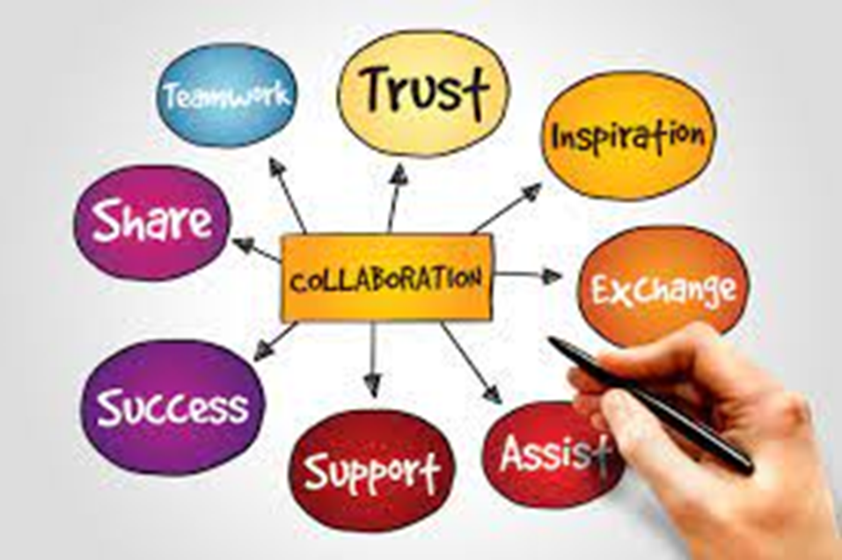
“I can do things you cannot, you can do things I cannot;
together we can do great things.”
~ Mother Teresa
Notes:
Mother Theresa reminded us of the power of collaboration:
“I can do things you cannot, you can do things I cannot;
together we can do great things.”

Slide 5
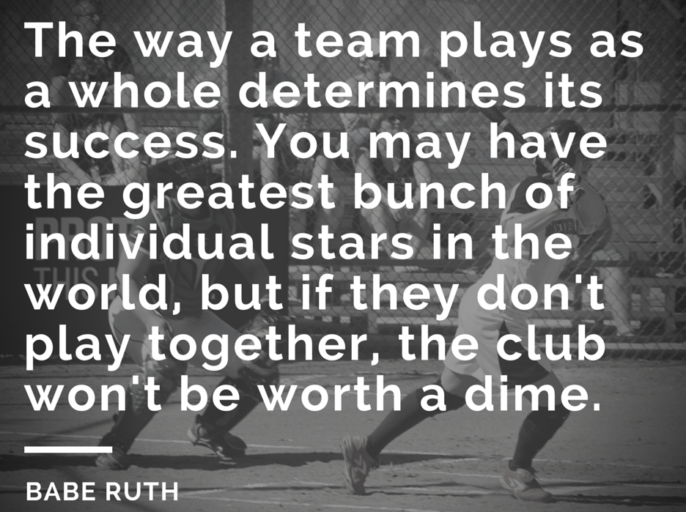
Notes:
But it’s not enough though to acknowledge we all have skills and talents. In a well-known quote, the baseball legend Babe Ruth warns:
“The way a team plays as a whole determines success. You may have the greatest bunch of individual stars in the world, but if they don’t play together, the club won’t be worth a dime.”
We are not competing as professional athletes, but the successes and wins we must achieve together as healthcare teams go far beyond the hunt for a trophy or title.
In our complex and high-stakes professional world, no team will be successful if the only leader they have is a manager or a coach.
Winning teams invest in creating a culture of collaborative leadership that welcomes, supports and leverages their combined strengths.

Slide 6
Collaborative Leadership: A Definition
“Is grounded in a belief that all of us together can be smarter, more creative, and more competent than any of us alone, especially when it comes to addressing the kinds of novel, complex, and multi-faceted problems that organizations face today. It calls on leaders to use the power of influence rather than positional authority to engage and align people, focus their teams, sustain momentum, and perform.
Success depends on creating an environment of trust, mutual respect, and shared aspiration in which all can contribute fully and openly to achieving collective goals.
Leaders must thus focus on relationships as well as results, and the medium through which they operate is high-quality conversation.”
Resource - https://www.oxfordleadership.com/wp-content/uploads/2017/07/OL-White-Paper-Collaborative-Leadership.pdf
Notes:
Oxford Leadership’s definition of Collaborative Leadership is long, but I share it because it contains important ideas.
Collaborative leadership “Is grounded in a belief that all of us together can be smarter, more creative, and more competent than any of us alone, especially when it comes to addressing the kinds of novel, complex, and multi-faceted problems that organizations face today.
It calls on leaders to use the power of influence rather than positional authority to engage and align people, focus their teams, sustain momentum, and perform.
Success depends on creating an environment of trust, mutual respect, and shared aspiration in which all can contribute fully and openly to achieving collective goals.
Leaders must thus focus on relationships as well as results, and the medium through which they operate is high-quality conversation.”

Slide 7
How does collaboration support well-being?
Notes:
How does collaboration support well-being?
This has its roots in our evolutionary history and the fact that living in a collaborative group was essential for survival.
The ability to collaborate to create a pro-social community made it possible to meet basic human needs such as safety, shelter, food and water, rest, relationships, reproduction; and the ability to adapt to challenges in the environment.
These basic needs remain as true today as they were then. As humans we are biologically programmed to monitor our environment for risks, and also for signs that we are safe and supported.

Slide 8
Signs of Collaboration
Connection
Community (a sense of belonging)
Caring (for people and purpose)
Communication
Curiosity
Creativity
Choices (and sense of shared control)
Contributing (diverse and numerous)
Notes:
So what are the signs that our work culture is collaborative and safe?
We have a felt sense of
Connection &
Community (a sense of shared identity and belonging)
Caring (for people and purpose)
Communication (open, transparent and trustworthy)
Curiosity (open to new ways of being and doing)
Creativity (supports our ability to solution-find and adapt)
Choices (and a sense of shared control)
Contributing (welcoming diverse and numerous)

Slide 9
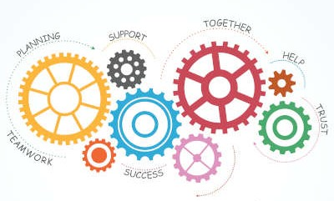
Notes:
Collaborative leaders and teams create conditions that support several key dimensions of well-being. These are:
Safety
The space and opportunity to take care of needs such as food, hydration and rest
Social well-being and the reduced stress that results from trusting relationships and social support
Professional life satisfaction - through Work enjoyment, enhanced teamwork, and an enhanced sense of autonomy
The presence of opportunities for learning & growth

Slide 10
Collaborative leadership is a learned skill
Notes:
The challenge is that even though collaboration is essential to our well-being (individually and collectively), and in some ways programmed into our biology, supporting collaboration as a leader is a learned skill.
Sometimes, as we’ve discussed in earlier sessions, our pro-social tendencies to nurture, care, help or problem-solve may actually get in the way of us being truly effective collaborative leaders.

Slide 11
Shifting towards collaborative leadership
Ego System
Eco System
“It’s About Me”
Top down control
Command
Independent silos
Territoriality
Power Struggles
Self-Interest
Withholding Information
Blaming
“It’s About Us”
Influence
Conversation
Aligned agility
Partnership
Mutual Empowerment
Mutual Support
Joint Knowledge Development
Mutual Accountability
Source - https://www.oxfordleadership.com/wp-content/uploads/2017/07/OL-White-Paper-Collaborative-Leadership.pdf
Notes:
Another challenge is that some of our organizational structures may be barriers to true collaboration. Oxford Leadership produced a white paper on collaborative leadership that I recommend. Meg will put a link to this resource in the chat.
https://www.oxfordleadership.com/wp-content/uploads/2017/07/OL-White-Paper-Collaborative-Leadership.pdf
They describe key shifts that collaborative leaders make as they move from an individually-focused leadership “it’s about me” Ego System to a collaboratively focused “it’s about us” Ecosystem.
Collaborative leaders focus on influencing others (not controlling them)
They invest in wide-ranging conversations and listening
They are flexible. They respect individual skills, expertise and even structures while seeking opportunities to reach across divides and disciplines, align and adjust.
They build and participate in partnerships and don’t engage in turf battles. They are less invested in ownership and more invested in results.
They believe that when we empower one, we empower all. That when leaders share power, our collective power to achieve the outcomes we care about increases.
This connects to a collaborative leader’s belief in the importance of mutual support, sharing information and developmental opportunities, and mutual accountability.

Slide 12
Wellness-Centered Leadership (WCL) is Collaborative
“Caring about people always is the only reliable foundation on which to build relational leadership skills that inspire individual and team performance” (p. 642)
Shanafelt T, Trockel M, Rodriguez A, Logan D. Wellness-Centered Leadership: equipping health leaders to cultivate physician well-being and professional fulfillment. Acad Med. 2021; 96(5): 641-651
Notes:
Above all collaborative leaders know that the foundation of our success is people, and the need to care about people always. And that brings us back to well-being.
Last year, Tait Shanfelt and colleagues from Stanford published a Wellness Centered Leadership Model. Their model integrates core leadership skills from prominent leadership philosophies (such as authentic and transformational leadership) and the evidence about how leaders support clinician well-being and performance.
“Caring about people always – they say - is the only reliable foundation on which to build relational leadership skills that inspire individual and team performance”
Without this foundation we are unable to inspire and lead change

Slide 13
10 Collaborative Leadership Practices
Connects with team members on a personal level
Is transparent and trustworthy
Listens with humility and curiosity
Welcomes, respects and honors diverse perspectives
Encourages a sense of shared purpose, and shared goals
Suspends premature judgment
Explores assumptions and beliefs
Embraces ambiguity and not-knowing
Creates a climate that welcomes and supports discovery and the emergence of new ideas and practices
“Focuses on setting the stage, not necessarily performing on it” (Linda Hall)
Some content drawn from https://www.oxfordleadership.com/wp-content/uploads/2017/07/OL-White-Paper-Collaborative-Leadership.pdf
Linda A. Hill quote: https://www.strategy-business.com/article/00315
Notes:
Let’s look at 10 important collaborative leadership practices. A collaborative leader
Connects with team members on a personal level
Is transparent and trustworthy
Listens with humility and curiosity
Welcomes, respects and honors diverse perspectives
Encourages a sense of shared purpose, and shared goals
Suspends premature judgment
Explores assumptions and beliefs
Embraces ambiguity and not-knowing
Creates a climate that welcomes and supports discovery and the emergence of new ideas and practices
“Focuses on setting the stage, not necessarily performing on it” (Linda Hall)

Slide 14
Final thought for today
Notes:
Final thought for today:
Some of the ideas I shared today may sound familiar to those of you who have attended other talks in this series.
That’s because collaborative leaders have learned to weave together many of the skills we have discussed in earlier sessions.
In doing so, they create a culture of collaboration that supports a healthy and positive work environment.

Slide 15
Theme: Leading with Well-being in Mind Episode 29: Collaborative Leadership
Manager tip #31:
Remember that relationships are your greatest resource mobilizers!
Agenda tip #35:
Make sure that you leave time on your agenda for conversations about how and why you collaborate
Notes:
Here are today’s tips
Manager tip #31: Remember that relationships are your greatest resource mobilizers!
Agenda tip #35: Make sure that you leave time on your agenda for conversations about how and why you collaborate.

Slide 16
Theme: Leading with Well-being in Mind
Episode 29: Collaborative Leadership
Next session: Celebration
Notes:
Next week Dr Safeer will be back with us to discuss the importance of celebration and taking time to acknowledge accomplishments in a healthy way.

Slide 17
Connect with Healthy at Hopkins and the Office of Wellbeing
Healthy at Hopkins
- Access the portal via my.jh.edu an click on the ‘Healthy at Hopkins’ tile
833-554-4554
healthyathopkins@jhmi.edu
Office of Wellbeing
https://www.hopkinsmedicine.org/joy-at-jhm/office-of-well-being
OWB@jhmi.edu
Follow us on Twitter and Instagram
@HealthyHopkins
@HealthyatHopkins
Additional Wellbeing and Leadership Resources
LinkedIn Learning
Sure People
Notes:
As always, we encourage you to use and share the resources at H@H and the Office of Well-Being

Slide 18
What Question Do You Have?
Notes:
I look forward to hearing your questions or insights

