Slide 4
Delete the following slides when your presentation is complete.

Slide 5
Strategic Plan Icons
Copy and paste these elements, if you choose.

Slide 6
PowerPoint Icons
Copy and paste these elements, if you choose.

Slide 7
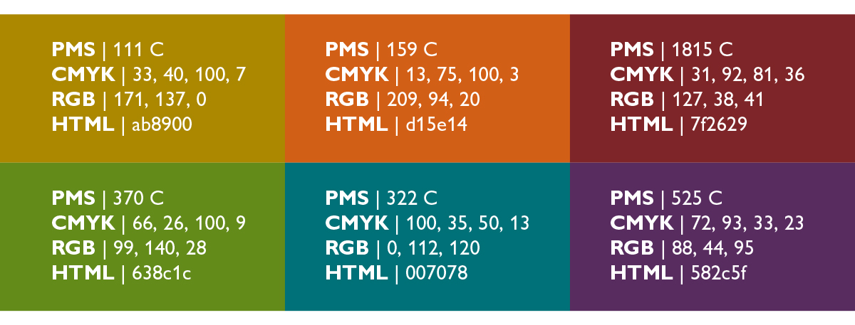
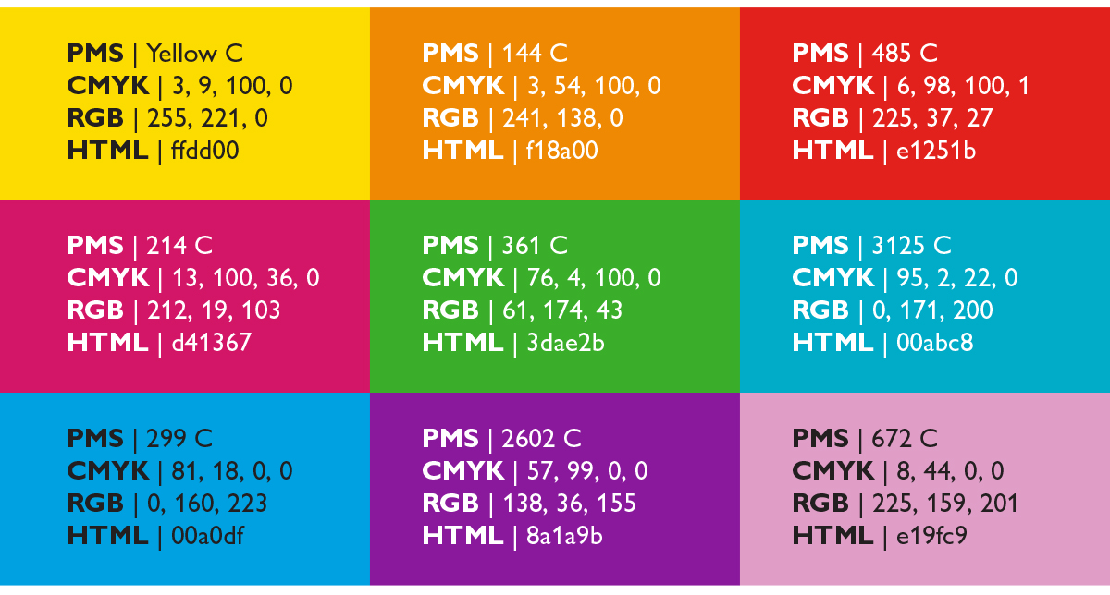
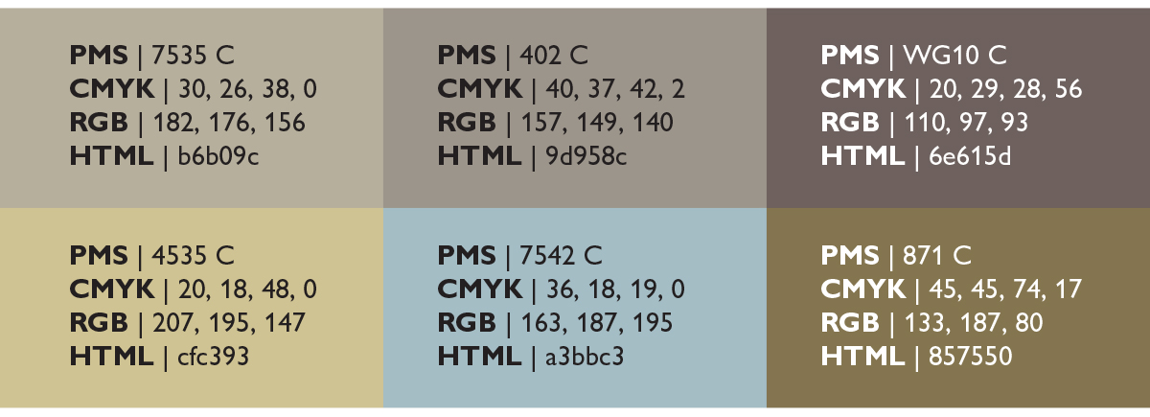
JHM Color Palate
Use these colors, if you choose.
Primary Brand Colors
Sophisticated Colors
Bright Colors
Neutral Colors

