Slide 1
Getting an IV
At Johns Hopkins All Children’s Hospital
Notes:
This flip book was created by the child life department to help children understand the steps of an IV. The pictures on each page show the steps of an IV, although not all steps are relevant for every child. You can use your discretion to eliminate certain pages as appropriate. On the back of each page is a sample script for the picture on the following page. Because each child’s understanding will be different, you are encouraged to use your own language to describe the steps in the pictures. This book can be used before an IV to teach the child about what to expect, or during the IV. If used during the IV, a parent or staff member can hold the book and flip the pages as each step of the procedure is completed on the child. Seeing a picture of what is happening may help some children to feel in control as the procedure is happening.

Slide 2
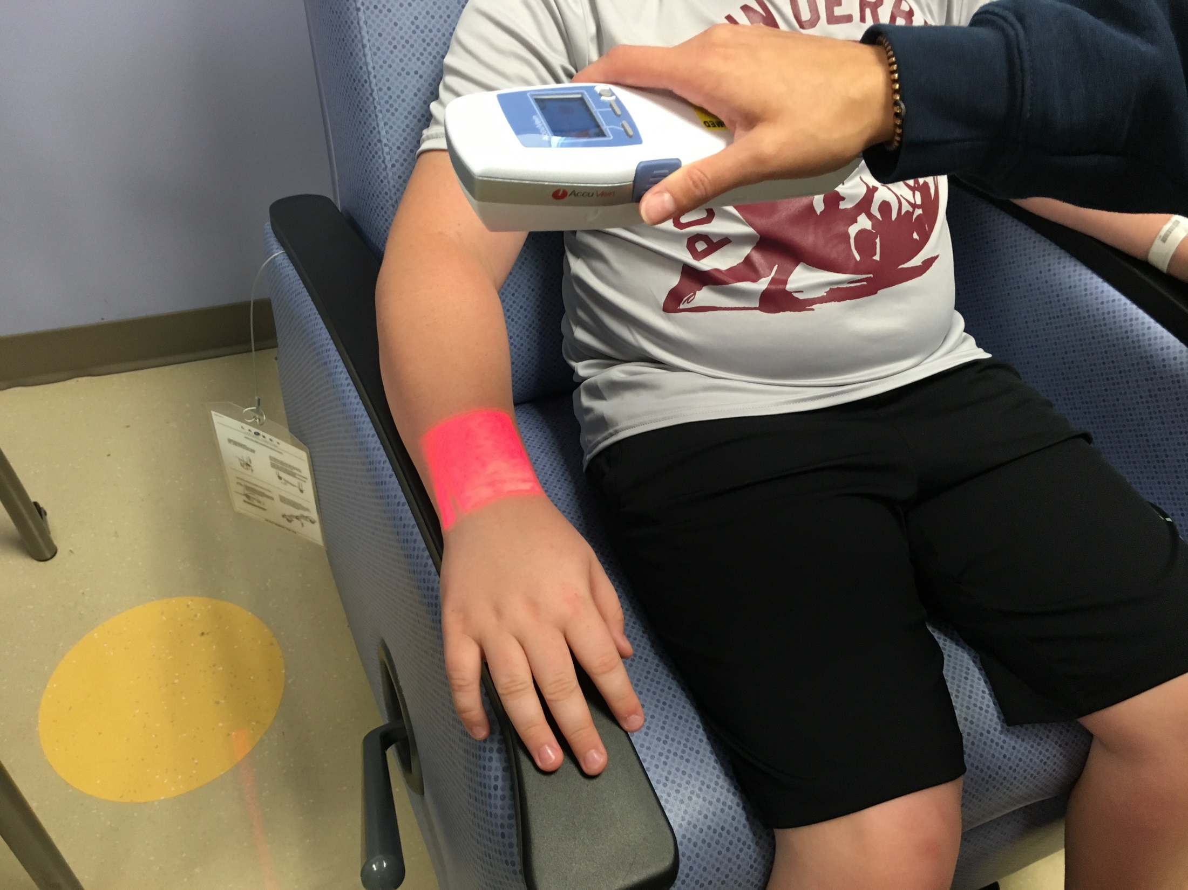
Notes:
The nurse uses a small machine to shine a red light on my arm. The red light helps her to see the blue veins in my arm and hand.

Slide 3
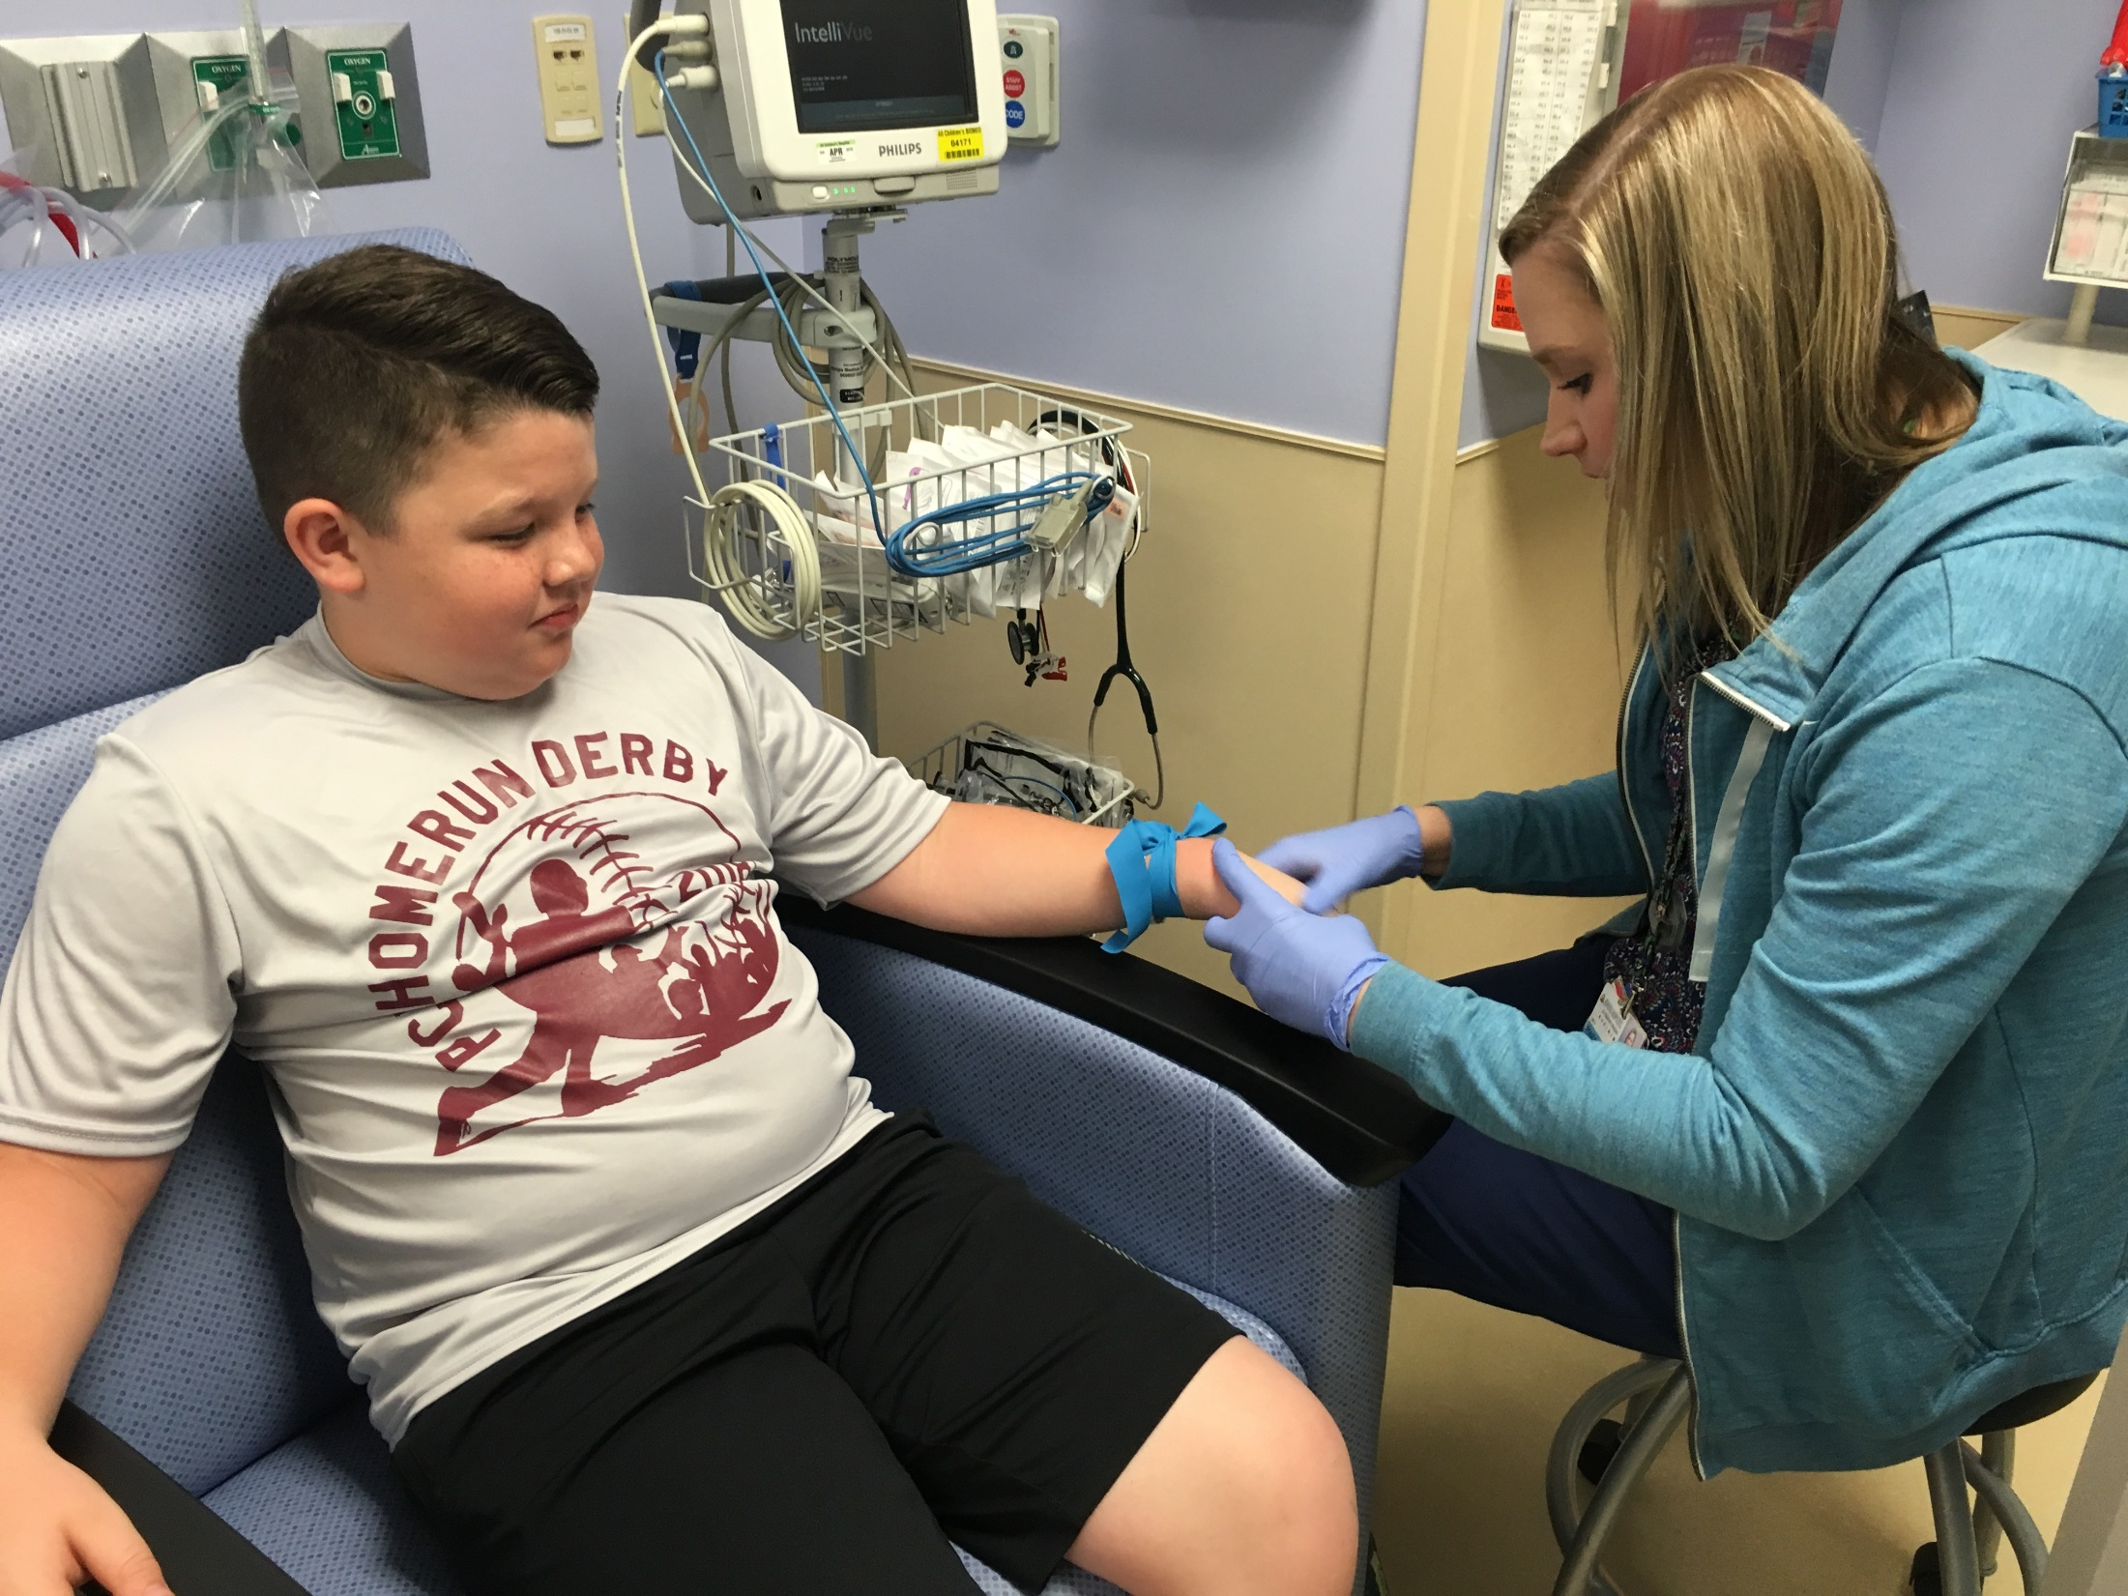
Notes:
The nurse ties a stretchy blue rubber band around my arm. It feels like a tight hug.

Slide 4
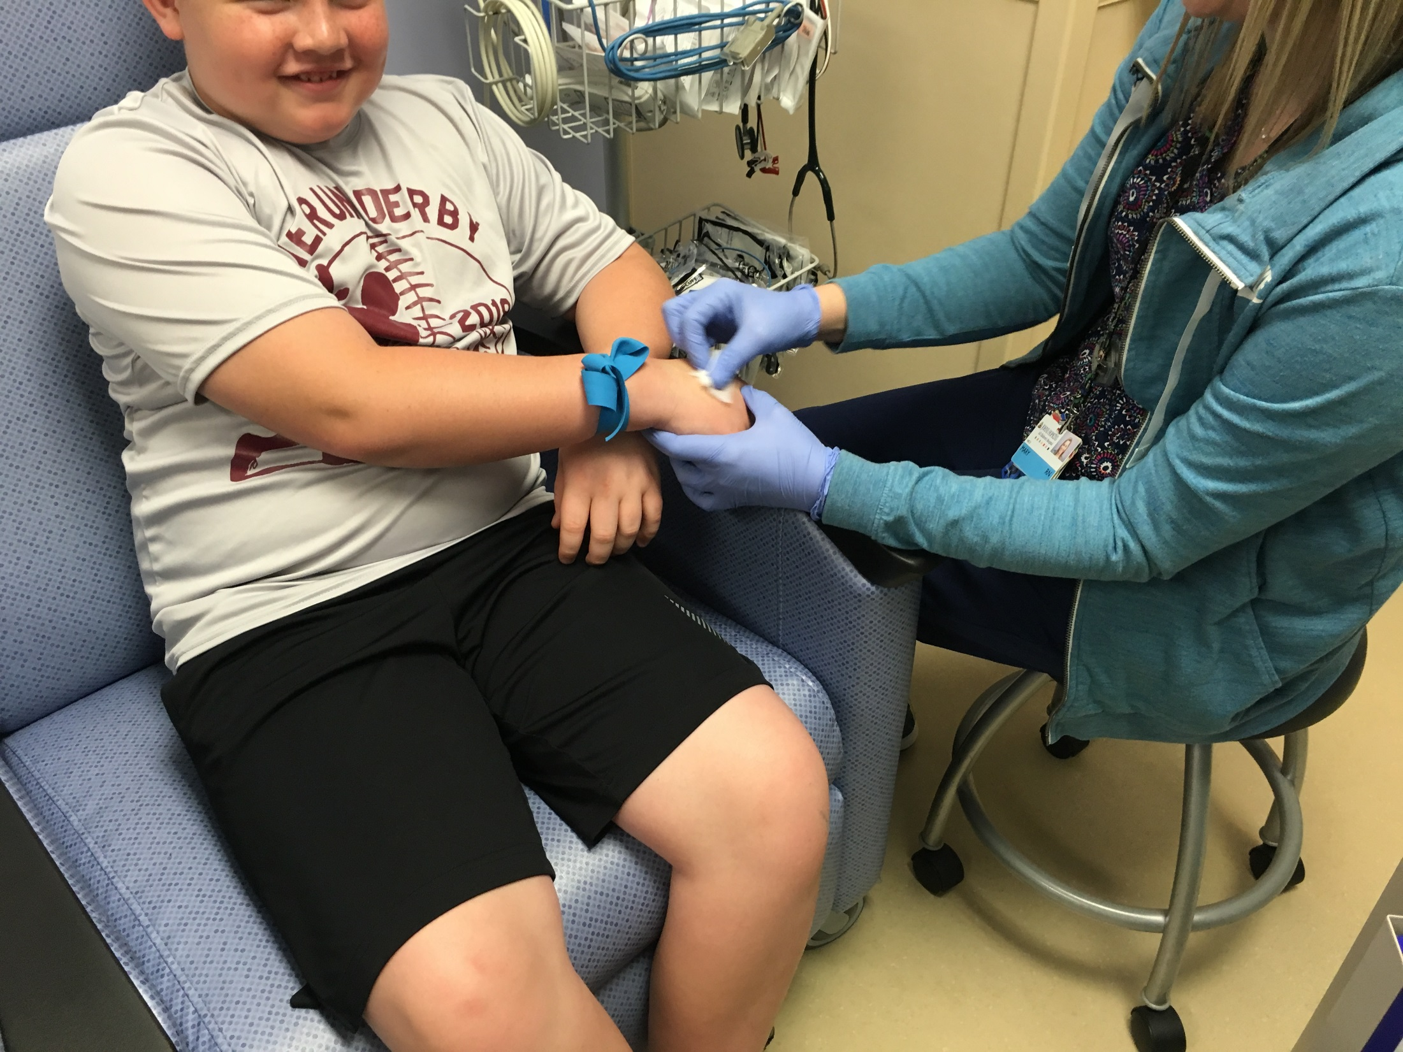
Notes:
The nurse uses a small, cold, wipe to clean my skin.

Slide 5
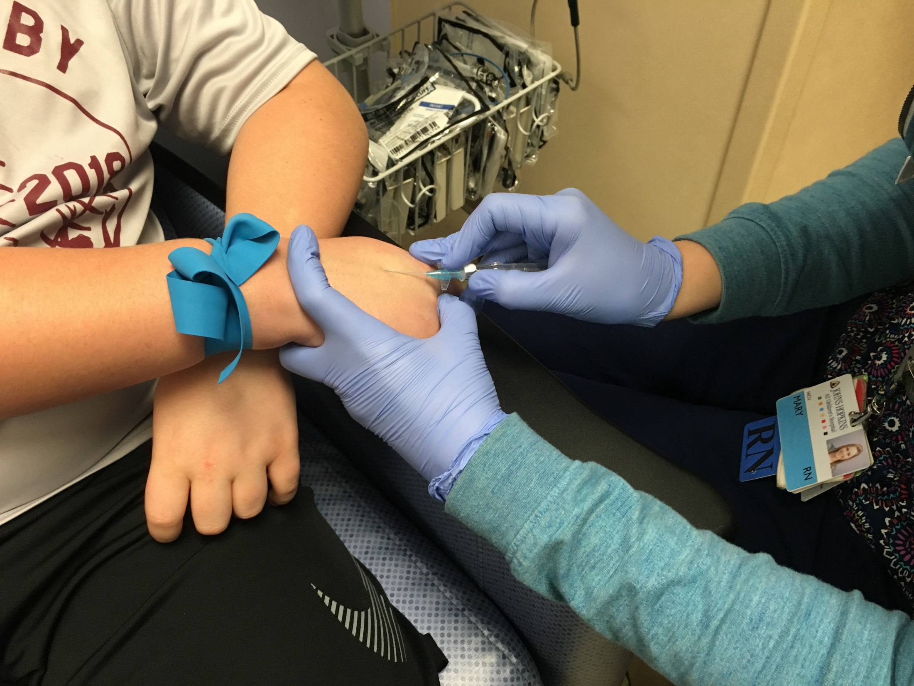
Notes:
The nurse uses a tiny needle to put the IV straw into a vein in my hand.

Slide 6
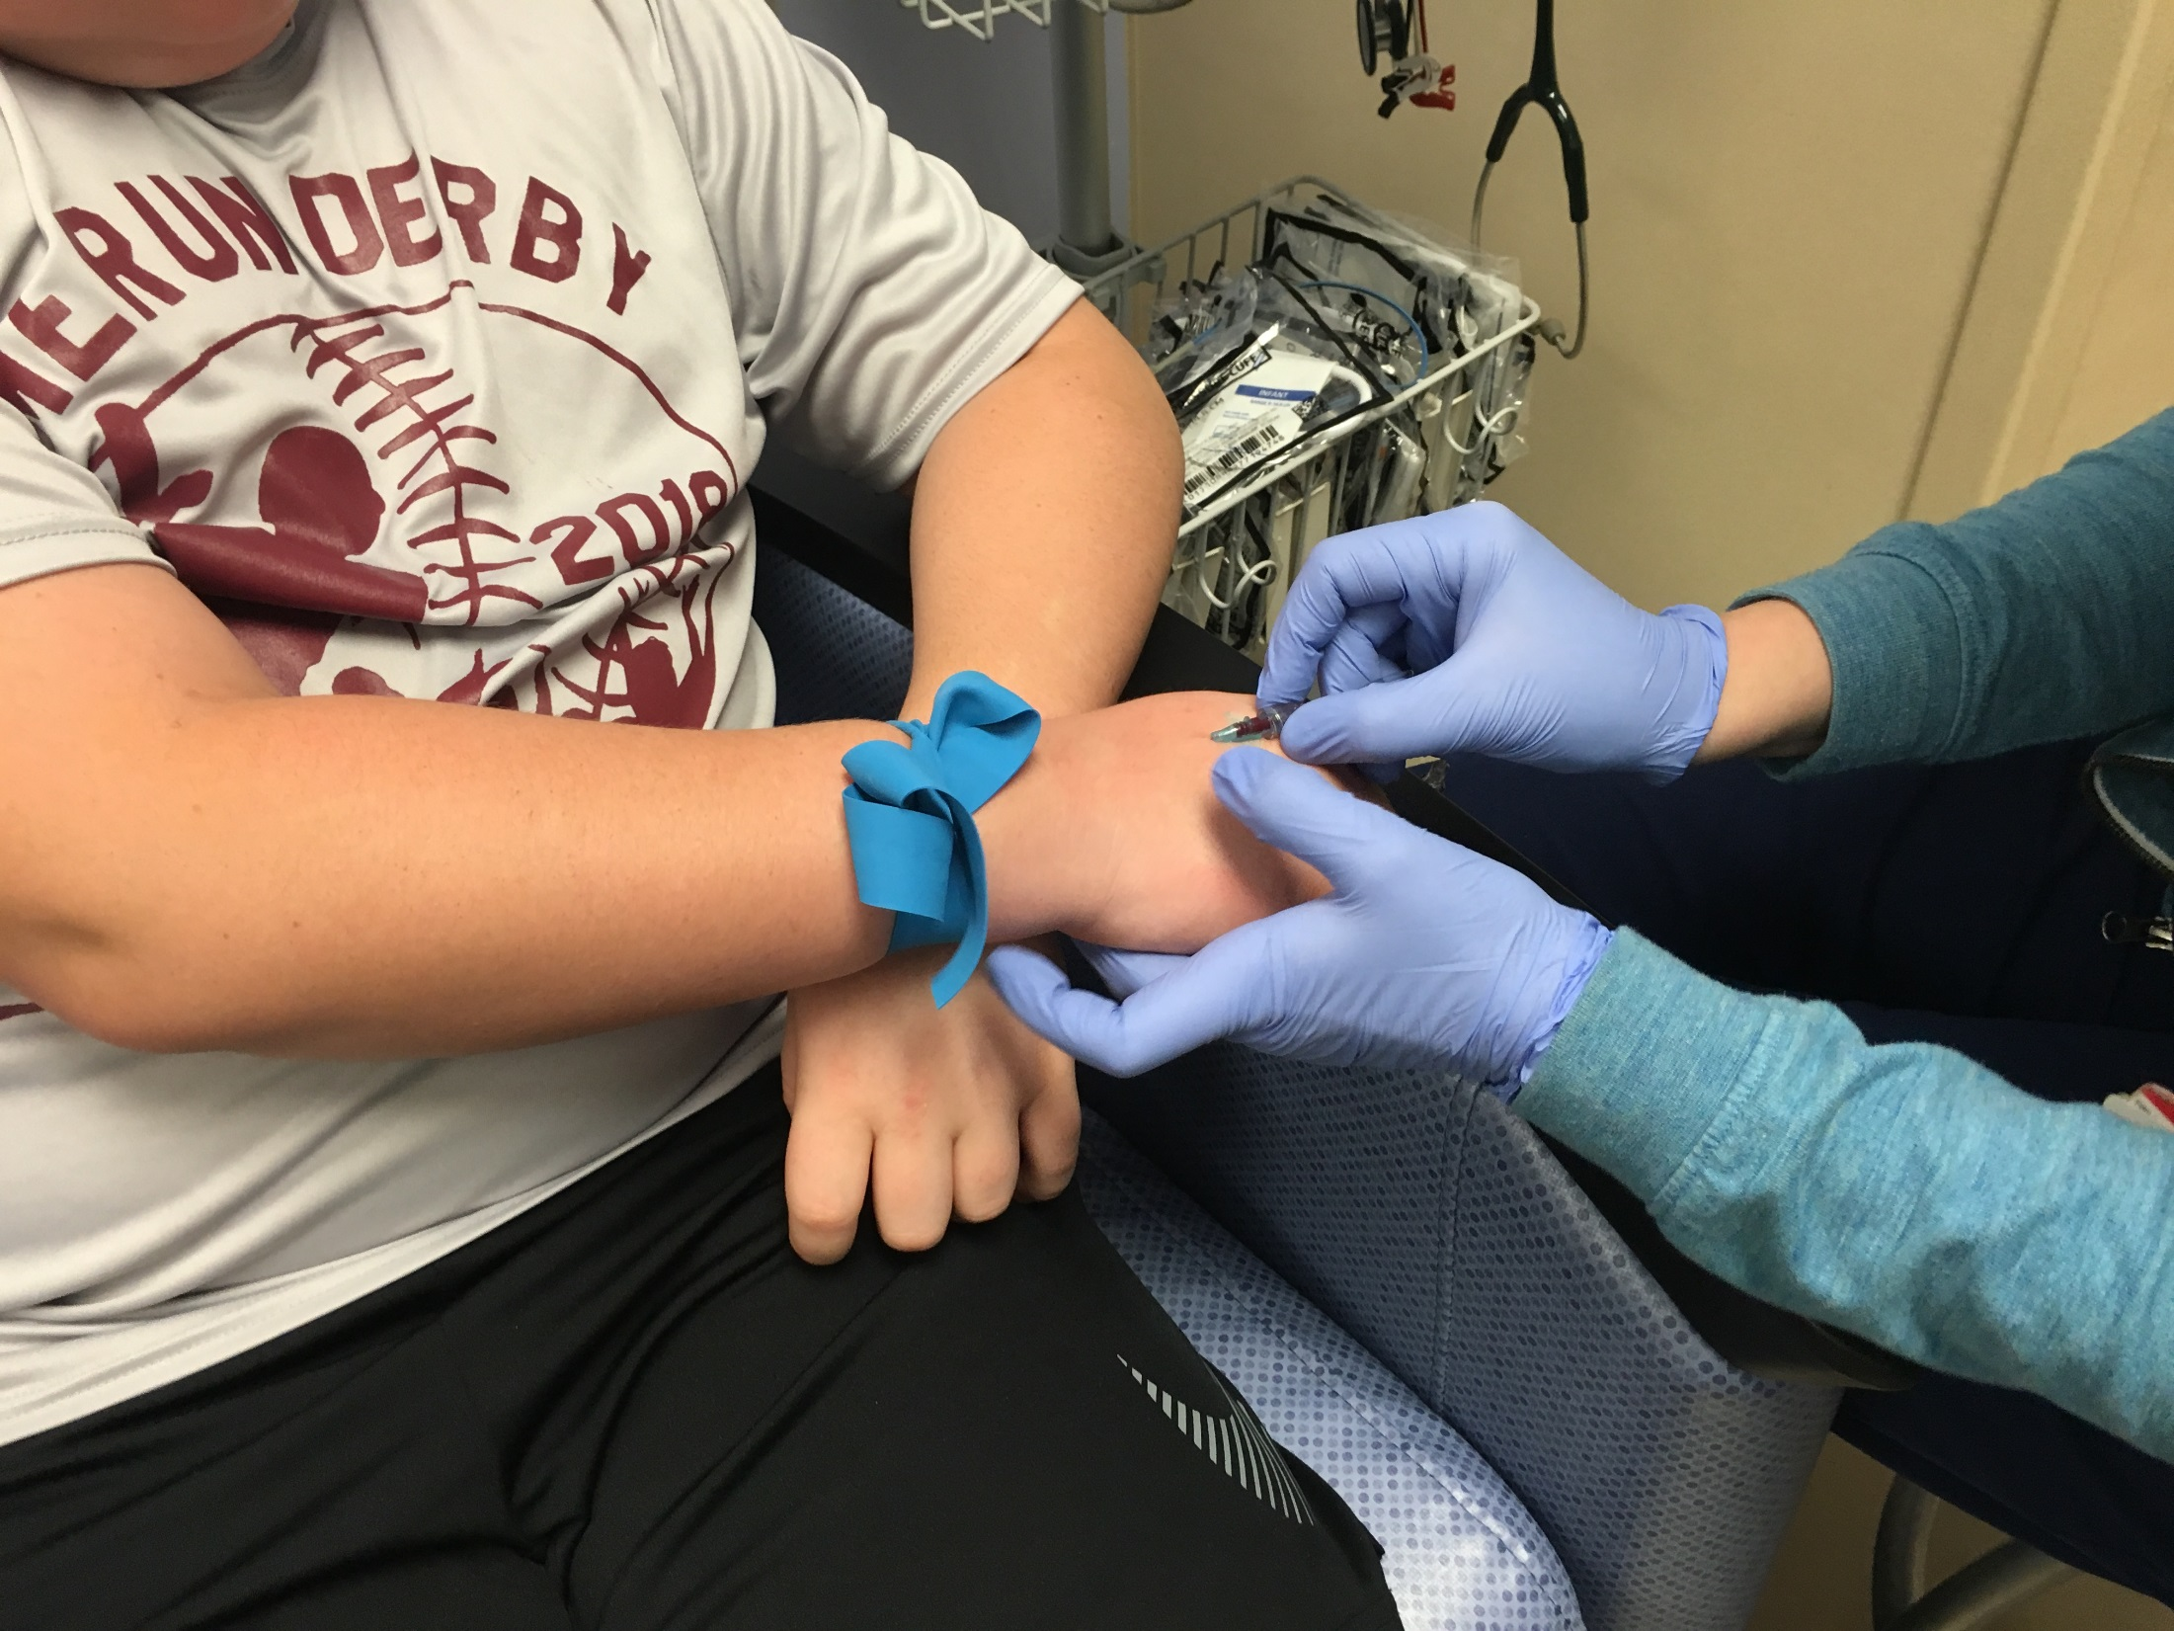
Notes:
The needle comes out of my hand and the IV straw stays inside my vein.

Slide 7
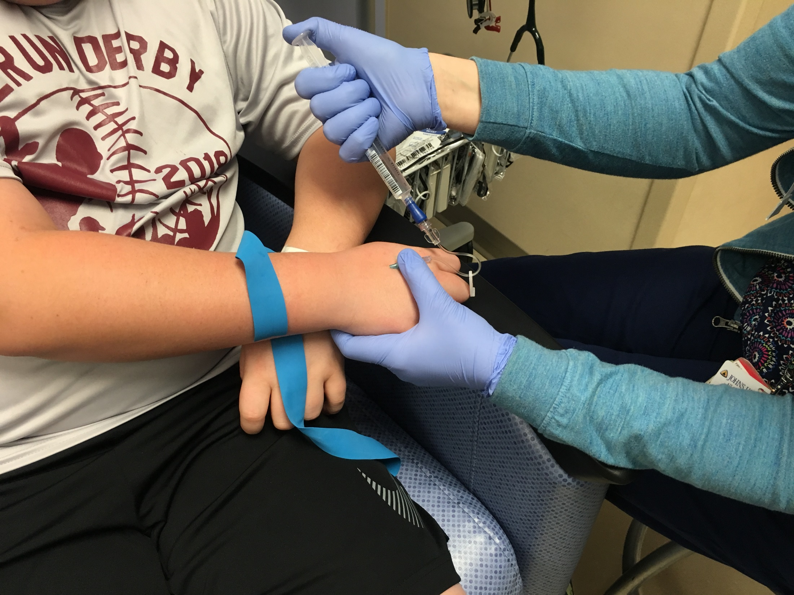
Notes:
The nurse uses a syringe to put water into my IV straw. The water moves through the straw and into my vein.

Slide 8
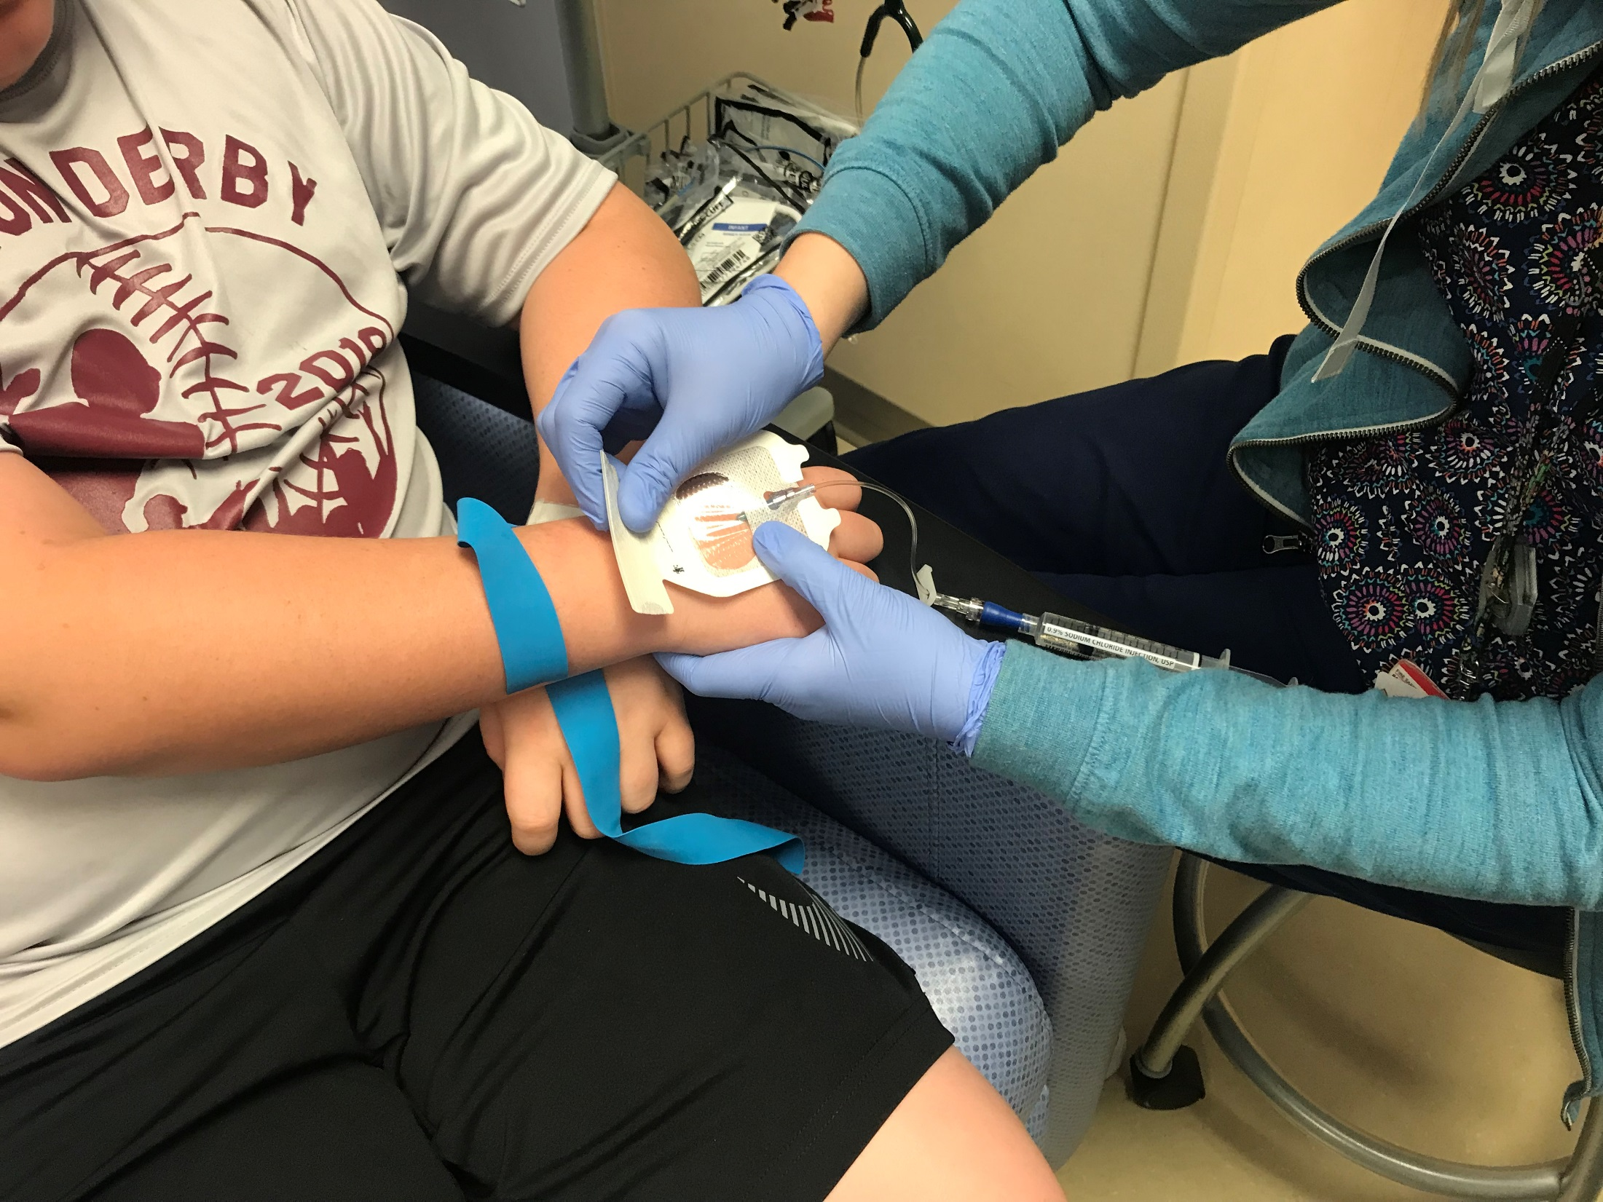
Notes:
The nurse places clear tape over the IV straw to keep it in place.

Slide 9
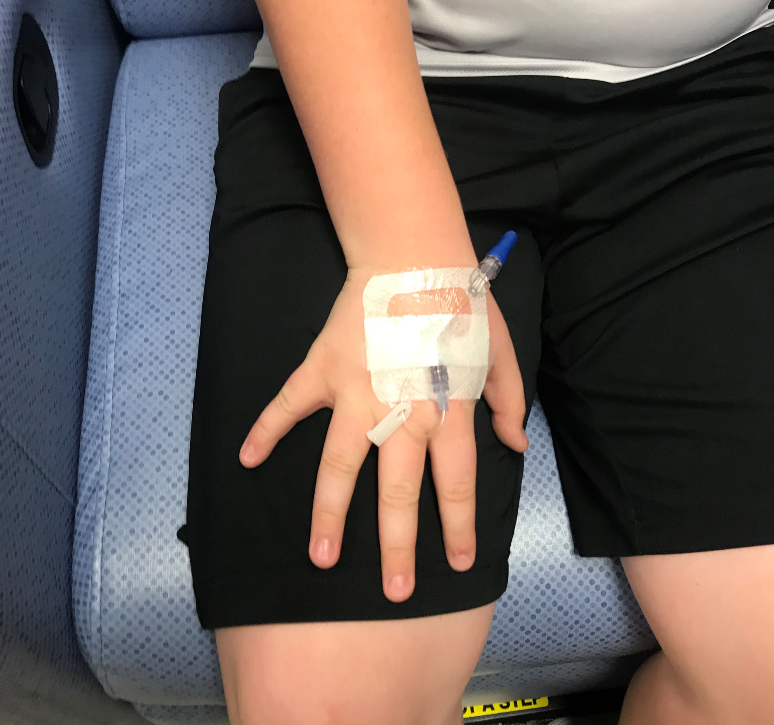
Notes:
This is what my IV looks like when it is all done.

Slide 10
