Slide 1
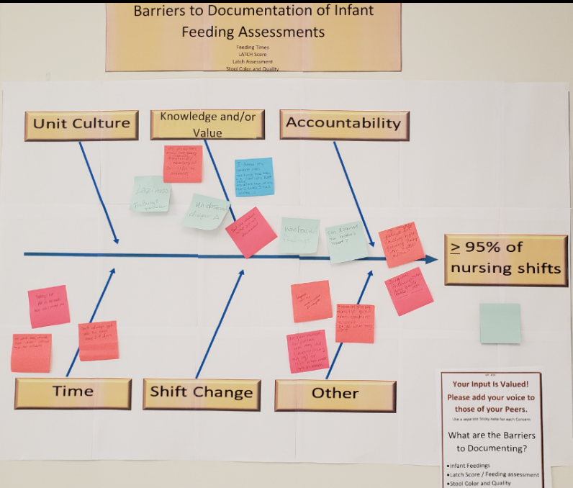
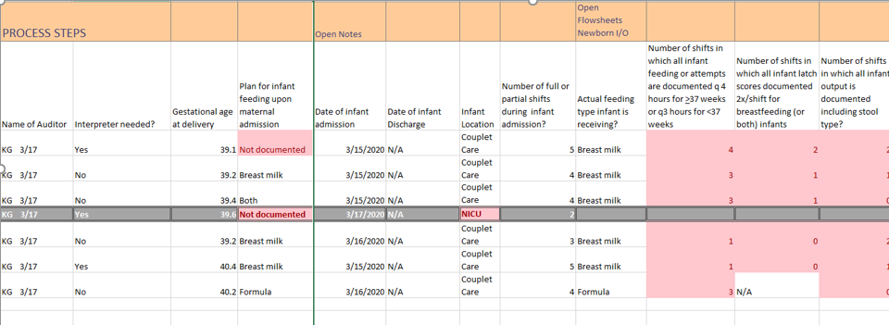
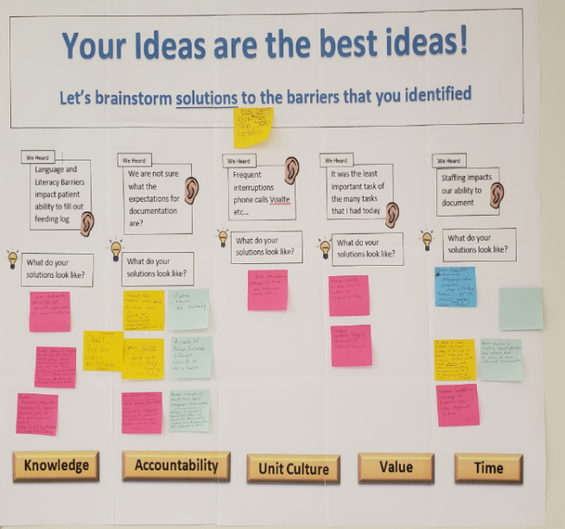
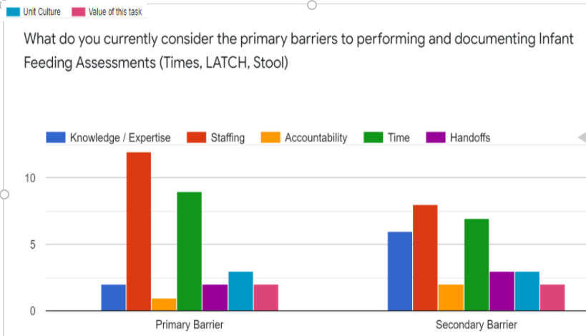
Improving Documentation of Infant Feeding Assessments
JHBMC Maternal Child Health
A3 Owner : Katharine Giancola MSN RN IBCLC C-EFM, Susan Aronson BSN RN-C C-EFM
Revision Date: 7/28/2021
Define: “Characterize the Current State”
Analyze: “Identifying Problem Root Causes”
Background / Problem Statement:
Nursing documentation of infant Feeding, latch documentation and score, and stool assessment do not meet regulatory or best practice standards 20-100% of nursing shifts potentially leading to increased incidences of formula supplementation and delay of discharge
JHM Strategic Priority to Improve the Quality and Affordability of Health Care
Objective / Goal / Scope:
The % total shifts with feeding assessment documentation meeting expectations will meet or exceed 95% benchmark by July 2021
% shifts with Infant feeding times documented per order will meet or exceed 95% benchmark by July 21
% shifts with Latch scores and feeding readiness documented will meet or exceed 95% benchmark by July 2021
% shifts with Stool assessment documented will meet or exceed 95% benchmark by July 21
Core Team Members:
Cusp Team
Unit Management
Pediatric Providers, FNPs, and PAs
Key Metrics:
% shifts with feeding assessment documentation meeting expectations
Scope: Limited to maternal and infant patient charts for deliveries that occur in JHBMC and remain admitted throughout their postpartum/newborn care in A2W and NBN
Improve: “Identifying, Prioritizing and Piloting Logical Interventions”
Work in Progress
Chart audits conducted monthly by CUSP team
Individualized feedback for charting deficits
Recognition follow-up for “perfect” charts
Newborn Nursery workgroup
Publish integrated policies for Glucose, newborn care, and thermoregulation of the late preterm in progress
Develop and provide staff education completed
Set target date for NBN implementation in progress
Measure: “Baseline the Process and Current Trends”
Control: “Structure and Process Controls to Sustain Improvements”
Next Steps
Recruit additional CUSP team members
Collaborate with Education and Lactation teams for staff education
Audit charts for non-NICU late preterm infants

