Slide 1
New Exempt Categories and Forms – Guidance under the New Common Rule
Elaine Stashinko, Ph.D., RN
JHMIRB 6 Board Member and Exempt Reviewer May 17, 2019

Slide 2
Presentation Objectives
Discuss the Revised Common Rule changes to the definition of human subjects and research.
Briefly summarize the changes to exempt research review categories.
Review the new protocol (eForm) template documents required with JHMeIRB research application submissions

Slide 3
Revised Common Rule
The Federal Regulations that govern research involving human subjects are referred to as the Common Rule.
As of January 21, 2019, all new federally funded human subjects research studies must comply with the revisions to the U.S. Department of Health and Human Services (DHHS) human subjects research regulations, the Revised Common Rule. In addition, all research conducted in Maryland must follow the Revised Common Rule.

Slide 4
How has the Revised Common Rule changed the definition of
Human Subjects
and
Research?

Slide 5
Human Subject- Common Rule Definition
Human subject means a living individual about whom an investigator (whether professional or student) conducting research obtains
Data through intervention or interaction with the individual, or
Identifiable private information.

Slide 6
Human Subject- Revised Common Rule Definition
Human subject means a living individual about whom an investigator (whether professional or student) conducting research:
Obtains information or biospecimens through intervention or interaction with the individual, and uses, studies, or analyzes the information or biospecimens; or
Obtains, uses, studies, analyzes, or generates identifiable private information or identifiable biospecimens.
Notes:
Studies that use selected genetic sequencing (e.g. WES) , analyzes certain biometric data (e.g. retinal scans, fingerprints), may not be eligible for exempt review.

Slide 7
Implications
The broadened definition of human subject may mean that more applications constitute human subjects research
Federal Agencies commit to re-examine the meaning of “identifiability”
Identifying analytic techniques capable of generating identifiable private information or biospecimens
Notes:
Some of these applications which were considered NHSR in past may now require expedited review .

Slide 8
Definition of Research
Research is defined by DHHS regulations as the systematic investigation, including development, testing and/or evaluation, designed to develop or contribute to generalizable knowledge.
The definition of research did not change with the Revised Common Rule.

Slide 9
Research Definition
The Revised Common Rule identifies four types of activities that are not “research” as defined in the Rule.:
1. Certain scholarly and journalistic activities,
2. Certain public health surveillance activities,
3. Collection and analysis of information, specimens, or records, by or for a criminal justice agency for certain criminal justice or investigative purposes, and
4. Certain authorized operational activities for national security purposes

Slide 10
Public Health Surveillance
“the collection and testing of information or biospecimens, conducted, supported, requested, ordered, required, or authorized by a public health authority.” [1]
To be considered a public health surveillance activity, these data must be collected, shared and used for health-related policy making, advocacy, and to prepare system responses to new threats.
Notes:
Examples of such data include information about:
The spread and control of communicable diseases
Injuries and conditions
Population vital statistics
Tracking of health risk factors and outcomes
Monitoring of environmental hazards and conditions that threaten access to safe workplaces and housing, and clean air, water, and uncontaminated food sources.

Slide 11
Public Health Surveillance IRB Application
Unlike other projects that do not qualify as human subjects research, the IRB MUST make a determination that a Public Health Surveillance Activity qualifies as not HSR
Public Health Surveillance Determination Worksheet
This form is required where the study team believes their project, or a component of the project, qualifies as a public health surveillance activity (upload in Section 1 of the eIRB application).

Slide 12
Changes to Exempt Review Categories

Slide 13
Human Subjects Research (HSR) Exempt review type categories: Common Rule
Exempt: Includes some research done in educational settings, observations of public behavior, surveys, most retrospective chart reviews, use of publically available data, or taste and food quality evaluation. This category does not apply to FDA regulated research.
Notes:
Research can be categorized as HSR or NHSR.

Slide 14
Research Review Category Changes
The Revised Common Rule increased the number of Exemption Categories, as well as modifies some of the existing categories.
Notes:
Exempt doesn’t mean exempt from IRB review. Exempt research is HSR and The JHU IRBs will still require exempt research be conducted in accordance with the principles of the Belmont Report and/or other applicable ethical standards.

Slide 15
DHHS Exempt Categories
Research conducted in established or commonly accepted educational settings, involving normal education practices that are not likely to adversely impact students’ ability to learn required educational content or the assessment of educators who provide instruction. This includes research on regular and special education instructional strategies, and research on the effectiveness of or the comparison among instructional techniques, curricula, or classroom management methods.

Slide 16
DHHS Exempt Categories
2. Research that only includes interactions involving educational tests (cognitive, diagnostic, aptitude, achievement), survey procedures, interview procedures, or observation of public behavior (including visual or auditory recording) if regulatory criteria is met.
JH has determined that focus groups require
expedited review
Notes:
Exempt 2: unless "(i) information is recorded in such a manner that human subjects can be identified, directly or through identifiers linked to subjects; and (ii) any disclosure of the human subjects' responses outside the research could reasonably place the subjects at the risk of criminal or civil liability or be damaging to the subjects' financial standing, employability or reputation."

Slide 17
DHHS Exempt Categories
3. Research involving benign behavioral interventions in conjunction with the collection of information from an adult subject through verbal or written responses (including data entry) or audiovisual recording if the subject prospectively agrees to the intervention and information collection and regulatory criteria is met.
Notes:
Adult participants are given educational materials (e.g. smoking cessation )with the intent of changing their behavior and then they report sensitive health history via an anonymous survey.
Adult participants play a virtual reality (VR) or videogame with the intent of changing behavior (reducing anxiety or de-conditioning fears).
In all cases, the investigator describes the study procedures and intervention, and participants prospectively agree to participate.

Slide 18
Benign Behavioral Interventions
Benign Behavioral Interventions must be:
Harmless
Brief in duration
Painless
Not physically invasive
Not likely to have a significant adverse lasting impact
Not offensive or embarrassing
Notes:
Adult participants are given educational materials (e.g. smoking cessation )with the intent of changing their behavior and then they report sensitive health history via an anonymous survey.
Adult participants play a virtual reality (VR) or videogame with the intent of changing behavior (reducing anxiety or de-conditioning fears).
In all cases, the investigator describes the study procedures and intervention, and participants prospectively agree to participate.

Slide 19
DHHS Exempt Categories
4. Secondary research for which consent is not required: Secondary research uses of identifiable private information or identifiable biospecimens, if regulatory criteria is met.

Slide 20
What is Secondary Research
Secondary Research is re-using identifiable information and/or identifiable biospecimens that are collected for some other ‘‘primary’’ or ‘‘initial’’ activity (HHS 2017), e.g. use of data from medical records, leftover tissue/samples from pathology or collected via a prior research protocol, or excess blood drawn for clinical purposes.
Secondary research does not involve any prospective research data collection [e.g. via surveys/interviews, or collection of new samples by the investigator that would have a primary research purpose.
Notes:
Projects that involve the secondary use of identifiable private information or identifiable biospecimens where the information is recorded in an identifiable manner [including those projects that involve protected health information[PHI]], a sensitive subject population or confidential data may be determined to require expedited review.

Slide 21
DHHS Exempt Categories
5. Research and demonstration projects that are conducted or supported by a Federal department or agency…and that are designed to study, evaluate, improve, or otherwise examine public benefit or service programs.
6. Taste and food quality evaluation and consumer acceptance studies.

Slide 22
DHHS Exempt Categories
Two other exempt categories not being used at Johns Hopkins as JH has made an Institutional decision that broad consent will not be permitted at this time. As a result, the JHM IRB will not consider applications under the new exempt categories 7 and 8, which require broad consent:
7. Storage or maintenance for secondary research for which broad consent is required: Storage or maintenance of identifiable private information or identifiable biospecimens for potential secondary research use if an IRB conducts a limited IRB review and makes the determinations required by §46.111.
8. Secondary research for which broad consent is required: Research involving the use of identifiable private information or identifiable biospecimens for secondary research use if regulatory criteria are met.
Notes:
“broad consent” as consent for an unspecified range of future research, subject to a few content and/or process restrictions. Broad consent is a new type of consent specifically defined in the regulation that is intended to serve as a substitute for traditional informed consent for non-exempt storage, maintenance, and secondary research use of identifiable private information or identifiable biospecimens (collected for either research studies other than the proposed research or no research purposes). https://www.hhs.gov/ohrp/sachrp-committee/recommendations/attachment-c-august-2-2017/index.html

Slide 23
How are these Revised Common Rule changes impacting the JHMeIRB application Process?

Slide 24
Review the new protocol (eForm) template documents required with JHMeIRB research application submissions

Slide 25
Old JHMIRB eForm Template Versions
eForm A protocol
eForm B Retrospective Study Protocol
data/material already in existence at the
time of IRB submission .
Notes:
eForm A was for investigator initiated protocols that were not Retrospective study protocols.

Slide 26
New eForm Template Versions
eFormA (still active)
eFormS
eFormE
eFormR
eFormQ
eFormN for Not Human Subjects Research activities [forthcoming]

Slide 27
eForm S
eForm S: Used for secondary research using identifiable private information and/or identifiable biospecimens.
Secondary research may qualify for exemption or require expedited review.
The IRB will make the determination as part of the review process.
*eForm B will no longer be accepted for new applications

Slide 28
eFormS: Data Management
Secure databases and data transfer.
Encrypted computers and flash drives, anonymous responses or coded data.
Use approved platforms for internet surveys and data transfer with PHI or confidential or sensitive data- Qualtrics, SAFE virtual desktop or REDCAP

Slide 29
eForm E
eForm E: This form should be used for projects thought to qualify for exemption.
This may include, interviews, surveys, public observations, educational tests, research conducted in normal educational settings or some behavioral interventions, if the intervention is considered to be benign.

Slide 30
eFormR
eForm R: Required for all protocols designed to cover the creation or set-up of a research resource :- data or biospecimen repository , patient registry, recruitment database.
Generally the purpose of a research resource is to help support current and future research rather than to answer any discrete research questions. Use this form to describe the resource you are creating, how it will be managed and how it will be accessed for future research use.

Slide 31
Quality Improvement Template
eFormQ Protocol Template
QI Determination Worksheet
[Tool to assist submitters in establishing whether an eForm Q may be submitted]

Slide 32
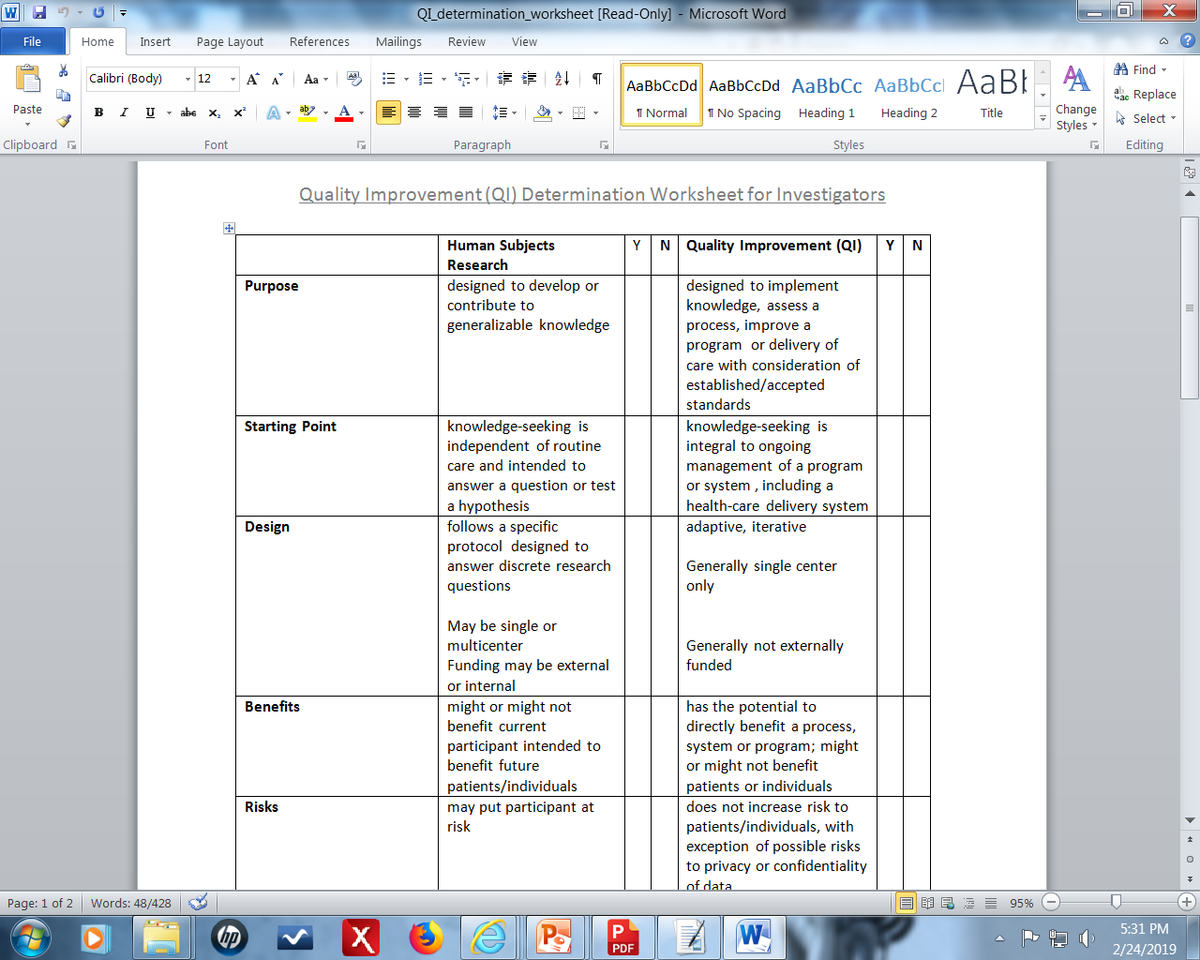
Notes:
Please use this worksheet to assist in determining if your project is Quality Improvement (QI) versus Human Subjects Research. If you tally the higher number of ‘yes’ marks under the QI header, submit an application to the IRB requesting Not Human Subjects Research (NSHR)/Quality Improvement (QI) review type

Slide 33
Requirements for Continuing Review
Continuing Review is not required by regulation for:
Research eligible for exempt studies that require limited IRB review or expedited review;
Research that has progressed to the point that it involves only one or both of the following:
(A) Data analysis, including analysis of identifiable private information or identifiable biospecimens, or
(B) Accessing follow-up clinical data from procedures that subjects would undergo as part of clinical care

Slide 34
JHU Options for Continued Oversight of Research
May require continuing IRB review
May require a Progress Report
May determine no further oversight via continuing review/progress report is required

Slide 35
New Resources Related to the Revised Common Rule

Slide 36
New Resources Related to the Revised Common Rule

Slide 37
Final Considerations
Check the JHMIRB Website for answers
Study teams may contact the eIRB Help Desk for training or technical problems or to request an appointment to help with questions about new applications affected by the Revised Common Rule.
410-502-2092 or jhmeirb@jhmi.edu

Slide 38
What is a Progress Report?
Would collect similar information to a continuing review submission
Time point for reporting could be set at 1, 2 or 3 years
Functions like a continuing review- No study activity should occur until the progress report is submitted
Study will not “expire” such that a new application must be submitted if the progress report due date has passed without submission
CIRs will not be accepted until required progress report is submitted
Notes:
What factors might JHMIRB consider in determining a need for progress report/CR?
Community/international context
FDA- CR required
Large scale secondary medical record data (> 500 records)

