Slide 1
eIRB 101: an Intro to SOM IRB and Submitting
an eIRB Application
JHMeIRB

Slide 2
Topics
IRB Website
Compliance Training
eIRB login
Investigator and Study Team Member Workspace
eIRB Application Functions
Application Screens
Study Proposal
Consent Form
Update/Delete documents
Supplemental Documents and Application Documents
Finalizing Application, Adding study team members, Submit!
Review Type and Application Workflow
eIRB Application States
Responding to Reviewer Notes
How to request an extension or withdraw a study
Create a Further Study Action (intro)

Slide 3
IRB Website

Slide 4
IRB Website http://www.hopkinsmedicine.org/institutional_review_board

Slide 9
Compliance Training

Slide 10
Compliance Training
All compliance training courses are available online through the
Hopkins myLearning website. BHSR and Health Privacy Issues for Researchers are administered on the CITI website.
Access training certificates through your myLearning history.

Slide 11
Institutional Compliance Training
Requirements
SOM affiliates must provide evidence of Basic Human Subject
Research, Conflict of Interest and Commitment, and Health Privacy Issues for Researchers compliance training. Clinical Research Billing Orientation is required for PIs and study team members who obtain consent on human subjects research studies.
SOM affiliates are required to recertify Basic Human Subject Research compliance training every 3 years. PIs register for Principal Investigator Human Subject Recertification. Non-PIs register for Study Team Member Human Subject Recertification.
School of Public Health and Homewood affiliates are required to provide evidence of their institutional Basic Human Subject Research compliance training.
School of Public Health and Homewood affiliates recertify Basic Human Subject Research compliance training every 5 years.

Slide 12
REWards training
The Research Ethics Workshops About Responsibilities and Duties of
Scientists (REWards) program is designed to address key concepts in human subjects protection in specific research communities. REWards combines lectures and small group discussions to provide practical information on the ethical issues involved in research protocol development and implementation.
Who needs it?
New Principal Investigators must complete their requirement to attend REWards within one year from the date of their first eIRB protocol submission as a PI. PIs must attend 2 workshops to fulfill their training requirement.
If the PI does not complete REWards within 1 year from the date of their first eIRB submission, they will not be able to submit new applications or changes in research until the requirement has been met. For eIRB applications that are determined to be not human subjects research (NHSR) REWards training is recommended, but not required.

Slide 13
eIRB login

Slide 14
Logging into eIRB

Slide 15
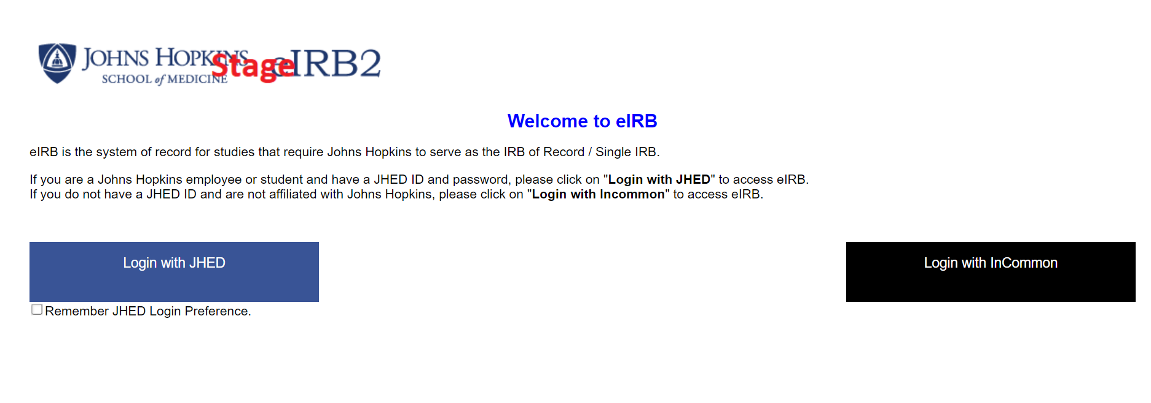
eIRB Accounts: JHED Users
Hopkins affiliates with a JHED ID and password should click on “Login with JHED” to access eIRB 2
Click on the box “Remember JHED Login Preference” to automatically log in when you click on “Login to eIRB 2” from the website.
Technical issues-call the JHED IT Support Center at 410-955-HELP.

Slide 16
Investigator and Study Team Member Workspace

Slide 17
Investigator Home Page
Left Navigation Bar
Account Management (Non- JHED Users Only)
eIRB Training
My IRB Studies
Create New Application
Welcome Message
Link to Archive eIRB website
User alerts
Important research community eIRB updates and announcements
Studies List
– Studies are listed by project type

Slide 18
Investigator Workspace
Studies List
Your studies are listed by type.
New Application
Change in Research
Continuing Review/Progress Report
Protocol Event
Termination Report
Emergency Use
Click the study name to open the study
workspace.

Slide 19
Investigator Tabs
Action Required (default tab)
Studies that have been returned for PI response
Researcher Prep
Studies that have never been submitted
In Process
Studies awaiting Pre-IRB or IRB review
Approved
Studies that have been approved
All My IRB Studies
All approved, disapproved, expired, terminated, or withdrawn studies with which you are associated.

Slide 20
Create a New Application
Select My IRB Studies on the left navigation bar.
Click the Create… button to begin a NEW eIRB application.

Slide 21
eIRB Application
Workspace
Functions

Slide 22
View Function
The View function now
allows users to see eIRB application in a continuous scroll mode.
The View function is similar to the Print Friendly function.
View Differences function will show any changes made to the application since the last submission.

Slide 23
Navigation Panel
Jump To function replaced with a Navigation Panel
The Navigation Panel shows eIRB application sections on the left side and is available on all actions (new, change in research, continuing review, etc.).
Each available application section will appear on the left navigation panel allowing you to jump to a specific section in the application.
Please note that clicking on an application section while in View mode takes you out of View mode.

Slide 24
Save, Exit, & Continue Functions
Save, Exit, and Continue
functions appear on the
bottom right corner of the application and will remain
on the screen while
scrolling up and down on a
page.
Save/Exit function saves
your place in the eIRB
application. When you log back in, you will be
returned to the place you last saved before exiting the application.
Continue moves you through the application.
The Back function has been
removed from the
application.

Slide 25
Compare Function
The Compare function works as View Differences.
When you select Compare, you can see what sections
have a change as indicated by a pencil icon next to the
section in the navigation bar.
A pop-up appears under the
question with a description
of the difference.
The Compare function will
also show where Reviewer
Notes have been added in the application.
This helps to keep reviewer notes
and changes made to each section
tracked in one place.
In the previous format the reviewer
notes are not separated by date or review number.

Slide 26
Validate Function
When you select the
Validate function, it will show errors in your application on the left side of the screen under each section with direct links to each issue.
Clicking the link will take you to the temporarily highlighted application error.
v c

Slide 27
Print Function
A Print function
appears at the top right on the application workspace and allows users to print the current application section or entire smart form.

Slide 28
User Alert Function
If two users are working in the same application at the same time, an Alert appears in the top right corner of the application. This helps to ensure that conflicting changes are not made by the users.

Slide 29
Go To Forms Function
The Go To Forms
function is located in the upper right corner of the application workspace next to the Print function and opens or reopens the navigation panel menu when the menu has been minimized by users.

Slide 30
Sliding Window Function
When you select an option that would open a secondary window (e.g., Add, Update functions), the new window now slides in to the right rather than being a separate pop-up window.
This allows you to see the question while you are working on the sub- question.
You can access a document from the main screen instead of having to navigate a separate window.

Slide 31
Application Screens

Slide 32
1 – General Information
Clicking the “Create…” button on the Investigator Home Page will bring you to the first page of the application.

Slide 33
* Required Field
* Required
The red asterisk * indicates a required field that MUST be completed.
The PI will not be able to submit the application until all required fields have been completed.
Be sure to enter a title for the study. Never leave the title field blank. You need a title to access the application.

Slide 34
Select Principal Investigator
Example: Click the Help Link icon for guidance.

Slide 35
Help Link
The Help Link icons appear beside each question.
– Click the help icon to access IRB Regulatory Guidelines and Policies and download forms/templates.

Slide 36
Select Principal Investigator
Helpful information will appear above or below the question.

Slide 37
Application Number Assigned
Complete all *required fields on the initial screen (Section 1 – General Information)
Click Save or Continue to create the application and an IRB number will be assigned. Save will not work until the application number is assigned by eIRB.
eIRB application numbers begin with “IRB” and may be found in the
upper right corner of the application screens.

Slide 38
Add Study Team Member (Quest. 25)
Select *Add
Question 1: Search for your name
Question 2: Select Study team role
Question 3: Select Primary
Affiliation
Question 4: Select “No” or “Yes”
Question 5 refers to Physician or
Mid-Level Provider Consent
Question 6: Select “No” or “Yes”
Select *Ok

Slide 39
I can’t find my study team member
Confirm that the user has
logged in to the eIRB website using their JHED credentials to generate a user account.
If they have generated a user account and you cannot locate them using their name or JHED ID, please email JHMeIRB@jhmi.edu

Slide 40
Adding
Non-Hopkins Study Team Members
The SOM IRB will not approve adding non-Hopkins affiliated study team members who are not considered engaged in human subject research (defined as interacting with living individuals and/or accessing PHI/PII for research purposes).
Non-Hopkins affiliates who will be engaged in human subject research with SOM PIs must enter into a Reliance Agreement with the institution. The PI should contact the IRB Reliance Manager (JHMIRBReliance@jhmi.edu) to begin the process.

Slide 41
2 - Study Team Compliance Training
2 – Study Team Compliance Training
Verify compliance training information (Q1)
If compliance training dates are incorrect or missing, upload copies of training certificates into Q2.
IRB Staff will enter the dates into the eIRB system upon submission.

Slide 42
Study Proposal
Section 6 – Protocol Information
Section 8-Conflict of Interest
Section 9-Support Information
Section 12-Participant Information
Section 13-Recruitment Material

Slide 43
Protocol Information

Slide 44
Upload Protocol
Q2 - Click Add to upload the completed eForm document.

Slide 45
Upload Protocol
Use the “Browse” button to locate the document.
Once the document is located, select the document and
click “open”.
Click “OK” when finished.

Slide 46
Upload Protocol
Remember: For new applications that have not been submitted, only a clean copy of the protocol is required.
Save the screen.

Slide 47
Upload Revised Protocol
Q: What happens when I need to make changes to my protocol?
Download the previously uploaded protocol – make a
tracked changes copy and a new clean copy.
Q2. Click Update to upload a new clean version.
Q3. Click ADD to upload the tracked changes version.

Slide 48
8 - Conflict of Interest
Conflict of Interest & Professional Commitment. Institutional policies require
that outside activity and
financial and fiduciary
interests be disclosed. Disclosures must be reviewed for conflicts of interest with research and conflicts of interest with other Johns Hopkins responsibilities.
All conflicted individuals must disclose potential conflicts of interest for each relevant study application vie eDisclose
This applies to current
interests/relationships within the
past 12 months.
For more information about disclosure requirements and conflict of interest review, visit the Office of Policy Coordination (OPC) Website
https://www.hopkinsmedicine.org/re search/resources/offices- policies/OPC/

Slide 49
9 - Support Information
Monetary and Material
If your protocol is receiving monetary support, the funding or material support source may not be listed in the menu of items.
Email jhmeirb@jhmi.edu with the legal entity name of the funding or material source and we will add it to eIRB.

Slide 50
12 - Participant Information
**Make sure the Participant Demographic Information matches the participant information in
the protocol, consent form, recruitment material, and other relevant application documents and sections.**

Slide 51
13 - Recruitment Information
Be specific in question 2 and answer each bullet.

Slide 52
13 - Recruitment Information
All recruitment documents should include the PI’s name, Designation as Principal Investigator, IRB application #, the phrase “research study” and contact information.
Recruitment Document Formatting Requirements:
To accommodate placement of the approval stamp, a 1.5 inch margin must be left at the top of the document and must be submitted as either an MS Word or a PDF document
“All advertising or other recruitment material must be reviewed and approved by the JHM IRB before they are used. Flyers and other advertising materials must be marked as approved by the JHM IRB before distribution or posting. Letters to potential participants must be submitted to JHM IRB for review and approval prior to mailing.”
This policy applies to all documents uploaded to the eIRB application under “Recruitment Information” (currently Section 13) as well as all other documents that require an IRB approval stamp. This may include, but is not limited to: flyers, posters, letters to potential participants, social media advertisements, scripts for radio or television advertisements, and story boards for television or video advertisements. (Please see policy 111.13 for more information and https://www.hopkinsmedicine.org/institutional_review_board/guidelines_policies/guidelines/study_subject_recruitment.html regarding requirements / limitations for recruitment of study subjects.)

Slide 53
Consent Form
Section 14 – Consent & Waivers

Slide 54
What type of consent are you planning to use for your study?
Select 14: Consent and Waivers
Select the type of consent planned for your study
Click Continue.
You will only see the screens relating to your selection.

Slide 55
Consent Form Section 15-
Written Consent

Slide 56
Download Consent Form Template
Right click the
consent form template link.
Save the form to your local drive.
Use a simple name including the upload date.
Consent Sample_010114.doc
The IRB will modify the name you give your approved consent form.
The modified name will appear in all letters.
Complete the consent form and save it to your local drive.

Slide 57
Upload Consent Form
You must select “Add ” to:
Upload a New Document
Only one version of each consent form should be visible.

Slide 58
Upload Consent Form
Use the “Browse” button to locate the document on your PC.
Once the document is located, select the document and click
“open”.
Click “OK” when finished.

Slide 59
Update/Delete documents and Document History

Slide 60
Update/Delete Documents
Update Documents
You must select “Update” to:
Upload a Revised document

Slide 61
Upload Revised Consent Form
Click Update to upload the tracked changes version into the consent form field.
This replaces, but does not delete, the previous version of the same consent.

Slide 62
Delete Documents
If you upload the wrong document…
Use “Update” to change the status of the document to “Deleted”
Click “OK”
A “strikethrough” will appear through the document name.
The status of the document will read “Deleted”.

Slide 63
Document History

Slide 64
Supplemental Documents and Application Documents

Slide 65
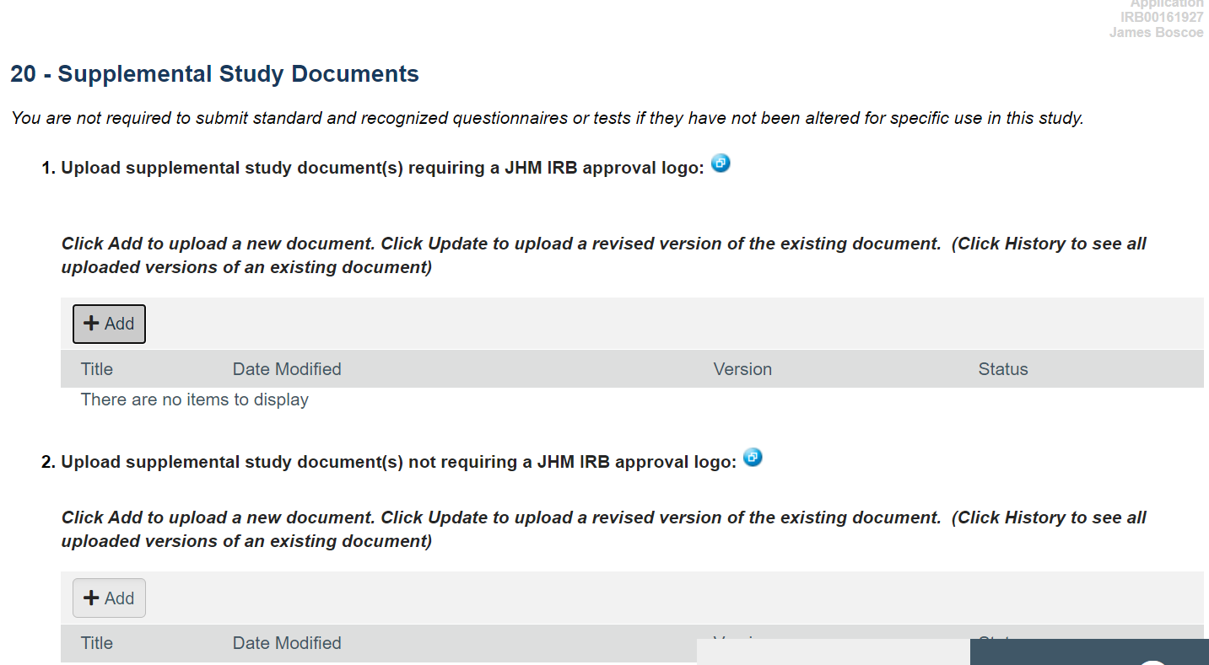
20 - Supplemental Study Documents
You may be using other documents that require IRB approval.
Upload supplemental study documents that require the JHM IRB approval logo into Q1.
Upload supplemental study documents that do not require the JHM IRB approval logo into Q2.
All supplemental documents will be listed in the approval letter.
Requires stamp
Doesn’t require stamp

Slide 66
37: Application Documents
This page displays all study team documents uploaded into the application.
Documents can be downloaded from this screen but not uploaded on this screen.
Click Continue to advance to the last application screen.
Click Finish to finalize the application

Slide 68
Documents and Forms
Things to remember…
– IRB templates/forms must be downloaded from within the eIRB application/IRB site. Use the Help Link icon to download the latest versions of templates/forms.
– Only electronic documents/forms are accepted in eIRB.

Slide 69
Finalizing Application, and
Submit !!

Slide 70
Application Complete
Click Finish
This returns you to the Application Workspace.
Finish indicates the last
page of the application.
You may continue to edit the application until it is submitted.

Slide 71
Application Workspace
Left Navigation Bar
Divided into two sections.
1 – Project Editor
Displays a list of actions that allow users to access the application.
2 - Current Activities
Displays a list of activities that may be completed.
Alert PI (not shown here): Notification sent to the PI that the application is complete and ready to be submitted

Slide 72
Application Workspace
Current Status
Displays the current status of the application in the submission/review process
Study Vital Statistics
Displays the study title, IRB number, PI, IRB committee, review type, date submitted and last scheduled review.
Application Waiting to be Submitted
Purple text will disappear upon submission of the application.

Slide 73
Application Workspace
IRB Review List
Displays the review date, review type, outcome, and letter sent (only if the application has undergone IRB review).
Workspace Tabs
Provide quick access to study- related information.
History Log
Reflects completed activities.
Reviewer Notes
Displays a collective list of IRB issues that require a response by the study team.
Further Study Actions
Displays after an application has secured initial IRB approval.

Slide 74
Request Study Team Participation
Select Request Study
Team Participation from the Current Activities section.
This opens the Request Study Team Participation Window.

Slide 75
Request Study Team Participation
Optional comments may be
entered into the text box.
Click OK. This sends out an email notification to everyone on the study team asking them to login to eIRB and complete the Agree to Participate activity.
Study team members may complete the Agree to Participate activity without having received the courtesy email notification.

Slide 76
Request Study Team Participation
The History Log may also be checked to determine when all study team
members have agreed to participate.
The PI may submit once all study team members have completed the Agreed to Participate activity.

Slide 77
Agree to Participate
Study team members may complete
the Agree to Participate activity without having received the courtesy email notification.
Select the Agree to Participate activity from the Current Activities section of the left navigation bar.
This opens the Agree to Participate window.

Slide 78
Agree to Participate
Read the Agree to Participate window content.
Click Yes.
Select whether you wish to receive all study-related notifications.
Select whether you are a physician investigator or mid-level provider obtaining consent.
Answer whether you have a financial conflict of interest on the study.
Click OK.
Performing this activity is the equivalent of an electronic signature.
The Principal Investigator does not complete the Agree to Participate activity.

Slide 79
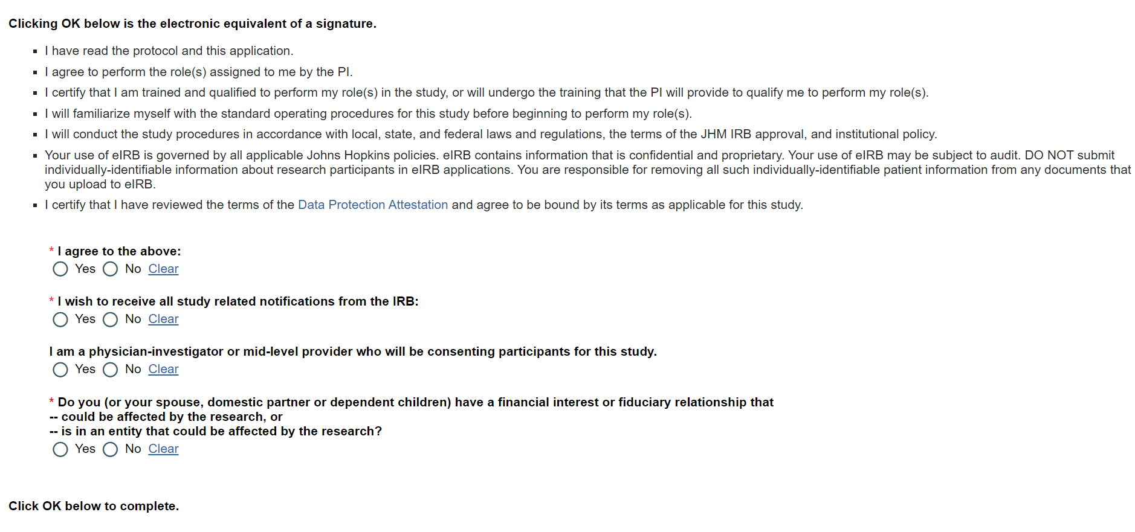
Agree to Participate

Slide 80
Agree to Participate
View the History Log to
see that you completed the Agree to Participate activity.
Select Dashboard to return to the Investigator Home Page.

Slide 81
Submit the Application
Select Submit from the Current Activities section.
Only the PI will have the Submit activity.
This opens the submit
window.

Slide 82
Submit the Application
The Submit function is only available to the PI of the study. It
is not available to study team members.

Slide 83
Application Submitted
Select the In
Process tab.
Scroll down to the New Applications section.
Monitor the progress of your application through IRB Review (Current State).
Upon approval by the IRB the application will appear under the Approved tab.

Slide 84
Review Types and Application Workflow

Slide 85
Review Types –
Convened and Expedited review types can apply to both new applications and Further Study Actions for a single study in eIRB.
Convened: more than minimal risk and or research involving vulnerable populations; full board review
Expedited: must present no more than minimal risk as defined by FDA regulations; 1 reviewer
Exempt: Includes some research done in educational settings, observations of public behavior, surveys, most chart reviews, use of publically available data, or taste and food quality evaluation. This category does not apply to FDA regulated research; this exempt from some federal regulations.
Not Human Subjects Research (NHSR)/ Quality Improvement (QI): Research does not involve identifiable human subjects (NHSR). Data collection and analysis activities in the healing services area that are not intended for general scientific knowledge, but rather are used as a management tool to improve the provision of services to a specific health care population (QI/QA)

Slide 87
eIRB Application
States

Slide 88
Researcher Prep
Application is being prepared by study team and has never been submitted for IRB review.
PRA review
Prospective Reimbursement Analysis Review. All New Applications (and Change in Research Applications previously marked as “PRA Required”) will transition to the “PRA Review” current status.
Departmental Review
Application requires Departmental Review – triggered by the Principal Investigator’s primary affiliation (as listed in the application) and/or eIRB application triggers.

Slide 89
IRB Assignment
Application is awaiting review type and IRB committee assignment.
Compliance Team Review
Application is assigned to a compliance associate for pre-IRB meeting review.
RSS Review – Pre-IRB
Application is assigned to a pre-team IRB Coordinator/Analyst for pre-IRB meeting review.

Slide 90
PI Response – Pre-IRB
Pre-IRB meeting reviewer notes (from pre-team IRB Coordinator/Analyst and compliance associate) have been sent to study team; Application requires the study team to respond and resubmit within 60 days.
CFS Review – Pre-IRB
Application is assigned to Consent Form Specialist team for
pre-meeting review/processing.
Waiting Outcome
Application has been assigned for review and is waiting for post team to record meeting outcome.

Slide 91
CFS Review – Post-IRB
RSS Application is assigned to Consent Form Specialist team for post meeting
review/processing.
RSS Review – Post-IRB
Meeting outcome has been recorded by post-team IRB Coordinator/Analyst.
Post-team performs all post meeting responsibilities.
PI Response – Post-IRB
Post-IRB meeting reviewer notes have been sent to the study team. Application requires the study team to respond and resubmit within 60 days.

Slide 92
Approved/Acknowledged
Application is approved/acknowledged and research may begin.
Disapproved
Application is disapproved. A new application must be submitted to pursue this study
Tabled
The application does not meet the criteria for approval at the time of review. A letter will be issued to the PI with review issues to resolve.
Approved/Acknowledged with Administrative Changes
The application requires administrative changes and re-review before final approval documents can be issued.

Slide 93
Reviewer Notes

Slide 94
Reviewer Notes
All applications are subject to a Pre-IRB review as well as an IRB reviewer.
Issues that require a response are referred to
as “Reviewer Notes”.
Action Required
Scenario:
You received an email like this → from the eIRB Help Desk.
Click on the “Link To Study Workspace” to open the application, or…

Slide 95
How do I respond to Pre-IRB Issues for my New Application?
Select the Dashboard Tab
Select the Action
Required tab.
Scroll down to the New Applications section.
Click on the study name to open the application workspace.

Slide 96
Where to find Reviewer Notes?
IRB Reviewer Notes are housed both in the eIRB application and a separate tab on your application workspace

Slide 97
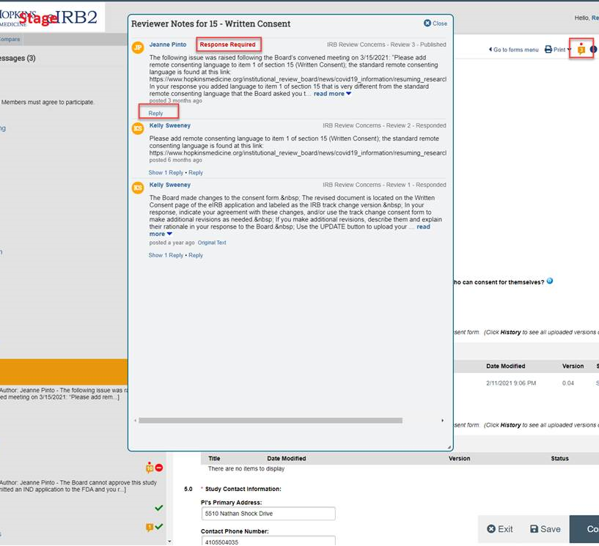
Reviewer Notes
Comment Box
IRB staff will add
reviewer notes to the applicable sections of the eIRB application.
The PI/study team must respond to each reviewer note and make revisions to the application (if applicable)
To open up the Reviewer Notes, Click on the comment box with the number in it in the top right corner. The number indicates the number of reviewer notes in that sections.
Select “Reply to enter a response.

Slide 98
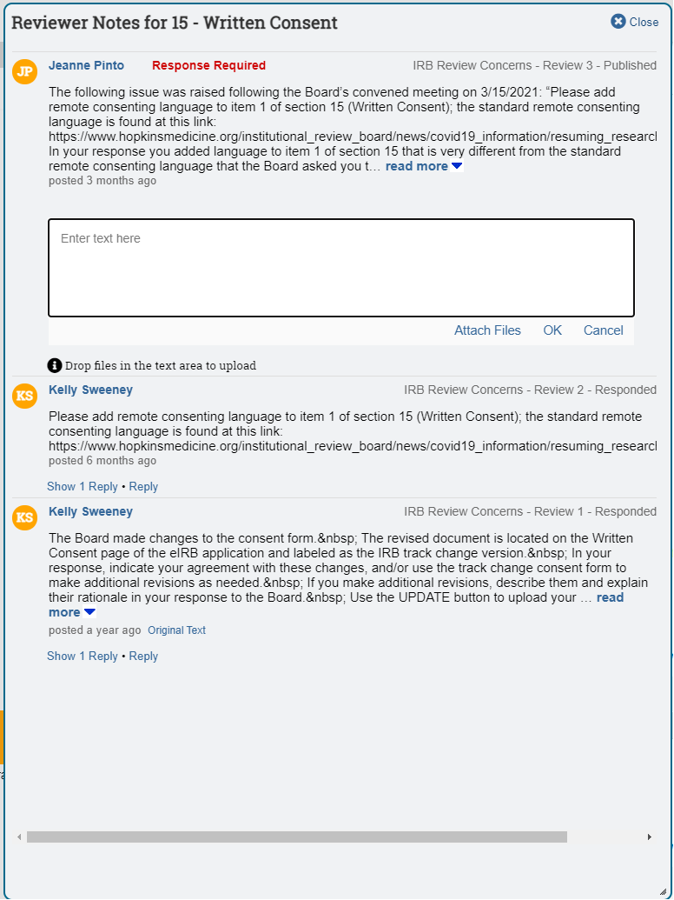
Reviewer Notes
Click “Ok” to save your response.
You can also attach files to your response. This does not replace uploading revised documents to the actual appropriate section of the application.
If you have questions about the reviewer note, please email the IRB staff member directly.

Slide 99
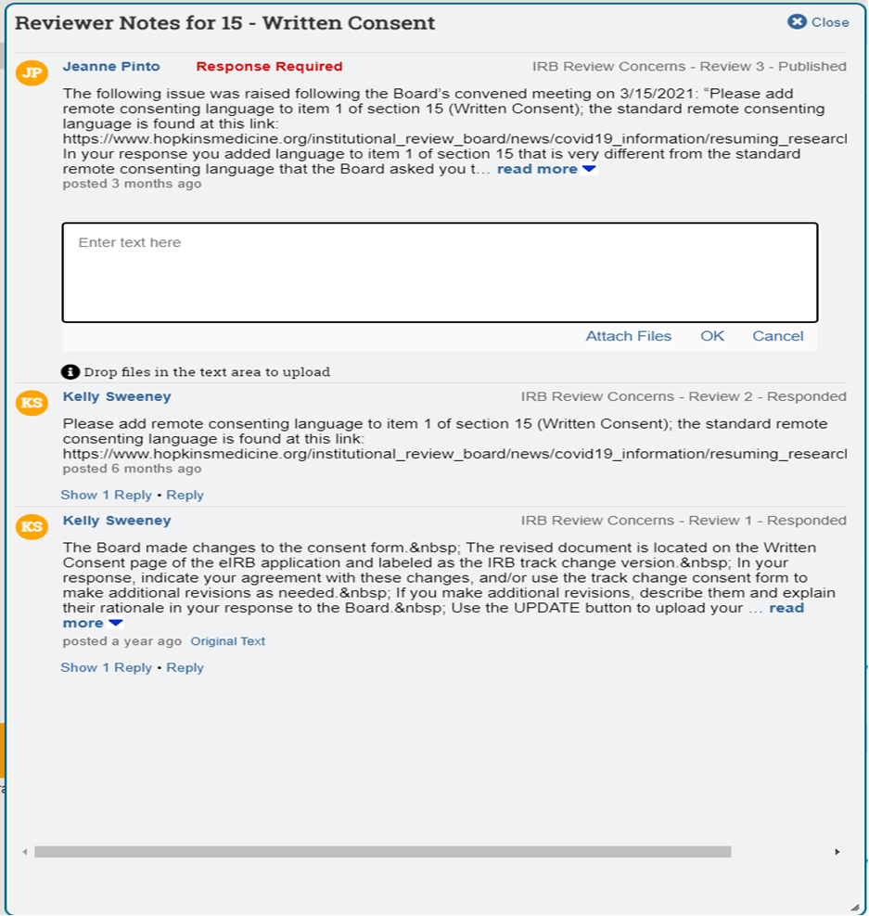
Reviewer Notes
Click OK to save.
To respond to an issues once you have selected “OK”, select “Reply”.

Slide 100
Resubmit the Application
Select Submit from the Current Activities section.
Only the PI will have the Submit activity.
This opens the submit
window.

Slide 101
How to Request an Extension or Withdraw a Study

Slide 102
Request Extension – Pre IRB
An application may be returned as incomplete after assignment to an IRB and before going to an IRB Committee for review.
The Principal Investigator has 60 days to resubmit the application.
You may seek an extension before the application is withdrawn.

Slide 103
Application Workspace – Pre IRB
Click Request Extension - Pre IRB from the Current Activities section.
This opens the Request Extension
– Pre IRB window.

Slide 104
Request Extension – Pre IRB
Request Extension - Pre
IRB window
Click OK.
Completing this activity automatically grants a 60 day extension to respond to the IRB.

Slide 105
Request Extension – Post IRB
You may seek an extension for the submission of a response to the IRB issues waiting to be addressed.
You must submit a request in eIRB before the original response due date.
Responses cannot be accepted beyond the deadline without a JHM IRB approved extension.
Only the Principal Investigator may submit the request.

Slide 106
Withdraw Application
The PI can opt to withdraw the application prior to IRB submission or after initial IRB review.
Only the PI may withdraw an application.
For Applications in Researcher Prep, click PI Withdraw Study from the Current Activities section.
This opens the
Withdraw window.

Slide 107
Withdraw Application
Click OK.
This inactivates the application in eIRB.
If you wish to pursue this study in the future, a new eIRB Application must be created and resubmitted for IRB review.
The study will appear as read-only under the All My IRB Studies tab on the Investigator Home Page.

Slide 108
PI Response – Pre/Post IRB
Request Withdraw – PI Response – Pre/Post IRB
Only the PI may withdraw an application.
For Applications in PI Response – Pre/Post IRB, Click Request Withdraw from the Current Activities section.
This opens the Request
Withdrawal window.

Slide 109
PI Response – Pre/Post IRB
Click OK.
Completing this activity sends
an email notification to the IRB office to consider your request.
You will receive an email notification confirming the withdrawal.
If you wish to pursue this study in the future, a new eIRB
Application must be created and resubmitted for IRB review.
The study will appear as read-
only under the All My IRB
Studies tab on the Investigator Home Page.

Slide 110
Create a Further Study Action

Slide 111
Further Study Actions
All actions on an approved study fall under the umbrella term Further Study Action (FSA).
This includes:
Continuing Review/Progress Report
Changes in Research
Protocol Event
Termination Report

Slide 112
Further Study Actions
A second FSA of the same type for the same study may not be created until the first has completed its review.
Protocol Events may be submitted at any time.
If more than one Termination Report has been created, all duplicates must be withdrawn by the PI before a Termination Report can be submitted for IRB review.

Slide 113
Create a Further Study Action
Select My IRB Studies from the left navigation bar.
Select the Approved tab on the Investigator Home Screen.
Scroll down to the New Applications section.
Select the currently
approved study.
This opens the application workspace.

Slide 114
Create a Further Study Action
Below Current
Activities, locate Create Further Study Action.
Click Create...

Slide 115
Create a Further Study Action
Select the type of
FSA to be created and select Continue.
You can only select one FSA at a time.
Once the FSA has been created, you can return to this screen, following the previous steps, to select a different type of FSA.

Slide 116
Questions???

