Slide 1
Mapping Genetic Risk of Suicide
Virginia Willour, Ph.D.

Slide 2
Suicidal Behavior
Suicidal behavior is a complex phenotype that includes both attempted and completed suicide
Family, twin, and adoption studies provide strong evidence for a heritable component to suicidal behavior
The heritable component for suicidal behavior depends on
    Strong association with psychiatric disorders, especially mood disorders
    Independent heritable factors, such as tendency towards impulsive aggression, have also been suggested
Under a two-hit hypothesis, individuals with a psychiatric disorder and a tendency towards impulsive aggression are at greatest risk for suicidal behavior

Slide 3
Suicide Genetic Research
Unlike some other complex genetic disorders, suicide research is still in its infancy
To date, neurobiologic and genetic studies of suicidal behavior have focused mostly on the serotonergic system
Environmental risk factors, such as parental abuse and early parental loss, may also interact with genetic factors and increase risk
The biggest challenges today in suicide research include educating the public about the complex nature of the behavior and identifying compelling candidate genes and biological pathways to study in depth

Slide 4
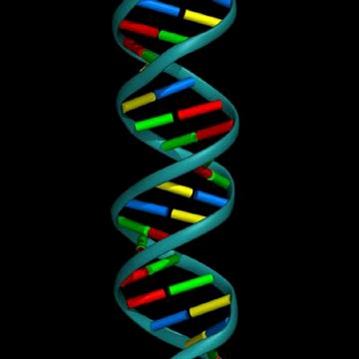
Genetic Risk Factors
We anticipate that the genetic component for
suicidal behavior may be due to genetic variation
in many genes, each with a small effect
These genes may cluster in biological pathways
related to brain functioning and development
Alternately, these genes could directly influence
personality characteristics, such as impulsivity,
aggressiveness, or neuroticism

Slide 5
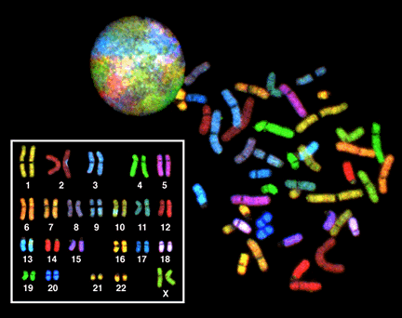
Two complementary strategies for identifying genes influencing suicidal behavior
The human genome: 23 pairs of chromosomes
Serotonergic Pathway
Genome-wide
Association Study

Slide 6
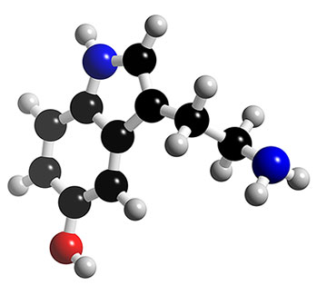
Serotonin and Suicide
The serotonergic system was initially
implicated in the etiology of suicidal
behavior by the finding of lowered
levels of the serotonin metabolite
5-HIAA in the CSF of patients who
attempted suicide, especially by
violent means.
The importance of the serotonergic
system in suicidal behavior is now
supported by multiple lines of
investigation, including
  Postmortem brain studies
  Pharmacological studies
Genetic studies of suicidal behavior
have also focused on the serotonergic
system, with inconsistent results.
3-D model of serotonin structure
(3DChem.com)

Slide 7
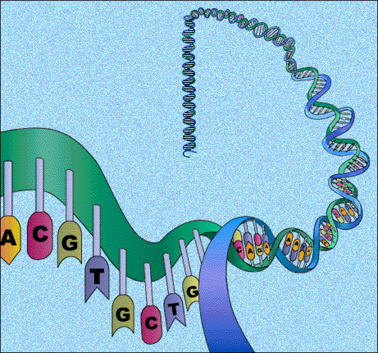
Genetic Association Studies
The goal of our serotonin
association study was to
investigate the patterns of
genetic variation in attempted
suicide for 17 genes
from the serotonin pathway
The 17 genes included
  Serotonin transporter
  MAOA
  Tryptophan hydroxylase genes
  13 serotonin receptor genes
Tested DNA samples from subjects
with and without a history of
suicide attempts

Slide 8
TPH1
Enzymes
5HT synthesis
TPH2
MAOA
Enzyme
5HT degradation
5HT
Presynaptic
Neuron
Integral membrane Protein,
5HT reabsorption
Synaptic Vesicle
SLC6A4
5HT
5HT
Presynaptic Receptors, 5HT exocytosis
5HT
5HT
5HT
5HT
5HT
HTR1B
5HT
HTR1A
HTR1D
5HT
5HT
Synaptic Cleft
5HT
5HT
HTR3A
HTR3B
HTR2A
HTR2B
HTR1E
HTR2C
Ion channels,
depolarize
postsynaptic membrane
HTR1A
HTR1D
HTR6
HTR7
HTR1B
HTR4
Postsynaptic receptors,
activate 2nd messenger cascades
HTR5A
Coupled Gs protein alpha
Mediate cyclic AMP levels
Best SNP:
HTR7
p=0.0066
OR=1.42
Postsynaptic
Neuron

Slide 9
Two complementary strategies for identifying genes influencing suicidal behavior
The human genome: 23 pairs of chromosomes
Serotonergic Pathway
Genome-wide
Association Study

Slide 10

Genome-Wide Association Studies (GWAS)
The goal of our attempted suicide GWAS was
to compare genetic variation in bipolar suicide
attempters and bipolar non-attempters
Our attempted suicide GWAS incorporated genetic
information from 2.4 million SNPs located
throughout the genome.
  SNP allele 1: AACGGT
  SNP allele 2: AACAGT
Cases: 20% allele G, 80% allele A
Controls: 50% allele G, 50% allele A
The larger the sample size, the smaller the effect that can be detected.
GeneChips: screen
genome using
common DNA markers

Slide 11
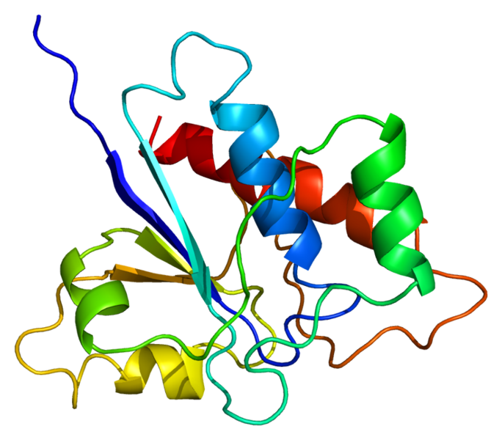
ACP1
Acid phosphatase 1 (enzyme)
ACP1 expression is significantly
altered in bipolar subjects who
have committed suicide
ACP1 protein influences the Wnt
signaling pathway, which is
regulated by lithium
Lithium is the primary medication
used to decrease suicidal
behavior in bipolar subjects
ACP1 structure
(Protein Data Bank)

Slide 12
LRRTM4
We also tested for evidence of sex-specific
attempted suicide risk variants
There was no overlap in the top male and
female risk variant lists
The most significant female risk variant was
located in the LRRTM4 gene
LRRTM4 is located in the part of the genome
previously implicated in suicidal behavior
in major depression, bipolar disorder, and
alcoholism
LRRTM4 is known to help determine the
hardwiring of the brain
Linhoff et al. 2009

Slide 13
Research Summary
Family, twin, and adoption studies provide strong evidence for a heritable component to suicidal behavior
The heritable component for suicidal behavior depends in part on an association with psychiatric disorders and in part on heritable factors specific to suicidality
Our serotonin pathway study did not support the hypothesis that these genes play a major role in suicide risk
Our genome-wide association study of attempted suicide identified two promising candidate genes: ACP1 and LRRTM4

Slide 14
Suicide Genetics Research in the 21st Century
Understand the role that genetics and biology plays in suicidal behavior
Sex-specific risk genes
    LRRTM4
    Sex chromosomes
Better treatment options
    Determine who would benefit most from lithium
    Identification of alternatives to lithium
Larger scale studies
    The Psychiatric GWAS Consortium (PGC)
    Cross-disorder analyses
Other factors
    Determine whether epigenetic modifications play a role in suicide risk
    Understand how genes interact with environment to increase risk

