Slide 1
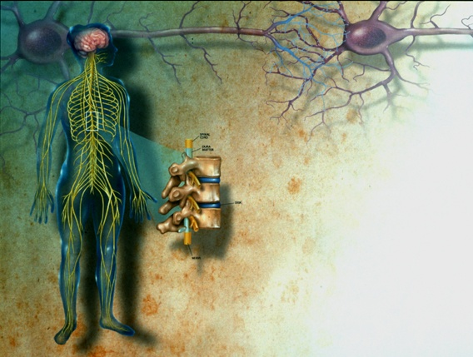
Stem Cells and
Psychiatric Disorders
Hongjun Song
Institute for Cell Engineering
Departments of Neurology & Neuroscience
Johns Hopkins University School of Medicine
Notes:
First, I would like to thanks the committee to give me the opportunity to present some of my work here. Let me introduce myself.
Xxx
I will present my postdoc work.
I am interested in neural development. Traditionally, people investigate neural development during embryonic and early postnatal period. We are particular interested in neural development in the adult central nervous system.

Slide 2
Stem cells
Stem cells are the foundation cells for every organ and tissue in the body. They are like a blank microchip that can ultimately be programmed to perform particular tasks. Under proper conditions, stem cells begin to develop or ‘differentiate’ into specialized cells that carry out a specific function, such as in the skin, muscle or brain. Additionally, stem cells can ‘self-renew,’ that is they can divide and give rise to more stem cells.
Notes:
First, I would like to thanks the committee to give me the opportunity to present some of my work here. Let me introduce myself.
Xxx
I will present my postdoc work.
I am interested in neural development. Traditionally, people investigate neural development during embryonic and early postnatal period. We are particular interested in neural development in the adult central nervous system.

Slide 3
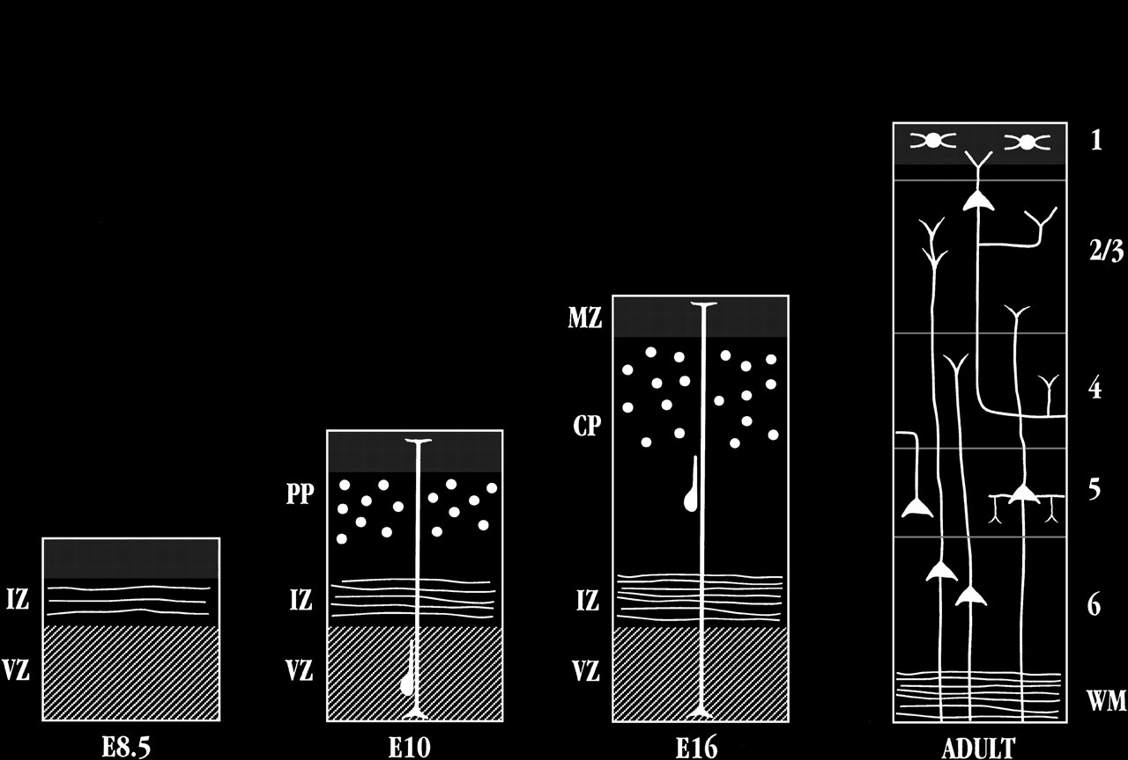
Formation of the nervous system during
embryonic development
Axon pathfinding &
Synapse formation
Proliferation & migration
(Adapted from Mary Hatten, Annual Review of Neuroscience, 1999 )

Slide 4
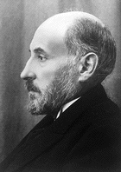
Hippocampus
1852-1934
“In the adult centers, the nerve paths are something fixed, ended, and immutable. Everything may die, nothing may be regenerated. It is for the science of the future to change, if possible, this harsh decree.”
-- Ramon y Cajal (1913).
Notes:
4

Slide 5
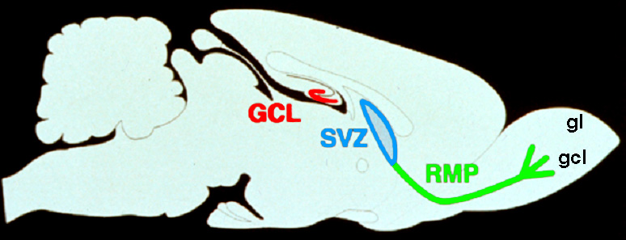
Neurogenesis in the adult brain
Altman and Das, J. Comp. Neurol. 1964
Eriksson, Gage et al. Nat. Med. 1998
BrdU
NeuN
GFAP
Mouse
Rat
Cat
Birds
Tree Shrew
Marmoset
Rhesus
Human

Slide 6
Brain’s stem cells give rise to
newborn nerve cells
(Sun G. et al. J. Neurosci. 2013)
Notes:
2’
Use a retrovirus-based methodology first developed by Conny Cepko and Josh Sane in 80s and first applied to adult neurogenesis by Rusty Gage’s group. The principle is that expression of transgene only occurs during mitosis, therefore it allows birth-dating the progeny and following their development.
How newborn neurosn go froma precsuors cells to such elaborate neuronal structures in vivo?

Slide 7
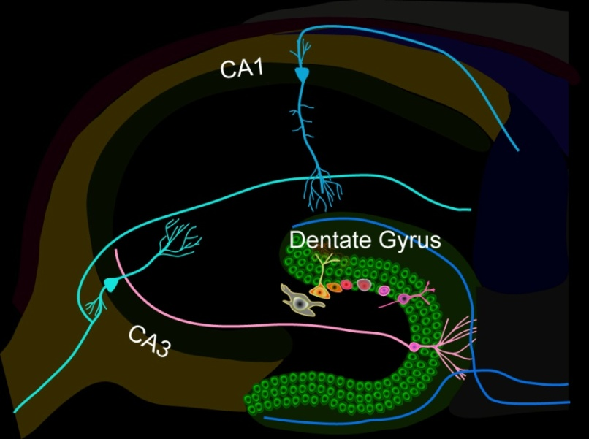
Continuous neurogenesis in the adult hippocampus - a model for understanding of basic principles of neural development, plasticity and repair in the mature mammalian brain
Adult human hippocampus
~ 700 new neurons/day
turnover of ~ 1.75% of neurons/year
(Spalding, Frisen, et al. Cell 2013)
Functions
Learning and memory
Mood regulation
Stress responses
Dysfunction
Epilepsy
Mental disorders
Degenerative neurological disorders
Notes:
The region of focus today in the hippocampus, a region involved in learning, memory and mood regulation. Neuorgenesis occurs in the dentate gyrus region. In the young rodent dentate gyrus, Heather Cameron and Ron McKay estimated that about 900 news cell per day.
In the dentate gyrus of the hippocampus, a region involved in learning and memory, about 9000 cells are born daily in young adult rodents, and they further differentiate into neurons, astrocytes and oligodendrocytes.
Adult neurogenesis is conserved in humans and a large body of evidence supports critical roles of adult neurogenesis in both cognitive and affective brain functions. In addition, dysfunction of postnatal neurgenesis contributes to epilepsy and brain disorders as well as brain tumors as nicely shown by Luis Prada’s lab.
Ongoing adult neurogenesis provides an in vivo model system to address basic principles in neural development, plasticity and repair in the adult brain.
During the past 10 years, we have been systematically investigating sequential processes of adult hipppocampal neurogenesis. We have discovered several novel molecular mechanisms regulating proliferation of precursors and their neuronal fate commitment. We have also identified novel cellular and molecular mechanisms regulating synaptic integrated of newborn neurons into existing neuronal circuitry.
Using disrupted in schizophrenia 1 as an entry point, we are studying how dysfunction of neurogenesis may contribute to mental disorders.
Today, I would like to highlight one line of recent studies focusing on precursor cells.

Slide 8
Disrupted-In-Schizophrenia 1 (DISC1)
(Millar et al., Hum Mol Genet 2000)

Slide 9
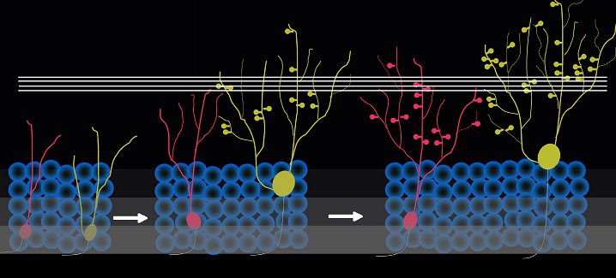
Abnormal development of neurons in the adult brain with deficiency in Disrupted-in-Schizophrenia (DISC1), a susceptibility gene for major mental illness
(Duan X. et al. Cell 2007; Faulkner R.L. et al. PNAS 2009)

Slide 10
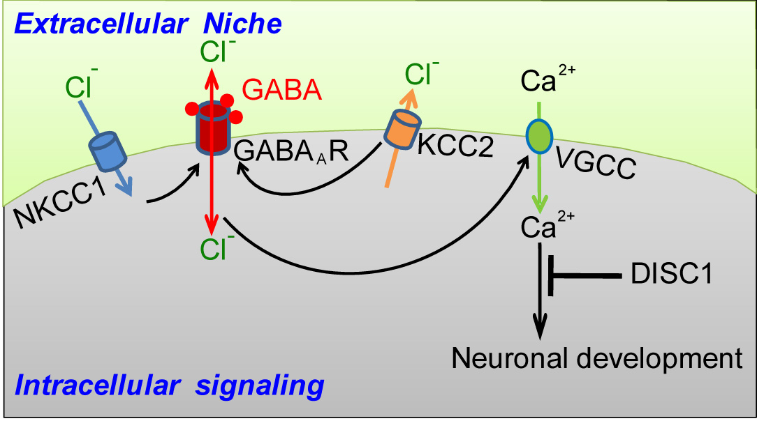
Intrinsic DISC1 interacts extrinsic depolarizing GABA signaling in regulating dendritic growth of newborn neurons during adult hippocmapal neurogenesis
Three independent case-controlled samples
(Kim J. et al. Cell 2012)

Slide 11
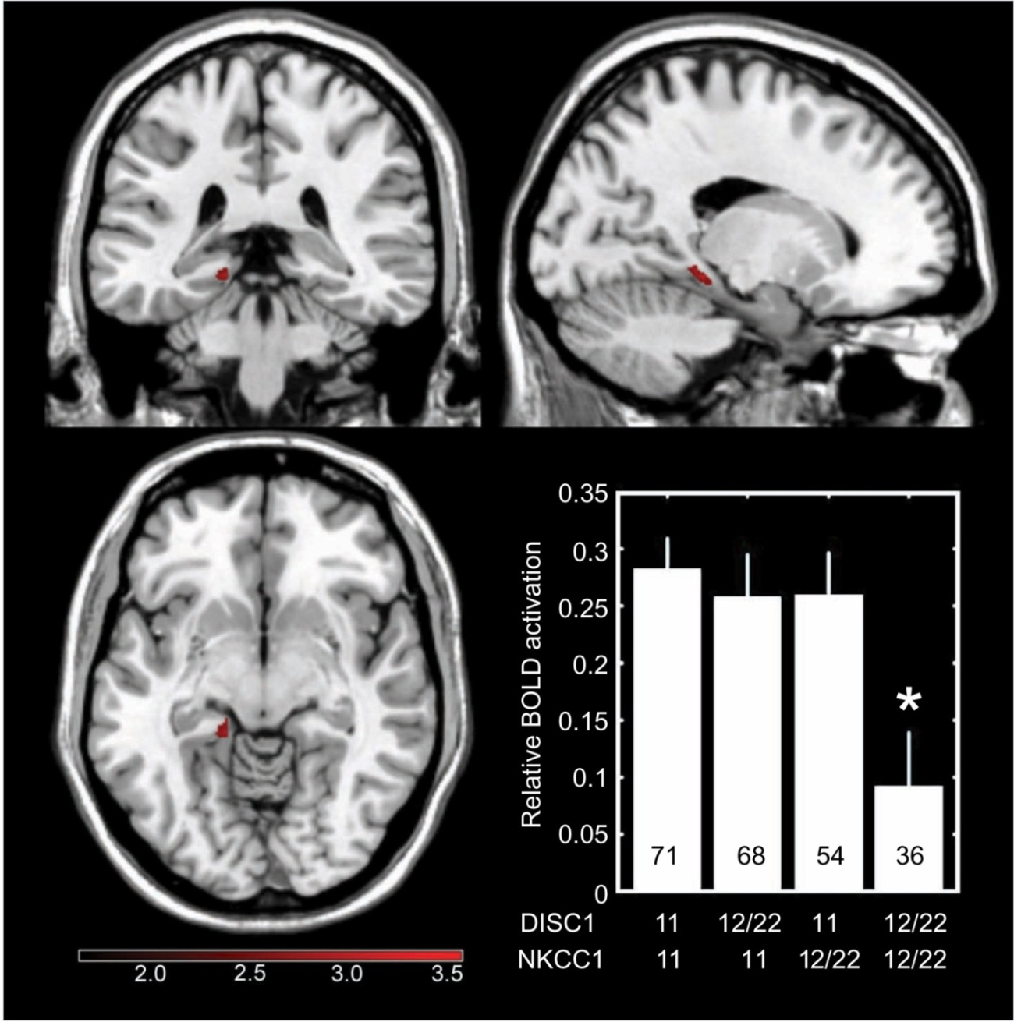
Interaction between DISC1 and NKCC1 impacts hippocampal function during recognition memory
(Callicott H.H.et al. J Clin Invest 2013)

Slide 12
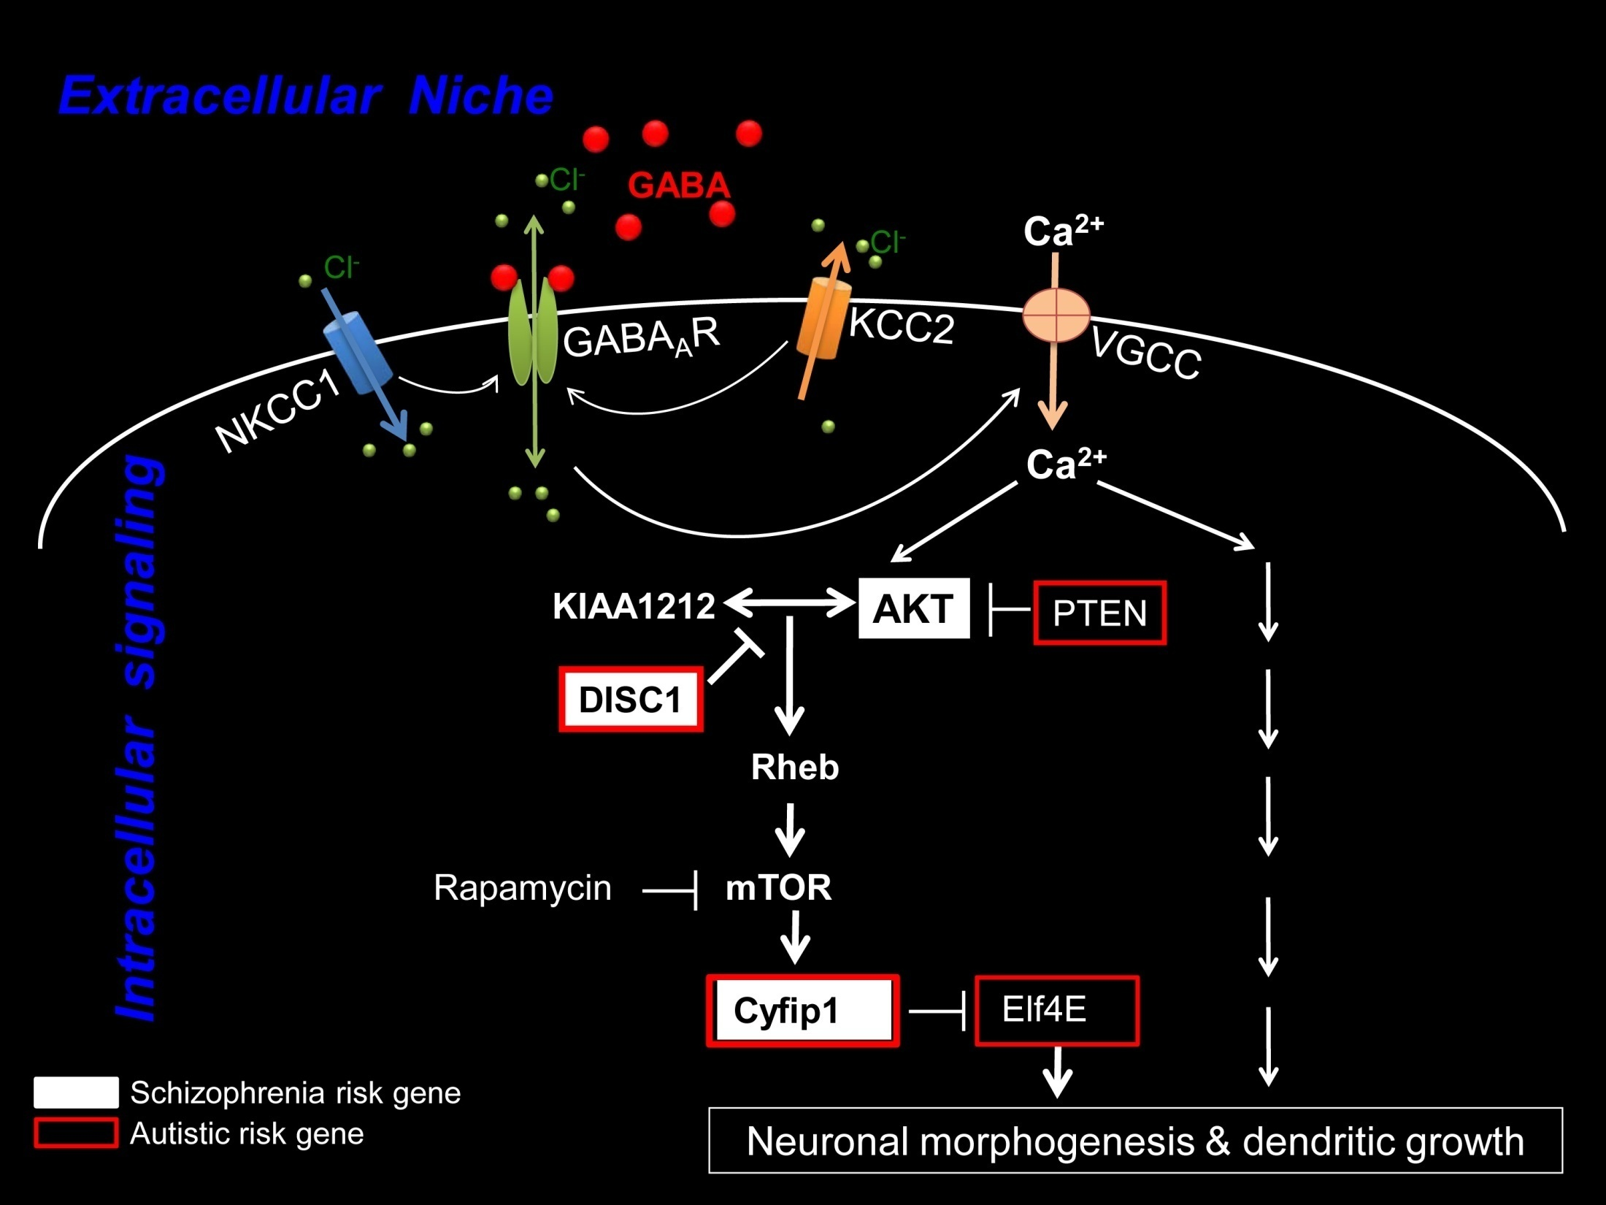
NKCC1
(Kim J. et al. Neuron 2009; Kim J. et al. Cell 2012)

Slide 13
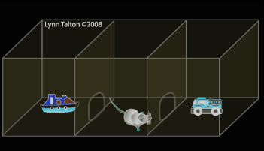
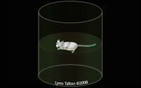
Knockdown of DISC1 in adult-born neurons is sufficient to induce hippocampal-dependent behavior deficits: rescued by rapamycin treatment
Forced-swim test
Object-place recognition
(Zhou et al, Neuron 2013)

Slide 14
Regulation of adult hippocampal neurogenesis by physiological, pathological and pharmacological stimuli
Enriched environment
Physical excise
Learning
Dietary restriction
Antidepressants
Seizure
Stroke
Hormones
Neurotransmitters
Degenerative
neurological
diseases
Stress
Aging
Opiates,
Methamphetamine
Inflammation
Quiescent neural stem cells
Neural progenitors
Neuroblasts
Post-mitotic
immature neurons
Mature
neurons
Notes:
90’ Probably one of the most striking forms of structural plasticity in the mature nervous system is continuous generation and integration of new neurons in the olfactory bulb and hippocampus.
In the dentate gyrus of the hippocampus, a region involved in learning and memory, about 9000 cells are born daily in young adult rodents, and they further differentiate into neurons, astrocytes and oligodendrocytes.
Adult neurogenesis is conserved in humans and a large body of evidence supports critical roles of adult neurogenesis in both cognitive and affective brain functions. In addition, dysfunction of postnatal neurgenesis contributes to epilepsy and brain disorders as well as brain tumors as nicely shown by Luis Prada’s lab.
Ongoing adult neurogenesis provides an in vivo model system to address basic principles in neural development, plasticity and repair in the adult brain.
During the past 10 years, we have been systematically investigating sequential processes of adult hipppocampal neurogenesis. We have discovered several novel molecular mechanisms regulating proliferation of precursors and their neuronal fate commitment. We have also identified novel cellular and molecular mechanisms regulating synaptic integrated of newborn neurons into existing neuronal circuitry.
Using disrupted in schizophrenia 1 as an entry point, we are studying how dysfunction of neurogenesis may contribute to mental disorders.
Today, I would like to highlight one line of recent studies focusing on precursor cells.

