Slide 1
Discovery of New Drugs for
Treatment of Human Diseases
Jun O. Liu
Department of Pharmacology
And Department of Oncology
Johns Hopkins School of Medicine
Baltimore, MD21205
April 29, 2013

Slide 2
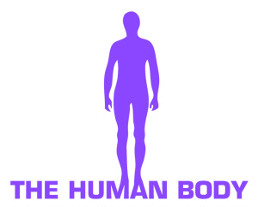
The Human Body—the Most Complicated
Molecular “Machine” Ever Existed
• It begins with a single cell—fertilized egg.
• An adult has about 50-100 x 10¹² cells.
• An adult has over 200 different tissues.

Slide 3
Basic Mechanism of Human Diseases
• Homeostasis or the intricate balance of cell growth and turnover is essential to the survival and well-being of individuals and perturbation of this balance leads to diseases.
e.g.
Too much growth of cells leads to cancer
Too much cell death leads to immunodeficiency (HIV)
or neurodegeneration (Alzheimer’s).

Slide 4
How Do Drugs Work?
• At the systems level, drugs work by restoring the homeostasis of the human body or selectively killing invading bacteria or viruses.
• At the molecular level, most drugs work by selectively binding to proteins to modulate—either inhibit or activate them.

Slide 5
Drugs work through binding to proteins
Drugs

Slide 6
How Are Drugs Discovered?
--The old way: Luck and serendipity
Willow
Tree
Aspirin
Prostaglandin
Biosynthesis
Advil, Tylenol
etc.

Slide 7
How Are Drugs Discovered?
--The new way: target-based high-throughput screening
1000
Select Target
Develop Assay
HST
Optimize
Lead
Select
Candidate
Phase I
Phase II
Phase III
Register
Market
Cost ($ in Millions)
Time (years)
14

Slide 8
Exploiting Johns Hopkins Drug Library
To Accelerate Drug Development
1000
JHDL Approach
Cost ($ in Million)
Select Target
Develop Assay
HST
Optimize
Lead
Select
Candidate
Phase I
Phase II
Phase III
Register
Market
Conventional Approach
Time (years)
14

Slide 9
The Johns Hopkins Drug Library
Build a library of every available drug that is FDA-
approved
3,464 unique FDA-approved drugs (1938-2003)
Culled from a list of > 32,000 new drug approvals
obtained via Freedom of Information Act requests

Slide 10
The Johns Hopkins Drug Library
Build a library of every available drug that is FDA-
approved
3,464 unique FDA-approved drugs (1938-2003)
Culled from a list of > 32,000 new drug approvals
obtained via Freedom of Information Act requests
Plate library in 96- or 384-well format

Slide 11
The Johns Hopkins Drug Library
Build a library of every available drug that is FDA-
approved
3,464 unique FDA-approved drugs (1938-2003)
Culled from a list of > 32,000 new drug approvals
obtained via Freedom of Information Act requests
Plate library in 96- or 384-well format
Screen the drug library in cell-based assays to search for novel biological and pharmacological activities.
Notes:
Show picture of a plate or a stack of plates.

Slide 12
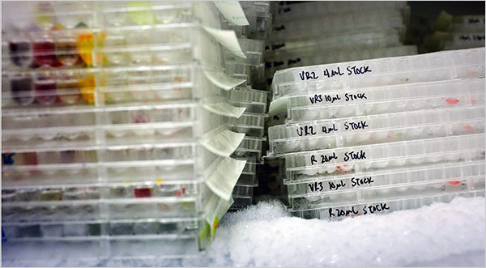
The Johns Hopkins Drug Library

Slide 13
Tumor growth is dependent on angiogenesis

Slide 14
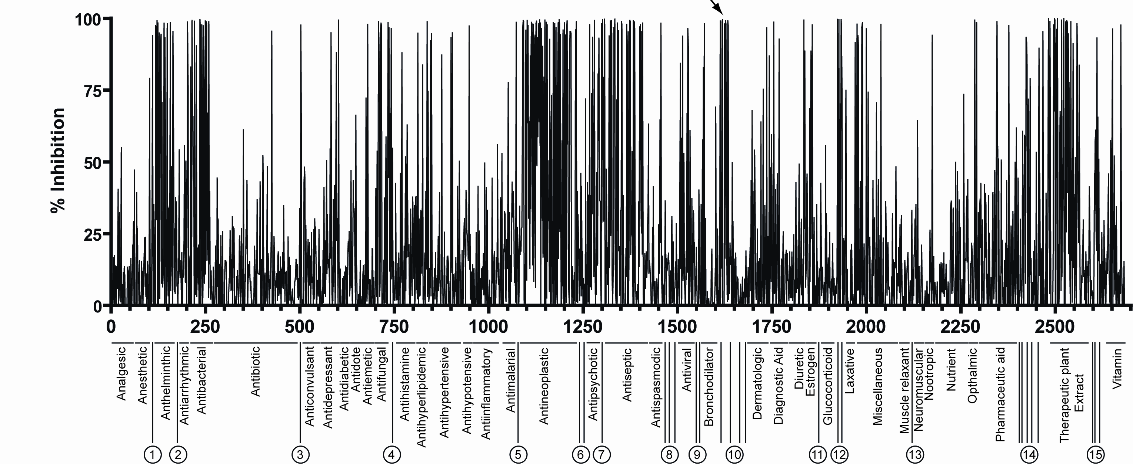
Hits from Endothelial Cell Proliferation Screen
Drugs

Slide 15
Itraconazole as a novel angiogenesis inhibitor
• Itraconazole has been used as an antifungal agent for treating systemic and toenail fungal infections for decades.

Slide 16
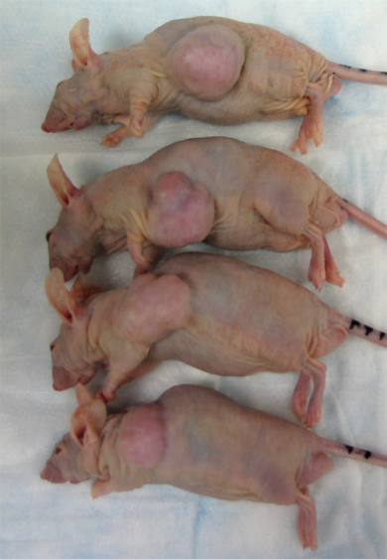
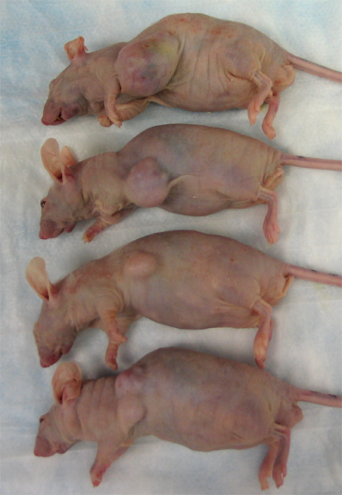
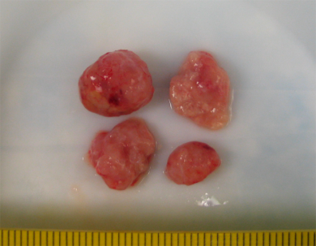
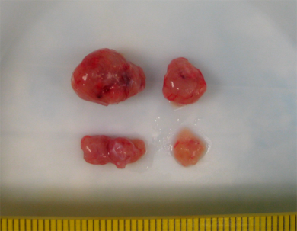
Inhibition of Xenograft of Prostate Cancer by Itraconazole in vivo
Placebo
Itraconazole
Tumor Volume (mm³)
Xenograft cancer type: 22Rv1 prostate cancer
Injection type: I.P. injection
Notes:
Show control and itra group separately using animation.

Slide 17
Treatment of A Recurrent Drug-Resistant
NSC Lung Cancer Patient
with Pemetrexed and Itraconazole
Charlie Rudin/Hopkins Kimmel Cancer Center

Slide 18
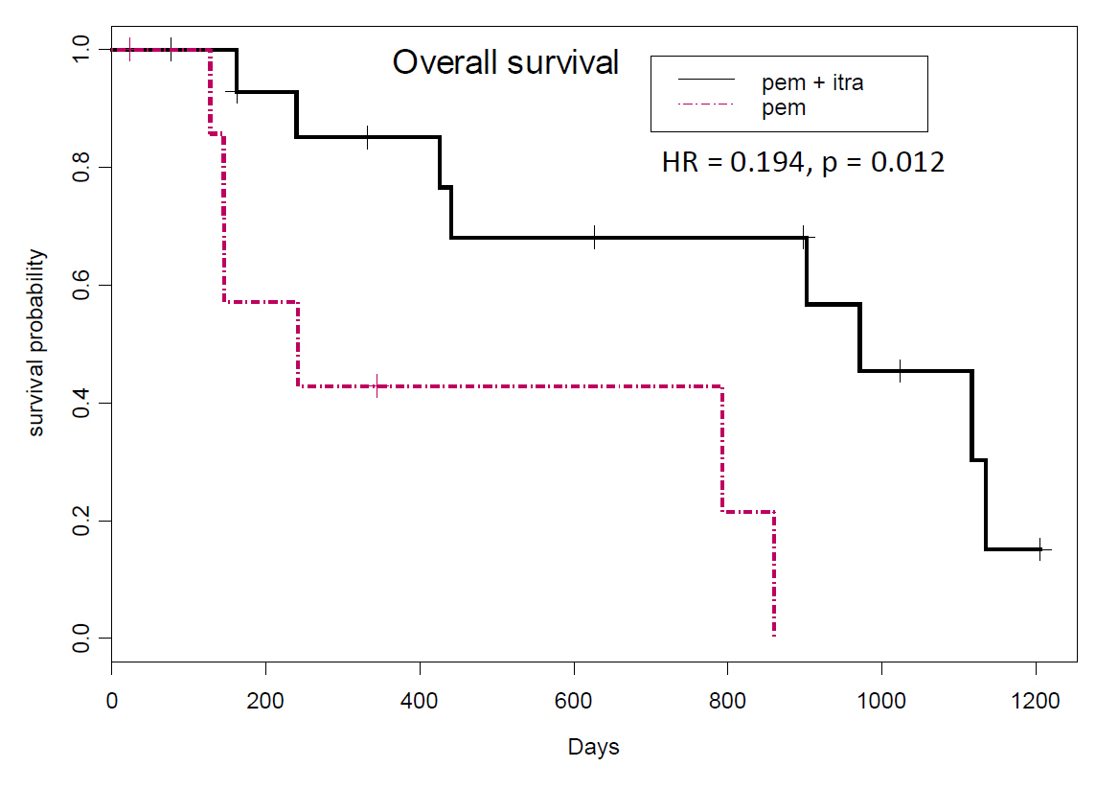
Randomized Phase 2 Study of Pemetrexed with or without Itraconazole
in Patients with Recurrent Non-Squamous Non-Small Cell Lung Cancer
32 Mo.
8 Mo.
Charles Rudin et al.

Slide 19
Some Additional Hits from the Johns Hopkins Drug Library
Chong et al. (2006)
Astemizole as an antimalarial agent.
Nat. Chem. Biol. 2, 415-416.
Ren et al. & Liu, J. O. (2008)
Clofazimine as a novel inhibitor of Kv1.3 channel and autoimmune diseases.
PLoS ONE. 3, e4009.
McMahon et al. & Siliciano, R. (2007)
The HBV drug entecavir inhibits HIV-1 replication and resistance.
N. Engl. J. Med. 356, 2614-2621.
Zhang, et al. & Semenza, G. L. (2008)
Digoxin and other cardiac glycosides inhibit HIF-1α synthesis and block tumor growth.
Proc. Natl. Acad. Sci. USA, 105, 19579-19586.
Lee, et al. & Semenza, G. L. (2009)
Acroflavine Inhibits HIF-1 dimerization, tumor growth and vascularization.
Proc. Natl. Acad. Sci. USA, 106, 17910-17915.
Lin, et al. & Nelson, Carducci. (2010)
Disulfiram causes DNA demethylation and inhibits prostate cancer growth.
Proc. Natl. Acad. Sci. USA, 106, 17910-17915.
Shim, et al. & Liu, J. O. (2010)
Effects of nitroxoline on angiogenesis and growth of human bladder cancer.
JNCI, 102, 1855-1873.
Shim, et al. & Liu, J. O. (2012)
Inhibition of Her2-positive breast cancer cells by the HIV protease inhibitor nelfinavir.
JNCI, 104, 1576-1590.

Slide 20
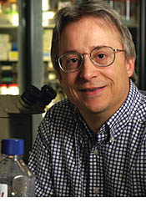
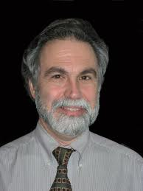
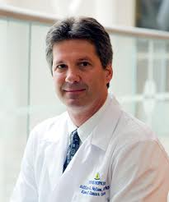
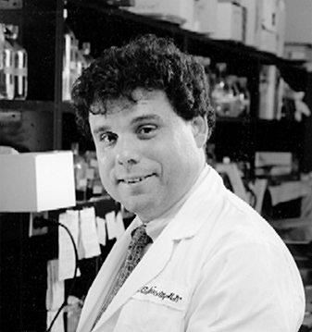
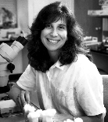
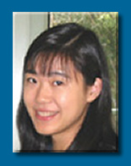
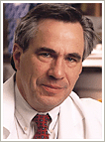
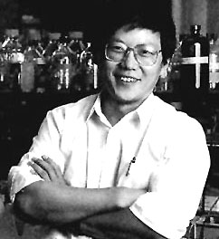
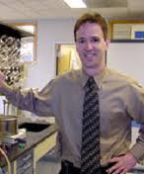
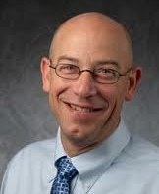
David Sullivan (Malaria)
Phil Beachy (Hedgehog signalling)
Gregg Semenza
(HIF-1)
Bill Nelson
(Prostate Cancer)
Rich Ambinder
(EBV)
JHDL
Denise Montell (Ovarian cancer)
Jin Zhang
(cAMP signaling)
Bill Isaacs(Prostate cancer)
Robert Siliciano (HIV)
Ying Zhang
(TB)
Marty Pomper(ABCG2)
Charlie Rudin(Lung Cancer)

Slide 21
Acknowledgments
COWORKERS
COLLABORATORS
Curtis Chong
Jing Xu
Ben Nacev
Joong Sup Shim
Wei Shi
Kalyan Pasunooti
Ruojing Li
Paweena Chalugun
Sara Head
Shridhar Bhat
Richard Ren
Fan Pan
Tilman Schneider
Yongjun Dang
Jun Lu
Roberto Pili/Angiogenesis
David Sullivan Jr./Malaria-library
Bill Nelson/Prostate Cancer
Vasan Yegnasubramanian/PC
Elizabeth Platz/Prostate Cancer
Charles Rudin/Lung Cancer
Phil Beachy/Hedgehog Pathway
Alan So (UBC)/Bladder Cancer
Peter Espenshade/Cholesterol pathway
Bob Siliciano/HIV
Marty Pomper/ABCG2-cancer
Rich Ambinder/EBV-Cancer
Michael Carducci/Prostate Cancer
Ying Zhang/TB
Jin Zhang/Kinases-signaling
Gregg Semenza/HIF-1
Bill Isaacs/Prostate Cancer
$ FINANCIAL SUPPORT $
National Cancer Institute
Johns Hopkins School of Medicine/Pharmacology
Johns Hopkins Malaria Institute
Patrick Walsh Prostate Cancer Fund
CTSA
Prostate Cancer Foundation
Keck Foundation
FAMRI
Notes:
1

Slide 23
The Human Genome
and the Human Genome Project
• 23 pairs of chromosomes.
• A total of about 3 billion base pairs.
• A total of about 20,000-25,000 individual genes.

Slide 24
A non-comparative randomized phase 2 study of two dose-levels of itraconazole in men with metastatic castration-resistant prostate cancer (mCRPC): a DOD/PCCTC trial
Emmanuel S Antonarakis, Elisabeth I Heath, David C Smith, Dana Rathkopf, Amanda L Blackford, Daniel C Danila, Serina King, Anja Frost, Seun Ajiboye, Sushant K Kachhap, Michelle A Rudek, Michael A Carducci
Sidney Kimmel Comprehensive Cancer Center at Johns Hopkins, Baltimore, MD
Barbara Ann Karmanos Cancer Institute, Wayne State University, Detroit, MI
University of Michigan, Ann Arbor, MI
Memorial Sloan Kettering Cancer Center, New York, NY

Slide 25
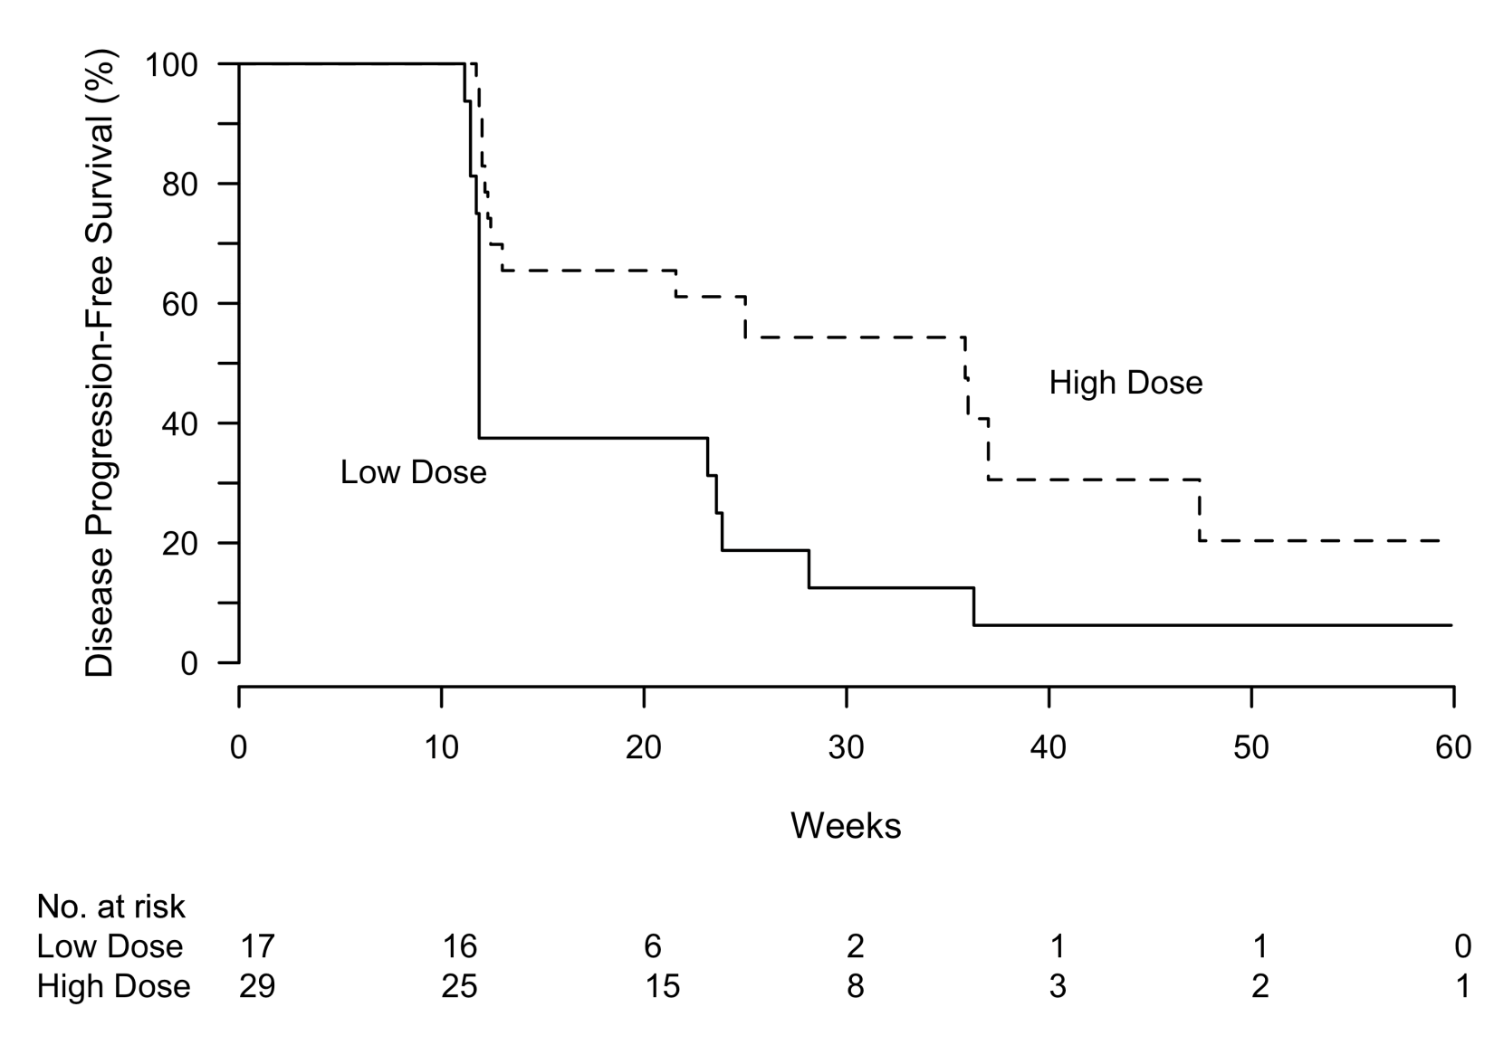
Progression-Free Survival (PFS)
High Dose: PFS at 24 wk = 61.1% (95% CI 44.1–84.6%)
Low Dose: PFS at 24 wk = 18.8% (95% CI 6.8–52.0%)
High Dose: median PFS = 35.9 wk (95% CI 13.0–60.0⁺ wk)
Low Dose: median PFS = 11.9 wk (95% CI 11.9–28.1 wk)
(600 mg daily)
(200 mg daily)

