Slide 1
Psychological
Management of Pain
Jennifer A. Haythornthwaite, Ph.D.
Department of Psychiatry & Behavioral Sciences
Johns Hopkins University School of Medicine
Baltimore, MD USA
jhaytho1@jhmi.edu

Slide 2
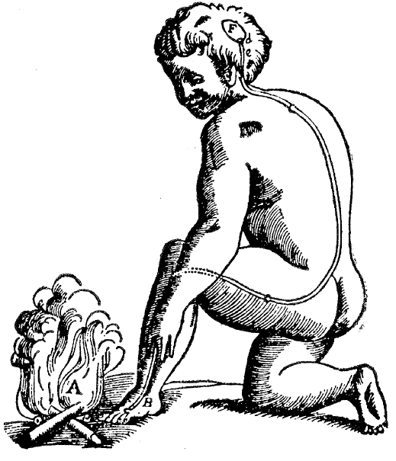
How do emotions (and thoughts) influence pain?
“An unpleasant sensory and emotional experience associated with actual or potential tissue damage or described in terms of such damage.” IASP, 1979

Slide 3
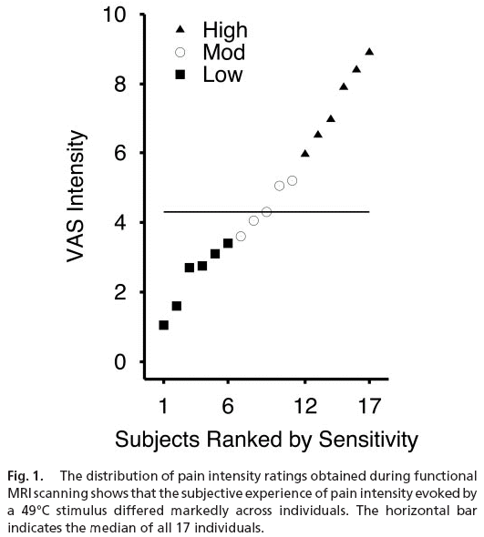
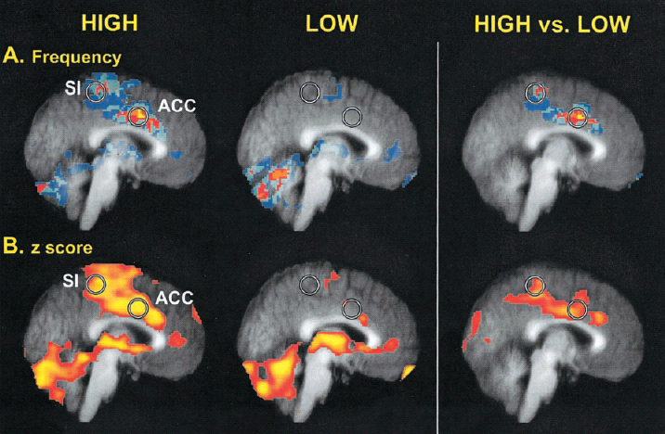
Individual Differences
in Pain Sensitivity
↑ Activation of Anterior Cingulate Cortex
and Prefrontal Cortex, as well as the
somatosensory area S1 in individuals
with High Sensitivity
Coghill et al., PNAS, 2003

Slide 4
Psychological Management of Pain
Anxiety and depressive symptoms
Pain-related catastrophizing
Sleep disturbance
Treatment

Slide 5
Depression and negative affect
related to pain…
General Distress
(anxiety, depression, distress)
Cognitive Intrusion
(Catastrophizing, Pain-related anxiety)
Fear of Pain
Mounce et al., A principal components analysis…J of Pain, 2010: 11, 710

Slide 6
Acute to Chronic Pain Trajectory
Anxiety
Depression
Acute Pain

Slide 7
Acute to Chronic Pain Trajectory
X
Anxiety
Depression
Pain Free
Acute Pain

Slide 8
Acute to Chronic Pain Trajectory
Anxiety
Depression
Acute Pain
Persistent
Pain

Slide 9
Anxiety and Depression Pain
1 Year Following Knee Replacement
Anxiety
Depression
Acute Pain
Persistent
Pain
Brander et al., Clin Orthoped Related Res, 2003, 146: 97

Slide 10
Acute to Chronic Pain Trajectory…..Consider Function
Acute Pain
Persistent
Pain
Poor Function

Slide 11
Acute to Chronic Pain Trajectory…..Consider Function
Acute Pain
Persistent
Pain
Anxiety
Depression
Poor Function

Slide 12
One Year Following
Severe Lower Extremity Trauma
3 months
post injury
12 months
post injury
→ → → →
pain
0.31
pain
0.20
(p<0.01)
6 Month
Depressive
Distress
0.23
(p<0.01)
6 Month
Anxious
Distress
0.54
(p<0.01)
0.55
(p<0.01)
Overall
Function
Overall
Function
0.31
Wegener et al., Psychological distress mediates the effect of pain on function. Pain, 2011

Slide 13
Acute to Chronic Pain Trajectory
Anxiety
Depression
Acute Pain
Persistent
Pain
Anxiety
Depression
Poor Function

Slide 14
Psychological Management of Pain
Anxiety and depressive symptoms
Pain-related catastrophizing
Sleep disturbance
Treatment

Slide 15
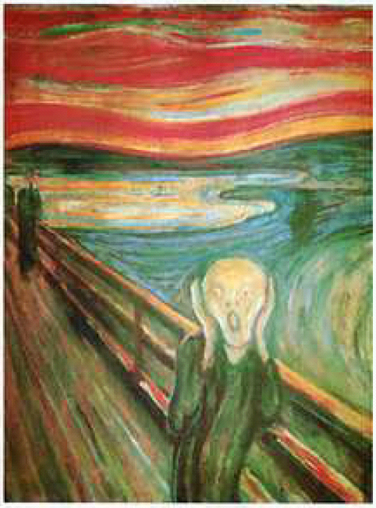
Pain-related Catastrophizing
Negative Emotions
Anxiety, Depression, Rumination
“I worry about whether it will end”
Attention to pain
Magnification, Exaggeration, Hypervigilance
“I can’t seem to keep it out of my mind”
Beliefs about pain
Threat, Helplessness, Pessimism
“I become afraid that the pain will get worse”

Slide 16
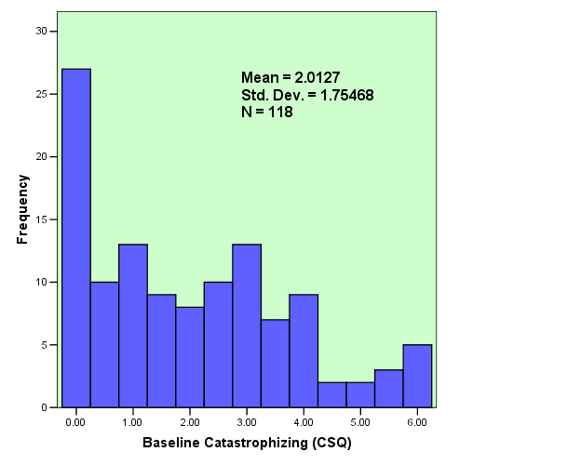
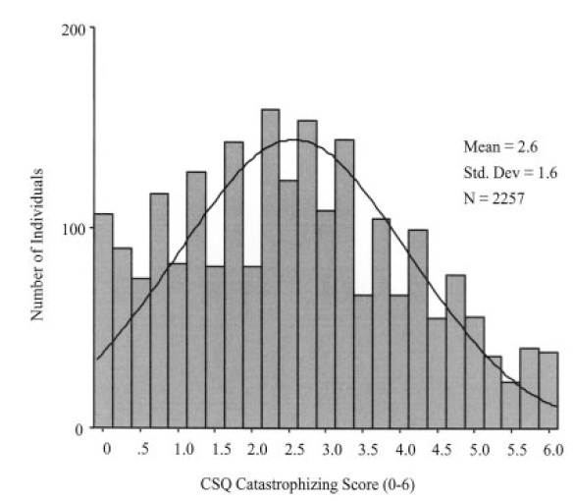
Individual Differences in Catastrophizing….
TMJ Pain on Palpation
Pain Clinic patients
TMJ patients
Notes:
Here you see the type of individual differences we often see in groups of patients with chronically painful conditions.
On the left is the distribution of scores we obtained when we measured catastrophizing in a group of patients with post-herpetic neuralgia, a painful condition that occurs in some individuals following a herpes zoster flare. Dr. Srinvasa Raja and I collaborated with others in conducting a randomized clinical trial evaluating 2 medications – opioids and tricyclic antidepressants – in reducing the pain experienced by elderly patients with PHN.
On the right is the distribution of scores we are seeing in an ongoing trial for patients with painful temporomandibular joint disorders. Dr. Raja and I are collaborating with a group at the University of Maryland Dental School, including Dr. Ed Grace, in conducting a trial examining the separate and combined effects of psychological and pharmacological treatments for TMJ pain.
Both groups show a typical pattern on catastrophizing scores – most people fall in the lower range but there are clearly individuals who are “high” on catastrophizing.

Slide 17
Catastrophizing (trait) scores are stable – scores do not change (i.e., decrease) – over relatively short periods of time
(Catastrophizing does decrease following CBT)
Catastrophizing Score
p =.05
ns
8
7
6
5
CSQ Catastrophizing
4
3
TKA: Edwards et al., Pain Res Manage, 2009, 14: 307.
Young & Healthy: Edwards et al., Pain, 2004, 111: 335;
Acute Pulpitis: Edwards et al., J of Pain, 2004, 3:164;
2
1
0
Pre-Surg
1 Month
3 Month
6 Month
12 Month

Slide 18
Catastrophizers show a heightened stress response to pain …
Pain Catastrophizing
Acute Pain

Slide 19
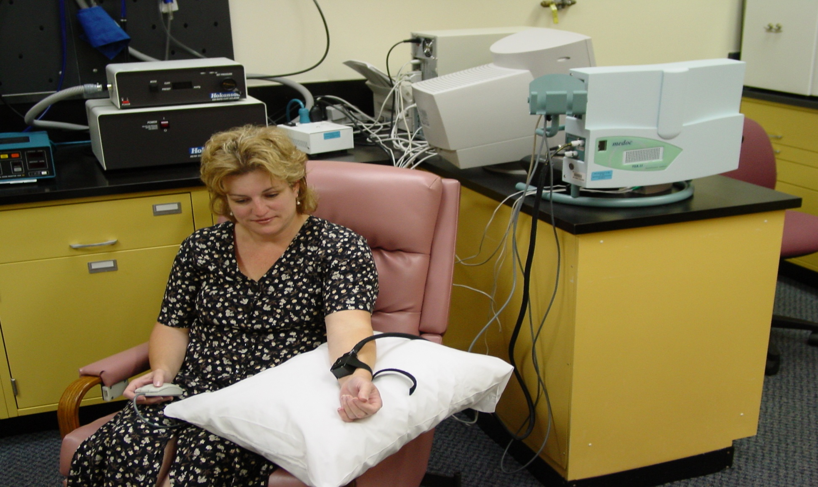
Thermal Pain Assessment
thermode

Slide 20
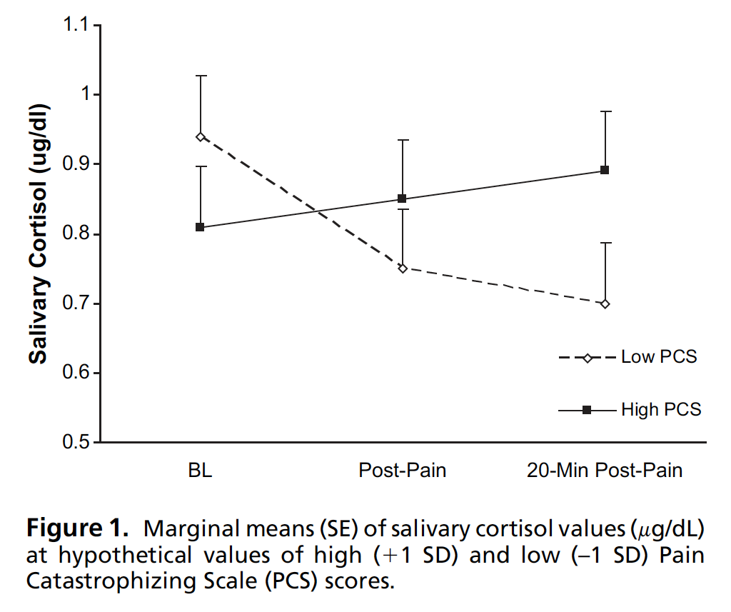
Catastrophizers show a stress response to pain …
Quartana et al., J of Pain, 2010, 11: 186

Slide 21
Pain is a stressor that activates pain-related catastrophizing and heightens pain…
Acute Pain
Acute Pain
Pain Catastrophizing

Slide 22
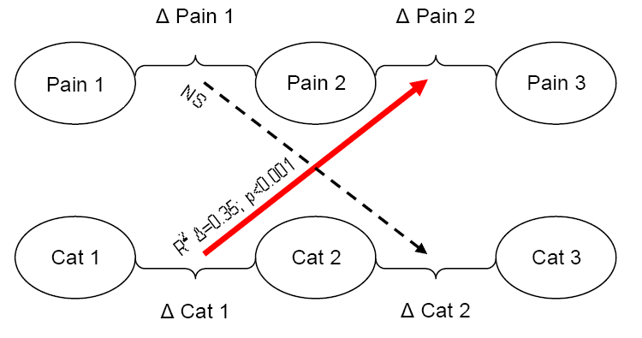
Situational CAT ➔ ➔ Pain
N=38 healthy adults: Topical capsaicin cream on hand
Constant heat (38º) is applied at time 1 – pain and cat rated - then heat increased (42º) at time 2 – pain and cat rated at time 3
Campbell et al., Changes in situation-specific pain CAT…J of Pain, 2010, 11: 876
Notes:
Update reference

Slide 23
Situational CAT ➔ ➔ Pain
Early
Mid
Late
Campbell et al., Changes in situation-specific pain CAT…J of Pain, 2010, 11: 876
Notes:
Update reference

Slide 24
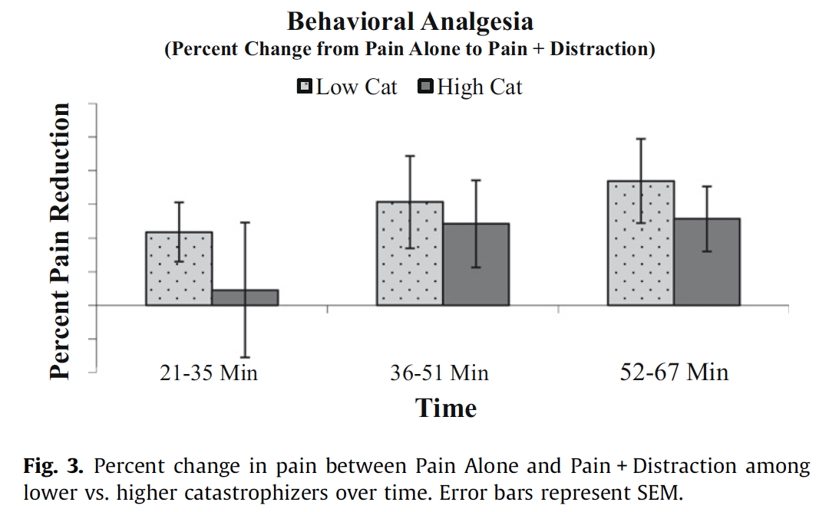
High catrastrophizers show delayed behavioral analgesia
Campbell et al., Pain, 2010, 149:202

Slide 25
Psychological Management of Pain
Anxiety and depressive symptoms
Pain-related catastrophizing
Sleep disturbance
Treatment

Slide 26
Pain is a stressor that activates pain-related catastrophizing and heightens pain…
Acute Pain
Chronic Pain
Sleep Disturbance

Slide 27
Smith et al.,
190 adults treated for major burn injury. Moderate levels of sleep onset insomnia (trouble falling asleep) at discharge were associated with persistent pain at 2-year follow-up (controlling for distress, discharge pain, and burn characteristics)
25
20
15
% moderate-severe pain
10
5
0
None or
Mild
Moderate or
More

Slide 28
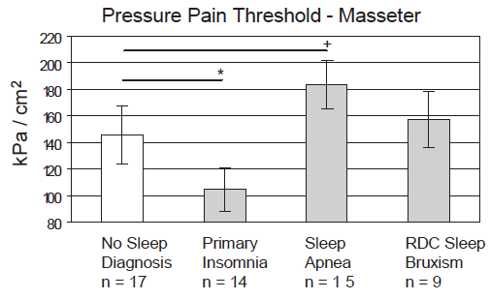

Slide 29
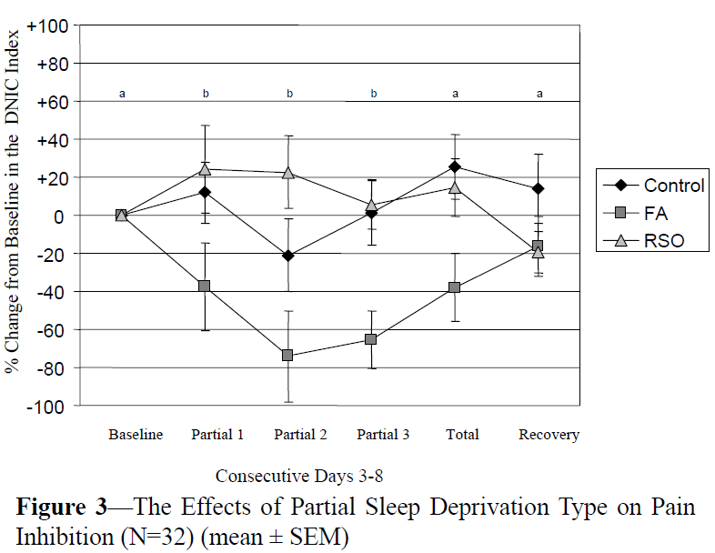
Sleep disruption (not restriction) alters DNIC
Acutely Disturbed Sleep Impairs an Indirect
Measure of the Endogenous Opioid System
Smith et al., Sleep, 2007, 30:494.

Slide 30
Psychological Management of Pain
Anxiety and depressive symptoms
Pain-related catastrophizing
Sleep disturbance
Treatment

Slide 31
High Negative Affect reduces
opioid analgesia in CLBP
(59.3%)
% summed pain intensity difference
(49.3%)
(37.3%)
Composite Negative Affect Score
Wasan et al., The association between negative affect and opioid analgesia…Pain, 117:450-461

Slide 32
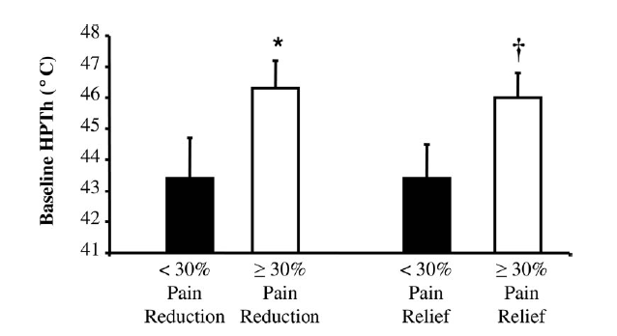
Higher pain sensitivity ➔ Poorer Opioid Response

Slide 33
Cognitive-Behavioral Treatment: Outcomes
↓ pain intensity
↓ pain-related disability and pain behaviors
control and self-efficacy, ↓ helplessness
improve emotional state
active coping, ↓ passive coping (e.g., catastrophizing)
RA: ↓ biological markers (joint swelling)

Slide 34
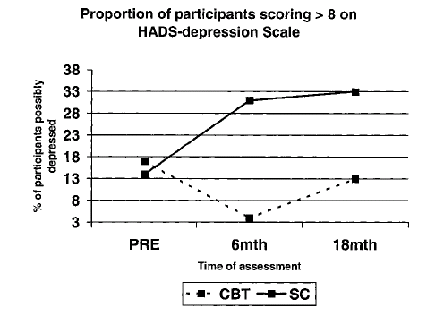
CBT in early RA: reduced depression and disability
SC
Percent Possibly Depressed
CBT
Sharpe et al., Long-term efficacy of CBT…, Rheumatology, 2001, 42:435.

Slide 35
Psychological Management of Pain: Future Directions
Combined and separate effects
Anxiety and depressive symptoms
Pain-related catastrophizing
Sleep disturbance
Pathophysiology
Influence on Central Processing of Pain
Treatment
Subgroups of At Risk Patients

Slide 36
Thank you to the NIH
Notes:
Pictures: mentors, post-docs, staff, family

