Slide 1
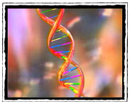

A smattering of mutations
Brainiacs: Recent Advances in Neuroscience
2014 IBBS Science Writer’s Workshop
April 28, 2014
National Press Club, Washington, DC
Aravinda Chakravarti, PhD
Center for Complex Disease Genomics
Johns Hopkins University School of Medicine
Disclosures: Biogen Idec (SAB)

Slide 2
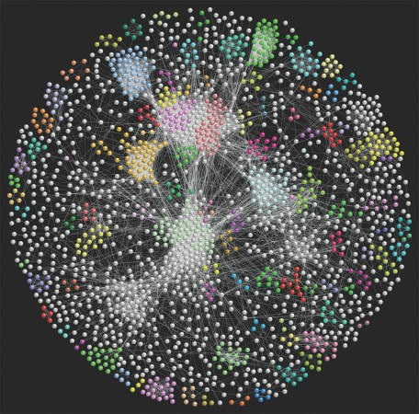
Biology is complicated but not random
The world of biology at the molecular level is complicated
…not only in the large number of components but in their interactions, never mind how these change with time, exposure, etc.

Slide 3
For future understanding of biology we have to come to grips with complexity…Occam’s razor rarely applies. So, how can sense be made of this complexity?...For that we need to know which parts of the network are at the heart of the process…Reducing the elements to the minimum will focus attention on those that are central to the process and this should help gain better understanding.
Paul Nurse
Emerging Themes in Biology: Hints for the Future
Cell, March 27, 2014

Slide 4
Finding “elite” genes for autism:
the roles of delta 2 catenin (CTNND2)

Slide 5
The many genes for autism…
Simons Foundation for Autism Research, 2014

Slide 6
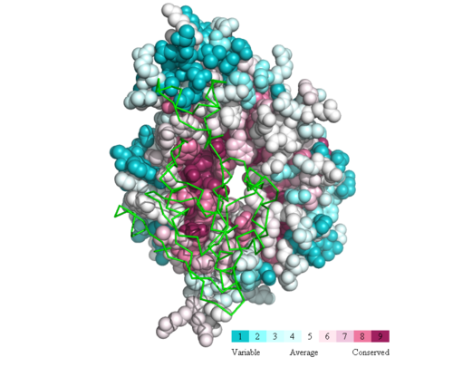
Genetic Principle #1: Structure begets function
Mutations occur at random but those retained are not…
…our genomes hold the code to conservation of function by conserving structure

Slide 7


Genetic Principle #2: Rarer forms of a disease arise from higher liability
Cedric Carter
Doug Falconer
Sex-Independent Threshold
Liability = susceptibility + exposure
The more critical the function the more severe the consequences
of its disruption and the greater the effect of natural selection
Notes:
(Fombonne et al. 2003)
(Jorde et al. 1991)

Slide 8
Female-enriched Multiplex families for autism (FEMFs)
Genetic reasoning (Carter effect) and empirical data indicate FEMFs should have the highest liability;
An extreme phenotype with incidence <1.6x10⁻⁵…(female patients ~ 0.0016, <10% families are multiplex, <10% are severe);
ADI-R and ADOS positive cases sampled from the NIMH and AGRE repositories;
>180 FEMFs being sequenced.

Slide 9

Sequencing FEMFs…a pilot study
13 FEMFs
    71 European controls
  Exome Sequencing
  Focus on variants of interest (VOI)
    absent in controls
    functionally deleterious
Notes:
CYFIP1 is an interactor of FMRP, resides in the
15q11-13 duplication region associated with autism, has a knock-out mouse with Fragile X like features, and its
expression is upregulated in patients with autism, DLG1 is a post-synaptic scaffolding protein which also resides in the
3q29 microdeletion region
Allen Brain Atlas Mouse In situ data (3 not tested, 6 high expression, 6 low expression 3 no expression)
ABP1 – no expression data available
ATP11A – Yes, brain expressed
CTNND2 – Yes, brain expressed
CYFIP1 - Yes, brain expressed (low)
DLG1 – Yes, brain expressed
ENO1 – Yes, brain expressed
ITGB5 – Yes, brain expressed
MEP1A – Yes, lowly expressed
MIPEP – Yes, lowly expressed
MYO1A – No
MYOF – Yes, lowly expressed
PARPBP – No
PLXNA3 – No
SIAE – Yes, brain expression
TAT – no expression data available
THBS4 – Yes, low expression
ZBTB39 – Yes, low expression
ZNF192 – no expression data available
----- Meeting Notes (4/5/13 11:56) -----
Not bold CTNND2,
bold CYFIP1 and DLG1 (mentione)
then animated and bold CTNND2

Slide 10
Potential mutations at CTNND2
EVS MAF
< 0.0002
EVS
MAF=0
EVS MAF
< 0.0002
EVS
MAF=0
EVS
MAF=0
EVS
MAF=0
EVS MAF
< 0.0002
EVS
MAF=0
EVS MAF
< 0.0002
EVS
MAF=0
300 independent autism females
5 conserved to zebrafish
Autism vs. controls: p=5.26x10⁻⁷
Notes:
Harvard et al. 2005
Marshall et al. 2008
Qiao et al. 2009
Sanders et al. 2011
Gai et al. 2012, current study
Gai et al. 2012, current study
He et al. 2012
Christa Martin, Ph.D., current study
Sau Wai Cheung, Ph.D., current study
Sau Wai Cheung, Ph.D., current study
Matthew State, M.D., Ph.D., current study
Matthew State, M.D., Ph.D., current study
T862M, current study
R713C, current study
Q507P, current study/Simons
R454H, current study
G275C, current study
P224L, current study
P189L, current study
G34S, current study
EVS: 5 alleles/10,755 alleles (total)
Autism: 5 alleles/724 alleles
> mat
Autism Variant Not Autism Variant
EVS 5 10755
Autism 5 724
chisq.test(mat)
Pearson's Chi-squared test with Yates' continuity correction
data: mat
X-squared = 25.1657, df = 1, p-value = 5.261e-07
----- Meeting Notes (4/5/13 11:56) -----
EVS=0
don't emphasize coverage, emphasize genotype concordance
300 independent probands not all FEMFs

Slide 11
CTNND2 mutations are loss-of-function
Deletion
Duplication
Deletions/Duplications Overlapping Exons vs. controls: p=5x10⁻⁴
Notes:
Harvard et al. 2005
Marshall et al. 2008
Qiao et al. 2009
Sanders et al. 2011
Gai et al. 2012, current study
Gai et al. 2012, current study
He et al. 2012
Christa Martin, Ph.D., current study
Sau Wai Cheung, Ph.D., current study
Sau Wai Cheung, Ph.D., current study
Matthew State, M.D., Ph.D., current study
Matthew State, M.D., Ph.D., current study
----- Meeting Notes (4/5/13 11:56) -----
controls we had access to

Slide 12

Loss-of-function of CTNND2 in zebrafish
Control variants look like this
(8-10 somite stage)
Mutant variants look like these…the greater the
mutant severity the more abnormal the embryos
in number and quality
Notes:
6/8 autism are loss of function
4/4 control are not loss of function
U=uninjected
M=morpholino to Ctnnd2
A482T and G810R=HapMap
G34S and R713C=Autism
----- Meeting Notes (4/5/13 11:56) -----
phenotypes information
George Kurtsinger
mutations currently popular

Slide 13










Autism variants have specific effects on neuronal function*
Dendritic spines are location of excitatory synaptic transmission
dsRed
GFP
Alone
wildtype-CTNND2
G34S
mutant
R713C
mutant
A482T
polymorphism
A482T
*rat hippocampal neurons (E18 embryos)
Notes:
CDKL5 OMIM #300203
Hemizygosity of delta-catenin (CTNND2) is associated with severe mental retardation in cri-du-chat syndrome.
Medina M, Marinescu RC, Overhauser J, Kosik KS.
Genomics. 2000 Jan 15;63(2):157-64.PMID: 10673328 [PubMed - indexed for MEDLINE]Related citations
Curr Biol. 2004 Sep 21;14(18):1657-63.
Deletion of the neuron-specific protein delta-catenin leads to severe cognitive and synaptic dysfunction.
Israely I, Costa RM, Xie CW, Silva AJ, Kosik KS, Liu X.
Department of Molecular and Medical Pharmacology, University of California, Los Angeles, CA 90095, USA.
d-Catenin at the synaptic–adherens
junction
Kenneth S. Kosik1, Christine P. Donahue1, Inbal Israely2, Xin Liu2 and
Tomoyo Ochiishi3
1Dept of Neurology, Brigham and Women’s Hospital, Harvard Medical School, Boston, Massachusetts, USA
2Molecular & Medical Pharmacology, Pathology & Laboratory Medicine, University of California, Los Angeles, USA
3Molecular Neurophysiology Group, Neuroscience Research Institute, AIST, Tsukuba, Ibaraki 305-8566, Japan
----- Meeting Notes (4/5/13 11:56) -----
When quantitated these are the results

Slide 14
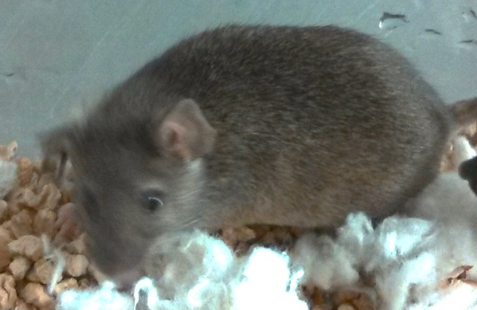
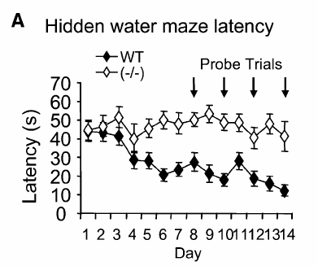
Is there any effect on behavior?
CTNND2 Knockout mouse: severe synaptic and cognitive dysfunction (Israely et al. 2004)
Involved in activity related change in morphology at the synapse (Kosik et al. 2005)
Israely et al. 2004
Notes:
Hemizygosity of delta-catenin (CTNND2) is associated with severe mental retardation in cri-du-chat syndrome.
Medina M, Marinescu RC, Overhauser J, Kosik KS.
Genomics. 2000 Jan 15;63(2):157-64.PMID: 10673328 [PubMed - indexed for MEDLINE]Related citations
Curr Biol. 2004 Sep 21;14(18):1657-63.
Deletion of the neuron-specific protein delta-catenin leads to severe cognitive and synaptic dysfunction.
Israely I, Costa RM, Xie CW, Silva AJ, Kosik KS, Liu X.
Department of Molecular and Medical Pharmacology, University of California, Los Angeles, CA 90095, USA.
d-Catenin at the synaptic–adherens
junction
Kenneth S. Kosik1, Christine P. Donahue1, Inbal Israely2, Xin Liu2 and
Tomoyo Ochiishi3
1Dept of Neurology, Brigham and Women’s Hospital, Harvard Medical School, Boston, Massachusetts, USA
2Molecular & Medical Pharmacology, Pathology & Laboratory Medicine, University of California, Los Angeles, USA
3Molecular Neurophysiology Group, Neuroscience Research Institute, AIST, Tsukuba, Ibaraki 305-8566, Japan

Slide 15
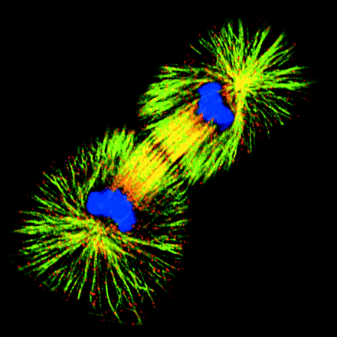
What does delta 2 catenin do?
Guilt-by-association: which genes are expressed with CTNND2?
Allen Brain Atlas: 28 developmental time-points
Negatively Correlated
662 genes
Positively Correlated
826 genes
Cell Cycle
(in particular, mitosis)
Morphogenesis, projection formation, and neuron differentiation
Notes:
Mitotic Cell:
Cover. Images show indirect immunofluorescence on fixed Xenopus cell line XL177 (background, cells in interphase; foreground, telophase/cytokinesis). Tubulin staining is shown in green, microtubule-associated protein XMAP215 is in red and DNA is in blue. The staining shows that XMAP215 is localized with the microtubule network both in interphase and mitosis. The pictures were taken on a confocal Zeiss LSM microscope. Andrei Popov is an HSFP fellow at the Cell Biology Program at EMBL, Heidelberg, Germany. His interests include microtubule-associated proteins and their role in the establishment of the mitotic spindle. For further details see Popov et al., pages 397--410.
Neuron: dsRED
We then furthered our analysis of the positively and negatively correlated datasets to look for some common function of genes in these categories as well as shared transcription factor binding sites (TFBS) within those genes which may indicated some form of co-regulation. DAVID (http://david.abcc.ncifcrf.gov/) was utilized for this analysis and in particular GOTERMs were examined in the biological process (BP), cellular compartment (CC), and molecular function (MF) categories. To determine significance we used the Bonferroni corrected p-value (as above and required a minimum of 30 genes) for the GO analysis and for the TFBS analysis required the Bonferonni corrected p-value (as above and a minimum of 500 genes). We found that for GOTERMS genes positively associated with CTNND2 are involved in morphogenesis, projection formation, and neuron differentiation whereas those negatively associated are involved in cell cycle (in particular mitosis) which makes sense in that a cell which is dividing is not actively forming projections or differentiating and vice versa. (Table 2, Figure 1) Additionally, by examining transcription factor binding sites we were able to find a number of transcription factors regulating the positively and negatively correlated genesets. By using a custom pubmed abstract counting script we were able to quickly determine if any of the transcription factor binding sites had been previously associated with CTNND2 or with autism, in general. We found one transcription factor (from positively correlated set) that previously known to be involved in regulating CTNND2, PAX6 (Zhang et al. 2010). Interestingly, a Pax6 mutant rat has been tested as an autism model and does show some autism-related features (Umeda et al. 2010) as well as a number of other publications implicating PAX6 (see below) in autism. Other transcription factors positively correlated with CTNND2 and suspected in autism include CHOP, p53, STAT3, MEF2, EN1, ELK1, and AP1 (references below).
EMBO Cover Volume 20 Number 3 01 February 2001
E18 Rat Hippocampal Neuron at DIV15

Slide 16
Many of these genes are enriched for those involved in dendrite morphogenesis, chromatin modification and include known autism genes

Slide 17
CTNND2 function?
Armadillo/beta-catenin superfamily, p120ctn sub-family;
adhesive junction associated protein that interacts with E-cadherins;
interacts with presenilins;
transcriptional activator when bound to ZBTB33 (Kaiso) and can repress Wnt-signaling target genes;
Nucleocytoplasmic shuttle protein: signal?

Slide 18
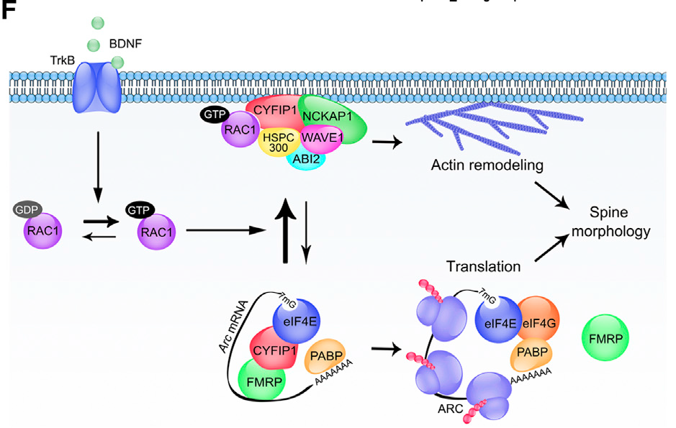
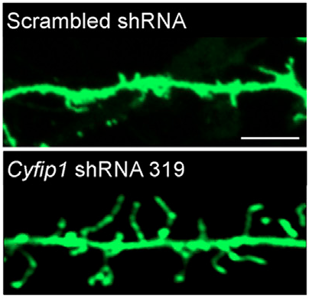
CYFIP1: Autism gene identified in FEMFs
7mG
7mG
CYFIP1
Synaptic Signal
eIF4G
Translational Regulator
eIF4E
eIF4E
PABP
PABP
CYFIP1
AAAAA
AAAAA
FMRP
FMRP
Variants identified in FEMFs
  Y777C (phyloP 3.54)
  A1003V (phyloP 5.97)
Now shown to simultaneously regulate actin polymerization (affects spine morphology)
(De Rubeis, Neuron September 18, 2013)

Slide 19
Thank you
<aravinda@jhmi.edu>

