Slide 1
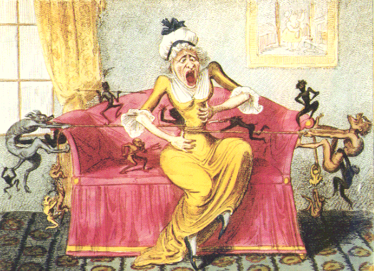
A Hot and Spicy Introduction to
Basic Pain Mechanisms
Michael J. Caterina M.D., Ph.D.
Professor of Biological Chemistry and Neuroscience
Member, Center for Sensory Biology
Johns Hopkins School of Medicine

Slide 2
Pain
An unpleasant sensory and emotional experience associated with actual or potential tissue damage, or described in terms of such damage
Source: International Association for the Study of Pain
Nociception
The detection of noxious stimuli by a neuron or organism
Hyperalgesia – Augmented perception of pain or feeling pain in response
to a formerly nonpainful stimulus

Slide 3
Different ways to classify pain
Timecourse
Acute (seconds to days) versus Chronic (weeks to years)
Acute pain is adaptive, allows us to avoid further injury and heal tissues
Chronic pain is maladaptive and leads to loss of productivity and quality
of life
Mechanisms of Origin of Chronic Pain
Inflammatory (arising from injury or inflammation in target tissues)
versus
Neuropathic (arising from injury or disease affecting the peripheral or central nervous system)
Peripheral (traumatic injuries to peripheral nerves)
Central (arising from damage to brain structures such as the thalamus)

Slide 4
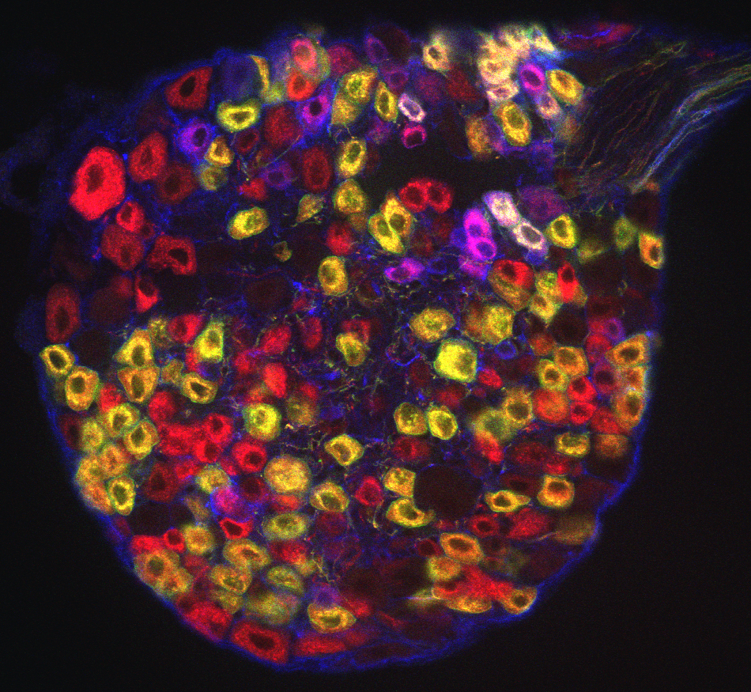
A little anatomy: Delivering the signal
Xinzhong Dong, Johns Hopkins

Slide 5
A little anatomy: Decending pathway from the brain modulates pain
DRG

Slide 6
A few major questions in the basic science of pain
What molecules allow us to sense and discriminate among painful and nonpainful stimuli?
Some are highly enriched in or specific to nociceptive neurons.
In which subpopulations of sensory neurons are specific painful stimuli detected?
What are the changes undergone by these molecules and neurons that lead to hyperalgesia and chronic pain?
Expression of new molecules, increases or decreases in abundance of existing molecules, changes in activity of existing molecules, changes in the anatomy of nerve endings in the periphery
What changes in the spinal cord and brain lead to an augmented sensitivity to incoming information from peripheral nociceptive neurons?
How do nonneuronal cells (glia, immune cells, keratinocytes) influence the perception of pain and hyperalgesia?

Slide 7
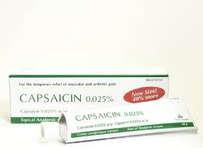
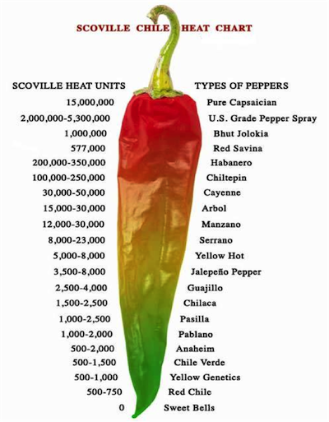
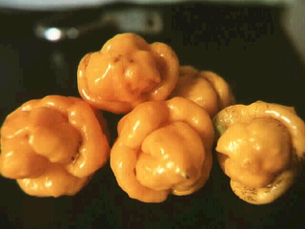
A little gift from nature to pain biologists
O
H
3
CO
N
H
HO
capsaicin

Slide 8
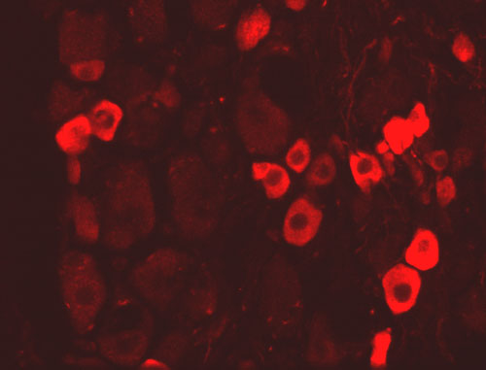
TRPV1 is an ion channel protein enriched in nociceptive neurons that can be activated by capsaicin
calcium
sodium
+
+
cap
DRG
Caterina et al. 1997
Disclosure:
Dr. Caterina is an inventor on a patent on the use of products related to TRPV1 and TRPV2, which is licensed through UCSF and Merck. He may be entitled to royalties on these products. He also consults for Hydra Biosciences, which develops TRP channel reagents. These conflicts are being managed by the Johns Hopkins Office on Policy Coordination.

Slide 9
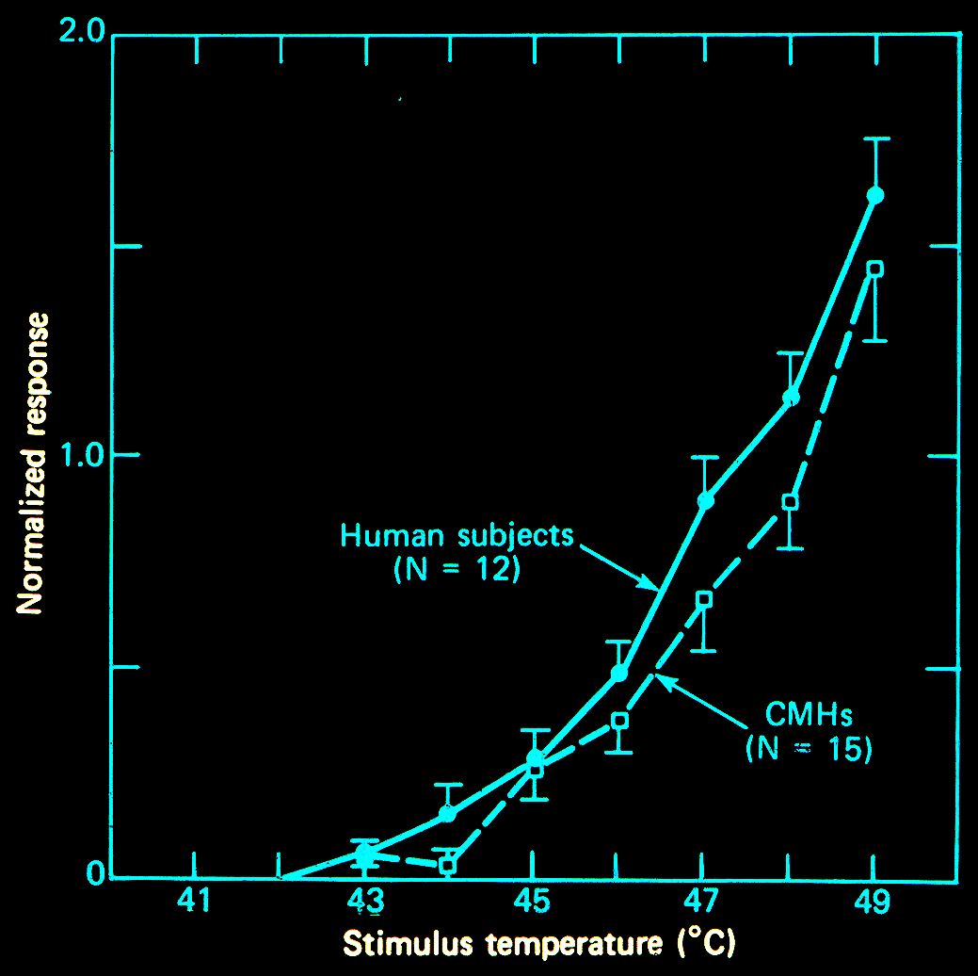
TRPV1 can alternatively be activated by painfully hot temperatures
Meyer and Campbell, 1981
TRPV1
Heat-evoked pain in humans
Heat-evoked nerve activity in monkeys
Heat-evoked activation of TRPV1

Slide 10
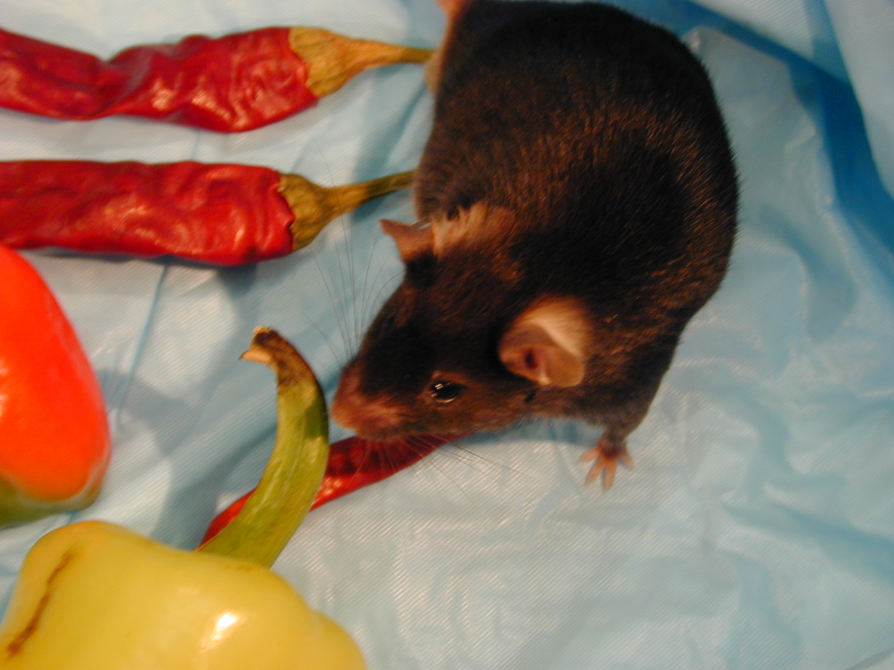
Mice lacking TRPV1 fail to detect capsaicin in their drinking water
TRPV1 +/+
TRPV1 -/-
Caterina et al. 2000

Slide 11
Reduced (but not absent!) heat sensation in mice lacking TRPV1
Wild Type
TRPV1 null
Time to tail removal (s)
Temperature (°C)
Caterina et al. 2000

Slide 12
A spectrum of thermosensitive TRP channels
TRPA1
TRPV3,
TRPV4
TRPM8
TRPV1
TRPV2
TRPM2,
TRPM3,
TRPM4,
TRPM5
Response
ο
1
0
2
0
3
0
4
0
5
0
6
0
C
Temperature (°C)

Slide 13
Heat-sensitive TRPV channel expression in nonneuronal skin cells
TRPV3
Peier et al., 2002 (Patapoutian lab)
Xu et al., 2002 (Clapham lab)
Smith et al., 2002 (Glaxosmithkline)
Guler et al. 2002 J. Neurosci.
Chung et al. 2003 JBC
Chung et al. 2004 JBC
Chung et al. 2005 J. Neurosci.

Slide 14
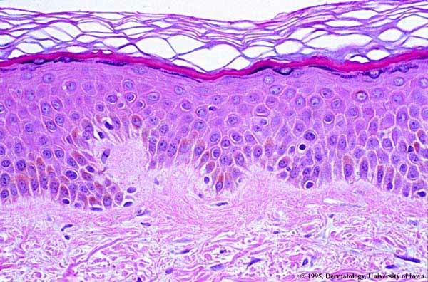
Corneum
Granulosum
Epidermis
Spinosum
Basalis
Dermis
© Dept. of Dermatology / University of Iowa / tray@blue.weeg.uiowa.edu
Zylka et al. (2005) Neuron 45, 17-25

Slide 15
Hypothesis: Keratinocytes initiate an “indirect” pathway
for sensing environmental stimuli such as heat
Skin
Keratinocytes
Sensory
Neuron
Spinal Cord
TRPV3
TRPV4
??????
Heat
stimulus
?
Receptor
TRPV1

Slide 16
Heat evokes release of substances from keratinocytes that
can stimulate or sensitize DRG neurons
Keratinocytes
Collect medium
and cool to 25°C
Apply to DRG Neurons
25°C or
52°C

Slide 17
Heat-evoked release of prostaglandin E2 from keratinocytes is enhanced by overexpression of TRPV3
8E-12
*
7E-12
WT
6E-12
TRPV3 TG
5E-12
PGE2 (mol/mg protein)
4E-12
3E-12
2E-12
1E-12
0
20
25
30
35
40
45
50
Temperature (C)
Huang et al. 2008

Slide 18
Altered thermal selection behavior in mice lacking TRPV3
C57Bl6 WT
C57BL6 TRPV3KO
Preference Index for >29°C
Occupancy (%)
129S6 WT
129S6 TRPV3KO
Temperature (°C)
Huang et al. 2011

Slide 19
Delayed heat-evoked pain in mice lacking
both TRPV3 and TRPV4
WT
V3V4 knockout
Huang et al. 2011

Slide 20
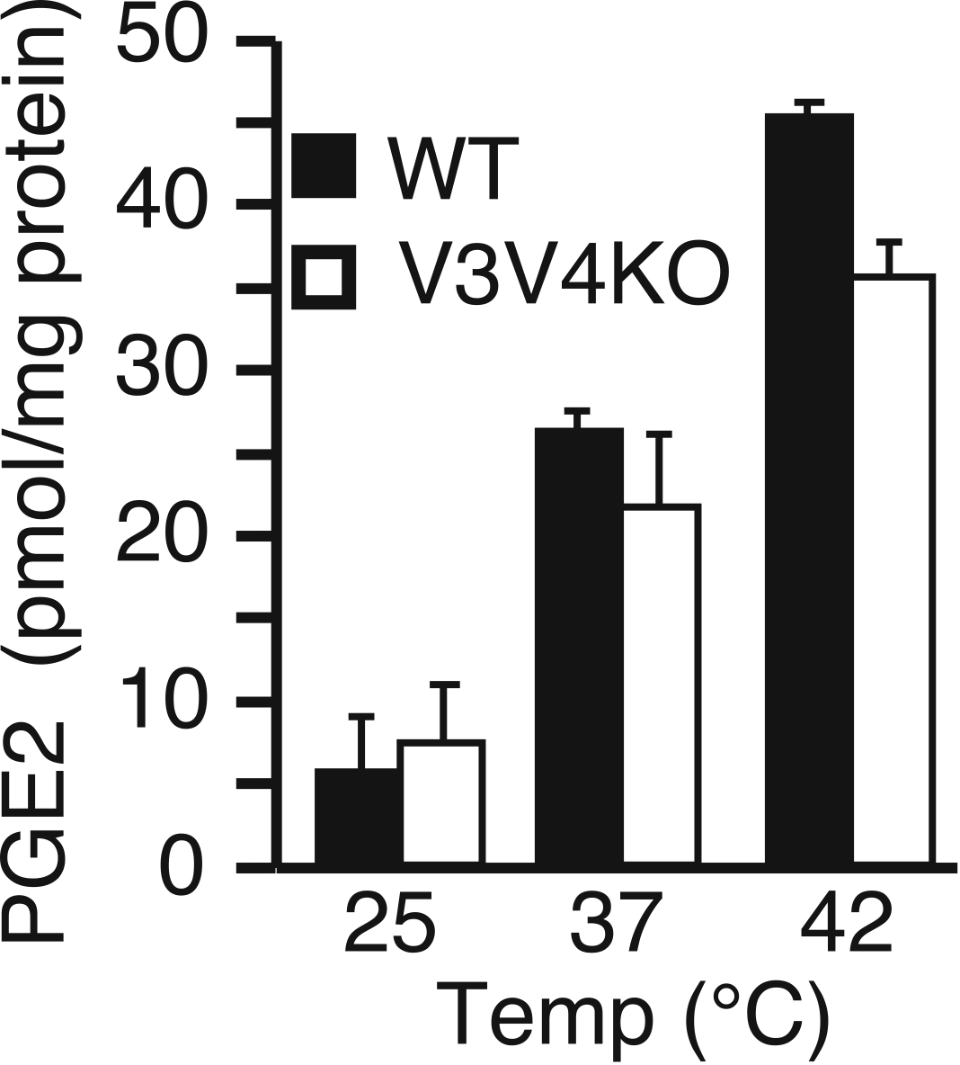
Residual heat detection in keratinocytes
lacking both TRPV3 and TRPV4
Susan Huang

Slide 21
Outstanding questions
What are the non-TRPV3/non-TRPV4 sensors for heat in keratinocytes?
Is keratinocyte stimulation sufficient to trigger the perception of pain in the body?
If so, what are the chemical messengers that mediate this communication
and which neurons/receptors are doing the “listening”?
Do other nonneuronal cells act as “antennae” for the nervous system?

Slide 22
Why should we care about nociceptive signaling
from nonneuronal cells?
Better understanding of causes/contributors to chronic pain and the role of skin diseases in pain sensation
Opportunity to target cells other than neurons might allow us to treat pain with reduced neurological side effects such as respiratory depression or addiction
Topical delivery of therapies to the skin could allow one to use high local concentrations of drug without systemic side effects such as gastrointestinal bleeding

Slide 23
Integration of Basic Pain Research at
Johns Hopkins School of Medicine
Center for Sensory Biology
Blaustein Pain Research Center
Brain Sciences Institute Pain Working Group
Neurosurgery Pain Research Institute

