Slide 1

inHealth Spring Retreat

Slide 2

REDCap at Johns Hopkins
Scott Carey
Senior Software Engineer
ICTR Informatics Core

Slide 3
Folks generally fall into 1 of 4 categories when it comes to understanding REDCap and it’s features…
I had no idea REDCap could do that!
I know I can do this in REDCap, but I’m not sure how to do it.
I know REDCap can do this and I know how to do it!
What’s REDCap?

Slide 4
REDCap Lightning Round
Goals for today:
Understand what REDCap “is” and “is not”
Understand what REDCap can do (not necessarily how to do it)
Understand where to find more information

Slide 5



IRB Expectations for Your Research Project / Data
Stored on a managed JH system
Restricted/controlled access
Appropriate permissions within the project
Audit trail of data and user activity
Well structured interface that facilitates adherence to the project design
Built-in data quality features (data type adherence, valid range checking…)

Slide 6
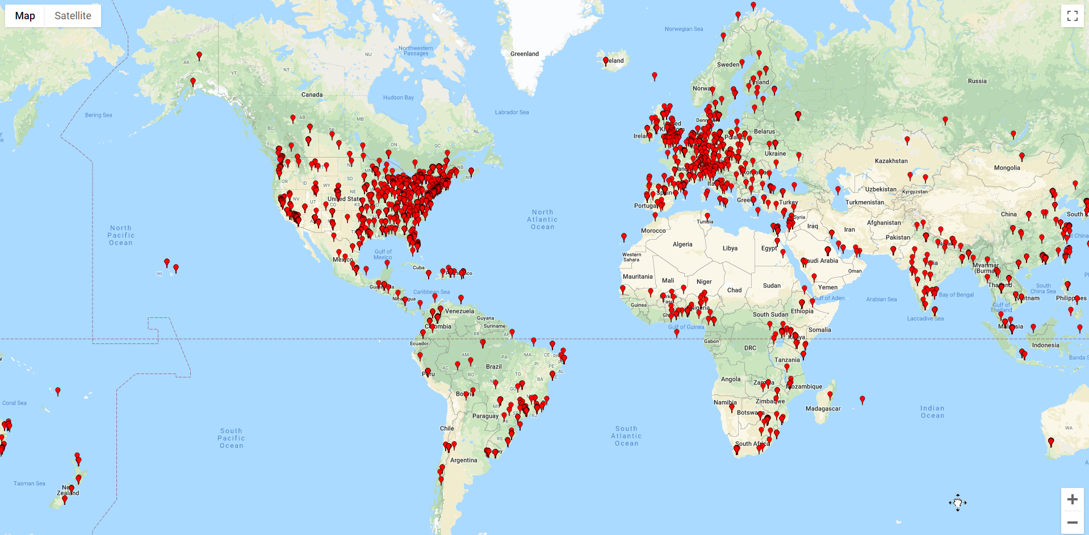
What is REDCap and how can it help?
REDCap: Research Electronic Data Capture
Developed at Vanderbilt University for use by universities and non-profit institutions
A secure web application for building and managing research data environments
Allows for direct data entry (study staff) as well as online surveys (study participants)
Accommodates multi-site collaborative studies via Data Access Groups (DAG’s)
Worldwide:
  ~6000 institutions
  145 countries
  1.5m projects
  2.1m users
JH:
  5700 projects
  14k+ users (~6k active)
JH IRB Approved

Slide 7
REDCap: Key Features
Web-based
Secure
Integrative
Direct entry by staff
Survey-style entry by study participants
Extensive data quality features
JHED Integration
MS Azure (for non-JH study team members)
Extensive user-level permissions
Role-based permissions
Single/Multi-Site Studies
EPIC Notes Interface
Direct EPIC-to-REDCap
OnBase Connector
Multi-Language Features

Slide 8
REDCap: Key Features (cont’d)
Project Types
Tools
Exports
Simple Surveys
One-and-Done
Structured Longitudinal
Unstructured Longitudinal
Automated Survey Invitations
Alerts / Notifications
Workflow Management
Calendar Integration
Mobile App / MyCAP
CSV
SAS
Stata
SPSS
R
RC2SQL (translates a REDCap project into an SQL database where data for each RC instrument is in a separate table)

Slide 9

REDCap at JH
Co-Sponsored (actually tri-sponsored!)
  SPH/SOE (Andre Hackman, Danny Scerpella, Brian Dyer. Gwendolyn Climens…)
  SOM/SON/JHH/Bayview/KKI (Scott Carey, Mike Sherman, Terrence Turner)
  ACH (Nuredin Joehar, Karly Anderson)
    *ACH will be providing a 21 CFR Part 11 compliant instance of REDCap (late summer of 2022?)
3-Tiers
  Bronze:
    No cost… no support
    Intended for smaller, unfunded projects
    Some advanced features not available
  Silver:
    Includes support
    Includes all REDCap features
  Gold:
    Includes additional support
    Very large studies

Slide 10
REDCap Resources
Training Videos
Help Files
Zoom Clinics (all project tiers)
1-on-1 Support (Silver / Gold tiers)
Online Support (JH REDCap Training Central)
www.redcap.jhu.edu

Slide 11

Let’s Look at a Few Screenshots

Slide 12
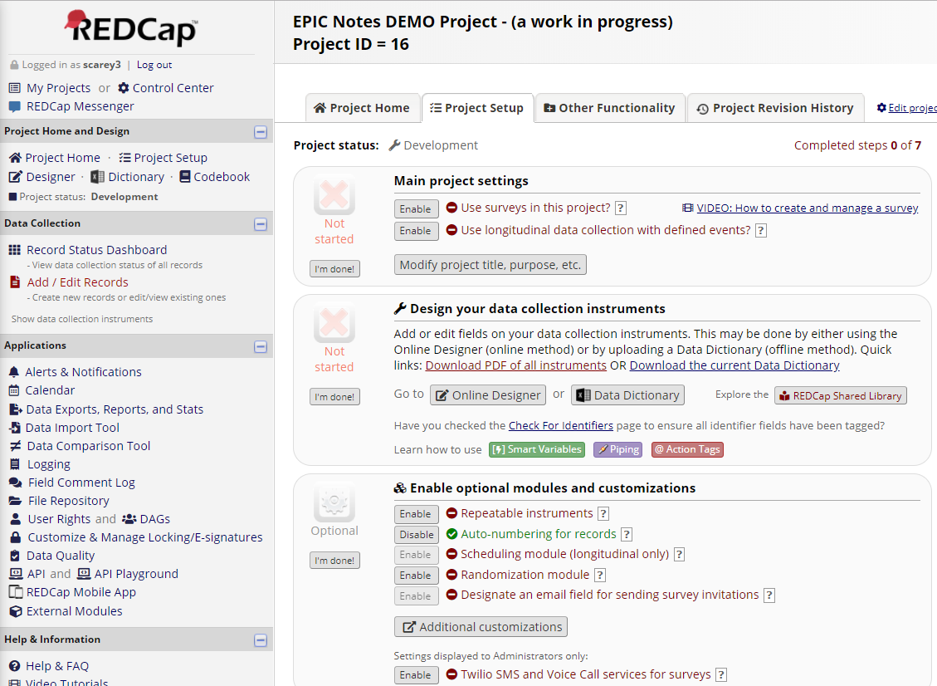
Project Setup (guided development)

Slide 13
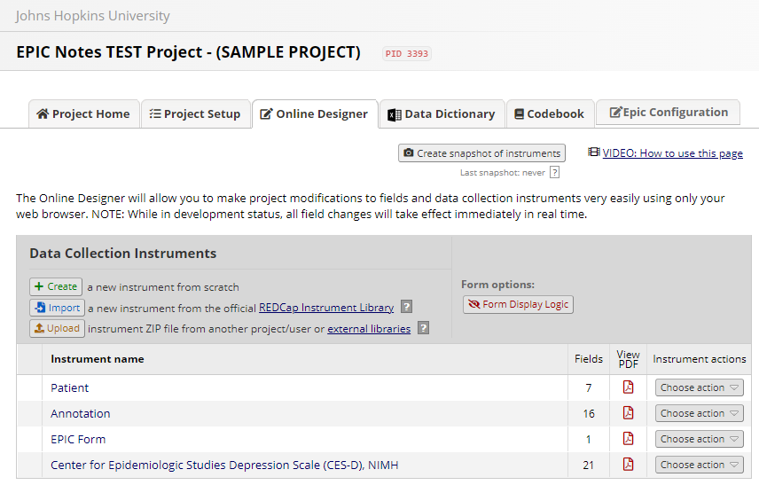
Project Setup (data collection instruments)

Slide 14
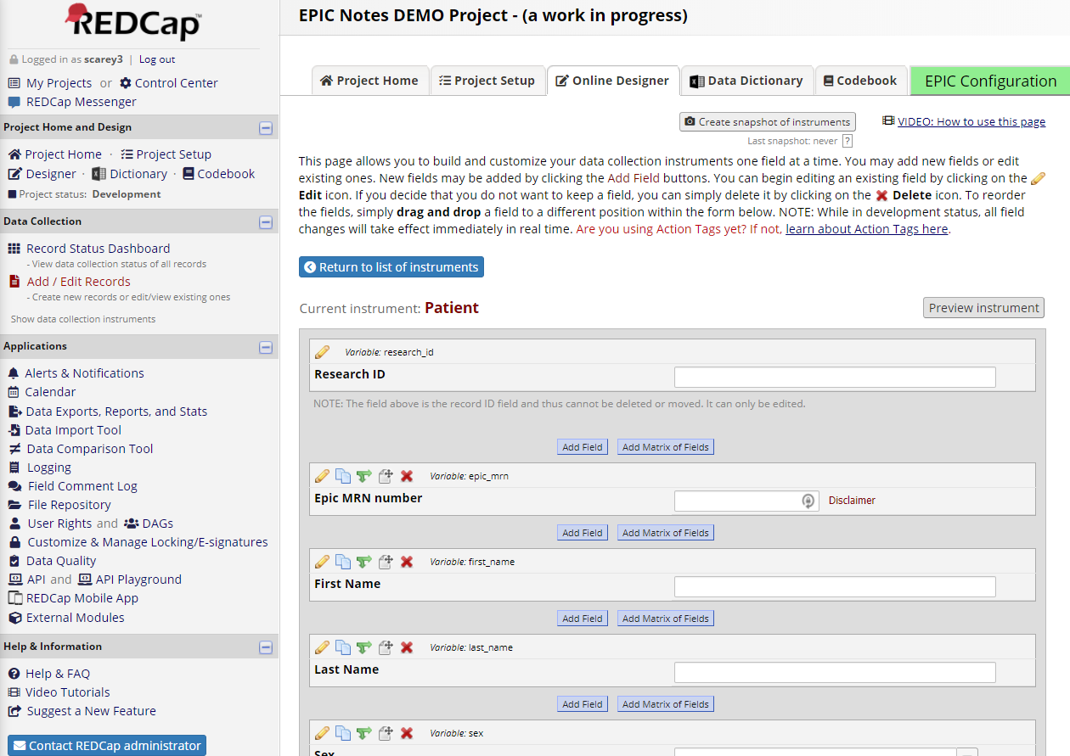
Project Setup (instrument development)

Slide 15
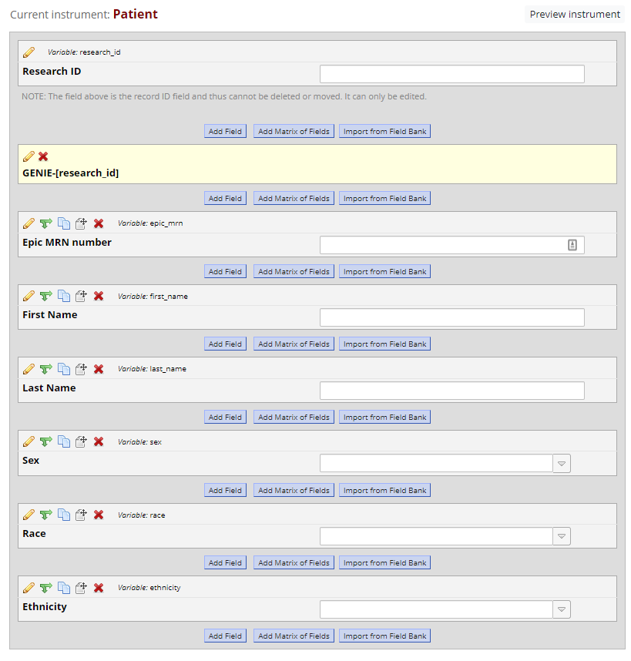
Project Setup (adding fields)

Slide 16
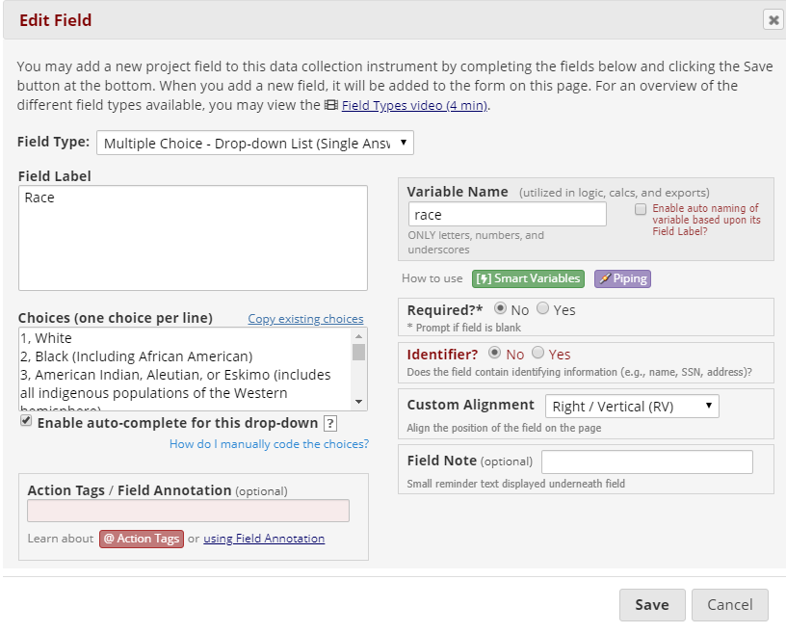
Project Setup (configuring fields)

Slide 17
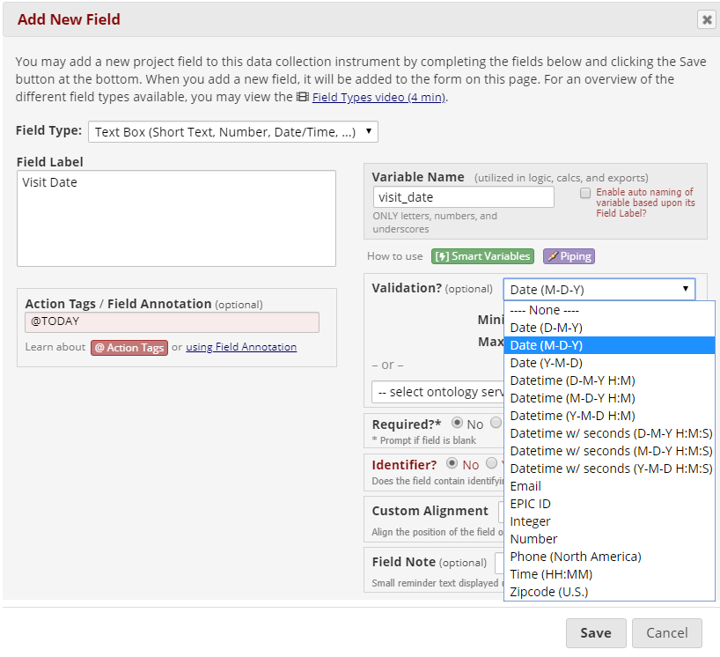
Project Setup (field validation)

Slide 18
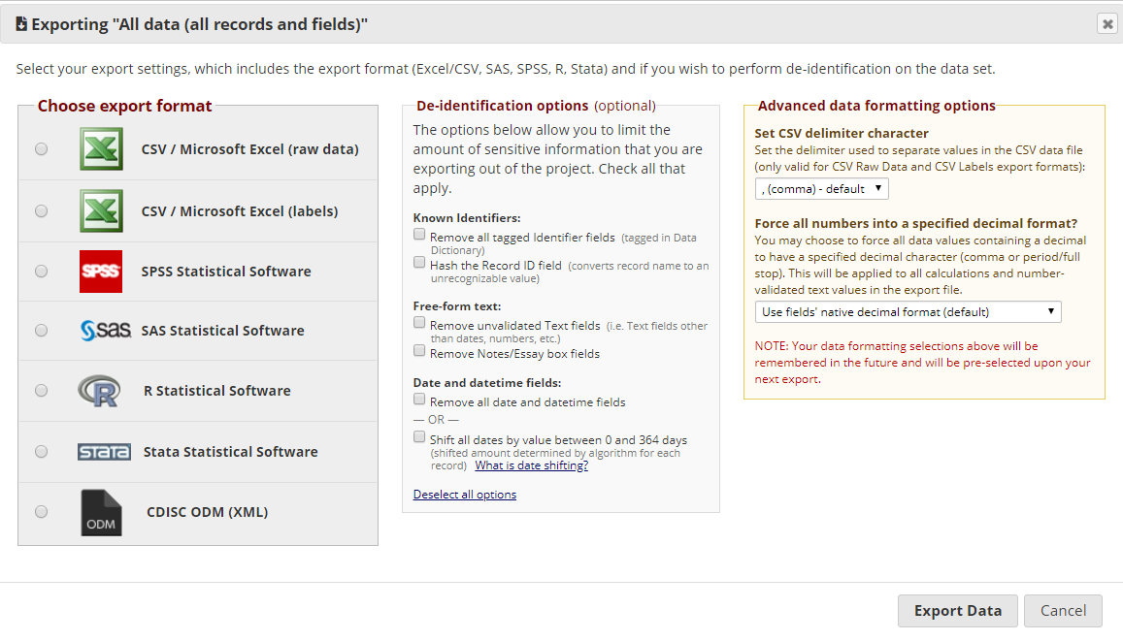
Project Setup (exporting data)

Slide 19

What’s New in REDCap?
It depends on the day!

Slide 20
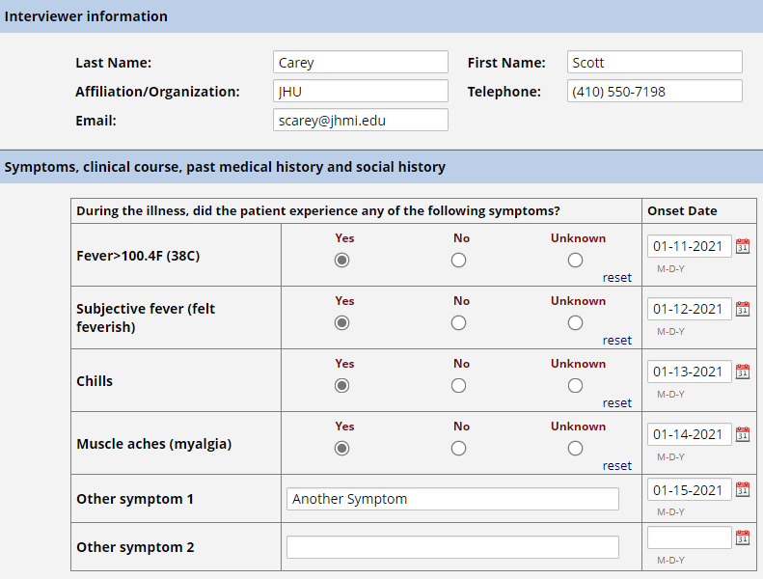
Field Embedding

Slide 21
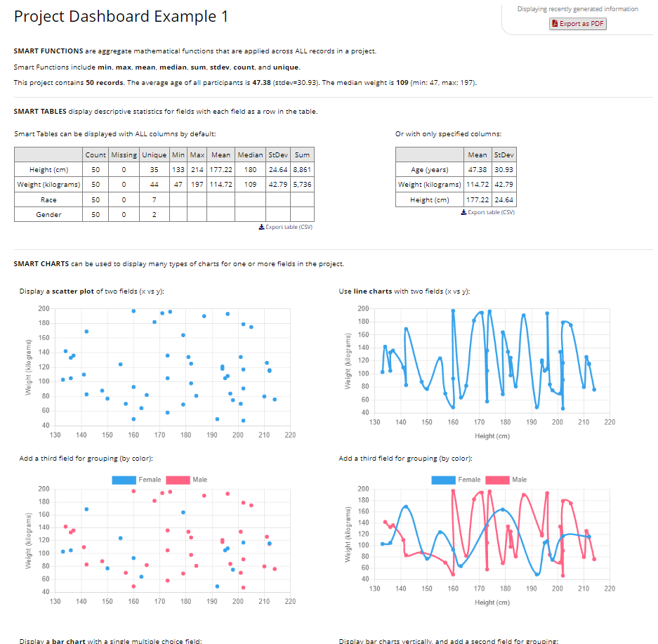
Project Dashboards (overview of project)

Slide 22
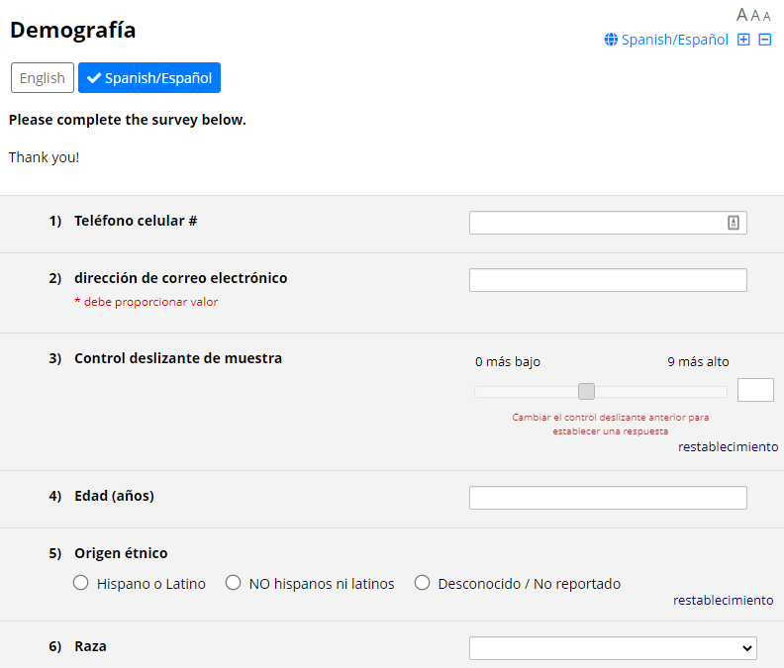
Multi-Language Management

Slide 23
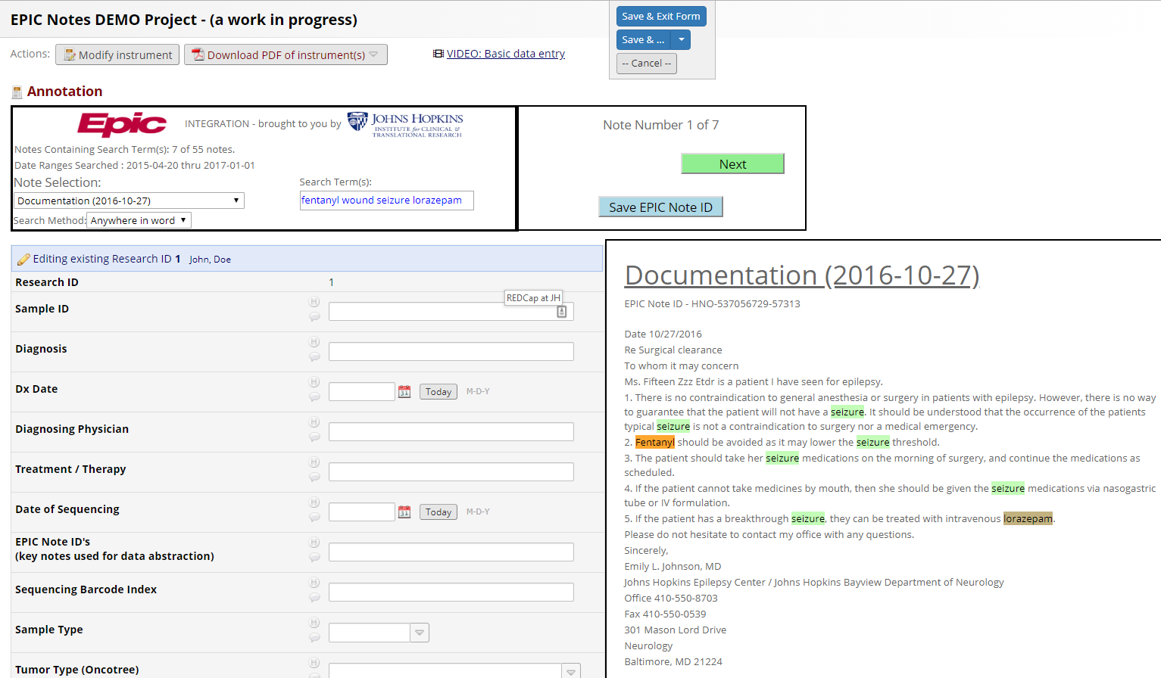
EPIC Notes Integration

Slide 24
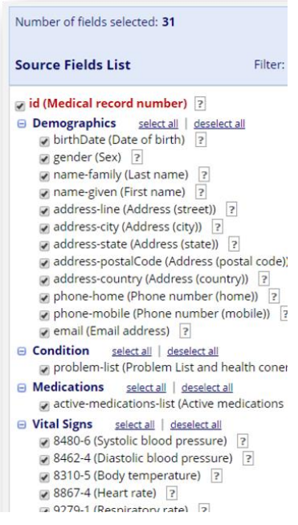
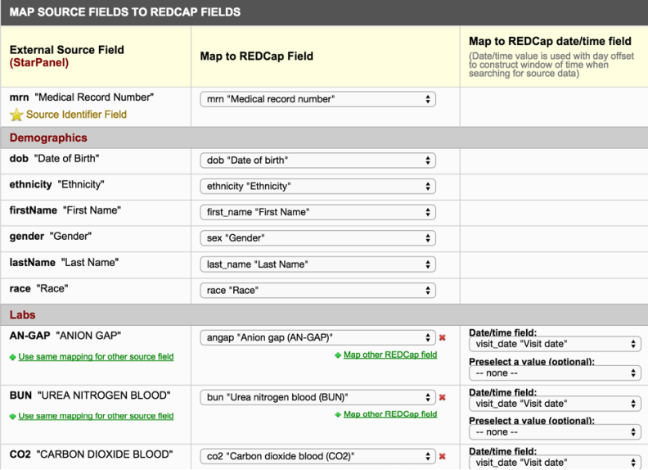
EPIC-to-REDCap Field Mapping
Select Fields From EPIC
Specify Mappings to Associated Fields In REDCap

Slide 25
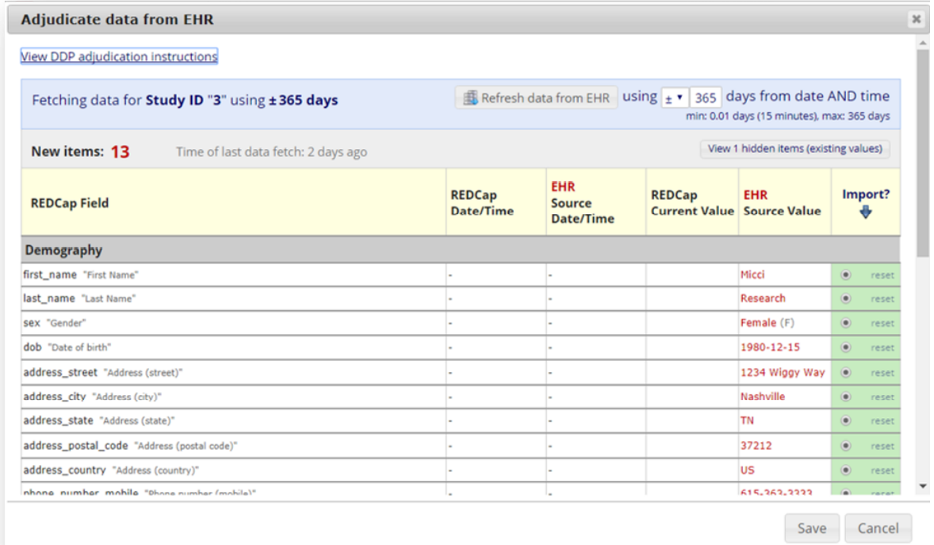
EPIC-to-REDCap Field Mapping
Review & Approve REDCap Updates From EPIC

Slide 26
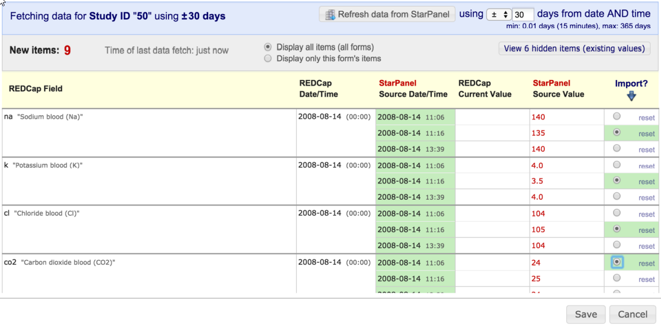
EPIC-to-REDCap Field Mapping
Example: Adjudicating Labs

Slide 27
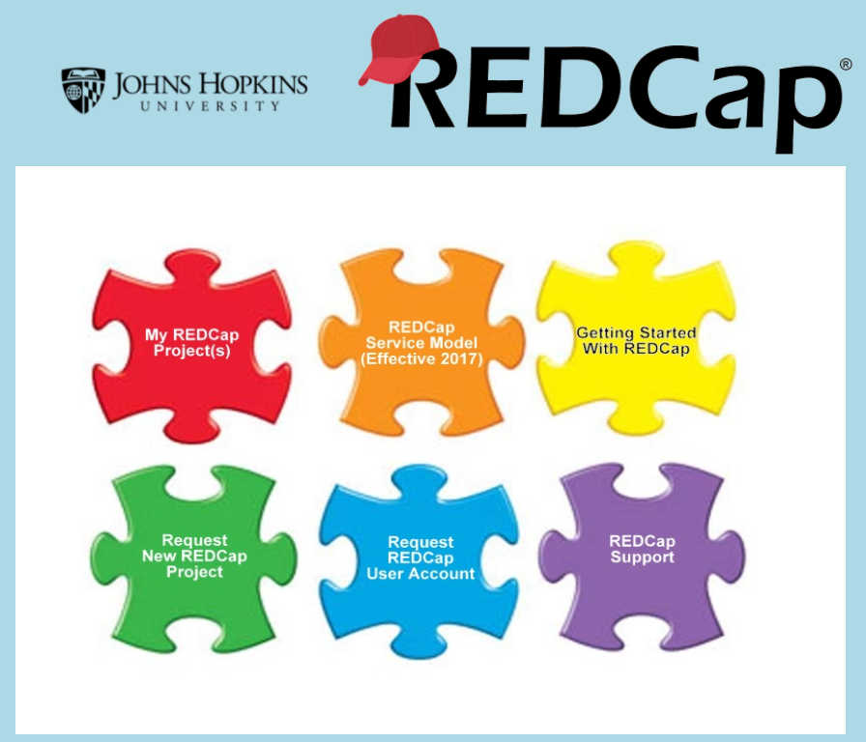
How do I get started?
Easy!
Visit www.redcap.jhu.edu
Click on Getting Started w/ REDCap

Slide 28

Questions?
scarey@jhmi.edu

