Slide 1

inHealth Spring Retreat

Slide 2






NICU Precision Medicine Center of Excellence:
Neonatal Brain Injury

Slide 3
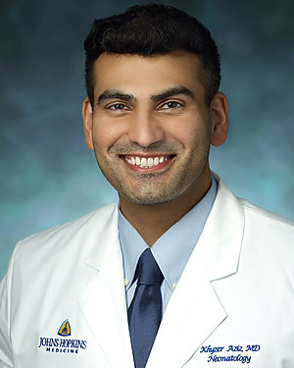


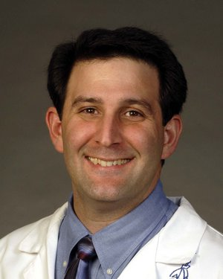

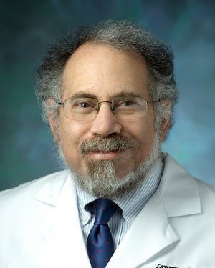

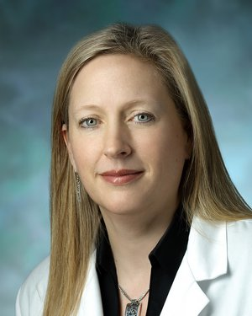

NICU PMCOE
K. Aziz, MD
A. Everett, MD
E. Graham, MD
A. Guerrerio, MD, PhD
P. Nagy, PhD
A. Nishimura, MS, PhD
L. Nogee, MD
F. Northington, MD
J. Sheffield , MD
J. Wynn , MD
PMCOE Goal: Development of the infrastructure and expertise that will allow for personalized
evaluation, counseling, and management of neonates at risk for brain injury.

Slide 4
OMOP? OHDSI? CDM?
Observational Medical Outcomes Partnership (OMOP)
Observational Health Data Sciences & Informatics (OHDSI)
Common Data Model (CDM)

Slide 5

LIVE DEMO
Atlas.pm.jh.edu

Slide 6
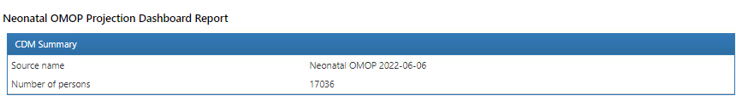
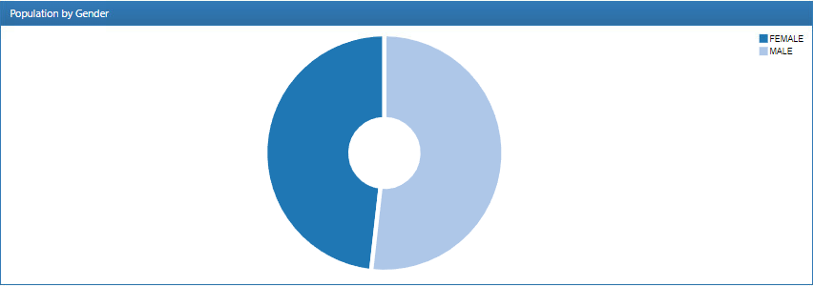
Live Demo Fail !

Slide 7
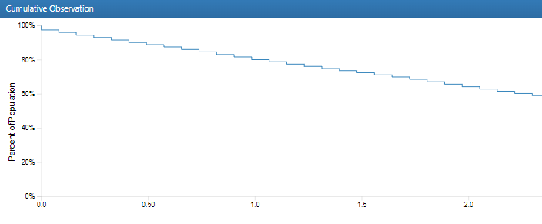

Slide 8
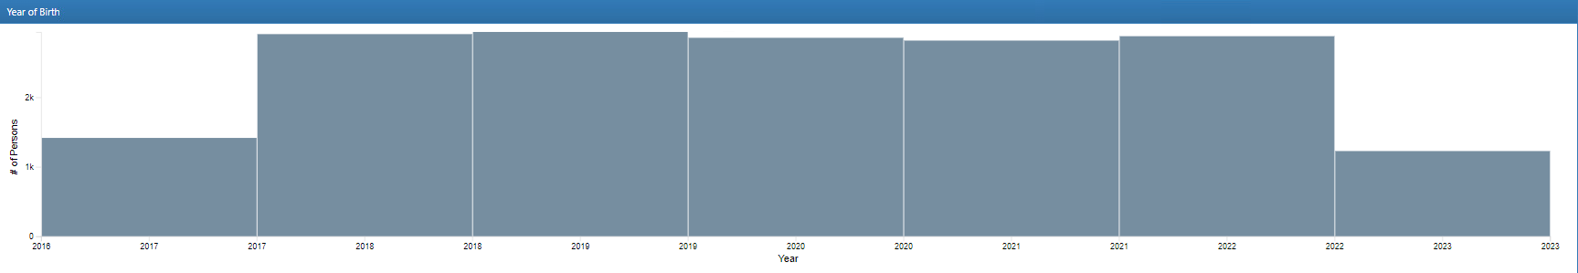
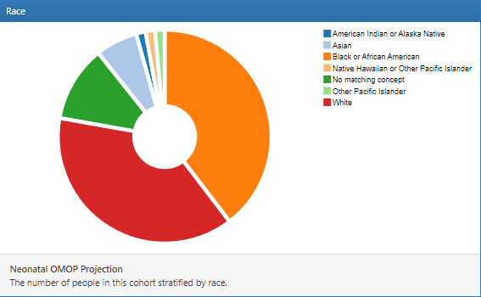
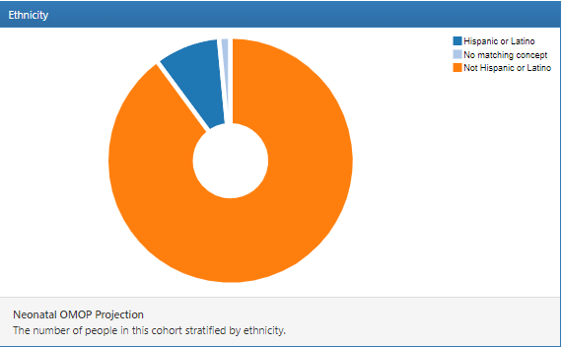

Slide 9
Concept ID | Name | Person Count | Prevalence | Records per person
9201 | Inpatient Visit | 17,034 | 99.99% | 1.22
9202 | Outpatient Visit | 13,690 | 80.36% | 19.96
9203 | Emergency Room | 5,976 | 35.08% | 2.76
5083 | Telehealth | 3,296 | 19.35% | 2.32
581476 | Home Visit | 1,466 | 8.61% | 20.65
0 | No matching concept | 10 | 0.06% | 1.3

Slide 10
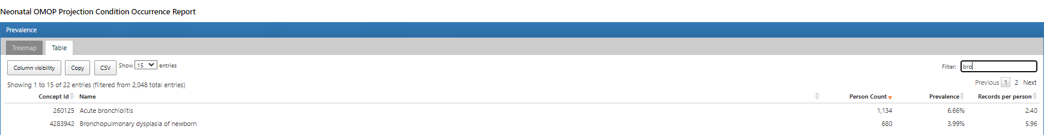

Slide 11
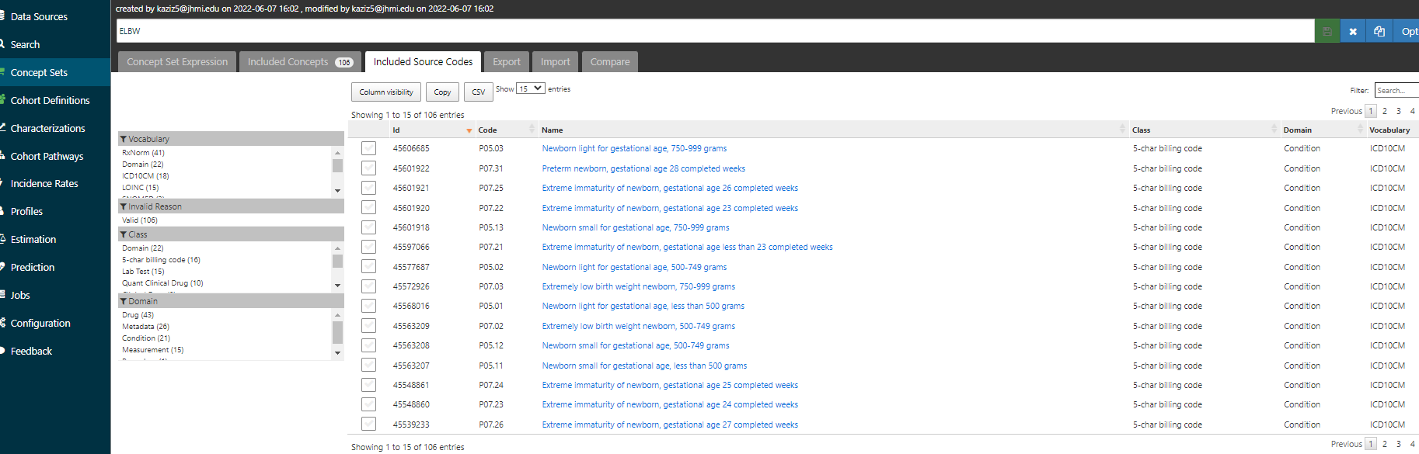


Slide 12
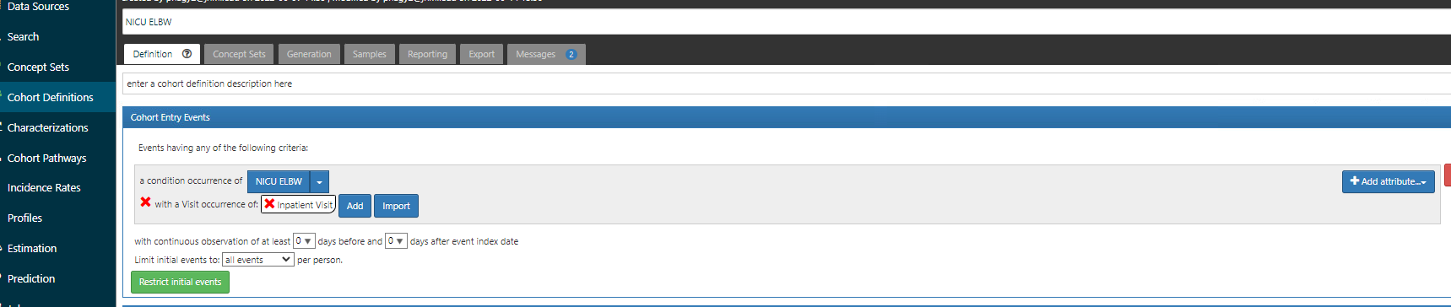

Slide 13
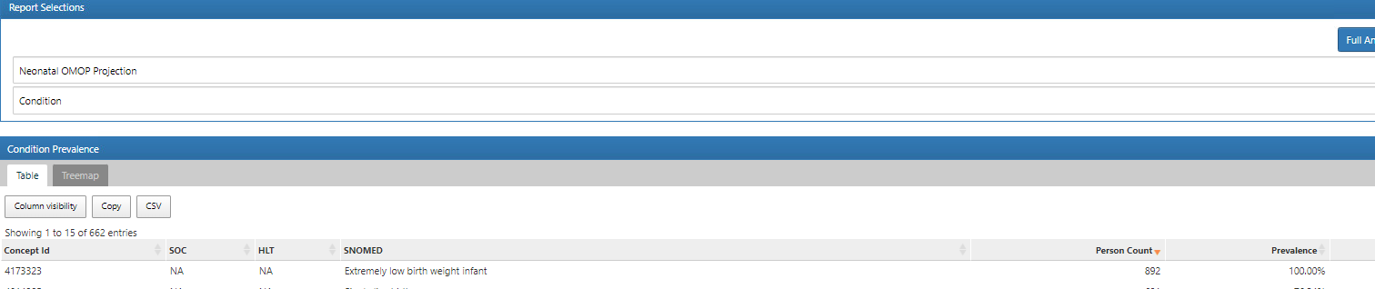

Slide 15
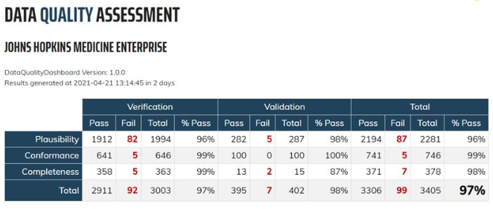

Slide 16



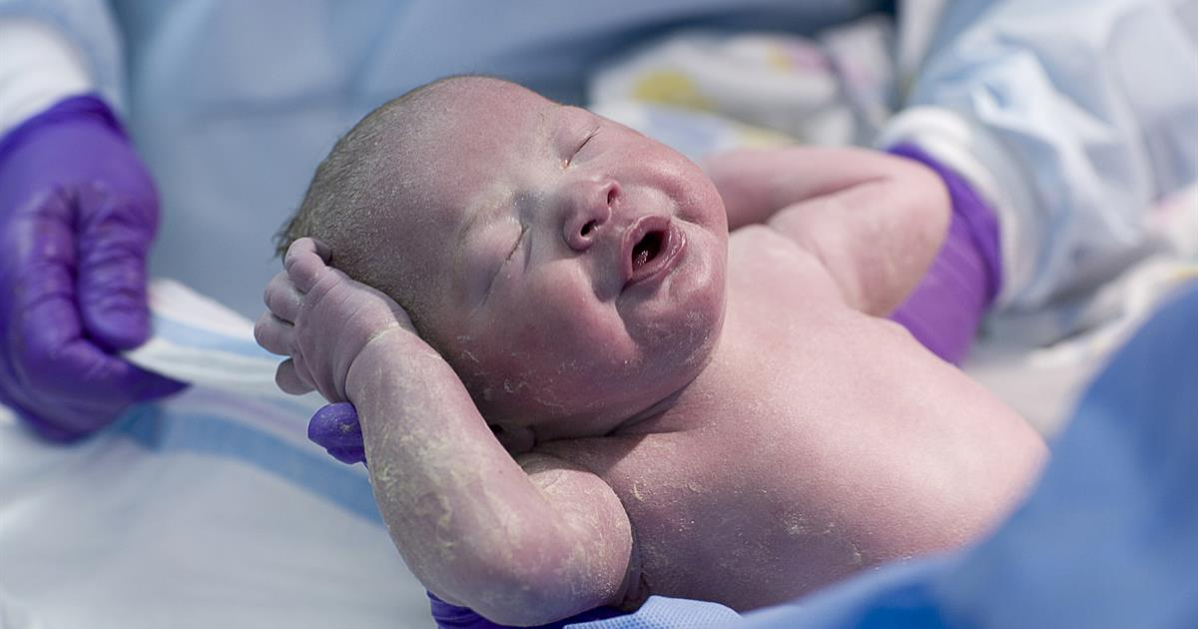



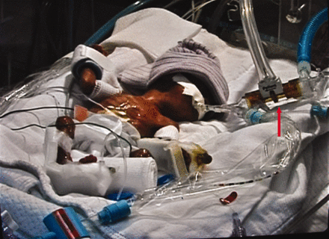
Current Practices
3 days
DC
3 weeks
DC
DC
3 months

Slide 17
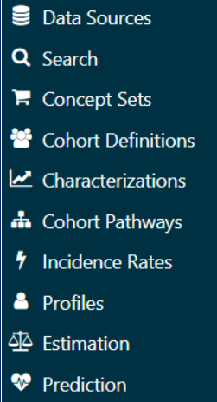
Standardize neonatal data collection via OMOP/OHDSI
JHM
OMOP
Atlas-prime
PMCOE
eFormR
Registry
eFormS
Researchers
Cohort Definition
NICU-PMCOE
Data Element Definition
Data Source
Cohort Definition
Data Source
Projection
Service
NICU PMCOE
OMOP
Data Element Definition
Manual
Dataset
creation
NICU PMCOE_IRB_XYZ_DATE
PMAP

Slide 18

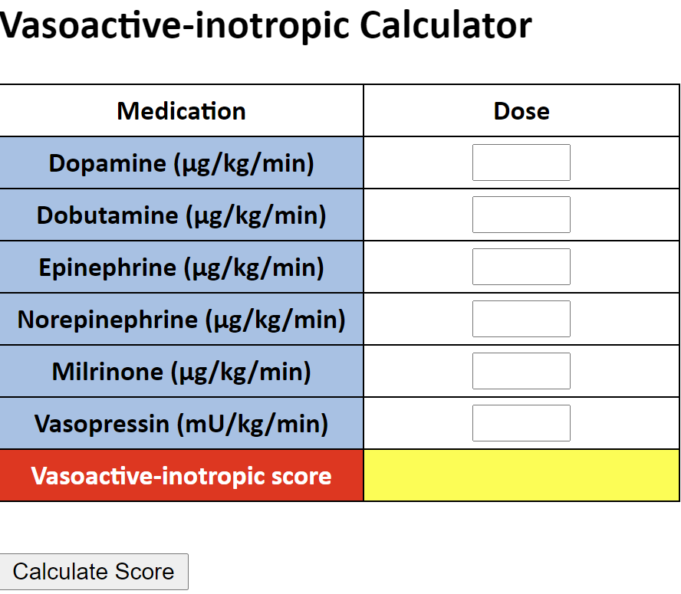
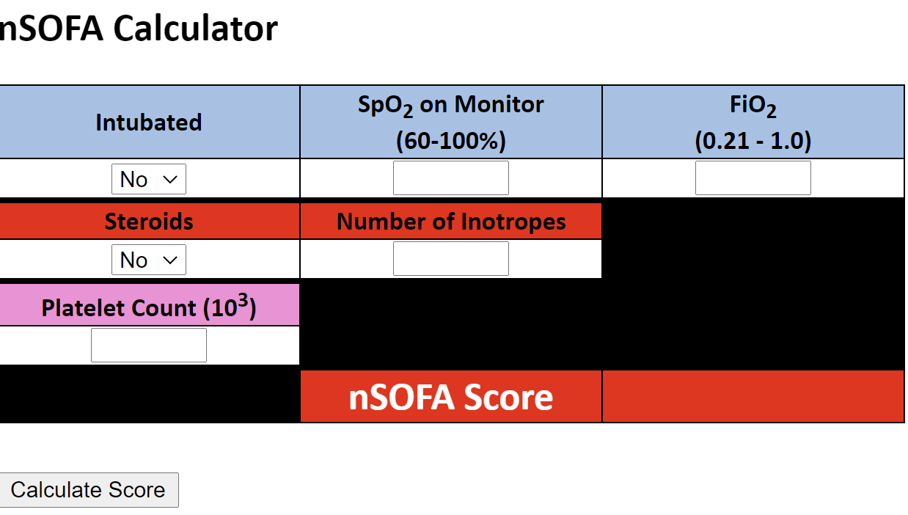
Standardize neonatal data collection via OHDSI OMOP CDM
Standardize measures of neonatal severity of illness
  nSOFA & VIS
Standardize →Define at scale →Change the research paradigm
  Improved subgrouping of neonatal patients by disease and individual severity of illness
    Earlier identification within subgroup of patients
    Response to treatment
    More targeted treatments
Feasibility
  National Covid Registry (N3C)
  OHDSI Community/Paul Nagy
  Multiple nSOFA and VIS publications

Slide 19
Standardize neonatal data collection
  OHDSI OMOP CDM
Standardize measures of neonatal severity of illness
  nSOFA & VIS
Standardize →Define at scale →Change the research paradigm
  Improved subgrouping of neonatal patients by disease and individual severity of illness
    Earlier identification within subgroup of patients
    Response to treatment
    More targeted treatments

Slide 20
JHM
OMOP
Atlas-prime
Cohort Definition
Data Element Definition
Projection Service
Access control to the database and to Atlas is tied to Active Directory under control by CCDA
PMAP

Slide 21
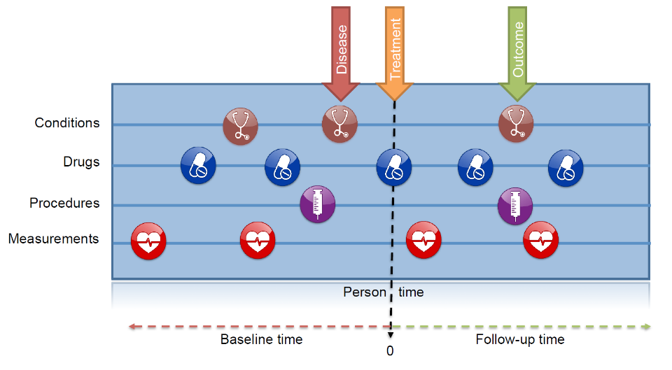
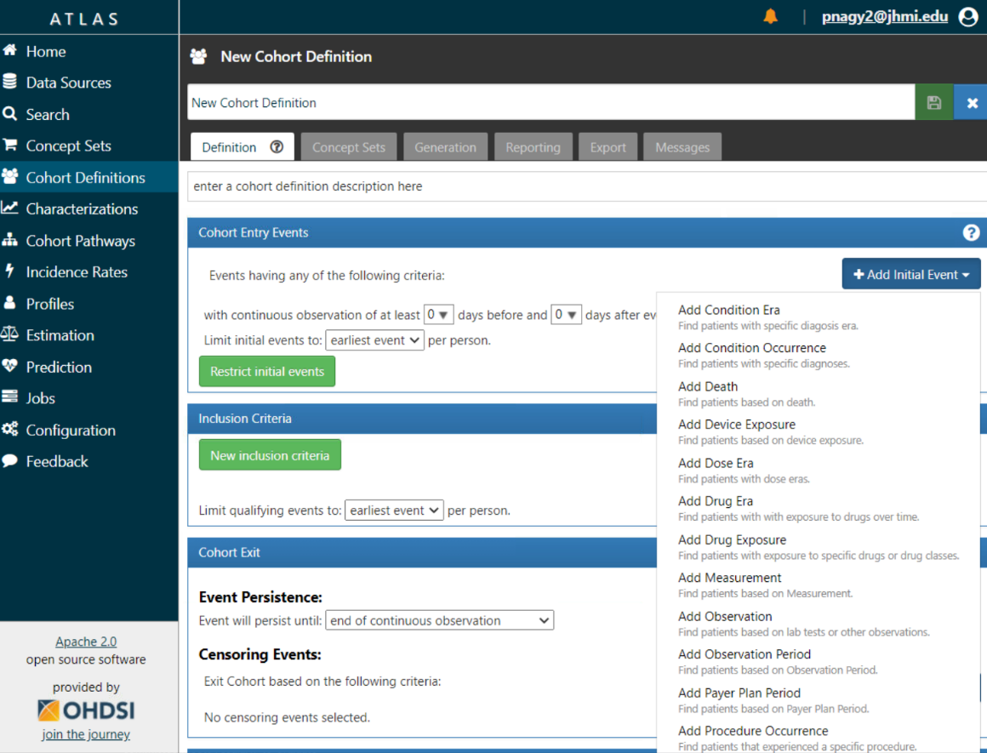
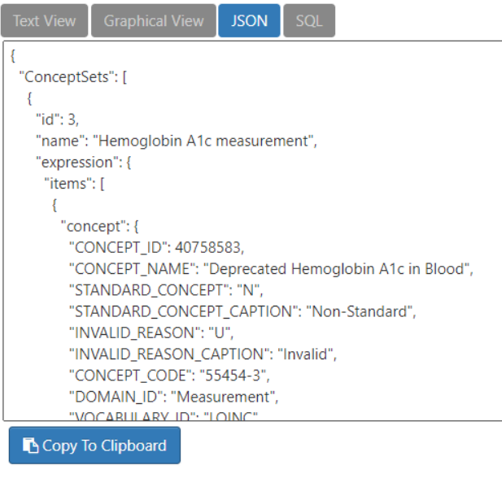
A computable Inclusion/exclusion criteria for events to identify a list of patients for a period of time.
JHM
OMOP
Atlas-prime
Cohort Definition
Data Element Definition
Projection
Service
Access control to the database and to Atlas is tied to Active Directory under control by CCDA
PMAP

Slide 22
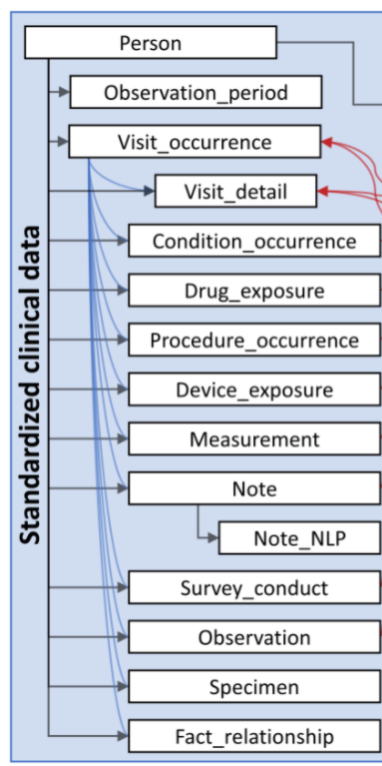
A computable list of which data elements/concepts to be included
JHM
OMOP
Atlas-prime
Cohort Definition
Data Specification:
Conditions:
Visit_occurrence: Outpatient only
Drug_exposure: *
Note: -
Measurements:
Observation:
Specimen: -
Data Element Definition
Projection
Service
PMAP

Slide 23

JHM
OMOP
Atlas-prime
Cohort Definition
Database Projector
Takes a cohort definition (list of patients) and a data specification to project that data to a database at a regular interval.
Data Element Definition
Projection
Service
PMCOE
OMOP
PMAP

Slide 24
JHM
OMOP
Atlas-prime
PMCOE
eFormR
Registry
Cohort Definition
Atlas-PMCOE
Data Element Definition
Data Source
Access control to the database and to Atlas is tied to Active Directory of the PMCOE
Projection
Service
PMCOE
OMOP
PMAP

Slide 25
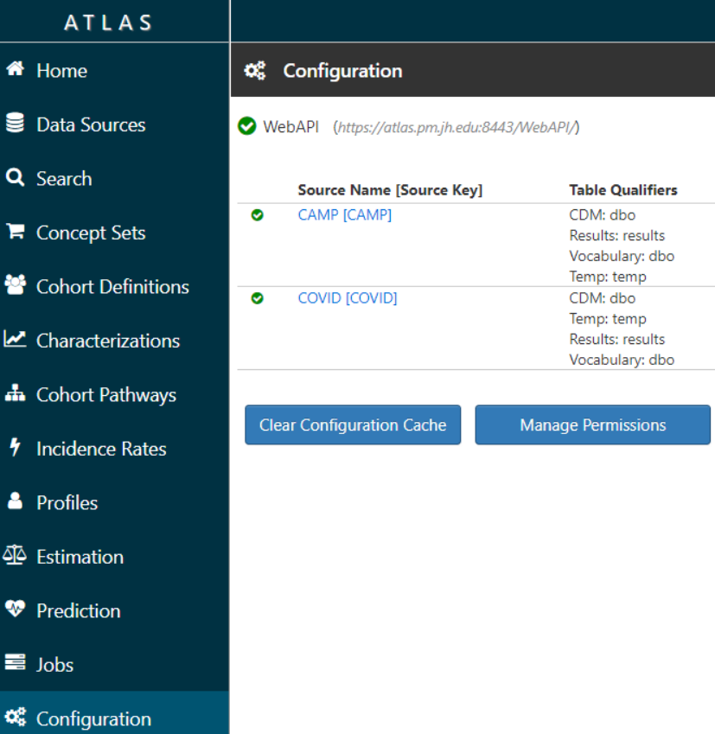
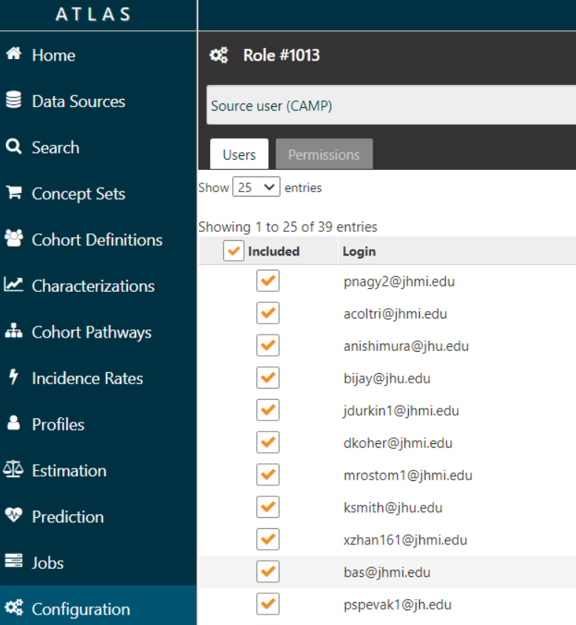
Atlas Controlling access by Data Source

Slide 26
eFormS
Researchers
JHM
OMOP
Atlas-prime
PMCOE
eFormR
Registry
Cohort Definition
Atlas-PMCOE
Data Element Definition
Data Source
Cohort Definition
Data Source
Projection
Service
PMCOE
OMOP
Data Element Definition
Manual
Dataset
creation
PMCOE_IRB_XYZ_DATE
PMAP

Slide 27
Limitations
Jargon
Medication Dosing
Row level data
View Tables
Graphics package
Absence of mapping does not mean absence of disease, drug, condition, etc
Mapping will never be “perfect”

Slide 28
Thank You!
Questions?

