Slide 1

inHealth Spring Retreat
UNDERSTANDING PMAP MEDICATION TABLES: Insights to be gained
Brant Chee, MS, PhD
Kerry Smith

Slide 2
EMR Medications Workflow
1
2
RxNorm Overview
Agenda
Gotchas
3
4
What’s Next?

Slide 3
EMR Medications Workflow
First Databank
Medication Names
Pharmaceutical and Therapeutic Classes
RxNorm Codes
Chronicles to Clarity
Orders
MAR (Administration)
Dispense
PMAP
OMOP
RxNorm Codes to OMOP Concepts
Med orders
Med admin
Custom meds
Current meds
Treatment plans
RxNorm codes
FDB sends pharmaceutical and therapeutic class as well as RxNorm codes*
Includes only meds that have an RxNorm code (or proxy has one)*
Handles logic to pull RxNorm from the “proxy” meds for custom meds
Limited to >= 7/1/2016
* = see the gotchas slide
Notes:
FDB = Hopkins' 3rd party vendor for all commercially available medications. NDCs are attached to the GPI (general product identifier) - generic medication.
FDB sends pharmaceutical classes, therapeutic classes, and RxNorm codes. Other fields include a Y/N for investigational drug, form, strength, and route. Epic also has groupers that categorize medications for easier reporting.
Sometimes, medications are cloned from FDB, resulting in a custom med. We need to be careful when reporting on these meds because they won't have the RxNorm or other metadata associated with them. We have to link to the "proxy med", or the FDB med

Slide 4
Overview of Medication Tables in PMAP
(Mostly based on optimized versions of tables from Clarity)
Order_med
All medication orders placed by JH Drs
Patient reported medications*
MedOrder_Components
Information about individual components of mixed medications.
Clarity_Medications
("the mother")
to PMAP
Record of medication reconciliation
  Taking/not taking
  Recorded at each encounter
Pat_enc_curr_meds
Dictionary table, full list of all medication records.
Unique medication IDs for each specific formulary of a medication.
Info about pharm and therapeutic classes is extracted from this table and associated tables and included in the derived tables in PMAP.
Med_admin
All recorded administrations of medications to patients (MAR)*
Treatment Plan Orders
Contains but not limited to medication orders placed from treatment plans.
RxNorm
Brant will explain :)
* = see the gotchas slide

Slide 5
RxNorm
RxNorm is two things (developed by NLM):
  Normalized naming system for generic and branded drugs
  A tool for supporting semantic interoperation between drug terminologies and pharmacy knowledge base systems.
Purpose of RxNorm
  RxNorm provides normalized names and unique identifiers for medicines and drugs.
  Enable computer systems to communicate drug-related information efficiently and unambiguously.
Scope of RxNorm
  Names of prescription and many over-the-counter drugs available in the United States. RxNorm includes generic and branded:
    Clinical drugs - pharmaceutical products given to (or taken by) a patient with therapeutic intent
    Drug packs - packs that contain multiple drugs, or drugs designed to be administered in a specified sequence
Non-therapeutic radiopharmaceuticals, bulk powders, contrast media, food, dietary supplements, and medical devices are all out-of-scope for RxNorm.
Medical devices include but are not limited to bandages and crutches.
https://www.nlm.nih.gov/research/umls/rxnorm/overview.html

Slide 6
RxNorm Names/Relationships
Graph based
In addition to the fully complete clinical drug names (ingredient, strength, and dose form):
  ingredient / precise ingredient / multiple ingredients
  ingredient + strength
  ingredient + dose form / ingredient + dose form group
Along with the RxNorm fully-specified name 'Naproxen 250 MG Oral Tablet', NLM creates:
  'Naproxen'
  'Naproxen 250 MG'
  'Naproxen Oral Tablet' / 'Naproxen Oral Products' / 'Naproxen Pills'
RxNorm Relationships:
  'Naproxen 250 MG Oral Tablet' has_dose_form 'Oral Tablet'
  'Naproxen' ingredient_of 'Naproxen 250 MG'
  'Naproxen 250 MG Oral Tablet' isa 'Naproxen Oral Tablet'
  'Naproxen Pills' has_ingredient 'Naproxen'

Slide 7
Data Sources
Source | Source Abbreviation (SAB)
Anatomical Therapeutic Chemical Classification System | ATC
Vaccines Administered | CVX
DrugBank | DRUGBANK
Gold Standard Drug Database | GS
Medi-Span Master Drug Data Base* | MDDB
Multum MediSource Lexicon | MMSL
Micromedex RED BOOK | MMX
Medical Subject Headings (MeSH) | MSH
CMS Formulary Reference File | MTHCMSFRF
FDA Structured Product Labels | MTHSPL
FDB MedKnowledge (formerly NDDF Plus) | NDDF
RxNorm Normalized Names and Codes | RXNORM
US Edition of SNOMED CT (drug information) | SNOMEDCT_US
USP Compendial Nomenclature | USP
Veterans Health Administration National Drug File | VANDF
Preserved from sources
  Meanings
  Drug names
  Attributes
  Relationships

Slide 8
RxNorm Term Types (TTYs)
TTY | Name | Description | Example
IN | Ingredient | A compound or moiety that gives the drug its distinctive clinical properties. Ingredients generally use the United States Adopted Name (USAN). | Fluoxetine
PIN | Precise Ingredient | A specified form of the ingredient that may or may not be clinically active. Most precise ingredients are salt or isomer forms. | Fluoxetine Hydrochloride
MIN | Multiple Ingredients | Two or more ingredients appearing together in a single drug preparation, created from SCDF. In rare cases when IN/PIN or PIN/PIN combinations of the same base ingredient exist, created from SCD. | Fluoxetine / Olanzapine
DF | Dose Form | See Appendix 2 for a full list of Dose Forms. | Oral Solution
DFG | Dose Form Group | See Appendix 3 for a full list of Dose Form Groups. | Oral Liquid
SCDC | Semantic Clinical Drug Component | Ingredient + Strength | Fluoxetine 4 MG/ML
SCDF | Semantic Clinical Drug Form | Ingredient + Dose Form | Fluoxetine Oral Solution
SCDG | Semantic Clinical Dose Form Group | Ingredient + Dose Form Group | Fluoxetine Oral Product
SCD | Semantic Clinical Drug | Ingredient + Strength + Dose Form | Fluoxetine 4 MG/ML Oral Solution
BN | Brand Name | A proprietary name for a family of products containing a specific active ingredient. | Prozac
SBDC | Semantic Branded Drug Component | Ingredient + Strength + Brand Name | Fluoxetine 4 MG/ML [Prozac]
SBDF | Semantic Branded Drug Form | Ingredient + Dose Form + Brand Name | Fluoxetine Oral Solution [Prozac]
SBDG | Semantic Branded Dose Form Group | Brand Name + Dose Form Group | Prozac Pill
SBD | Semantic Branded Drug | Ingredient + Strength + Dose Form + Brand Name | Fluoxetine 4 MG/ML Oral Solution [Prozac]
PSN | Prescribable Name | Synonym of another TTY, given for clarity and for display purposes in electronic prescribing applications. Only one PSN per concept. | Leena 28 Day Pack
SY | Synonym | Synonym of another TTY, given for clarity. | Prozac 4 MG/ML Oral Solution
TMSY | Tall Man Lettering Synonym | Tall Man Lettering synonym of another TTY, given to distinguish between commonly confused drugs. | FLUoxetine 10 MG Oral Capsule [PROzac]
BPCK | Brand Name Pack | {# (Ingredient Strength Dose Form) / # (Ingredient Strength Dose Form)} Pack [Brand Name] | {12 (Ethinyl Estradiol 0.035 MG / Norethindrone 0.5 MG Oral Tablet) / 9 (Ethinyl Estradiol 0.035 MG / Norethindrone 1 MG Oral Tablet) / 7 (Inert Ingredients 1 MG Oral Tablet) } Pack [Leena 28 Day]
GPCK | Generic Pack | {# (Ingredient + Strength + Dose Form) / # (Ingredient + Strength + Dose Form)} Pack | {11 (varenicline 0.5 MG Oral Tablet) / 42 (varenicline 1 MG Oral Tablet) } Pack

Slide 9
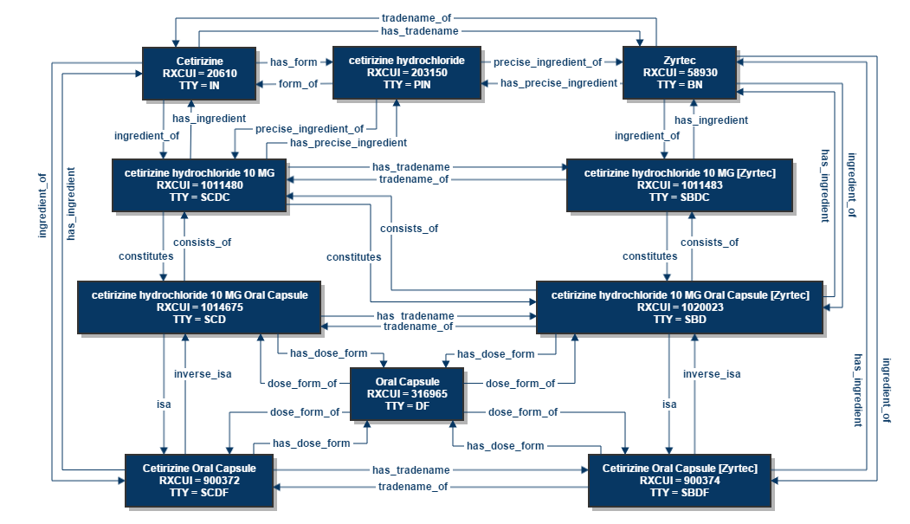
Relationships

Slide 10
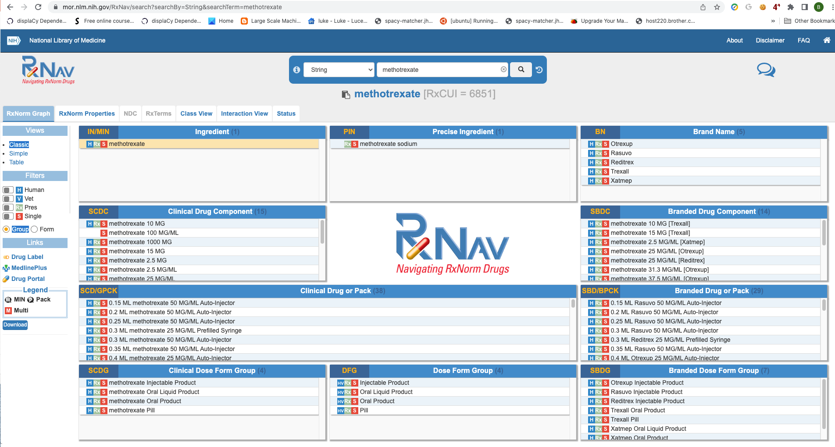
Navigation
Lookup specific ingredient or brand name
Get various
  pack
  form
  dose group
  brand names
View Interactions
View Class/Graph
https://mor.nlm.nih.gov/RxNav/

Slide 11
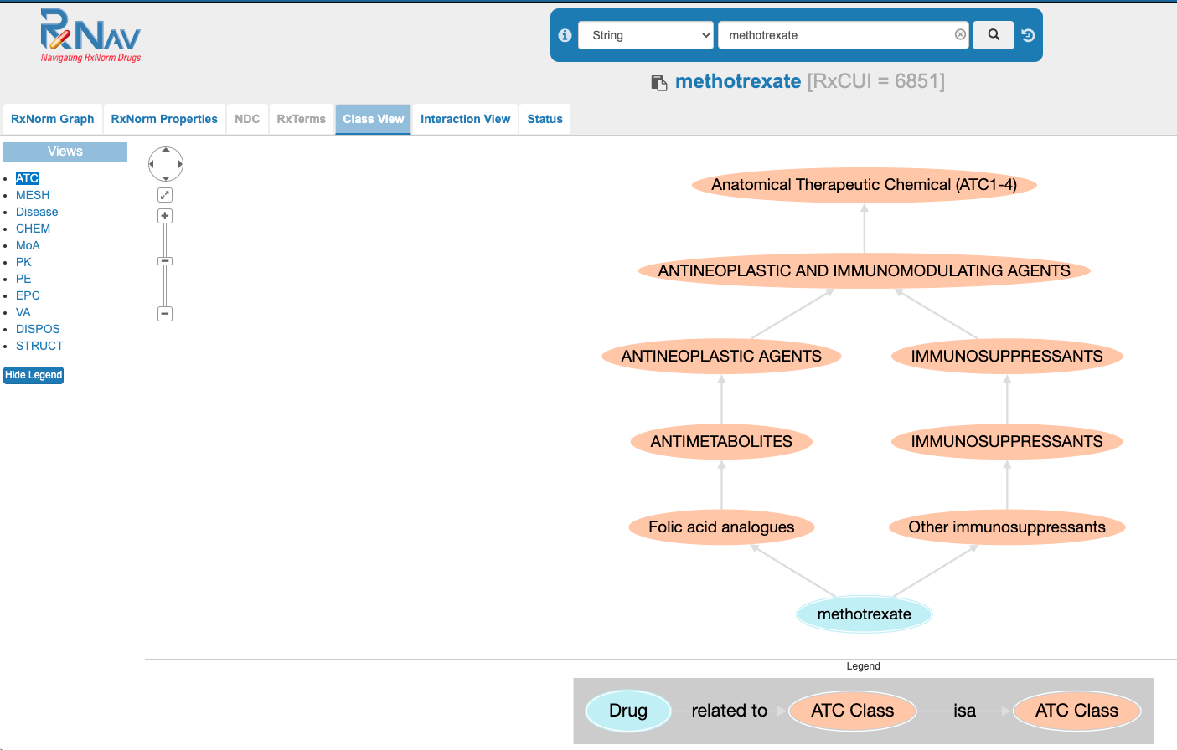
RxNav Class View

Slide 12
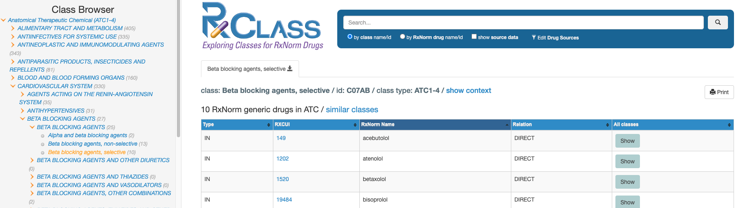
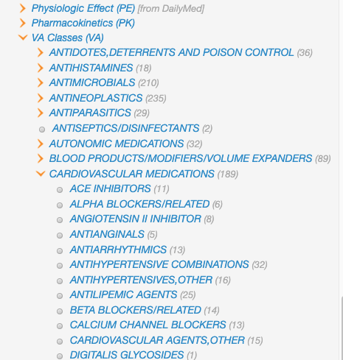
RxClass
Search by ATC/VA/Other classes
Medications are in multiple classes!

Slide 13
API
Restful API
  JSON and XML responses
  Documentation: https://lhncbc.nlm.nih.gov/RxNav/APIs/index.html
Example: Brand names and branded packs of morphine (RXCUI=7052)
  XML: https://rxnav.nlm.nih.gov/REST/rxcui/7052/filter?propName=TTY&propValues=IN+PIN
  JSON: https://rxnav.nlm.nih.gov/REST/rxcui/7052/filter.json?propName=TTY&propValues=IN+PIN
RxNorm API
  Active, current and current historical
RxTerms API
  Current RxTerms
Prescribable RxNorm API
  Currently prescribable drugs found in RxNorm
RxClass API
  drug classes and drug members for a number of different drug class types
Drug Interaction API
  drug-drug interactions

Slide 14
Example Use Case
Find all patients taking a drug
  Clinician – Use RxNav/RxClass to identify classes
  Data Scientist
    Use restful API to get RxCUI
    Identify medids in derived_rxnorm_codes
    Identify patients using medids
Use RxNav/RxClass to identify useful classes
  class: Beta blocking agents, selective
  id: C07AB
  class type: ATC1-4
Use restful API to get all RXCUI of classes of interest
  https://rxnav.nlm.nih.gov/REST/rxclass/classMembers.json?classId=C07AB&relaSource=ATC

Slide 15
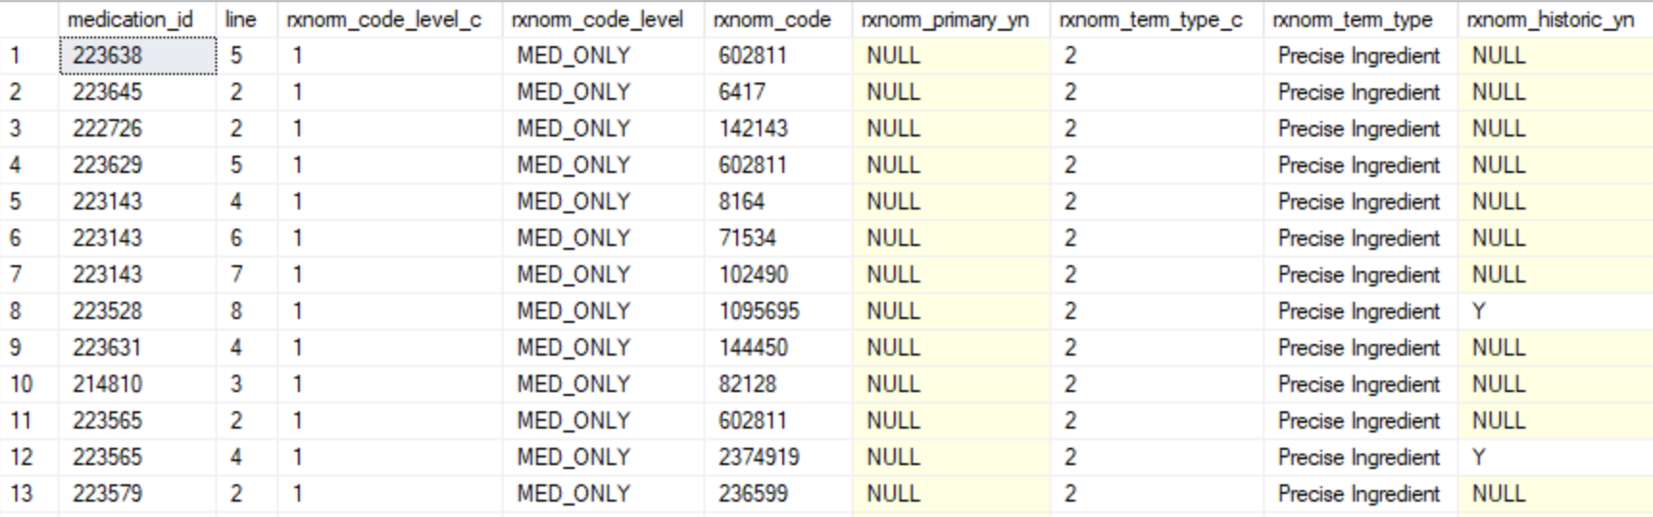
derived_rxnorm_codes
rxnorm_code_level
  MED_ONLY
  MED_FORM
  MED_FORM_STRENGTH
rxnorm_term_type
  Brand Name
  Brand Name Pack
  Generic Pack
  Ingredient
  Multiple Ingredients
  Precise Ingredient
  Semantic Branded Drug
  Semantic Clinical Drug
  Semantic Clinical Drug Form

Slide 16
Gotchas
Not all medications will map to RXCUI
Drug information prior to 2015 is spotty
  We use > July 1, 2016 – ensures we also have proper ADT information across Hopkins
Combination therapy eg LABA-LAMA
  Combination treatments will have a specific RXCUI
  Individual ingredients (LABA and LAMA) will also map to this medication
Not all expected classes are represented
  Eg Short acting, long acting
RXCUI does not differentiate dose form group, strength
  Oral, inhaled, IV
  Extended release
Specific RXCUI
LABA
LAMA
LABA RXCUI will also retrieve combination LABA/LAMA

Slide 17

What’s Next?
Include dispensed medications from Care Everywhere and SureScripts, if possible
  Enhance RxNorm coding for OMOP
  More accuracy on mixtures and compounds
Create derivations for “home medications”
What else? We need your feedback!

Slide 18
Gotchas and Other Medication Considerations
(we're working on a better dictionary, code repository, and general data info portal; stay tuned!)
Limitations of medication data:
  No dispense data at this time
  Excludes pending meds and empty order dates
  Limited to patient cohort per each PMCOE
  Medication information is not comprehensive. Many medications missing info about therapeutic and pharmaceutical classes, and many missing correlated RxNorm codes.
  "Custom meds" are cloned from FDB and won't have metadata – need to link to the FDB "proxy" med
Gotchas:
  Med orders.
    Orders with provider_id 69907 are patient reported medications.
    Specific selected drug can be "close to" what the patient described when recording patient reported meds, so take care when searching on specific medication IDs
  Med admin. Accuracy of this data is HIGHLY dependent on department workflow.
  Be careful how you join these tables. Most of these tables can be joined at the patient, order, medication, or encounter level so make sure you are using the correct fields.

Slide 19

What’s Next?
Include dispensed medications from Care Everywhere and SureScripts, if possible
  Enhance RxNorm coding for OMOP
  More accuracy on mixtures and compounds
Create derivations for “home medications”
What else? We need your feedback!

