Slide 1

Five Year Review: inHealth
Hopkins intelligent healthcare

Slide 2
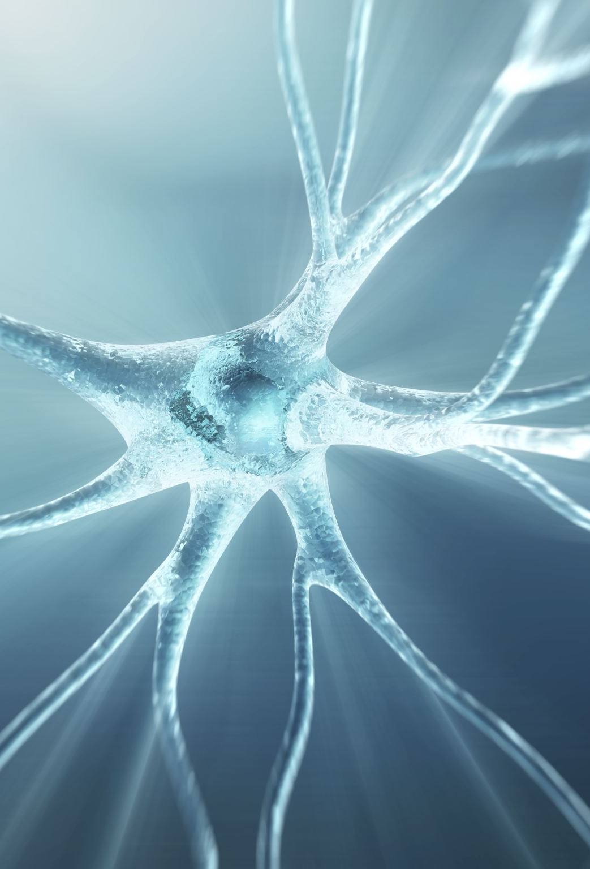
Philosophy of Founders
Human health and disease represent a key synthesis of biology and soul
The human condition is shared among all, regardless of origin, social or economic stratum
Establish a University and hospital, with embedded values
Care and learning occur in the same venue

Slide 3
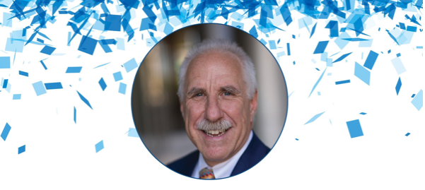
"...Rothman says he is proudest of the way Johns Hopkins Medicine is pioneering the use of data to advance research, clinical care and education.
Because of his advocacy, JHM now supports dozens of precision medicine centers of excellence that use large amounts of data to better understand how diseases including Alzheimer’s, cystic fibrosis and prostate cancer vary by individual and how treatments can be tailored to specific patients."
Dean Rothman Retires After a Decade of ‘Leading the Change’
PUBLISHED IN DOME MAY/JUNE 2022

Slide 4
Use the era’s transformational tools of measurement, data science, and connectivity to discover clinically-relevant and mechanistically-anchored disease subgroups at scale, and deliver what we learn to impact the quality and value of health care at both the patient and population level.

Slide 5
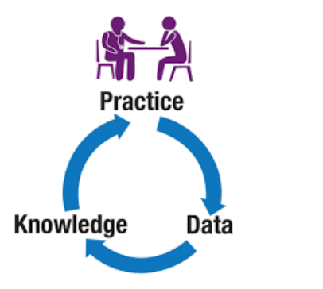
JHM as a Learning Healthcare System
Johns Hopkins intelligent Healthcare
Diseases are heterogeneous, but are comprised of much more homogeneous subgroups
Subgroups are generally anchored to mechanism
  implications for discovery, therapy and management
New tools of measurement and data science
  greatly expand ability to discover relevant subgroups
New opportunities in harnessing data in flight, and in moving electrons instead of humans, massively expand the efficiency of health care delivery
Making the “new” medicine sustainable cannot only add technology and computation
  It has to improve the discovery of dominant mechanisms, and improve the specificity and quality of care, make it more efficient and cheaper, and better serve the needs of patients and providers
Traditional research focus

Slide 6
The 3 Revolutions brought to focus on
Measurement
Computation
Connectivity
Data ingestion
Subgroup discovery
Insight generation
Care delivery
Value capture

Slide 7





One University
Notes:
Added engineering schools here; others?

Slide 8
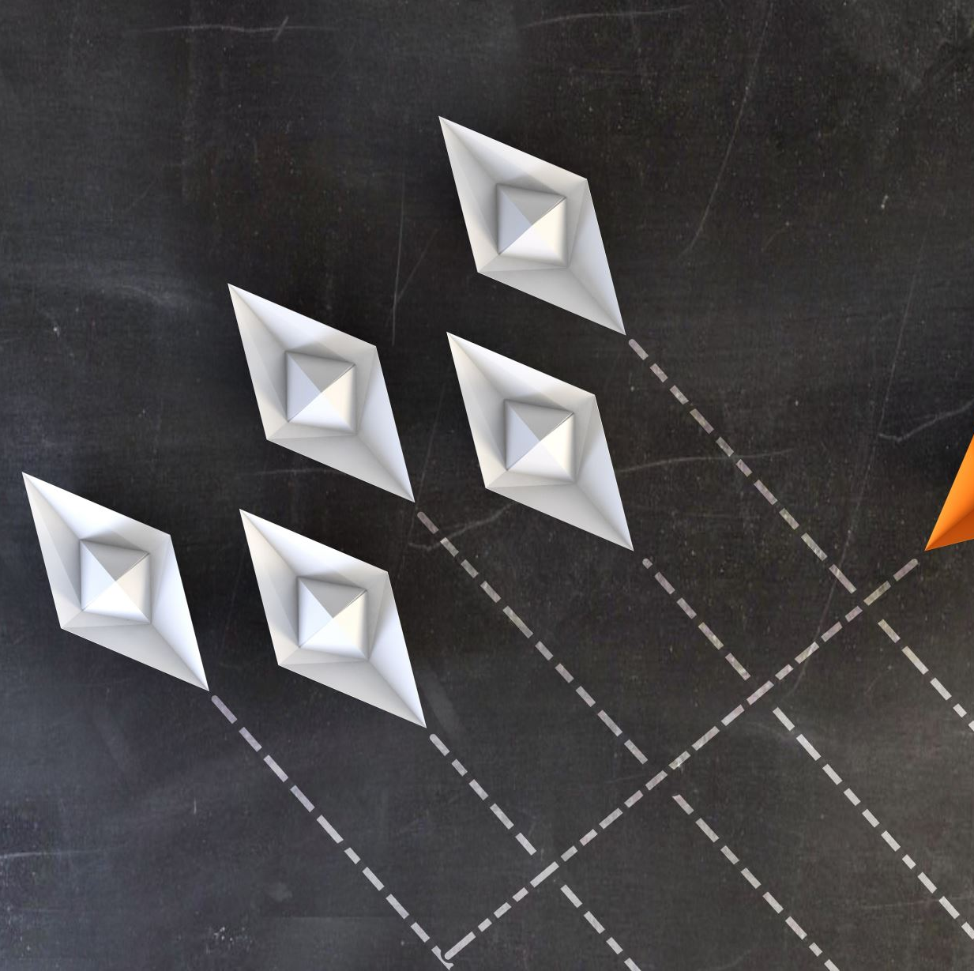
How do you find homogeneous subgroups within heterogeneous categories?
Application of Filters across orthogonal planes

Slide 9


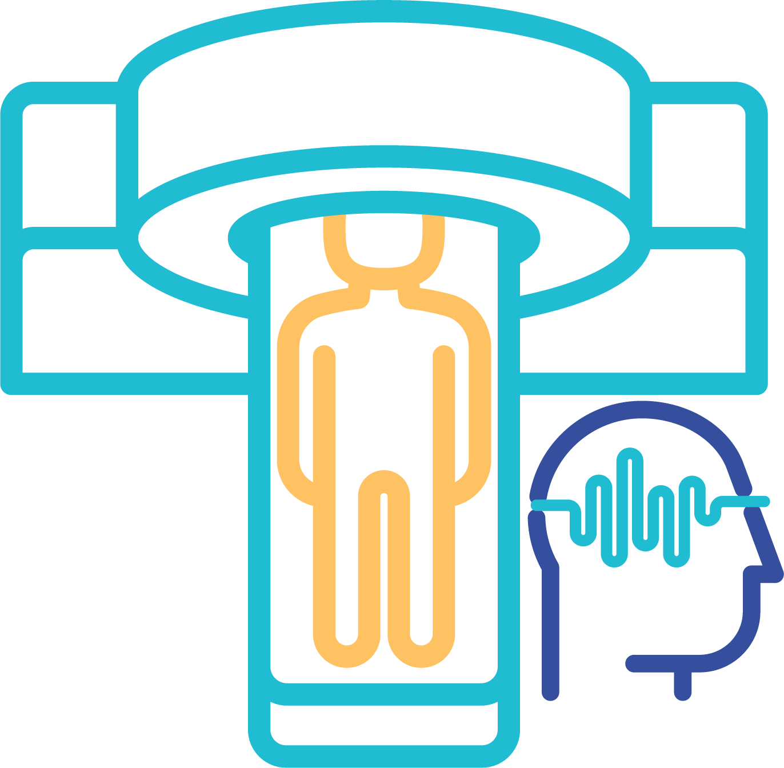


Measurement Continuum
Molecular
Structural
Physiological
Sociodemographic
Cost

Slide 10
Wonder involves appreciating a previously hidden pattern, and imagining its origin
Temporal clustering
Phenotypic clustering
Subsets by trajectory
Coincidence of orthogonal measures
Coherent changes upon perturbation

Slide 11
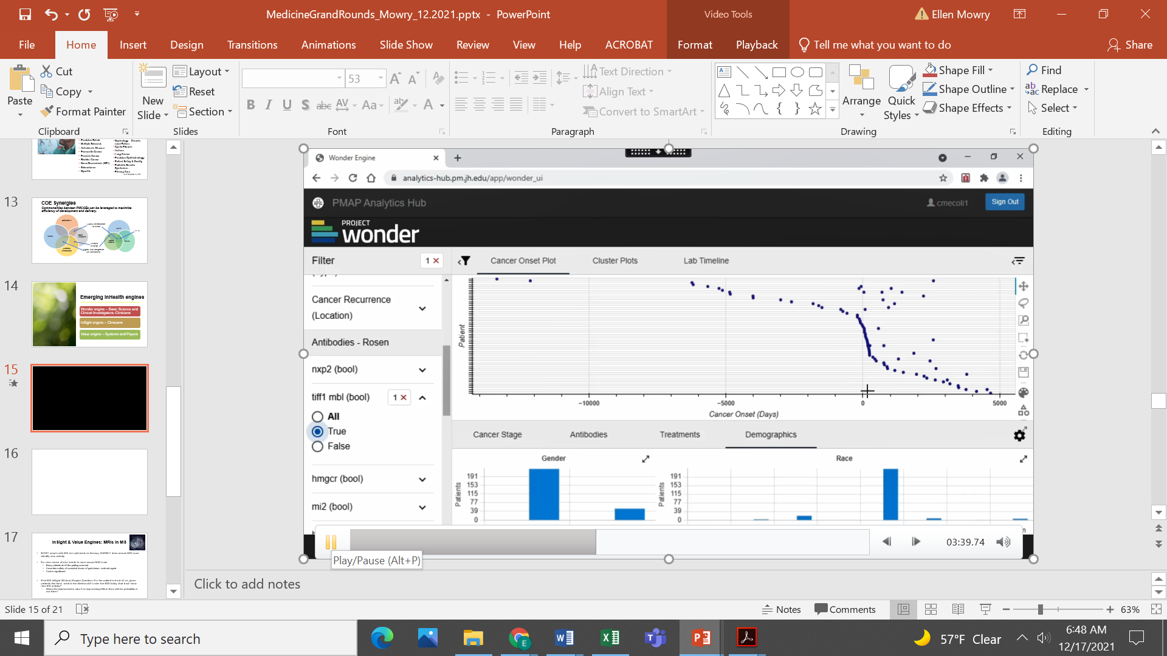

Temporal clustering in Myositis
Notes:
We have always known about cancer risk in some myositis patients, apparent clustering around time of dx. Here we see true if TIFF1-positive, not so much (#s/timing) for Jo1-positive. Also although prior teaching thought cancer less likely in younger, cluster of cancer around myositis onset in young people.

Slide 12
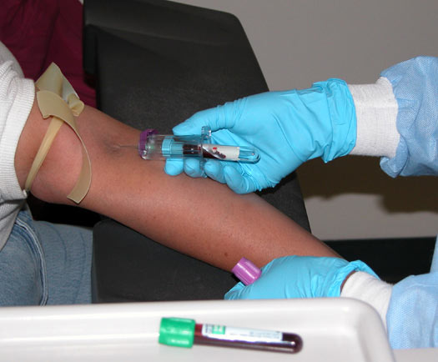
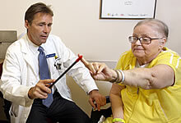

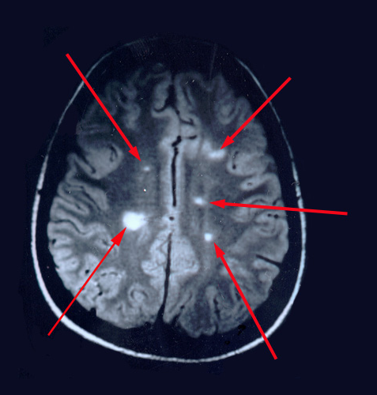
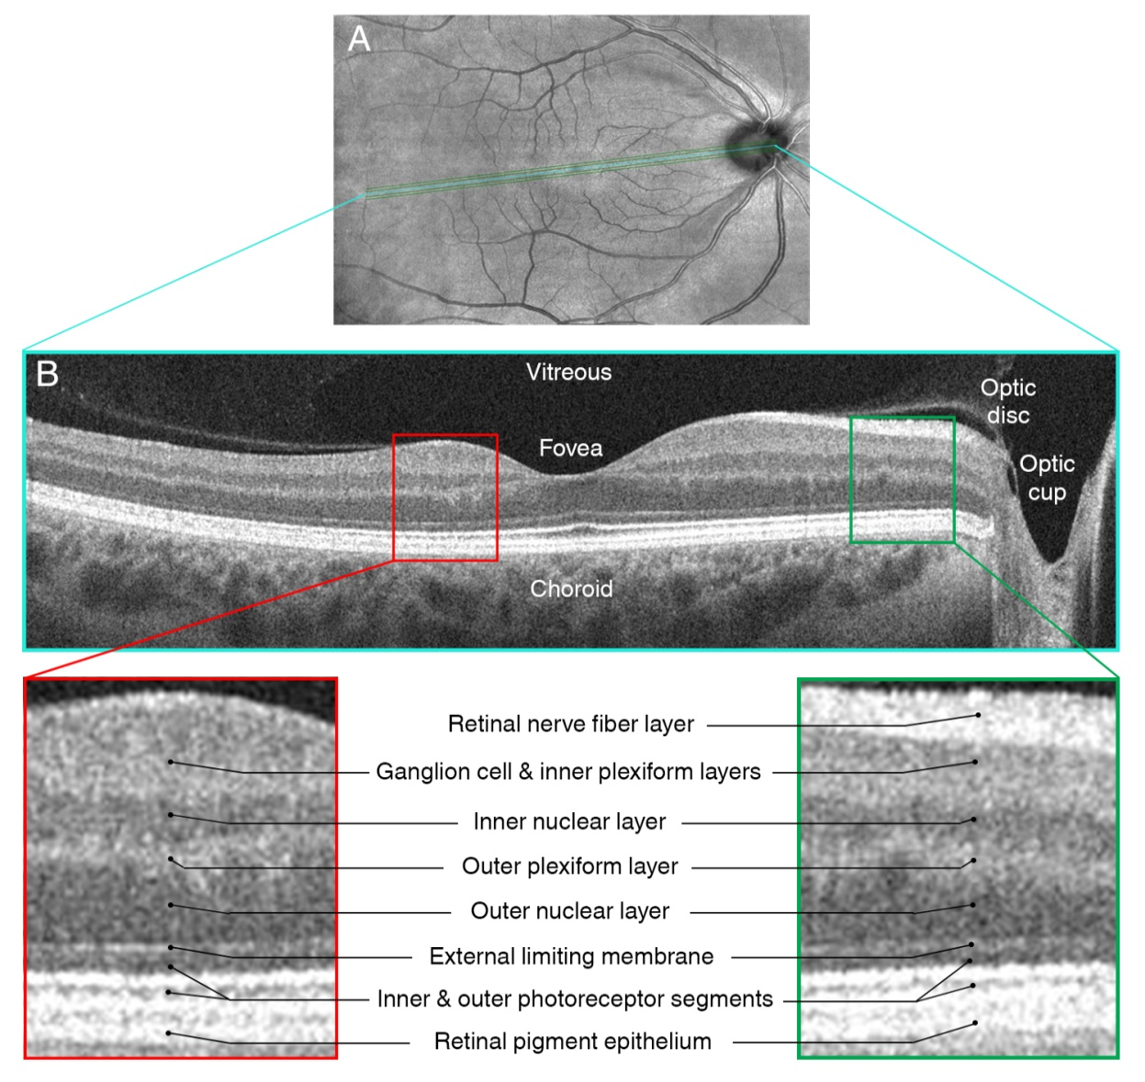
A Tale of Transformation: The MS PMCOE Clinical Encounter
CORE MEASURES
Clinical phenotyping: discrete endpoint and exam templates for care and secondary research
Biobanking
Retinal imaging
Standardized annual brain [± cord] MRI to assess for new lesions/need to change treatment

Slide 13
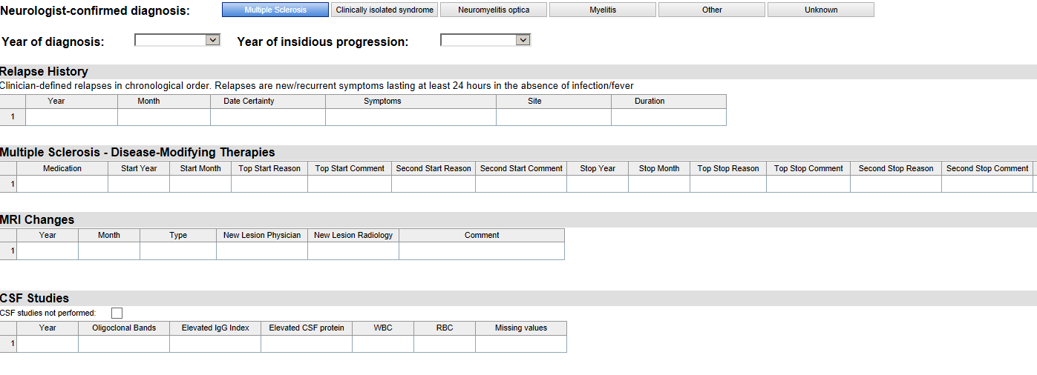
MS Smartform*: Scalable Clinical Tracking Within the Electronic Medical Record
*Freely available now to all Epic users, and recently adapted to Cerner. In use/in development at:
Cleveland Clinic (OH, NV) UC San Diego
NYU U. Washington
Columbia University Ohio State University
University of Rochester U. Alabama
Washington U., St. Louis OhioHealth
Yale Allegheny Health Network

Slide 14
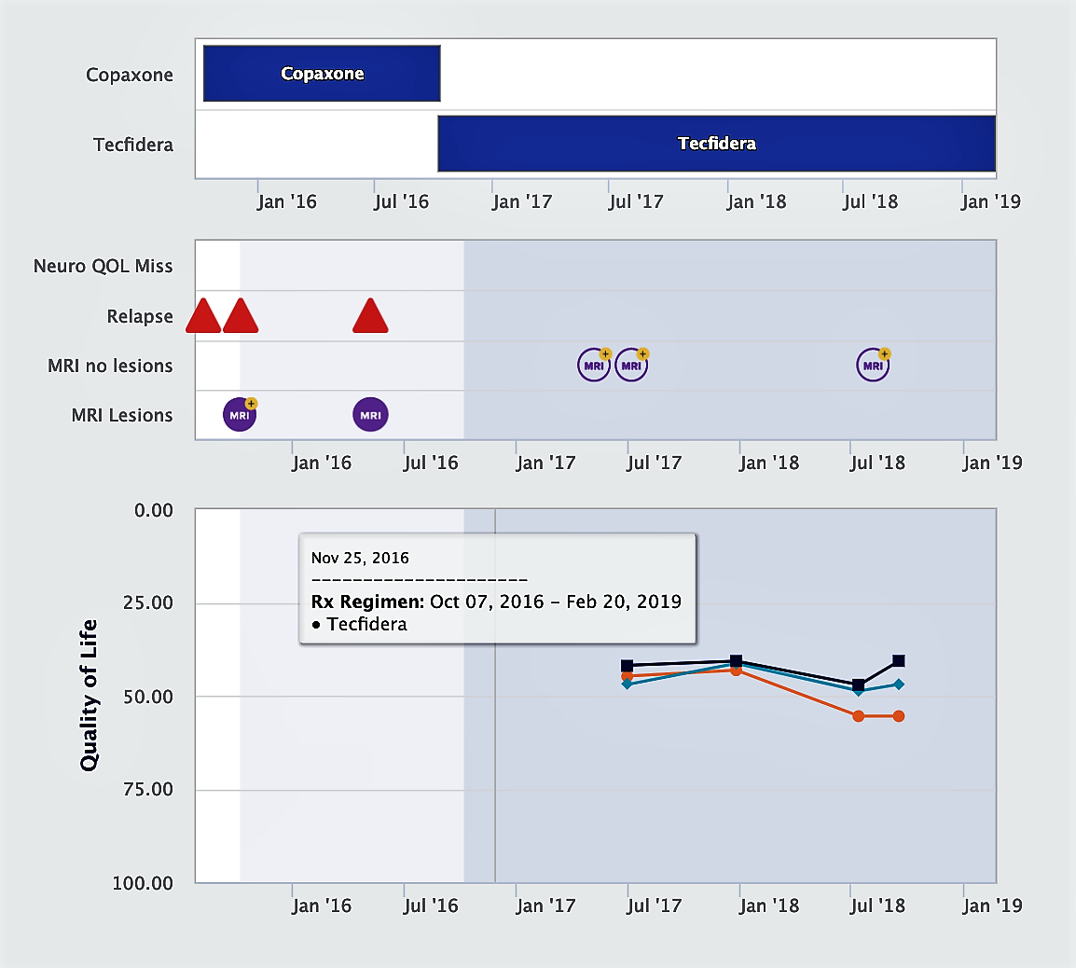
MS Visualization: Returning Data to Patients
Notes:
Would like to get some updated screenshots

Slide 15
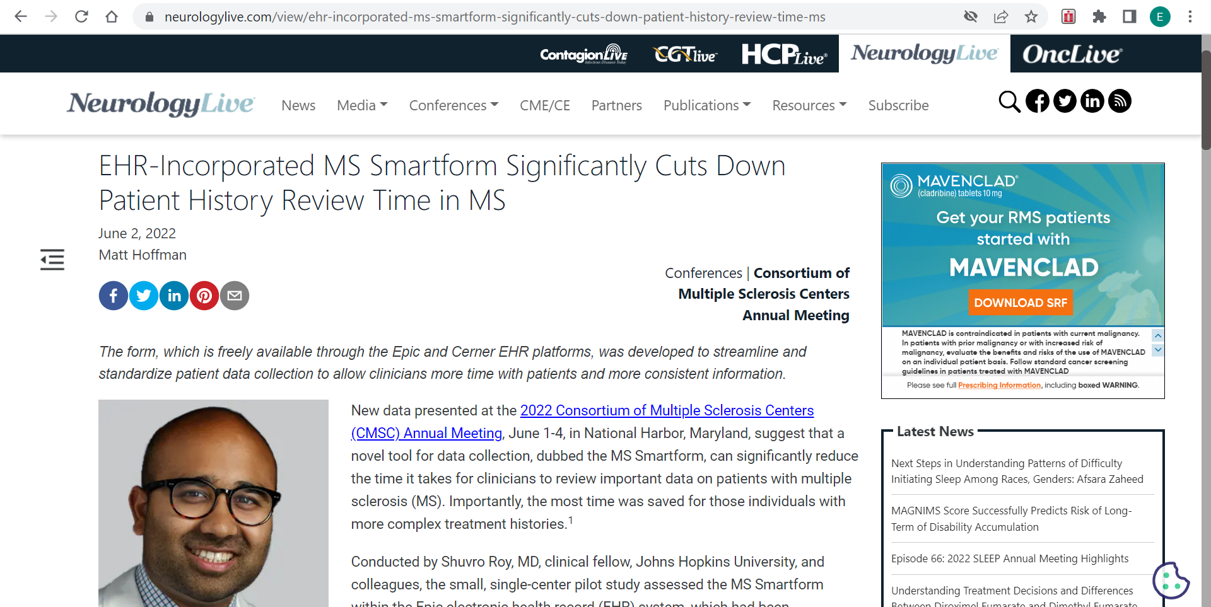
Smartforms: Improving Care Efficiency
Recent presentation led to marked interest in Smartform adoption by other MS centers throughout North America

Slide 16
inHealth – an ecosystem centered around disease subgroups
The ‘right’ measurements – at scale
Mechanism discovery & Therapeutics
Filter discovery and application
Disease subgroup
Pathway credentialing in tissue
(Genomics, epigenomics, single cell studies, molecular path, modeling)
Research and clinical care meshed
Subgroup-focused patient management
Ongoing Curation and Validation; expansion to other sites
Tools for subgroup discovery embedded in PMAP

Slide 17
Validation and Curation Committee
  Includes several JHU faculty with expertise in generating, continuously validating, and evaluating the reception and impact of clinical tools generated
  Actively establishing guidelines for PMCOEs to bring their insights through the process of tool development and implementation
Notes:
Validation and Curation Committee
Includes several JHU faculty with expertise in generating, continuously validating, and evaluating the reception and impact of clinical tools generated
Actively establishing guidelines for PMCOEs to bring their insights through the process of tool development and implementation

Slide 18
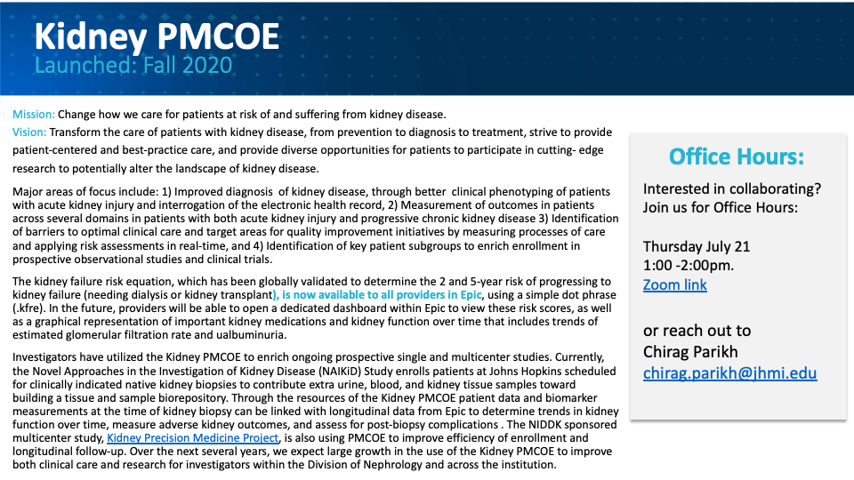
Engaging with inHealth after the retreat: Check your inbox!

Slide 19
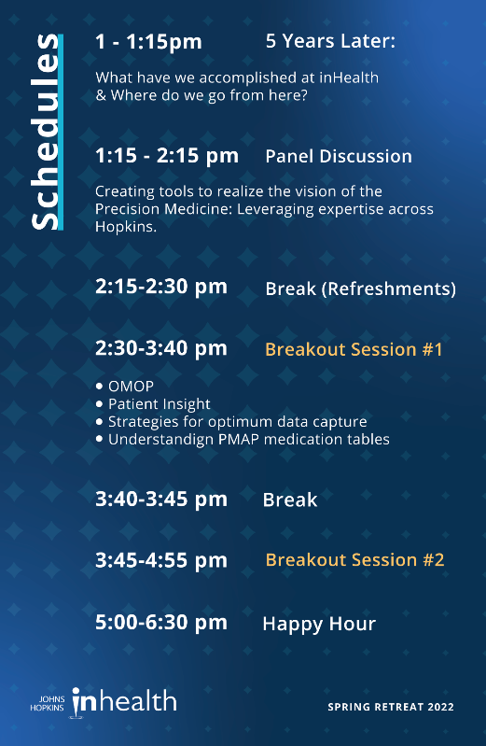
Today’s Agenda
Breakout #1-choose a room!

