Slide 1


Mental Health in the Workplace
&
mySupport Services
Managers’ Toolkit
mySupport= More Support

Slide 2


Identify mental health disorders and recognize the impact they have on the workplace.
Identify resources managers can use to support mental wellbeing on their teams.
Locate and list the full range of mySupport services, for employees and managers.
Identify best practices managers can implement to assist team members in distress.
Learning
Objectives
mySupport

Slide 3


Nearly one in five adults in the United States is living with a mental health condition
Mental health is the leading cause of disability in the United States.
https://www.nimh.nih.gov/health/statistics/mental-illness.shtml
Mental Health
in the Workplace
mySupport
Notes:
Mental Illness is quite common, yet still not something we openly talk about. It is likely that you or someone close to you will experience difficulty with mental health over the course of your lifetime.
Mental health is the leading cause of disability in the United States.

Slide 4

Mental Health conditions are NOT
Caused by personal weakness
Lack of character
Poor upbringing
Mental Health conditions ARE
Medical conditions which can impact:
  Cognition
  Feeling or mood
  Ability to relate to others
  Daily functions/routines
Impacted by genetics, environment and lifestyle
Mental Health
in the Workplace
National Association on Mental Illness
Notes:
Mental health conditions are NOT caused by personal weakness, lack of character or poor upbringing. They ARE medical conditions that can impact a person’s thinking, feeling or mood and may affect their ability to relate to others and function on a daily basis. Genetics, the structure of the brain, environment and lifestyle can all impact mental health.
https://nami.org/NAMI/media/NAMI-Media/downloads/Stigmafree%20Company/NAMI_2017Handouts_FINAL.pdf
……………………………………………

Slide 5


Reduced Turnover
Attraction
of qualified Talent
Enhanced customer service
Improved performance
Benefits of Promoting Mental Well-being @ Work
Corporate and social responsibility
Reduced sick leave
mySupport
www.WorkplaceStrategiesforMentalHealth.com
Notes:
Reduced turnover and costs associated with recruitment and training.
Attraction of qualified talent that prefer a workplace that supports mental health.
Reduced sick leave as employees are supported to remain productive at work.
Corporate and social responsibility in providing a workplace that is supportive of all employees.
Enhanced customer service when employees are healthier and happier at work.
Improved performance by supporting employees to contribute their best work.
www.WorkplaceStrategiesforMentalHealth.com

Slide 6
Behaviors
Lateness and absenteeism
Withdrawal from team
missed deadlines
Reactivity
Procrastination
“presenteeism”
detachment
slowed productivity
isolation
Change in appearance
irritability
Lack of confidence
accidents on the job
Absentmindedness
poor relationships
on the job
What a mental health
disorder may look like
at work
Poor grooming
Low motivation
mySupport
6
6

Slide 7


It’s possible to be experiencing a mental health disorder and yet function well at work.
The workplace symptoms of someone with a mental health disorder can also be displayed by a poor worker or an employee who has issues unrelated to a psychiatric or medical condition.
Keep
In
Mind
mySupport
7

Slide 8


How
Can managers help?
It is never a manager’s role to diagnose employees, but there are concrete ways managers can promote mental wellness for their teams and safely address concerns they may have about an employee’s well-being.

Slide 9

Demonstrate the importance of wellness by committing to your own.
Eight Dimensions of Wellness
Emotional
Spiritual
Social
Occupational
Intellectual
Financial
Physical
Step One
Environmental
mySupport

Slide 10
Promote Stigma Reduction and Civility
See the whole person
Offer support
Challenge misconceptions
Use respectful language
How managers can help
mySupport
10

Slide 11
Promote Healthy Communication
Provide clear, regular, and consistent feedback.
Solicit ideas and create a safe space for individuals to discuss their thoughts, mistakes, or ideas.
How managers can help
mySupport
11
11

Slide 12
Help Employees Counter
Negativity Bias
Humans pay more attention to negative experiences than to positive ones, and negative experiences carry more weight.
How managers can help
12
mySupport
12
12

Slide 13
Help Your Team Practice Gratitude
Daily Practice: Write down three things a day. “I am grateful for…”
  Calendar reminder for team to practice daily
  Board in office or on online (for example, in Microsoft Teams) where individuals can express gratitude to others.
How managers can help
13
13
mySupport
13
13

Slide 14
Promote Psychological Safety in the Workplace
Are members of this team able to bring up problems and tough issues?
Is it safe to take a risk on this team?
Are team members’ unique skills and talents valued and utilized?
Is it easy to ask team members for help?
Are all team members welcomed and treated with respect?
How managers can help
14
14
14
mySupport
14
14

Slide 15
Remind Employees of Resources
Regularly remind employees about supportive resources including mySupport
Promote mySupport for
    Frustrations of daily living
    Significant crises
Display and disseminate mySupport materials and information openly to avoid singling out
How managers can help
15
15
15
15
mySupport
15
15
Notes:
Regularly remind all employees about supportive resources, including mySupport.
Promote mySupport as a service that can assist with a range of problems, from frustrations of daily living to significant crises.
Display and disseminate mySupport materials and information--doing so avoids singling out employees and provides resources to all, and also demonstrates your commitment to their well being.

Slide 16
mySupport Information for Employees and Managers
Visit
https://hr.jhu.edu/benefits-worklife/support-programs/
for comprehensive information about mySupport services for employees and managers.

Slide 17



Resources for Living Website
www.resourcesforliving.com
Username and Password: JHU or JHHS
mySupport Information for Employees and Managers
For employees
Webinars, articles and podcasts on life and relationships, mental health, substance use, career and workplace, current crises and more. Includes COVID- 19 Resource Center.
For managers
Articles, videos, and newsletters provide guidance on a range of topics, such as:
Managing conflict
Providing performance feedback
Helping the troubled employee
Many others
Notes:
www.resourcesforliving.com (Username and Password: JHU or JHHS)
For employees: Webinars, articles, and podcasts on life and relationships, mental health, substance use, career and workplace, current crises, and more. Includes a COVID-19 Resource Center.
For managers: articles, videos, and newsletters provide guidance on a range of topics, including
Managing conflict
Providing performance feedback
Helping the troubled employee
Helping the employee or team that’s experiencing loss or distress
Helping your team through crisis
Managing a team working from home
Working with different generations
Improving employee engagement
The art of delegation
Onsite all entities but sibley, suburban, howard county and all children’s.
Sibley and suburban have access to all other aspects of my support, and howard county and all children’s have their own EAP programs, contact benefits in HR to find out more information.

Slide 18
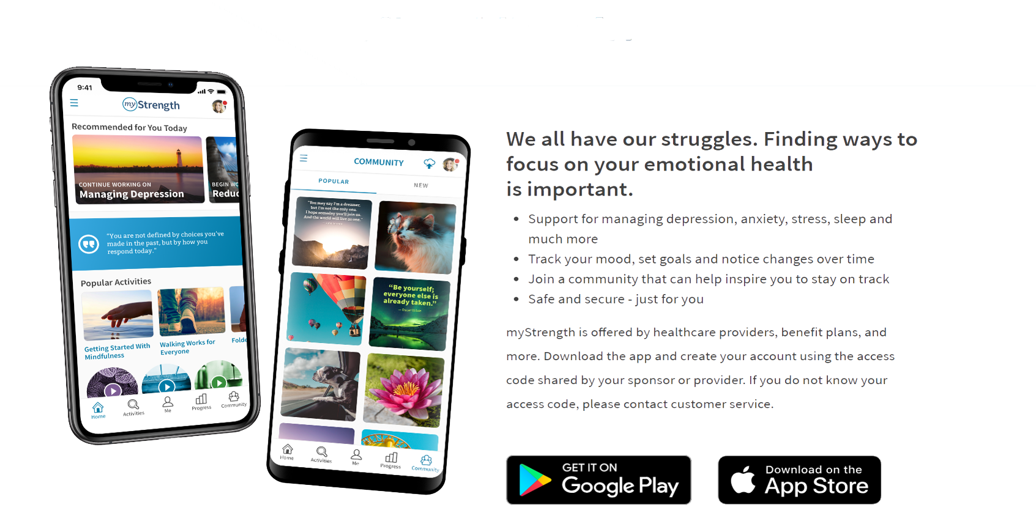
myStrength Mobile App
mySupport Information for Employees and Managers
We all have our struggles. Finding ways to focus on your emotional health is important.
Support for managing depression, anxiety, stress, sleep and much more
Track your mood, set goals and notice changes over time
Join a community that can help inspire you to stay on track
Safe and secure- just for you
ACCESS CODE: JHU OR JHHS
18

Slide 19

What to do if you are worried about an employee
19
19

Slide 20

Have a private conversation with the employee in which you note the performance concerns:
Say:
I’m concerned that you’ve been late to work recently and aren’t meeting your performance objectives. You are a valued employee and I’d like to see you get back on track. How can I help?” Focus on what you’re observing and on job performance.
If the employee shares they are feeling low or going through a rough patch in their personal life, then remind them that mySupport’s services are available to help with a range of personal concerns.
It’s best not to encourage the employee to disclose health information to you, but assure them that confidential help is available. Avoid suggesting a diagnosis or treatment options, the problem will resolve itself on its own, and assuming they aren’t trying hard enough to be happy or feel better.
When in doubt about how to help, call mySupport at 443.997.7000, option 2, and ask for a management consultation. The Onsite Team can hear your concerns and recommend best next steps.
If you notice that an employee’s performance is declining:
mySupport
20

Slide 21
If they say: “I just don’t know if I can go on”, “This is killing me”, “I can’t take it anymore”, “I’m done”
Do not avoid or delay asking the employee about the statement and checking in on their well-being.
Take a few deep breaths so that you can speak calmly and warmly to the employee. Check in with your own emotional state so you can. focus on the employee.
If you feel uncomfortable speaking with the employee alone, ask another manager or supervisor to join the conversation.
If you’re together in person, find a private space to talk with the employee.
If you are in different locations, talk over the phone or televideo. Televideo is preferable. Ask the employee if they are alone.
What to do if a client makes vague, concerning statements:
mySupport
21

Slide 22
Say:
I am concerned about you because I heard you say “I just can’t do this anymore.” Can you share what you meant and why you said that? I’m wondering if you’re having thoughts of hurting yourself. Are you okay? I care about you, and I’d like to call mySupport together, right now, so that I know you’re connected with support.
Asking someone whether they are thinking of hurting or killing themselves does not encourage suicidal thinking, but instead provides protection and conveys support and care.
Avoid labeling the employee or suggesting a diagnosis (e.g., “I think you’re depressed”).
Do not tell the employee to call mySupport and leave it at that.
Once you’ve reached mySupport 24/7 by calling 443.997.7000, option 2, and explained the concern to the clinician, ask the employee for permission to get back on the phone with the clinician at the end of the call to learn about next steps. Then give the employee privacy to speak with the clinician.
If the employee declines, provide them mySupport’s number and encourage them to call. Then call mySupport yourself and request a management consult.
Check in with the employee later in the day to follow up and express care.
What to do if a client makes vague, concerning statements:
mySupport
22
22

Slide 23
Take a few deep breaths so that you can speak calmly and warmly to the employee. Check in with your own emotional state so you can focus on the employee.
Be sure you have a private space to talk with the employee.
Say:
Thank you for trusting me by sharing this information. I care about you, and I want to make sure you have support. Would you be willing to call mySupport together?
If the employee declines, provide mySupport’s number—443.997.7000, option 2, and remind them confidential help from a clinician is available 24/7 at that number.
Call mySupport and request a management consult.
What to do if an employee tells you they tried to hurt themselves recently:
mySupport
23
23

Slide 24
Assuming you have no concerns for the employee’s safety, or anyone else’s, a Facilitated Management Referral (FMR) to mySupport may be a helpful tool. An employee who agrees to a facilitated management referral works with an Onsite Clinician to address the concerning behavior.
FMRs are voluntary appointments. If the employee agrees to the FMR, they give the Onsite Clinical Team permission to let you know whether or not they have made and attended an initial appointment with the Onsite Team.
Please go to the following links to learn more about FMRs and to obtain an FMR Agreement Form. Please note that you must consult HR before initiating an FMR, and HR must sign the FMR Agreement Form.
What to do if an employee’s behavior is inappropriate for the workplace:
mySupport
24
24

Slide 25
Facilitated Management Referral (FMR) Paperwork
Links to the following documents:
FMR FAQs for Managers and HR
FMR FAQs for Referred Faculty and Staff
FMR Agreement Form
25
25
25

Slide 26
To Reach mySupport, 24/7:
Call 443-997-7000;
Option #2
26
26
26
26

Slide 27

27
27
27
27
27

