Slide 1
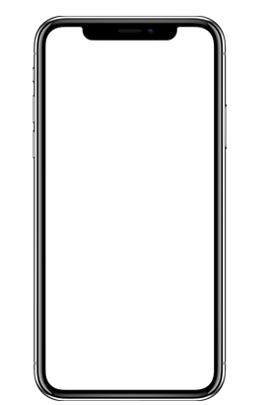
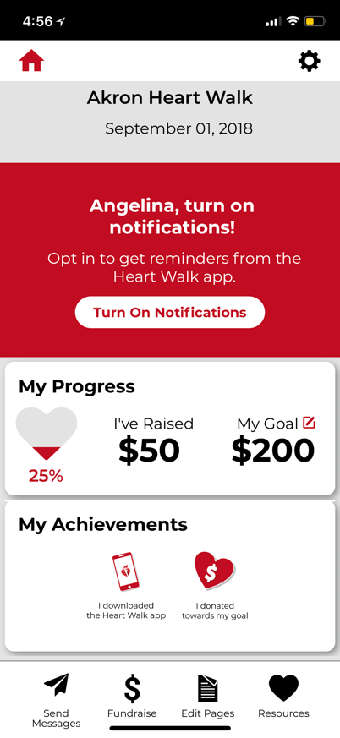
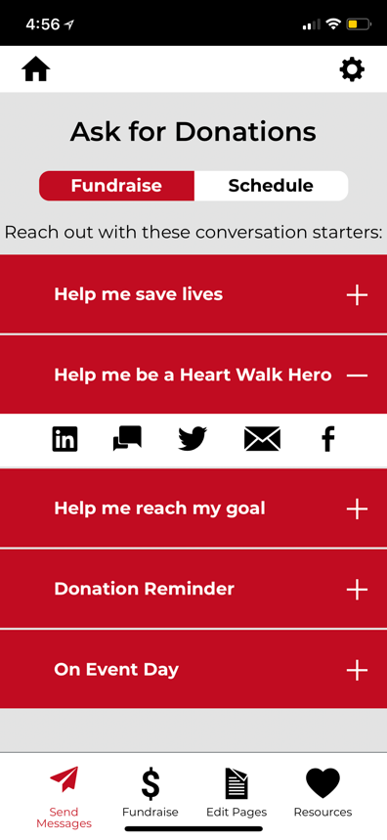
What Can I Do in the Heart Walk Mobile App?
  Download the NEW Heart Walk Mobile App for iPhone or Android. Wondering what you can do with the App?
  Personalize your Heart Walk experience, by adding a photo and/or story.
  Send pre-written Emails, Text Messages or make posts to your Social Media channels asking for donations. You can even pre-schedule posts ahead of time!
  Recruit Team Members and easily communicate with your team
  Deposit Checks through the app, just like you can at your bank.
  Access Fundraising Tips and earn Achievement Badges along the way

