Slide 2
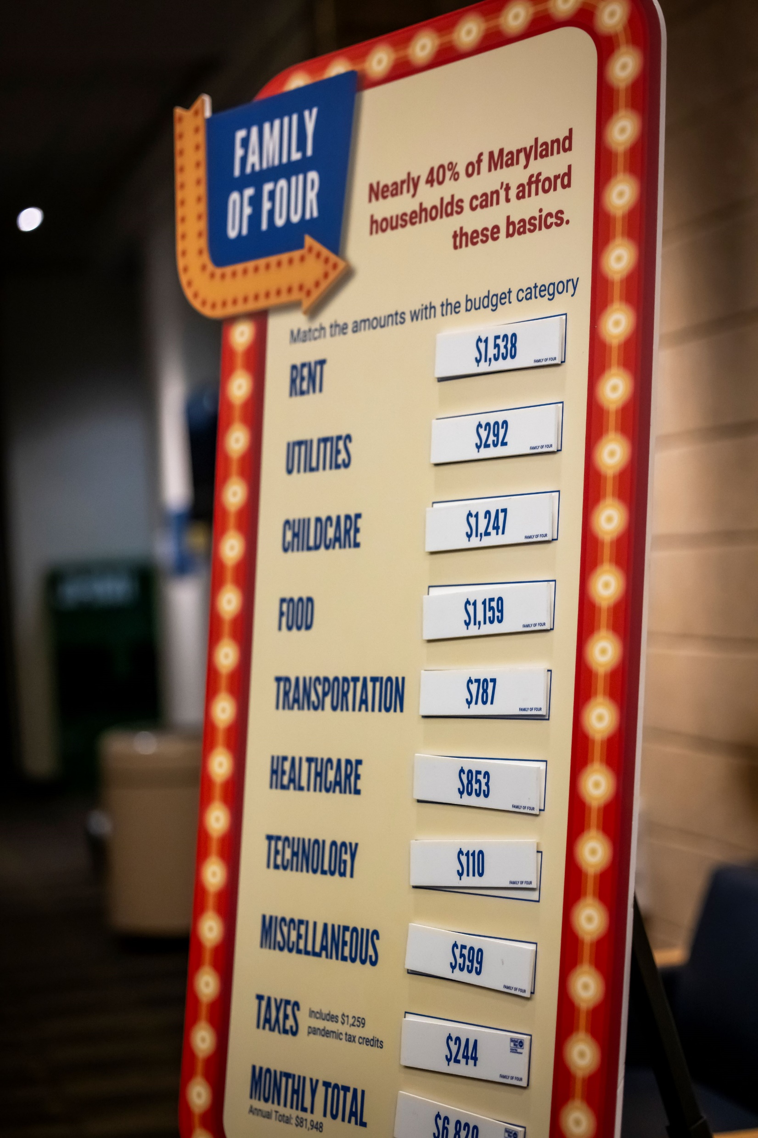
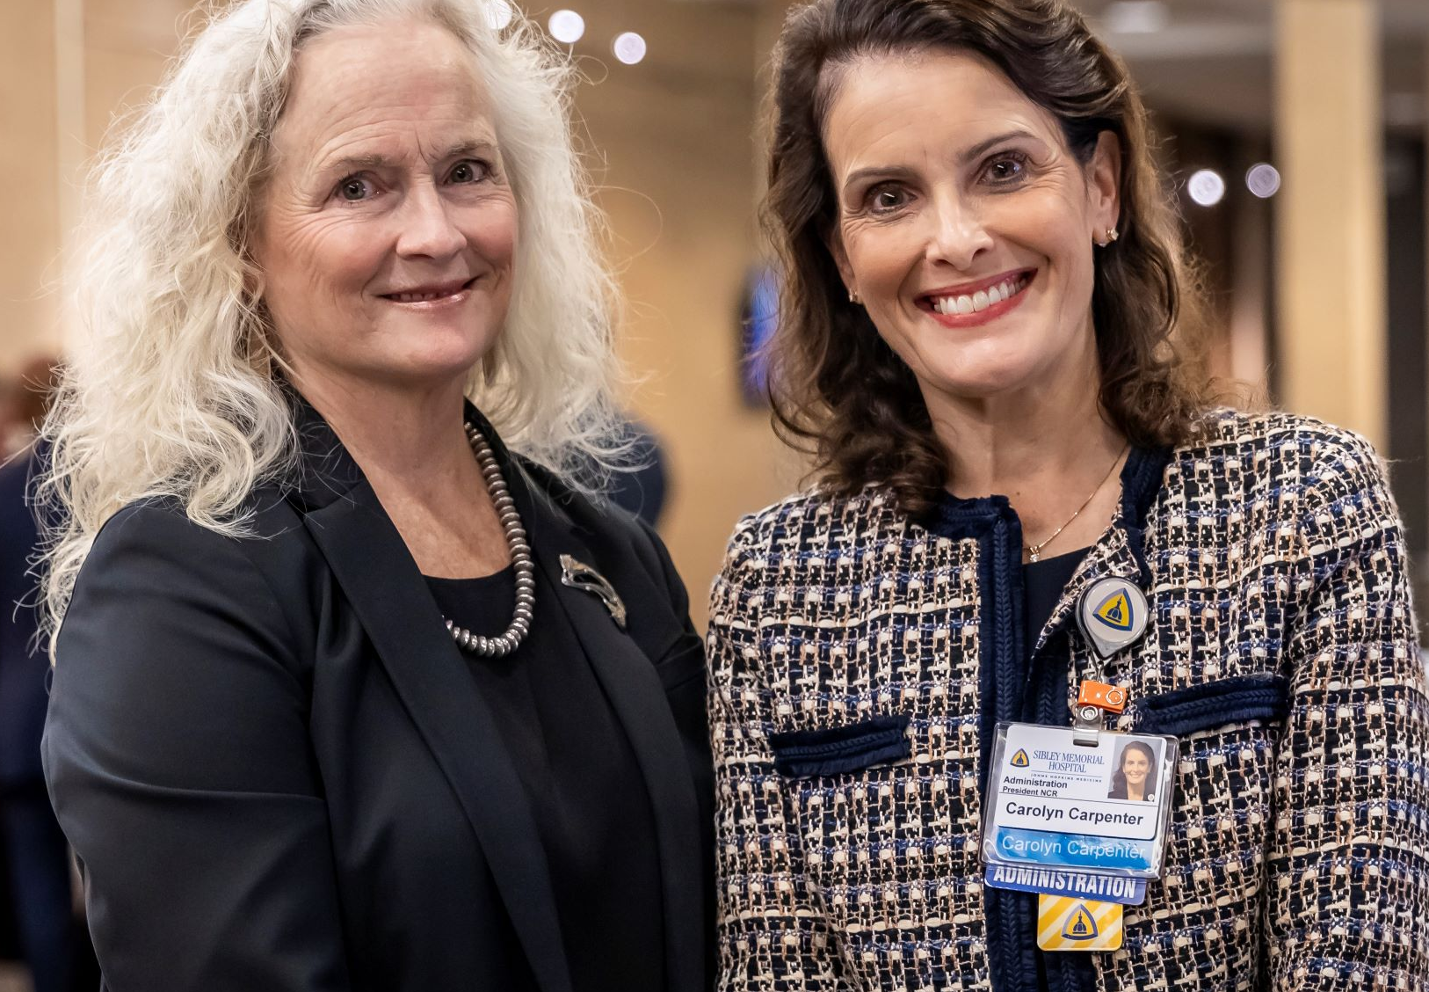
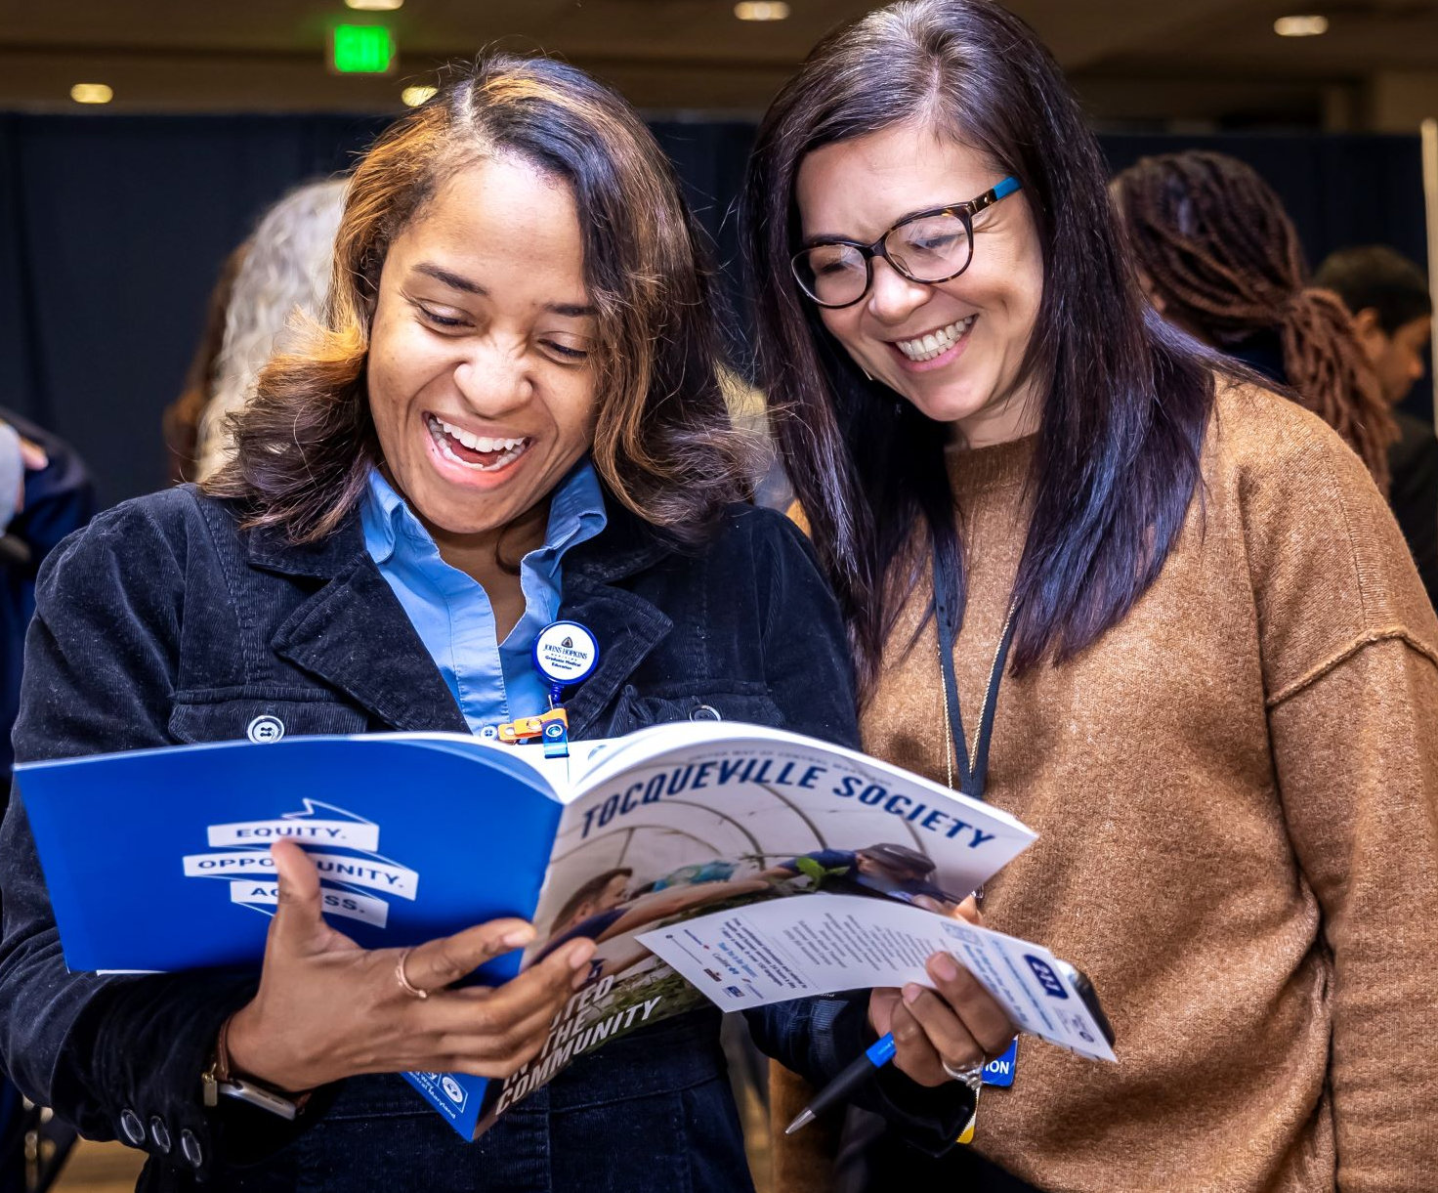
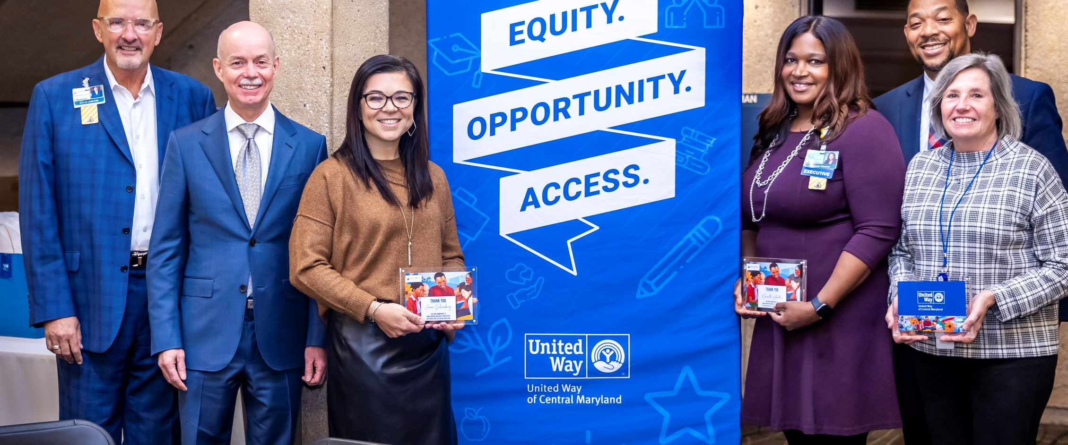
The JHM Leadership Breakfast kicked off the campaign, which runs Oct. 16-Dec. 22
Photos from United Way of Central Maryland

Slide 3
A partnership of more than 50 years to build stronger communities and help people in need.
Education
Financial stability and employment
Housing
Health

Slide 4
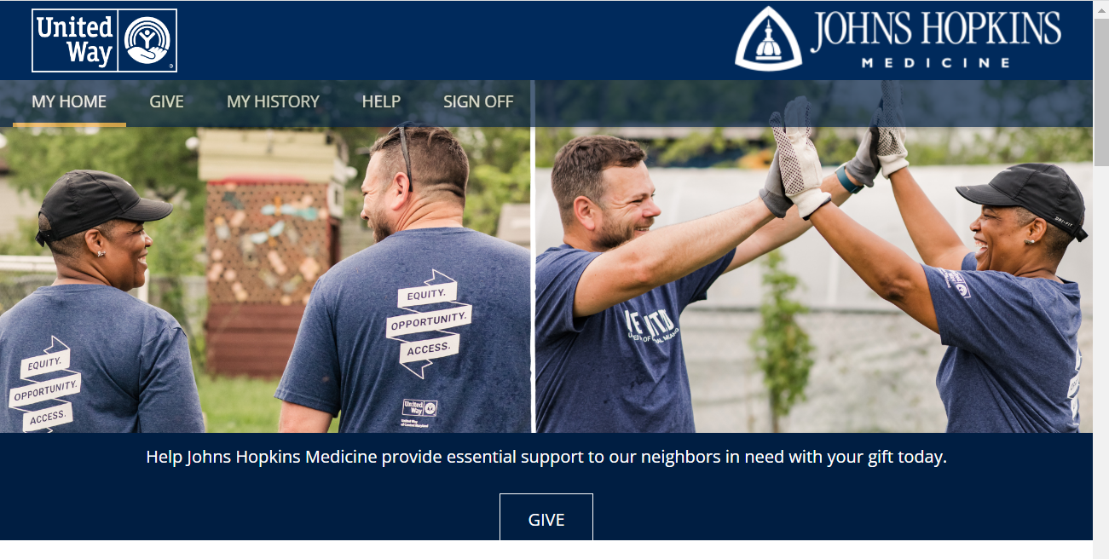
You can give to United Way to help the communities we serve.
HERE’S HOW TO GIVE
Go to https://hopkins.org/unitedway or scan the QR code.
Click on the Give button.
Give by credit card or payroll deduction
Donate the value of your unused paid time off (PTO). Complete the form at https://forms.office.com/r/uhUY29GVPp
Your generosity is appreciated and meaningful.
Notes:
The JHM overall goal is

Slide 5
The JHM Fundraising Goal is $1.24 Million. Here’s how we’re supporting that goal.
List your activities
Notes:
Include your organization’s activities and goal.

