Slide 1
External Customer’s Guide Agilent iLab Solutions Johns Hopkins University School of Medicine Core Facilities

Slide 2
Welcome to Agilent iLab. iLab is a core management program that Johns Hopkins University uses to manage workflow, billing and reporting for its core facilities. The following is a guide to assist you in navigating the system after you have your account set up.
Contents
Logging into iLab
Home Page
Menu/Navigating iLab
Invoices/Payment Options

Slide 3
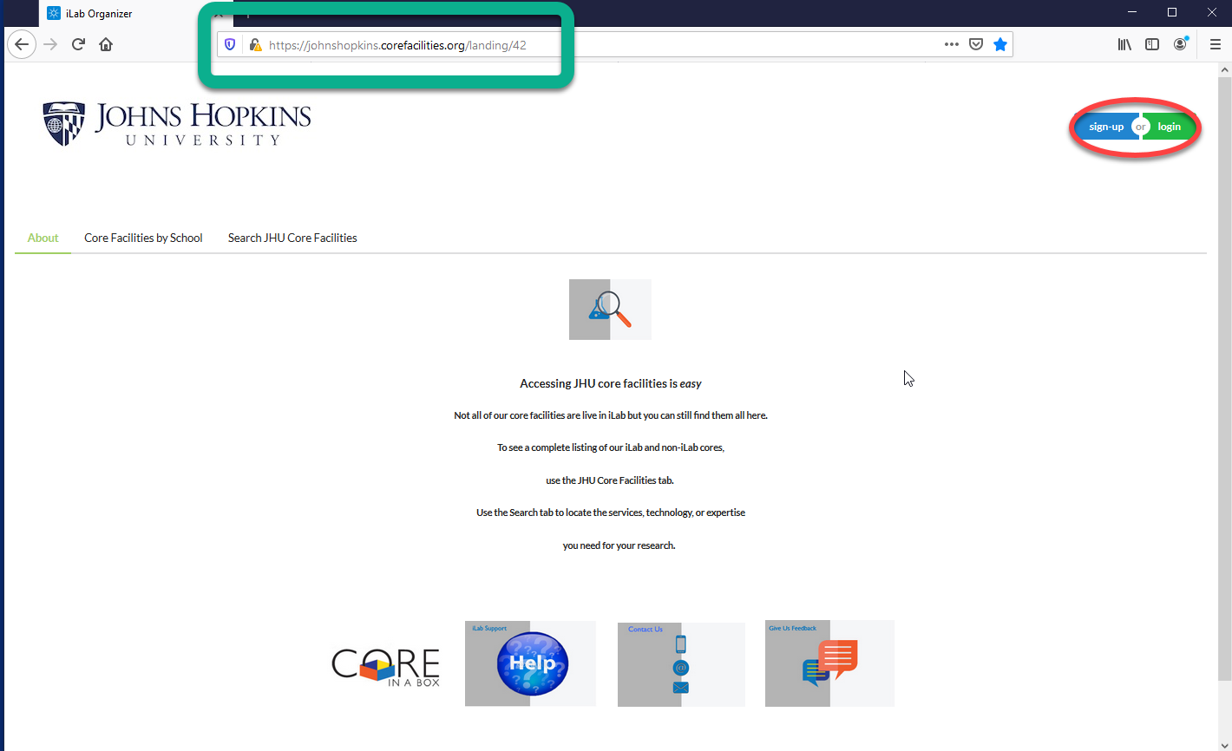
iLab Login Procedure
Once your account has been set up you can log into iLab by following these instructions
To login to iLab, go to:
https://johnshopkins.corefacilities.org
as indicated in the green rectangle
Click on the green login button in the upper right side of the page as indicated by the red oval.

Slide 4
