Slide 1
The Poggi Pediatric Orthopaedic Research Fellowship
__________________________________
Department of Orthopaedic Surgery
Johns Hopkins Children’s Center
Paul D. Sponseller, MD, MBA
Department of Orthopaedic Surgery
Chief - Division of Pediatric Orthopaedics
Professor of Pediatric Orthopaedic Surgery
Johns Hopkins Medicine
R. Jay Lee, MD
Ranjit A. Varghese, MBBS
Erin Melissa Honcharuk, MD
Aaron Brandt, MD

Slide 2
The Poggi Fellowship
Award
Award Details:
The Johns Hopkins Poggi Pediatric Orthopaedic Research Scholar Award promotes clinical research by giving extraordinary medical students the opportunity to investigate pertinent topics in clinical orthopaedic research at The Johns Hopkins Children’s Center in Baltimore, MD. While there are many year-out programs for medical students to conduct research, this award is rare in that it is a fully funded opportunity specifically designed for students pursuing a career in orthopaedic surgery. The Poggi Fellowship focuses on giving its medical students clinical research opportunities, advanced orthopaedic skills through weekly clinical exposure, and mentoring for residency applications and beyond.
Department of Pediatric Orthopaedics at The Johns Hopkins Hospital:
The Johns Hopkins Children's Center offers one of the most comprehensive pediatric medical programs in the country, with more than 92,000 patient visits and nearly 9,000 admissions each year. Johns Hopkins Children Center is consistently ranked among the top children's hospitals in the nation by U.S. News & World Report. The Division of Pediatric Orthopaedics at The Johns Hopkins Children's Center offers a wide variety of state-of-the-art services for children and adolescents in a compassionate and caring environment. Division faculty and staff are leaders in their fields, whether as educators, clinicians, surgeons, or researchers. The division's faculty provide expertise in diagnosing and treating a wide variety of bone-related growth problems, including dwarfism, scoliosis, Marfan Syndrome, and skeletal dysplasias. In addition to its surgical and clinical offerings, the division also has ongoing basic sciences studies on bladder exstrophy and on tibial osteotomies for partial ACL tears.
Eligibility:
Applicants should be completing their third year of medical school (in rare circumstances, uniquely qualified students finishing their second year may be considered). Students must be in good academic standing and have an interest in pursuing a career in orthopaedic surgery. The successful applicant will be responsible, self-motivated, intellectually curious, and able to work independently.
Award Stipend and Benefits:
The recipient of this award will receive a $30,000 stipend to cover living expenses for the year, as well as travel expenses for national presentations.
How to Apply:
Eligible students can apply by filling out the application located online at http://www.hopkinsmedicine.org/orthopaedic-surgery/education/fellowships/peds-ortho-med-student.html, along with sending all supporting documents by email to PoggiFellowship@jhmi.edu.
Additional questions may be sent to poggifellowship@gmail.com

Slide 3
The Poggi Fellowship
Research
The Poggi Pediatric Orthopaedic Fellowship’s goal is to launch the careers of tomorrow’s leaders. This funded year of research is designed for medical students between their third and fourth years pursuing a career in orthopaedic surgery. There are three components to the program: research, clinical exposure, and mentoring.
The Poggi Fellow will be involved in retrospective and prospective, single-center and multi-center research projects. The research is designed to answer questions and solve problems in the area of pediatric orthopaedic trauma, sports medicine, spine, hip and hand disorders, patient safety, and healthcare quality and value, as well as medical economics. Students meet with Dr. Sponseller and Pediatric Faculty several times weekly to assure satisfactory supervision and mentorship.
There is a long-established clinical research office in the Pediatric Orthopaedic Surgery Department at The Johns Hopkins Children’s Center. A few of the benefits of doing clinical research in our Department include the following:
• An orthopaedic research coordinator who will help Poggi Fellows design and complete IRBs, adhere to department and Johns Hopkins Research policies, review clinical data, measure X-rays, and complete manuscripts for publication. She offers crucial assistance to new students and researchers who join the department
• Active and engaged academic/surgical faculty who are well-known in the orthopaedic community
• Weekly clinical conferences, visiting speakers, monthly journal club, and many other educational events to inspire and educate medical student researchers
• A high-volume clinical practice (more than 15,000 outpatient visits, 500 in-patient visits, and 1,000 surgical procedures annually) that allows the Poggi Fellows to shadow and gain clinical exposure to inspire research ideas.
• A faculty member with an MBA, who can assist the Poggi Fellows with study design, statistical analysis, and designing healthcare quality, value, and medical economics projects
Completed projects by Poggi Fellows will be submitted for publication in the best orthopaedic journals and presentations at national and international conferences. In many cases, Poggi Fellows present their research at these national meetings. Additionally, there are several annual Department research meetings and an opportunity to present to the entire Johns Hopkins Pediatric Orthopaedic Division at the year-end orthopaedic research symposium.

Slide 4
The Poggi Fellowship
Clinical Experience
The second component of this program includes robust clinical exposure. Poggi Fellows participate actively in the outpatient clinical program. There are weekly outpatient clinics where the Poggi Fellows will be trained and mentored. Poggi Fellows see patients alongside the pediatric orthopaedic faculty, developing mastery of pediatric physical exam of fractures, shoulders, knees, spines, and hips, image interpretation, and decision-making. By the end of the year, Poggi Fellows should function independently in the clinic.
In addition, there is an opportunity to observe surgical procedures. Poggi Fellows are welcomed and encouraged to attend a variety of clinical conferences including didactic lectures, case presentation conferences, Orthopaedic Grand Rounds, and a variety of clinical research journal clubs attended by faculty, students, residents and fellows. With the experience in clinic, observation in the operating room, attendance at conferences, and the interaction with the Johns Hopkins orthopaedic residents and fellows, Poggi Fellows will advance to the next level of their training ahead of those students who have not had such an immersive experience.

Slide 5
Orthopaedic Research at the Johns Hopkins Children’s Center
The Department of Orthopaedic Surgery at the Johns Hopkins Children’s Center has a very active clinical and biomedical research program that offers stimulating opportunities. The Orthopaedics Department also has its own dedicated editorial team and a media specialist. All attending physicians in our program are involved in research and available as mentors.
The Poggi Fellows and Orthopaedic Research:
The Poggi Fellows are a central part of the orthopaedic research team, playing a major role in the department’s research efforts. Poggi Fellows are trained within the Good Clinical Practice (GCP) guidelines including protection of human research subjects, with particular emphasis on pediatrics. Poggi Fellows are guided through the clinical research process from the development of a hypothesis to data collection and manuscript writing. Poggi Fellows have the opportunity to work independently in bringing their projects to completion. It is our intention that multiple publications result from the year’s effort.

Slide 6
Direct Mentor
Dr. Sponseller is the director of the Division of Orthopaedics and has been at the Johns Hopkins Children’s Center for more than 30 years. He earned his medical degree at the University of Michigan, and he completed residency at the University of Wisconsin. At Boston Children’s Hospital, Dr. Sponseller completed a fellowship in pediatric orthopaedics. More recently, he earned both a Master of Science degree in Business of Medicine and a Master of Business Administration at Johns Hopkins University.
Dr. Sponseller‘s special interests include spine deformity, pediatric trauma, Marfan syndrome, bladder exstrophy, and hip disorders. He has been awarded the Arthur H. Heune Award for career research by the Pediatric Orthopaedic Society of North America (POSNA). In addition, he has received the Yamaguchi Award for best paper in pediatrics by the American Urological Association (AUA). He has been on the Board of Directors of the Scoliosis Research Society (SRS) and POSNA. He is the Deputy Editor for Pediatrics of the Journal and Bone and Joint Surgeons (JBJS). He has more than 200 publications.
Honored on several occasions for his excellence in teaching and research, Dr. Sponseller was named Outstanding Teacher by the Union Memorial Orthopaedic Program and was twice awarded Teacher of the Year in Orthopaedic Surgery by The Johns Hopkins Hospital. Dr. Sponseller has traveled to Guyana, South America on three separate occasions to volunteer as a pediatric orthopaedic surgeon for Project Dawn while simultaneously teaching medical students, residents, and fellows.
Paul D. Sponseller, MD, MBA

Slide 7
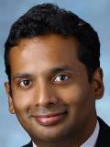
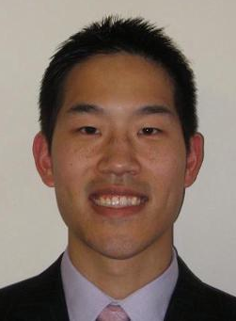
Additional Pediatric
Orthopaedic Faculty Mentors
Dr. Varghese has been at Hopkins for eight years. His interests include cerebral palsy, clubfoot, and hip dysplasia. He earned his medical degree at Kasturba Medical College in Mangalore, India and completed a residency in orthopaedic surgery at Kasturba Medical College in Mangalore, India. He has completed fellowships in pediatric orthopaedic surgery at Kasturba Medical College in India, Gillette Children’s Hospital, British Columbia Children’s Hospital in Vancouver, and a fellowship in orthopaedic oncology at Massachusetts General Hospital.
Ranjit A. Varghese, MBBS
Dr. Lee became a faculty member at Johns Hopkins in 2014. His research interests include sports medicine and resident education. Originally from California, he earned his medical degree at the Ohio State University and completed his residency in orthopaedic surgery at Hopkins. He pursued a fellowship in pediatric orthopaedics at the Children’s Hospital of Philadelphia.
R. Jay Lee, MD

Slide 8
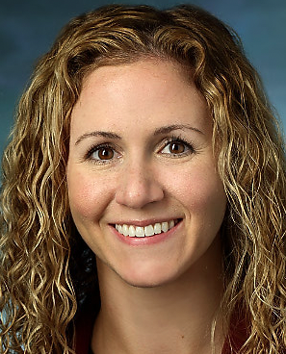
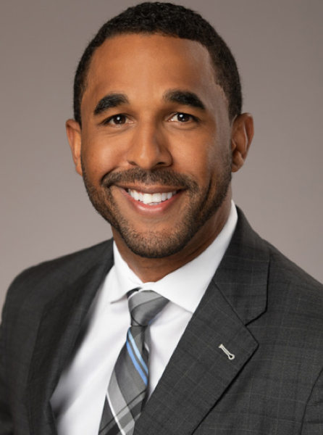
Additional Pediatric
Orthopaedic Faculty Mentors
Dr. Honcharuk is a new member of our department. Her areas of interest within pediatric orthopedics include congenital and childhood pathologies of the lower extremity such as leg-length discrepancy, hip dysplasia, joint instability, clubfoot, and bone dysplasias. Her medical degree is from Rutgers-Robert Wood Johnson Medical School in New Jersey. She completed her residency there and then trained as a pediatric orthopaedic fellow at the Texas Scottish Rite Hospital for Children in Dallas, Texas. She did an additional fellowship at the Paley Orthopaedic and Spine Institute in West Palm Beach, Florida, focusing on limb reconstruction and lengthening.
Erin Melissa Honcharuk, MD
Dr. Brandt is the newest member of our department. He specializes in hip conditions and traumatic injuries. He has expertise in treating children with hip dysplasia, limb deformities and fractures, as well as foot and ankle conditions. He is also trained in joint preservation and limb reconstruction procedures. He is interested in education and reducing health disparities. Dr. Brandt graduated from the New York University School of Medicine. He completed a residency in orthopaedic surgery at the Carolinas Medical Center/OrthoCarolina in Charlotte. He received additional training in limb reconstruction in with the Atrium Health RESTORE Central America in Honduras. He also completed a pediatric orthopaedic surgery fellowship at the Children’s Hospital Colorado in Denver.
Aaron Brandt, MD

Slide 9
Adam Margalit, Poggi Fellow
2015 –2016
Selected Abstracts and Presentations
Margalit A, McKean G, Lawing C, Galey S, Ain MC. Walking Out of the Curve: Thoracolumbar Kyphosis in Achondroplasia. SRS (Podium) 2016.
Margalit A, McKean G, Lee RJ, Sponseller PD. BMI Hides the Curve: Using the Scoliometer as a Referral Tool for Patients with Different BMIs. POSNA (Podium) 2016.
Lee RJ, Margalit A, Nduaguba A, Gunderson Mganley T. Collateral Ligament Injuries in the Setting of Anterior Cruciate Ligament (ACL) Tears in the Pediatric Population. POSNA (Podium) 2016
Margalit A, Ukwuani G, Lee RJ, Sponseller PD. Prophylactic Antibiotic Use in Pediatric Orthopaedic Surgery: Reducing Variability, Cost and Risks. POSNA (e-poster) 2016.
Margalit A, Yu L, Fritz J, Lee RJ. Using Magnetic Resonance Images to Assess the Order of Physeal Closure in the Normal Knee PRISM (e-poster) 2016.
Margalit A, Yu L, Lee RJ, Tis J. Arthroscopic Medial Imbrication for Patellar Instability. PRISM (e-poster) 2016.
Margalit A, McKean G, Constantine A, Thompson C, Lee RJ, Sponseller PD. BMI Hides the Curve: Using the Scoliometer as a Referral Tool for Patients with Different BMIs. First Johns Hopkins High-Value Practice Research Symposium (e-poster) 2016.
Margalit A, Ukwuani G, Lee RJ, Sponseller PD. Prophylactic Antibiotic Use in Pediatric Orthopaedic Surgery: Reducing Variability, Cost and Risks. First Johns Hopkins High-Value Practice Research Symposium (Podium) 2016.
Sullivan B, Margalit A, Garg V, Njoku D, Sponseller P. Operative Blood Pressure Monitoring in Patients with Osteogenesis Imperfecta. Johns Hopkins Seventh Annual Patient Safety Summit (podium) 2016.
Margalit A, Peddada KV, Remenapp C, Lee RJ. Non-operative Management of Salter-Harris II Fractures of the Distal Tibia. PRISM (poster) 2017.
Selected Papers/Publications
Margalit A, McKean G, Lawing C, Galey S, Ain MC. Walking Out of the Curve: Thoracolumbar Kyphosis in Achondroplasia. Journal of Pediatric Orthopaedics. 2016.
Suresh S, Margalit A, Sponseller PD. Evaluating the sagittal spinal and pelvic parameters in Marfan syndrome patients affected with scoliosis. The Spine Journal, Volume 16 , Issue 4 , S84 -S85.
Margalit A, Stein BE, Hassanzadeh H, Ain MC, Sponseller PD. Percutaneous Screw Fixation of Lateral Condylar Humerus Fractures. JBJS Essential Surgical Techniques Key Procedures. 2016.
Margalit A, Sponseller PD. Myelokyphectomy in Spina Bifida: The Modified Fackler/Sagittal Technique. Operative Techniques in Orthopaedics. 2016.
Lawing C, Margalit A, Ain M. Open Femur Fracture with Soft Tissue Loss. Pediatric Orthopedic Trauma Case Atlas. 2016

Slide 10
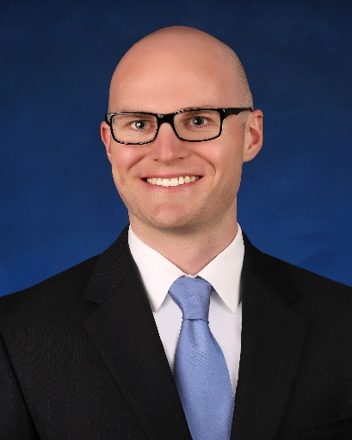
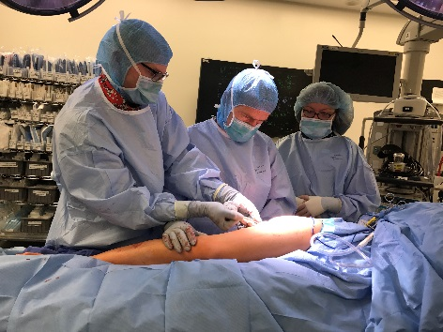
Brian Sullivan, Poggi Fellow
2016 –2017
Selected Abstracts and Presentations
Peddada KV, Sullivan BT, Margalit A, Sponseller PD. Fracture Patterns Differ Between Osteogenesis Imperfecta and Routine Pediatric Fractures. Podium presentation at AAP, Sep 16-19, 2017, Chicago, IL.
Hwang B and Sullivan BT. Practice-Specific Pathways for the Modern Physician. Podium at American Medical Association, ChangeMedEd 2017, Sep 14-16, Chicago, IL.
Sullivan BT, Abousamra O, Puvanesarajah V, Jain A, Hadad MJ, Sponseller PD. Deep Infections Differ Following Spinal Fusion for Idiopathic, Syndromic and Neuromuscular Deformity. Podium presentation IMAST July 14, 2017, Cape Town, South Africa.
Sullivan BT, Friedlander DA, Di Carlo HN, Sponseller PD, Gearhart JP. Pelvic osteotomy in the newborn classic bladder exstrophy closure: complications and outcomes. Featured Paper Presentation. 32nd Annual EAU Congress, March 27, 2017, London, England.
Sullivan BT, Margalit A, Garg V, Njoku D, Sponseller PD. Operative Blood Pressure Monitoring in Patients with Osteogenesis Imperfecta. Podium Presentation. 7th Annual Patient Safety Summit, Baltimore, MD. 14 October 2016.
Sullivan BT, Abousamra O, Tropf J, Sponseller PD. The Value of Spinal Aspiration in Diagnosing Deep Infections Following Spinal Fusion. Poster presentation at The Armstrong Institute, Diagnostic Summit 2017, April 20, 2017, Baltimore, MD.
Sullivan BT, Margalit A, Garg VS, Njoku D, Sponseller PD. Blood Pressure Cuffs are Safe in Osteogenesis Imperfecta. E-Poster Presentation. EPOSNA, May 3-6, 2017, Barcelona, Spain.
Selected Papers/Publications
Sullivan BT, BS; Jain A, MD; Aziz KT, MD; Khanna AJ, MD. Clinical and Radiographic Evaluation of Adult Spinal Deformities. Seminars in Spine Surgery, August 2017.
Homlar K, MD; Sullivan BT, BS; Sharma S, MD; Biddinger P, MD. Phosphaturic mesenchymal tumor: A single case report discussing diagnostic and therapeutic challenges of tumor induced osteomalacia. Accepted with revisions, AJSP: Reviews and Reports, August 2017.
Sullivan BT, BS; Margalit A, BS; Garg V, BS; Njoku D, MD; Sponseller PD, MD. Incidence of Fractures from Perioperative Blood Pressure Cuff Use, Tourniquet Use, and Patient Positioning in Osteogenesis Imperfecta. Accepted with revisions, J Pediatr Orthop on August 2017
Jain A, MD; Sullivan BT, BS; Kuwabara A, MD; Kebaish K, MD; Sponseller PD, MD, MBA. Sacral-Alar-Iliac Fixation in Children with Neuromuscular Scoliosis: Minimum 5-Year Follow-Up. Accepted with revisions, World Neurosurgery on July 2017.
Stroh DA, MD; Sullivan BT, BS; Shannon BA, MD; Sponseller PD, MD, MBA. Treatment of a Pediatric T-Type Intercondylar Humerus Fracture with Hybrid Percutaneous Pinning and External Fixation: A Case Report. 2017;Epub ahead of print, June 6.

Slide 11
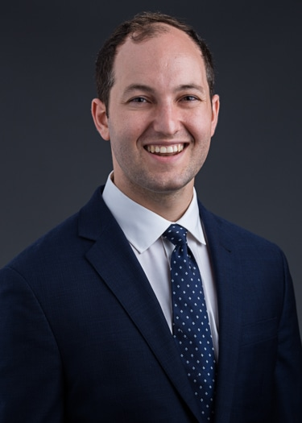
Walter Klyce, Poggi Fellow
2017 –2018
Selected Abstracts and Presentations
Klyce W, Fritz J, Ahlawat S, Fritz B, Thawait GK, Raithel E, Lee RJ. 10-minute 3D TSE MRI in Children with Acute Knee Trauma: Arthroscopy-based Diagnostic Accuracy for the Diagnosis of Internal Derangement. Podium presentation at Johns Hopkins Armstrong Institute Summit for Diagnostic Excellence, Baltimore, MD, April 2018. Accepted poster presentation at the Pediatric Research in Sports Medicine Society Annual Meeting, Atlanta, GA, January 2019. Accepted podium presentation at the AAOS Annual Meeting, Las Vegas, NV, March 2019.
Klyce W, Mitchell SL, Pawelek J…..Sponseller PD, Growing Spine Study Group. Characterizing Current Use in Growth-Friendly
Implants for Spinal Deformity: A Ten-Year Update. Accepted podium presentation at the International Congress for Early-Onset Scoliosis, Lisbon, Portugal, November 2018; and AAOS Annual Meeting, Las Vegas, NV, March 2019.
Klyce W, Toci G, Lee RJ, Shannon C. Let Them Have NSAIDs: Routine Pediatric Fracture Healing is Not
Impeded by Non-Steroidal Anti-Inflammatory Drugs. Accepted podium presentation at the AAOS Annual Meeting, Las Vegas, NV, March 2019.
Klyce W, Jain A, Parent S…..Sponseller PD, Harms Study Group. Pedicle Screw "Plowing" in
Adolescent Idiopathic Scoliosis: How Common Is It, and Is It a Problem? Accepted poster presentation at the AAOS Annual Meeting, Las Vegas, NV, March 2019.
Klyce W, Cottrill E, Nhan DT….Sponseller PD. A Rabbit Model for Physeal Function in Bladder Exstrophy: Resection of the Pubic Symphysis Leads to Progressive Deformation of the Pelvic Skeleton. Accepted moderated poster presentation at Societies for
Pediatric Urology Fall Congress, July 2018. Accepted poster to the AAOS Annual Meeting, June 2018.
Margalit A, Nhan DT, Klyce W, Venuti K, Sponseller PD. Optimizing Non-Operative Management in Adolescent Idiopathic Scoliosis: Increased Body Mass Associated with Decreased Bracing Outcomes. Accepted podium presentation to Scoliosis Research Society Annual Meeting, September 2018.
Selected Papers/Publications
Fritz J, Ahlawat S, Thawait GK, Raithel E, Klyce W, Lee RJ. 10-minute 3D TSE MRI in Children with Acute Knee Trauma: Arthroscopy-based Diagnostic Accuracy for the Diagnosis of Internal Derangement. Accepted with revisions, Journal of Magnetic Resonance Imaging, June 2018.
Nhan DT, Klyce W, Lee RJ. The Epidemiology of Alternative Racquet-Sport Injuries in the United States, 2007-2016. Orthopaedic Journal of Sports Medicine, July 2018.
Xin T, Yubo L, Mingfan P, Nhan DT, Klyce W, Fritz J, Lee RJ. An Abbreviated Scale for the Assessment of Skeletal Bone Age Using Radiographs of the Knee. Orthopedics, July 2018.
Klyce W, Lee RJ. Pediatric Problems and Rehabilitation Geared to the Young Athlete. Baxter’s Foot and Ankle in Sport, 3rd ed. Accepted for publication, Elsevier, February 2018.
Klyce W, Lee RJ. Osteochondritis Dissecans of the Knee. The 5-Minute Orthopaedic Consult, 3rd ed. Accepted for publication, Lippincott Williams & Wilkins, January 2018.

Slide 12
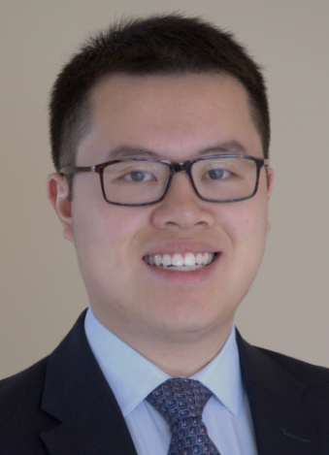
Derek Nhan, Poggi Fellow
2017 –2018
Selected Abstracts and Presentations
Nhan DT, Sponseller PD, Shufflebarger HL, Shah SA, Yaszay B, Marks MC, Newton PO, Harms Study Group. Single- Stage Implant Exchange Provides Less Correction Loss than Implant Removal Only Following Late Infections After Posterior Spinal Fusion for AIS. Podium Presentation. 53rd Annual Meeting & Course, Scoliosis Research Society. Oct 2018.
Nhan DT, Jain A, Sponseller PD, Sullivan BT, Shah SA, Samdani AF, Yaszay B, Abousamra O, Cahill PJ, Marks MC, Newton PO, Harms Study Group. Outcomes of Spinal Fusion in Children with Cerebral Palsy: Are We Getting Better? Podium Presentation. 53rd Annual Meeting & Course, Scoliosis Research Society. Oct 2018.
Nhan DT and Sponseller PD. Prune Belly Syndrome: Importance of Anterior Abdominal Musculature in Maintenance of Thoracic Kyphosis. Podium Presentation. 53rd Annual Meeting & Course, Scoliosis Research Society. Oct 2018.
Nhan DT. Margalit A, Sponseller PD, Lee RJ. Childhood Obesity is Associated with Greater Risk for Upper Extremity Physeal Fractures. Podium Presentation. Pediatric Orthopaedic Society of North America Annual Meeting. May 2018.
Nhan DT, Bryant BR, Kotian RN, Tis JE, Varghese R, Sponseller PD, and Lee RJ. Patient-Reported Functional Outcomes Following Treatment of Pediatric Lateral Humeral Condyle Fractures: Open Reduction is Better than Percutaneous for Operative Injuries. Podium Presentation. AAP 2018. November 2018.
Selected Papers/Publications
Nhan DT, Schoenecker JG, Sponseller PD. Are We Spending Wisely? Impact of POSNA Grants on Scholarly Productivity and Future Funding Success. J Pediatr Orthop. 2018 Sept 26. Published ahead-of-print.
Nhan DT, Robles Garcia M, Lee RJ. Bilateral Bicondylar Osteochondritis Dissecans in a Child with Spastic Diplegia and Crouch Gait. JBJS Case Connect. 2018 Apr-June; 8(2):e41.
Nhan DT, Klyce W, Lee RJ. Epidemiological Patterns of Alternative Racquet- Sport Injuries in the United States, 1997-2016. Orthop J Sports Med. 2018 Jul 23;6(7).
Xin T, Yubo L, Mingfan P. Nhan DT, Klyce W, Fritz J, Lee RJ. An Abbreviated Scale for the Assessment of Skeletal Bone Age Using Radiographs of the Knee. Orthopedics. 2018 Sep 1; 41(5)e676-680.
Nhan DT and Sponseller PD. Bilateral Anterior Innominate Osteotomies for Bladder Exstrophy. JBJS Essenti Surg Tech. Accepted 2018 Oct; In Press.
Nhan DT, Sponseller PD, Shufflebarger HL, Shah SA, Yaszay B, Marks MC, Newton PO, Harms Study Group. Single-Stage Implant Exchange Provides Less Correction Loss than Implant Removal Only Following Late Infections After Posterior Spinal Fusion for AIS. Spine. Accepted with revisions. September 2018.
Nhan DT, Sponseller PD, Jain A,..., and Harms Study Group. Outcomes of Spinal Fusion in Children with Cerebral Palsy Over the Last Decade: Are We Getting Better? Spine. Manuscript submitted Aug 2018.
Cleveland A, Nhan DT, Kleck CJ, Patel V. Limited Open Sacroiliac Joint Fusion Using Intraoperative Navigation to Guide Direct Sacroiliac Bone Grafting and Minimally Invasive Fixation. Global Spine J. Accepted 2018. In Press.
Margalit A, Cottrill E, Nhan DT, Yu L, Tang X, Fritz J, Lee RJ. Using Magnetic Resonance Imaging to Assess the Spatial Order of Physeal Maturation in the Normal Human Knee. J Pediatr Orthop. Accepted with revisions. September 2018.

Slide 13
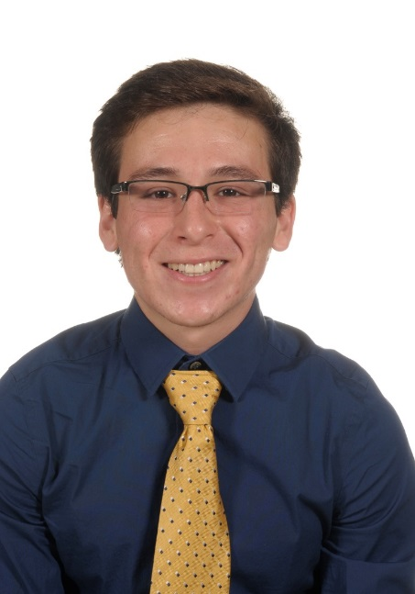
Francisco Eguia, Poggi Fellow
2018 –2019
Selected Abstracts and Presentations
Francisco Eguia, BA; Derek Nhan, BS; Suken Shah, MD; Amit Jain, MD; Amer Samdani, MD; Burt Yaszay, MD; Joshua Pahys, MD; Michelle Marks, PT; Paul Sponseller, MD, MBA. “Major Perioperative Complications After Spinal Fusion Do Not Influence Health-Related Quality of Life Outcomes in Children with Cerebral Palsy”. Podium Presentation at 2019 POSNA (Pediatric Orthopaedic Society of North America), Charlotte, North Carolina.
Francisco Eguia, BA; Brian Sullivan, MD; Patrick Cahill, MD; David Spiegel, MD; Keith Baldwin, MD; Suken Shah, MD; Burt Yaszay, MD; Peter Newton, MD; Paul Sponseller, MD, MBA. “Of Cerebral Palsy Patients Fused Short of the Pelvis, What Predicts Good Radiographic Results?”. Podium Presentation at 2019 POSNA, Charlotte, North Carolina.
Francisco Eguia, BA; Caleb Gottlich, BS, MS; Sherif Hassan MBBS, PhD; Molly Vora, BS; Walter Klyce, BS; Rushyuan Jay Lee, MD. “Pediatric Supracondylar Fractures: Do Pre/Postoperative Radiographic Criteria Predict Long-Term Outcomes?”. Podium Presentation at 2019 MOA (Maryland Orthopaedic Association), Annapolis, MD.
Francisco Eguia, BA; Caleb Gottlich, BS, MS; Gilberto Lobaton, BS; Kareem Kebaish, BS; Marcus Daniels, BS; Paul Sponseller, MD, MBA. “Can We Predict Choice of Academic Career in Orthopaedic Surgery?”. Poster Presentation at 2019 Johns Hopkins Medical Students Research Symposium, Baltimore, Maryland.
Francisco Eguia, BA; Brian Sullivan, MD; Patrick Cahill, MD; David Spiegel, MD; Keith Baldwin, MD; Suken Shah, MD; Burt Yaszay, MD; Peter Newton, MD; Paul Sponseller, MD, MBA. “Consider these Factors to end Fusion Short of the Pelvis in Children with CP?” Submitted to SRS and IMAST 2019
Francisco Eguia, BA; Caleb Gottlich, MS; Peter G. Gabos, MD; Paul D. Sponseller, MD, MBA. “Diaphragm Intrusion and Thoracic Dimensions Improve Following PSF in CP Scoliosis”. Submitted to SRS and IMAST 2019
Walter Klyce, BA; Francisco Eguia, BA; Derek Nhan, BS; Lana Nirenstein, MD; Mari Groves, MD; Kristen Venuti, CRNP; Paul D. Sponseller, MD, MBA. “A Rule of Thumb: The Thumb Ossification Composite Index (TOCI) to Assess Bone-Age in Scoliosis Patients under Low-Dose Imaging”. Submitted to SRS and IMAST 2019
Francisco Eguia, BA; Itai Gans, MD; Jacob Joseph, BA; Jorge Rojas, MD; Uma Srikumaran, MD; Edward McFarland, MD. “Is Handgrip Strength Associated with Clinical Outcomes after Total Shoulder Arthroplasy?”. Submitted to International Congress of Shoulder and Elbow Surgery 2019 and Southern Orthopaedic Association Annual Meeting 2019.
Francisco Eguia, BA; Uma Srikumaran, MD. “Minimal Clinically Important Differences (MCID) in ASES, Subjective Shoulder Value, and Visual Analog Pain Scale, and Preoperative Predictors of Reaching an MCID after Biceps Tenodesis.” Submitted to International Congress of Shoulder and Elbow Surgery 2019 and Southern Orthopaedic Association Annual Meeting 2019.
Selected Papers/Publications
Francisco Eguia, BA; Caleb Gottlich, BS, MS; Gilberto Lobaton, BS; Kareem Kebaish, BS; Marcus Daniels, BS; Paul Sponseller, MD, MBA. “Can We Predict Choice of Academic Career in Orthopaedic Surgery?”. Researcher Prep
Francisco Eguia, BA; Derek Nhan, BS; Suken Shah, MD; Amit Jain, MD; Amer Samdani, MD; Burt Yaszay, MD; Joshua Pahys, MD; Michelle Marks, PT; Paul Sponseller, MD, MBA. “Major Perioperative Complications After Spinal Fusion Do Not Influence Health-Related Quality of Life Outcomes in Children with Cerebral Palsy”. Researcher Prep
Francisco Eguia, BA; Brian Sullivan, MD; Patrick Cahill, MD; David Spiegel, MD; Keith Baldwin, MD; Suken Shah, MD; Burt Yaszay, MD; Peter Newton, MD; Paul Sponseller, MD, MBA. “Consider these Factors to end Fusion Short of the Pelvis in Children with CP?”. Researcher Prep
Francisco Eguia, BA; Caleb Gottlich, BS, MS; Sherif Hassan MBBS, PhD; Molly Vora, BS; Walter Klyce, BS; Rushyuan Jay Lee, MD. “Pediatric Supracondylar Fractures: Do Pre/Postoperative Radiographic Criteria Predict Long-Term Outcomes?”. Researcher Prep

Slide 14
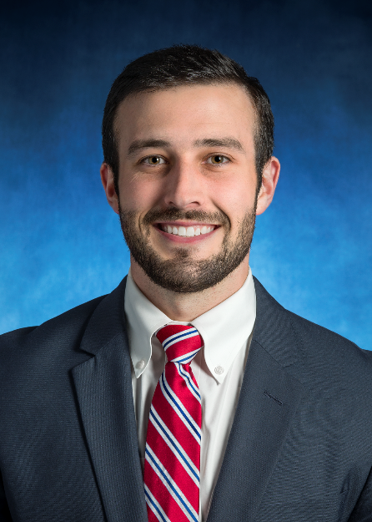
Caleb Gottlich, Poggi Fellow
2018 –2019
Selected Abstracts and Presentations
Gottlich C, Nhan D, Sponseller PD. The Prevalence of Orthopedic Complications in Inborn Errors of Metabolism. AAP/ASCI/APSA Joint Annual Meeting. April 6th, 2019
Bryant B, Gottlich C, Nhan D, Sullivan B, Sponseller PD. Cochlear Implants in Scoliosis Patients: A Review and Survey. Submitted to IMAST/SRS
Gottlich C, Margalit A, Alenezy N, Biros J, Lee RJ. Operative and Non-Operative Management of Medial Epicondyle Fractures of the Distal Humerus. E-poster presentation at Maryland Orthopedic Association Feb 9th, 2019.
Francisco Eguia, BA; Caleb Gottlich, BS, MS; Sherif Hassan MBBS, PhD; Molly Vora, BS; Walter Klyce, BS; Rushyuan Jay Lee, MD. “Pediatric Supracondylar Fractures: Do Pre/Postoperative Radiographic Criteria Predict Long-Term Outcomes?”. Podium Presentation at 2019 MOA (Maryland Orthopaedic Association), Annapolis, MD.
Francisco Eguia, BA; Caleb Gottlich, BS, MS; Gilberto Lobaton, BS; Kareem Kebaish, BS; Marcus Daniels, BS; Paul Sponseller, MD, MBA. “Can We Predict Choice of Academic Career in Orthopaedic Surgery?”. Poster Presentation at 2019 Johns Hopkins Medical Students Research Symposium, Baltimore, Maryland.
Francisco Eguia, BA; Caleb Gottlich, MS; Peter G. Gabos, MD; Paul D. Sponseller, MD, MBA. “Diaphragm Intrusion and Thoracic Dimensions Improve Following PSF in CP Scoliosis”. Submitted to SRS and IMAST 2019
Gottlich C, Rao S, Williams R. A Case of Cancer Mistaken for Infection. Poster Presentation at Johns Hopkins 13th Annual Research Symposium. December 6th, 2018
Gottlich C, Spector C, Lee RJ. Patient Reported Outcomes in Lyme Arthirits. Poster Presentation at Johns Hopkins 13th Annual Research Symposium. December 6th, 2018
Selected Papers/Publications
Francisco Eguia, BA; Caleb Gottlich, BS, MS; Sherif Hassan MBBS, PhD; Molly Vora, BS; Walter Klyce, BS; Rushyuan Jay Lee, MD. “Pediatric Supracondylar Fractures: Do Pre/Postoperative Radiographic Criteria Predict Long-Term Outcomes?”. Researcher Prep
Francisco Eguia, BA; Caleb Gottlich, BS, MS; Gilberto Lobaton, BS; Kareem Kebaish, BS; Marcus Daniels, BS; Paul Sponseller, MD, MBA. “Can We Predict Choice of Academic Career in Orthopaedic Surgery?”. Researcher Prep
Gottlich C, Sponseller PD. Ponte Osteotomy Essental Surgical Techniques. Research Prep for JBJS EST.
Harris A, Puvanesarajah V, Marrache M, Gottlich C, Raad M, Skolasky RL, Njoku DB, Sponseller PD, Jain A. Opioid Prescribing Practices after Posterior Spinal Arthorodesis for Adolescent Idiopathic Scoliosis. Submitted to JBJS and pending
Gottlich C. Review of Pembrolizumab and other Anti PD-1/ PD-L1 Antibodies. Glob J of Pharmaceu Sci. 2018; 6(5)555696.

Slide 15
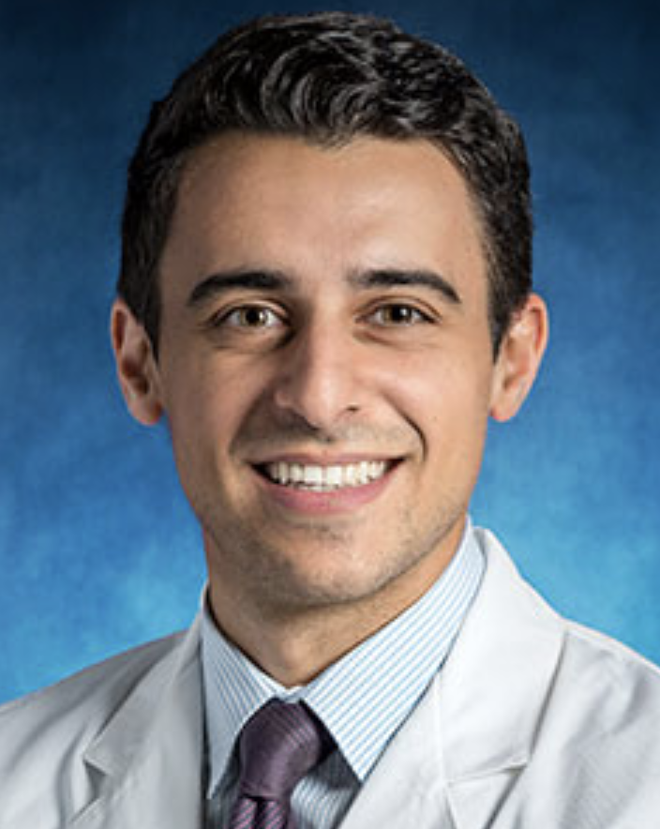
Majd Marrache, Poggi Fellow
2019 –2020
Selected Publications:
Marrache M, Byers PH, Sponseller PD. Orthopaedic Conditions Associated with Aneurysms. JBJS Rev. 2020 Jun;8(6):e0122. doi: 10.2106/JBJS.RVW.19.00122. PMID: 33006458.
Marrache M, Best MJ, Raad M, Mikula JD, Amin RM, Wilckens JH. Opioid Prescribing Trends and Geographic Variation After Anterior Cruciate Ligament Reconstruction. Sports Health. 2020 Nov/Dec;12(6):528-533. doi: 10.1177/1941738120954432. Epub 2020 Sep 23. PMID: 32966157; PMCID: PMC7785898.
Marrache M, Harris AB, Puvanesarajah V, Sponseller PD. Seasonal Variation in the Volume of Posterior Spinal Arthrodesis Procedures for Pediatric Scoliosis. Spine (Phila Pa 1976). 2020 Sep 15;45(18):1293-1298. doi: 10.1097/BRS.0000000000003517. PMID: 32341304.
Marrache M, Harris AB, Puvanesarajah V, Raad M, Hassanzadeh H, Srikumaran U, Ficke JR, Levy JF, Jain A. Hospital Payments Increase as Payments to Surgeons Decrease for Common Inpatient Orthopaedic Procedures. J Am Acad Orthop Surg Glob Res Rev. 2020 Apr 1;4(4):e20.00026. doi: 10.5435/JAAOSGlobal-D-20-00026. PMID: 32377615; PMCID: PMC7188271.
Marrache M, Harris AB, Raad M, Puvanesarajah V, Pakpoor J, Bicket MC, Hassanzadeh H, Jain A. Preoperative and Postoperative Spending Among Working-Age Adults Undergoing Posterior Spinal Fusion Surgery for Degenerative Disease. World Neurosurg. 2020 Jun;138:e930-e939. doi: 10.1016/j.wneu.2020.03.143. Epub 2020 Apr 3. PMID: 32251816.
Marrache M, Bronheim R, Harris AB, Puvanesarajah V, Raad M, Lee S, Skolasky R, Jain A. Synthetic Cages Associated With Increased Rates of Revision Surgery and Higher Costs Compared to Allograft in ACDF in the Nonelderly Patient. Neurospine. 2020 Dec;17(4):896-901. doi: 10.14245/ns.2040216.108. Epub 2020 Dec 31. PMID: 33401868; PMCID: PMC7788413.
Marrache M, Harris AB, Puvanesarajah V, Raad M, Hassanzadeh H, Riley LH, Skolasky RL, Bicket M, Jain A. Health Care Resource Utilization in Commercially Insured Patients Undergoing Anterior Cervical Discectomy and Fusion for Degenerative Cervical Pathology. Global Spine J. 2021 Jan;11(1):108-115. doi: 10.1177/2192568219899340. Epub 2020 Jan 14. PMID: 32875850; PMCID: PMC7734273.

Slide 16
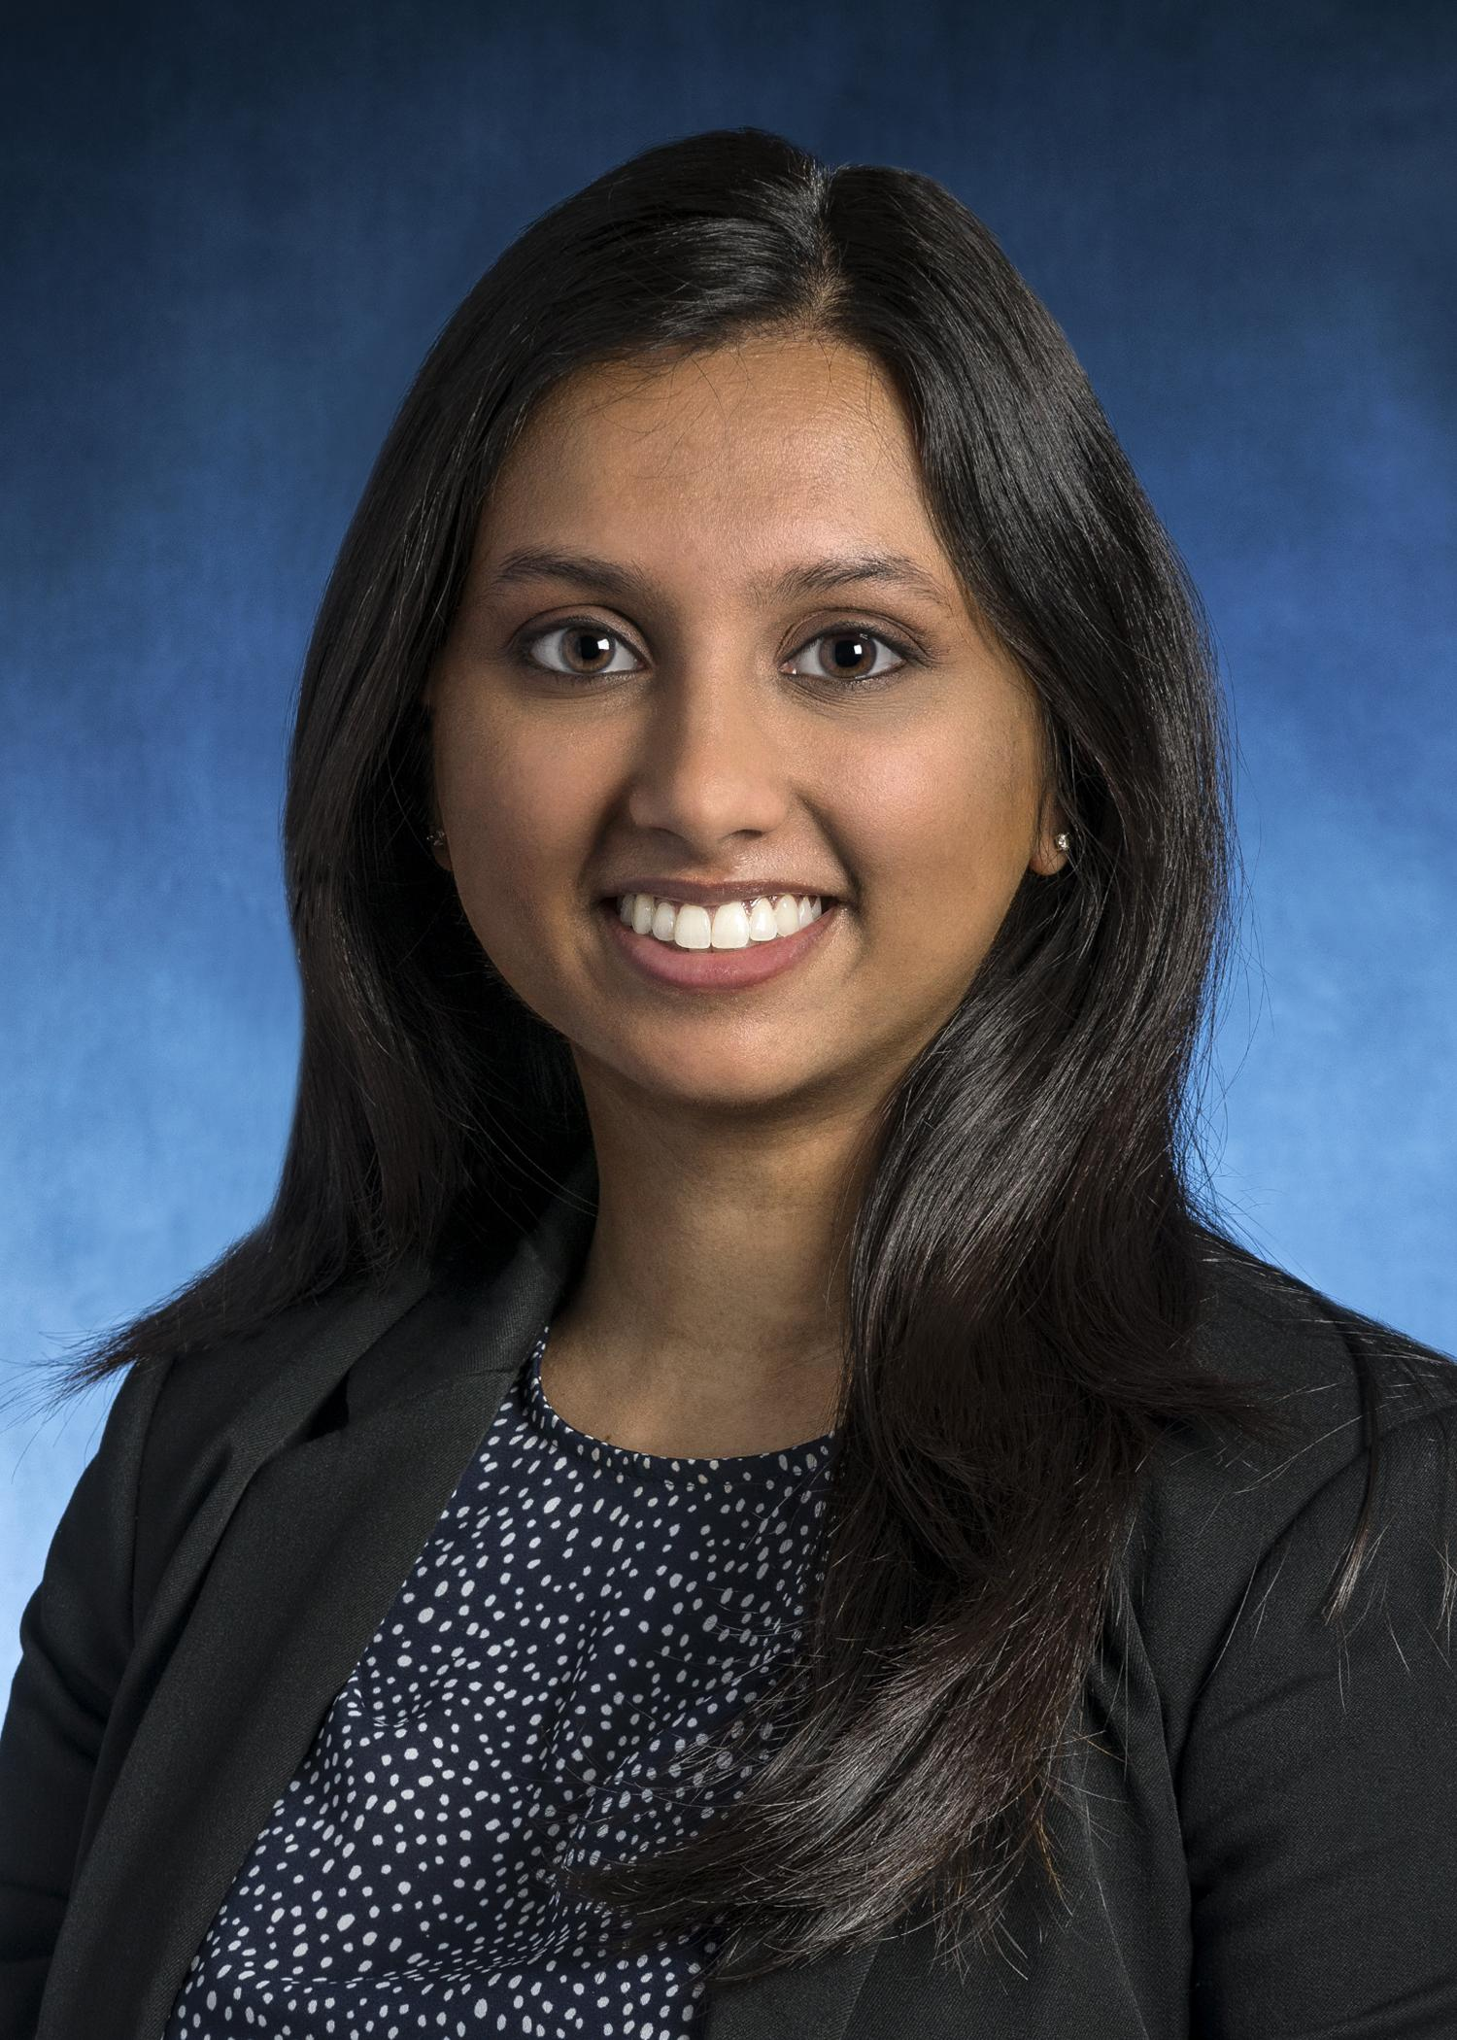
Niyathi Prasad, Poggi Fellow
2019 –2020
Selected Publications:
Prasad, N., Hamosh, A., & Sponseller, P. (2021). Orthopaedic Manifestations of Inborn Errors of Metabolism. JBJS reviews, 9(7), e20.
Prasad, N., Gottlich, C., Nhan, D., Hamosh, A., & Sponseller, P. D. (2021). Orthopaedic Problems in 35 Patients With Organic Acid Disorders. Journal of Pediatric Orthopaedics, 41(6), e457-e463.
Jami, M., Marrache, M., Puvanesarajah, V., Raad, M., Prasad, N., & Jain, A. (2021). Treatment of Neck Pain with Opioids in the Primary Care Setting: Trends and Geographic Variation. Pain Medicine, 22(3), 740-745.
Lee, S. H., Prasad, N., & Jain, A. (2020, December). Cervical fixation in the elderly. In Seminars in Spine Surgery (Vol. 32, No. 4, p. 100829). WB Saunders.
Tibial Spine Research Group, Prasad, N., Aoyama, J. T., Ganley, T. J., Ellis Jr, H. B., Mistovich, R. J., ... & Lee, R. J. (2021). A Comparison of Nonoperative and Operative Treatment of Type 2 Tibial Spine Fractures. Orthopaedic Journal of Sports Medicine, 9(1), 2325967120975410.

Slide 17
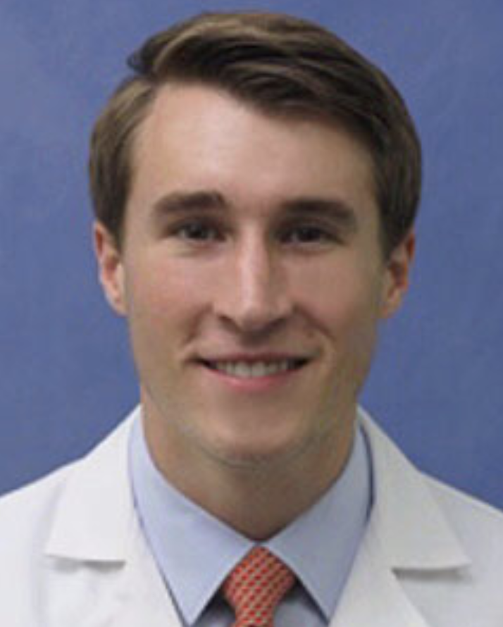
Graham Beutler, Poggi Fellow
July 2019 – February 2020
Selected Publications and Abstract Presentations:
Beutler, G.J., Sponseller, P.D. “Pelvic Fixation for Neuromuscular Scoliosis” Chapter 76 in Operative Techniques in Orthopaedic Surgery: Pediatric Volume. 3rd Edition. Accepted with expected publication in March 2021.
Anil, U., Badri, A., Pham, H., Beutler, G.J., Strauss, E., Alaia, M., Jazrawi, L., & Campbell, K. A. (2020). “Perioperative Antibiotic Utilization by Orthopedic Surgeons in Arthroscopic Surgery: A Survey of Practice Patterns” Bulletin of the Hospital for Joint Diseases (2013), 78(2), 97-100.
Beutler, G.J., Shah, S.A., Shufflebarger, H.L., Newton, P.O., Lonner, B.S., Sponseller, P.D. “Disc Height Predicts Recurrent Deformity Following Implant Removal in AIS Patients” Manuscript in preparation. Beutler, G.J., Atwater, L.C., Davidson, L., Dietz, H.C., Sponseller, P.D. “Talipes equinovarus in Loeys-Dietz Syndrome” Manuscript in preparation.
Beutler, G.J., Sullivan, B., Jain, A., Kebaish, K., Sponseller, P.D. “Late Spinal Infections Are Five Times More Common in Pediatric vs. Adult Deformity Patients” Manuscript in preparation.
Hayashi, B., Beutler, G.J., Margalit, A., Lewallen, L., Lee, R.J., Sponseller, P.D. “Intramedullary Screw Fixation for Pediatric Olecranon Fractures: Case Series Review” Manuscript in preparation.
Beutler, G.J., Chan, D.S., Konsin, Z.B., Oral, E., Muratoglu, O.K. “Layered UHMWPE as a Bearing
Beutler, G.J., Sullivan, B., Jain, A., Kebaish, K., Sponseller, P.D. “Late Spinal Infections Are Five Times More Common in Pediatric vs. Adult Deformity Patients” Abstract and Eposter at Scoliosis Research Society (SRS) 55th Annual Meeting; Phoenix, AZ (2020).

Slide 18
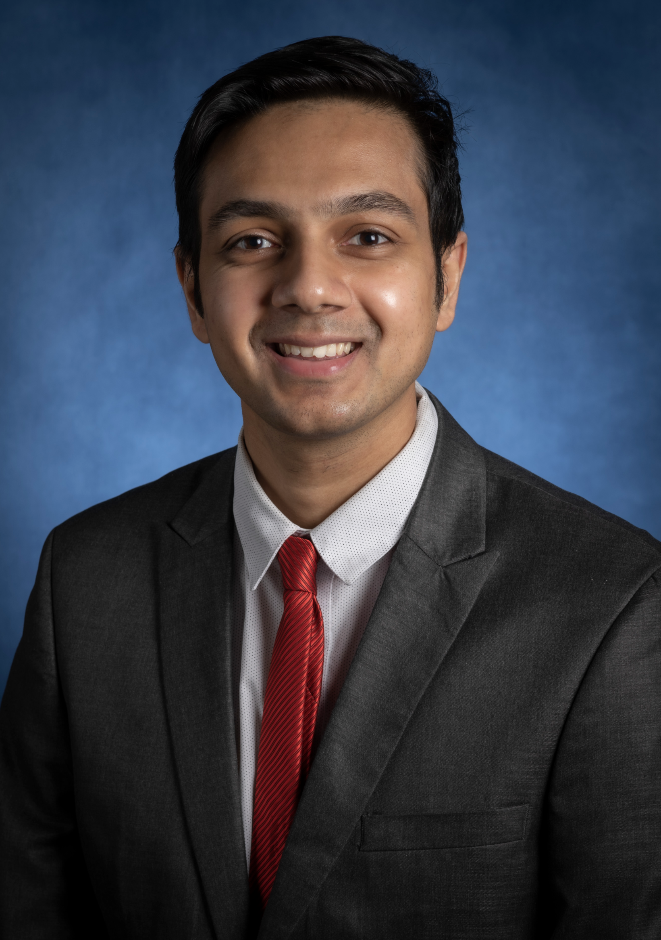
Krishna V. Suresh, Poggi Fellow
July 2020 – February 2021
Selected publications
Suresh KV, Wang KY, Margalit A, Jain A. Trends in Out-of-Pocket Healthcare Expenses before and after passage of the Affordable Care Act. JAMA Network Open.2021. [Accepted-In Press]
Suresh KV, Wang KY, Sethi I, Zhang B, Margalit A, Puvanesarajah V, Jain A. Spine Surgery and Preoperative Hemoglobin, Hematocrit, and Hemoglobin A1c: A Systematic Review. Global Spine Journal. 2020. [Accepted - In Press]
Raad M*, Suresh KV*, Puvanesarajah V, Forsberg J, Morris C, Levin A. The Pathologic Fracture Mortality Index: A Novel Externally Validated Tool for Predicting 30-day Postoperative Mortality, JAAOS. 2021. [Accepted-Pending Revisions]. *Co-first authorship
Suresh KV, Revak T. Dual vs. Lateral Plating for Bicondylar Tibial Plateau Fractures: Factors Influencing Decision Making. Mid-America Orthopaedic Association. 2021 [Accepted Podium Presentation]
Suresh KV, Sponseller PD. Pediatric Limb Reconstruction in Osteogenesis Imperfecta. Osteogenesis Imperfecta. Elsevier. 2021 [Accepted-Book Chapter]
Suresh KV, Sponseller PD. Osteochondroma: A Comprehensive Handbook of Spinal Surgery. Spring Nature. 2021 [Accepted-Book Chapter]
Suresh KV, Sponseller PD. Osteoid Osteoma and Osteoblastoma: A Comprehensive Handbook of Spinal Surgery. Spring Nature. 2021 [Accepted-Book Chapter]
Suresh KV, Sponseller PD. Syndromic Scoliosis: A Comprehensive Handbook of Spinal Surgery. Spring Nature. 2021 [Accepted-Book Chapter]
Suresh KV, Marrache M, Miller D, Hwang S, Schorry E, Rios J, Sponseller PD. Early-Onset Spinal Deformity in Neurofibromatosis Type 1: Natural History, Treatment, and Imaging Surveillance. JBJS Reviews. 2021 [Accepted-Pending revisions]
Wang KY, Suresh KV, Puvanesarajah V, Raad M, Margalit A, Jain A. Using predictive modeling and machine learning to identify patients appropriate for outpatient ACDF. Spine. 2020. [Accepted - In Press]
Xu A, Suresh KV, Lee RJ. Progress in cheerleading: An update on the Epidemiology of Cheerleading-Related Injuries Presenting to Emergency Departments in the US. AOSSM. 2021. [Accepted-Poster Presentation]
Margalit A, Suresh KV, Hayashi B. Sponseller PD. Surgical Treatment of Unstable Pelvic Ring Injury in a Young Child: A Case Report. JBJS Case Connector. 2021. [Accepted]
Suresh KV, Karius A, Sadowsky C, Sponseller PD. Scoliosis in Pediatric patients with Acute Flaccid Myelitis. Topics in Spinal cord Rehabilitation. 2021.
Suresh KV, Ikwuezunma I, Margalit A, Sponseller PD. Spinal Fusion with SAI Pelvic Fixation in Severe Neuromuscular Scoliosis. JBJS Essential Surgical Techniques. 2021.
Margalit A, Mixa P, Day L, Marrache M, Mitchell S, Suresh KV, Wang KY, Sabharwal S, Li TP, Loeb A, Naziri Q, Henn F, LaPorte D. Do the Three Top Learning Platforms for Orthopedic In Training Knowledge Produce Different Results? JAAOS. 2021.
Wang KY, Suresh KV, Harris A, Marrache M, Levy J, Jain A. Out-of-Network Billing in Elective Orthopaedic Surgery. JAAOS. 2021
Selected Submitted Papers undergoing review
Suresh KV, Wang KY, Ikwuezunma I, Margalit A, Puvanesarajah V, Lee R, Lee S, Jain A. Complications following posterior cervical arthrodesis for cervical spondylotic myelopathy: a single institution’s experience. World Neurosurgery. 2021 [Submitted]
Suresh KV, Xu A, Ingari J, Tuffaha S, Strike S, LaPorte D, Margalit A. Suture Reconstruction for Scapholunate Ligament Injuries: Postoperative and Patient Reported Outcomes in a Single Institution. Hand. 2021. [Submitted]
Suresh KV, Ikwuezunma I, Margalit A, Babu J, Jain A. Minimally Invasive Lateral Access and Robotic Spinal Fusion Surgery. Orthopaedic Video Theatre American Academy of Orthopaedic Surgeons. 2021.
Margalit A, Suresh KV, Marrache M, Lee RJ, Tis J, Varghese R, Hayashi B, Jain A, Sponseller PD, LaPorte D. Slipped Capital Femoral Epiphysis Surgical Simulation for the Orthopaedic Trainee: Does Surgical Training in Virtual Reality Translate to Improved Surgical Technique?. JAAOS. 2021
Margalit A, Suresh KV, Zhang B, Puvanesarajah V, Jain A. Robotics in Spine Surgery: The History, Current State, Clinical Outcomes, and Future Directions. Neurospine. 2021.
Mackenzie J, Suresh KV, Margalit A, Shafiq B, Zirkle L, Ficke J. Rate of Tibiotalocalcaneal (TTC) Fusion Using the Surgical Implant Generation Network (SIGN) Intramedullary Nail in Developing Countries. 2021.

Slide 19
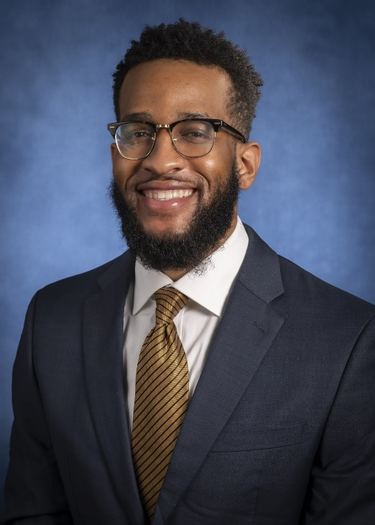
Ijezie Ikwuezunma, Poggi Fellow
August 2020 – February 2021
Selected Projects, Presentations and Publications:
Ikwuezunma IA, Sponseller PD. Surgical Evaluation and Management of Spinal Pathology in Patients with Connective Tissue Disorders. Syndromic Neurosurgery. 2021 [Accepted]
Ikwuezunma IA, Suresh KV, Nhan DT, Bryant BR, Kotian, Lee RJ. Patient-Reported Outcomes after Operative versus Nonoperative Treatment of Pediatric Lateral Humeral Condyle Fractures. Medicine. 2021 [Submitted]
Ikwuezunma IA, Beutler G, Margalit A, Jain A, Kebaish KM, Sponseller PD. Late Spinal Infections More Common Among Pediatric than Adult Spinal Deformity Surgery. JBJS. 2021 [Completed, pending revisions]
Ikwuezunma IA, Wang KY, Margalit A, Sponseller PD, Jain A. Cost-Utility Analysis Comparing Bracing vs. Observation for Skeletally Immature Patients with Thoracic Scoliosis. Spine. 2021 [Completed, pending revisions]
Ikwuezunma IA, Sponseller PD. Tranexamic Acid Use is Associated with Reduced Intraoperative Blood Loss during Spine Surgery in Marfan Syndrome. JBJS. 2021 [Completed, pending revisions]
Ikwuezunma IA, Sponseller PD. The Case of the Missing Vertebra. JBJS Case Connector [Completed, pending revisions]
Ikwuezunma IA, Wang KY, Raymond S, Sponseller PD, Jain A, Margalit A. Postoperative Height Gain following Spinal Fusion for Lenke 1 Thoracic Adolescent Idiopathic Scoliosis: Comparison Study of 5 Explanatory Models. Spine. 2021 [Completed, pending revisions]
Ikwuezunma IA, Rahman R, Humbyrd C. The Impact of Neighborhood Disadvantage on Utilization of Pediatric Orthopedic Services. CORR. 2021 [Completed pending revisions]
Ikwuezunma IA, Civilette MD, Rate WR, Haislup BD, Cohen AS, Bodendorfer BM, Gould HP. The 100 Most Impactful Articles on the Meniscus: An Altmetric Analysis of Online Media. American Journal of Sports Medicine. 2021 [Completed, pending revisions]
Ikwuezunma IA, Andras L, Marrache M, Sponseller PD, NM RIG. Which Neuromuscular Disorders Benefit most from Growth-Friendly Scoliosis Treatment? JBJS. 2021 [Near completion]
Ikwuezunma IA, Wang KY, Jain A. Racial Disparities in Spine Care: Systematic Review & The Societal Cost of Disparities in Treatment of Symptomatic Cervical Myelopathy [Robert Gladden Orthopaedic Society Grant Recipient]
Loeb AE, Ikwuezunma IA, Marrache M, LaPorte DM, Bernard JA. Objective Measures of Surgical Competence for the ACGME Meniscal Injury Milestone: Cadaveric Meniscectomy and Meniscus Repair Assessed with Arthroscopic Video. JBJS. 2021 [Completed, pending revisions]
Wang KY, Ikwuezunma IA, Puvanesarajah V, Babu J, Margalit A, Raad M, Jain A. Using Predictive Modeling and Supervised Machine Learning to Identify Patients at Risk for Venous Thromboembolism following Posterior Lumbar Fusion. Global Spine Journal. 2021 [Submitted}
Suresh KV, Ikwuezunma I, Margalit A, Sponseller PD. Spinal Fusion with SAI Pelvic Fixation in Severe Neuromuscular Scoliosis. JBJS Essential Surgical Techniques. 2021. [Submitted]
Suresh KV, Wang KY, Ikwuezunma I, Margalit A, Puvanesarajah V, Lee R, Lee S, Jain A. Complications following posterior cervical arthrodesis for cervical spondylotic myelopathy: a single institution’s experience. World Neurosurgery. 2021 [Submitted]
Suresh KV, Ikwuezunma I, Margalit A, Babu J, Jain A. Minimally Invasive Lateral Access and Robotic Spinal Fusion Surgery. Orthopaedic Video Theatre American Academy of Orthopaedic Surgeons. 2021. [Submitted]

Slide 20
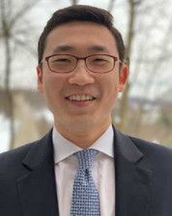
Frederick Mun, Poggi Fellow
2021-2022
Selected Publications
Mun F, Badin D, Snow M, Harris AB, LaPorte DM, Aiyer AA. AAMC Guidance on Interviewing for the 2022-2023 Residency Cycle: Orthopaedic Program Director Perspectives. Journal of Bone and Joint Surgery Open Access. 2022. [Provisional Acceptance]
Alley M, Tornetta P, Orthopaedic Trauma Research Consortium (OTRC). Risk Factors for Avascular Necrosis After Talar Fractures. Journal of Orthopaedic Trauma. 2022. [Provisional Acceptance] *Lead Author for Site
Mun F, Suresh KV, Pollak AC, Morris CD. Professional Societies for Early-Career Orthopaedic Surgeons: How can I get involved? Journal of the American Academy of Orthopaedic Surgeons. 2022. [Accepted, Print Pending]
Mun F, Suresh KV, Hayashi B, Margalit A, Sponseller PD, Lee RJ. Compression Screw Fixation for Pediatric Olecranon Fractures. Journal of Pediatric Orthopaedics. 2022. [Accepted, Print Pending]
Mun F, Suresh KV, Li TP, Aiyer AA, LaPorte DM. Preference Signaling for Orthopaedic Surgery Residency Applicants: A Survey of Program Directors. Journal of the American Academy of Orthopaedic Surgeons. 2022 Sep 9. doi: 10.5435/JAAOS-D-22-00478. Epub ahead of print. PMID: 36094792.
Mo K, Ikwuezunma I, Mun F, Ortiz-Babilonia C, Wang KY, Suresh KV, Mesfin A, Jain A. Racial Disparities in Spine Surgery: A Systematic Review. Clinical Spine Surgery. 2022 Aug 22. doi: 10.1097/BSD.0000000000001383. Epub ahead of print. PMID: 35994052.
Xu AL, Mun F, Gupta A, Margalit A, Prasad N, Lee RJ. The Financial Burden of Pediatric Anterior Cruciate Ligament Reconstruction. Journal of Pediatric Orthopaedics. 2022 Aug 8. doi: 10.1097/BPO.0000000000002230. Epub ahead of print. PMID: 35941092.
Mun F, Suresh SJ, Marrache M, Suresh KV, Ikwuezunma I, Lee RJ. Minimizing the Risk of Vascular Injury: Anatomy of the Popliteal Artery in the Pediatric Knee. Journal of Pediatric Orthopaedics. 2022 Sep 1;42(8):e847-e851. doi: 10.1097/BPO.0000000000002208. Epub 2022 Jul 13. PMID: 35819314.
Mun F, Vankara A, Suresh KV, Margalit A, Kebaish KM, Sponseller PD. Sacral-Alar-Iliac (SAI) Fixation in Children With Spine Deformity: Minimum 10-Year Follow-Up. Journal of Pediatric Orthopaedics. 2022 Aug 1;42(7):e709-e712. doi: 10.1097/BPO.0000000000002187. Epub 2022 May 17. PMID: 35575763.
Mun F, Vankara A, Suresh KV, Margalit A, Crasta N, Sponseller PD. Pelvic Osteotomy in Patients with Previous Sacral-Alar-Iliac (SAI) Fixation. Journal of Pediatric Orthopaedics. 2022 Aug 1;42(7):376-381. doi: 10.1097/BPO.0000000000002166. Epub 2022 May 5. PMID: 35522850.
Mun F, Vankara A, Suresh KV, Margalit A, Sponseller PD. Sacral-Alar-Iliac (SAI) Fixation in Patients with Previous Pelvic Osteotomy. Clinical Spine Surgery. 2022 May 3. doi: 10.1097/BSD.0000000000001339. Epub ahead of print. PMID: 35501910.
Nayar SK, Li TP, Mun F, Lentz JM, Lee RJ. Distal clavicle fixation with nonabsorbable suture in a pediatric patient: a case report. JSES Reviews, Reports & Techniques. Epub ahead of print. 2022 April 8. doi: 10.1016/j.xrrt.2022.03.0001.
The ICM-VTE Pediatric Delegates. Recommendations from the ICM-VTE: Pediatric. Journal of Bone and Joint Surgery. 2022 Mar 16;104(Suppl 1):238-251. doi: 10.2106/JBJS.21.01513. PMID: 35315612. *Lead Author for Site
Lentz JM, Mun F, Suresh KV, Groves ML, Sponseller PD. How and When to Use Hooks to Improve Deformity Correction. Journal of the Pediatric Orthopaedic Society of North America. 2021 November 1. Volume 3, No 4.

Slide 21
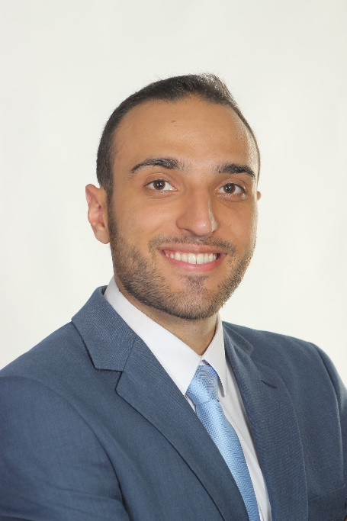
Daniel Badin
2021-2022
Select Publications
Badin D, Shah SA, Narayanan UG, Cahill PJ, Marrache M, Samdani AF, Yaszay B, Hunsberger JB, Marks MC, HARMS Study Group, Sponseller PD. 15 years of spinal fusion outcomes in children with cerebral palsy: are we getting better? Spine (Phila Pa 1976)
Gupta A, Badin D, Ortiz-Babilonia C, Davidson AJ, Lee RJ. Is delayed anterior cruciate ligament reconstruction associated with a risk of “new” meniscal tears? Reevaluating a longstanding paradigm. Orthop J Sports Med.
Margalit A, Badin D, Sponseller PD. Even When Bracing Fails to Prevent Surgery, it May Improve the Lumbar Curve in Patients with Adolescent Idiopathic Scoliosis. J Surg Orthop Adv. August 2023
Harris AB, Vankara A, McDaniel C, Badin D, Laporte D, Aiyer A. Match Rates Among Underrepresented Minority and Female Applicants to Orthopaedic Surgery Residency Programs from 2011-2021: How Are We Doing? JBJS Open Access. July 2023.
Gupta A, Singh P, Badin D, Mo KC, Greenberg M, Musharbash FN, Hughes AJ, Ficke JR, Aiyer AA. Racial disparities in lower extremity orthopaedic injuries presenting to U.S. emergency departments from 2010–2020. Trauma.
Gupta A, Badin D, Leland CR, Vitale MG, Sponseller PD. Updating the evidence: Systematic literature review of risk factors and strategies for prevention, diagnosis, and treatment of surgical site infection after pediatric scoliosis surgery. J Pediatr Orthop. July 10, 2023. DOI: 10.1097/BPO.0000000000002464
Badin D, Mun F, Akbarnia BA, Perez-Grueso F, Sponseller PD. Outcomes of Growth-friendly Intervention in Osteogenesis Imperfecta: A Preliminary Report. J Pediatr Orthop. p e458-e464, July 2023, DOI: 10.1097/BPO.0000000000002405
Badin D, Baldwin KD, Cahill PJ, Spiegel DA, Shah SA, Yaszay B, Newton PO, Sponseller PD. When to Fuse Short of the Pelvis in Patients with Cerebral Palsy? Indications and Outcomes. JBJS Open Access.
Harris AB, Badin D, Hegde V, Oni J, Sterling R, Khanuja H. Preoperative Anemia is an Independent Risk Factor for Increased Complications and Mortalities After Total Knee Arthroplasty Regardless of Postoperative Transfusions. Journal of Arthroplasty. Jan 2023
Samuel Z, Yao VJH, Badin D, Levy KH. Letter to the Editor: Preference Signaling in Orthopaedic Surgery: The Applicant's Perspective. J Am Acad Orthop Surg. 2023 Feb 13. doi:10.5435/JAAOS-D-22-00942
Badin D, Leland CR, Bronheim RS, Balmuri N, Lee RJ. Synovectomy in juvenile idiopathic arthritis: a protocol for systematic review and meta-analysis. Medicine. 2022;101(49)
Badin D, Boustany M, Lee RJ, Varghese R, Sponseller PD. Incidence, Risk Factors, and Consequences of Radiographic Pin Migration after Pinning of Pediatric Supracondylar Humeral Fractures. J Pediatr Orthop B.
Shu H, Yang V, Badin D, Rogers D, Covell M, Osgood G, Shafiq B. Risk Factors for Delayed Wound Closure in Open Reduction and Internal Fixation of Adult Both Bone Forearm Fractures. Clin Orthop Rel Res.
Mun F, Badin D, Snow M, Harris AB, LaPorte, DM, Aiyer AA. AAMC Guidance on Interviewing for the 2022-2023 Residency Application Cycle: Orthopaedic Program Director Perspectives. JBJS Open Access. 2022 Dec 8;7(4):e22.00075
Badin D, Ortiz-Babilonia CD, Gupta A, Leland C, Musharbash FN, Parrish J, Aiyer A. Prescription Patterns, Associated Factors, and Outcomes of Opioids for Operative Foot and Ankle Fractures: A Systematic Review. Clin Orthop Relat Res. 2022. Online ahead of print. Doi:10.1097/CORR.0000000000002307
Badin D, Ortiz-Babilonia CD, Musharbash FN, Jain A. Disparities in Elective Spine Surgery for Medicaid Beneficiaries: A Systematic Review. Global Spine J. 2022. Online ahead of print doi:10.1177/21925682221103530
Badin D, Atwater LC, Dietz HC, Sponseller PD. Talipes Equinovarus in Loeys-Dietz Syndrome. J Pediatr Orthop. 2022. 42(7):e777-e782.

Slide 22
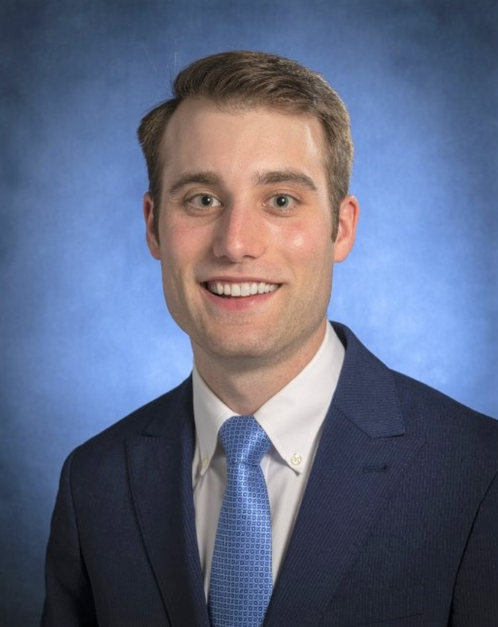
Gregory Benes
2022-2023
Select Publications
Benes G, Shufflebarger HL, Shah SA, et al. Late Infection After Spinal Fusion for Adolescent Idiopathic Scoliosis: Implant Exchange Versus Removal. Journal of Pediatric Orthopaedics. 2023;43(7):e525-e530. doi:10.1097/BPO.0000000000002440. PMID: 37253710.
Benes G, Hunsberger JB, Dietz HC 3rd, Sponseller PD. Opioid Utilization after Scoliosis Surgery Is Greater in Marfan Syndrome than Adolescent Idiopathic Scoliosis. Spine (Phila Pa 1976). 2023 Jun 8. doi: 10.1097/BRS.0000000000004741. Epub ahead of print. PMID: 37294802.
Benes G, Saade R, Fayad LM, Sponseller PD. Case of the False Fracture: A Report of a Radiographic Stitching Error in a Scoliosis Patient. Journal of Bone & Joint Surgery Case Connector. 2023;13(3):e23.00104. Published 2023 Aug 9. doi:10.2106/JBJS.CC.23.00104
Benes G, Seidenstein A, Brandt A. Isolated Dysplasia Epiphysealis Hemimelica (Trevor Disease) of the Acetabulum: Literature Review. Journal American Academy Orthopedic Surgeons Global Research Reviews. 2023 Oct 6;7(10):e23.00138. doi: 10.5435/JAAOSGlobal-D-23-00138. PMID: 37801667; PMCID: PMC10558227.
Harris AB, Benes G, Ghanem D, Cartagena-Reyes M, Jain A, Laporte DM. Using a Modern Linked Research Database to Examine Gender Disparities in Orthopaedic Grant Funding from 2010 to 2022. Journal of Bone & Joint Surgery (JBJS). 2023 Oct 6. doi: 10.2106/JBJS.23.00358. Epub ahead of print. PMID: 37801587.
Ghanem D, Rogers DL, Benes G, Siler B, Lobaton G, Shafiq B. Gluteal compartment syndrome: who is most at risk? European Journal of Orthopaedic Surgery & Traumatology. 2023 Sep 11. doi: 10.1007/s00590-023-03704-w. Epub ahead of print. PMID: 37695367.
Benes G, Roye B, Hresko T, McClellan C, Stikeleather L, Sucato D, Welborn M, Sponseller PD. Scoliosis Bracing: Details Make the Difference. Journal of Pediatric Orthopaedic Society North America (JPOSNA). [accepted/in-press]
Cartagena MA, Silva-Aponte JA, Benes G, Choudhary A, Raad M, Frank S, Musharbash FN, Jain A. The Cost Utility of Intraoperative Tranexamic Acid in Adult Spinal Deformity Patients Undergoing Long Posterior Spinal Fusion. Spine Deformity. [accepted/in-press]
Benes G, Ghanem D, Badin D, Greenberg M, Honcharuk E. The Effect of Socioeconomic Deprivation on Radiographic Deformities in Children with Blount Disease. Journal of Pediatric Orthopaedics. [accepted/in-press]
Benes G, Sponseller PD. Orthopedic Management and Consideration for Classic Bladder Exstrophy. Journal of African Urology: Special Edition. [accepted/in-press]
Book Chapters
Benes G, Greenberg M, Aiyer A, Jackson B. (2023). Osteomyelitis. In A. Aiyer & Thompson (Eds.), Complications in Orthopaedics Series- Foot and Ankle (1st ed., Ch 25). Elsevier.
Select Oral Presentations
Benes G, Shufflebarger H, Shah SA, Yaszay B, Marks MC, Newton PO, Sponseller PD. “Single-Stage Revisions Provide Less Correction Loss than Implant Removal Only Following Late Infections After Posterior Spinal Fusions for Adolescent Idiopathic Scoliosis. Podium Presentation at International Meeting on Advanced Spine Techniques (IMAST) in Dublin, Ireland. March 22-24, 2023.
Benes G, Elnemer W, Njoku D, Sponseller PD. Defect in Extrinsic Pathway Impacts Clotting Efficiency in Neuromuscular Scoliosis. Podium presentation at Scoliosis Research Society (SRS) in Seattle, Washington. September 9, 2023.

Slide 23
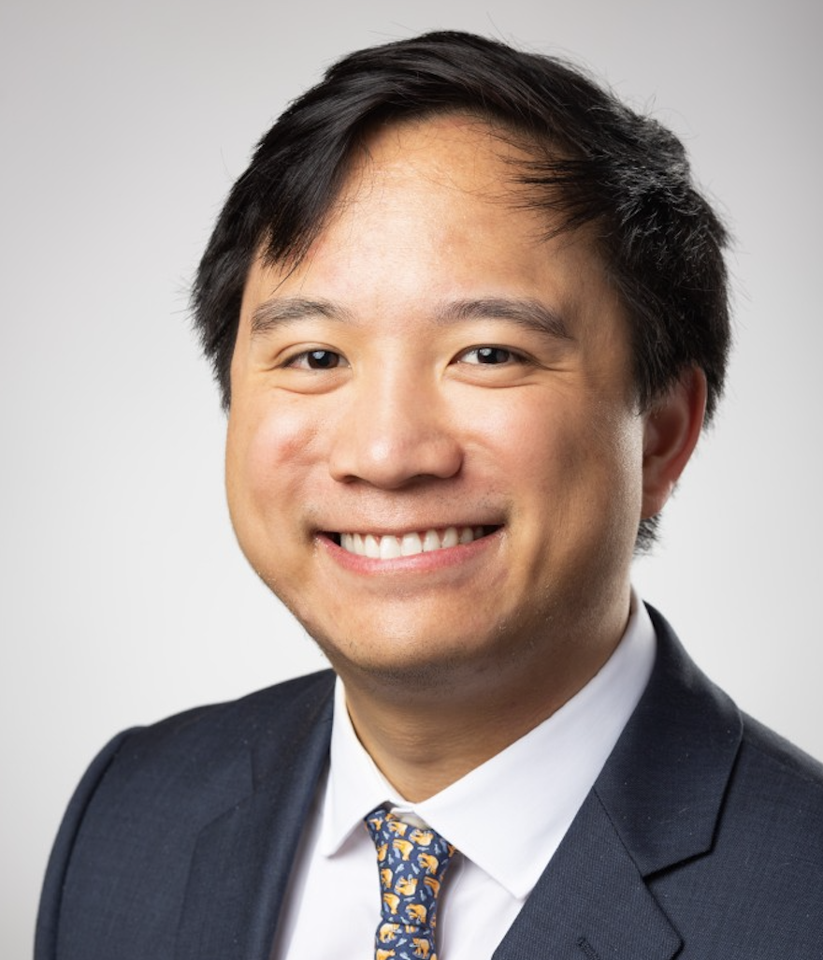
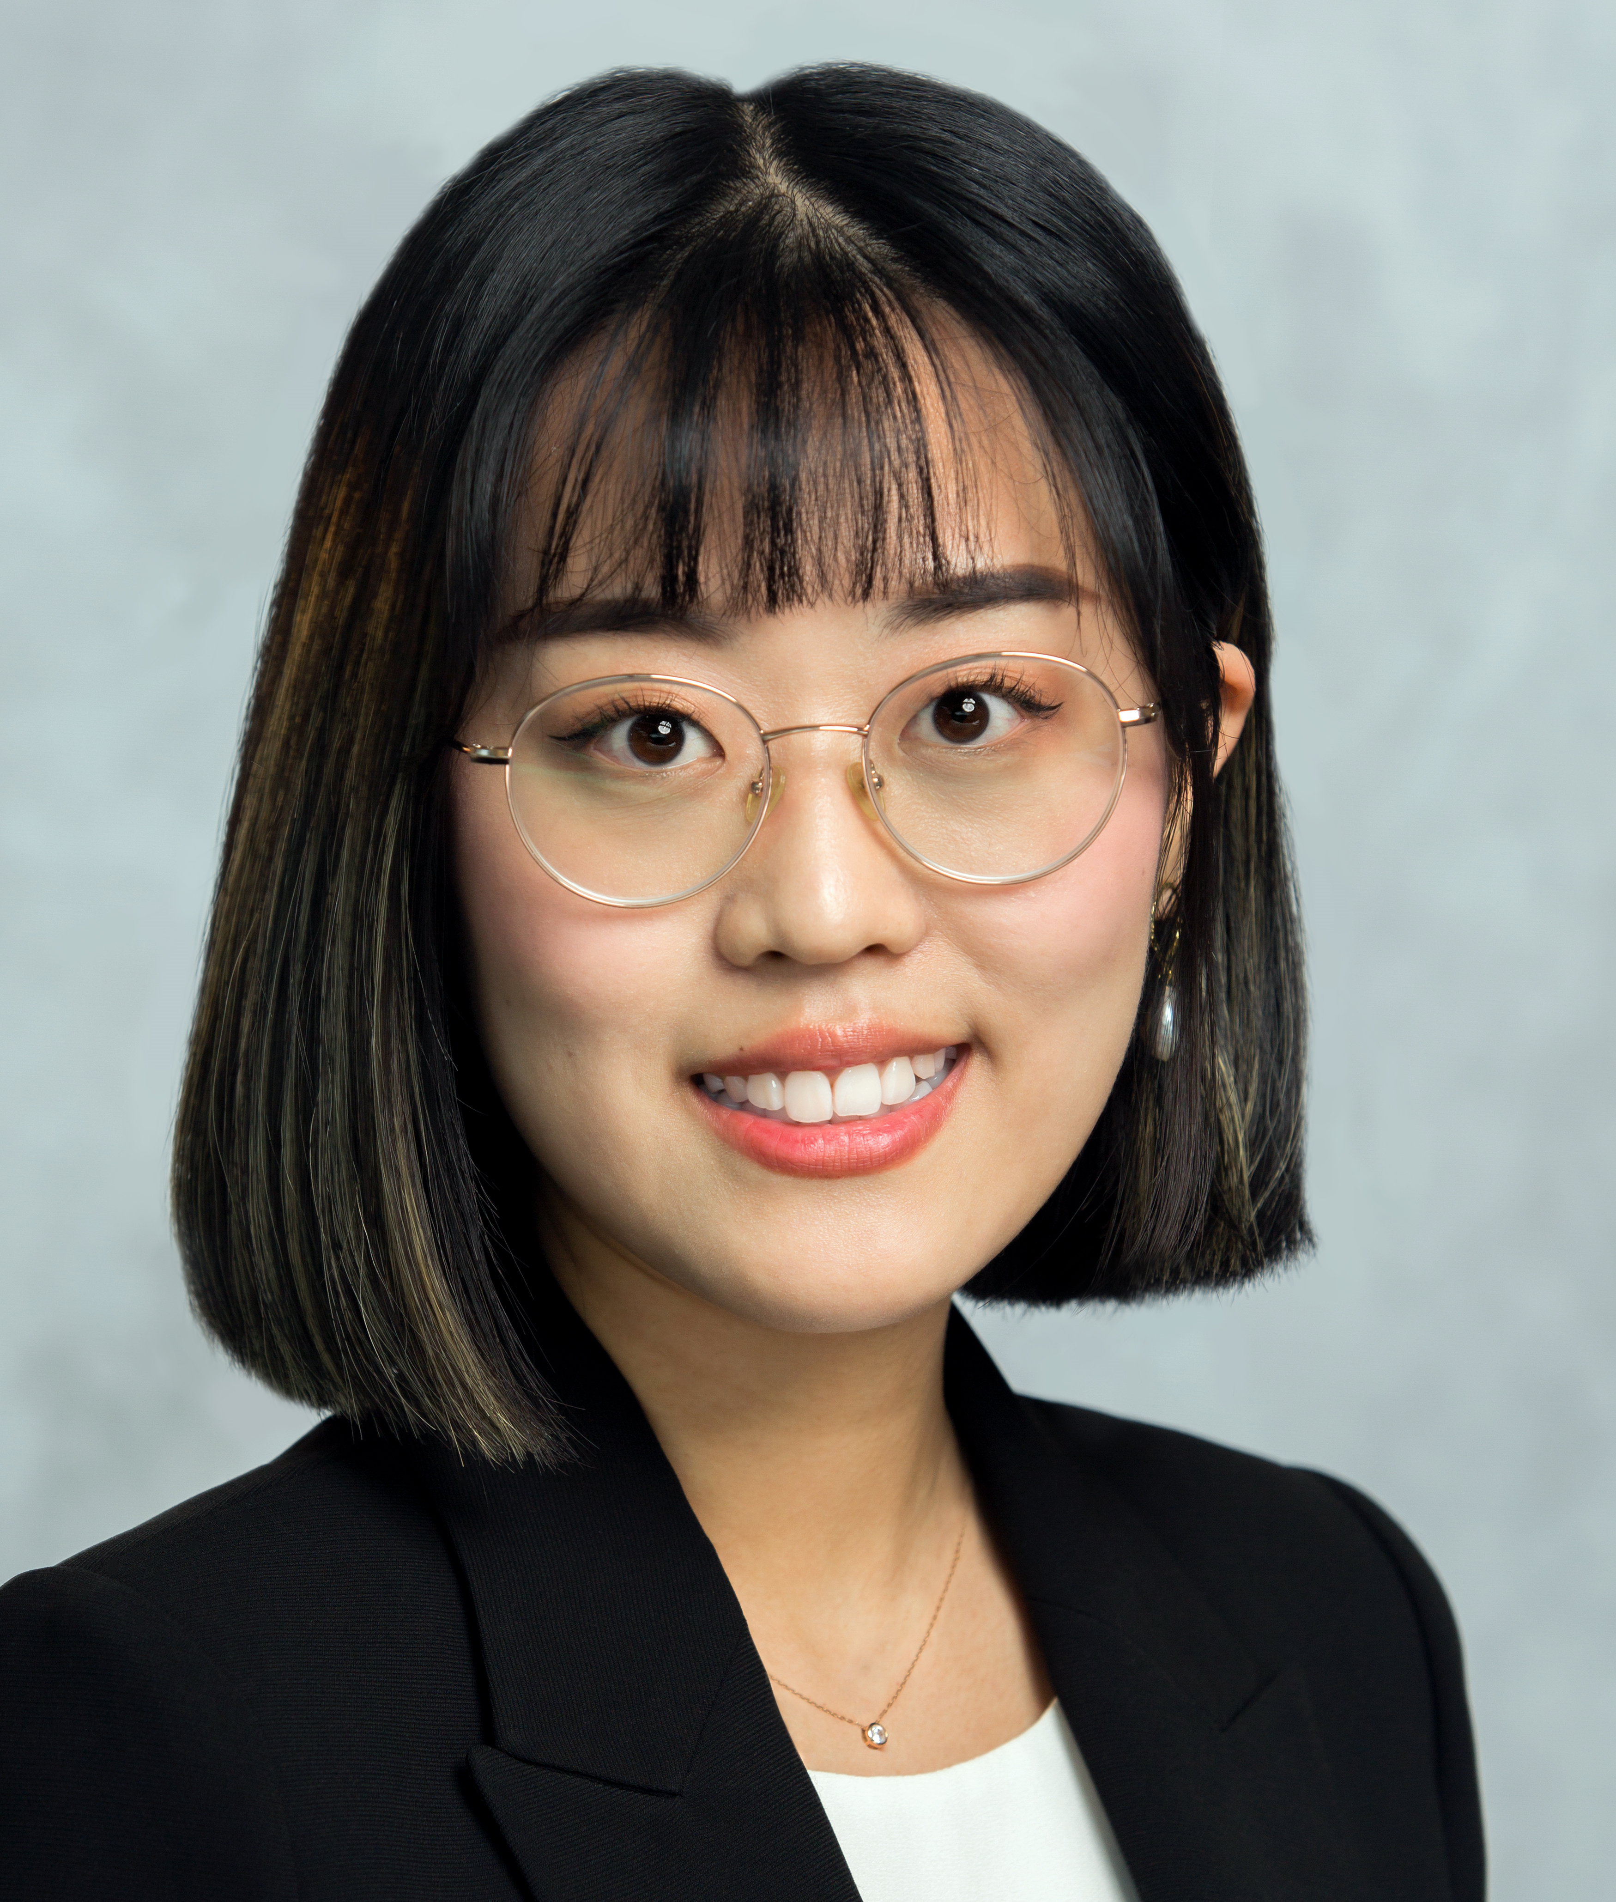
Current Poggi Fellows
John P. Avendano | Medical School: Rutgers Robert Wood Johnson Medical School Undergraduate school and degree; Columbia University; B.A. in Psychology Hometown: Colts Neck, NJ Early on in my medical school career, I knew that I wanted to pursue a research year to learn more about the world of academic Orthopaedics. When I came across the Poggi Fellowship and read about its emphasis on direct mentorship, in addition to its combination of clinical and academic exposure, I knew it was unlike any other research year program. It is an absolute privilege to work under the tutelage of leaders in the field of Pediatric Orthopaedics on a day-to-day basis and take part in projects that try and contribute to the Orthopaedic literature in a meaningful fashion. Thank you, Dr. Sponseller, for your unwavering commitment to us as Poggi Fellows, and thank you to the rest of the Pediatric Orthopaedics team, for making me understand what makes the Hopkins Orthopaedics family so special. Outside medicine, I enjoy spending time with my family and friends, lifting, long distance running, spending time outdoors, watching the NBA, and following the winter and summer Olympics. In a former life, I was a competitive fencer, both for team USA and as a student-athlete at Columbia.
Myung-Jin Cha | Medical School: University of Texas at Rio Grande Valley School of Medicine Undergraduate school and degree; University of Texas at Austin; B.S.A. in Biochemistry and minor in French Hometown: Seoul, Korea Mentorship has always been crucial to my life. Having moved from Korea about 9 years ago without any English proficiency, it was my generous friends and mentors that allowed for all of the wonderful opportunities I came across. Poggi Fellowship at the department of pediatric orthopaedics at Johns Hopkins offers unparalleled combined clinical and research experience, but also create a community that fosters learning and growth. Its deep roots in direct mentorship allows for fellows to connect and work closely with world renowned leaders, teachers, and role models in orthopaedics. Most importantly, Dr. Sponseller is an absolute delight to learn from and work with. Outside of medicine, I enjoy propagating plant cuttings from friends, running, and keeping up with pop culture.

Slide 24
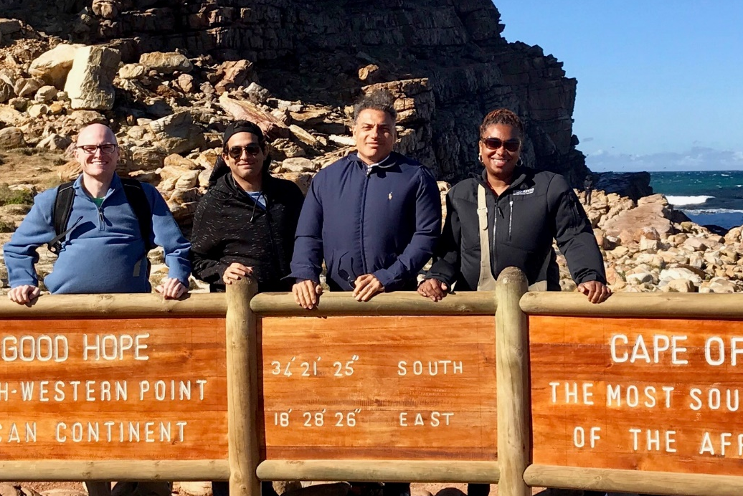
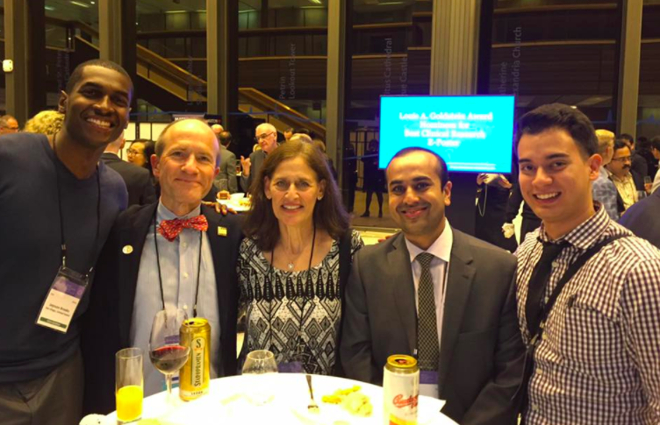
Poggi Fellow Travel
’16-17 Poggi Fellow Brian Sullivan, then-chief resident Mostafa El Dafrawy, Chief of Spine Surgery Dr. Khaled Kebaish, and Mayala Gamble, CRNP in Cape Town, South Africa for the annual IMAST meeting
Then-chief resident Jaysson Brooks, Dr. Sponseller, Amy Sponseller, then-resident Amit Jain, and ’15-16 Poggi Fellow Adam Margalit at the annual SRS meeting in Prague, Czech Republic

Slide 25
The Johns Hopkins
Children’s Center
Johns Hopkins’s state-of-the-art Charlotte R. Bloomberg Children's Center building opened on May 1, 2012. Families and visitors now enter a world designed from the ground up for 21st-century pediatric medicine. From its soaring lobby and large operating rooms—equipped for the most technically complex procedures imaginable—to its spacious patient rooms and welcoming family facilities, the new building provides a hospital experience that matches the world-class medicine it affords.
The Charlotte R. Bloomberg Children’s Center for Pediatric Care features 205 private inpatient rooms including 120 acute care rooms, 85 intensive care rooms, a level 1 pediatric trauma service, pediatric burn services, 10 pediatric operating rooms, multiple playrooms, and a two-story indoor play area for patients.

Slide 26
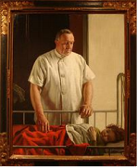
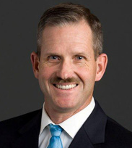
History of the Department of Orthopaedic Surgery
The Johns Hopkins Department of Orthopaedic Surgery has been caring for patients, fostering innovation, and nurturing orthopaedic leaders for over a century. At the invitation of Dr. William Halsted, Chief of Surgery at Johns Hopkins, Dr. William S. Baer organized the first orthopaedic outpatient clinic in 1900. He graduated his first resident, Lewis C. Spencer, from the Department of Orthopaedic Surgery in 1915. Until his death in 1931, he graduated one resident annually, many of whom became leaders in American orthopaedics. One of Dr. Baer's partners in private practice, George E. Bennett, was appointed orthopaedic surgeon in charge in 1931. By 1937, one-sixth of the 150 surgeons certified as orthopaedists by the American Board of Orthopaedic Surgery had completed their residencies at Johns Hopkins.
A third partner of Drs. Baer and Bennett, Dr. R. W. Johnson, Jr. became the next program chairman. Among his many significant contributions was the organization of the Journal of Bone and Joint Surgery. Dr. Robert A. Robinson was appointed the first full-time professor of Orthopaedic Surgery at Hopkins in 1953. Under Dr. Robinson's tutelage, the residency program expanded to include additional residents, a research component, and rotations through affiliated hospitals. In 1973, with reorganization of the Department of Surgery into a section of surgical sciences, orthopaedics achieved greater organizational and financial independence with elevation to departmental status. Dr. Lee H. Riley, Jr., was appointed director of the Department in 1979 when Dr. Robinson became professor emeritus. Under Dr. Riley, the program expanded to graduate five residents annually; a new Orthopaedic Center was opened, in 1982; a rotation to the Maryland Institute for Emergency Medical Services was initiated to increase residents' experience with polytrauma; a spine service was added to the Department; and the residency program was approved for an additional year of training.
In April 1991, Dr. Richard Stauffer joined the Department of Orthopaedic Surgery as the orthopaedic surgeon in-chief. Dr. Stauffer's status as an internationally known orthopaedic surgeon enhanced the department and its involvement with the rest of the Johns Hopkins Medical Institutions. Dr. Stauffer expanded the already outstanding faculty and staff with the addition of world-renowned physicians and researchers. In 1998, Dr. John P. Kostuik, Professor of Spinal Surgery, led the department followed by Dr. Frank J. Frassica, Professor of Orthopaedic Oncology, in 2000. Dr. Frassica served as director until 2011, when Dr. James R. Ficke took over as Department Director after completing work as an orthopaedic surgeon for the United States Army.
Dr. William Baer
Dr. James Ficke

Slide 27

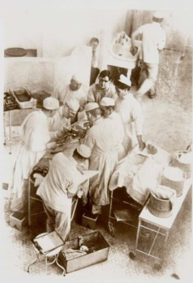
The City of Baltimore
The City of Baltimore:
Centrally located on the East Coast, Baltimore combines the advantages of a convenient urban center with access to cultural and athletic activities. A thriving community of young professionals promises important connection.
Baltimore and Medicine:
Baltimore and the Johns Hopkins School of Medicine have a history of a long, productive partnership, fostering medical innovation and leadership over the past two centuries. Hopkins, well-known for a long list of “firsts” including the first residency program, the development of CPR, and the first bone marrow transplant, boasts a diverse and highly touted medical staff.

Slide 28


Highlights of Baltimore
Baltimore Sports:
Baltimore is home to both the Ravens, the two-time Super Bowl champions of the National Football League (NFL), and the Orioles, the three-time World Series champion of Major League Baseball (MLB). The Ravens’ M&T Bank Stadium offers the latest in technology, while Camden Yards is one of the most storied ballparks in professional baseball. The two stadiums are easily accessible from the Johns Hopkins campus via public transportation.
Baltimore’s Waterfront:
Baltimore’s Inner Harbor is the city’s premier tourist attraction. Here you can find the National Aquarium, Harborplace, Maryland Science Center, and a host of restaurants and shops. There is surely something for everyone to enjoy at the Inner Harbor. Other nearby attractions include Fort McHenry (birthplace of the “Star-Spangled Banner”), Lexington Market, and Walters Art Museum.

Slide 29
Application
Complete the online application on the Poggi Fellowship website by December 31, 2022
Submit the following additional materials and any questions to poggifellowship@gmail.com
A letter of recommendation
Your curriculum vitae
A pdf of your USMLE Step 1 score

