Slide 1
This is an QI poster template for BetterPoster. Please use slide 2 to design your poster. It is just a suggestion and can be updated to suit your specific project. Remember, the idea of BetterPoster is to provide sparse information on the poster itself and focus on the main takeaways. Delete this slide when you are done

Slide 2
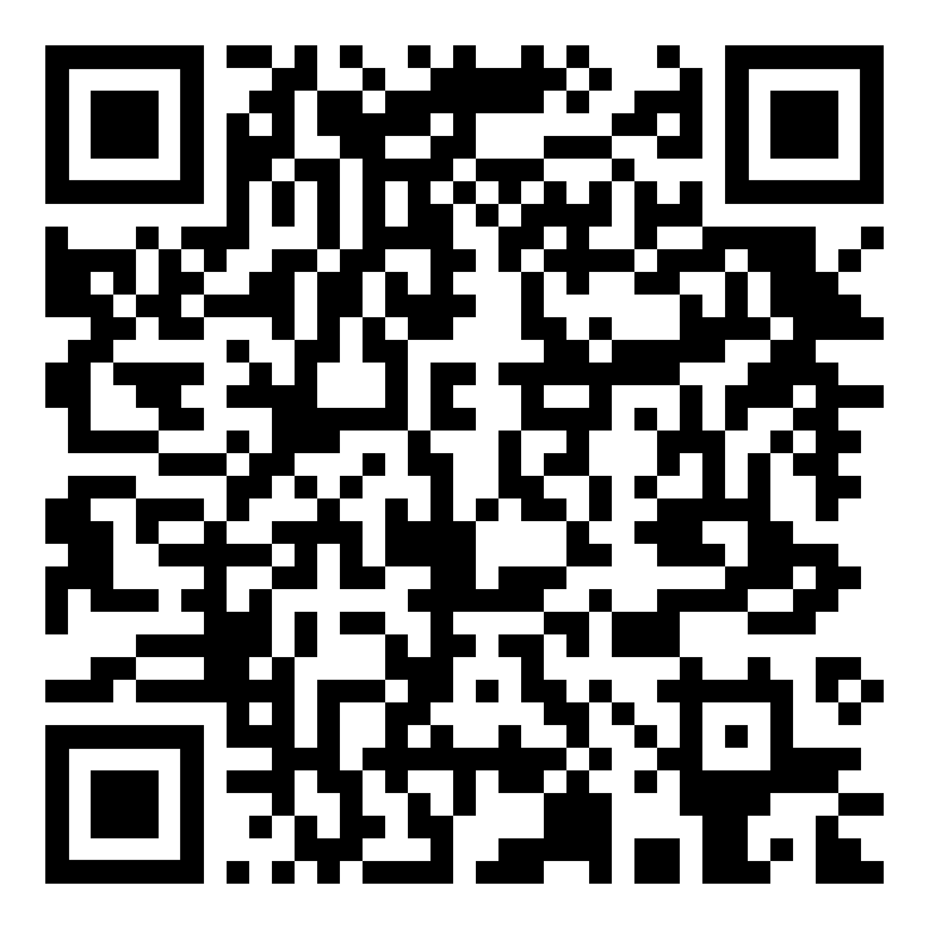
Main finding goes here, translated into plain English. Emphasize the important words.
Non-Cognitive Predictors of Student Success: A Predictive Validity Comparison Between Domestic and International Students
Title: Subtitle
Tables & Figures
PRESENTER:
Name
INTRODUCTION: Explain why your project matters and any important background information
AIM: What was the goal of the project? What metrics were you trying to improve?
METHODS:
What did you do?
What data did you collect?
How did you analyze it?
RESULTS: What did you find? You can include results here or in the bar on the right, they don’t need to be repeated .
DISCUSSION: What impact did you project have in your setting? Why was is successful or not successful?
Use an icon, image or graphic to visualize your findings.
First author¹, Second Author², Third Author², Fourth Author³, etc
You can use a QR code to provide more information, including a link to the full paper, graphics or more. See QR instructions in notes
¹ Author affiliation (name of school of hospital)
² Author affiliation
³ Author affiliation (name of school of hospital)
email
References available upon request
Notes:
How do I create a QR code?
https://www.qrcode-monkey.com/ is free, URLs don’t expire, and you can add cool features like images.

