Slide 1
“ Now that we have his genes, can my child wear soccer shorts?”
Janet N Scheel, MD
Pediatric Cardiology

Slide 2
Disclosures
I have no financial disclosures
I will not talk about off –label use of any medication or medical equipement

Slide 3
Non-financial Disclosures
I am a clinician, not a researcher

Slide 4

Translating Basic Science into Clinical Practice

Slide 5
NP + BP
MI 50 ‘s
?

Slide 6
Hypertrophic Cardiomyopathy:
Inherited disease
of the sarcomere

Slide 7
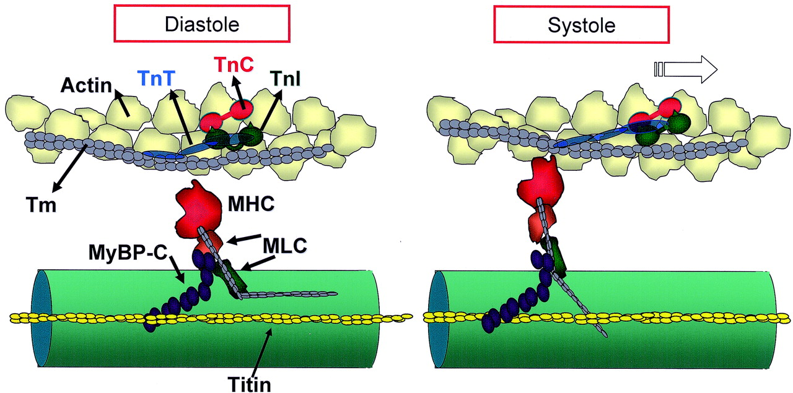


A structural unit of the sarcomere with thick-filament cross-bridges (myosin heavy chain, MHC) shown in diastole (left) and reacting with thin-filament actin in systole (right)
Kass, D. A. et al. Circulation 2006;113:305-315
Copyright ©2006 American Heart Association

Slide 8
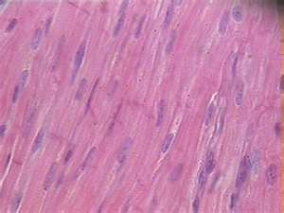
Heart Muscle

Slide 9
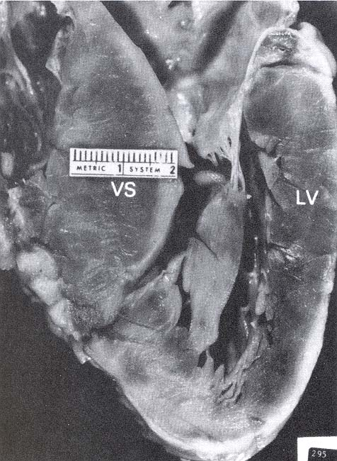
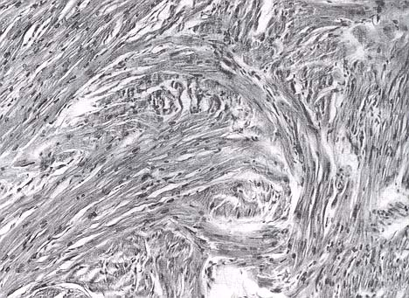
HCM Gross Appearance and Histology
Moss & Adams 5th edition

Slide 10
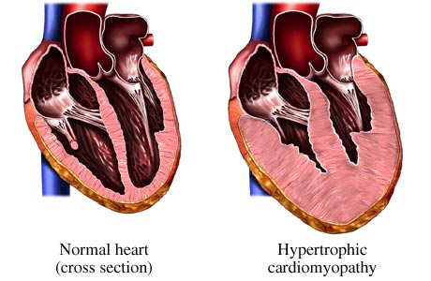
Hypertrophic Cardiomyopathy

Slide 11
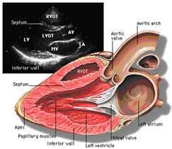
Long Axis View

Slide 12
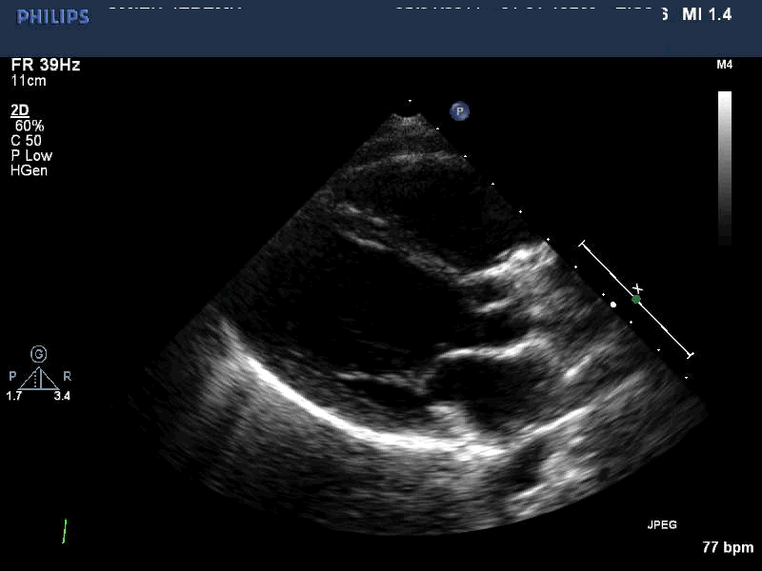
Normal Long Axis

Slide 13
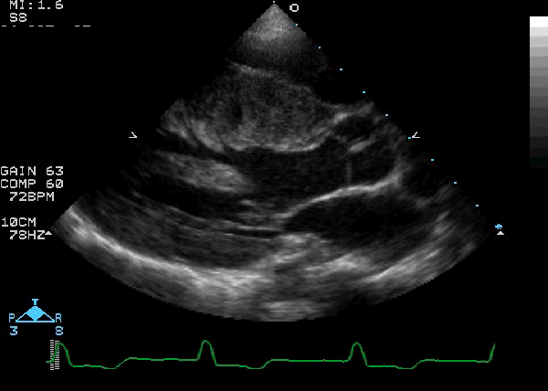
Long Axis HCM

Slide 14
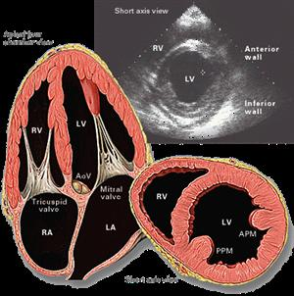
Short Axis View

Slide 15
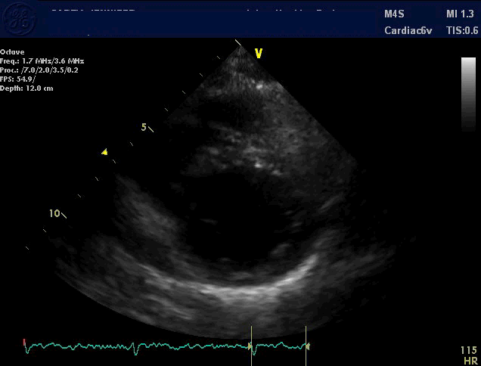
Normal Short Axis

Slide 16
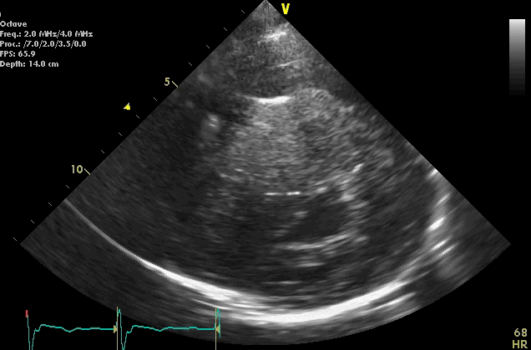
Short Axis HCM

Slide 17
Clinical Presentation of HCM
Genetic disorder, generally autosomal dominant, prevalence 1/500
Infants and young children: Murmur, abnormal ECG
Adolescents and young adults
  Dyspnea/chest pain with exertion
  Syncope
  Sudden death
  Leading cause of unexpected death in young athletes—often the first presentation

Slide 18
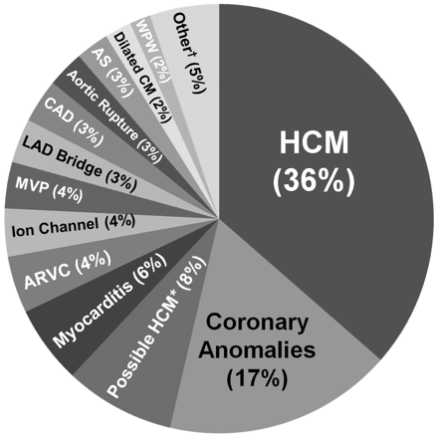
Cardiac Causes of Death on Autopsy

Slide 19
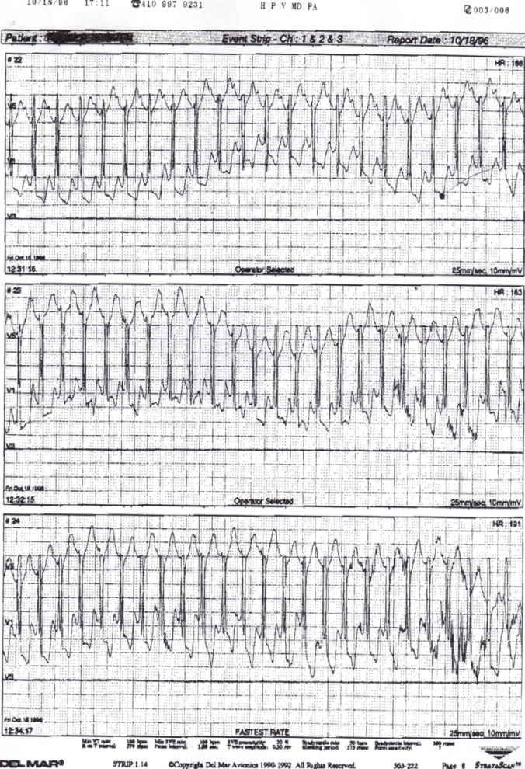

Slide 20
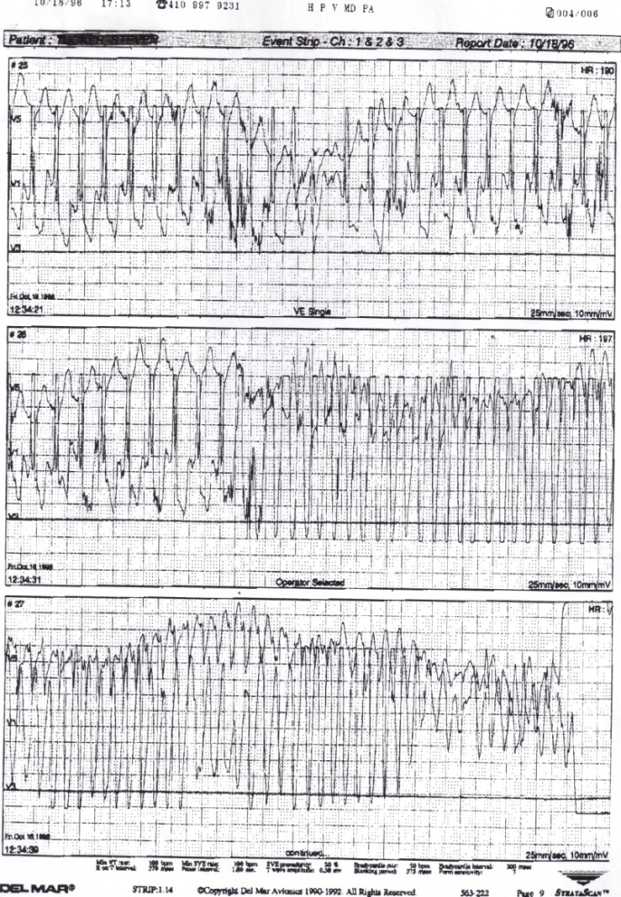

Slide 21
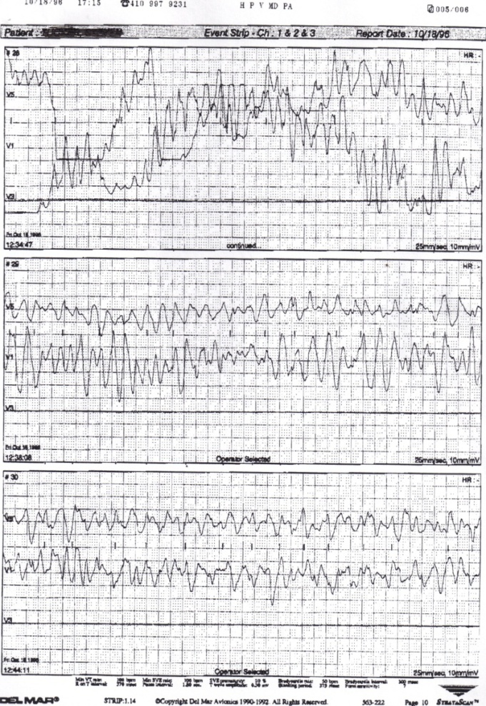

Slide 22
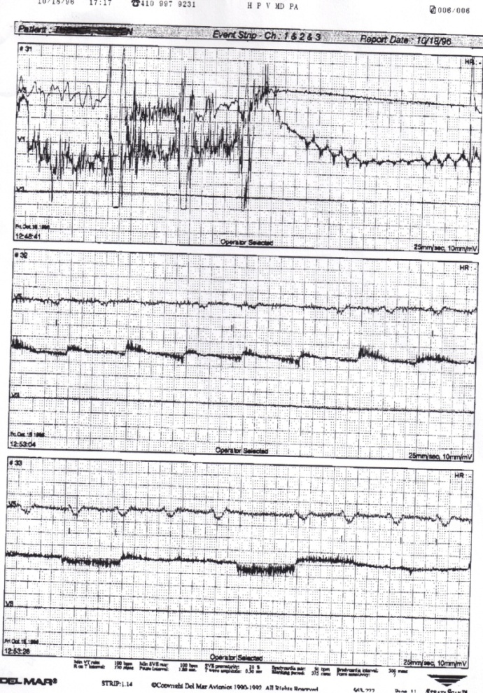

Slide 23
To an Athlete Dying Young
  A. E. Housman 1859–1936
The time you won your town the race
We chaired you through the market-place;
Man and boy stood cheering by,
And home we brought you shoulder-high.
Today, the road all runners come,
Shoulder-high we bring you home,
And set you at your threshold down,
Townsman of a stiller town. ………

Slide 24
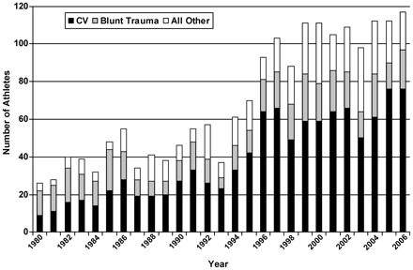
Causes of Death in Athletes

Slide 25
NP + BP
MI 50 ‘s
?

Slide 26
JF
D
13
15

Slide 27
CW

Slide 28
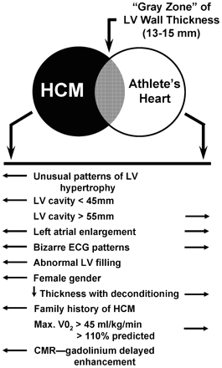

Slide 29
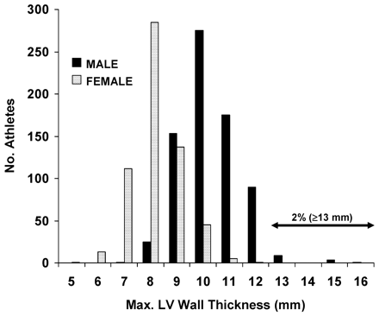

Slide 30
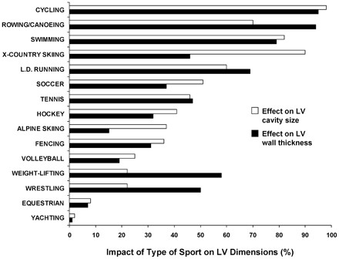

Slide 31
CW

Slide 32
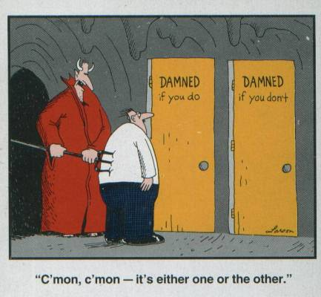

Slide 33
There are known knowns. These are things we know that we know. There are known unknowns. That is to say, there are things that we know we don't know. But there are also unknown unknowns. There are things we don't know we don't know.
Donald Rumsfeld

Slide 34
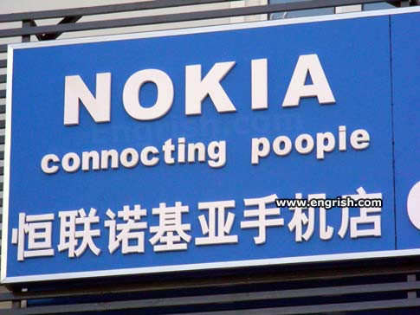
I hope my translation came out better than this:

Slide 35
Thank You
“One does not discover new lands without consenting to lose sight of the shore for a very long time”
Andre Gide
jscheel@jhmi.edu

