Slide 1
Monitoring Stroke Recovery with Brain Images
Argye E. Hillis

Slide 2
Aphasia Caused by Left Hemisphere Lesions
It has been known since the 1800s that left hemisphere is the “language hemisphere”
And damage to particular parts of the left hemisphere tends to affect certain aspects of language, such as motor speech or comprehension
This language impairment after brain injury is known as “aphasia”
Distinct types of aphasia caused by damage to certain areas of the brain led to the conclusion that various parts of the left hemisphere were “necessary” for particular language functions

Slide 3
Recovery from Aphasia
Remarkably, people usually recover from aphasia, indicating that no areas are truly necessary for language
We used to ask questions like:
Does the right side of the brain take over language if someone has a stroke in the left hemisphere?
Or do undamaged parts of the left hemisphere take over language?

Slide 4
Important Observations: 1. People with large left hemisphere strokes sometimes recovered. 2. Anesthesia to the right hemisphere of of recovered aphasic people sometimes produced recurrent aphasia

Slide 5
But Functional Imaging Yielded Conflicting Results:
Some studies showed mostly right hemisphere “activation” during language tasks in people with left brain lesions
Some studies showed mostly left hemisphere
“activation” (around the lesion)
Some studies showed both

Slide 6
I will show
There is no simple answer
The brain recovers language in different ways
At different times after stroke
In response to different locations or sizes of stroke
in different people with nearly the same stroke for the same task at the same time after injury
May depend on education/expertise with the language task
May depend on medications that affect neuroplasticity
different language tasks in the same person

Slide 7
“The Language Network”
Parker Jones,
et al., 2011
Word Retrieval
Naming & Oral
Reading –
Saying “1,2,3”
Prabhakaran
et al 2007
fMRI
Word Generation
Rapp &
Lipka, 2011
fMRI
Reading (blue)
Spelling (green)
Segaert et al., 2011
Syntax repetition

Slide 8
Passive Viewing/Listening Bartels & Zeki, Neuroimage, 2005

Slide 9
Smits, et al., 2011 Archives of Physical Medicine and Rehabilitation

Slide 10
Lesions
To different components of network cause distinct varieties of aphasia
Lesions to left inferior frontal gyrus (“Broca’s area) cause a number of impairments in speech production, including impaired motor speech
Lesions to left posterior temporal cortex (“Wernicke’s area) cause many deficits in language processing, including impaired word comprehension.

Slide 11
Dorsal & Ventral Language Streams –Hickok & Poeppel, 2000

Slide 12
Saur et al., 2006 (Brain 129: 1371-84)
Reorganization of Structure/Function Relationships

Slide 13
Our Hypothesis
How the brain adapts to a lesion to recover from aphasia depends not only on time since onset but also:
Changes in blood flow in the brain
Size and site of stroke
Individual variables (education? Expertise?)
Language task

Slide 14
⏎
Methods
Day 1: Structural imaging; blood flow imaging
Intervention to restore blood flow
Language Testing
DAY 3-4: structural and blood flow imaging
Week 2: DWI, PWI, FLAIR, MRA, SWI, MPRAGE, DTI, rsfcMRI
Language Testing
Month 12: structural and blood flow imaging
Language Testing
fMRI reading, spelling, naming, listening
fMRI reading, spelling, naming, listening
fMRI reading, spelling, naming, listening Language Testing
Week 2, Month 6: structural and blood flow imaging

Slide 15
Early Recovery: Restoration of Blood Flow to Critical Areas of Brain

Slide 16
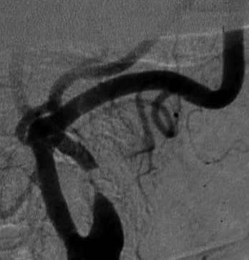
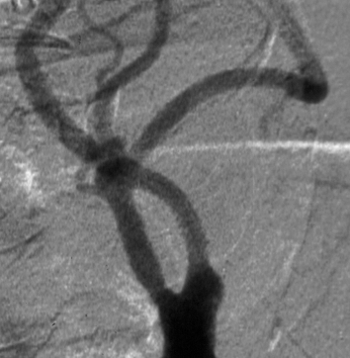
Reperfusion of Wernicke’s Area:
Improves Word Comprehension
Pre-stent
Post-stent

Slide 17
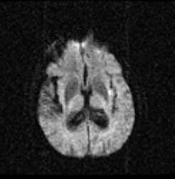
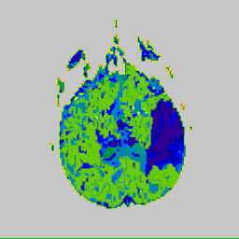
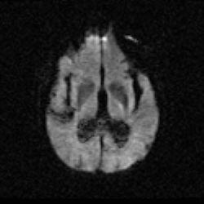
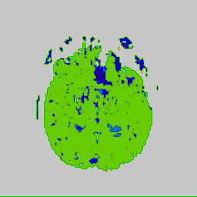
Reperfusion of Wernicke’s Area:
Improved Word Comprehension

Slide 18
Reperfusion of Broca’s Area: Improves Speech & Written Production

Slide 19
SuBacute Recovery
Reorganization of Structure-Function Relationships
(Neuroplasticity)

Slide 20
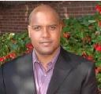
Picture Naming
Acute Subacute
Acute
Subacute
p<.03 p<.05
corrected

Slide 21
Patient 1
Laterality Index
Patient 2
Laterality Index

Slide 22
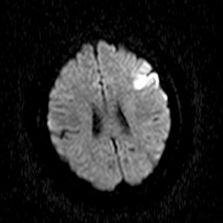
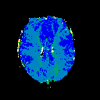
Reorganization of Structure/Function Relationships
39 yo woman; 3
Days post stroke;
Broca’s aphasia
57 yo woman; 3
Days post stroke;
Anomic aphasia
Depends on:
Language task
Individual
As well as
Time post-onset
Lesion site
(already shown)

Slide 23
Silent Spelling Task (What is the missing letter vs what is the lower case letter?)
T_BLE
vs
TaBLE
.03 p<.05
corrected
39 y.o.; 80% accurate on task
59 y.o. 100% accurate; slow on task

Slide 24
Patient 3
Patient 4

Slide 25
Silent Word Reading – Seeing Squiggles + Saying “Nonsence”
39 y.o.
With
Broca’s
Aphasia
3 Days
Post
Stroke
100%
Accurate;
Slow on
Task
.03 p<.05
corrected

Slide 26
Chronic Recovery
Depends more on time since stroke than volume of lesion, age, sex, handedness, site of lesion (Hope et al., 2014)
Depends more on education & antidepressant use than volume of stroke, initial severity, age, time since onset (Suneja et al., 2014)
Most studies show patients who recover better show are those who show more left hemisphere activation during language (Saur et al, 2006, Sebastian & Kiran, 2010)
May depend on the task

Slide 27
Residual Deficits in Chronic Stroke
We surveyed 33 stroke survivors and their caregivers to identify the sequelae of stroke that had the greatest impact on quality of life
The most common residual important impairment reported by both survivors of left hemisphere stroke and their caregivers (reported in 71% each)
Spelling & writing !
(Urrutia, Johnson, Hillis, 2014)

Slide 28
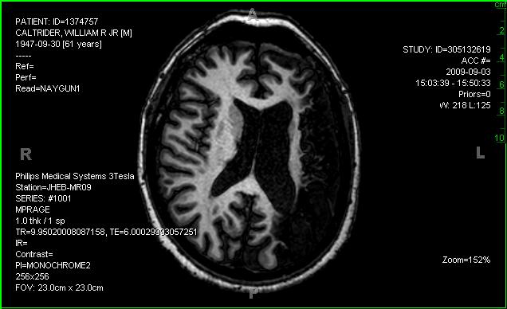
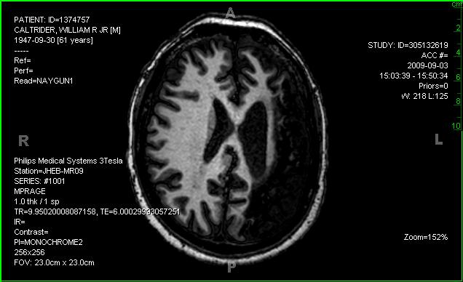
2 Years after Severe Aphasia
No word comprehension deficit.
No naming or reading deficits.
No speech articulation impairment.
Severe spelling impairment, mild hesitancy
In word retrieval.

Slide 29
ONLY right
Hemisphere
Activation
During reading
- In right
Midfusiform
Area
So-called
“Visual Word
Form Area”
Some patients who make excellent recovery show only right hemisphere activation, despite intact left hemisphere regions that are normally activated in the task

Slide 30
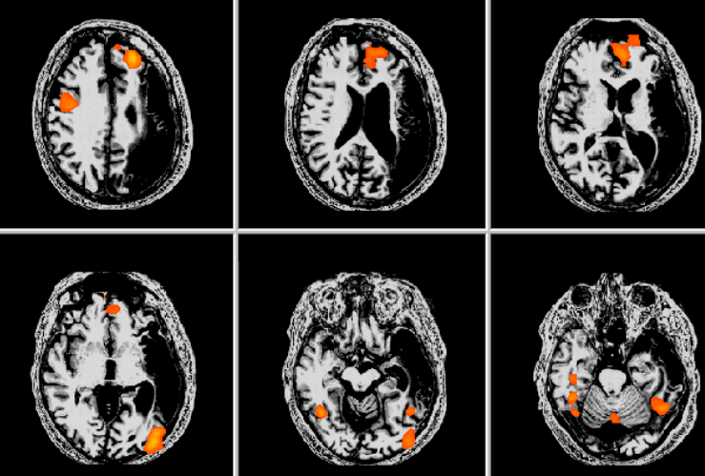
After Therapy to Improve Spelling
Corrected p < 0.05

Slide 31
Conclusions
Language network is similar across healthy individuals, across language tasks; includes Broca’s area and Wernicke’s area
Lesions to individual components of left language network cause relatively predictable, distinct language deficits
The brain adapts to lesions in dynamic ways, relying on right hemisphere homologues of left language network components or other areas of left hemsisphere, depending on time after injury, size and site of the stroke, individual factors, and language task

Slide 32
John Krakauer, MD; Rebecca Gottesman, MD, PhD, Robert Wityk, MD;
Rafael Llinas, MD, Victor Urrutia, MD; Richard Leigh, MD, Stephen Zeiler, MD, PhD, Liz Marsh, MD; Jennifer Dearborn, MD; Roland Faigle, MD, PhD
Cerebrovascular Division
Andreia Faria, MD, Susumu Mori, PhD,
Peter Barker, D Phil, Peter Van Zijl, PhD, Edward Herskovits, MD, PhD
Rong Chen, PhD, Mikolaj Pawlak, PhD; Ken Oichi, MD, PhD;
John Hsu, PhD & all of the MRI techs
Neuroradiology
SCORE Lab
Cameron Davis, Yessenia Gomez, Joseph Posner, Tushar Chakravarty
(Jon Kleinman, MD; Shaan Khurshid; Melissa Newhart)
Rajani Sebastian, PhD; Donna Tippett, MA, David Race, PhD,
Kyrana Tsapkini, PhD, Jeremy Purcell, PhD,
Samson Jarso, PhD; Marlis Gonzalez-Fernandez, MD, PhD
Jenny Crinion, PhD
Neurology Residents, NCCU Faculty & Fellows
Funding from: NIH (NIDCD, NINDS)

Slide 33
