Slide 1
Stem Cell Implants to Repair Damaged Hearts
Rationale
Two clinical trials
  Cardiac-derived stem cells
    Cedars Sinai Medical Center, Dr. Eduardo Marban
  Mesenchymal stem cells
    U. of Miami Miller School of Medicine, Dr. Joshua Hare
Challenges

Slide 2
Coronary Artery Disease
Heart Valve Disease
Cardiac Muscle
Dysfunction
Congestive Heart
Failure
Hypertension
Shortened survival
Frequent hospitalizations
Breathlessness
Fatigue
Volume overload
Idiopathic

Slide 3
Intrinsic Response to CHF
Increased sympathetic stimulation
  Increased heart rate
  Increased contractile force
Increased renin-angiotensin-aldosterone
  Increased blood pressure
  Salt retention
Initial compensation, eventual self-defeating

Slide 4
Current Treatment Options
Prevent new damage
Diuretics – improve salt excretion
Decrease cardiac workload
Neurohumoral blockade
Transplantation/mechanical devices
None of these address the primary problem– the loss of living, working heart muscle

Slide 5
TRADITIONAL TEACHING
All heart cells are terminally differentiated
The heart cells we have now are those we were born with, and we will not have any others
Only responses to injury, e.g. a heart attack
  Hypertrophy (increase in cell size)
  Dilation (cell slippage)
  Scar formation*

Slide 6
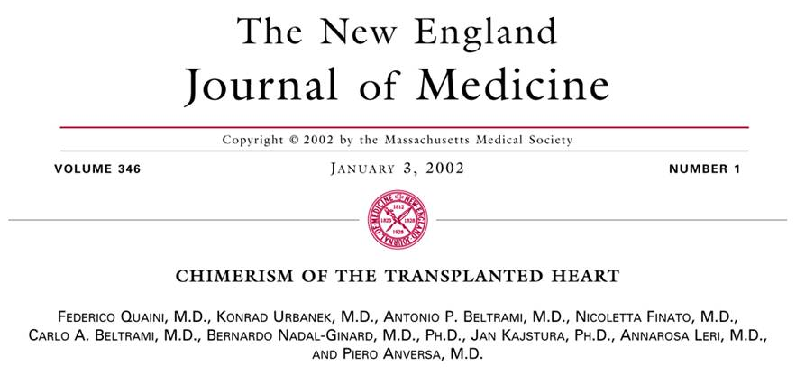

Slide 7
Female hearts (with XX chromosomes) transplanted into males (XY chromosomes)
Y chromosome (and other markers) in heart muscle cells and coronary arteries, indicating new heart muscle cells were formed from male bone marrow

Slide 8
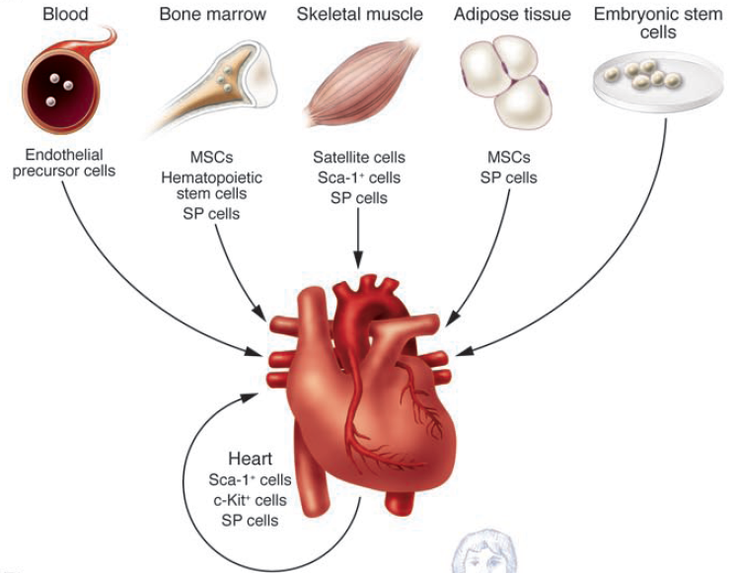
From: Dimmeler S et al, JCI 2005; 115:572-83

Slide 9
From: Dimmeler S et al, JCI 2005; 115:572-83

Slide 10
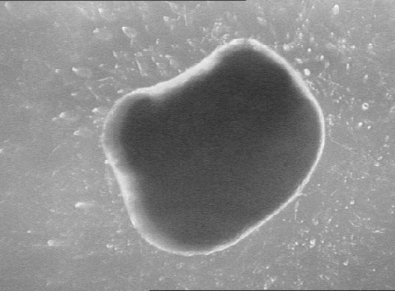
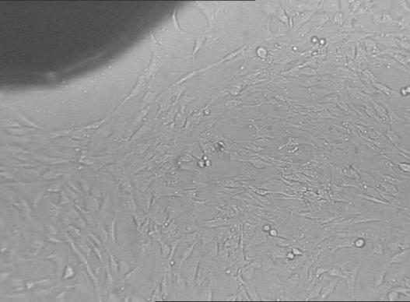
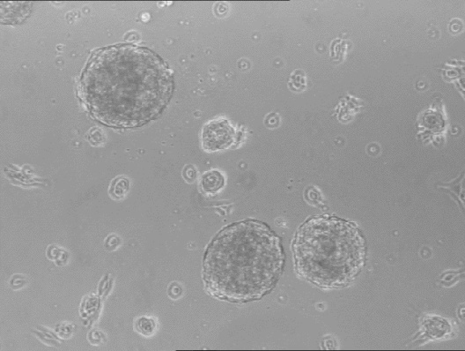
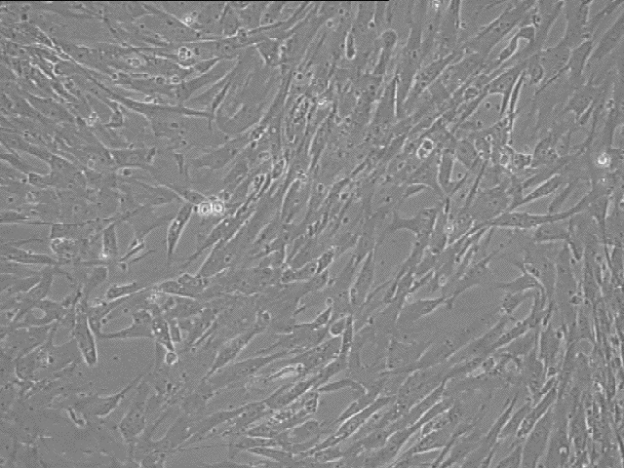
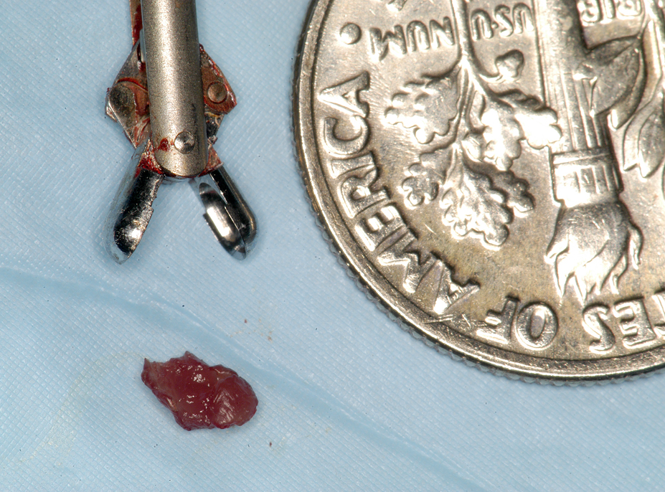
Cardiosphere-Derived Cells (CDCs)
Biopsy
Explants (1)
Cardiosphere
-forming cells
Cardiospheres (4)
Cardiosphere-
derived cells (CDCs, 5,6)
2,3
1
2
3
200 μm
200 μm
100 μm
4
5
6
100
90
80
70
60
% of total
50
40
30
20
200 μm
100 μm
10
0
c-Kit⁺
CD105⁺
CD90⁺
CD34⁺
CD31⁺

Slide 11
CADUCEUS: The Cardiosphere-Derived Autologous Stem Cells to Reduce Ventricular Dysfunction Trial
Phase I/II randomized, prospective, controlled study - with Cedars Sinai Medical Center
Acute MI with resultant LV dysfunction (LVEF 25%-45%)
Intracoronary infusion of autologous CDCs in infarct-related artery vs. optimal medical therapy
Primary outcome: Safety
Secondary outcome: Efficacy (Scar size, chamber size, LV function as assessed by gadolinium-enhanced MRI)
Lancet 2012; 379(9819):895-904.

Slide 12
CADUCEUS Study Time Course
Baseline
MRI
6 month
MRI
12 month
MRI
4 weeks
4-6 weeks
6 months
6 months
Myocardial infarction
Biopsy
CDC infusion
In patients randomized to receive CDCs:
Endomyocardial biopsy performed within one month of MI after screening MRI to r/o infarction of right ventricular septum
Autologous CDCs infused in infarct-related artery 4-6 weeks later using angioplasty balloon during intermittent balloon inflation
Two dose strata: 12.5 million, 25 million
Lancet 2012; 379(9819):895-904.

Slide 13
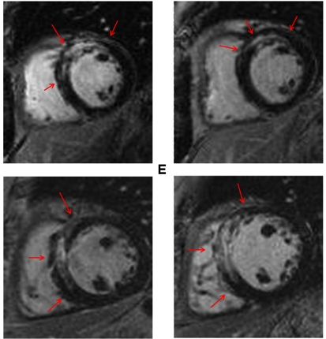
Intracoronary CDC Infusion Reduces Gd-Enhancement after MI
Baseline 6 months
Control CDCs
For CDC-treated patients ΔScar:
Mean -8.4g (28%) at 6 mos
Mean -12.9g (42%) at 12 mos
Lancet 2012 379(9819):895-904.

Slide 14
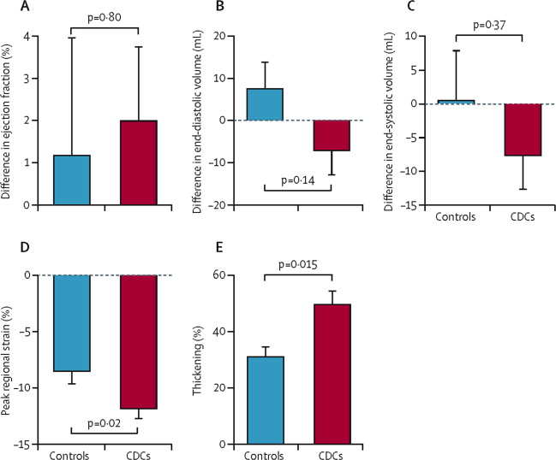
Effects on LV Function and Remodeling
Regional Function in Infarct Zone
LV Volumes
Controls CDCs
Lancet 2012 379(9819):895-904.

Slide 15
POSEIDON (The PercutaneOus StEm Cell Injection Delivery Effects On Neomyogenesis Study)
Phase I/II randomized, prospective, controlled study - with University of Miami Miller School of Medicine
Ischemic left ventricular dysfunction
Randomized trial of autologous (from the patient) vs allogeneic (from a donor) mesenchymal stem cells
Three dose strata (20, 100, 200) million cells
Primary outcome: Safety
JAMA 2012;308(22):2369-79

Slide 16
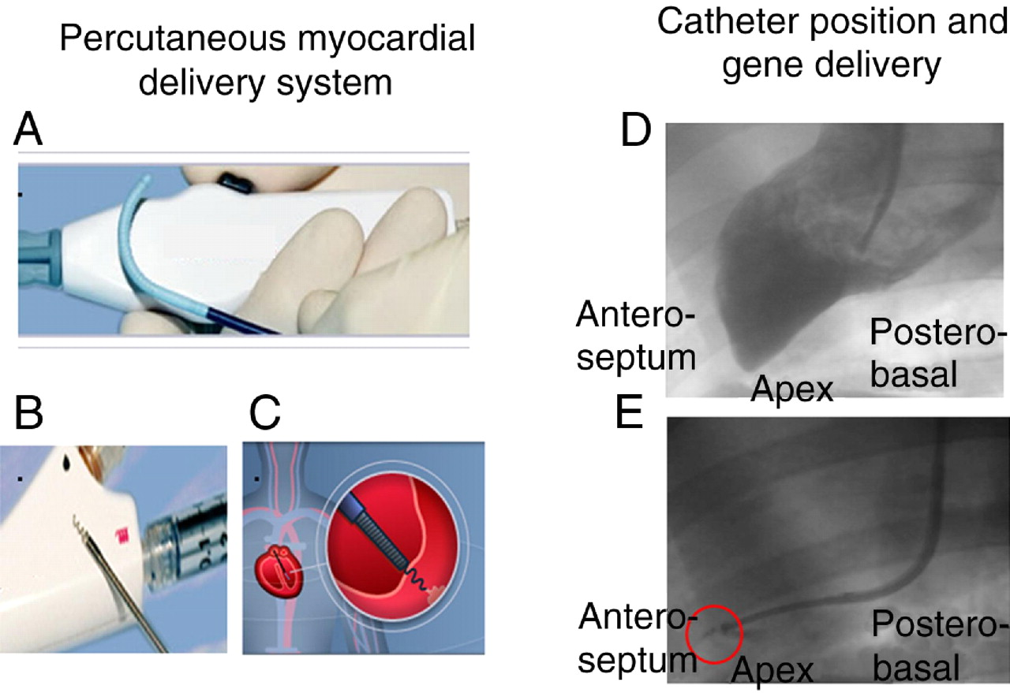
Biocardia Helix Intramyocardial Stem Cell Injection Catheter
Biocardia, Inc; Rodriguez-Porcel, M. et al. J Am Coll Cardiol 2008;51:595-597

Slide 17
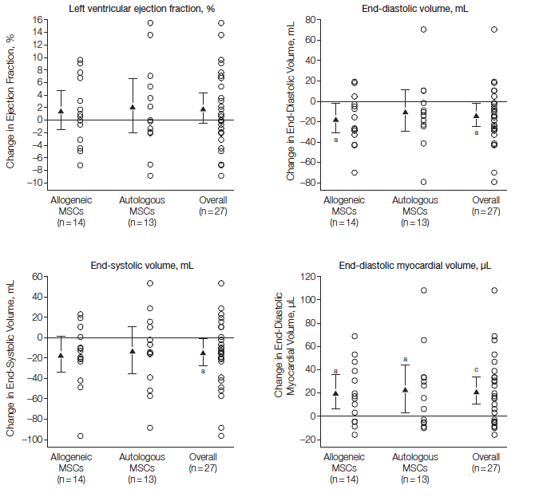
POSEIDON (The PercutaneOus StEm Cell Injection Delivery Effects On Neomyogenesis Study)
Both allogeneic and autologous MSCs were safe and well tolerated
  Low rate of sensitivization to allogeneic cells (1/15)
No significant difference between MSCs in effects on LVEF, infarct size, or LV remodeling
JAMA 2012;308(22):2369-79

Slide 18
Challenges/Opportunities for Cardiac Stem Cell Therapies
Clinical studies of bone marrow and cardiac-derived stem cells are safe, but beneficial effects are modest to date
How can the modest effects of stem cell therapy for the heart be improved upon?

Slide 19
Challenges: Where to Get the Cells
(From the patient or from a donor)
From the patient (autologous)
Advantage: no immune response, perfect match
Disadvantages:
  “Host” factor (age, disease)
  Requires harvesting (risks), isolation, and expansion (time, expense) of patient’s cells

Slide 20
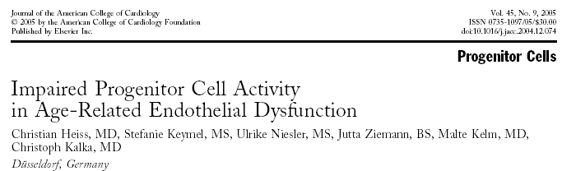
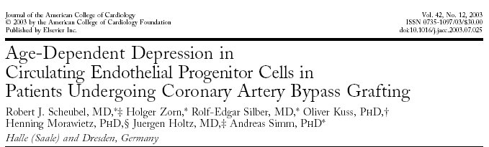
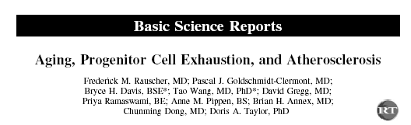
JACC 2005;45:1441-8
JACC 2003:42:2073-2080
Circulation 2003;108:457-463

Slide 21
Injury
Inflammation
Recruitment of Stem Cells
YOUNGER,
SMALL INJURY
OLDER
LARGE INJURY
Repair and
Regeneration
Less effective
repair
Decreased
Inflammation
Continued
inflammation
Scar
Atherosclerosis

Slide 22

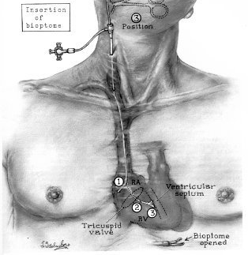
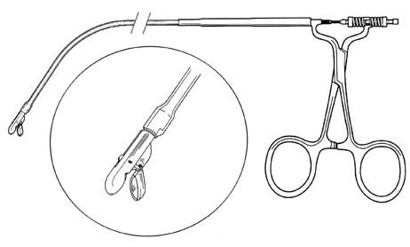
Challenge in Obtaining Cells From Patient: Heart Biopsy

Slide 23
Challenges: Where to Get the Cells
From a donor (allogeneic)
Advantage:
  Young healthy donor
  Ready availability, no biopsy risk, no time delay
  Less expensive, scalable
Disadvantage:
  Immune attack on cells
  Generates antibodies in recipient which may preclude further cell administration and heart transplantation

Slide 24
Challenges: How to Give the Cells
Into a coronary artery OR direct injection into the heart
Intra-coronary
  Size limitation for type of cells which can be used
  Requires coronary artery catheterization
  Requires an open artery through which to infuse the cells
  Requires trans-vascular migration of the cells
Intra-myocardial injection
  Risk of perforation
  Uncertainty regarding injection site

Slide 25
Challenges: How Long the Cells Are Able to Function After They are Given
Limited retention of cells following administration
  Washout
  Dilution
  Immune attack if allogeneic
  “Hostile” environment
Brief duration for cells to have a benefit
Uncertainty regarding time of administration

Slide 26
Present Focus
Paracrine hypothesis:
  There are intrinsic, natural repair processes, which are overwhelmed in the setting of major injury and incapable of complete repair.
  The primary mechanism responsible for stem cell benefit is not the stem cells themselves becoming new heart muscle and artery cells, but rather soluble factors released by stem cells (paracrine factors) which turn “on/up” these intrinsic mechanisms.
“Rejuvenate” old stem cells

Slide 27
Summary
Cardiac dysfunction is widespread, associated with significant mortality risk and impaired quality of life
Treatment options are limited
Clinical need for and therapeutic promise of stem cell therapies are great; significant opportunities for progress
Significant challenges remain; translation to the clinical setting is just beginning
Safety and efficacy assessments require careful oversight and multi-disciplinary collaboration

