Slide 1



Navigation: A “GPS” in the brain?
David Foster,
Department of Neuroscience,
The Johns Hopkins University School of Medicine
Johns Hopkins Medicine Science Writers’ Boot Camp
April 28, 2014

Slide 2
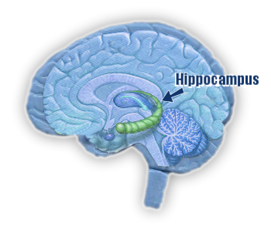
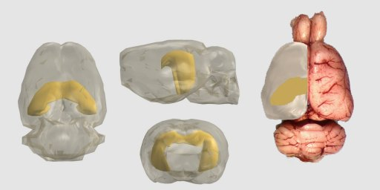
The Hippocampus
Damage causes:
Severe anterograde amnesia
Impaired spatial memory
Inability to imagine novel experiences

Slide 3
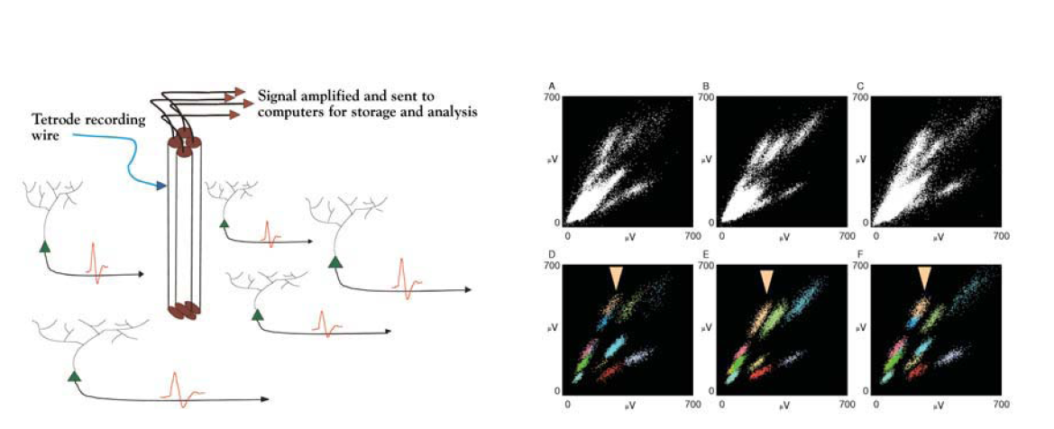
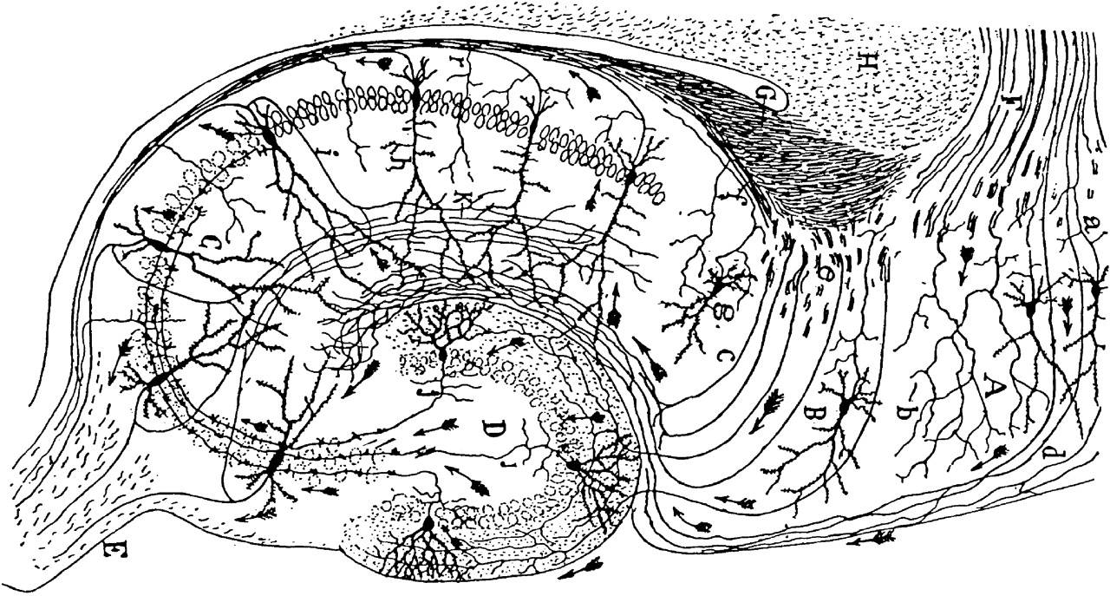
Multiple Single-Unit Recording

Slide 4
Place cells in hippocampus respond to single places.
Hippocampus
Moser et al, Annu Rev Neurosci 2008

Slide 5
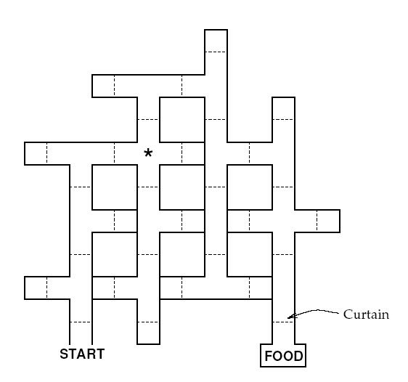
Stuck in a maze

Slide 6
Which way do I go?

Slide 7
Place cells fire in their place fields

Slide 8
Place cells fire in their place fields
Place Cells Tell Me Where I Am

Slide 9
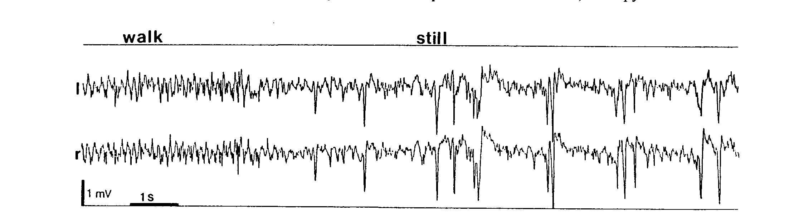
Two states of hippocampal activity
Sharp-Wave / Ripples Unexplored
Buzsaki, 1989
Buzsaki, 1989

Slide 10
Two states of hippocampal activity
Sharp-Wave / Ripples Unexplored
Sharp Wave
Ripple
Sharp Wave Ripple (SWR)
Buzsaki, 1989
Buzsaki, 1989

Slide 11
A spatial memory task
Rat 1, Day 1
200
RANDOM
Latency (s)
HOME
x
0
0
25
Trial
Food
o
***
90
80
11
***
RANDOM
***
***
HOME
2m
0
150
Latency (s)
Path Length (m)
Number of Trials
Latency (s)
0
45
0
0
D1
D2
D1
D2
0
0
20
RANDOM
HOME
Path Length (m)
Odd trials: Random foraging
Even trials: Back to Home
Pfeiffer and Foster, Nature 2013

Slide 12
212 simultaneously recorded place cells

Slide 13
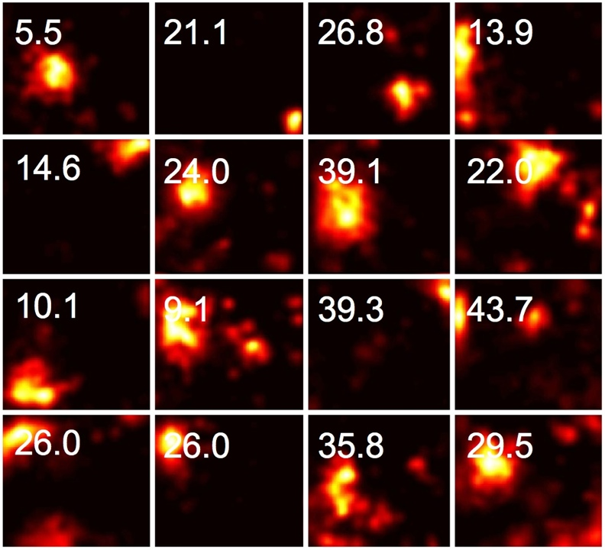
Place fields are relatively large (eg 50cm diameter):
16 out of 212 simultaneously recorded cells showing place fields in a 2m x 2m open field environment.
(Peak firing rate in Hz is shown)

Slide 14
Decoding position from many neurons
Coordinated activity produces a focused representation (where the place fields overlap)

Slide 15
Decoding position from many neurons
Coordinated activity produces a focused representation (where the place fields overlap)

Slide 16
Decoding position from many neurons
Non coordinated activity doesn’t produce overlap

Slide 17
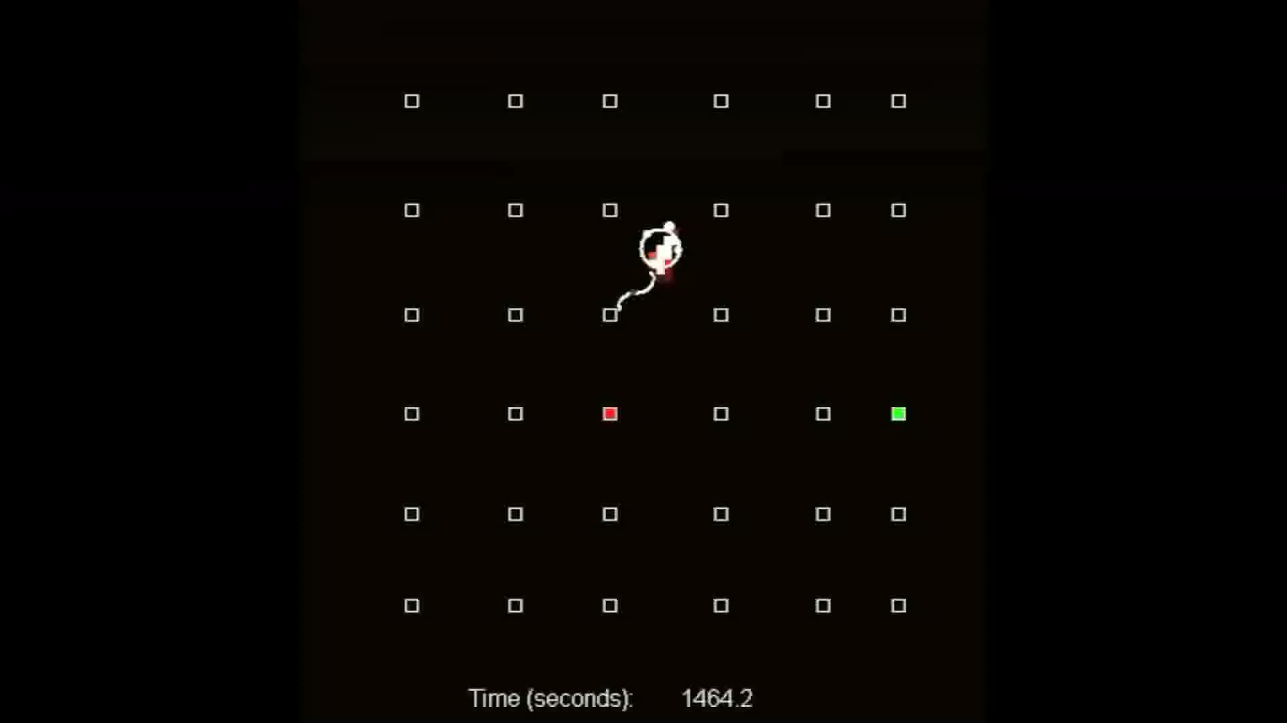
Position representation during running

Slide 18
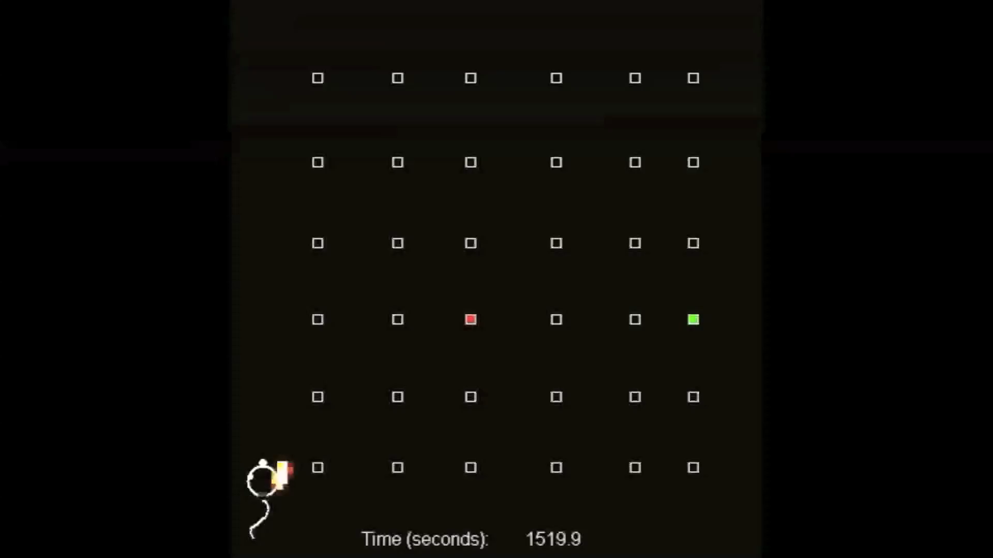
Position representation during pause

Slide 19
Coordinated activity during non-local events

Slide 20
Place-cell sequences encode 2D trajectories

Slide 21
Events reveal memory for the current goal location

Slide 22
Events reveal memory for the current goal location

Slide 23
Sequences match immediate future trajectory
a
b
2
Event
2
Event
Future Path
Future Path
Past Path
Past Path
Y Position
0
2
0
2
0
0
X Position
X Position
c
Away-Events
d
Future Path
Past Path
25
25
***
Rat 1
π/2
Rat 2
Rat 3
Rat 4
All Rats
Crossings (%)
Abs. Displacement
1577
0
0
0
1577
-π
π
-π
π
0
0
A-FP
Angular Displacement
Angular Displacement
A-PP
e
Home-Events
f
g
Future Path
Past Path
π
π/2
25
25
***
***
Crossings (%)
Abs. Displacement
451
1577
0
0
451
451
-π
0
0
π
-π
π
0
0
H-PP
H-FP
H-FP
Angular Displacement
Angular Displacement
A-FP

Slide 24
Every trial a novel path
x
o

Slide 25
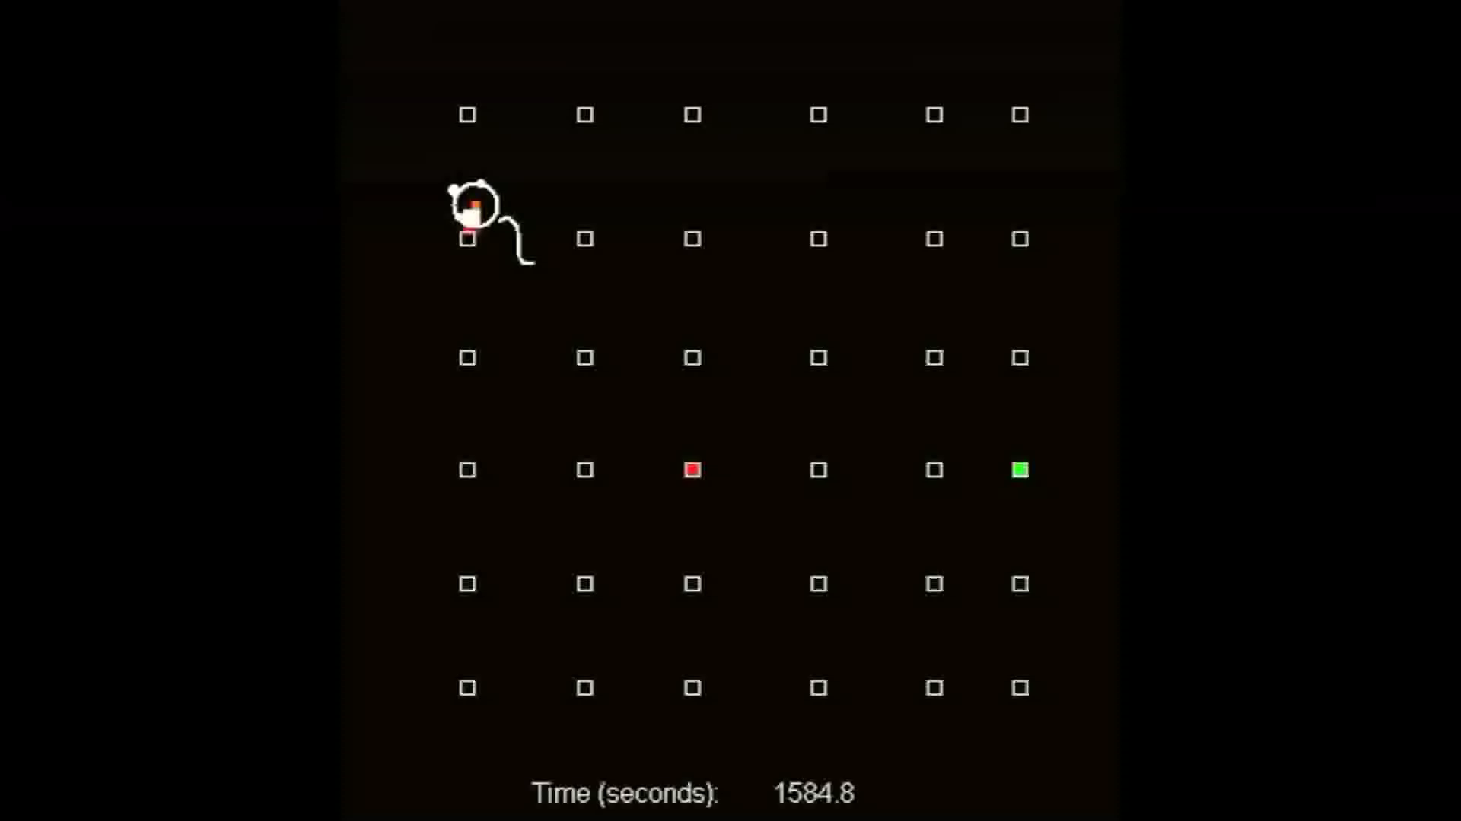
Example novel path
(run and pause activity)

Slide 26
Predictive novel place-cell sequences
First 19 Trials
Away-Events
Future Path
Away-Events
Past Path
***
25
25
π/2
Abs. Displacement
653
653
0
0
0
-π
π
0
-π
π
Angular Displacement
0
Angular Displacement

Slide 27
Summary
During exploration, hippocampal neurons act as place cells that represent location.
During pauses in exploration, the same neurons are active in sequences that predict future behavioral trajectories, and reflect a memory for the goal location.
These predictive sequences can even “imagine” trajectories that the animal has never taken before.

Slide 28

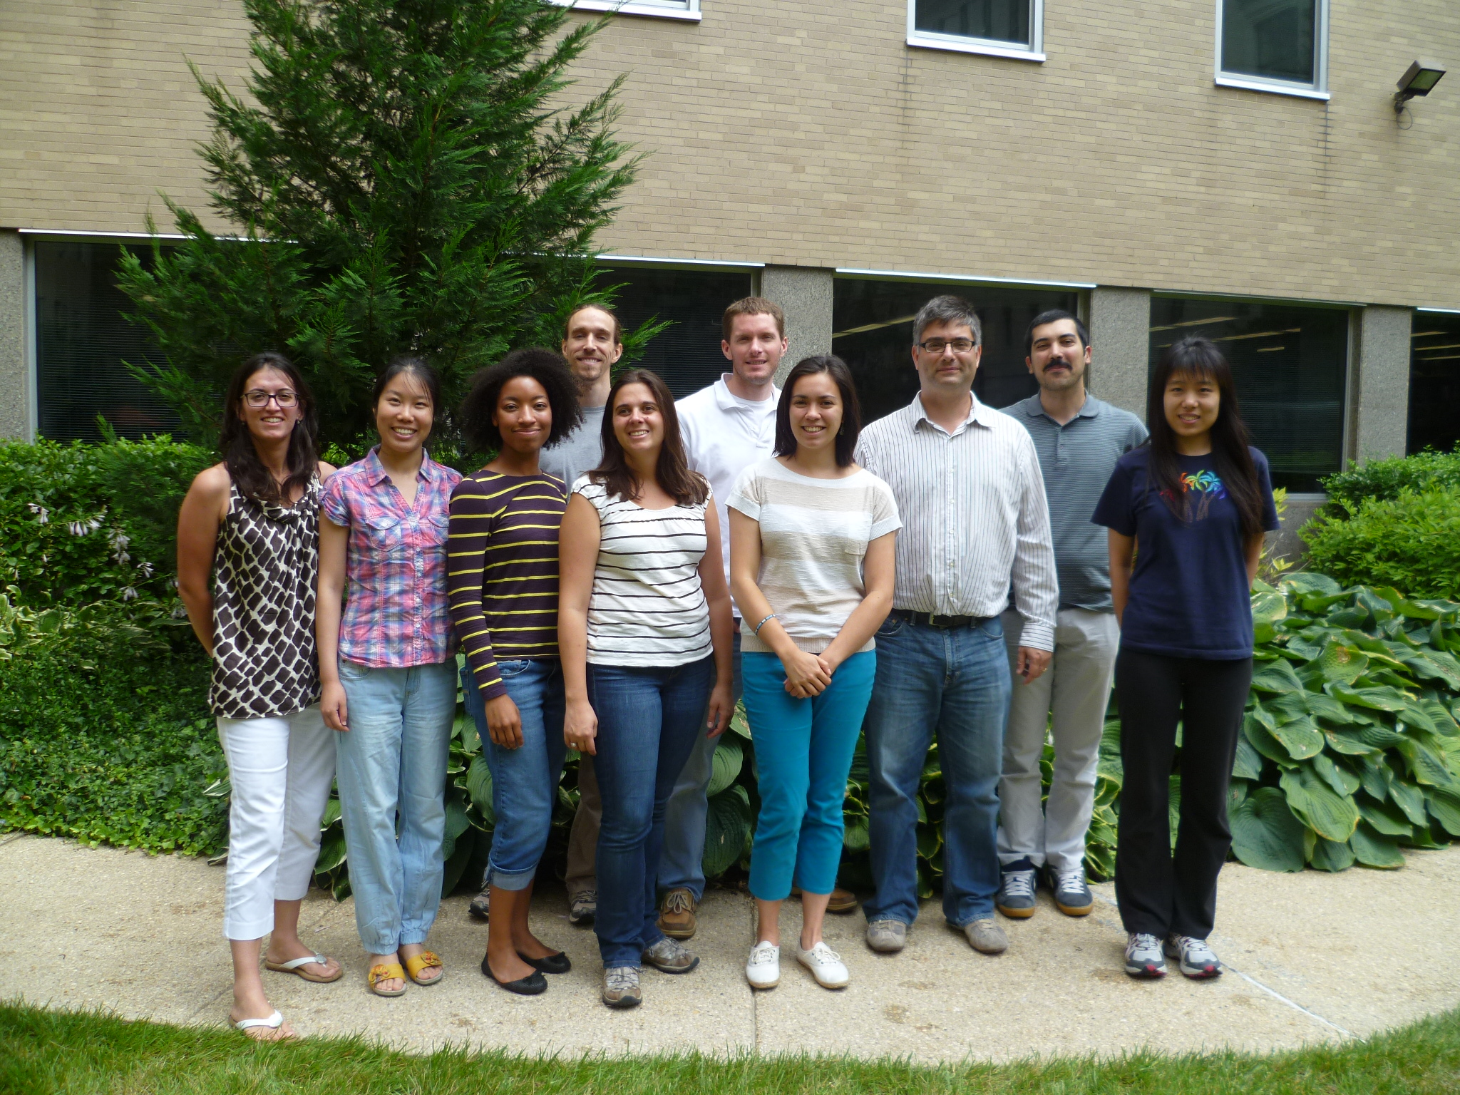
Acknowledgments
Lab:
Xiaojing Wu
Delia Silva
Dr. Brad Pfeiffer
Dr. Cara Altimus
Ting Feng
Christine Boone
Collaborators:
MIT: Dr. Junghyup Suh
Dr. Susumu Tonegawa
Dr. Matt Wilson
JHU: Dr. Akira Sawa
Dr. Don Price
Dr. Phil Wong
Dr. Paul Worley
Felice Zhang
Jane Syh
Ellen Ambrose
Heydar Davoudi
Jon Harrold
Support:
Alfred P Sloan Foundation
Brain & Behavior Research Foundation
(NARSAD Young Investigator)
Whitehall Foundation
National Science Foundation
National Institute of Mental Health (1R01MH085823, 1R21MH086702)
Brain Science Institute,
Johns Hopkins

Slide 29


Slide 30
What do you need sequences for?

Slide 31
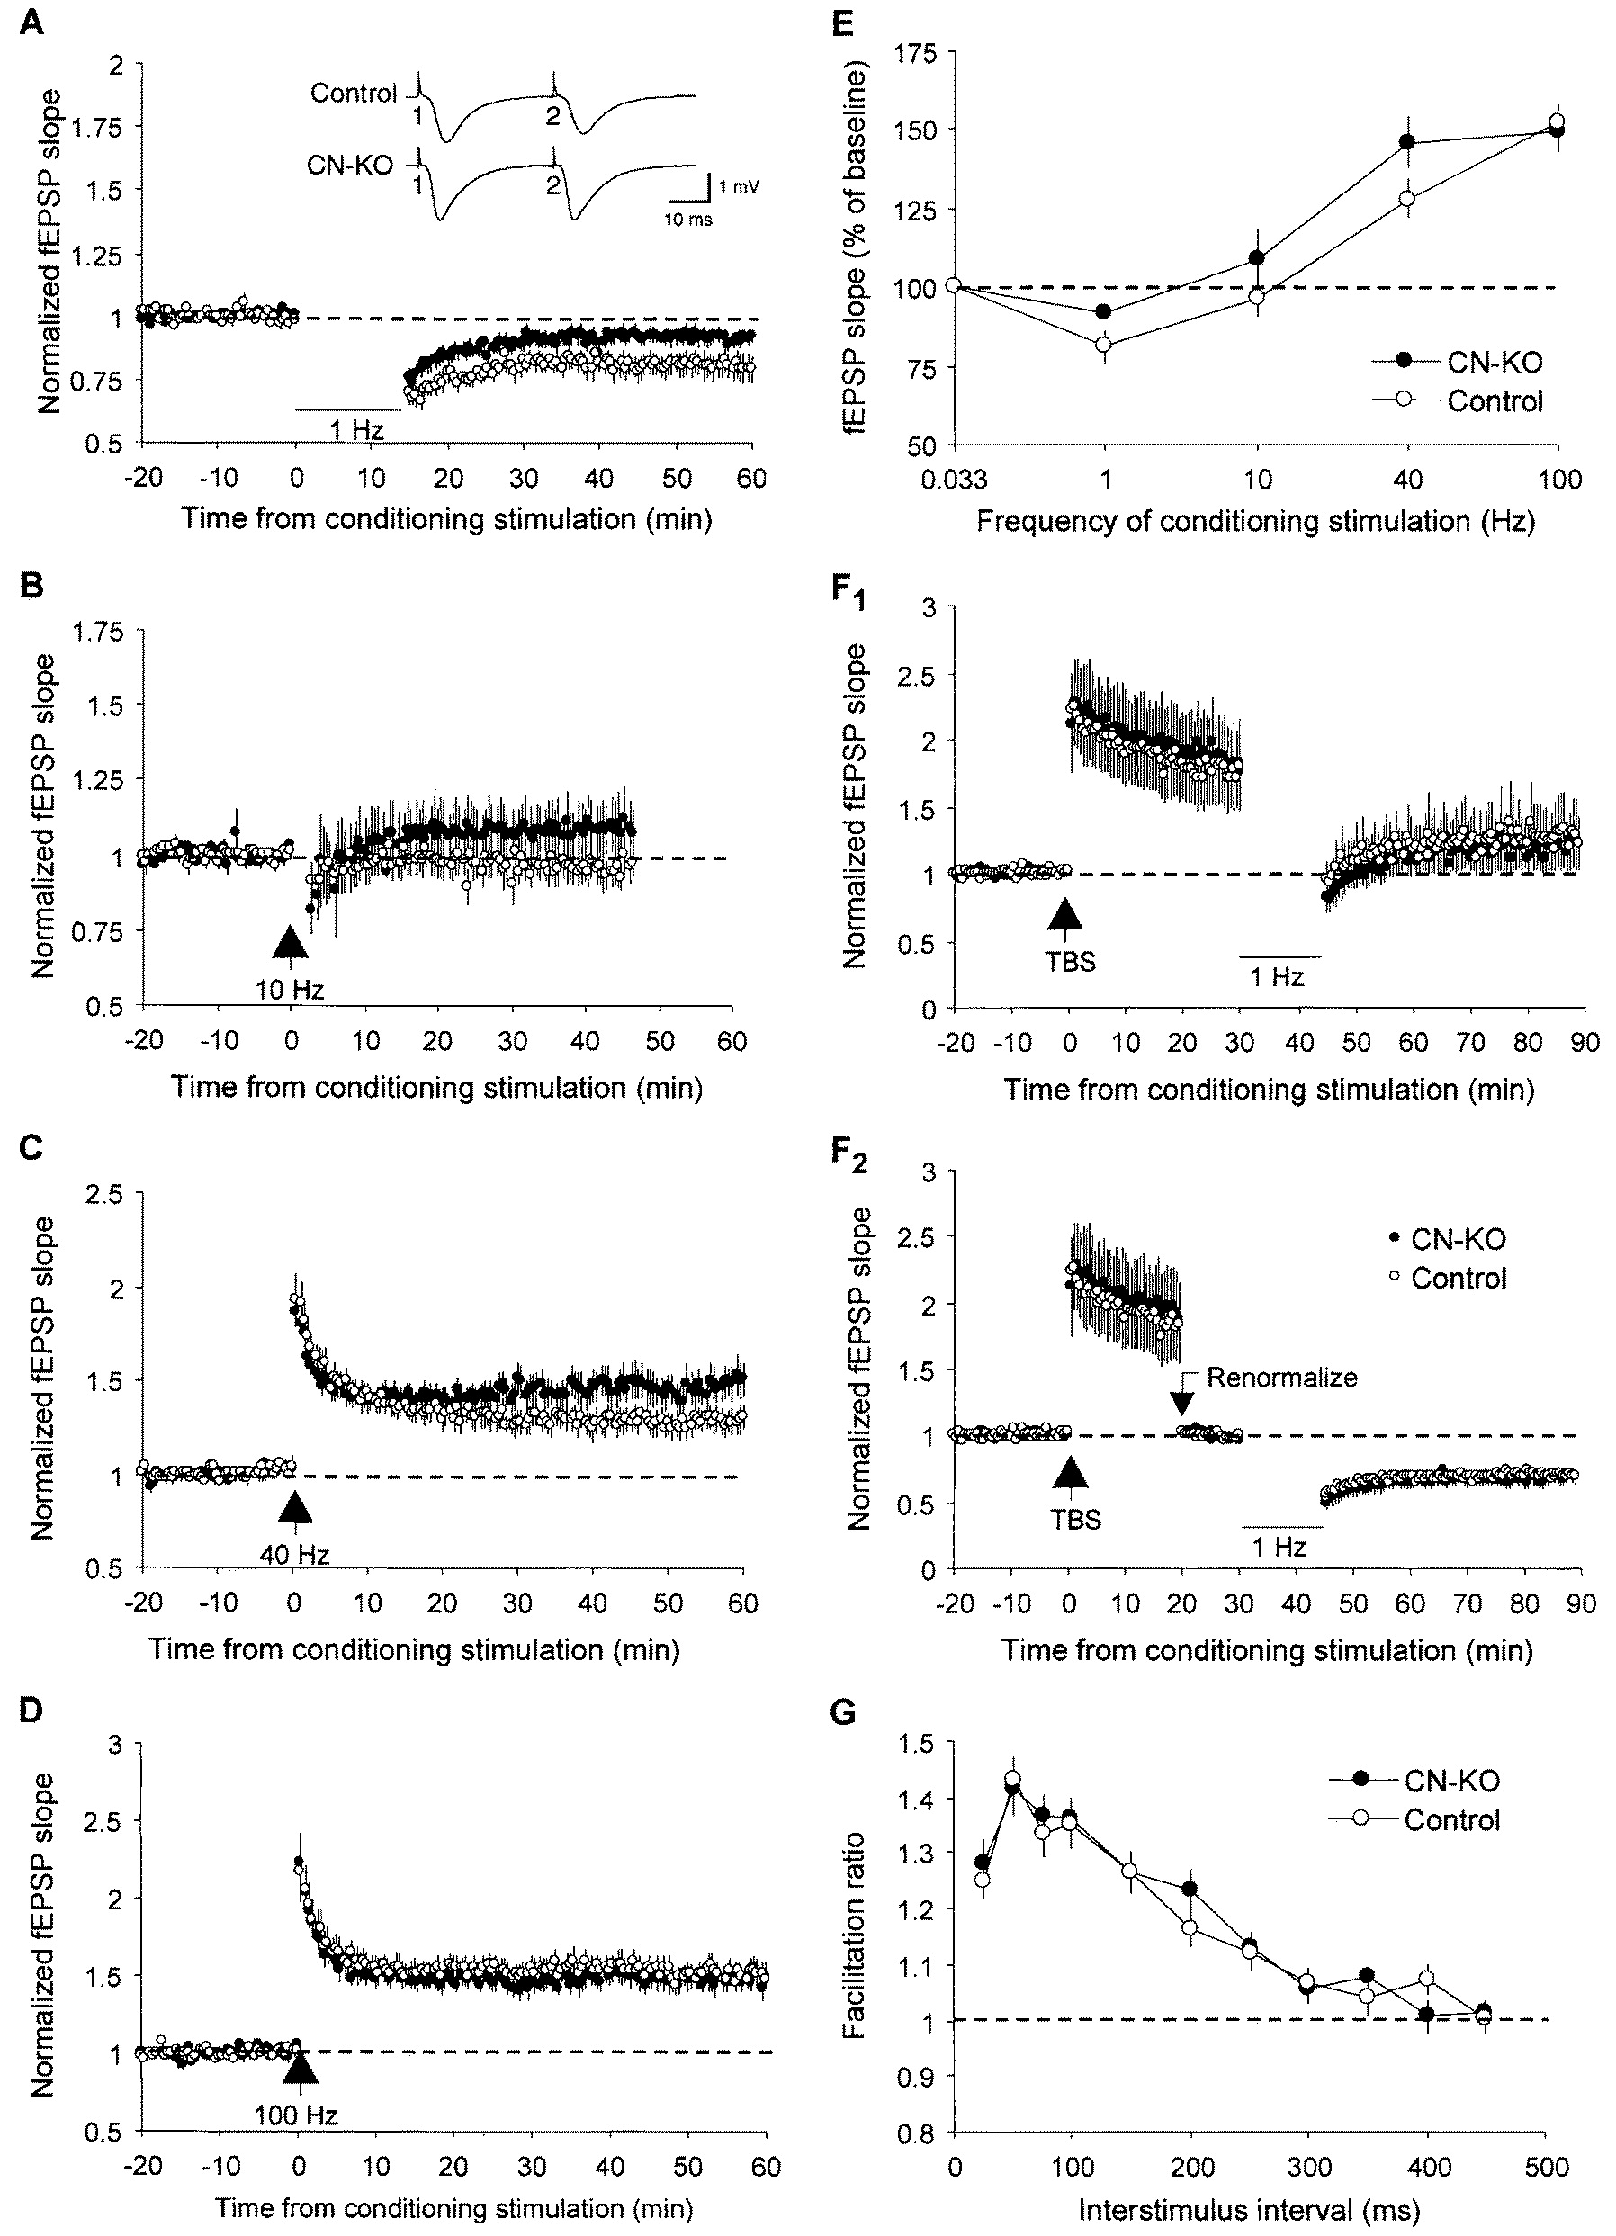
Hippocampal Replay and A Mouse Model of Schizophrenia
Calcineurin KO Mouse: forebrain specific
- LTD is impaired
- LTP is mildly enhanced
Zeng, et al., 2001

Slide 32
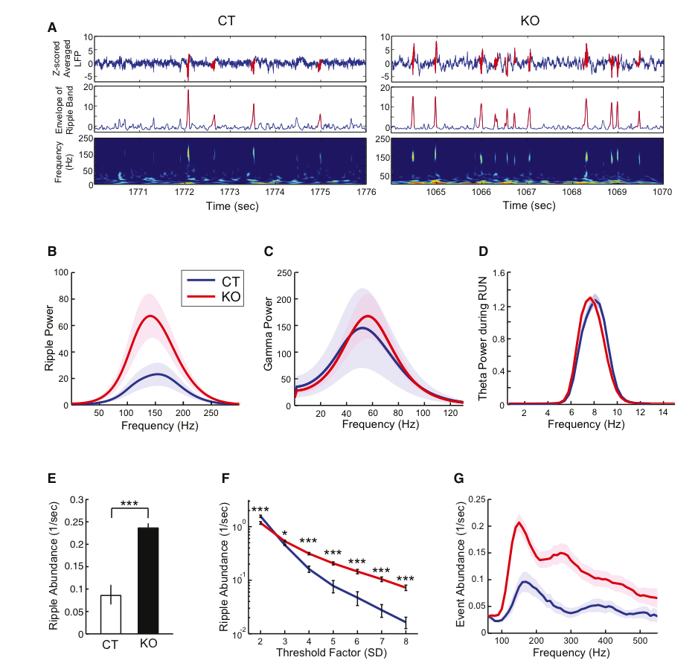
Overabundance of sharp-wave ripples
Suh*, Foster* et al, Neuron 2013

Slide 33
Normal place fields

Slide 34
Normal place fields
Overactive ripples

Slide 35
Disrupted replay sequences

Slide 36
Summary Part II
Place-cell sequences may underlie “working memory”, and specifically, the retrieval of memories.
Place-cell sequences may provide a model system for the effects of brain diseases on memory and cognition.

