Slide 1
Managing Breast Cancer in the Genomic Era
Leisha A. Emens, M.D., Ph.D
Associate Professor of Oncology
Tumor Immunology and Breast Cancer Research Programs
Johns Hopkins University

Slide 2
Conflict of Interest Statement
Biosante, Incorporated: Under a licensing agreement between Biosante and the Johns Hopkins University, the University is entitled to milestone payments and royalty on sales of the vaccine product described in the presentation. The terms of this arrangement are being managed by the Johns Hopkins University in accordance with its conflict of interest policies.
Roche/Genentech, Incorporated: Advisory Board Member, Research Funding pending

Slide 3
Learning Objectives
Apply current knowledge of clinical medicine to the management of breast cancer
Recognize and integrate new scientific developments in molecular medicine as they apply to the management of breast cancer
Interpret the efficacy of target-based therapy for early and late stage breast cancer, and for breast cancer prevention

Slide 4
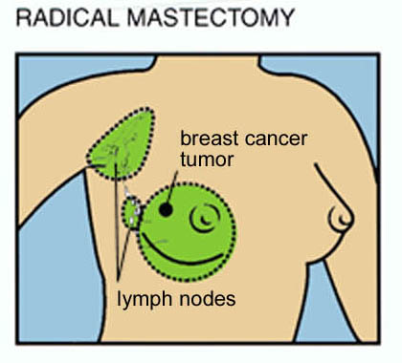
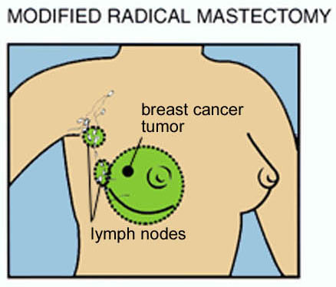
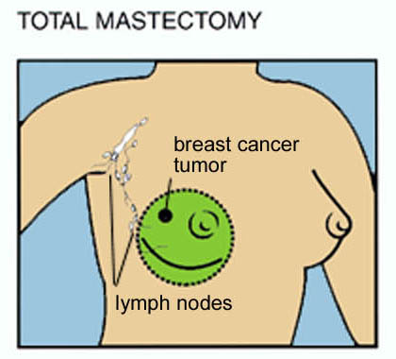
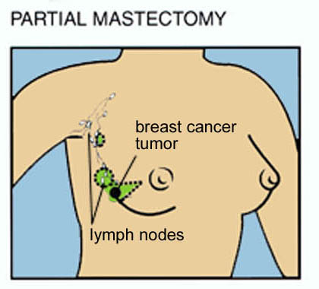
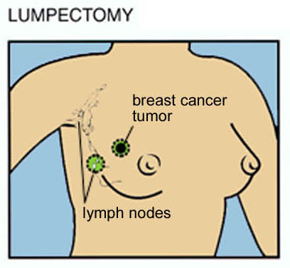
The Evolution of Breast Cancer Therapy—Surgery as a Model
www.bhset.org

Slide 5
Breast Cancer Staging
I T < 2 cm, N0
II T > 2 cm – 5 cm or N1
III Locally advanced breast cancer
IV Distant metastases

Slide 6
Adjuvant Therapy Options:
Predictive Markers
  Chemotherapy:
    lymph node status
    tumor size
  Endocrine Therapy:
    ER, PR status
  Trastuzumab Therapy:
    HER-2 status

Slide 7
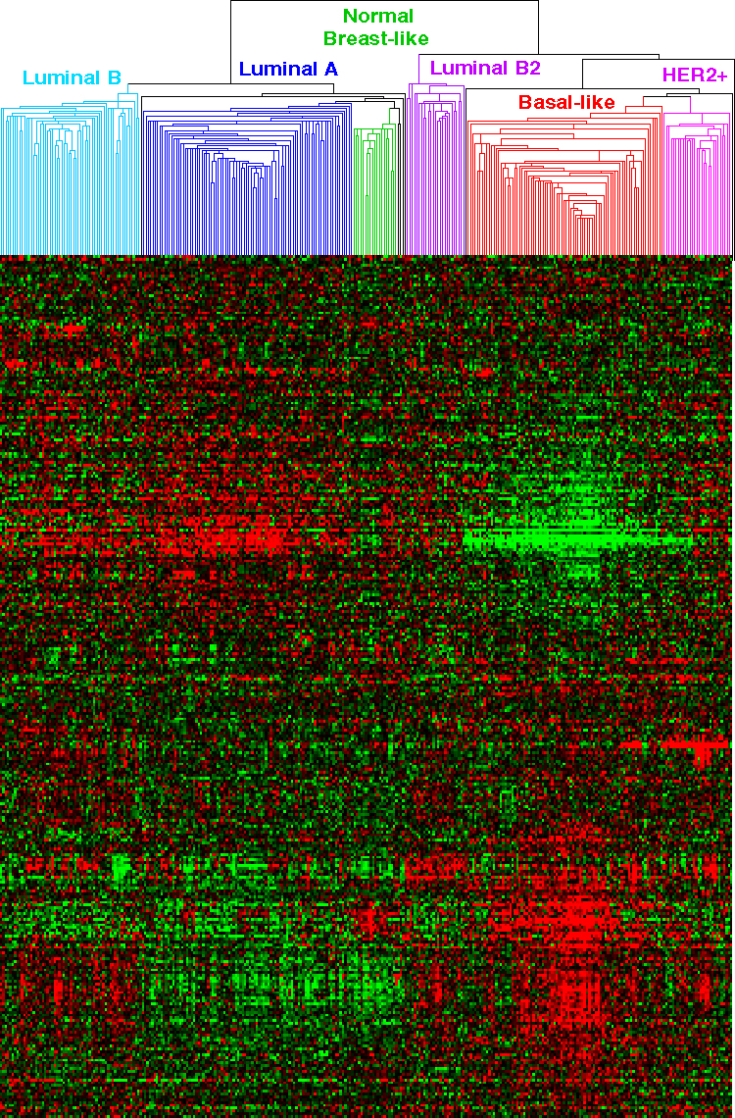
Genomic Profiling Identifies Distinct Subtypes of Breast Cancer
6 Subtypes of Breast Cancer
--distinct natural histories
--distinct responses to therapy
ER + subtypes
ER-neg subtypes
Courtesy Chuck Perou

Slide 8
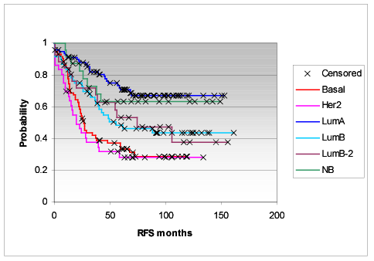
Genomically Distinct Subtypes of Breast Cancer Have Distinct Natural Histories
p < 0.0000001
N= 311

Slide 9
Breast Cancer Subtypes Have Distinct Treatment Options
 | Endocrine Therapy | Trastuzumab | Chemo
Luminal A | Yes | No | Yes
Luminal B | Yes | Y/N | Yes
HER2 | No | Yes | Yes
Basal-like | No | No | Yes

Slide 10
How Can We Improve Therapy For Luminal Type ER+ Breast Cancers?

Slide 11
Oncotype Dx: Genomic Stratification of Luminal Breast Cancers for Therapeutic Benefit
The 21-Gene Recurrence Score (RS) (Oncotype DX) is an RT-PCR based gene expression profiling assay that includes 16 cancer genes and 5 reference genes.
PROLIFERATION
Ki-67
STK15
Survivin
Cyclin B1
MYBL2
ESTROGEN
ER
PR
Bcl2
SCUBE2
INVASION
Stromelysin 3
Cathepsin L2
HER2
GRB7
HER2
GSTM1
CD68
BAG1
REFERENCE GENES
Beta-actin, GAPDH, RPLPO
GUS, TFRC

Slide 12
Oncotype Dx: Genomic Stratification of Luminal Breast Cancers for Therapeutic Benefit
RS = + 0.47 x HER2 Group Score
- 0.34 x ER Group Score
+ 1.04 x Proliferation Group Score
+ 0.10 x Invasion Group Score
+ 0.05 x CD68
- 0.08 x GSTM1
- 0.07 x BAG1
Category | RS (0 – 100)
Low Risk | RS < 18
Interm Risk | RS > 18, < 31
High Risk | RS > 31

Slide 13
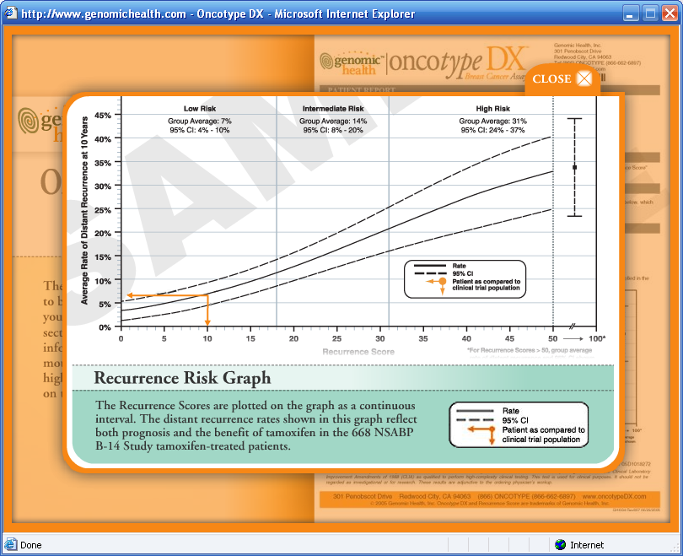

Slide 14
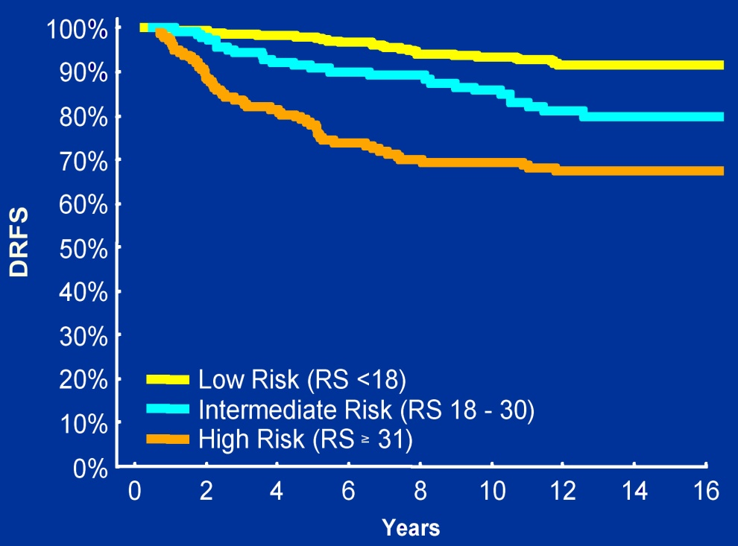
Oncotype Dx: Genomic Stratification of Luminal Breast Cancers
NSABP B-14
Validation Study
The RS has been shown to quantify risk of distant recurrence in node-negative, ER-positive patients
Validated on 668 tamoxifen-treated patients from NSABP
B-14
Paik S, et al: N Engl J Med, 2005

Slide 15
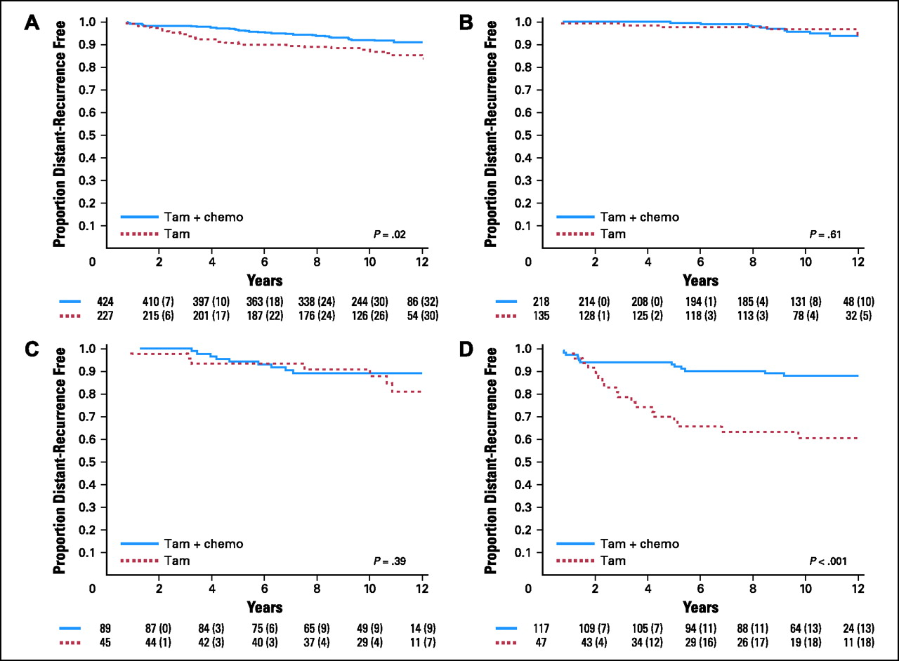
Oncotype Dx: Genomic Stratification of Luminal Breast Cancers
NSABP B-20
Validation Study
Paik S, et al: J Clin Oncol, 2006

Slide 16
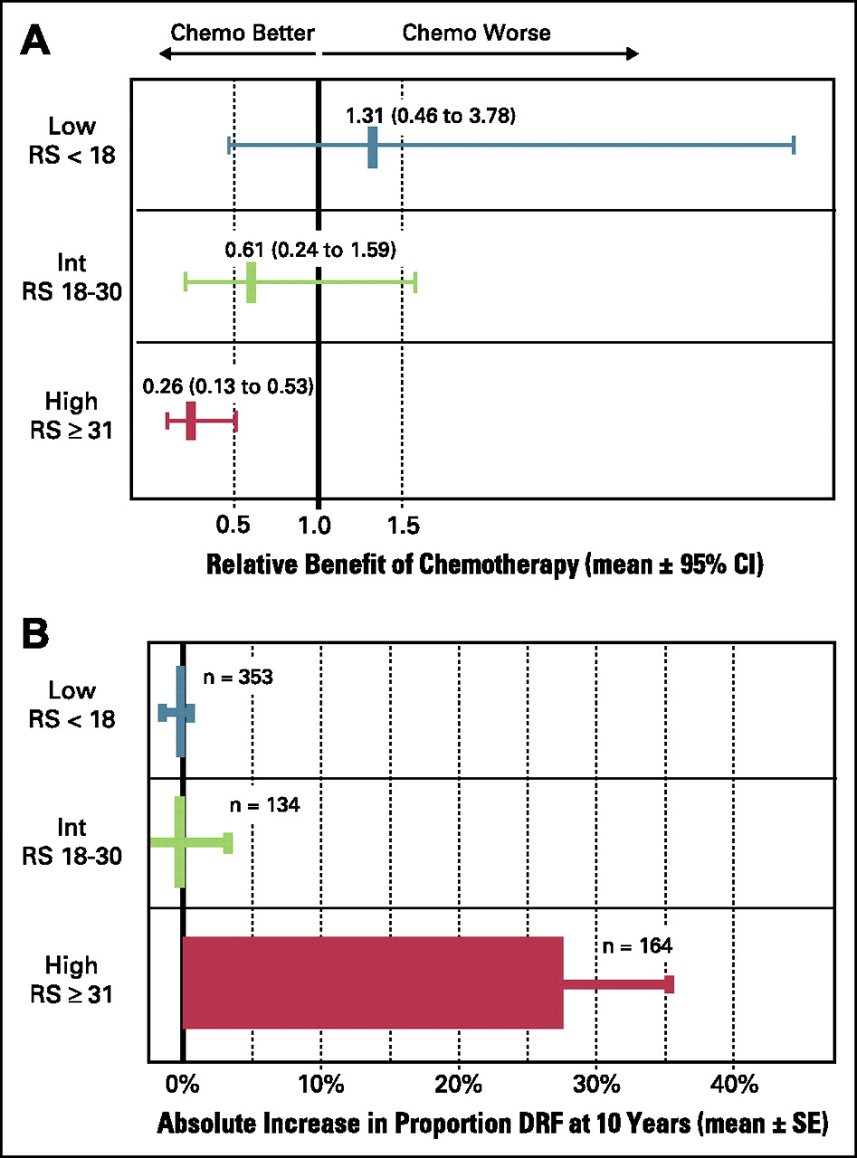
Oncotype Dx: Genomic Stratification of Luminal Breast Cancers
The RS has been shown to quantify the benefit of chemotherapy in node-negative, ER-positive patients
Validated on 651 tamoxifen- or tamoxifen and chemotherapy treated patients from NSABP
B-20
Paik S, et al: J Clin Oncol, 2006

Slide 17
What About Breast Cancer Prevention for Luminal Cancers?

Slide 18

Study of Tamoxifen and Raloxifene
(STAR): Initial Findings from the NSABP P-2 Breast Cancer Prevention Study
D.L. Wickerham, J.P. Costantino, V. Vogel,
W.M. Cronin, R.S. Cecchini, J. Atkins, T. Bevers,
L. Fehrenbacher, W. McCaskill-Stevens, N. Wolmark
ASCO 2006

Slide 19
NSABP STAR Schema
Risk-Eligible
Postmenopausal Women
STRATIFICATION
  Age
  Gail Model Risk
  Race
  History of LCIS
TAMOXIFEN
20 mg/day
x 5 years
RALOXIFENE
60 mg/day
x 5 years

Slide 20
P-2 STAR
Average Annual Rate and
Number of Invasive Breast Cancers
10
8
312*
6
Av Ann Rate per 1000
4
2
163
168
0
Gail Model
TAM
Raloxifene
Projection
* # of events

Slide 21
What About HER-2+ Breast Cancers?

Slide 22



The HERs Are a Dysfunctional Family of Receptors Implicated in Cancer
TGF-α
EGF
Epiregulin
Betacellulin
HB-EGF
Amphiregulin
HER2 does not bind its own ligand
Heregulin (neuregulin-1)
Epiregulin
HB-EGF
Neuregulins-2,3,4
Heregulin
(neuregulin-1)
Ligand-
binding
domain
Transmembrane
Tyrosine
kinase
domain
Erb-B1
EGFR
HER1
Erb-B2
HER2
neu
Erb-B3
HER3
Erb-B4
HER4

Slide 23
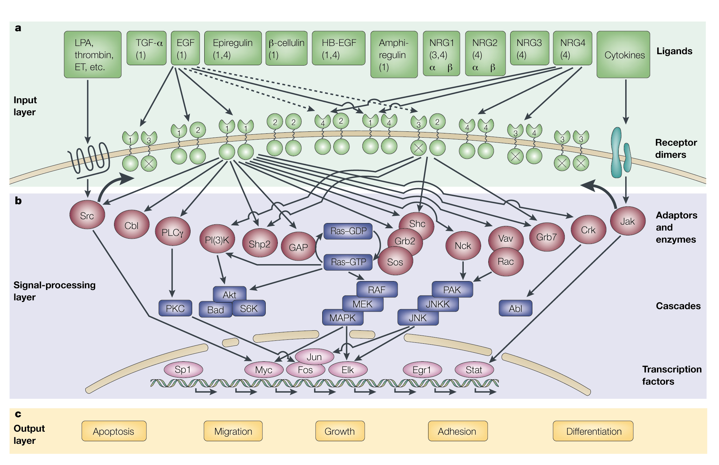
Complex Interactions Between HER Receptors Influence Tumor Cell Behaviour

Slide 24
Trastuzumab
Humanized monoclonal antibody
Specific for the extracellular domain of HER-2/neu
Single agent activity in HER-2/neu-overexpressing metastatic breast cancers:
Toxicities: fever, chills, nausea, cardiac toxicity
 | 1st Line | 2nd/3rd Line
ORR | 26% | 15%
Response duration | >12 mos | 9 mos
Median survival | 24 mos | 13 mos

Slide 25
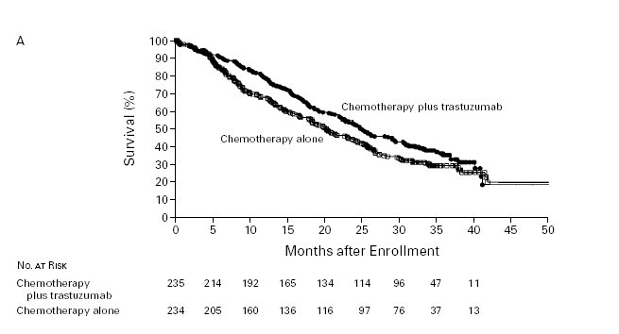
Trastuzumab Added To Chemotherapy
Improves Survival In MBC
% w/trastuz.@ POD:
24
62
65
RR=0.76
P=0.025
Slamon et al NEJM 2001; 344:783-92

Slide 26
HER2 Gene Amplification Is Predictive of Significant Survival Benefits With Trastuzumab
HER2 gene amplified
(FISH +)
Not amplified
(FISH –)
1.0
Trastuzumab + Chemo
(n = 176)
Chemo Alone
(n = 169)
1.0
Trastuzumab + Chemo
(n = 50)
Chemo Alone
(n = 56)
0.8
0.8
0.6
0.6
Probability
0.4
0.4
0.2
Risk ratio = 0.70
95% Cl = 0.54, 0.91
0.2
Risk ratio = 1.13
95% Cl = 0.72, 1.79
0.0
0.0
0
10
20
30
40
50
0
10
20
30
40
50
Months
Months

Slide 27
Trastuzumab Improves Disease Free Survival in Early Breast Cancer
1.0
93%
0.9
91%
86%
84%
86%
80%
80%
0.8
77%
% Disease Free
73%
0.7
Patients
Events
0.6
1073
147
AC->T
1074
77
AC->TH
HR (AC->TH vs AC->T) = 0.49 [0.37;0.65] P<0.0001
1075
98
TCH
HR (TCH vs AC->T) = 0.61 [0.47;0.79] P=0.0002
0.5
0
1
2
3
4
5
Year from randomization

Slide 28
Lapatinib
Binds to intracellular ATP binding site of EGFR (ErbB-1) and HER2 (ErbB-2) preventing phosphorylation and activation
Blocks downstream signaling through homodimers and heterodimers of EGFR (ErbB-1) and HER2 (ErbB-2)
Dual blockade of signaling may be more effective than the single-target inhibition provided by agents such as trastuzumab
Lapatinib
1+1
2+2
1+2
Downstream signaling cascade
Rusnak et al. Mol Cancer Ther 2001;1:85-94; Xia et al. Oncogene 2002;21:6255-6263;
Konecny et al. Cancer Res. 2006;66:1630-1639

Slide 29
Lapatinib Increases Time to Disease Progression in HER-2+ Metastatic Breast Cancer
% of patients free from progression*
Lapatinib + Capecitabine
Capecitabine
100
No. of pts
160
161
90
Progressed or died*
45 (28%)
69 (43%)
80
Median TTP, mo
8.5
4.5
70
Hazard ratio (95% CI)
0.51 (0.35, 0.74)
P-value (log-rank, 1-sided)
0.00016
60
50
40
30
20
10
0
0
10
20
30
40
50
60
70
Time (weeks)
* Censors 4 patients who died due to causes other than breast cancer

Slide 30
What About Breast Cancer Prevention
for HER-2+ Cancers?

Slide 31
What About Basal-Type Breast Cancers?
Triple negative: ER-, PR-, HER2-
Frequently BRCA1+
Responds initially to chemotherapy, but characterized by early treatment failure
No specific drug target for this subtype approved to date

Slide 32
Conventional Chemotherapy in Basal-like Breast Cancer
Regimen Subtype | T-FAC¹ (N=82) | AC-T² (n=107)
Luminal A/B | 2/30 (7%) | 4/62 (7%)
Normal-like | 0/10 (0) | NA
HER2+/ER- | 9/20 (45%) | 4/11 (36%)
Basal-like | 10/22 (45%) | 9/34 (26%)
P<0.001
P=0.003
1 Rouzier et al, Clin Cancer Res 2005;
2 Carey LA et al, SABCS 2004

Slide 33
Triple-Negative Breast Cancers: Some Potential Therapeutic Targets
Cetuximab
EGFR Tyrosine Kinase
C-KIT tyrosine kinase
Dasatinib Sunitinib
MAP Kinase Pathway
Akt Pathway
MAPK inhibitors; NOTCH inhibitors
Transcriptional Control
PARP inhibitors; Trabectedin
Anti-Angiogenesis
DNA Repair pathways
Cell Cycle
Bevacizumab
After Cleator S et al. Lancet Oncol. 2006:8:235-244
Cell Death

Slide 34

Phase II PARPi TNBC Study: Treatment Schema
Metastatic TNBC
N = 120
RANDOMIZE
Gemcitabine (1000 mg/m², IV, d 1, 8)
Carboplatin (AUC 2, IV, d 1, 8)
BSI-201 (5.6 mg/kg, IV, d 1, 4, 8, 11)
Gemcitabine (1000 mg/m², IV, d 1, 8)
Carboplatin (AUC 2, IV, d 1, 8)
21-Day
Cycle
RESTAGING
Every 2 Cycles
* Patients randomized to gem/carbo alone could crossover to receive gem/carbo + BSI-201 at disease progression
34
O’Shaughnessy J et al: J Clin Oncol 2009; abstract 3

Slide 35
Progression-Free Survival
_{BSI-201 + Gem/Carbo (n = 57)}
_{Median PFS = 6.9 months}
_{Gem/Carbo (n = 59)}
_{Median PFS = 3.3 months}
_{P < 0.0001}
HR = 0.342 (95% CI, 0.200-0.584)
35
O’Shaughnessy J et al: J Clin Oncol 2009; abstract 3

Slide 36
Overall Survival
_{BSI-201 + Gem/Carbo (n = 57)}
_{Median OS = 9.2 months}
₈
_{Gem/Carbo (n = 59)}
_{Median OS = 5.7 months}
_{P = 0.0005}
HR = 0.348 (95% CI, 0.189-0.649)
36
O’Shaughnessy J et al: J Clin Oncol 2009; abstract 3

Slide 37
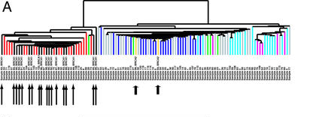
Basal-like Breast Cancer and BRCA1
Intrinsic gene list applied to Van’t Veer dataset (Nature 2002)
Basal-like
= BRCA1+
= BRCA2+
Sorlie T et al. PNAS 03

Slide 38
What About Prevention for
Basal-Type Breast Cancers?

Slide 39
Breast Cancer Prevention: Heredity and Risk
Contribution to Hereditary Breast Cancer
20%–40%
10%–30%
<1%
<1%
30%–70%
Gene
BRCA1
BRCA2
TP53
PTEN
Undiscovered genes

Slide 40
Breast Cancer Prevention: Heredity and Risk
Contribution to Hereditary Breast Cancer
20%–40%
10%–30%
<1%
<1%
30%–70%
Gene
BRCA1
BRCA2
TP53
PTEN
Undiscovered genes

Slide 41
“Hope is not a strategy—you have to follow the science”

Slide 42
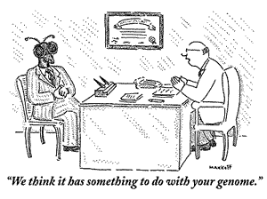
Thank you!

