Slide 1
Regenerative Medicine to Cure Sickle Cell Anemia
Robert A. Brodsky, MD
Johns Hopkins Family Professor of Medicine and Oncology
Director: Division of Adult Hematology

Slide 2
Glossary of terms
BMT
  Bone marrow transplantation
  Blood or marrow transplantation
  Stem cell transplantation
  Hematopoietic cell transplantation
  Peripheral blood stem cell transplantation
Donor
  Syngeneic – identical twin
  Autologous – self (blood or bone marrow)
  Allogeneic – another of same species
    Matched sibling
    Alternative Donor
      Matched unrelated donor (MUD)
      Non-matched sibling (haplo identical)
      Cord Blood
      HES or iPSC (not yet feasible)
Synonyms

Slide 3
Glossary continued: Conditioning regimen
Myeloablative
  Conditioning without BMT would lead to permanent aplasia
Non-myeloablative
  aka miniBMT, reduced intensity
  Autologous recovery would occur without BMT

Slide 4
Indications for Hematopoietic Stem Cell Transplants in the United States, 2009
Number of Transplants
Slide 8
SUM-WW11_8.ppt
Notes:
Slide 8: The most common indications for HCT in the United States in 2009 were multiple myeloma and lymphoma, accounting for 60% of all HCTs. Multiple myeloma continue to be the most common indication for autotransplantation and acute myeloid leukemia for allogeneic transplantation.

Slide 5
Possibilities of BMT
Traditional Uses
New/Future Uses
Eradicate cancer
  Leukemia
  Lymphoma
  MDS
Replace a defective organ
  Aplastic anemia
Genetic blood disease
  Sickle cell anemia
  Thalassemia
Replace a defective immune system (autoimmunity)
  Lupus, MS, Crohn’s, RA
Solid organ transplantation

Slide 6
Obstacle to Success of BMT
Hematologic malignancies
  Toxicity
    GVHD
    Death
  Donors
  Relapse
    Biggest obstacle for hematologic malignancies
Non-malignant disease (e.g, Sickle cell)
  Toxicity
    GVHD
    Death
  Donors
SAFETY and Donor availability

Slide 7
Reduced Intensity BMT
Non-myeloablative or “mini” BMT
Low-dose immunosuppressive conditioning to allow BMT to take
  Lower conditioning regimen toxicity
  Available to older (>70) and less fit patients
  Substantially cheaper than standard BMT
  Outpatient procedure

Slide 8
Genetics of HLA system
One allele from each parent
If 1 sibling: 25% chance of inheriting same HLA allelle s (perfect match)
If 2 siblings 44% chance of having perfect match.

Slide 9
Alternative Stem Cell Sources
Matched sibs available <30% pts
Matched unrelated donor: available in ∼ 60% of Caucasians
  Rare for many ethnic groups - <10% of African-Americans
Umbilical cord – 2 antigen MM in 80%
  Delayed engraftment in adults
  Immune dysfunction in adults
Embryonic stem cells
Patient specific iPSC
Haploidentical related – rapidly available to almost everyone
  Unacceptably high rates of GVHD, historically
Don’t‘ engraft!

Slide 10
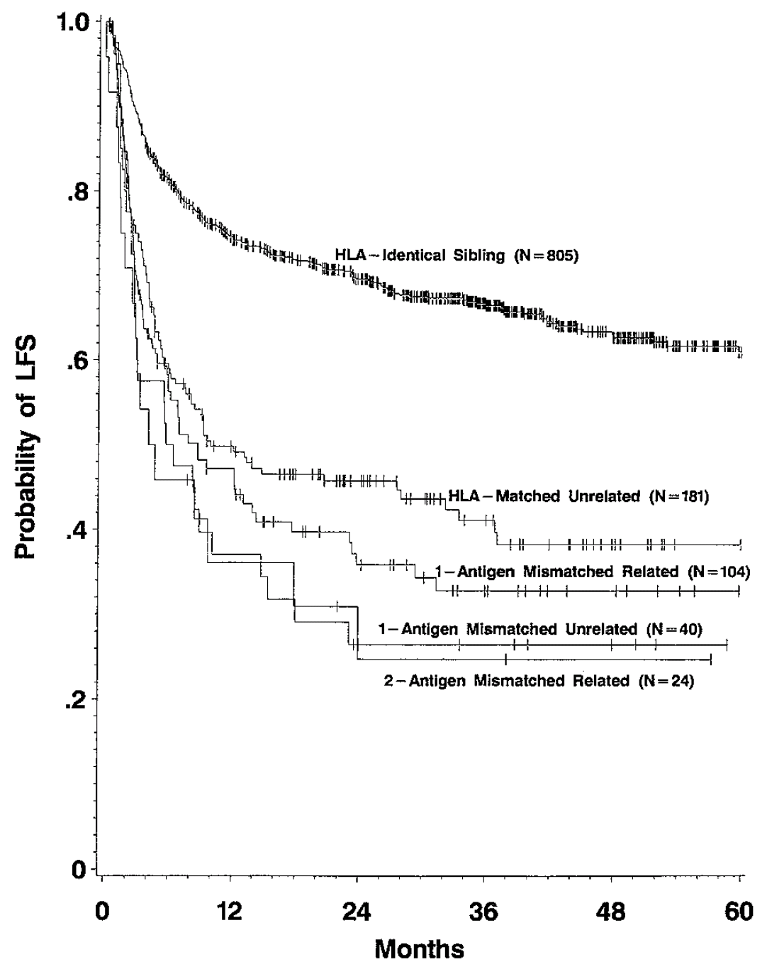
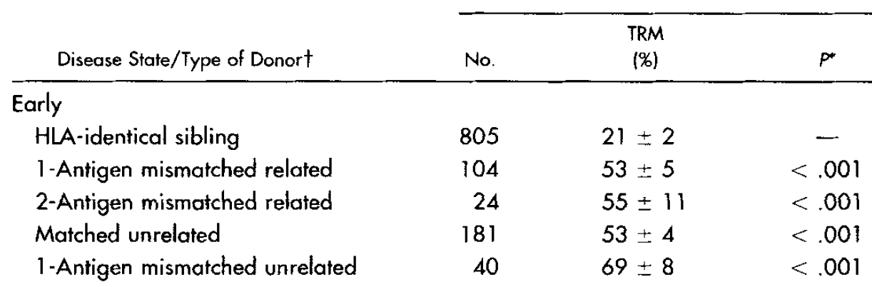
Alternative Donor AlloBMT (1997)
The Holy Grail of BMT?
Early Leukemia
Early Leukemia
IBMTR
Szydlo et al JCO 1997

Slide 11
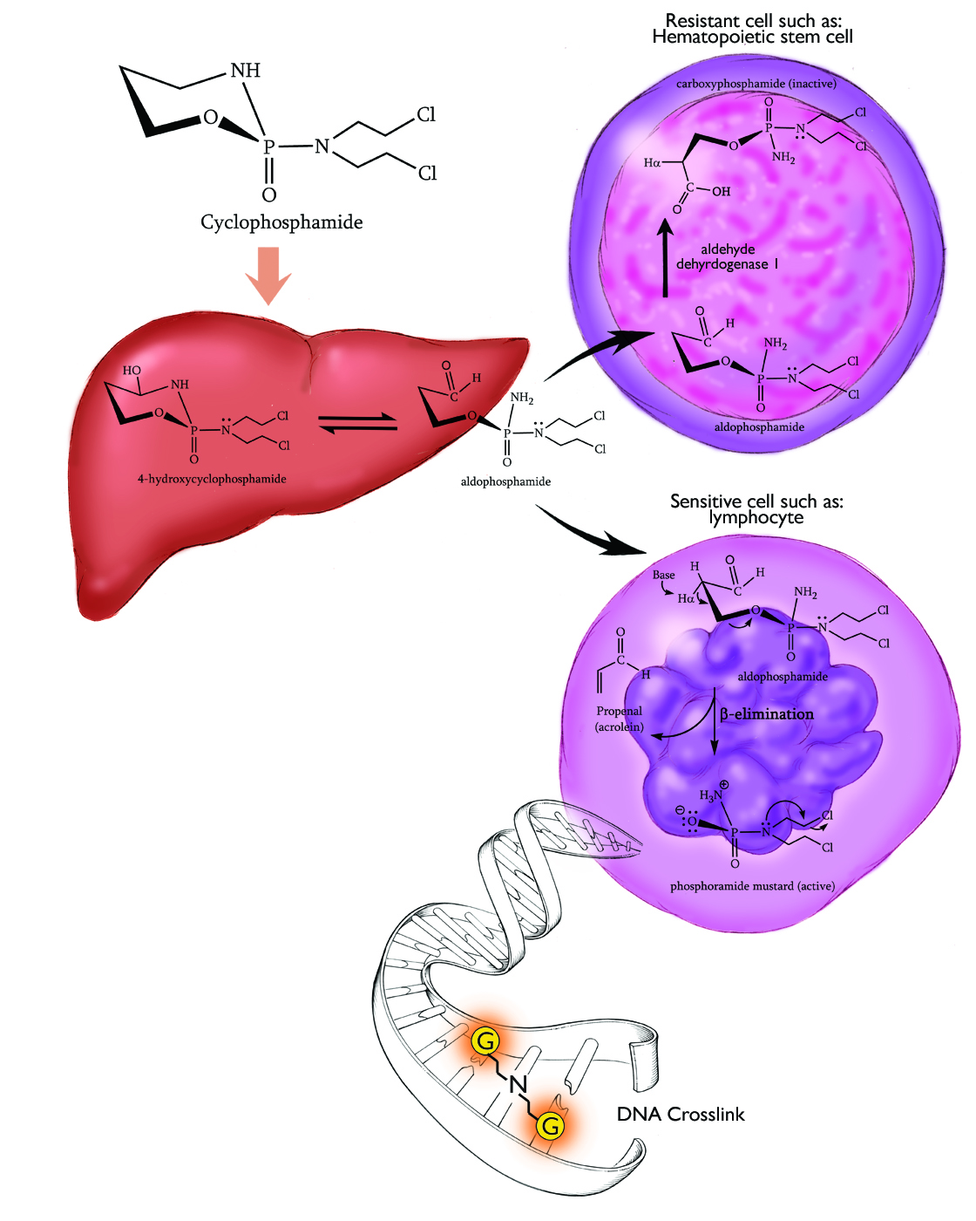
High Dose Cyclophosphamide to Mitigate Alloimmunity
Transport forms:
  aldophosphamide
  4-hydroxyCy
Metabolized by:
  ALDH
HSC
  High levels ALDH
  resistant
Lymphocytes
  Low levels ALDH
  sensitive
Emadi, Jones and Brodsky. Nat Rev Clin Oncol 2009

Slide 12
Post Transplant High Dose Cy
Mitigates GVHD
Allows for greater use of alternative donors (haplo BMT)
Average person in US has 4.5 HLA haplo-identical donors
Helpful for malignant diseases but may revolutionize the treatment of genetic and autoimmune disease

Slide 13
Hypothesis
Non-myeloablative conditioning with post transplant HiCY will expand the number of SCD patients eligible for allogeneic BMT by allowing the safe and effective use of related HLA-haploidentical donors

Slide 14
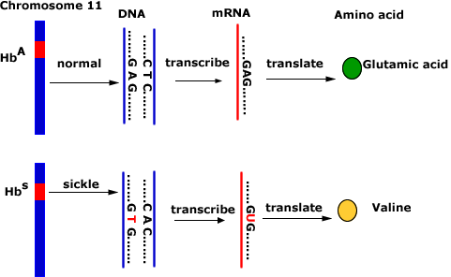
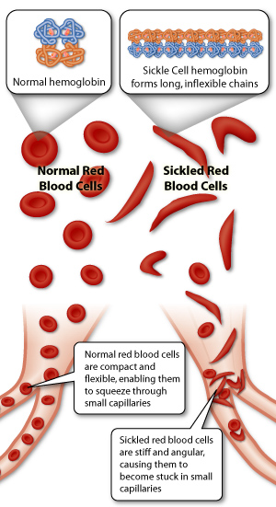
Sickle Cell Anemia
First Genetic Disease
Hydroxyurea only FDA approved drug

Slide 15
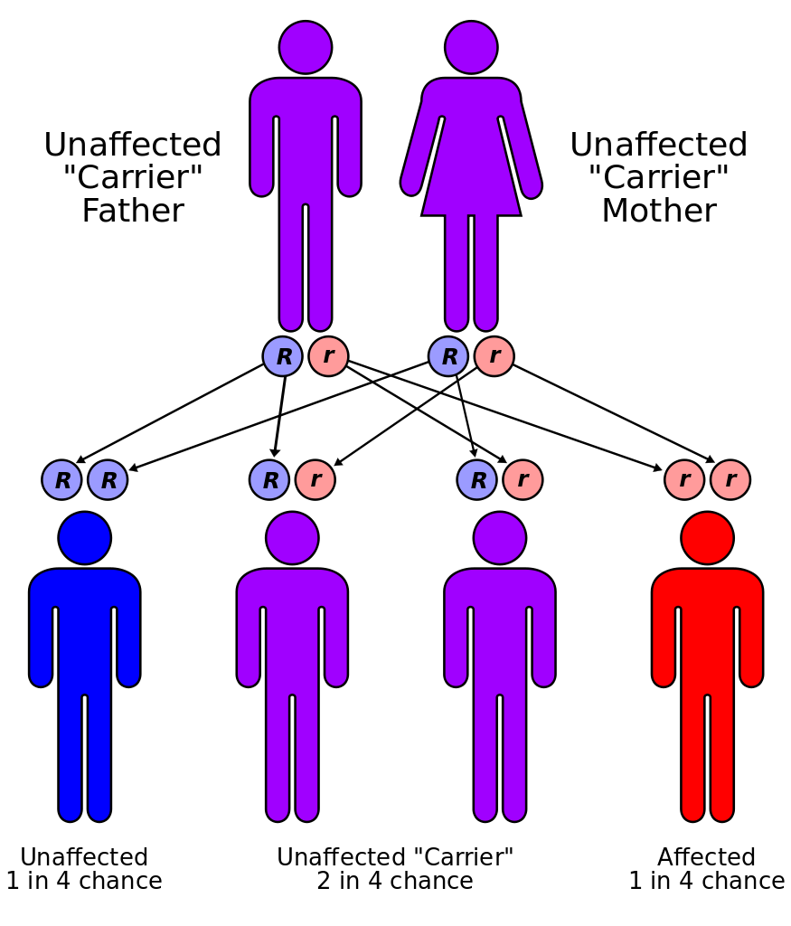
Genetics of Sickle Cell Disease

Slide 16
Epidemiology
1:400 births in African Americans
1:36,000 births in Hispanics
1:123,000 births in Whites
~ 100,000 in US with SCD
  Median survival 42 yrs in males
  Median survival 48 yrs in females
SCD kills an estimated half-million people worldwide annually.

Slide 17
Annual cost of medical care in the US for people who suffer from sickle cell disease exceeds $1.1 billion
Average cost per patient: $2000 / month
  10k/yr for children
  35K/yr for adults
45 yo with SCD will cost $1 million lifetime
"When one considers the additional contributions of sickle cell disease associated with
reduced quality of life, uncompensated care, lost productivity, and premature mortality,
the full burden of sickle cell disease is likely to be quite higher."
Kauf et al, Am J Hematol. 2009

Slide 18
BMT for Sickle Cell Disease
1st 1984 in patient with AML
Known cure, but many obstacles
  Need for HLA-matched sibling
    <8% of patients have a suitable donor
    Cord blood results have been disappointing
  Toxicity of conditioning regimen
    Non-myeloablative preps have had high rates of graft failure
  High rate of graft failure

Slide 19
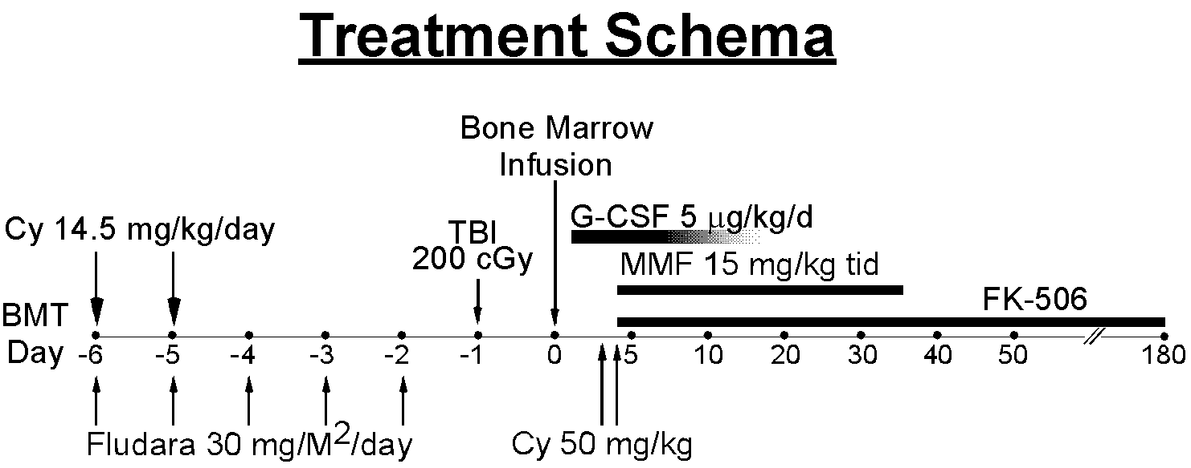
Reduced intensity haploidentical BMT
with post-transplant Cyclophosphamide (CY)
ATG Day -9 to -7
Alloreactive T cells maximally stimulated at days 3-4 postBMT
  Non-alloreactive T cells quiescent
  Memory T cells (like HSCs) relatively resistant to Cy via high expression of ALDH
~
Bolanos-Meade et al, Blood 2012

Slide 20
Expanding the Availability of BMT for SCD
19 patients screened (17 adult; 2 pediatric)
17 transplanted (90%)
  3 matched sibling donors (all 3 engrafted)
  14 haplo donors (8 engrafted)
11/19 (58%) of screened patients cured
11/17 (65%) of transplanted patients cured
No mortality
No GVDH that required treatment

Slide 21
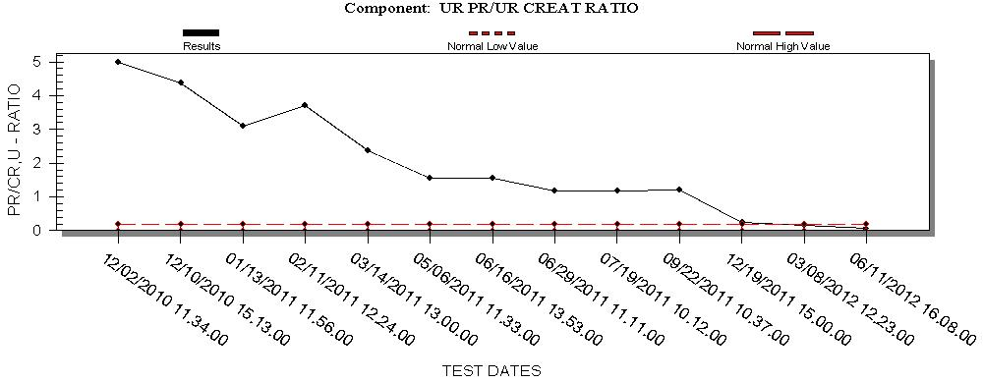
27 yo female with SCD and Lupus
 | T = 0 | 3 mos | 6mos | Recent
C3 | 57 | 156 | 141 | 107
C4 | 14 | 37 | 37 | 21
Anti-DNA | + | - | - | -
Hbg | 6.5 | 10.0 | 9.8 | 13.5
Abs Retic | 448K | 122K | 49K | 37K
LDH | 355 | 186 |  | 180
HB S | 86.1 | 26.2 | 36.8 | 37.7

Slide 22
Conclusions
Allogeneic BMT is the only cure for SCD
HiCY post BMT safely expands the donor pool by allowing for the use of haploidentical donors
The majority of patients with SCD are potentially eligible for therapy with curative intent
Graft failure remains an obstacle when using haploidentical donors

Slide 23
Engraftment with G-CSF-primed Donors
Pt/Age/sex | Indication for bmt | Donor | Date of BMT | Last Hgb | % donor red cells | % donor myeloid cells | % donor T cells
20/f | Osteonecrosis Acute chest | Haplo mother | 10/2011 | 9.7* | N/A | 0 | 0
21/f | Stroke Acute chest | Haplo sister | 11/2011 | 13.4 | 100 | 100 | 100
15/f | Stroke Moyamoya | Haplo mother | 11/2011 | 13.5 | 100 | 100 | 100
26/f | Acute chest Iron overload | Haplo half-brother | 7/2012 | 12.3 | 100 | 82 | <5
39/m | VOC alloimmunization | Haplo father | 9/2012 | 10.0 | 100 | 95 | 47
26/m | Stroke | Haplo Mother | 9/2012 | 9.5 | 100 | 90 | 95
* Hgb reflects transfusion of RBCs within last 90 days

Slide 24
Future Directions
Genetic disease of stem cells
  Sickle cell disease, Thalassemia
  Goal to increase engraftment to >75%
Autoimmune disease
  Lupus, Crohn’s disease etc.
  Solid organ transplantation

Slide 25
Take home
Morbidity and mortality following Allo BMT has decreased substantially
  Better supportive care
  Reduced intensity prep regimens
  Post transplant Cy
Alternative donor transplants are a reality
  Virtually everyone has a donor
BMT for genetic disease, autoimmunity and solid organ transplantation is the next frontier

Slide 26

Acknowledgments
Laboratory
JHU Nursing
JHU Housestaff
Patients/Families
George Santos
Albert Owens
Lyle Sensenbrenner
Rick Jones
Ephraim Fuchs
Leo Luznik
Sophie Lanzkron
Chris Gamper
Javier Bolanos-Meade
Sue Leffell
Clinic

