Slide 1
Discrete data collection in Epic:
- Smartform Overview -
Thomas Grader-Beck MD
Clinical Director, PACE
Epic Physician Builder

Slide 2
1
Explain Smartforms
2
Show Examples
Agenda
3
Discuss Pros and Cons
4
5

Slide 3
What are Smartforms?
Highly customizable forms that are part of Epic
Smartforms can fulfill several functions, including:
Data collection (Use of Smartdata elements)
Data analysis (Use of scripting/logic)
Data organization (Data display)
Workflow organization

Slide 4
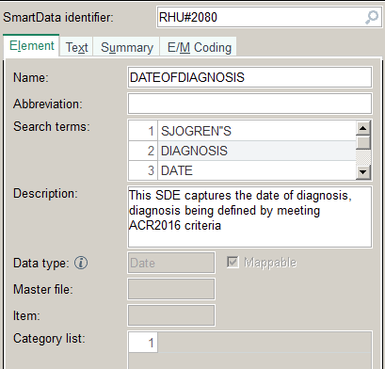
Smartforms: Data collection
Backbone: Discrete data fields defined by Smartdata elements (SDEs)
SDEs can have many types (for example String, Number, Boolean, List etc)
They can be Epic-released or custom created
SDEs can have many contexts (for example “Encounter”,”Patient”,”Note”)
Applied logic around data entry can improve data quality

Slide 5
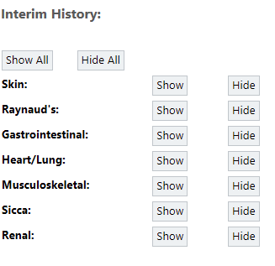
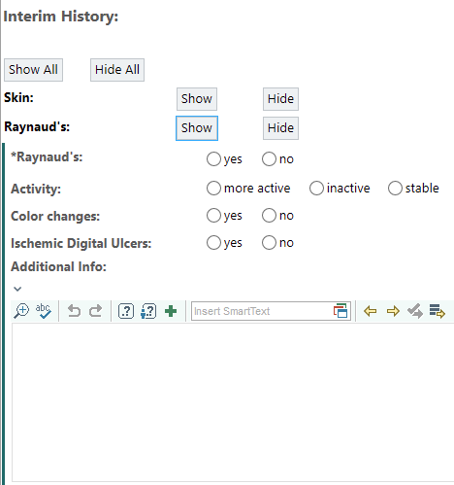
Smartforms: Data collection Example

Slide 6
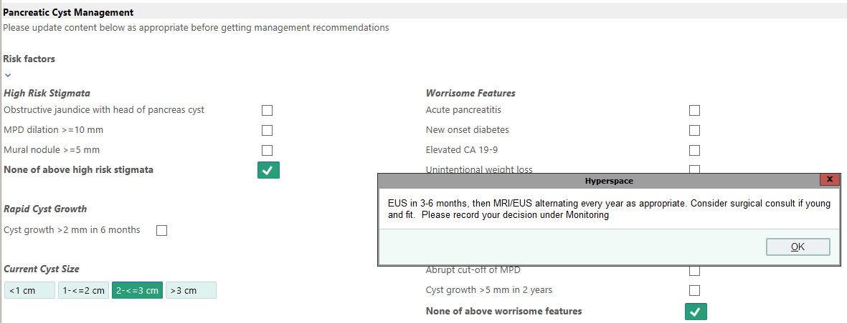
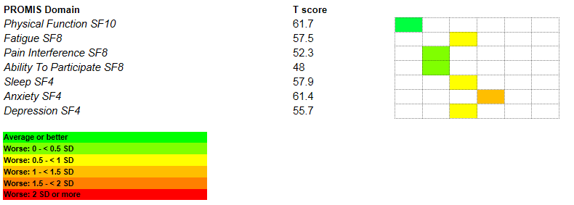
Smartforms: Data analysis and display
For example: Score calculation (disease activity, risk scores etc.)

Slide 7
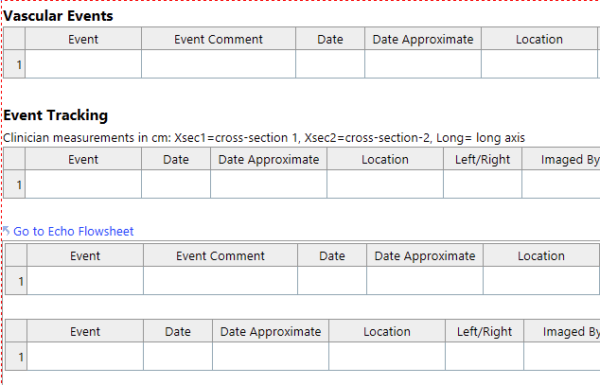
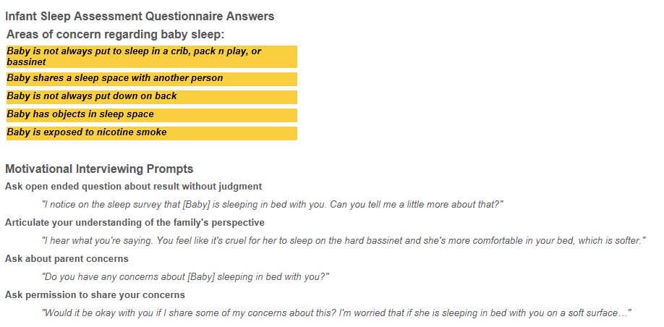
Smartforms: Workflow organization
Smartforms can embed links to other activities
They can provide dynamic guidance on clinical care
They can trigger downstream decision support

Slide 8
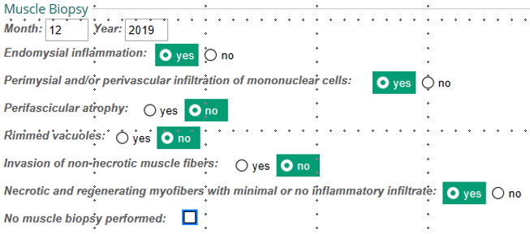
Other important characteristics of Smartforms
Conditional display of Smartforms
Contents of Smartforms can be pulled into notes
Smartform
Note

Slide 9
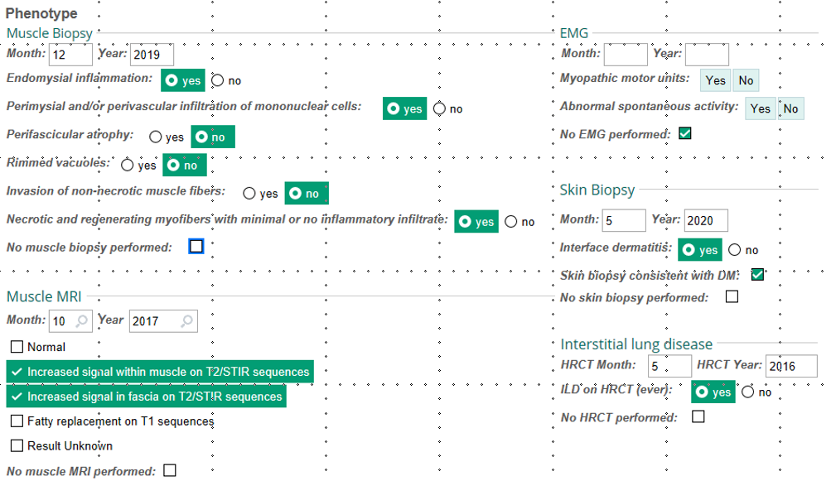
When to use Smartforms
When collecting a larger amount of granular data (usually longitudinally)
When high quality data collection is needed
To better prepare for data extraction

Slide 10
Caveats when considering Smartforms
Smartforms require more extensive build (time and cost consideration)
Use of Smartforms requires clinician education (perhaps more than once …)
Obtaining high quality data requires consistent Smartform use
Recommendation to request reporting tools to identify problems with data early
When complex scoring is required
Establish data dictionary and definitions in the beginning

Slide 11
Alternatives to Smartforms
Using Smartlists, Smarttexts, silent Best Practice Alerts
Use of Documentation Flowsheets
Manual chart review and database population from free text (use of templates for data collection)
Natural language processing

Slide 12
Questions?
Contact:
Program To Accelerate Clinical Research using Epic (PACE)
Thomas Grader-Beck, Clinical Director
tgb@jhmi.edu
Debora Green, Application Coordinator
dgree124@jhu.edu
Bonnie Woods, IT Director
Bonnie.Woods@jhu.edu

