Slide 1

PMCOE OVERVIEWS & OFFICE HOURS
Spring Retreat
June 24, 2022

Slide 2
Arrhythmogenic Right Ventricular Cardiomyopathy (ARVC) PMCOE
Launched: 2019
Overview: Arrhythmogenic cardiomyopathy (ACM) is a major cause of sudden cardiac death (SCD) and heart failure in young adults. It is an inherited, autosomal dominant condition with reduced penetrance and markedly variable expressivity. While a growing group of genomic and environmental factors are implicated in ACM pathogenesis, predictors of penetrance, severity, and response to treatment remain elusive. Arrhythmogenic right ventricular cardiomyopathy (ARVC) is the best-described among the ACMs, has an extremely high risk of SCD, and disproportionately affects athletes.
Our PMCOE goals are directed toward personalization of risk assessment and management for both patients and at-risk family members.
Research Aims:
1: Development and Validation of Models for Individualized Ventricular Arrhythmia Risk Prediction
  Our ACM PMCOE led an effort of 5 ACM Registries encompassing 14 academic centers to develop an individualized risk prediction model for incident ventricular tachycardia following diagnosis which is used around the world to inform shared decision-making for ICD implantation.
  The model was externally validated in an additional cohort of 900 patients from 32 centers in 9 countries.
  A second model predicting lethal arrhythmias (cycle length <240 msec) was subsequently developed.
  Studies of longitudinal risk modeling and utility of adding results of EP study and exercise to the model are underway / recently published.
  These “risk calculators” are freely available to the community: www.arvcrisk.com
  Development of a gene-specific risk prediction algorithm for DSP cardiomyopathy is underway
  We have a collaboration with the ADVANCE center (BME) to investigate computational approaches for refining non-invasive risk assessment (2022 Discovery Award)
2: Towards an evidence base for early detection, family screening, and family management
  Investigation of the impact of family genotype on family-member diagnosis and arrhythmia outcomes to support development of a personalized screening algorithm.
  Assessment of utility of strain rate imaging and feature tracking to improve early detection – (echo, CMR)
  Defining a “safe” level of exercise for genotype positive phenotype negative family members
  Randomized clinical trial of sequence of genetic counseling and testing (NIH sponsored)
Office Hours:
June 30 at 11 am
Zoom link
Meeting ID: 975 1215 3407
Passcode: 718524
Or reach out directly to discuss or set up an alternate time with Cindy James (cjames7@jhmi.edu
410-294-5554)
Notes:
Director: Hugh Calkins, MD
Research director: Cindy James, PhD, CGC
Overview: Arrhythmogenic cardiomyopathy (ACM) is a major cause of sudden cardiac death (SCD) and heart failure in young adults. It is an inherited, autosomal dominant condition with reduced penetrance and markedly variable expressivity. While a growing group of genomic and environmental factors are implicated in ACM pathogenesis, predictors of penetrance, severity, and response to treatment remain elusive. Arrhythmogenic right ventricular cardiomyopathy (ARVC) is the best-described among the ACMs, has an extremely high risk of SCD, and disproportionately affects athletes.
A central scientific challenge of managing ACM patients and families is the striking clinical heterogeneity relatively poorly predicted by genotype alone. Additionally, penetrance in pathogenic variant carrier family members is difficult to predict. Participation in endurance exercise is a known key risk factor. However, there remains significant uncertainty about which family member will develop disease and how best to approach longitudinal screening of at-risk family members. Finally, genetic and other environmental modifiers likely influence outcomes of our patients. Our PMCOE goals are directed toward personalization of risk assessment and management for both patients and at-risk family members.
A significant practical challenge relates to having sufficient sample sizes to answer these complex questions given 1) wide clinical variability in patients, 2) the relative rarity and under-recognition of ACM, and 3) the high prevalence of sudden death as a first symptom. The ACM PMCOE has harmonized outcomes definitions with colleagues around the world and has aligned our REDCap database encompassing genotype, clinical, exercise, and psychosocial PROM data (N=1893) with the ACM database of the Netherlands Heart Institute to facilitate adequately powered analyses.
Scientific Specific Aims:
Aim 1: Development and Validation of Models for Individualized Ventricular Arrhythmia Risk Prediction
Our ACM PMCOE led an effort of 5 ACM Registries encompassing 14 academic centers to develop an individualized risk prediction model for incident ventricular tachycardia following diagnosis which is used around the world to inform shared decision-making for ICD implantation.
The model was externally validated in an additional cohort of 900 patients from 32 centers in 9 countries.
A second model predicting lethal arrhythmias (cycle length <240 msec) was subsequently developed.
Studies of longitudinal risk modeling and utility of adding results of EP study and exercise to the model are underway / recently published.
These “risk calculators” are freely available to the community: www.arvcrisk.com
Development of a gene-specific risk prediction algorithm for DSP cardiomyopathy is underway
We have a collaboration with the ADVANCE center (BME) to investigate computational approaches for refining non-invasive risk assessment (2022 Discovery Award)
Aim 2: Towards an evidence base for early detection, family screening, and family management
Investigation of the impact of family genotype on family-member diagnosis and arrhythmia outcomes to support development of a personalized screening algorithm.
Assessment of utility of strain rate imaging and feature tracking to improve early detection – (echo, CMR)
Defining a “safe” level of exercise for genotype positive phenotype negative family members
Randomized clinical trial of sequence of genetic counseling and testing (NIH sponsored)

Slide 3
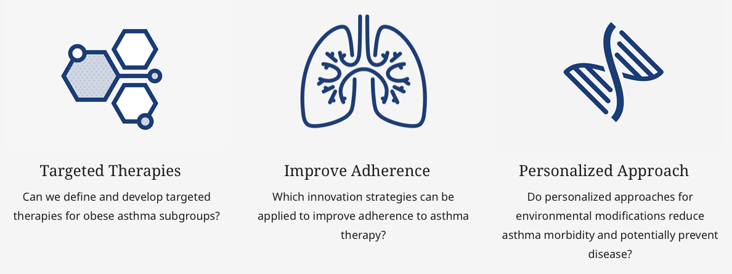
Asthma PMCOE
Launched: October 2020
Mission: We seek to define the drivers of asthma, develop therapies and customized approaches targeting lifestyle and behavioral factors absent from current asthma guidelines. Our specific focus will be on obese asthma patients who are prone to more severe, worse outcomes and are at an increased risk of hospitalization and a lower quality of life.
Vision: Asthma is a chronic disease affecting 25 millions people, including 6 million children. Our vision is to advance the field of asthma for specific subgroups with novel therapies at the individual level and with specific approaches at the system level.
Research Aims:
Office Hours:
TBD
Please contact Rachelle Koehl rkoehl1@jhmi.edu
  https://www.hopkinsmedicine.org/inhealth/precision-medicine-centers/asthma/index.html

Slide 4
Bladder Cancer PMCOE
Launched: 2019
Vision: Integrate precise genomics measurements with prospective and comprehensive clinical annotation to optimize the precision management of patients with bladder cancer. Near-term goals include developing methods for prospectively selecting patients for perioperative therapy with chemotherapy, radiation therapy, targeted therapy, immune checkpoint blockade, and bladder preservation. Longer-term goals include developing more precise tools for detecting and treating the bladder cancer variants, for screening patients with hematuria, for monitoring recurrence, and for selecting second-line therapies for patients who are no longer benefiting from BCG.
Research Aims:
Develop an integrated clinical, genomic, and tissue inventory database for acceleration of discovery.
Expand our current REDCap database to include more comprehensive descriptions of clinical variables, including histopathological characteristics (variant content, depth of lamina propria invasion for T1 tumors, lymphovascular invasion, etc). Capture and store high quality H&E and radiological images in connected image databases for future assessment and computer-based discovery. Create robust links between REDCap, EPIC, and image repositories for AI and machine learning.
Prospectively collect FFPE tissues, blood, and urine for all new patients and at every subsequent opportunity during clinical management of their diseases for longitudinal evaluation of disease trajectory. Isolate high quality DNA and RNA from these tissues and store them in an OpenSpecimen database with seamless links to EPIC, REDCap, and image warehouse databases. Perform whole transcriptome and panel DNA exome sequencing on tumor tissues and store the genomic data in an integrated genomics database. Expand sequencing coverage to whole exome and whole genome as these technologies become more affordable.
Develop apps, wearables, and other tools for more efficient acquisition of patient-reported data. Integrate these data sources into the other PMCOE databases.
Short-term Goal (2 years): Prospectively collect the highest quality clinical, histopathological, and genomic (DNA and RNA sequencing, including blood and urine “liquid biopsies”) information on every patient and every tumor at every opportunity for longitudinal evaluation of disease evolution. Validate candidate precision biomarkers for the prospective identification of patients for treatment with cisplatin-based combination chemotherapy, immune checkpoint blockade, and FGF receptor inhibitors.
Longer-term (up to 5 years): Lock down the RNA-based molecular subtypes of bladder cancer and define the molecular and biological relationships of the histological variants to them. Develop integrated clinical- and biomarker-based strategies to select patients for treatment with intravesical BCG, radiation, cystectomy, and bladder preservation. Define differences in the biological and clinical characteristics of disease trajectory in men and women. Integrate urine- and blood-based “liquid biopsy” analyses into the clinical workflow to improve early diagnosis of bladder cancer in patients with hematuria, early detection of recurrence, and identification and precision treatment of patients with subclinical metastatic disease.
Contact David J. McConkey dmcconk1@jhmi.edu
with questions or collaboration ideas
Office Hours:
Notes:
Bladder Cancer PMCOE proposal (2 years)
Moments of wonder:
Converging results from several independent, large-scale, whole transcriptome-based projects revealed that bladder cancers can be grouped into basal and luminal molecular subtypes that resemble the corresponding subtypes of breast cancer. Basal cancers are associated with advanced stage and metastatic disease at presentation and shorter disease-specific survival. However, like their breast cancer counterparts, retrospective studies suggest that patients with basal bladder cancers appear to benefit the most from perioperative chemotherapy. Patients with luminal cancers tend to have better prognoses but obtain less benefit from chemotherapy, and there is evidence that they may also be refractory to immunotherapy with immune checkpoint blockade. It appears that basal versus luminal tumor molecular subtype membership could also be associated with differential benefit from other targeted agents.
Parallel characterizations of the patterns of DNA alterations that are present in bladder cancers has also produced complementary insights into tumor heterogeneity that complement the molecular subtype-based findings. Specifically, inactivating mutations in ERCC2, ATM, RB1, FANCC, and other DNA damage and repair (DDR) genes were found to be associated with response to neoadjuvant cisplatin-based combination chemotherapy in patients with muscle-invasive bladder cancer (MIBC), and tumor mutational burden (TMB) predicted benefit from immune checkpoint blockade. More recently, activating mutations and fusions involving FGFR3 identified tumors with high response rates to the FGFR inhibitor, erdafitinib (Janssen), resulting in the drug’s receiving FDA breakthrough status in March. There are a number of other targets (activating mutations in PIK3CA, ERBB2, and ERBB3, and loss of TSC1/2) that are potentially actionable as well.
Bladder cancers are also characterized by morphological and clinical heterogeneity. Pathologists have defined a number of histopathological variants (i.e., squamous, small cell/neuroendocrine, micropapillary, plasmacytoid, etc) that tend to be associated with poorer prognoses. However, in clinical “moments of wonder”, we have observed that patients whose tumors contain some percentage of micropapillary or small cell histology have dramatic responses to immune checkpoint blockade. Prior treatment with intravesical BCG for high risk non-muscle invasive bladder cancer is also associated with more aggressive disease on a stage-by-stage basis for reasons that are unclear. Integrating these and other clinical variables with genomic variables into the assessment of clinical disease heterogeneity is likely to produce synergistic impact on the precision estimation of disease biology, just as the integration of clinical factors into PAM50 classifications to produce the risk of recurrence (ROR) score has done for breast cancer.

Slide 5
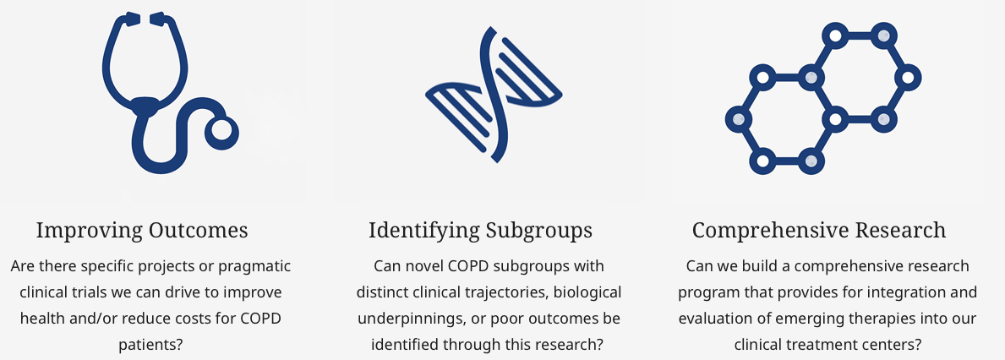
Chronic Obstructive Pulmonary Disease (COPD) PMCOE
Launched: 2019
Mission: Better understand COPD characteristics and health outcomes to more effectively manage and improve the care of individuals living with COPD.
Vision: Personalize our approach to diagnosis and treatment and potentially change the way we manage patients with chronic obstructive pulmonary disease (COPD) with the ultimate goal of improving clinical outcomes and supporting ongoing discovery.
Research collaboration with Highmark Allegheny Health Network
Our aim is to leverage institutional reach, expertise, experience, resources and infrastructure to raise the standards of excellence in COPD patient care, research and education. Over the last 2 + years, the collaboration focused on establishing uniform, longitudinal data sets across the JHM and Highmark populations - integrated complex data from diverse health systems into a common data and research environment. This enables precise analysis and discovery of high-risk patient subgroups, to facilitate the discovery of optimal treatment models and algorithms for patients with COPD.
Office Hours:
July 1, 2022
2-3PM
https://jhjhm.zoom.us/j/97721613060
Questions?
Nadia Hansel nhansel1@jhmi.edu
Bob Wise rwise@jhmi.edu
  https://www.hopkinsmedicine.org/inhealth/precision-medicine-centers/copd/index.html

Slide 6
COVID-19 PMCOE
Launched: 2019
Mission: Improve the care of patients infected with SARS-CoV-2 by learning about COVID-19 pathobiology, likelihood of disease progression and impact of specific therapeutic interventions. We aim to provide this information to clinicians, patients and family members at the point of care.
Vision: Understand the factors that underlie the pathobiology of COVID-19, the progression to severe illness or death, and the effectiveness of therapeutic interventions in order to provide personalized care to patients infected with SARS-CoV-2.
Recognizing that we needed to learn from our first COVID-19 patients in order to better care for those that would come after, the JHU SOM created the COVID-19 PMCOE and the JH-CROWN registry which includes more than 12,000 COVID-19 inpatients and 100,000 COVID-19 outpatients.
The COVID-19 PMCOE has conducted comparative effectiveness analyses demonstrating the real-world benefits of therapeutics such as remdesivir, tocilizumab, and high-flow nasal cannula and developed real-time prediction models for COVID-19 clinical trajectories used by frontline clinicians around the world. The COVID-19 Inpatient Risk Predictor is featured on MDCalc, one of the most widely used medical resource sites. The Severe COVID-19 Adaptive Risk Predictor (SCARP) is currently live in the Epic electronic health record where it gives Hopkins frontline providers real-time predictions about the likelihood of a patient developing severe disease or death.
The COVID-19 PMCOE also explored racial disparities in pulse oximetry and found that pulse oximetry overestimates oxygenation in underrepresented minorities. This overestimation contributes to a delay in recognition of COVID treatment eligibility. In addition to the JH-CROWN dataset, the COVID-19 PMCOE partnered with HCA-Healthcare and other academic institutions to create the COVID-19 Consortium of HCA Healthcare and Academia for Research GEneration (CHARGE). The CHARGE dataset contains data on over 200,000 hospitalized individuals with COVID-19. The COVID-19 PMCOE also contributes data to the National Cohort Collaborative (N3C).
In addition to ongoing research on COVID-19, the COVID-19 PMCOE is working with the FDA to develop tools to convert electronic health record (EHR) data into the Observational Medical Outcomes Partnership (OMOP) common data model for easier sharing and collaboration between institutions.
Research Aims: See more at:
https://www.hopkinsmedicine.org/inhealth/precision-medicine-centers/covid-19/index.html
Office Hours:
July 22, 2022
11:00 AM – 12:00 PM
Zoom Link
Meeting ID: 986 2087 2129
If you would like to learn more or are interested in collaborating, please contact Brian Garibaldi (bgariba1@jhmi.edu)

Slide 7
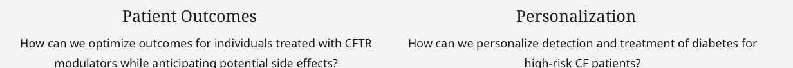
Cystic Fibrosis PMCOE
Launched: February 2021
Cystic fibrosis (CF) is a life-shortening, multi-organ system disease, due to abnormal chloride transport, with manifestations that include obstructive lung disease, chronic sinusitis, exocrine pancreatic insufficiency, impaired glucose metabolism/diabetes, liver disease, and male infertility. Complications of CF and disease progression are quite variable, even among individuals with the same disease-causing genetic mutations. CFTR modulator drugs that restore chloride channel function are now available for approximately 90% of persons with CF (pwCF) who meet age and genetic criteria; however clinical response is variable and for a subset, side-effects preclude use of these medications.
Mission: Provide outstanding, individualized holistic care to each CF patient, while seeking to expand our understanding of the disease at the individual level. Our research combines traditional basic science techniques with genetic information, big data, and remote monitoring to gain insights that can be efficiently incorporated into clinical practice for optimized patient care.
Vision: Fully harness all available clinical and patient-derived information to deliver safe, beneficial, and cost-effective treatment tailored to every individual with CF. We believe that a data-driven, precision medicine approach to care will lead to improved understanding of each patient’s disease trajectory and allow for earlier detection and treatment of disease complications, resulting in improved quality of life and long-term prognosis for our CF population
Research Aims:
https://www.hopkinsmedicine.org/inhealth/precision-medicine-centers/cystic-fibrosis/index.html
Office Hours:
July 7 at 11:00 am
Zoom link
Meeting ID: 353 097 3581
Or please contact Lori Vanscoy (lvansco2@jhmi.edu) or Garry Cutting (gcutting@jhmi.edu).
Notes:
Cystic fibrosis (CF) is a life-shortening, multi-organ system disease, due to abnormal chloride transport, with manifestations that include obstructive lung disease, chronic sinusitis, exocrine pancreatic insufficiency, impaired glucose metabolism/diabetes, liver disease, and male infertility. Complications of CF and disease progression are quite variable, even among individuals with the same disease-causing genetic mutations. CFTR modulator drugs that restore chloride channel function are now available for approximately 90% of persons with CF (pwCF) who meet age and genetic criteria; however clinical response is variable and for a subset, side-effects preclude use of these medications. Our PMCOE seeks to incorporate a variety of different data streams, including structured clinical information from the EHR, imaging, genetic testing, remote in vivo monitoring (including spirometry, glucose monitoring, and physiologic monitoring) and social determinants of health measurements to identify subgroups of persons with CF who have similar disease complications and/or clinical progression utilizing machine learning techniques. This subgroup identification will inform additional mechanistic studies, which will include evaluation of biomarkers, pharmacokinetics of CFTR modulator drugs, and CFTR response in primary nasal epithelial cells. We will return insights gained from data analysis to the patient and the clinician for use at point of care, with tools that will include visualization of longitudinal disease progression and risk prediction scores for disease complications (such as CF-related diabetes or progression to lung transplantation) to tailor and optimize therapeutic recommendations for the individual patient. Recognizing that the overall health of the CF population has improved significantly in the era of highly effective CFTR modulator drugs, we will also utilize our understanding of likely disease trajectories to inform clinic planning and staffing decisions, optimizing our use of limited healthcare resources.
Our patient cohort includes approximately 1000 persons with CF of all ages who receive or who have previously received their care at JHH East Baltimore campus and All Children’s Hospital in Florida. Recommended clinical care for pwCF includes (at a minimum) quarterly visits to the CF clinic with measurement of lung function (for those who are able to perform the test), annual laboratory screening, and bi-annual chest imaging; thus, our population affords a robust clinical data set with which to study disease progression over time. Additionally, this engaged population is familiar with remote collection of clinical data (including symptom surveys, home spirometry and glucose monitoring, and even collection of airway cultures) – providing a unique opportunity to understand day to day variation in health for a discrete, well-defined patient cohort.
If you would like to learn more about the CF PMCOE or are interested in collaborating, please contact Lori Vanscoy (lvansco2@jhmi.edu) or Garry Cutting (gcutting@jhmi.edu). You may also join us on zoom on July 7 at 1100 at the link below.
Post-retreat CF PMCOE Office Hours (July 7 at 1100 am): https://jhjhm.zoom.us/j/3530973581
Meeting ID: 353 097 3581
One tap mobile
+13017158592,,3530973581# US (Washington DC)

Slide 8
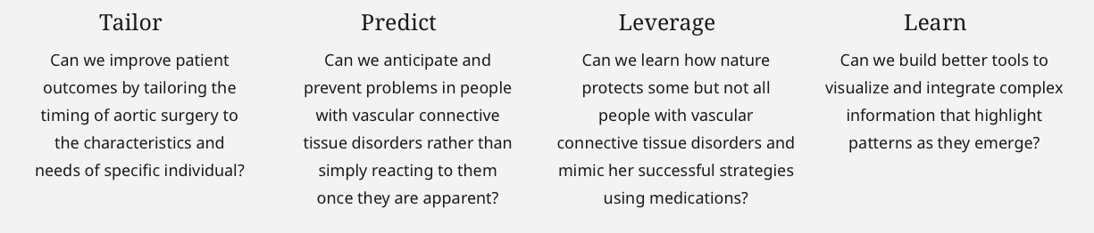
Kasper PMCOE for Pediatric Genetic Syndromes
with Aortopathy
Launched: January 2021
Several genetic syndromes result in aortic disease. Of these syndromes, the more commonly diagnosed are Marfan Syndrome (MFS), Loeys-Dietz Syndrome (LDS), and vascular Ehlers-Danlos Syndrome (vEDS). While the specific details of these syndromes differ, they all result in an increased risk of arterial rupture and sudden death.
Mission: Current practice guidelines are based on what is best for the average patient with an inherited aotopthy. Our mission is to be able to answer: What is best for the patient sitting in front of me right now?
Vision: Personalized evaluation, counseling, and management of patients with heritable aneurysm conditions. Data derived from the JHH Cardiovascular Connective Tissue Disorders Clinic has already led to the development and widespread use of guidelines for the care of Loeys Dietz Syndrome (LDS) patients. Through the integration of many new sources of data, this project will both refine and extend our ability to anticipate and prevent morbidity and mortality in inherited aneurysm conditions including LDS, Marfan syndrome, Vascular Ehlers-Danlos syndrome (vEDS, VEDS, previously known as EDS type IV), and others.
Research Aims:
Office Hours:
Monday, June 27
4:00-5:00 pm
Zoom link
Alternatively, please email Tony Guerrerio at aguerrerio@jhmi.edu to set up a mutually convenient time
https://www.hopkinsmedicine.org/inhealth/precision-medicine-centers/pgs-with-aortopathy/index.html
Notes:
Several genetic syndromes result in aortic disease. Of these syndromes, the more commonly diagnosed are Marfan Syndrome (MFS), Loeys-Dietz Syndrome (LDS), and vascular Ehlers-Danlos Syndrome (vEDS). While the specific details of these syndromes differ, they all result in an increased risk of arterial rupture and sudden death. Our goal is to prevent such catastrophic events through enhanced identification of at-risk patients and initiation of prophylactic surgical intervention once the individualized risk-to-benefit ratio favors moving forward. According to the old tenet of evidence-based medicine, one would try to determine what intervention works best and when it should be applied for the average patient with an aortopathy. The new frontier of precision medicine asks ‘What will work best for this particular person sitting in front of me right now?’. With respect to pediatric genetic syndromes and aortopathies, we struggle to individualize the diagnosis, prognostic counseling and management of our patients. This issue is particularly challenging for rare disorders.
We currently hypothesize that there is a specific subset of mutations in every aortopathy syndrome that lead to unusually severe manifestations including aortic rupture at atypically small aortic diameters. Even within this subset, our preliminary data suggest a wide range of variation in clinical course. Our ultimate goal is to develop a "polyfactorial risk score" that integrates all accessible determinants of outcome including disease-causing mutation, other modifying genetic markers, age, medication, personal history, gender, imaging findings and all other features that can be extracted through the use of complex computational methods available in the PMCOE database framework. Through the development of this tool, we hope to provide specific information to every patient regarding their individualized risk of aortic dissection as it evolves over time. This would herald a transition from current practices (implementing a treatment plan for the “average” person with a condition) to true precision medicine (use of all information and predictive algorithms to tailor treatments to a specific individual).
We are also working with an APL team to develop automated methods for measuring vascular tortuosity. Currently, this measurement must be made manually on each vessel for every scan. There are data to suggest that vessel tortuosity is a predictor of particularly aggressive vascular disease that may ultimately help to guide therapy. As an automated tool, this metric can be applied to the radiology workflow and calculated automatically as part of a patient’s report for an MRA or CTA scan. In this manner, this method can help to identify patients with an underlying aortopathy who have not yet been diagnosed using established clinical or molecular genetic parameters.

Slide 9
Kidney PMCOE
Launched: Fall 2020
Mission: Change how we care for patients at risk of and suffering from kidney disease.
Vision: Transform the care of patients with kidney disease, from prevention to diagnosis to treatment, strive to provide patient-centered and best-practice care, and provide diverse opportunities for patients to participate in cutting- edge research to potentially alter the landscape of kidney disease.
Major areas of focus include: 1) Improved diagnosis of kidney disease, through better clinical phenotyping of patients with acute kidney injury and interrogation of the electronic health record, 2) Measurement of outcomes in patients across several domains in patients with both acute kidney injury and progressive chronic kidney disease 3) Identification of barriers to optimal clinical care and target areas for quality improvement initiatives by measuring processes of care and applying risk assessments in real-time, and 4) Identification of key patient subgroups to enrich enrollment in prospective observational studies and clinical trials.
The kidney failure risk equation, which has been globally validated to determine the 2 and 5-year risk of progressing to kidney failure (needing dialysis or kidney transplant), is now available to all providers in Epic, using a simple dot phrase (.kfre). In the future, providers will be able to open a dedicated dashboard within Epic to view these risk scores, as well as a graphical representation of important kidney medications and kidney function over time that includes trends of estimated glomerular filtration rate and ualbuminuria.
Investigators have utilized the Kidney PMCOE to enrich ongoing prospective single and multicenter studies. Currently, the Novel Approaches in the Investigation of Kidney Disease (NAIKiD) Study enrolls patients at Johns Hopkins scheduled for clinically indicated native kidney biopsies to contribute extra urine, blood, and kidney tissue samples toward building a tissue and sample biorepository. Through the resources of the Kidney PMCOE patient data and biomarker measurements at the time of kidney biopsy can be linked with longitudinal data from Epic to determine trends in kidney function over time, measure adverse kidney outcomes, and assess for post-biopsy complications . The NIDDK sponsored multicenter study, Kidney Precision Medicine Project, is also using PMCOE to improve efficiency of enrollment and longitudinal follow-up. Over the next several years, we expect large growth in the use of the Kidney PMCOE to improve both clinical care and research for investigators within the Division of Nephrology and across the institution.
https://www.hopkinsmedicine.org/inhealth/precision-medicine-centers/kidney/index.html
Office Hours:
Interested in collaborating? Join us for Office Hours:
Thursday July 21
1:00 -2:00pm.
Zoom link
or reach out to
Chirag Parikh chirag.parikh@jhmi.edu

Slide 10
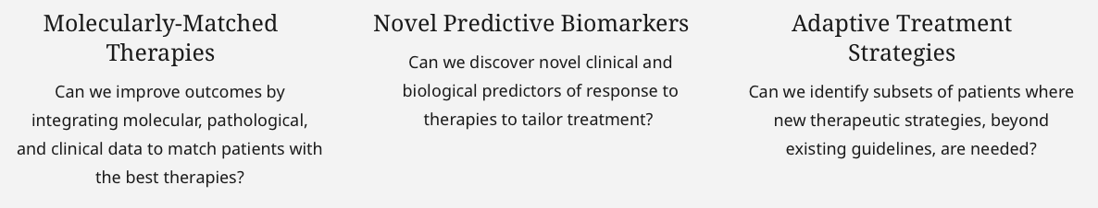
Lung Cancer PMCOE
Launched: February 2021
Mission: Build a learning health system integrating clinical and molecular understanding from patients with lung and thoracic cancer. Lung cancer care has been revolutionized through molecularly-matched therapies, driven by the adoption of next-generation sequencing, targeted therapies, and immunotherapy. It remains a challenge to integrate this genomic data into diagnostic pathways, clinical care, and translational research.
Vision: Enhance the outcomes for our patients through data-driven approaches that deliver precise diagnosis and personalized treatment.
With over 21,000 patients with lung and thoracic cancers in our registry, we specifically focus on: (1) aggregating complex molecular diagnostic data into useful clinical and translational research repositories; (2) using molecular and clinical features as novel biomarkers for tailoring treatment and predicting response; and (3) identifying patients that “break the mold” of expected therapeutic benefit to enable translational investigation.
Research Aims:
https://www.hopkinsmedicine.org/inhealth/precision-medicine-centers/lung-cancer/index.html
Office Hours:
Tuesday, July 5th between 12-1 PM
Zoom Link
Contact: Joe Murray
joseph.murray@jhmi.edu

Slide 11
Mood Disorders PMCOE
Launched: 2022
The Precision Medicine Center of Excellence (PMCoE) on Mood Disorders brings together a multi-disciplinary team of clinicians and researchers with expertise in genomics and informatics sciences to advance the care of patients with mood disorders, including depression and bipolar disorder. Mood disorders are common and debilitating mental illness that are among the leading causes of disability worldwide. They are associated with high levels of health care service utilization and often prove fatal due to excess morbidity and suicide. There are multiple treatment options - including psychotherapy, pharmacotherapy and neuromodulation - but these are rarely fully effective and often associated with side-effects that discourage adherence. Approximately two-thirds of patients will fail first-line treatments and nearly one-third will fail multiple treatments and be designated as treatment-resistant. A significant challenge in treating mood disorders is the considerable heterogeneity in the clinical course, severity of illness and response to available treatments. Due to the limited understanding about the underlying reasons for this heterogeneity, current treatment guidelines follow a one size fits all approach, and clinicians will typically try different treatments through a process of trial and error informed by their own clinical biases. During this time, patients will continue to suffer from the consequences of poorly treated illness, and often optimal treatments are never identified.
To address this challenge, our PMCoE is working to establish a learning health system for mood disorders in which we integrate our clinical and research activities to more efficiently learn from our patients while we provide them with best-evidence care and then rapidly translate what we learn back into improved care. As part of the learning health system, we have gathered and are analyzing electronic health record data on over 200,000 patients with mood disorders seen in the Department of Psychiatry and the Johns Hopkins Community Physicians to examine how patients with mood disorders are treated across the health system and the impact on outcomes. We are currently building on this learning health framework to pursue four driving initiatives. (1) We have established and are disseminating across the health system a measurement-based care program in which we collect patient-reported outcome measures at each clinic visit to monitor the patients’ clinical progress and engage them in their own care. At the same time, these validated measures are collected in our registry to provide standardized outcomes for research goals. (2) We are collecting blood from an embedded cohort of patients with depression and bipolar disorder to investigate whether genetic risk scores identified from recent genome-wide association studies can be used to predict treatment responses to different psychotropic medications, including both related to efficacy and adverse events such as treatment-emergent mania with antidepressants. (3) We are following patients with a mobile mental health app and a wearable device (the Oura ring) to evaluate whether active ecological momentary assessments and/or passive digital signals can predict when a patient’s course of illness is worsening and requires intervention. (4) We are collaborating with sleep health experts to investigate whether the use of a novel portable electroencephalogram (EEG) device can be used to accurately measure sleep architecture of patients in a naturalistic setting in the convenience of their homes, and then used to identify patients who require specific treatment interventions targeted at their sleep disturbances, and whether doing so can improve clinical outcomes. The goal of these initiatives is to derive practical insights that will lead to meaningful improvements in how we care for patients with mood disorders through a multi-modal approach to precision-guided care.
Office Hours:
Depression is frequently co-morbid with many of the illnesses that are the focus of other PMCoE’s. If you are interested in collaborating with us, please join us for office hours:
Monday, July 18 @4pm
Zoom: https://jhjhm.zoom.us/j/4106142686
Host: Peter Zandi (pzandi1@jhu.edu)
Microsite coming soon on: https://www.hopkinsmedicine.org/inhealth/

Slide 12
Multiple Sclerosis PMCOE
Launched: April 2017
The Johns Hopkins MS PMCOE was launched in April 2017 with the primary goals of both identifying clinical, imaging, and blood biomarkers of long-term disability risk as well as translating this evidence to clinical trials to identify new therapeutic strategies to prevent disability and promote repair in people with MS. With a team that includes 12 MS neurologists as well as experts in MS neuroimaging, neuropsychology, and neurorehabilitation, the expanded center delivers on the promise of precision medicine through five core foci of integrated care and research: 1) technology-enabled tracking of neurologic functional performance (via the sponsored MS PATHS project) and systematic clinical data capture at every clinic visit via an internally-developed Smartform; 2) baseline and annual non-invasive imaging of optic nerve damage using optical coherence tomography (OCT); 3) collection of blood at biannual clinic visits for research to identify biomarkers of prognosis and treatment response; 4) standardization of annual surveillance brain magnetic resonance imaging (MRI) across (and beyond) the Johns Hopkins Health System, and 5) home-based collection of data regarding environmental and lifestyle exposures that may be relevant to the prognosis of MS.
Since its inception, over 2,000 people with MS have participated in the PMCOE. The Johns Hopkins MS Smartform is enabling efficient collation of information relevant to MS state and is being leveraged to graphically project the individual disease course for a given patient. It is also being used, with other Epic-derived data, to generate predictive models to more specifically determine if a given person will likely benefit from brain MRI scan at a given timepoint, with early estimates suggesting ~60% of patients can be correctly classified as not requiring a surveillance scan. The Johns Hopkins MS Smartform is being widely adopted across other prominent institutions throughout the US. Concomitantly, an ongoing project is evaluating the performance of serum neurofilament light chain (sNfL) as a prognostic biomarker and monitoring tool in MS.
https://www.hopkinsmedicine.org/inhealth/precision-medicine-centers/multiple-sclerosis/index.html
Office Hours:
Interested in collaborating? Join us for office hours:
Monday, June 27 @1:00PM
https://jhjhm.zoom.us/j/5704293332
Host: Ellen Mowry, emowry1@jhmi.edu

Slide 13
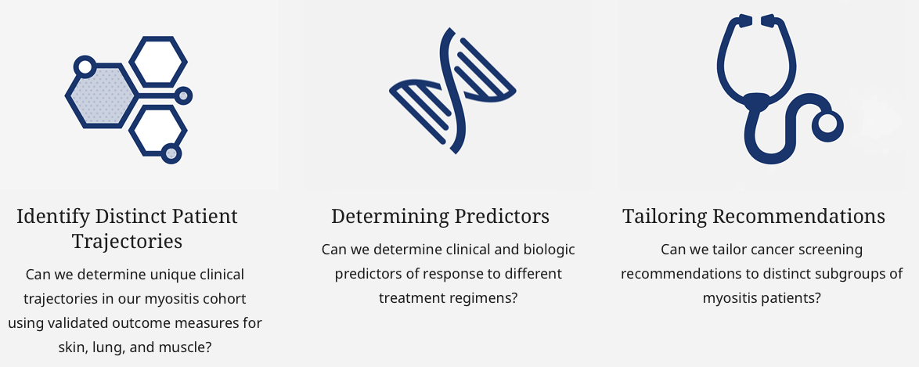
Myositis PMCOE
Launched: 2018
Idiopathic Inflammatory Myopathies (IIM, commonly referred to as simply ‘myositis’) comprise a group of rare chronic autoimmune diseases affecting multiple organ systems that can lead to substantial morbidity and mortality. While many of the underlying mechanisms of IIM remain unknown, the disease expression can impact the muscles, lungs, joints, skin, and heart. The diseases can be subclassified based on clinical type (dermatomyositis, polymyositis, necrotizing myopathy) or biomarkers in the blood such as autoantibodies (e.g. anti-Jo1, anti-NXP2, anti-HMGCR). Current therapies for IIM are generally nonspecific, are not targeted to individual disease pathologies, and often are prescribed on a ‘trial and error’ basis.
The Johns Hopkins Myositis Precision Medicine Center of Excellence was launched in 2018 with the vision of increasing the efficiency of healthcare delivery to patients with IIM and to use our multidisciplinary approach, trajectory analysis, and novel subgroup identification to tailor the monitoring and treatment of the disease to the individual. Our mission is to leverage the longitudinal nature of our clinical cohort, coupled with prospectively collected biospecimens, to better classify unique phenotypes of IIM. Precise phenotyping allows for a directed personalized approach to potentially better identify early signs of disease flare, determine appropriate clinical trial candidates that represent more homogenous groups, and eliminate the longstanding trial and error approach of therapeutic decision making.
Our center is multidisciplinary and includes neurologists, rheumatologists, pulmonologists, and physical, occupational, and speech language therapists. To date we have streamlined electronic consenting, automated biospecimen collection including DNA, RNA, sera, and PBMCs, and are currently undergoing transition of our data to the common data model OMOP. Our main areas research goals include:
Office Hours:
Interested in collaborating?
July 13th @9:00 AM
https://jhjhm.zoom.us/j/95844244734
Host: Lisa Christopher, lchrist4@jhmi.edu
Chris Mecoli, cmecoli1@jhmi.edu
https://www.hopkinsmedicine.org/inhealth/precision-medicine-centers/myositis/index.html
Notes:
Interested in collaborating? Join us for office hours: Wednesday July 13 at 9 AM
Link Lisa Christopher-Stine is inviting you to a scheduled Zoom meeting.
Topic: Johns Myositis Center Office Hours
Time: Jul 13, 2022 09:00 AM Eastern Time (US and Canada)
Join Zoom Meeting

Slide 14
Neonatal Intensive Care Unit (NICU PMCOE) Launched: February 2022
Mission: Development of the infrastructure and expertise that will allow for personalized evaluation, counseling, and management of neonates at risk for brain injury.
Vision: Clinicians who routinely care for children with life-threatening diseases, such as prematurity, neonatal birth injury, and congenital heart disease face the substantial challenge that prognostic tables and algorithms are not available for most pediatric conditions, especially neonates. In adult medicine, by contrast, the large numbers of patients who suffer from diseases such as congestive heart failure and cancer have made possible predictive algorithms that can be used to counsel patients and families about the relative advantages of treatments and interventions. By comparison, the number of neonates with long term morbidity and mortality from neonatal brain injury is much smaller, and the outcomes calculations much weaker, leaving pediatricians with less predictive power to inform discussions with families regarding patient survival and quality of life. Moreover, neonates with developmental disabilities (i.e. major learning disabilities, cerebral palsy, hearing impairment, visual impairment) have lifetime economic costs which are greater than those neonates without developmental disabilities, anywhere in excess of $300,000- $900,000. The best way to transform clinical care in our field is to use data (clinical phenotypes, biometric data, biomarkers, and genomic) to build treatment and diagnosis specific predictors for clinician and researchers.
Research Aims: The research aims for the NICU PMCOE are to develop risk/prediction models for premature neonates, neonates with brain injury at birth, and neonates born with congenital heart disease so that we can triage neonates to more targeted therapies and tailor length of therapy according to disease burden/risk stratification, and determine clinical processes associated with the development of brain injury (prematurity and congenital heart disease) that could be targeted to diminish brain injury. We would also develop new benchmarks that can be used for new therapies.
The NICU PMCOE will help develop and publish unbiased hypothesis generating studies concerning major health outcomes for neonates using internal institutional databases and national data registries. These studies will provide more effective pre- and postnatal counseling, help build QI initiatives, and help build predictive models for individual disease processes. The output from the initial studies will also be ripe for publications that will increase our national reputation and leadership, increase efficiency & synergy and lower barriers to research & analytics, and result in extramural funding for faculty members working in this PMCOE by way of K and R awards.
More importantly, the predictive models will aid in producing the best outcomes for patients in the most cost-effective manner by allowing for a more nuanced assessment of neonates and accurate, effective, and efficient allocation of healthcare resources and personnel once these neonates are discharged from the NICU/PICU/hospital.
NICU PMCOE Available Data: EPIC derived tables, medical imaging (x-rays, ultrasound, echocardiography, and magnetic resonance imaging), biological biomarkers, waveform
Projected Statistical Methods/Data Science Plan: In building predictive models, risk calculators, and clinical decision support tools we collect continuous, categorical, and binary variables that are analyzed via various mechanisms. In order to collect the required variables and then perform statistical analysis we use the Precision Medicine Analytics Platform (PMAP) to accelerate our research by combining EMR, medical imaging, physiological monitoring, and genomics onto a cloud based big data platform. The data is acquired and curated into databases, where the clinical and research data needs to be linked to develop PMAP backed applications; the linkage occurs on multiple levels – i.e. mother-baby linkage and time (an individual patient’s birth history, hospitalization, and post-discharge follow-up). Once the data is acquired into the PMAP backed platform (automated data fetching via AI, NLP algorithms), then we use PMAP tools to analyze the data – such as crunchr, data catalog, Phoenix (Hopkins high performance computing), etc.
Office Hours:
Tuesdays @1pm via MS Teams
Contact: Khyzer Aziz – kaziz5@jhmi.edu
Microsite coming soon on: https://www.hopkinsmedicine.org/inhealth/
Notes:
Dr. Khyzer Aziz’s research interests are utilizing complex information found in the electronic medical record and national registries/databases to provide clear, cohesive, and concise information for patients, families, and clinicians that can be used for clinical decision-making and neonatal precision medicine. With his mentorship team, he is developing and validating neonatal specific severity of illness metrics for the neonatal population – the neonatal sequential organ failure assessment (nSOFA) score and the vasoactive-inotropic score (VIS) – over the last year, he has published this work in high impact, peer reviewed journals. He is also the Director and Faculty/Scientific lead of the NICU Precision Medicine Center of Excellence (PMCOE) initiative at Johns Hopkins along with Dr. Frances Northington. His short-term goal is to develop and publish unbiased studies concerning major health outcomes for NICU patients using internal institutional databases and national data registries via neonatal specific severity of illness metrics (nSOFA and VIS). His hope is that these studies will provide the framework towards more effective pre- and postnatal counseling, quality improvement initiatives, and help build predictive models for individual disease processes. In doing this work, his ultimate goal is to build predictive models that can aid in producing the best outcomes for patients in the most cost-effective manner and build a path towards neonatal precision medicine.
Dr. Frances Northington’s research work includes funding via two R01s, an R21 and a U01. Her laboratory focuses on mechanisms of neurodegeneration following neonatal hypoxic-ischemia (HI) brain injury. Along with Dr. Chavez-Valdez, they continue to publish papers based on the murine model of HIE, therapeutic hypothermia that they developed. Dr. Northington has an active collaboration with Dr. Sujatha Kannan (Anesthesiology and Critical Care Medicine-Pediatrics) investigating nanoparticle delivery of N-acetyl cysteine as a microglial targeted therapeutic to prevent the development of cerebral palsy. This dendrimer-drug combination is under review by the FDA for use in humans. In collaboration with Drs. Jiangyang Zhang, Dr. Northington investigates novel and advanced imaging analysis of neonatal brain injury, and they are doing novel studies of metabolism with the Applied Imaging Mass Spectrometry Center at JHU. She and Dr. Everett collaborate with the Johns Hopkins All Children’s Molecular Determinants Core on additional preclinical and clinical studies of metabolomic pathways altered by neonatal HIE. Dr. Northington is pioneering work on the effect of early life injury in the setting of genetic susceptibility to Alzheimer’s Disease with Dr. Lee Martin. They have just published the first paper on cholinergic neurodegeneration in neonatal HI since the original papers published 40 years ago. An R21 was resubmitted to look at therapies designed to treat this neurodegeneration. Fruitful collaborations continue with Dr. Lauren Jantzie and Dr. Robinson on a potential novel treatment to prevent PHHP. Dr. Northington’s clinical research work is largely focused on the studies she, Drs. Everett, Graham, and Aziz are pioneering to improve predictive models of injury and outcome in neonates. She has played a supporting role for Dr. Aziz in establishing the Neonatal Neuro Precision Medicine Center of Excellence and she continues in her leadership role of the NICN. In all of this work she mentors multiple fellows, residents and undergraduates.

Slide 15
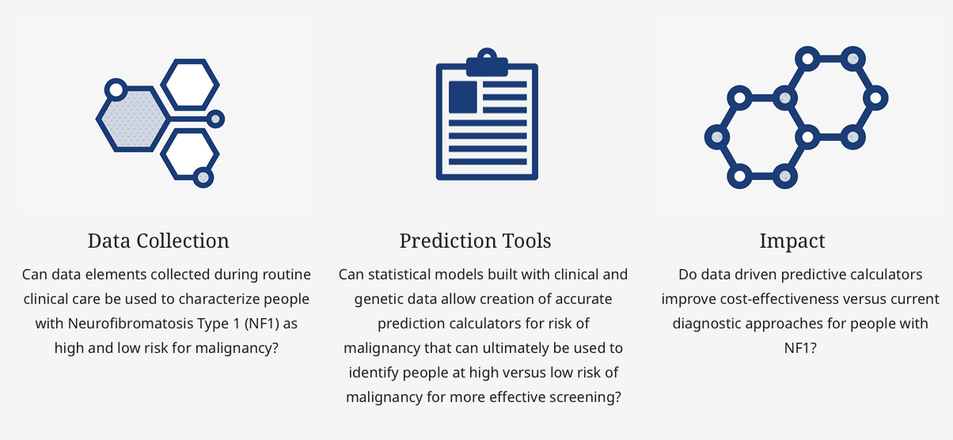
Neurofibromatosis PMCOE
Launched: 2019
Mission: Improve diagnostic accuracy for people living with NF1, NF2 and schwannomatosis to reduce health insecurity and its associated stress, eliminate unnecessary testing and associated health care spending and improve the speed and accuracy of diagnosis and treatment with the ultimate goal of improving patient outcomes. The NF PMCOE’s first project is to apply existing clinical and genetic data to create predictive models to determine which individuals with NF1 are at high versus low risk for MPNST.
Vision: The generation of a self-sustaining, annotated clinical database supports the development of applications such as a predictive nomogram for people with Neurofibromatosis Type 1 (NF1) developing the rare, but aggressive and hard to diagnose sarcoma, MPNST. Such real-life data-driven predictive models will have tremendous value to patients, caregivers, clinicians and third party payers. Development of data-driven predictive tools for rare diseases like NF1, NF2 and schwannomatosis will also improve the efficiency of clinical therapeutic development via targeted enrollment.
Research Aims:
Office Hours:
TBD –
Contact:
Jaishri Blakeley jblakel3@jhmi.edu
  https://www.hopkinsmedicine.org/inhealth/precision-medicine-centers/neurofibromatosis/index.html

Slide 16
Neurocritical Care (NCCU) PMCOE
Launched: 2021
The Johns Hopkins Precision Medicine Center of Excellence for Neurocritical Care was established in early 2021 with the vision to bring transformative innovations in the care of patients with critical neurological disorders and injuries. The Center is designed specifically to address unmet needs in diagnosis, classification, treatment, prevention, and prognostication as they relate to patients treated in the neurocritical care unit (NCCU). It is hoped that these unmet needs can be addressed by establishing and scaling a data-driven computational research program in neurocritical care and creating an institutional resource for research in precision therapeutics. The research is articulated on innovative modeling which focuses on increasing precision in prognostic modeling, treatment selection, and on health economics analysis as they relate to the target population and setting.
Short- and medium-term aims are: (1) to create computational models for the prediction of postoperative neurosurgical complications; (2) to build computational models to predict the deterioration of patients admitted to the NCCU and patients discharged from the NCCU; and (3) to determine the efficacy and cost-effectiveness of clinical decision support systems based on aims 1 and 2 by examining their feasibility, safety, efficacy and health-economic impact in prospective clinical studies. Implementation of these aims is expected to lead to improved outcomes and greater efficiency in clinical operations for patients in the NCCU domain. Longer term goals are: (1) To advance mechanistic knowledge of specific neurological injuries; (2) To develop personalized therapeutic interventions for patients admitted to the NCCU; (3) To establish computational neuroimaging and neurophysiological pipelines that could be applied to the care of critically ill neurological patients, and (4) To explore genomic sources of variance in the clinical expression of specific neurological injuries, as well as proteomic and metabolomic signatures of the latter.
The PMCOE in Neurocritical Care is composed of an interdisciplinary team with expertise in intensive care, neurology, neurosurgery, engineering, data science, clinical trials, imaging, and neurophysiology. This team meets bi-weekly to work on data access, extraction and preprocessing, model design and training, inference from model outputs, and strategic next steps. Much of the work is enabled by a dedicated NCCU-specific Precision Medicine Analytics Platform projection which prospectively collects detailed data on all patients treated in the NCCU in compliance with regulatory requirements of the Johns Hopkins Medicine Institutional Review Board and Data Trust. Members of the Center have been instrumental in facilitating the establishment of a unique data monitoring system across intensive care units and many operating rooms in Johns Hopkins Medicine; this system enables real-time remote physiological monitoring of critically ill patients as well as high-frequency time-series and waveform analyses that are the basis for several ongoing research programs.
Office Hours:
Faculty and students interested in learning more and in collaborating, join us for office hours:
Wednesday June 29, 2022 @ 1:00 pm
https://jhjhm.zoom.us/j/93781176068
Robert David Stevens rstevens@jhmi.edu
Jose Suarez jsuarez5@jh.edu
  https://www.hopkinsmedicine.org/inhealth/precision-medicine-centers/neurocritical-care/index.html

Slide 17
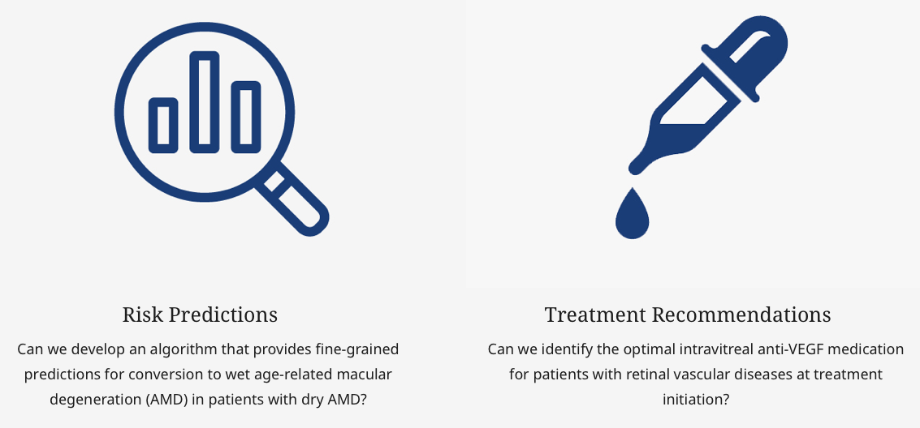
Ophthalmology PMCOE
Launched: 2021
Mission: Usher in an era of personalized ophthalmic care and transform the field of ophthalmology using artificial intelligence.
Vision: Harness the power of artificial intelligence, multimodal ophthalmic imaging and big data to provide previously-unavailable stratification, prognostication and treatment recommendations for patients with ophthalmic diseases.
Research Aims:
Office Hours:
  https://www.hopkinsmedicine.org/inhealth/precision-medicine-centers/ophthalmology/index.html

Slide 18
Pancreatic Cancer PMCOE
Launched: November 2017
The Johns Hopkins PaC PMCOE was launched in November 2017 with the primary goals of both identifying clinical, genomic, and imaging biomarkers of “Exceptional” patients as well as translating this evidence to clinical trials to identify new therapeutic strategies to treat every pancreatic cancer patient as an exceptional one. With a team that includes 10 medical oncologists, 5 surgical oncologists, and 2 radiation oncologist as well as experts in endoscopic-ultrasound guided biopsy, pancreatic and hepatobiliary pathology, radiology, pain management, nutrition, and palliative care, the expanded center delivers on the promise of precision medicine through five core foci of integrated care and research: 1) a Nation’s first multidisciplinary clinic for pancreatic cancer as a “one-stop shop” for patients; 2) a standardized pathway for clinical NGS test ordering, tracking, reporting and data capture; 3) an Openspecimens system that track biospecimens from clinical trials and also from biobanking protocols; 4) a PMCOE registry database to capture clinical and genomic data and the EPIC structured data projection , and 5) a user friendly platform that images the registry database for flagging actional genetic alterations and for cohort discovery.
Since its inception, over 3,000 pancreatic cancer patients have participated in the PMCOE. The Johns Hopkins Pancreatic Cancer PMCOE Registry is one of the largest disease specific registry with more than 13,000 patient records and is being leveraged for clinical genomic test results from approximately 1,500 recent patients. It is also being used, with other Epic-derived data, to generate predictive models to more specifically identify patients with exceptional responses to the treatments and to discovers the genomic and imaging biomarkers that predict the responses to the treatments. The PMCOE Registry REDCap database has provided clinical datasets, historical control cohorts, and biospecimens that are tracked by Openspecimens to support over 40 active research projects per year.
https://www.hopkinsmedicine.org/inhealth/precision-medicine-centers/pancreatic-cancer/index.html
Office Hours:
Interested in collaborating?
Wednesday, August 3 @4:00PM
https://jhjhm.zoom.us/j/97309032822
Hosts: Lei Zheng lzheng6@jhmi.edu,
Jin He jhe11@jhmi.edu,
Amol Narang anarang2@jhmi.edu

Slide 19
Patient Safety and Quality PMCOE
Launched: October 2019
The Johns Hopkins Precision Medicine Center of Excellence for Patient Safety and Quality (PSQ PMCoE) aims to transform the science and delivery of patient safety and quality using precision medicine and systems engineering approaches. PSQ PMCoE initiatives align with the following objectives:
Synthesize heterogeneous data to identify previously invisible risks and opportunities
Build novel interventions to prevent patient safety events
Tailor patient care to prevent healthcare-associated complications in identified subgroups
Examples of two specific projects under development include prevention of wrong-site procedures and prevention of healthcare-associated VTE. The former will be activated when a case is posted and repeatedly search backward and forward in clinical documentation to warn of potential incongruence relative to the intended site. The latter evaluates the accuracy and effectiveness of service-specific admission risk assessments for VTE and subsequent prophylaxis. PMAP provides the capability to integrate inpatient and outpatient care, facilitate active follow-up post-discharge, and optimize the totality of patient care to improve outcomes.
The PSQ PMCoE is also systematically building critical infrastructure necessary to advance operational safety, quality, and efficiency. An example is machine-assisted clinical data abstraction to enable timely, reliable curation of data for clinical quality improvement. The initial focus is the National Cancer Data Base, with other clinical registries to follow.
The PSQ PMCoE began in October 2019 and is led by the JHM Armstrong Institute for Patient Safety and Quality. Collaborators for various projects in development and formulation include several JHM clinical departments, the JHU Applied Physics Laboratory, Malone Center for Engineering in Healthcare, Institute for Assured Autonomy, and Laboratory for Computational Sensing and Robotics.
Office Hours:
Interested in collaborating? Join us for office hours:
Friday, July 8 @11:00AM
https://jhjhm.zoom.us/j/4432878220?pwd=WG5oa1JXYTlDL2JQMWx5TnJZRHNmUT09
Host: Richard Day rday3@jhmi.edu
email to RSVP or schedule an appointment
https://www.hopkinsmedicine.org/inhealth/precision-medicine-centers/patient-safety/index.html

Slide 20
Primary Care PMCOE
Launched: June 2021
The Primary Care Center of Excellence was launched in June 2021 with the mission of accelerating both discovery and translation of research findings into practice, creating a learning health system in primary care at Johns Hopkins. We seek to promote the health of people and communities through delivery of the best interventions to each adult patient in primary care, including health promotion and disease prevention, diagnosis, and treatment.
Our initial work focuses on two clinical conditions, diabetes and hypertension, and the impact of social needs and social determinants of health on clinical outcomes. Our primary interests include: 1) variation in care delivery and barriers to delivery of evidence-based care to inform targeted improvement interventions; and 2) identification of subgroups of patients at highest risk of adverse clinical outcomes who would benefit from early treatment escalation. To date, we developed a tool to identify the barriers that keep patients from reaching their best diabetes outcomes and used spatial analysis to identify communities with elevated risk of diabetes hospitalizations. In addition, our COE is leading an evaluation of telemedicine implementation at Johns Hopkins. We presently are seeking input from varied stakeholders about their need for evidence that will inform allocation of resources within primary care.
Our COE includes adult patients receiving primary care at > 30 clinical locations across Johns Hopkins Health System. We welcome collaborations with other researchers.
Office Hours:
Our COE includes adult patients receiving primary care at > 30 clinical locations across Johns Hopkins Health System. We welcome collaborations with other researchers. Please join our office hour Thursday, July 7th at 2 PM, or email spitts4@jhmi.edu to set up another time.
https://www.hopkinsmedicine.org/inhealth/precision-medicine-centers/primary-care/index.html

Slide 21
Prostate PMCOE
Launched: 2018
Since its inception in 1995, the Johns Hopkins Active Surveillance Program has been an IRB-approved registry of patients on expectant management for low risk prostate cancer. The cohort was one of the first such cohorts in the world, and was studied with semi-annual PSA testing, and annual DREs and annual prostate biopsies for many years. As we learned more about the disease and newer testing modalities became available, the protocol evolved and become more personalized. Currently, patients with low risk prostate cancer still get labs every 6 months but these typically include PSA, free PSA and/or PHI (a marker of disease that we have published on extensively), prostate MRIs are done every 2-3 years as well, and these guide biopsy technique and recommendations. The biopsy regimen has thus also evolved into: A confirmatory biopsy being done within 6-18 mo of diagnostic biopsy (MRI-guided if a target is noted), and serial surveillance biopsies being done every 2-5 years depending mostly on the variables above in addition to prior biopsy results. About 5 years ago, a Bayesian adaptive model was created through a collaboration with the School of Public Health to predict the actual/latent pathologic Gleason grade within a surveillance patient’s prostate, and calculate their risk of harboring higher grade cancer at that time using many of the above biomarkers and disease-specific parameters. This model was turned into an “ActiveCare” tool which is available to any physician monitoring patients in our program as an EPIC Toolbar. This tool graphically displays a patients longitudinal PSA, MRI, and biopsy results, and predicts their risk of harboring various higher grade of disease. When the model predicts increasingly high risks of aggressive cancer, repeat MRI and biopsy recommendations are made.
Currently, all data are input manually by our program coordinator Tricia Landis, and then into a SQL server managed by the Hopkins TIC. The data are used to run the ActiveCare predictive model weekly which then updates its outputs for every patient into EPIC. Ongoing projects include 1) Optimization and incorporation of new inputs into the ActiveCare model, 2) Assessment of radiographic change on MRI using the PRECISE scoring system and its ability to predict grade progression, 3) Questioning the need for confirmatory biopsy in the MRI-targeting era of prostate biopsy, 4) Assessment of a cumulative cancer location score on grade progression, 5) Assessment of genetic alterations in MRI targets vs MRI-invisible areas with cancer on biopsy over time, 6) Assessment of cumulative cancer location as a marker of grade progression, 7) Utility of longitudinal biomarker and pathologic findings to predict adverse outcomes on surveillance (eg. pathologic perineural invasion, PHI) , 8) Prospective assessment of self-reported dietary and lifestyle information on grade progression on surveillance, and many others. In addition, we are working with a large collaborative dataset of active surveillance programs housed in Europe to study the utility of our predictive model and of MRI in general to predict adverse outcomes for specific patients.
Office Hours:
Monday, Aug 1 @3:00PM
https://jhjhm.zoom.us/j/99429561054?pwd=TE9Sbm1TN2pZRFJNdW4rRVJKc3BZdz09
Tricia Landis plandis1@jhmi.edu
https://www.hopkinsmedicine.org/inhealth/precision-medicine-centers/prostate-cancer/index.html

Slide 22
Psychosis PMCOE
Launched: December 2021
Psychosis is a devastating condition that emerges in many disease conditions. The representative diseases with psychosis are schizophrenia (SZ) and related disorders. Furthermore, psychosis also appears in bipolar disorder, major depressive disorder, Alzheimer’s disease and other neurodegenerative disorders, and pediatric neurological disorders. We launched our PMCOE to address this common medical issue that encompasses psychiatry, neurology, pediatrics, and other specialties
To address this common medical issue that encompasses psychiatry, neurology, pediatrics, and other specialties, this PMCOE was launched in December 2021. We study the pathophysiological mechanisms for psychosis commonly underlying these disorders in a transdiagnostic manner and look for means for a novel treatment with relevant biomarkers. More specifically, we hypothesize that lysosomal dysfunction may be a key pathophysiological mechanism for this. We also hypothesize that redox imbalance may also be involved in the pathophysiology. In our past studies, we have identified a specific set of novel compounds that augment lysosomal function in patient-derived neurons and model animals, which in turn leads to a beneficial impact on behaviors at least in the model animals. We are also in the process of establishing a high throughput assessment to detect the lysosomal dysfunction for psychosis.
Research Aims:
Refine and establish a high throughput assessment to detect the lysosomal dysfunction for psychosis
Apply such method to a wide range of medical conditions that accompany psychosis beyond the boundary of psychiatry and other medical specialties
Test the novel compound(s) at the clinical levels, which starts from a rare genetic disorder that accompanies psychosis to a sub-stratified group of SZ and other common neuropsychiatric conditions.
Office Hours:
Monday, June 27th
11:00 am – 12:00 pm
Zoom link
Akira Sawa
asawa1@jhmi.edu
Director, Johns Hopkins Schizophrenia Center
Notes:
To address this common medical issue that encompasses psychiatry, neurology, pediatrics, and other specialties, this PMCOE was launched in December 2021. We study the pathophysiological mechanisms for psychosis commonly underlying these disorders in a transdiagnostic manner and look for means for a novel treatment with relevant biomarkers. More specifically, we hypothesize that lysosomal dysfunction may be a key pathophysiological mechanism for this. We also hypothesize that redox imbalance may also be involved in the pathophysiology. In our past studies, we have identified a specific set of novel compounds that augment lysosomal function in patient-derived neurons and model animals, which in turn leads to a beneficial impact on behaviors at least in the model animals. We are also in the process of establishing a high throughput assessment to detect the lysosomal dysfunction for psychosis.
National Institute of Mental Health (NIMH) regards a transdiagnostic, dimensional approach as a road for precision medicine when we study mental conditions. This PMCOE follows this discipline by focusing on a specific mechanism of lysosomal dysfunction that may result in a key feature of psychosis in a transdiagnostic manner. We aim (1) to refine and establish a high throughput assessment to detect the lysosomal dysfunction for psychosis; (2) to apply such method to a wide range of medical conditions that accompany psychosis beyond the boundary of psychiatry and other medical specialties; and (3) to test the novel compound(s) at the clinical levels, which starts from a rare genetic disorder that accompanies psychosis to a sub-stratified group of SZ and other common neuropsychiatric conditions.
Thus far, we have built our study within the framework of the Johns Hopkins Schizophrenia Center (JHSZC) and are excited to have an opportunity to enhance the transdiagnostic approach through the Hopkins PMCOE mechanism.

Slide 23
Rehabilitation PMCOE
Launched: 2019
The goal of the Rehabilitation PMCOE is to change the model of rehabilitation from a “one size fits all” approach toward a data-driven, patient-specific approach. We focus on constructing subgroups of individuals based on their level of function as a whole-person by leveraging real-world digital monitoring techniques (e.g., wearable devices and artificial intelligence for measuring motor function, as well as web and mobile applications for measuring cognitive and psychosocial function) and large-scale electronic health record data.
Comprising our collaborative team are clinician-scientists who develop clinically-relevant research questions and translate findings back into clinical care, engineers who develop new ways of collecting data about a patient’s functional status, and data scientists who develop techniques for big data analysis and predictive modeling through machine learning and biostatistics.
To achieve our goal of providing the right intervention to the right patient at the right time, we pursue three primary aims: 1) improving the rigor of real-world measurement of whole-person functional status, 2) identifying patient subgroups that will be most responsive to particular interventions, and 3) developing and delivering patient-specific interventions that improve whole-person function.
Office Hours:
Interested in collaborating and/or learning more about our digital monitoring techniques?
Join us for office hours:
Tuesday, June 28
1:00 pm
https://jhjhm.zoom.us/j/5772442682
Host: Ryan Roemmich, rroemmi1@jhmi.edu
https://www.hopkinsmedicine.org/inhealth/precision-medicine-centers/pmr/index.html

Slide 24
Richman Family Precision Medicine Center of Excellence in Alzheimer’s
Launched: January 2019
The Richman Center launched in January 2019 focuses on applying the concepts and culture of Precision Medicine to the challenge of developing treatments for Alzheimer’s and related dementias (AD). AD is a pandemic associated with severe disability, mortality, adverse effects on caregivers, and huge societal costs. Multiple efforts are underway to prevent or cure this terrible disease. These efforts have failed to produce a disease-modifying therapy, in part because dementia/AD has been approached as a unitary biologic entity. There is great variability in prognosis, trajectory, treatment response suggesting that the next step is a better understanding of clinical, eventually biologic, disease subgroups. As the brain is complex and difficult to access, brain imaging techniques have been used with limited resolution. Other approaches use CSF or blood to develop biomarkers. As well, animal models have not proven adequate in treatment development. Therefore, there is need to develop better approaches to modeling brain activity involving human tissue. While amyloid beta and tau are central disease components, factors such genetics, stress, inflammation, insulin resistance, vascular disease, mono-amine degeneration, and co-morbidities influence clinical and biological disease progression to equal or greater extents. Better understanding of variables that affect AD progression before and after onset of clinical manifestations will improve our ability to subtype the disease, and to develop novel clues for treatment and prevention.
The Richman Center is focused on a series of activities to define therapeutically relevant subtypes of dementia/AD in the near future. The Center brings together a Brain Trust of 16 faculty from 6 School of Medicine departments and from the National Institute on Aging intramural program, representing a wide range of expertise including clinical phenotyping, neuropsychology, brain imaging, genetics, induced pluripotent stem cell (iPSCs), extracellular vesicles (EV), biomarker development, drug development, cohort studies, clinical trials, data science/AI, biostatistics all working towards a common goal. Center activities can be broadly categorized into three groups: methods development, hypothesis generation, and hypothesis testing. In addition to generous support from the Johns Hopkins inHealth program, these activities are funded through a number of sources including philanthropic support for core activities, the Center’s innovative Venture Discovery Fund, the Johns Hopkins Alzheimer’s Disease Research Center as well as the National Institutes of Health and private grants.
Methods development takes several directions. This includes development and application of:
  Novel brain imaging methodologies including automated quantification of digital brain images to define subtypes based on in distribution and type of disease in the living brain;
  Blood draw, processing and banking protocols to simplify collection of samples at Johns Hopkins or anywhere in the world and which can reliably be assayed for the novel biomarkers the Center is developing (see below).
  EV based biomarkers of brain activity that are cell specific and that could be used to define subtypes, identify treatment targets, demonstrate treatment engagement, or be used as clinical trial outcomes.
  Digital biomarkers that can be used to characterize subgroups based on subtle phenotypes.
  Blood derived, personalized iPSC platforms to study inter-individual variability in specific mechanisms (e.g., brain inflammation) and/or predict in vitro clinical response to repurposed as well as novel/in development medications.
  Risk prediction models using real world data from medical records to improve prognosis (e.g., transition from MCI to dementia or from mild to severe dementia)) and better target available interventions (e.g., home based care) in Johns Hopkins primary and specialty care settings. This will produce early wins for the center as they will be generalizable to widespread clinical practice in the next few years.
  Novel methods for analysis of electronic medical records including use of natural language processing (NLP).
Hypothesis generation is focused on identifying or defining distinct or overlapping patient subgroups or pathways to cognitive decline by analyzing over 130,000 unique electronic medical records (EPIC) of patients seen in the Johns Hopkins Memory and Alzheimer’s Treatment Center (MATC) or in Johns Hopkins Community Physicians (JHCP) primary care clinics. This includes analysis of digital brain MRI images from over 2,000 patients imaged at Johns Hopkins. At the same time a whole new cohort of patient seen at MATC is being assembled from whom blood will be drawn and banked with samples of DNA, plasma, and PBMC cells to which the novel biomarkers being developed will be applied. Finally, the Center is collaborating with the Post-Acute COVID Clinic (PACT) longitudinally studying JHU patients recovered from COVID to understand causes of cognitive decline after COVID.
Hypothesis testing is its early phases focused on proof of concept studies to define targetable subgroups (e.g., a “vascular subgroup” of patients with MCI) for novel drug development with re-purposed medications or new chemical entities. This includes the piloting of home-based care for dementia (MIND at HOME) within MATC and JHCP Primary Care at Johns Hopkins for future application of the risk prediction models being developed.
Office Hours:
Interested in collaborating?
Wednesday, September 14 4:00 -5:30 PM
https://jhjhm.zoom.us/my/lyketsos
Host: Kostas Lyketsos, kostas@jhmi.edu
  https://www.hopkinsmedicine.org/inhealth/precision-medicine-centers/alzheimers/index.html

Slide 25
Schizoaffective Disorder PMCOE
Launched: March, 2022
Schizoaffective disorders (scz-aff), the spectrum of disorders that includes schizophrenia and its variants with different degrees of affective symptoms, affect 1-1.5% of US population with devasting impact on affected individuals and their families. The focus of our PMCOE is the hypothesis that scz-aff disorders can be split into three subtypes: patients that respond well to conventional antipsychotics (non-treatment resistant), patients that fail to respond to conventional antipsychotics but who respond to the atypical agent clozapine (treatment-resistant), and those who do not respond to any medicines (ultra-treatment resistant). The difference in neurobiology among these three subtypes remains unknown.
The PMCOE has three goals: 1) To develop methods that distinguish these subtypes prior to the onset of treatment, as a guide to choosing among current treatments. 2) To determine the neurobiological underpinnings of the subtypes, with goal of facilitating development of novel treatments, especially for patients who do not respond to clozapine. 3) To use health system data to change clinical practice, especially in the use of clozapine.
Aim 1 (patient phenotyping): Deeply phenotype a large population of patients with scz-aff disorders treated by our group to establish the phenotypical differences among the three scz-aff subtypes. Analysis will include detailed assessments of clinical symptoms, cognition, olfaction, and function.
Aim 2 (neuroimaging): Use 7T MRI, with development of novel methods to improve precision, to determine structural, connectivity, and neurovascular signature of each of the scz-aff subgroups. I
Aim 3 (cell models): Generate and study iPSCs and induced neurons to determine the cellular phenotypes (eg, transcriptome, proteome, mitochondria function, and electrophysiological signatures) that correlate with scz-aff subtypes. Determine the effect on cell phenotype of rare mutations that substantially increase the risk of scz-aff, using CRISPR/Cas9 protocols to insert recently identified rare mutations of major effect into iPSCs.
Aim 4 (mouse models): Use mouse models to explore recently discovered genetic risk factors for scz-aff, which may shed light on subtype specific pathophysiology. In Aim 5 (data mining), we will develop methods to improve clozapine use by taking advantage of data in EPIC to track the >8000 patients seen yearly in the Hopkins system with a scz-aff disorder.
Team summary
Director: Russell L. Margolis, M.D. Co-Director: Fred Nucifora, DO, PhD, MHS
Scientific Advisors: Peter Zandi, PhD, and Christopher A. Ross, MD, PhD
Biostatistician: Gayane Yenokyan
Investigators: Vidya Kamath (psychologist), Jun Hua and Tilak Ratnanather (imaging), Leslie Nucifora (biochemistry), Pan Li (molecular biology), Juhyun Kim (electrophysiology).
Office Hours:
Monday, June 27th 1-2 pm
Zoom link
Please contact me any time at rmargoli@jhmi.edu, or co-Director Fred Nucifora at nucifora@jhmi.edu
Or send a text to my cell 410-227-3660 (Russ Margolis)

Slide 26
Scleroderma PMCOE
Launched: 2018
Scleroderma is a very heterogeneous, multisystem autoimmune disease that can affect the skin, joints, muscles, blood vessels, gastrointestinal tract, kidney, heart and lung, and it is associated with substantial morbidity and mortality. Even if most patients have a particular organ involved with their disease, such interstitial lung disease, the clinical course can vary substantially between patients and not all patients have progression. Identifying patients who are most likely to worsen and therefore benefit from immunosuppressive and other therapies is critical.
The Johns Hopkins Scleroderma PMCOE was launched in 2018 with a major goal of addressing this substantial heterogeneity and variability by identifying unique patient subsets who behave similarly. This would improve our ability to predict who is likely to progress and when, which events co-occur in patients, who is most likely to benefit from intervention. These challenges lay the foundation for our research and value aims for the precision medicine initiative. In addition, defining more homogenous subgroups is critical to performing more meaningful mechanistic studies to understand disease pathogenesis.
Over the first several years since established as a PMCOE, the center has made substantial progress including:
Developing and implementing more granular data collection via Epic SmartForms
Transitioning legacy data into RedCap and building data pipelines for Epic data and legacy data into PMAP.
Developed and deployed our PROs in EPIC and deploy them to patients on an automated schedule.
Longitudinal Viewer
We then developed an individual level data visualization of patient’s clinical phenotype and trajectory in collaboration with Scott Zeger and Ji Soo Kim in an R Shiny app.
The Technology Innovation Center (TIC) has embedded this prototype in Epic (Patient Insight).
Our work also brought new features into Patient Insight to benefit other COEs, including the ability to compare a patient’s trajectory to that of a population and distinct subpopulations.
We have two studies underway examining the value of this tool from providers and patients’ perspectives. We have been analyzing multivariate trajectory data to predict future clinical events at the individual patient level.
The ultimate goal is to improve our ability to identify high risk patients who need early intervention. We are working with the TIC to embed our individualized predictive analytics into Patient Insight. We have also initiated studies examining the value of home monitoring with spirometry and fitbit to predict progressive lung disease.
Office Hours:
July 7, 2022
10-11 AM
https://jhjhm.zoom.us/j/93672913177’
Questions?
Ami Shah Ami.Shah@jhmi.edu
Laura Hummers lhummers@jhmi.edu
  https://www.hopkinsmedicine.org/inhealth/precision-medicine-centers/scleroderma/index.html

Slide 27
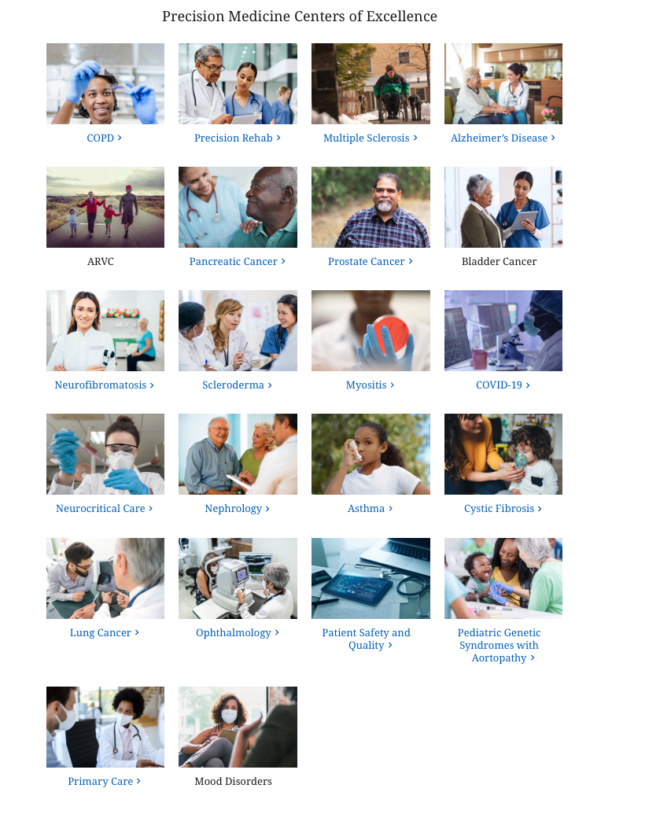
inHealth landing page with links to all PMCOE microsites
Go to: https://www.hopkinsmedicine.org/inhealth/

Slide 28
Slide Title Here

