Slide 1

inHealth Retreat
Panel Discussion

Slide 2
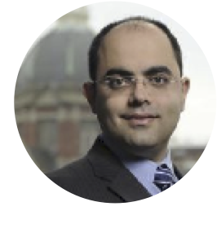
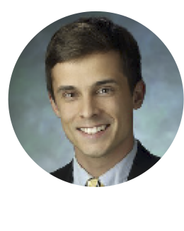
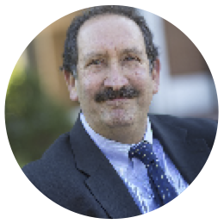
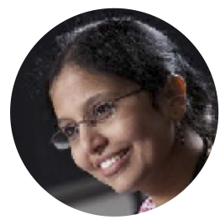
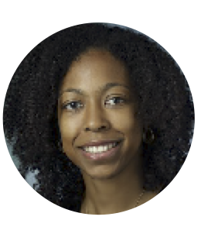
inHealth Retreat Panel
Dr. Hadi Kharrazi
JHU Center for Population Health IT
Dr. Ryan Roemmich
Assistant Professor of Physical Medicine and Rehabilitation, KKI
Dr. Michael Miller
Director of Biomedical Engineering at JHU
Suma Subbarao
Principal Staff at JHU APL
Dr. Casey Overby Taylor
Assistant Professor of Medicine and Biomedical Engineering
Notes:
Ryan Roemmich - I am a human movement scientist interested in walking and rehabilitation of persons with neurologic damage or disorders. My background spans engineering, clinical gait analysis, and neuroscience. My research focuses on combining these disciplines to understand how the nervous system controls locomotion and how we can improve walking in persons with gait dysfunction. I use many techniques to study human movement, including three-dimensional motion capture, pose estimation electromyography, interactive feedback, musculoskeletal modeling, and clinical examination. Interdisciplinary collaboration is a strong emphasis of my work, as I have published with academic and clinical faculty in engineering, kinesiology, physiology, psychology, neurology, neuroscience, neurosurgery, physical therapy, and language sciences. My long-term research goals aim to develop innovative, effective walking treatments for persons with neurologic damage or disease. Our work has been funded by the NIH, the American Heart Association, the American Parkinson Disease Association, the Association of Academic Physiatrists, and pilot project awards through Stanford University.
Suma Subbarao has a Master’s degree in Computer Science and Software Engineering from Johns Hopkins University and has been working at the Johns Hopkins Applied Physics Laboratory for the past 16 years. Prior to APL, Suma worked as a consultant to Lockheed Martin and worked at the State of Maryland’s Department of Health and Mental Hygiene to help redesign and rearchitect the state’s WIC (Women Infants Children) program.
At APL, Suma has worked in a variety of roles for various sponsors and mission areas. She worked as a software engineer for the electronic syndromic surveillance system ESSENCE, as an android mobile engineer and lead to build a tactical sampling app for the detection of biological and chemical releases, a project manager to help build a global bio surveillance portal for the force, and over the last couple years as a project manager for PMAP.
In addition to her technical responsibilities, Suma is also an Assistant Group Supervisor for the Health and Human Machine Systems group at the Asymmetric Operations Sector of APL. She helps manage a diverse team of systems engineers, data scientists, cognitive and behavioral specialists working on a variety of National Health related projects including the COVID response, medical preparedness of the force, as well as projects with DHA, CDC, and FDA.
Michael Miller - https://www.hopkinsmedicine.org/profiles/details/michael-miller
Michael I. Miller is the Bessie Darling Massey Professor and Director of Biomedical Engineering at Johns Hopkins University. He is also co-director of the Kavli Neuroscience Discovery Institute.
As a biomedical engineer who specializes in data science, Dr. Miller is pioneering cutting-edge technologies in computational medicine to understand and diagnose neurodegenerative diseases. His research focuses on the functional and structural characteristics of the human brain in health and disease, including Huntington’s disease, Alzheimer’s disease, dementia, bipolar disorder, schizophrenia, and epilepsy. By developing new tools to analyze patient brain scans, derived from advanced medical imaging technologies, Dr. Miller aims to predict the risk of developing neurological disorders years before the onset of clinical symptoms. His lab is currently devising cloud-based methods to build and share libraries of brain images—and the algorithms used to understand them—associated with neuropsychiatric illness. Dr. Miller’s research is highly translational, and he has co-founded four start-up companies in the past decade.
Dr. Miller has co-authored more than 300 peer-reviewed publications, as well as two highly cited textbooks on random point processes and computational anatomy. He has received numerous awards for his work, including the national Institute of Electrical and Electronics Engineers (IEEE) Biomedical Engineering Thesis Award, the Johns Hopkins Paul Ehrlich Graduate Student Thesis Award, and the National Science Foundation (NSF) Presidential Young Investigator Award. He was named an inaugural Johns Hopkins University Gilman Scholar in 2011 for demonstrating a distinguished record of research, teaching, and service. He is an elected Fellow of the American Institute for Medical and Biological Engineering and the Biomedical Engineering Society.
Dr. Miller earned his B.S. from the State University of New York at Stony Brook, and his M.S. and Ph.D. in biomedical engineering from Johns Hopkins University. He was the Newton R. and Sarah L. Wilson Professor in Biomedical Engineering at Washington University in St. Louis until joining Johns Hopkins University in 1998 as the founding director of the Center for Imaging Science. He was named the Herschel and Ruth Seder Professor in Biomedical Engineering in 2003, before his appointment as the director of the Department of Biomedical Engineering in 2017.
Hadi Kharrazi - http://hkharrazi.com or https://www.hopkinsmedicine.org/profiles/details/hadi-kharrazi
Dr. Hadi H.K. Kharrazi holds a joint appointment with Biomedical Informatics and Data Sciences (BIDS) at the Johns Hopkins University School of Medicine. He is an associate professor of health policy and management at the Johns Hopkins Bloomberg School of Public Health. His research primarily focuses on population and global health informatics.
Dr. Kharrazi serves as the co-director of the Center for Population Health Information Technology (CPHIT) at the Johns Hopkins Bloomberg School of Public Health.
Dr. Kharrazi has been recognized by Johns Hopkins with a Discovery Fund Synergy Award for his work in addressing medication regimen complexity in-home health care.
Casey Overby Taylor https://www.hopkinsmedicine.org/profiles/details/casey-taylor
Dr. Casey Overby Taylor is Assistant Professor of Medicine and Biomedical Engineering at Johns Hopkins University. She completed pre-doctoral National Library of Medicine biomedical informatics training and National Human Genome Research Institute genome sciences training fellowships at the University of Washington. She also completed a post-doctoral National Library of Medicine informatics training fellowship at Columbia University.
Dr. Taylor's research draws from biomedical informatics and the related field of biomedical data science, to address the challenge of how to incorporate technology and digital approaches into clinical research and healthcare practices. She also draws from comparative effectiveness research approaches, including experience with conceptualizing and measuring implementation outcomes, to study the use of clinical decision support as a strategy to improve the adoption of clinically actionable guidance. Prior to Dr. Taylor’s move to Hopkins, she was Assistant Professor in University of Maryland’s Program for Personalized and Genomic Medicine.

Slide 3
inHealth Retreat
Panel Discussion

Slide 4

Panel Questions: Data Analysis
Mike Miller
Casey Overby-Taylor
Suma Subbarao
Are you using or planning to use PMAP in your work?
We have several PMCOEs who are interested in incorporating imaging analysis into their work – how can we foster collaboration between the PMCOEs and engineering faculty/students with image processing expertise?
How can we encourage mutually beneficial collaborations or synergies between your teams and the PMCOEs – providing your students with opportunities to use real world data and providing the PMCOEs with computational/analytic support that they might otherwise lack?
Additionally, what other expertise could your BME teams bring to our PM efforts?
Can you describe the composition/expertise of your precision medicine teams at APL?
Please describe some of your previous and ongoing projects.
Can you outline the process by which a PMCOE would create a work proposal for APL data scientist support?
Notes:
Dr. Miller, your work focuses on mathematical analysis of brain anatomy (imaging) and prediction of disease development and progression, particularly with Alzheimer’s disease. Your team recently created an interpretable deep learning strategy that delineates unique Alzheimer’s disease signatures from multimodal inputs of MRI, age, gender, and mini-mental state exam scores and then validated this model in 3 independent cohorts.
What does it mean for a deep learning strategy to be “interpretable” and why is that so important for your model?
Casey - your Precision Medicine course utilizes PMAP and pairs students with PMCOEs who have discrete questions that can be answered using PMAP data. Can you describe what types of projects are being conducted as part of your course?
Ms. Subbarao, the Applied Physics Lab has been instrumental in not only the development of PMAP itself, but in several early PMCOE projects seeking to identify clinically relevant subgroups of patients.

Slide 5
Panel Questions: Data Capture
Ryan Roemmich
Hadi Kharrazi
Can you describe how you team is harnessing wearable technologies to improve your understanding of function?
What are the challenges you have faced with collection of data from wearable devices (enrolling patients, connecting devices, storage for large volumes of data, etc)?
Usability in the wild is complex. What is your team doing to subgroup patients that may show similar difficulties with usability but for different reasons?
How can such large amounts of data be distilled into actionable intelligence for the clinician?
Describe the Digital Monitoring Workgroup’s goals
Can you describe the different types of SBDH data – individual level and population level?
What are some of the barriers to and facilitators of using SBDH information in the EHR?
Can we reliably collect SBDH data that is useful both in clinical practice and for research purposes?
How does a health system prioritize and systematically implement that data collection?
Notes:
Ryan - Your work with the Precision Rehab PMCOE seeks to gain a more complete understanding of an individual’s physical abilities than can be derived from clinic-based measurements that provide only discrete snapshots of functional status. New and broadly available technologies, such as wearable devices and mobile apps, are expanding the types of data available to monitor function in the real-world setting.
Hadi - Clinicians have long been aware that social and behavioral factors modify disease states and overall health of our patients. Historically, these factors (if collected at all) are captured in free-text notes that are not easily extractable. The Johns Hopkins Center for Population Health Information (CPHIT) studies use of SBDH in healthcare, both for direct patient care and for research, and seeks to develop recommendations for systematic implementation of SBDH data collection into EHRs.

Slide 6
Panel Questions: Validation and Deployment of Tools
Dr. Overby-Taylor: Your research interests include how to effectively incorporate technology and digital approaches into clinical research and healthcare practices. What key elements must teams consider regarding validation, implementation, and long-term curation of clinical decision support tools?
Dr. Miller: Is your predictive model for Alzheimer’s disease progression available as a clinical decision support tool at the point of care? How do you ensure that your model remains clinically relevant (ie – how are “updates” issued)?
Dr. Roemmich: How do you envision remote physiologic monitoring being incorporated into your routine clinical practice? Are there examples from other disease states where this has been done and if so, will you please describe?
Ms Subbarao: If the APL creates a CDS tool with a PMCOE, how would the PMCOE ensure that the work remains valid (coding updates to reflect changes in data capture, incorporation of new medications, etc)?
Dr. Kharrazi: The Johns Hopkins ACG (Adjusted Clinical Groups) system is the world’s leading population health analytics software and continues to evolve. In fact, a new software release (V13.0) is being rolled out and includes innovation in social determinants of health (ACG Social needs markers and ACG GeoHealth) in addition to medication complexity scores.
  Briefly, what is the tool curation process for ACG?
  Can you describe how this tooling can be used at the population level? At the individual patient level?
  How could use of the ACG system help a PMCOE define or understand their cohort?
  Many Precision Medicine groups are interested in using ACG output in their modeling. Will ACG data become available within PMAP or in a way that is accessible to PMCOEs for use with cohorts and projections?

Slide 7

Questions for the panelists from the audience?

Slide 8
Panel: Closing Questions
What is the biggest challenge your teams face with PMCOE engagement?
What do you see as the biggest opportunity for PMCOE collaboration?

Slide 9
THANK YOU!

Slide 10
Supporting Materials from Panelists

Slide 11
Ryan Roemmich

Slide 12
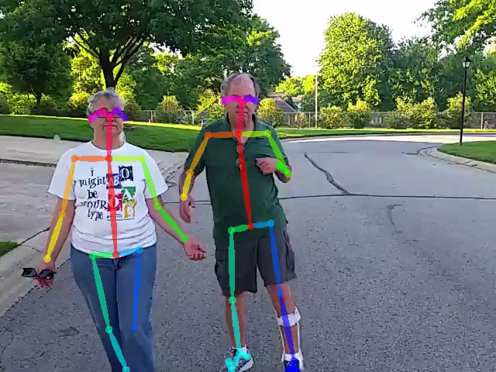
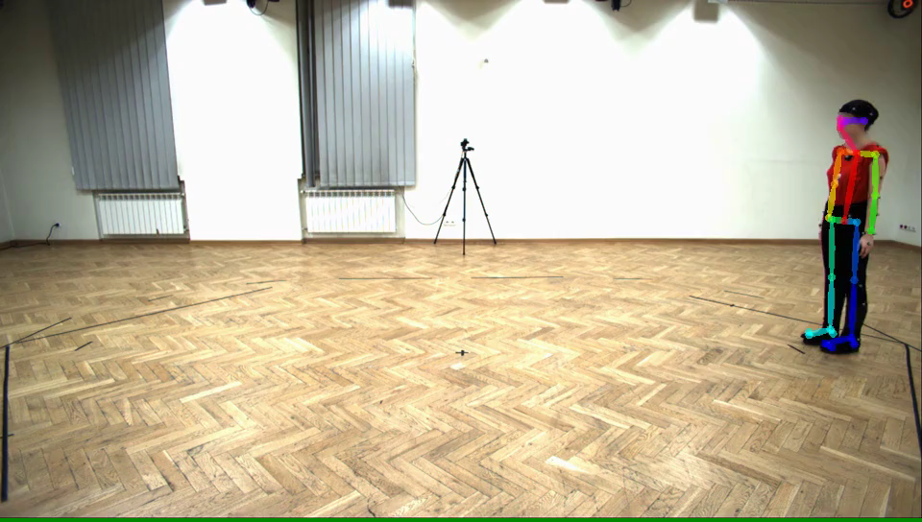
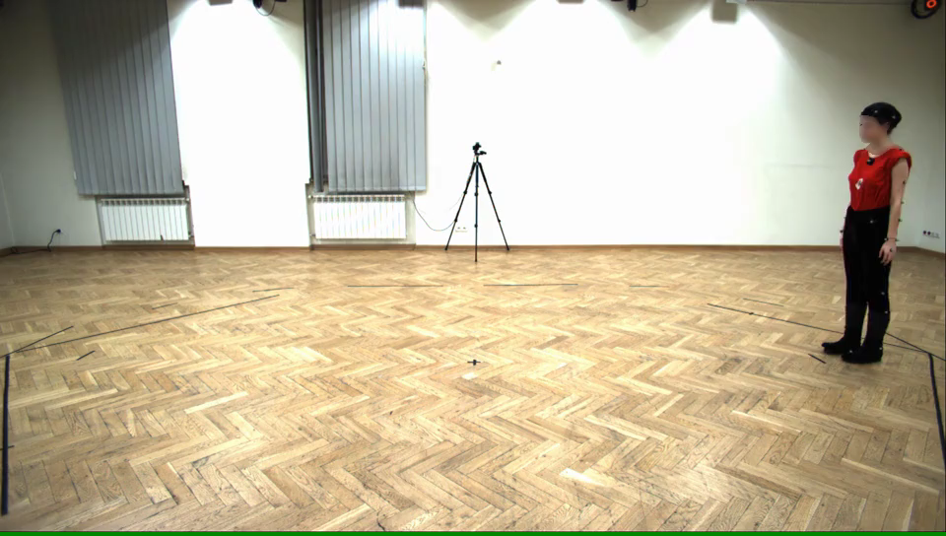
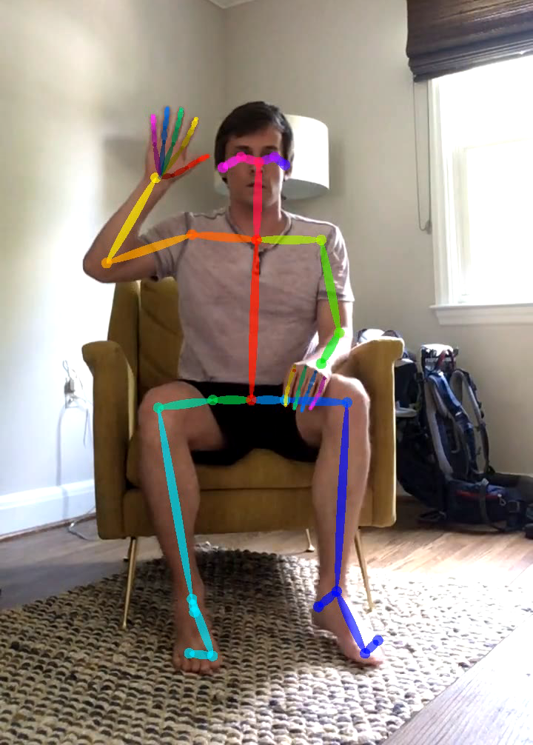
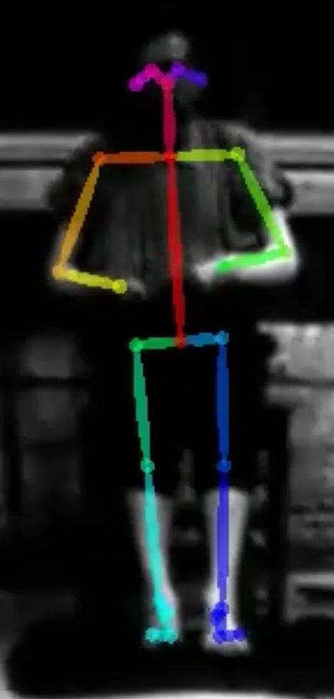
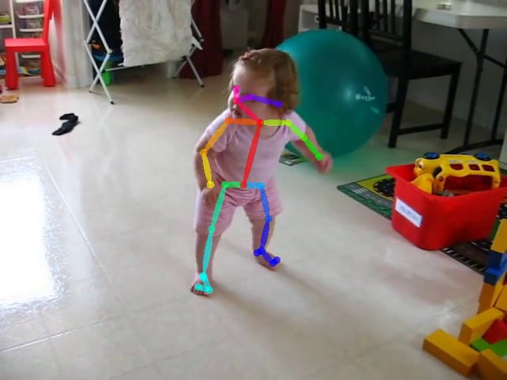

Slide 13
Casey Overby Taylor

Slide 14
Opportunity for Hands-On Learning
Course Instructors:
  Joseph L Greenstein
  Casey Overby Taylor
  Robert Stevens
  Veteran TAs
  Tony Wei
  Jacob Desman
Course name:
Precision Care Medicine I – II, 2021-22
EN.580.480-481 / EN.580.680-681
Project–based immersive two-semester course: incorporates the paradigm of modeling, personalization, and application.
Writing-intensive and Design credits
We turn students into “forged steel” by working with real healthcare data to solve real healthcare problems.
Casey Overby Taylor
cot@jhu.edu
@coverbytaylor

Slide 15


Interested SOM faculty are asked to complete proposal
Due: June 30, 2022
All proposals are reviewed by a BME/SOM advisory committee
For more information please email Dr. Robert Stevens - rstevens@jhmi.edu
Request for Proposals

Slide 16

2021 – 2022: Projects (8 Teams of 5-7 students)
Engineering PI(s), All Projects: Drs. Joseph L Greenstein and Casey Overby Taylor, Department of Biomedical Engineering
Precision Antibiotic Choice for Presumed Sepsis in Children – Team Panda
Biomedical PI(s): Dr. Jim Fackler, Pediatric Critical Care Attending JHMI; Dr. Luis Ahumada, Director Center for Pediatric Data Science and Analytic Methodology, All Children’s Hospital; Dr. Pranita Tamma, Dept. of Pediatrics JHMI
Predicting Neurologic Injury in Pediatric ECMO – Team Beaver
Biomedical PI(s): Dr. Mela Bembea, Director, JHMI Children's Center ECMO Program; Dr. Dennis Leung, JHMI Anesthesiology and Critical Care Medicine
Early Prediction of Length of Stay in Hospitalized Patients with Stroke and Traumatic Brain Injury (TBI) – Team Dolphin
Biomedical PI(s): Dr. Robert Stevens, Assoc. Prof. Anesth. Crit. Care Med.
Prediction of Cardiac Arrest in the Pediatric ICU – Team Owl
Primary Engineering PI: Dr. Timothy Ruchti, Director of Algorithms, Nihon Kohden US
Biomedical PI(s): Dr. Jim Fackler, Pediatric Critical Care Attending JHMI; Dr. Jules Bergmann, Clinical Research Fellow JHMI
Assessment of Ocular Torsion from Fundus Images and Oculography Videos – Team Hot Dog
Biomedical PI(s): Dr. Kemar Green, Assistant Professor of Neurology JHMI; Dr. David Zee, Paul and Betty Cinquegrana Professor, Departments of Neurology, Ophthalmology, Otolaryngology-Head and Neck Surgery, and Neuroscience, Division of Neuro-Visual and Vestibular Disorders, JHMI
Mechanical Ventilation: Redefining Predictors of Successful Weaning – Team Orca
Biomedical PI(s): Dr. Pedro Mendez-Tellez, Asst. Prof. Anesth. Crit. Care Med. JHMI
Using Machine Learning Models to Identify Epileptogenic Zone (EZ) and to Predict Surgical Outcome after EZ Resection – Team Ragdoll
Biomedical PI(s): Dr. Joon Kang, Asst. Prof. of Neurology JHMI; Dr. Nathan Crone, Prof. of Neurology JHMI, Dr. Sri Sarma, Assoc. Prof. of BME JHU
Predicting COVID-19 Resistance Using JH-CROWN Dataset – Team Mountain Goat
Biomedical PI(s): Dr. Stuart Ray, Prof. of Medicine JHMI

Slide 17
Michael Miller

Slide 18
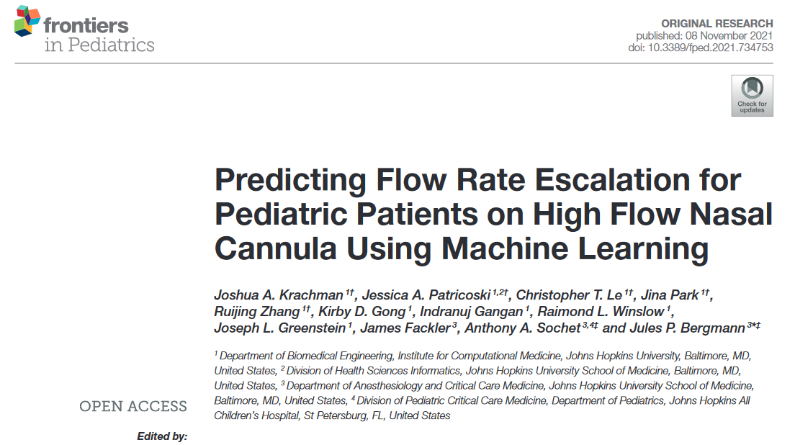
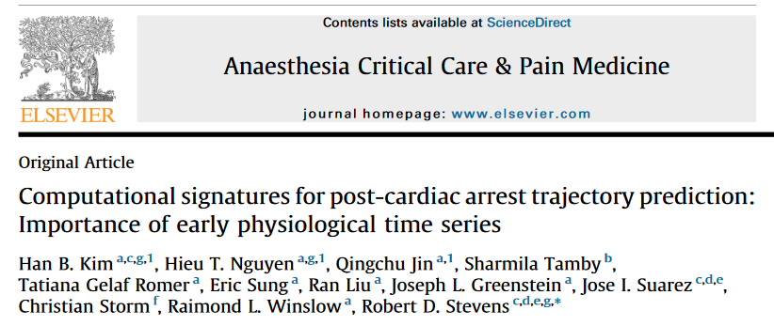
Publications
Many projects continue beyond the end of the course year and lead to conference presentations and publications in peer-reviewed journals.

Slide 19
Hadi Kharrazi

Slide 20
Population Health Informatics
& inHealth
Hadi Kharrazi, MD PhD FAMIA
Johns Hopkins School of Public Health
Johns Hopkins School of Medicine
Jun 24, 2022

Slide 21
Population Health
Better Health for the Population
Lower Cost Through Improvements
Better Care for the Individuals
Triple Aim developed by the Institute for Healthcare Improvement (IHI)

Slide 22
Population Health Risk Stratification
Provider/payer-based population health management operations

Slide 23
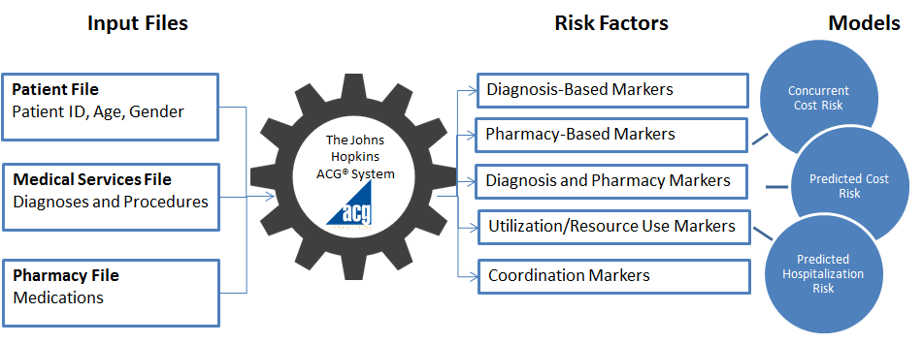

Population Health Risk Stratification
https://www.hopkinsacg.org
Johns Hopkins ACG Solution/Tool

Slide 24
Population Health Data Sources
Public Health Systems
IDS / ACO / Virtual Net
Community / Population
Web Portals
Social Network
National Datasets
Practice Team
Family and
Care givers
HIE
Social
HR data
GIS
Physician
Patient
Biomet.Tele-H.
mHealth
apps
Claims
MIS
HIS
EHR
CDSS
PHR
email and others
Various population health level data sources

Slide 25
Population Health Data Sources
Population health stakeholders and data sources

Slide 26
Population Health Analytics
Population health analytics and potential informatics challenges/solutions

Slide 27
Data Quality: Data Sources
EHR only
EHR & Claims
EHRs
Claims
Claims only
Comparing the Completeness of Dx in EHR versus Claims across 55 provider organizations

Slide 28
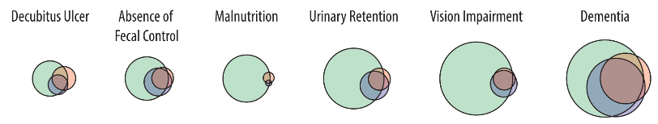
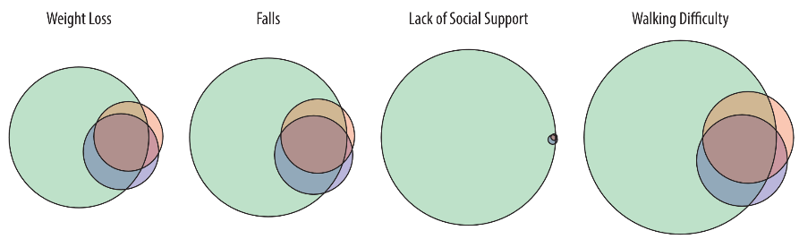
Data Methods
Added value of free text represented by the Venn diagram
Circle sizes represent the number of patients identified by each methodology/data-source
Green: EHR Free Text; Blue: EHR Structured; Red: Insurance Claims

Slide 29
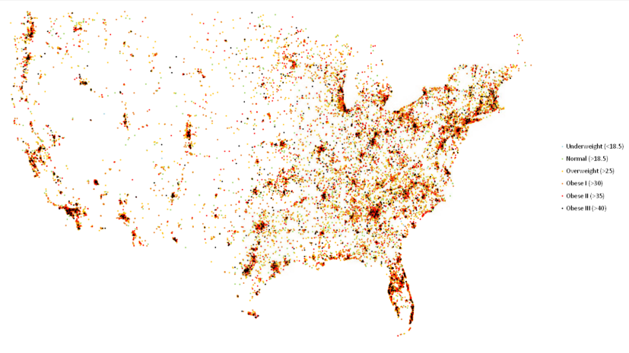
Big Data
Geographic distribution of obesity among VHA population
(Limited to 29,322 visits occurred in one day of 2013; generated using CDW data)

Slide 30
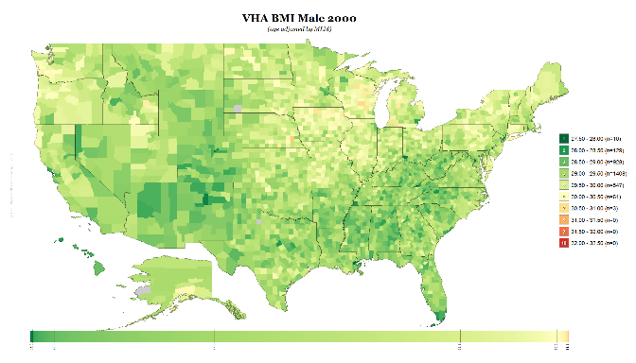
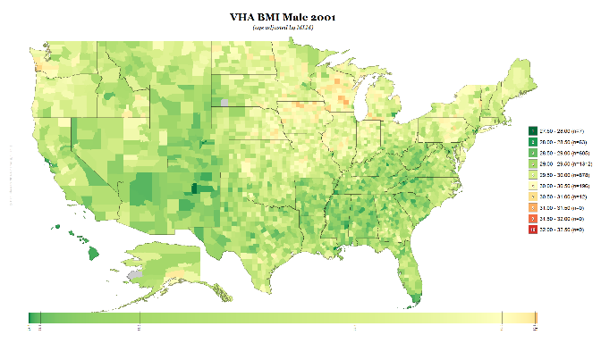
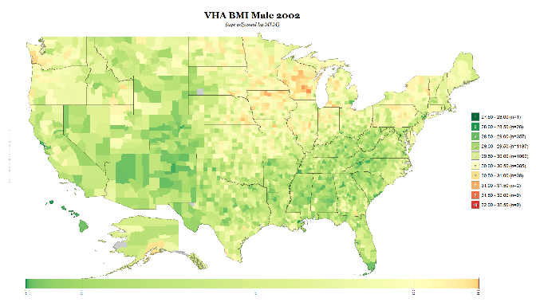
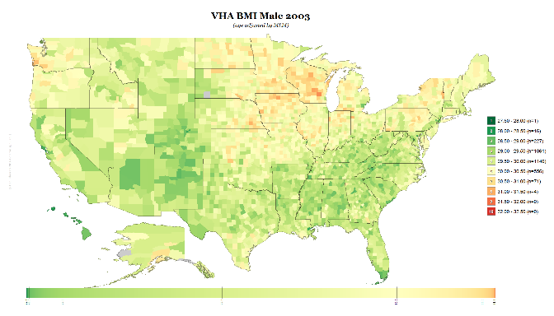

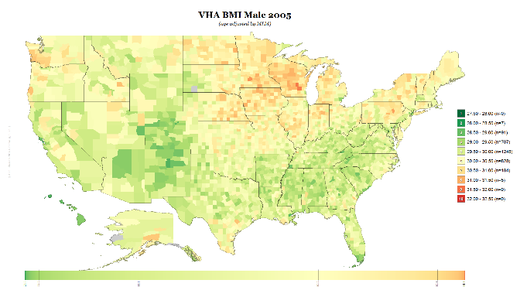
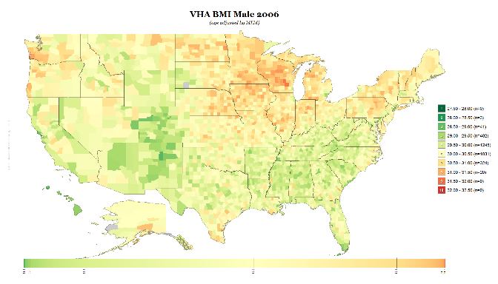
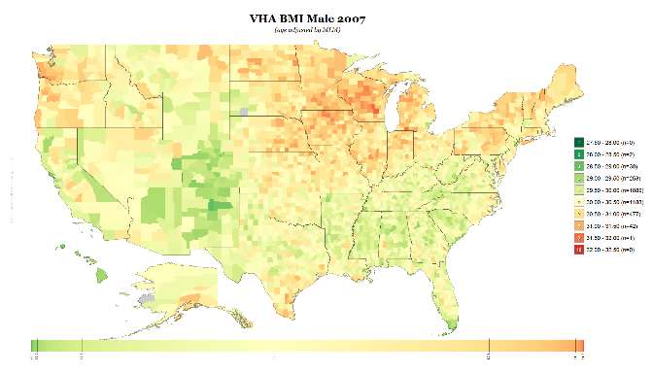
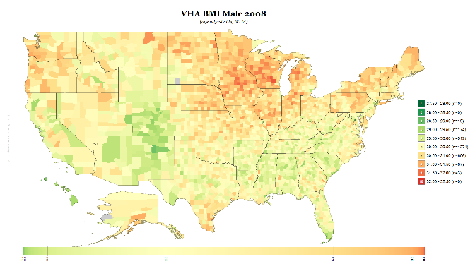
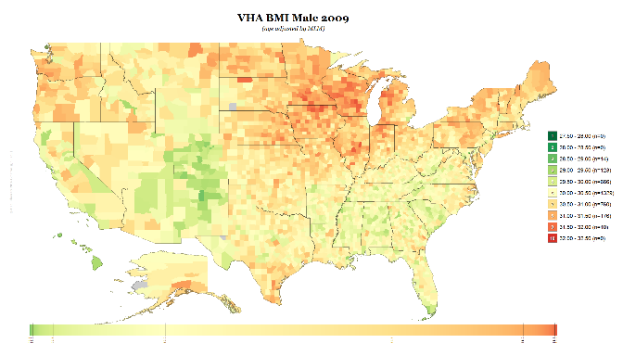
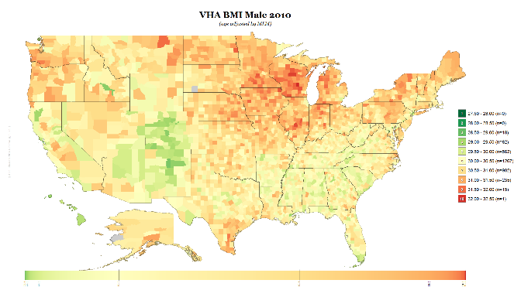
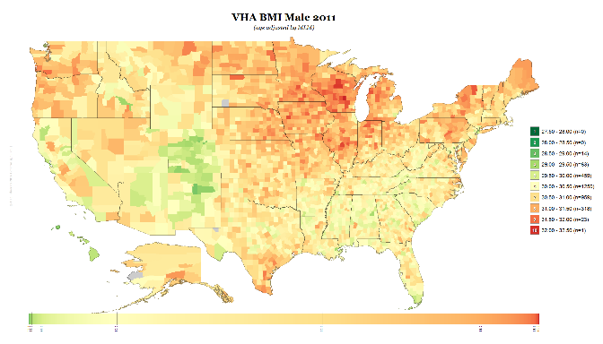
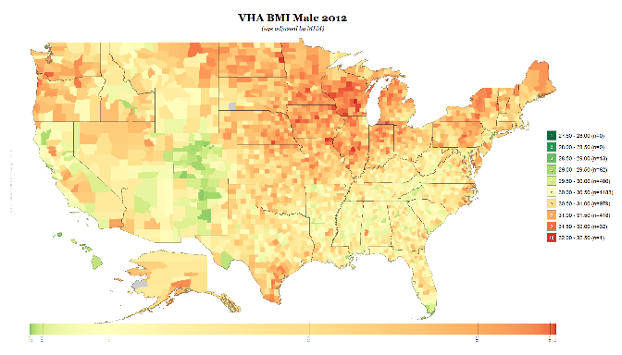
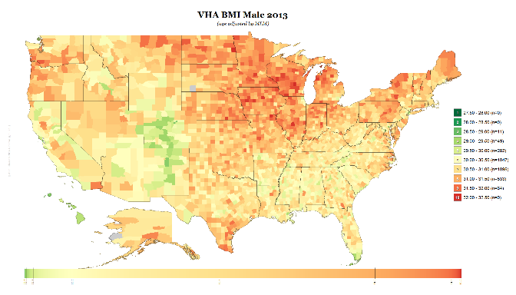
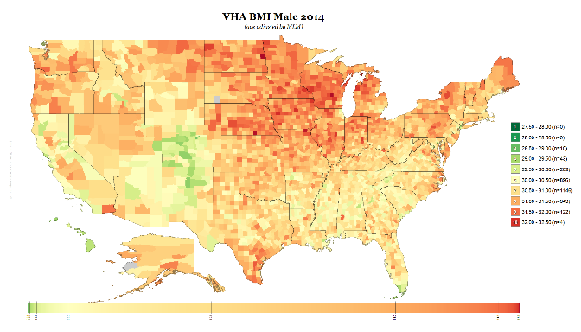

Big Data and Population Health
County BMI (using MLM adjustment) for Males 2000-2015

Slide 31
Challenges and Opportunities
New data sources/types (going beyond claims/EHRs)
Data quality
Denominator selection (phenotyping)
Comparing models (going beyond regression)
Feature reduction
Temporal data
Privacy and Security

Slide 32

Q & A
Thank you!
kharrazi@jhu.edu
www.jhsph.edu/cphit
www.hkharrazi.com

