Slide 1



Patient Insight
Longitudinal Visualization of Patient Data
Aparna Natarajan
anatara8@jhu.edu
Notes:
Hello Everyone, my name is Aparna Natarajan, I am a Product Manager at the Johns Hopkins Precision Medicine Team.
We, at the Precision Medicine team are responsible for driving the success of clinical teams in the inHealth Precision Medicine program through the development of technology solutions, thereby giving researchers the ability to discover new patient subgroups and clinicians the ability to deliver new insights into their clinical practice.
I am here today to discuss Patient Insight, our tool for longitudinal visualization of patient data.

Slide 2

1
Problems
2
Solution
3
Value Proposition
Agenda
4
Product Design
5
Development Pipeline
6
Voice of our Customers
Notes:
In this session today, we will be discussing the problems faced by clinicians and how Patient Insight serves as the solution.
We will highlight its value proposition before moving on to the specifics about the product, its design and development pipeline and finally have a peek into what our customers say about the tool.

Slide 3
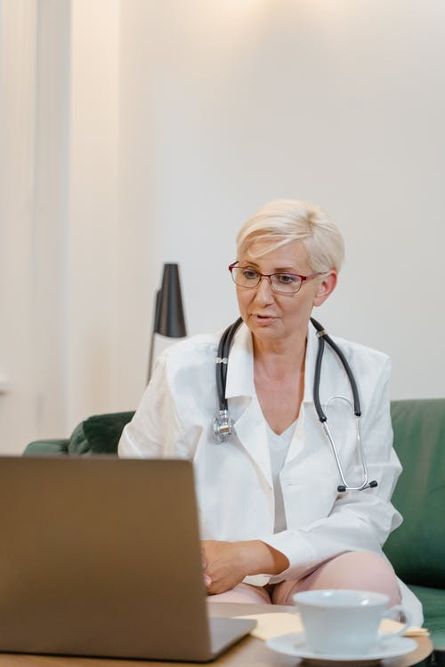
Meet Dr. Jane
A cardiologist whose research focuses on understanding the effects of estrogen in aiding cardiac function on patients diagnosed with diabetes.
She wants to:
Map her patients to the population and understand their prognosis with her treatment in-light of the medications and other interventions.
Assess disease trajectory and treatment options in context of patient subset
Notes:
Let us meet Dr Jane, a cardiologist whose research focuses on understanding the effects of Estrogen in aiding cardiac function on patients diagnosed with Diabetes.
As part of her research, she wants to map her patients to the population and understand their prognosis with the treatment in-light of the medications and other interventions.
She also wants to assess their disease trajectory and treatment options in context of the patient subset.

Slide 4
But she is facing roadblocks in achieving them.
Need to refer multiple data sources to assess disease parameters make it time consuming
EMR is displayed in tabular format, making it hard to interpret.
Lastly, without a unified view, she is having a hard time collating information together to look at the larger picture.
Notes:
But she is facing roadblocks in achieving them.
Having to refer multiple data sources to assess disease parameters make it time consuming
EMR in tabular format, makes it harder to interpret
And without a unified view of all data, she is finding it hard to look at the larger picture.

Slide 5

Solution

Slide 6




What’s the Solution?
Unified view of curated data normalized on a common longitudinal scale
Medication Panels
  Discrete Patient Events
Multiple Charts
Notes:
The solution we have developed for researchers like Dr. Jane aims to address all those challenges.
The tool we call as Patient Insight provides a unified view of curated data that is normalized on a common longitudinal scale.
This use case extends beyond the realms of research into clinical practice thereby assisting physicians to look at their patients ‘overall disease trends. With medication panels, patient events and custom-built charts its easy to look at the complete picture of the patient’s disease state and make tailored recommendations to the patient in context of the subgroups.

Slide 7
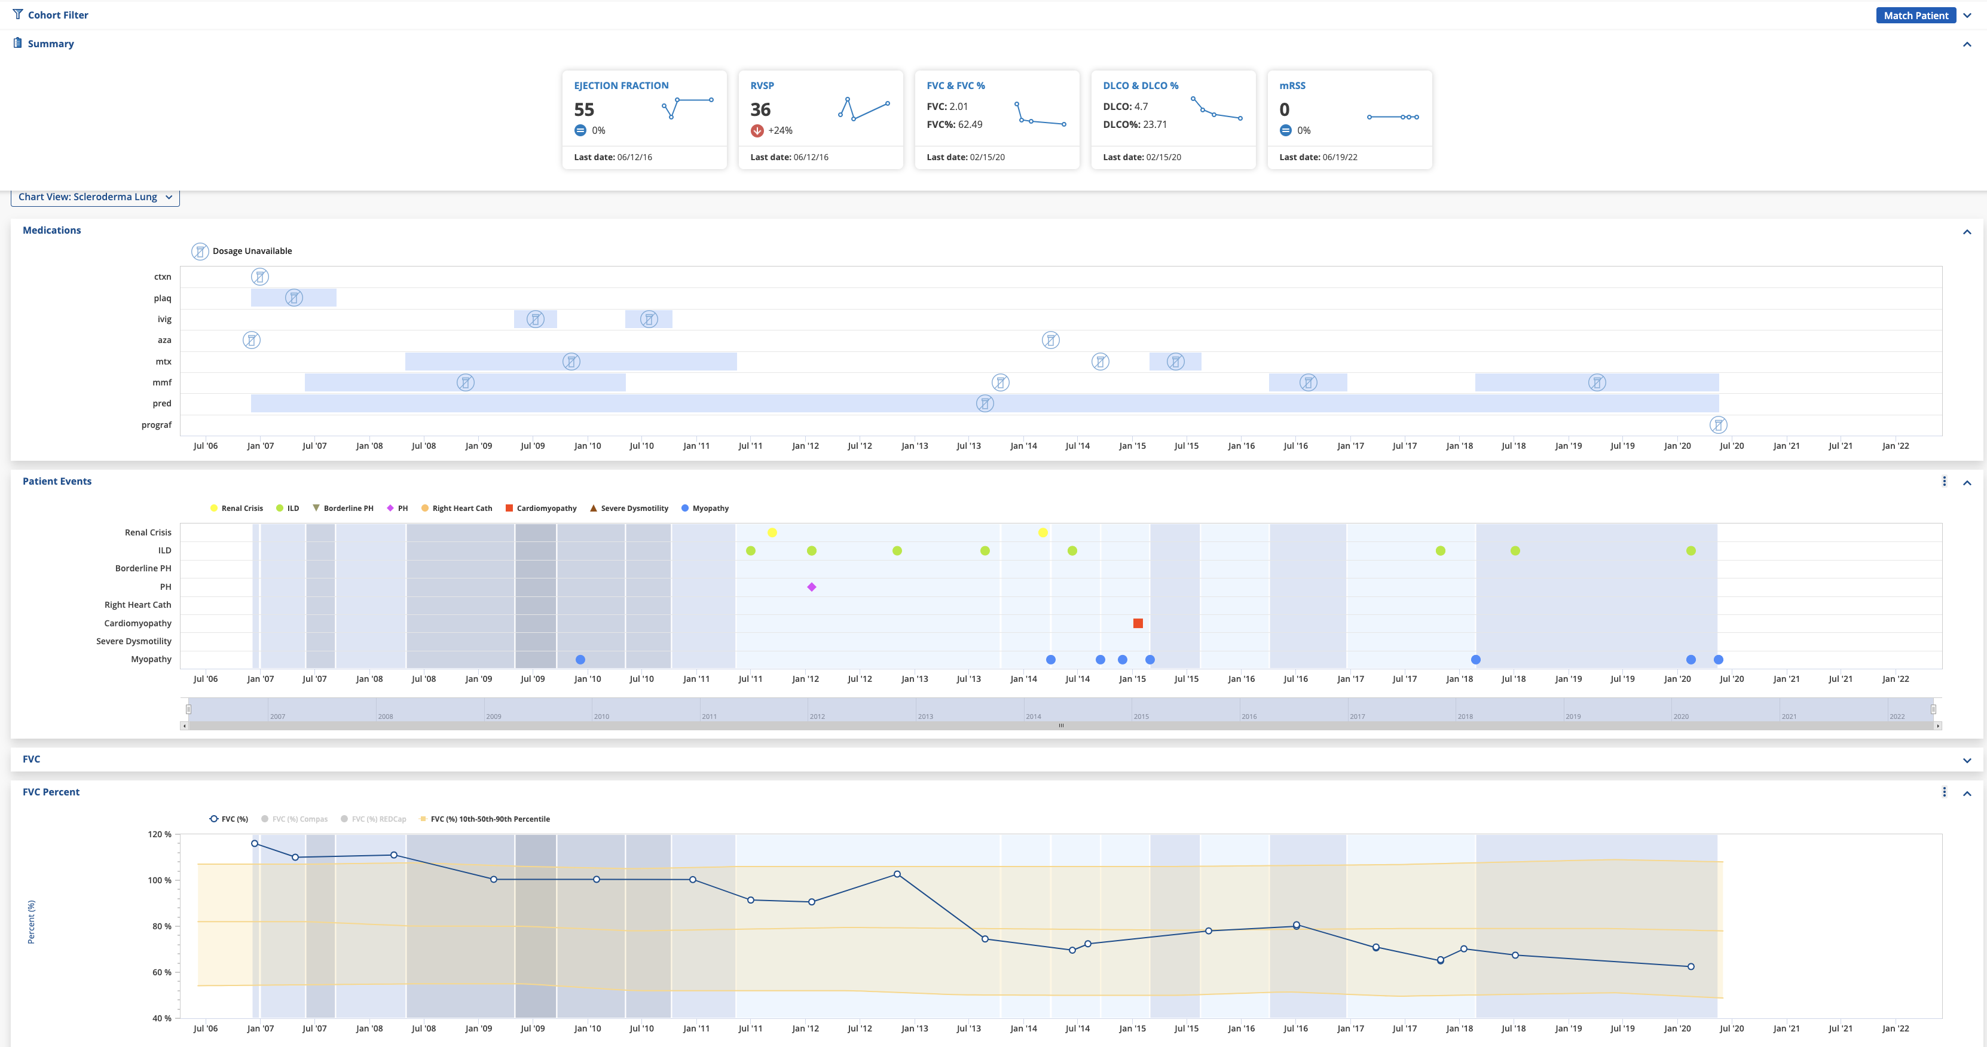
Notes:
Here is a quick sneak peak of the application. We’ll see it all in action in the demo following this presentation.

Slide 8
Value Proposition

Slide 9

Why it Works for Dr. Jane?
Actionable Research Insights into Practice
Increase Assessment Confidence
Aid in Diagnosis and Treatment
Save Prep Time for Patient
Notes:
Its one thing to have an application to look at trends and make projections, but the true value proposition for clinicians comes from getting actionable research insights implemented into practice.
This helps in boosting assessment confidence and aids is better diagnosis and treatment, all while saving Prep-time for each patient.

Slide 10

Why it works for her Patients?
Access overall trajectory in one place
Increase confidence and awareness about current health state
Promote shared decision making and enhanced quality of care
Notes:
Patients also stand to gain from this tool by being able to access to overall disease trajectory in one place.
Such insights help increase confidence and awareness about one’s health state.
By acting as a liaison between the physician and the patient, the tool helps increase patient participation in the decision-making process and thereby enhancing the quality of care.

Slide 11
Product Design

Slide 12
Our Design Philosophy
Dynamic
Derived and Transformed Data
Layer 3
Aggregated Data i.e., EMR + Research Data
Layer 2
Layer 1
Unified View of Curated EMR Data from Epic
Static
Notes:
Moving on to our design philosophy, we start a unified view of curated EMR data from Epic, forming Layer 1 of the design.
We then add research data to it to form the “Aggregated Data”, constituting Layer 2 of the design.
Finally, we move on to Layer 3, where the data is transformed to build custom prediction models.
This way, the transition from static data visualization to dynamic data presentation is embedded into the user experience through a human centered design approach.

Slide 13
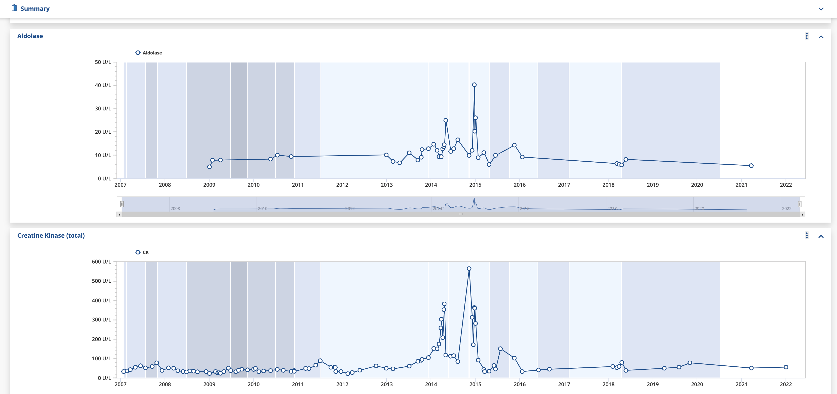
Case Study - Scleroderma CoE
Layer 1: Unified visualization of lab data
Layer 1
Notes:
How we accomplish this design philosophy is depicted through a series of case studies from different COE’s.
Our first case study is Scleroderma COE whose requirement to view lab data as discrete charts on the longitudinal scale entails the redisplay of lab results from Epic in Patient Insight.

Slide 14
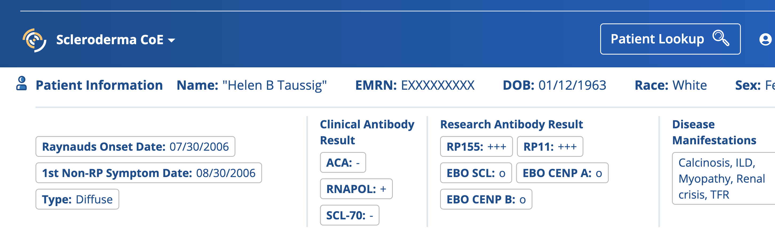
Case Study - Scleroderma CoE
Layer 2: Visualization of aggregated clinical and research antibody results for patient
Layer 2
Layer 1
Notes:
Another requirement from Scleroderma CoE was to view both clinical and research antibody results data, at which point, we aggregated both them for the visualization.

Slide 15
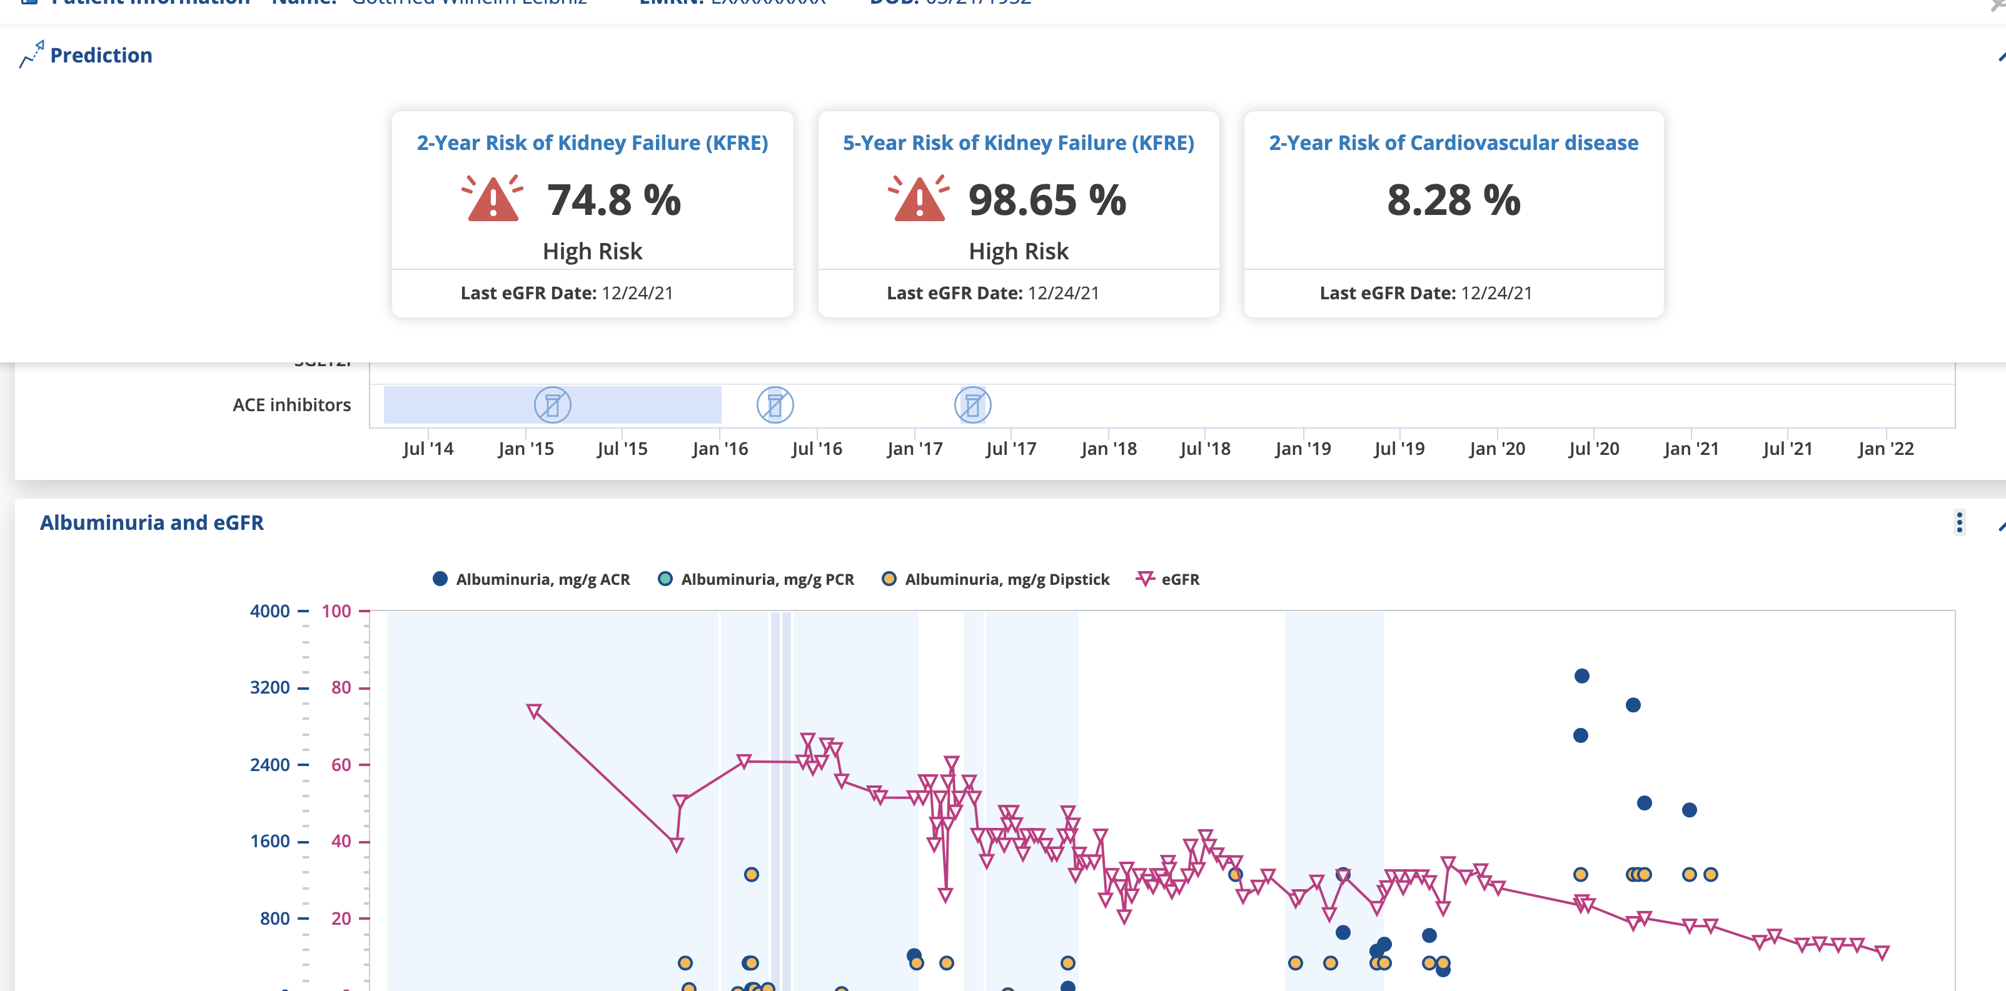
Case Study - Nephrology CoE
Layer 3: Derived and Transformed data to predit 2-year and 5-year risk of Kidney Failure based on KFRE scores
Layer 3
Layer 2
Layer 1
Layer 1
Notes:
Our last case study is from Nephrology CoE whose requirement was to predict 2-year and 5-year risk of Kidney failure based on KFRE scores. This was accomplished though transformation of the aggregated data using prediction models.

Slide 16
Product Development

Slide 17
Need your own Patient Insight?
Cohort List
Data Elements and Features
Data Dictionary to pull data from multiple sources
Notes:
And for research teams that need their own Patient Insight, we start the process by getting the Cohort List, the Data Elements and features followed by the Data Dictionary to pull data from multiple sources

Slide 18
Got Multiple Data Sources?
Epic*
RedCap
PMAP
SmartForms
Patient Insight
* Real time with FHIR
Notes:
One of the primary data sources for Patient Insight is PMAP. The tool consumes data projected and transformed from PMAP and the consumed data is segregated by COE specific cohorts.
Besides that, the application can also ingest data from Epic, RedCap or Smartforms independently based on specific data requirements of the research teams.
With Epic, the tool can also display data elements like medications, observations and smartforms in real time through FHIR.
That way, we are able to enrich the existing data from PMAP that has a 48-hr latency with real time data from Epic through FHIR.

Slide 19
FHIR - How it helps?
Real time Clinical Data
Out-of-the-box interoperability with multiple sources
Fast and Simple Design
Quicker Deployments for Common Views
Notes:
FHIR, in short is a standard that defines how healthcare information can be exchanged between multiple systems. Through its REST API approach, it enables sharing, integration and retrieval of clinical health data and other electronic health information easily.
One of the biggest advantages of FHIR is its ability to make data sharing real time.
It facilitates Interoperability out-of-the-box, where base resources can be used as is, but can also be adapted for local requirements.
By adopting existing standards and technologies already familiar to software developers, it has a strong focus on fast and simple design and facilitates quicker deployment for common views.

Slide 20






Here’s How We Work
Gather Requirements
Create Data Dictionary
Schedule and Transform Data Projection
Configure Views
FHIR Code Mapping and/or FHIR Converters
Deploy Instance in Epic
Notes:
Coming to our development process, once we get the requirements and data dictionary from research teams, we move on to schedule and transform the data projection.
Based on the sources of the data elements, we enable FHIR converters and map the FHIR codes.
After that, we configure the views based on design specifications and finally deploy the instance in Epic.

Slide 21
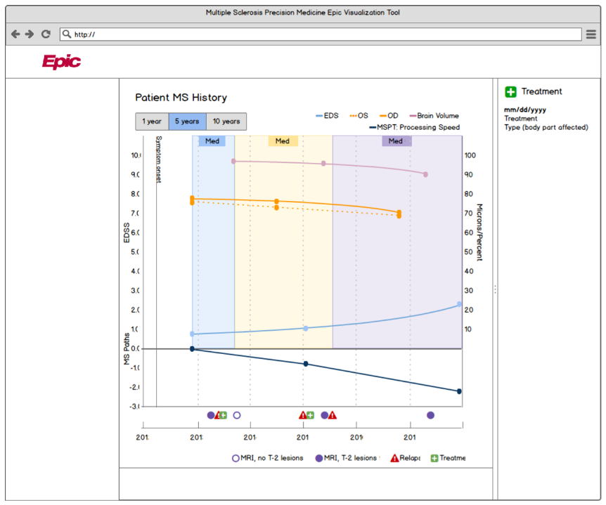
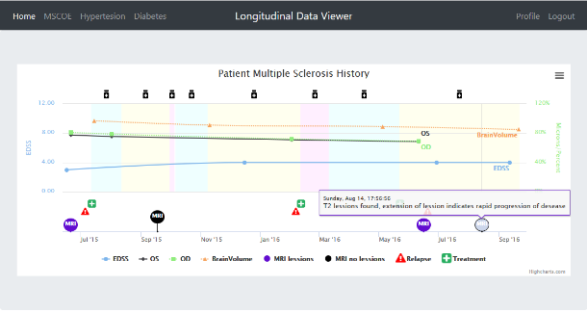
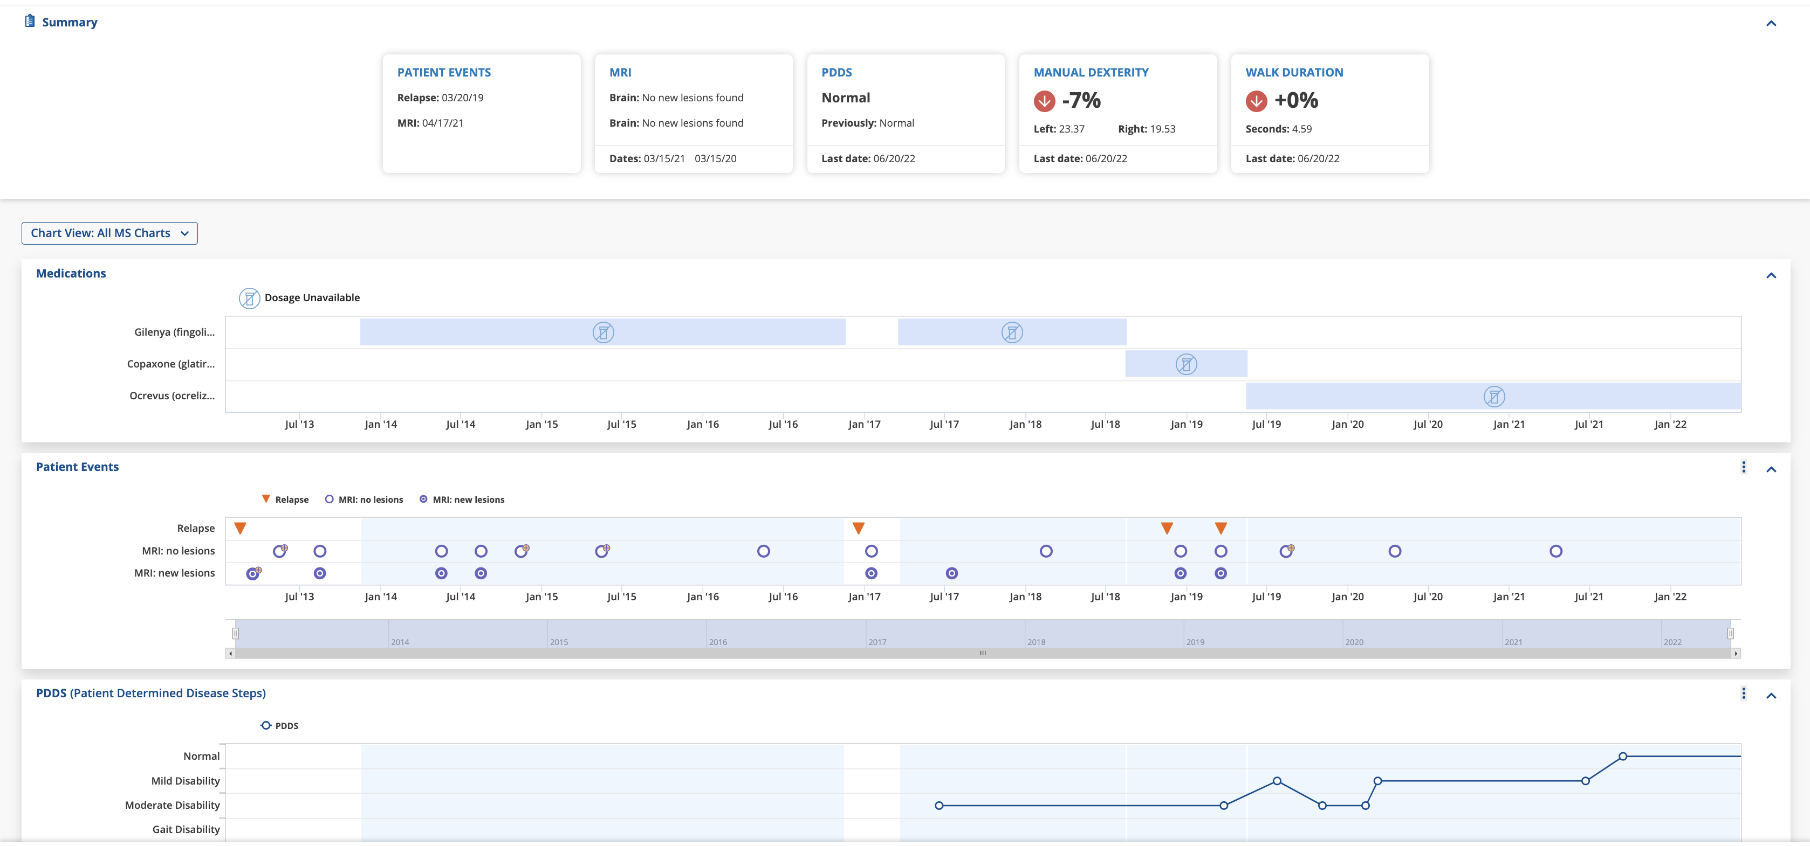
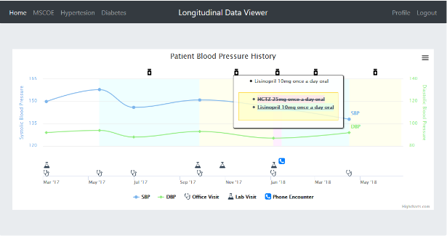
Development Cycle
Our Development Cycle
Wireframe
Prototype
Deployed Application
Notes:
As part of that development process,
Our design team meets with the clinical research team to get their requirements
Then we create wireframe mockups followed by a prototype
And after multiple iterations, we deploy the application in Epic.

Slide 22
Our Scale up Strategy
Abstract new COE requirements into common feature sets
Deploy new instance for each COE
Balance between COE specific requirements and generalization
Notes:
As part of this endeavor, we aim to leverage the existing solution developed for current CoE’s by abstracting commonalities from their requirements into common feature sets and use them to deploy new instances.
That way, we reduce the time and resources required for development and maintenance of the instance.
There are, however, scenarios where requirements need to be considered w.r.t their usefulness in some contexts.
In such situations, we evaluate whether the generalized solution can be made to work, or the use case merits custom application development.

Slide 23
Recipe for a Successful Patient Insight Launch
Pre-Requisite Checklist to initiate build
Data Manager and PI on the Research Team
Active Collaboration between Research Team and Development Team
Notes:
In order to have a successful launch of the application, some things are imperative
To start the build, we need the Cohort list, data elements and data Dictionary.
In order to validate the data elements and sources, we would actively collaborate with the Data Manager on the research team. And to validate the clinical findings, collaboration with the Principal Investigator is crucial.
This active collaboration between us and the research team, will serve as the foundation for a successful launch.

Slide 24
Voice of our Customers

Slide 25
What Have We Done So Far?
4+ Research Teams and Counting
In Transition to Real Time Data Visualization
Help Improve Diagnostic Outcomes
Notes:
As we saw earlier in the case study, we have several Centers of Excellence like Multiple Sclerosis, Scleroderma, Nephrology and Myositis using the Patient Insight Application and many more lined up to get their own instance built in the near future.
Of them, Multiple Sclerosis gets data in real time through FHIR and Myositis is currently in the process of transitioning to FHIR, followed by the rest of the COE’s
And through this application, we aim to help physicians improve diagnostic outcomes in their patients.

Slide 26
What our Users Say?
“Harmonizing multiple data sources into comprehensive viewer which gives a more complete picture of the patient's disease state and is a huge time saver.”
- Physician from Scleroderma COE
“It makes very obvious to patients what the trajectory of their illness is. It also demonstrates well our careful documentation thereof!”
- Physician from Multiple Sclerosis COE
“Information presented succinctly and clearly in a visually appealing way”
- Physician from Nephrology COE
What our Users Say?
Notes:
As you can see here, our users benefit in several ways from the Patient Insight Application.

Slide 27

Ready to get powerful insights built into your clinical decision- making process?
We are here to help!
Notes:
On that note, I would like to invite you to come and join our growing team and get powerful insights into your clinical practice.
Thank you for your time and attention today.
Next, let us move on to the Demo of the application to see it in Action.

Slide 28
Thank you!

