Slide 1

inHealth Spring Retreat
OpenSpecimen as a Biospecimen Management Tool
Ara Wally
awally1@jhu.edu

Slide 2
What is OpenSpecimen?
OpenSpecimen is a biospecimen management tool administrated and supported by JHU and the ICTR.
Assigned as a Tier A by the Data Trust’s Research Sub-council to manage and store Personal Health Information (PHI).
Interface with Epic and Precision Medicine (PMAP) that allows participant’s basic demographics data to be pulled directly to openSpecimen from epic, and specimen and participant data to be sent to PMAP weekly.

Slide 3

How to use OpenSpecimen?

Slide 4
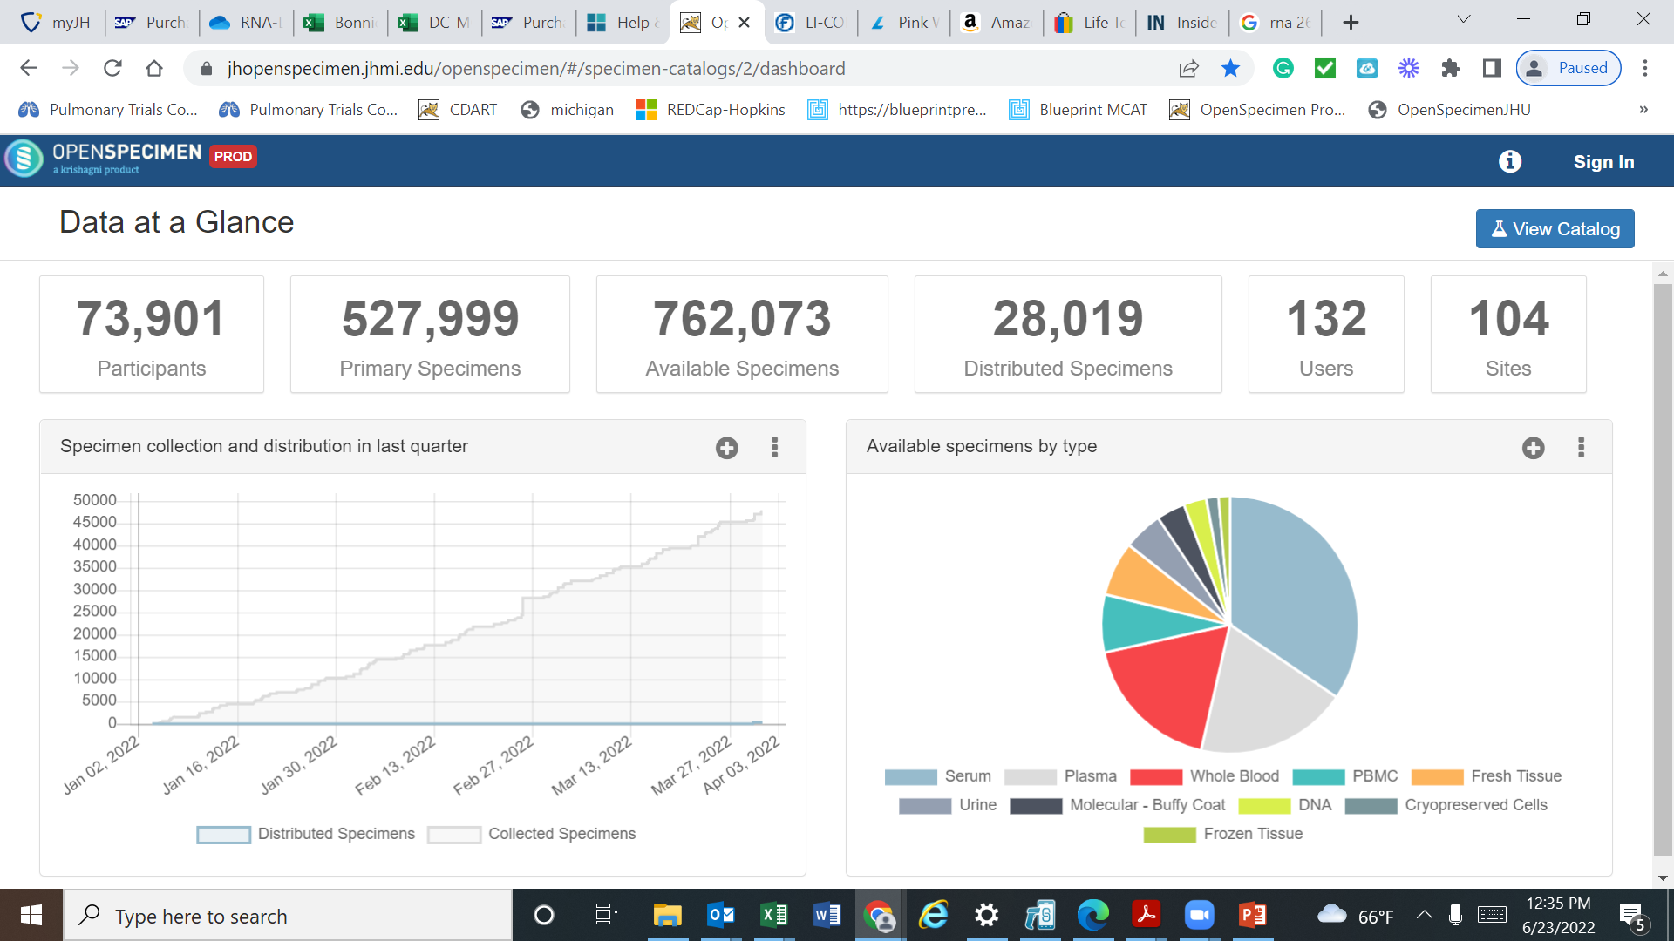

Slide 5
Participants, Specimens, Study Visits

Slide 6
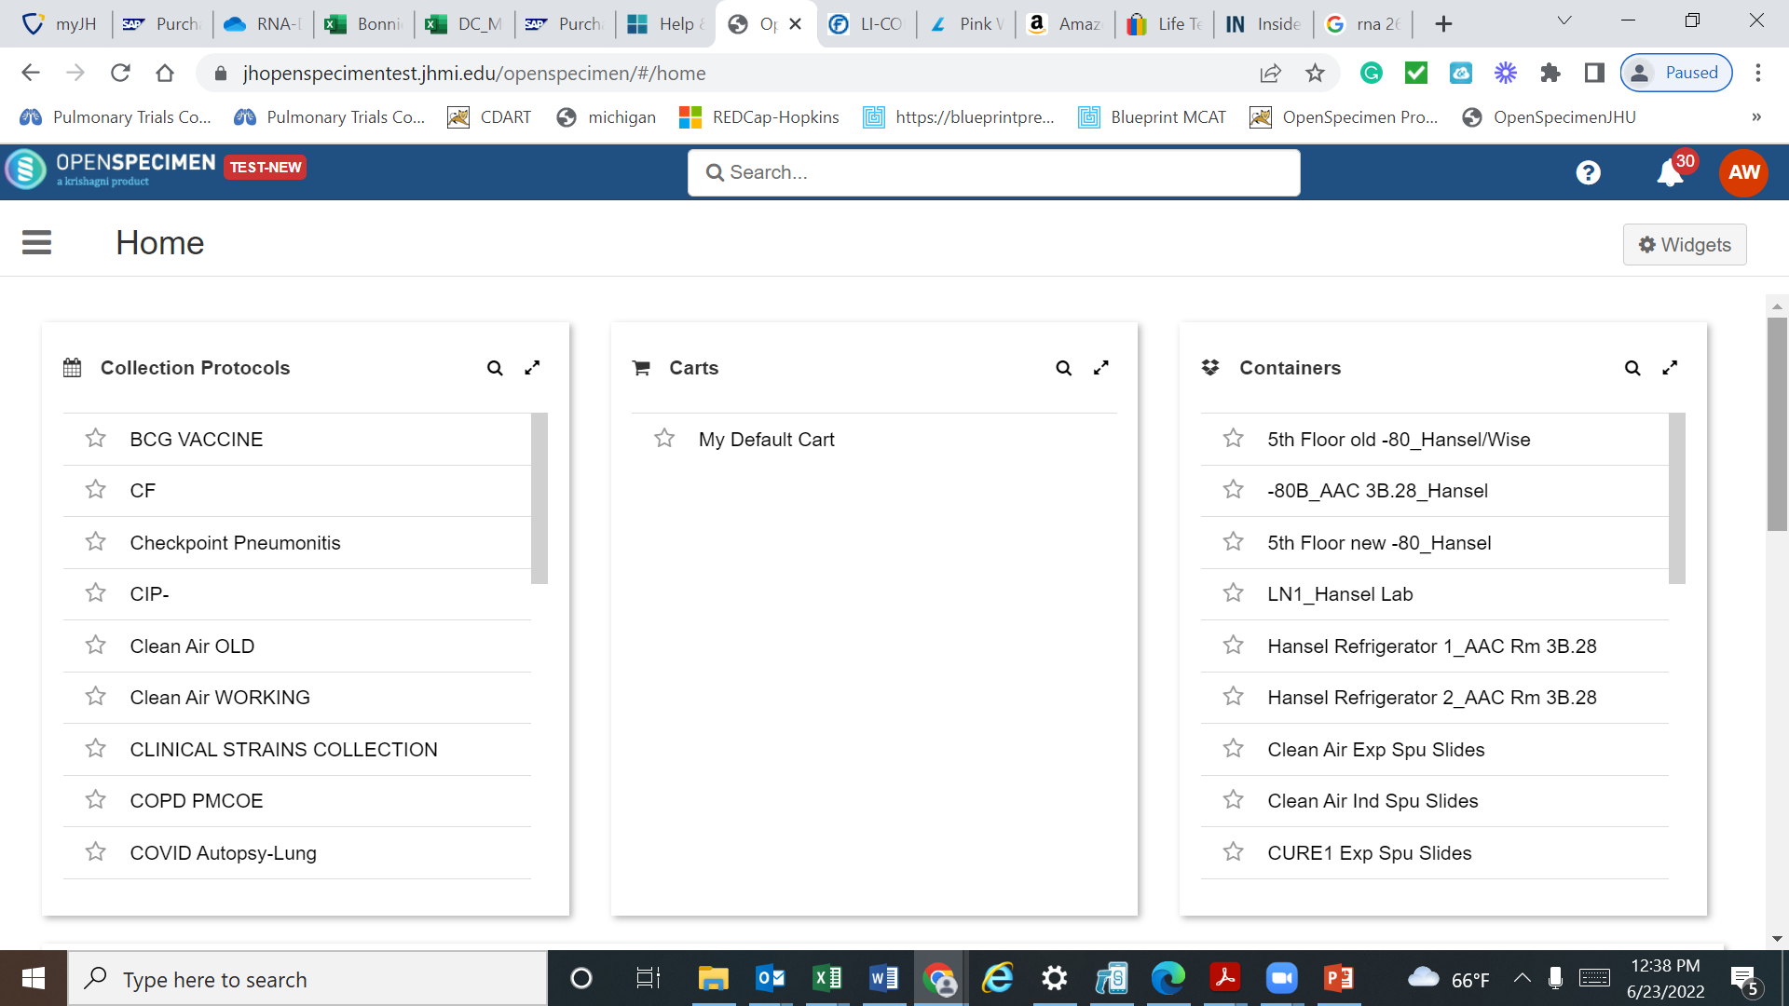

Slide 7
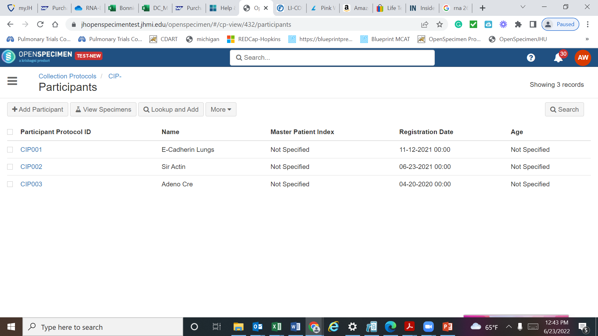

Slide 8
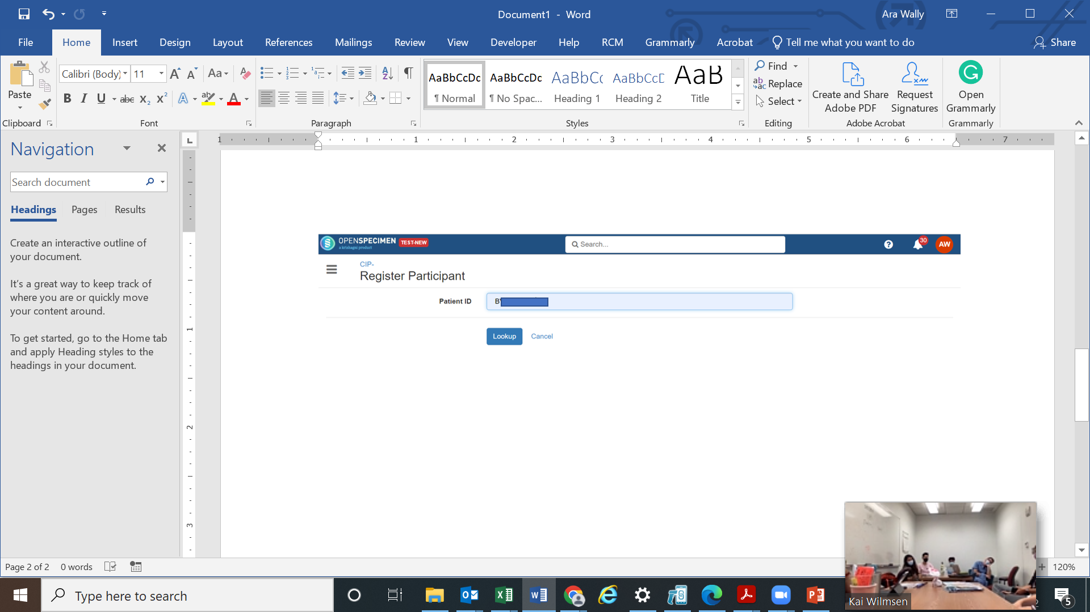

Slide 9

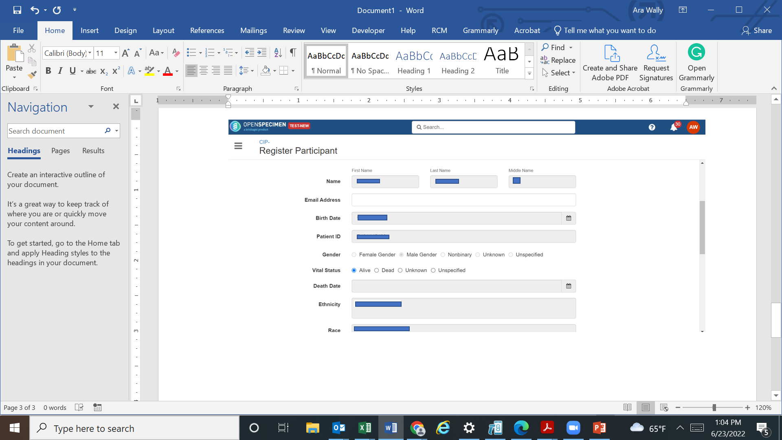

Slide 10
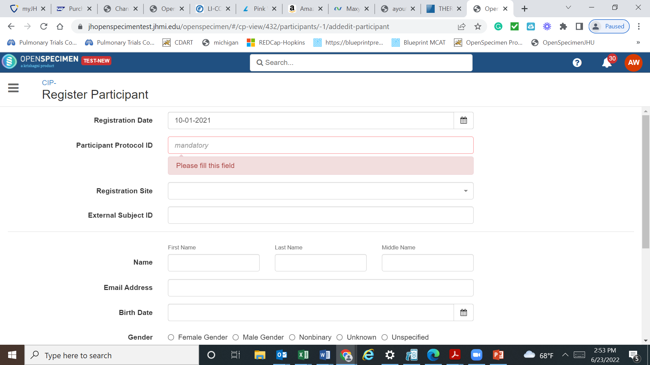

Slide 11
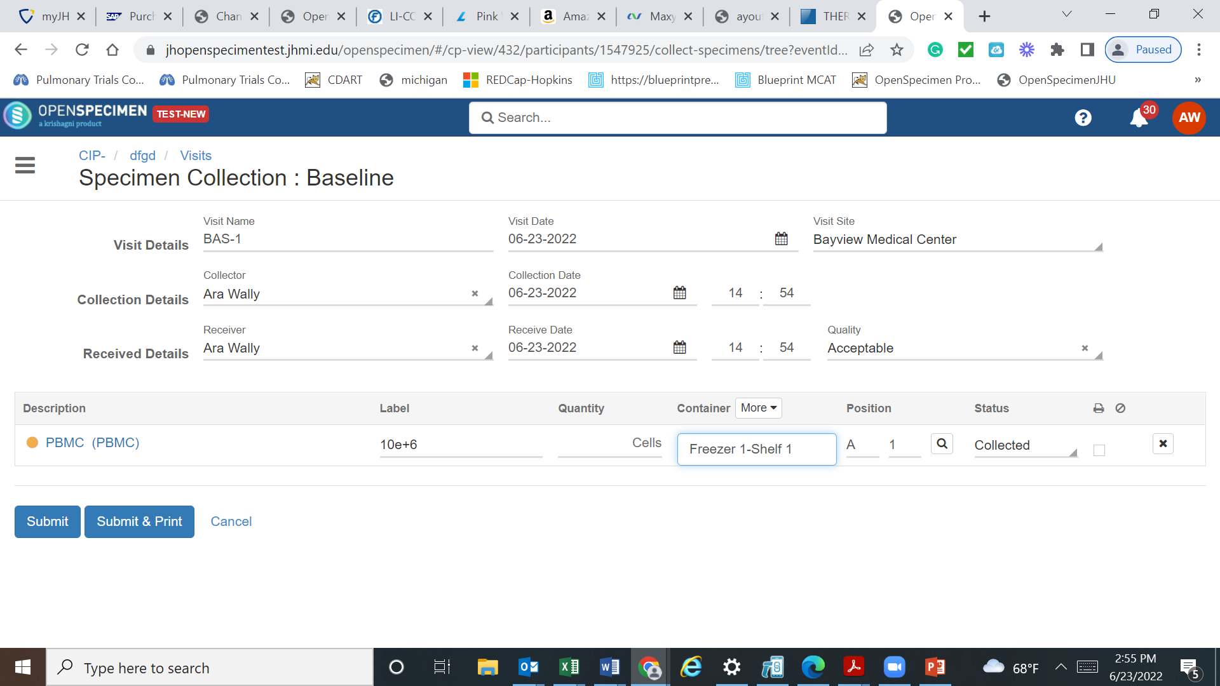

Slide 12
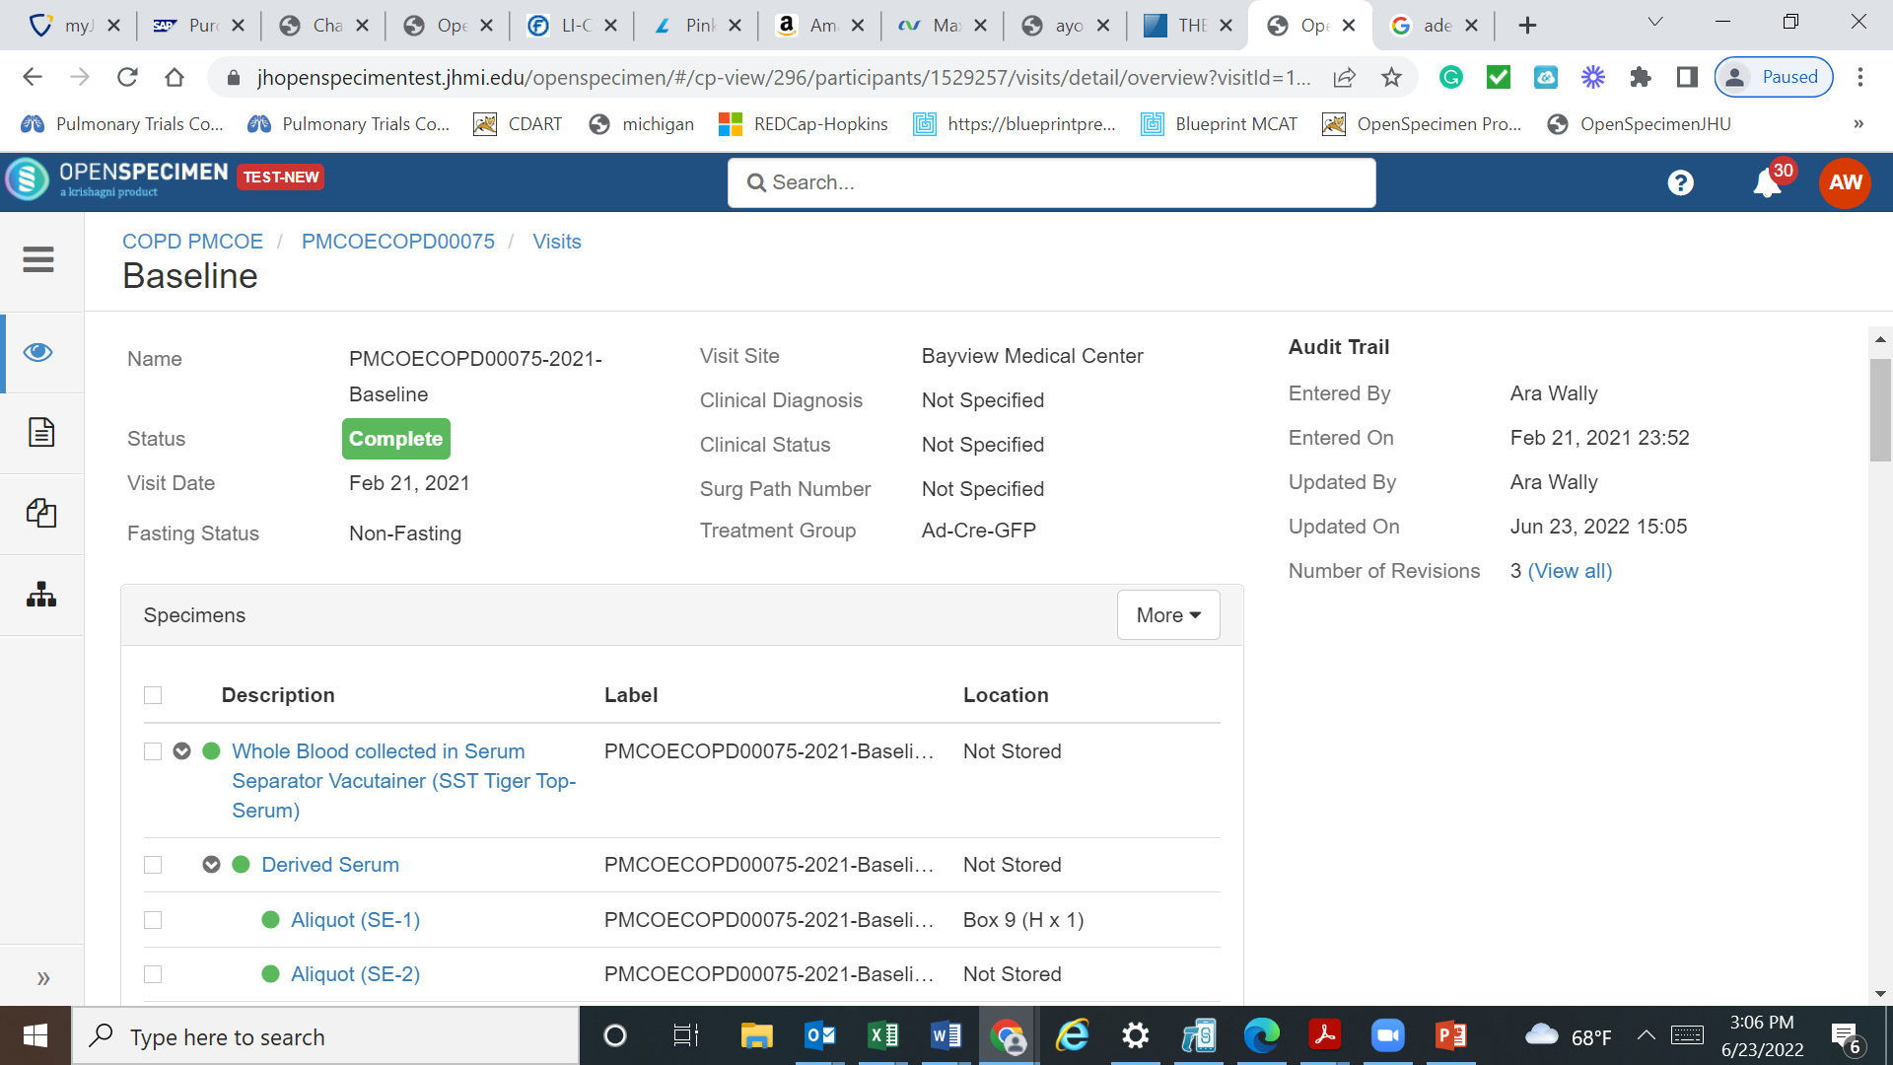

Slide 13
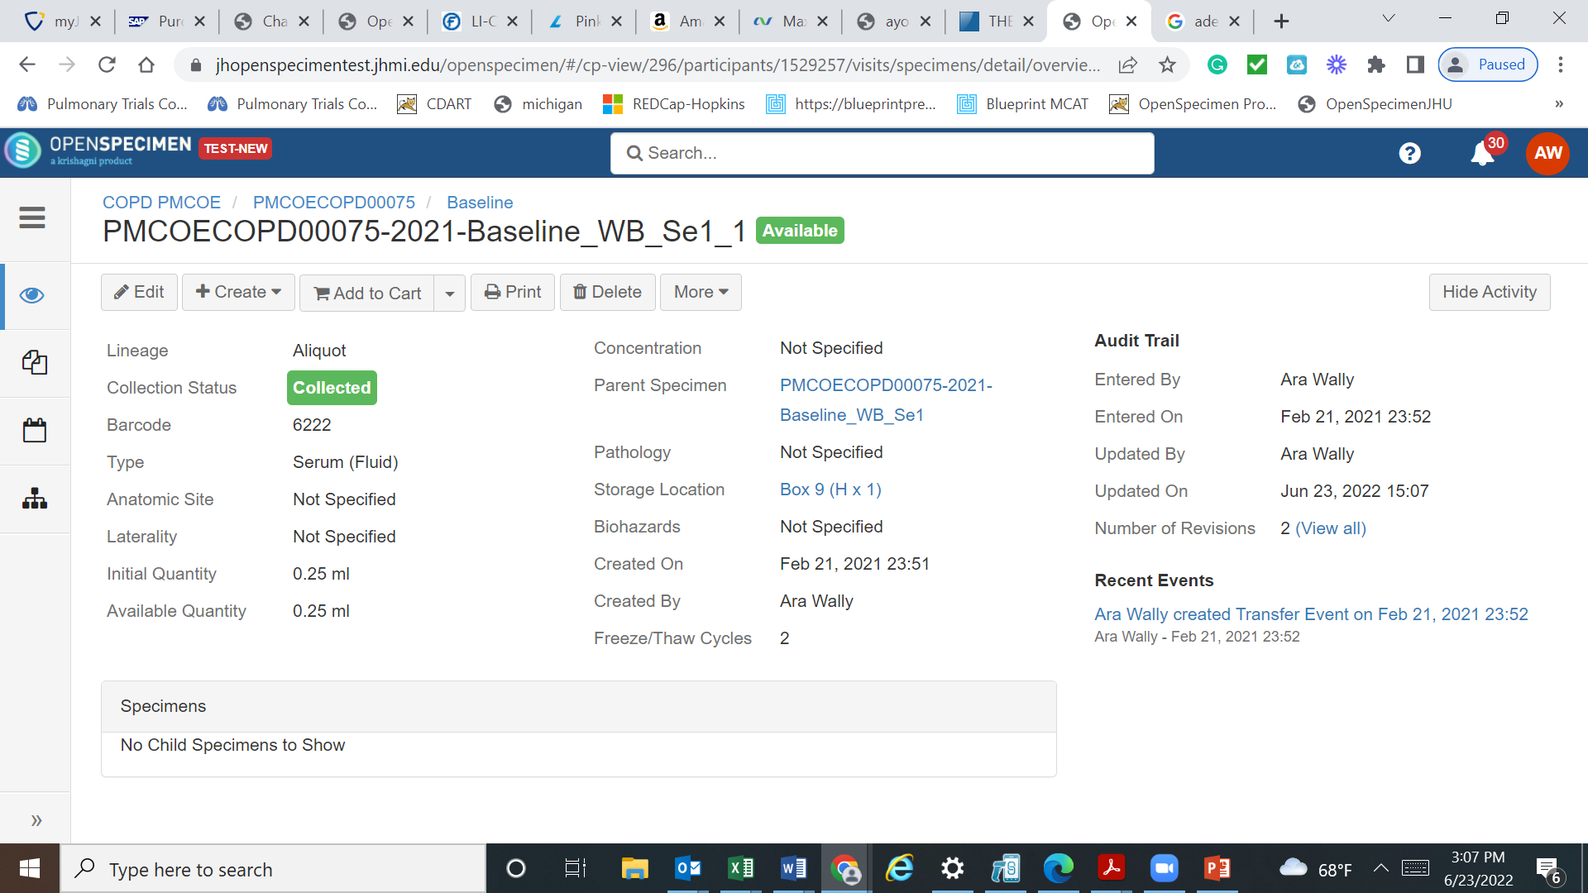

Slide 14
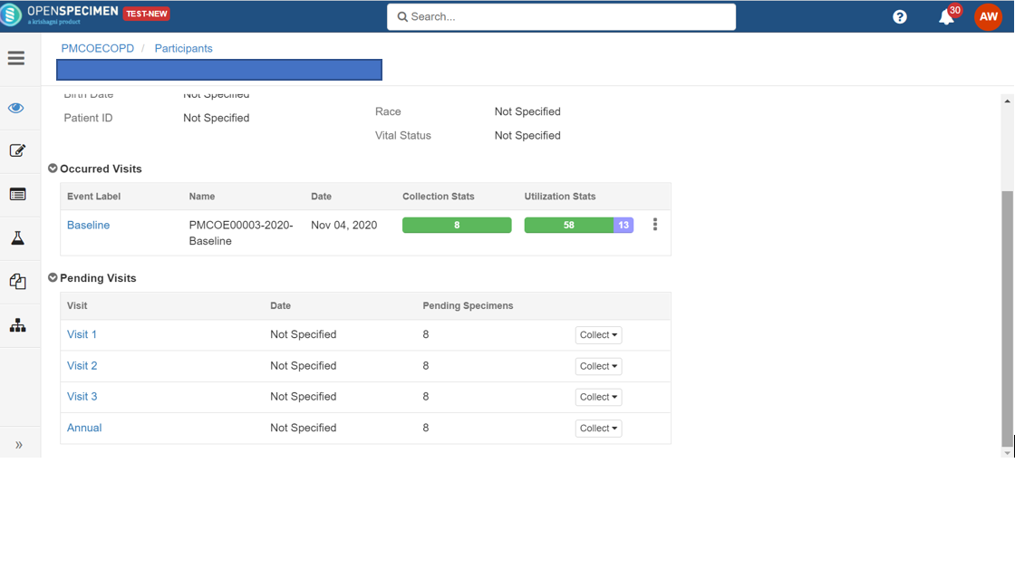

Slide 15
Custom Data Forms and Fields

Slide 16
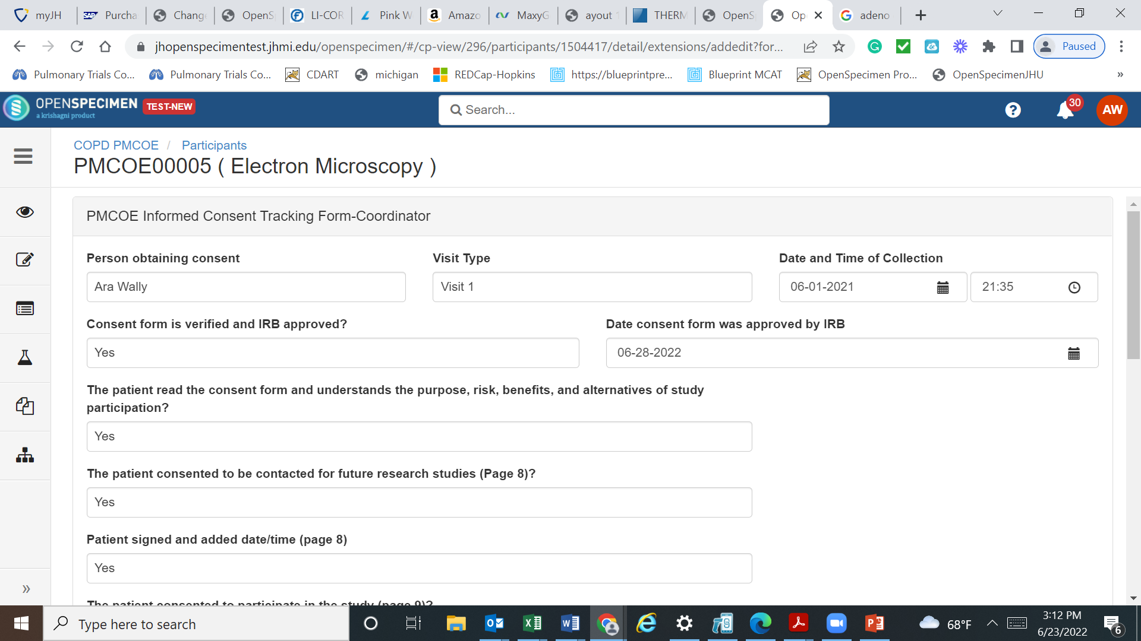

Slide 17
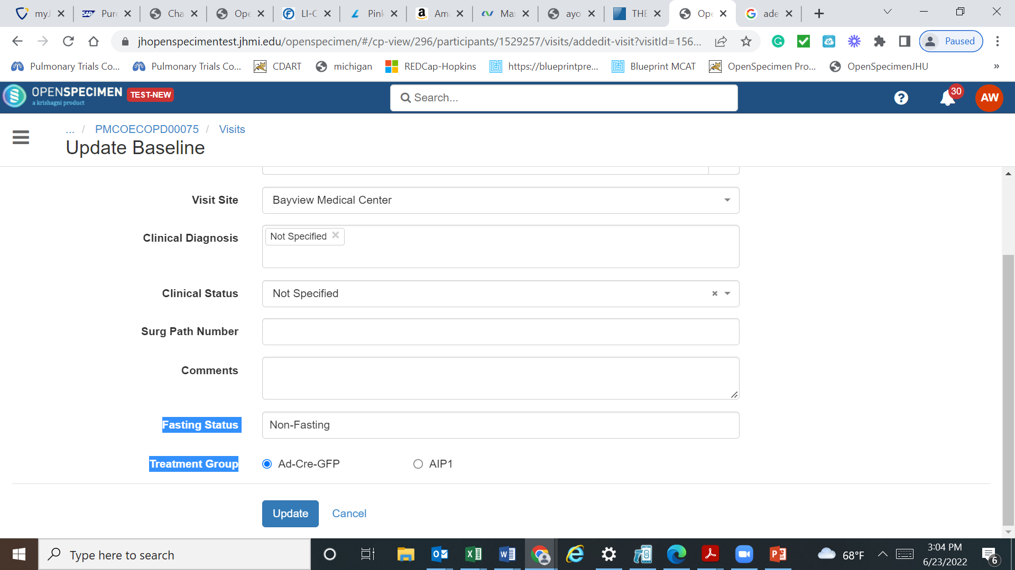

Slide 18
Queries, Data Export, User Roles.

Slide 19
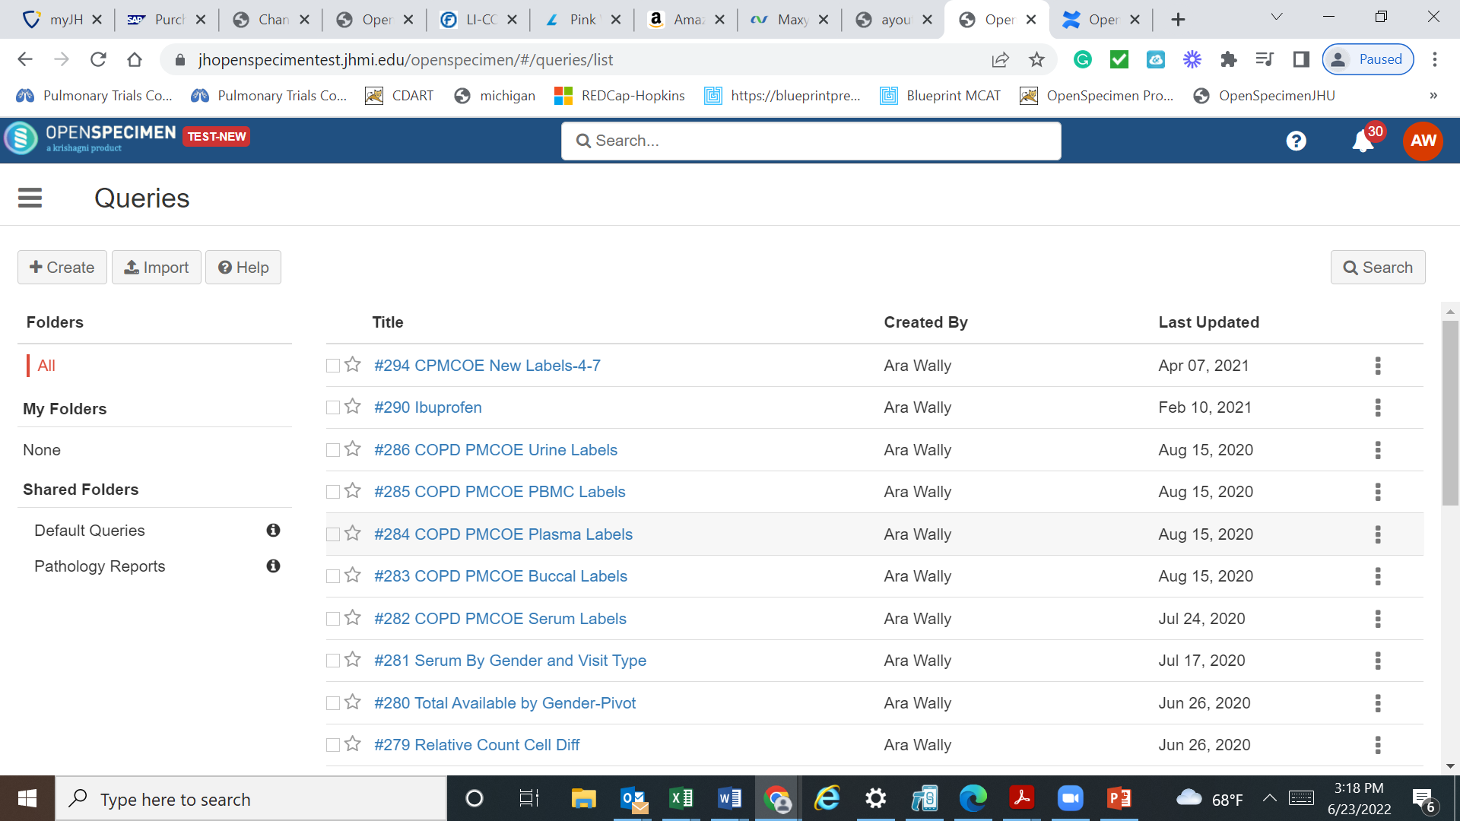

Slide 20
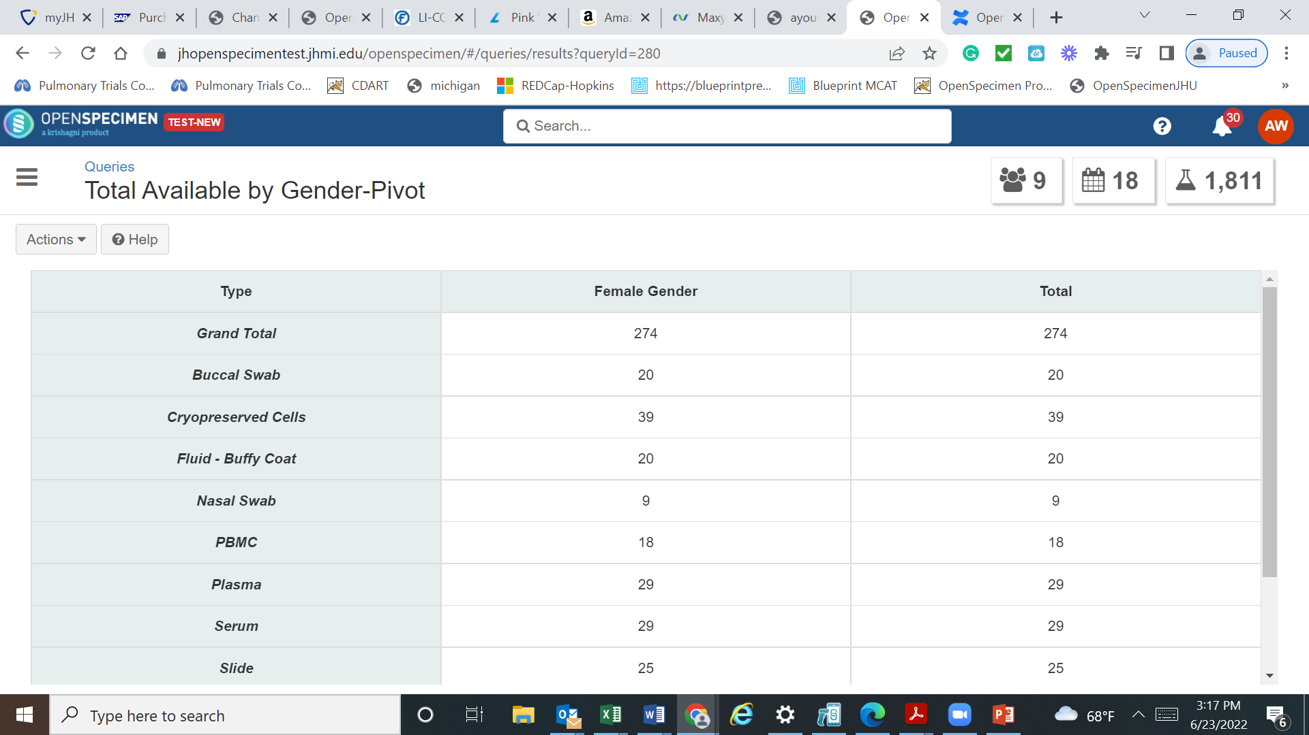

Slide 21
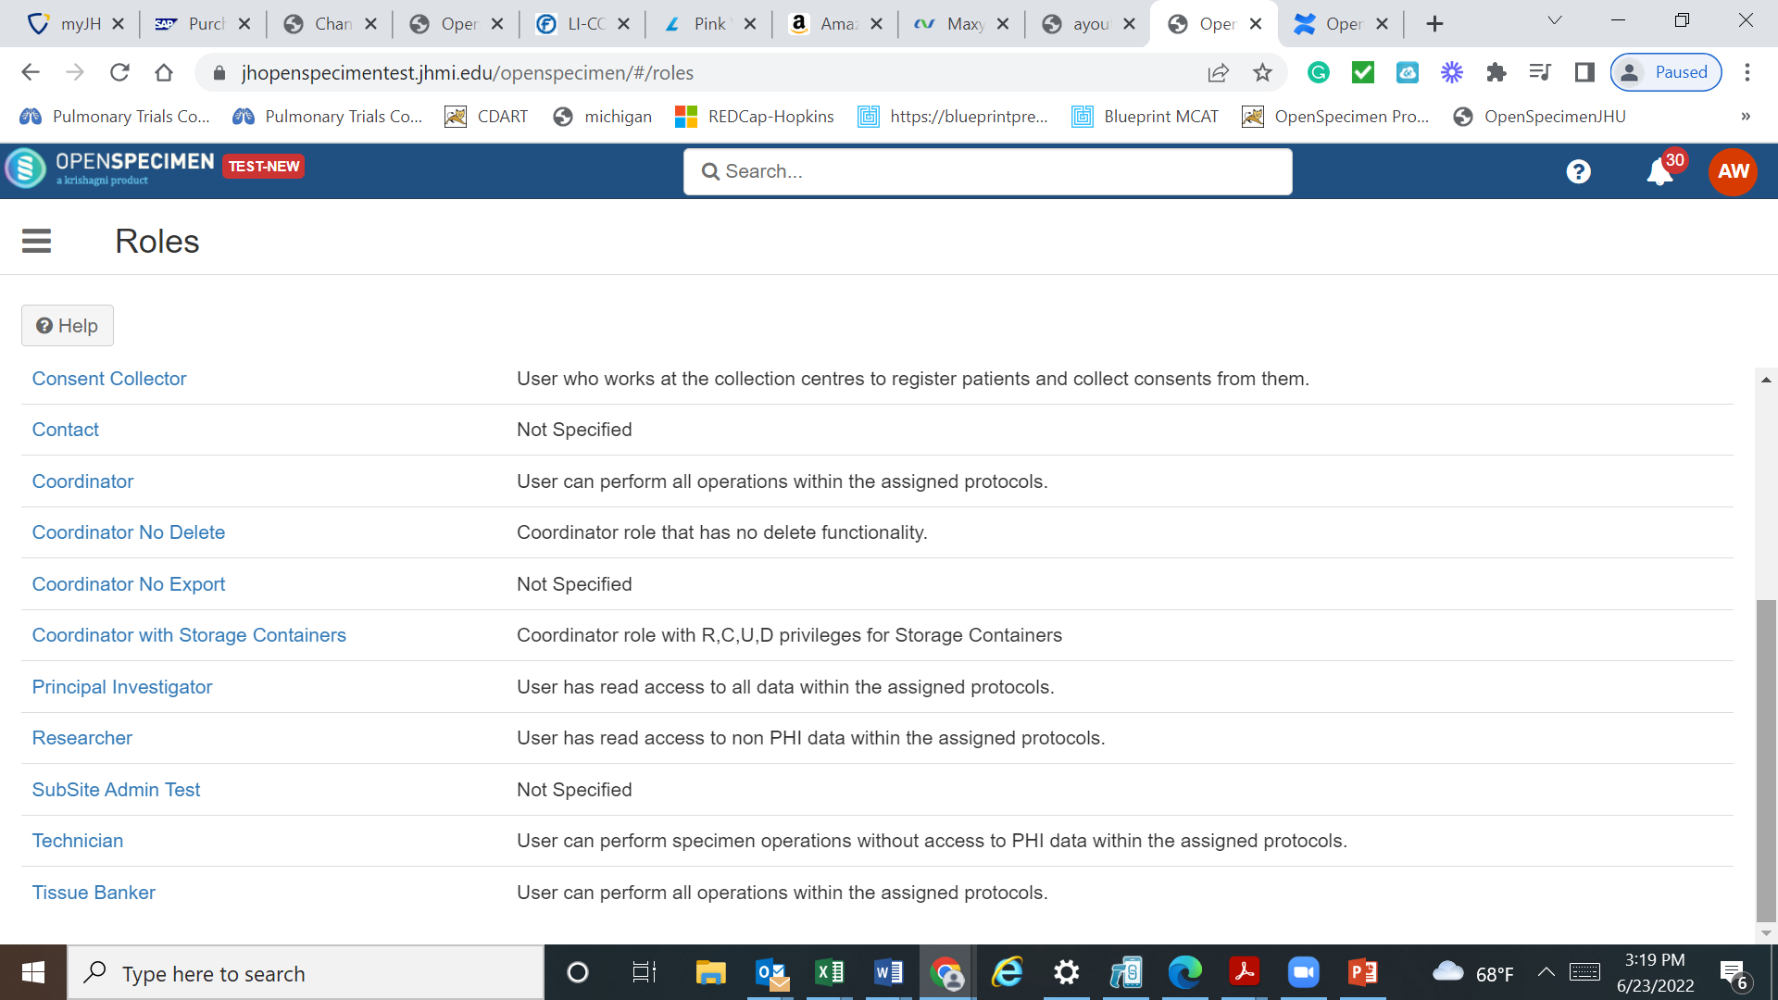

Slide 22
Why OpenSpecimen?
Data Trust preferred biospecimen management system.
Epic patient data lookup.
Specimen and derivative tracking from beginning to end.
User friendly and extensive query and data export capabilities.
Annotation of clinical and specimen data using custom fields and forms.
PMAP interface.
Controlled access of data-JHED and VPN enabled.

Slide 23
Questions

