Slide 1
State of the department 2022
JHU SOM Department of Neurology, 9.15.2022
Justin C. McArthur

Slide 2
Zolgensma™, gene therapy for SMA.
This is the first SMA baby treated at JHH with the gene transfer therapy Zolgensma®.
Born May 31st, on day 7, Tom Crawford was notified that she had SMA (by MD newborn screening). He saw her that afternoon ~ mildly weak but “within normal range”.
Day 14 of life she was substantially weaker, unable to draw her legs up, with signs that her trunk muscles were weakening.
Day 24 by the time of gene transfer (outpatient IV), she couldn’t move her arms from her sides. Cost = $2.3M
By 22 days after dosing, she moves her arms easily. Without therapy, she would likely have died by 4 months.
Day 22 after dosing

Slide 3
Overview
What has happened this year ?
What are we facing in the coming year ?
What is our vision for the department ?

Slide 4
Thank you to all for your resilience and leadership during COVID !!

Slide 5
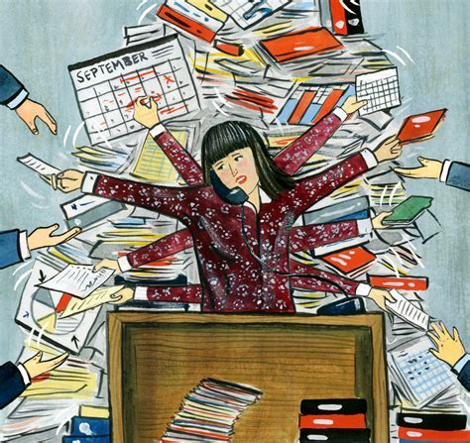
SHOUT OUT TO Administrative team
To Carly Collins and her team for going above and beyond.
Thank you all !

Slide 6
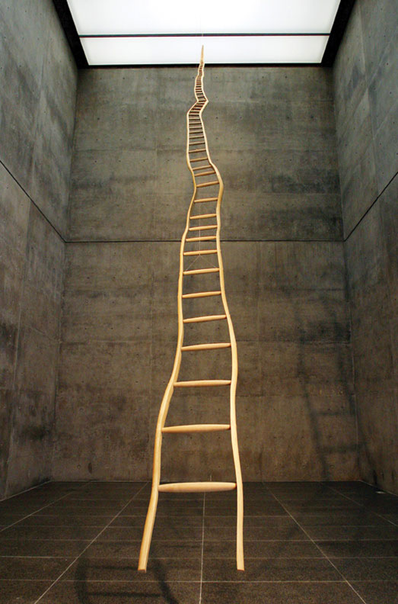
Congratulations to newly promoted faculty !!
Faigle | Romanus | Asso Prof | 10/01/21
Haith | Adrian | Asso Prof | 02/01/22
Urrutia | Victor | Professor | 06/01/22
Soldan | Anja | Asso Prof | 11/01/21
Probasco | John | Professor | 06/01/22
Saylor | Deanna | Asso Prof | 05/01/22
Cervenka | Mackenzie | Professor | 11/01/21
Ko | Han Seok | Professor | 06/01/22
Lee | Gabsang | Professor | 01/01/22
Mao | Xiaobo | Asso Prof | 07/01/21
Nemeth Mertz | Christina | Asst Prof | 11/01/21
Mills | Kelly | Asso Prof | 11/01/21
Lefebvre | Austen | Asst Prof | 07/01/21
Bhargava | Pavan | Asso Prof | 10/01/21
Venkatesan | Arun | Professor | 11/01/21
Lloyd | Thomas | Professor | 07/01/21
Felling | Ryan | Asso Prof | 07/01/21

Slide 7
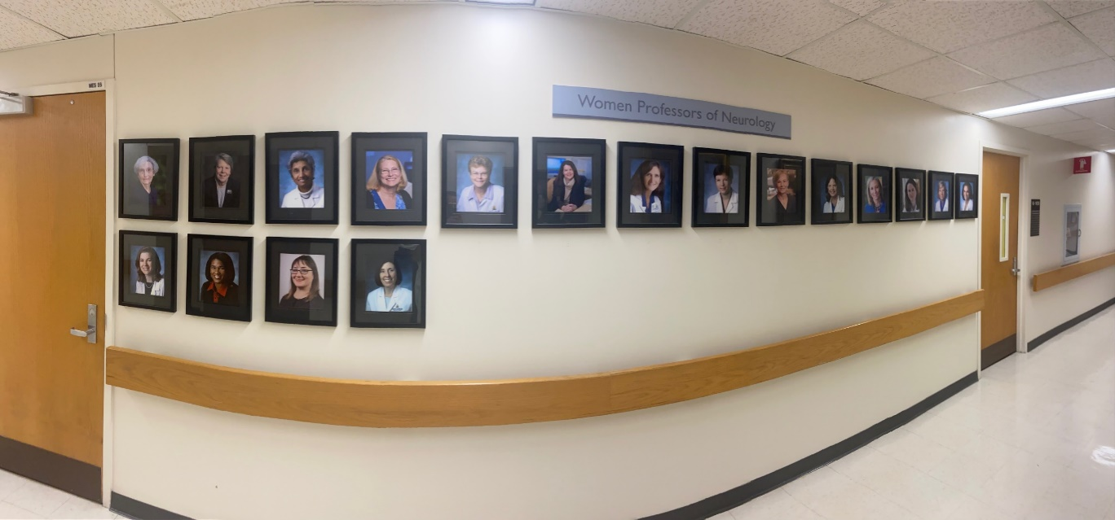
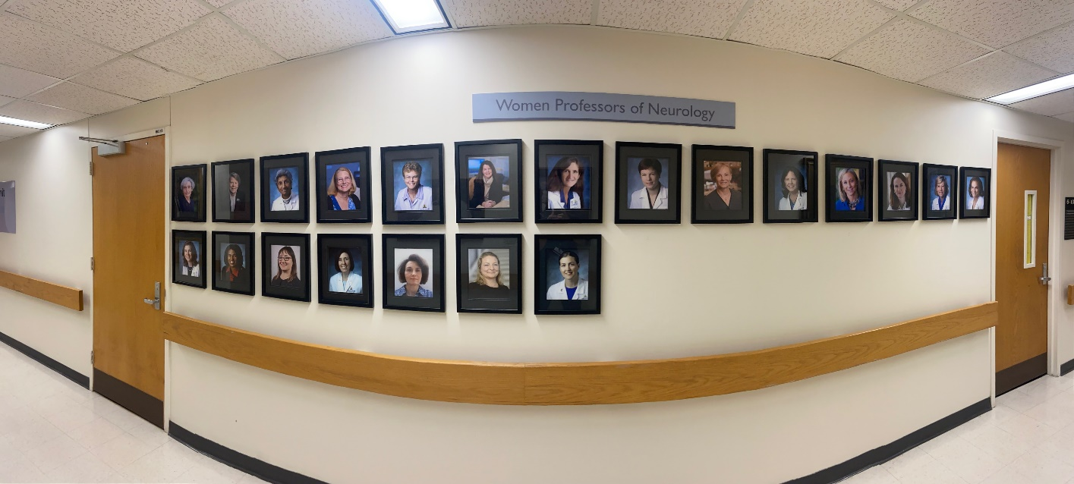
Women Professors of Neurology at JHU
2021
2022
2021 2022

Slide 8
Gottesman, Jordan, Lloyd & Reich elected into ASCI

Slide 9
Congratulations to Ahmet Hoke
PNS awarded him the prestigious Alan J. Gebhart Prize for Excellence in Peripheral Nerve Research for 2022. This award recognizes your ongoing contributions to our mission of “improving the lives of people with peripheral neuropathies”.
Ahmet is also the new editor of ACTN…..and just climbed Kilimanjaro

Slide 10
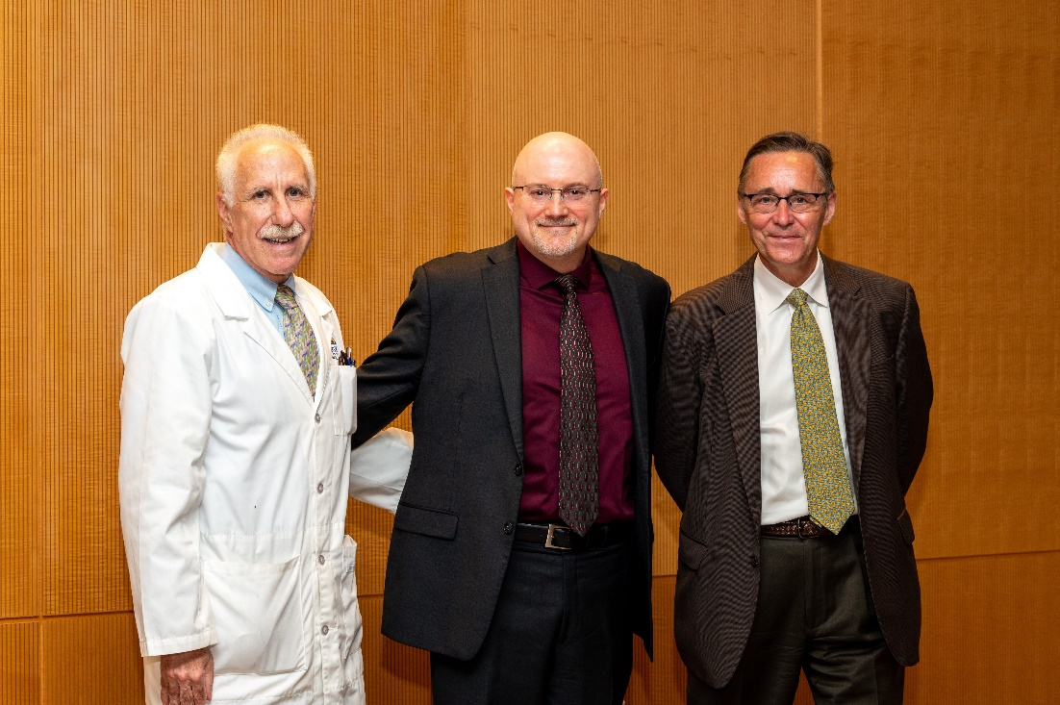
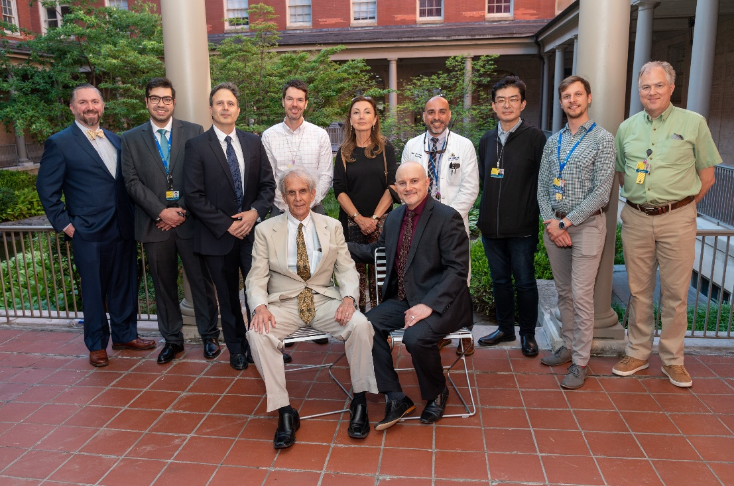
New Endowed Professorships in Neurology
David Robinson Professorship in Vestibular Neurology
Inaugural recipient, David Newman-Toker, MD, PhD, was installed on June 27, 2022

Slide 11
New Endowed Professorships in Neurology
Richard T. and Frances W. Johnson Professorship
Inaugural recipient, Ellen M. Mowry, MD, MCR, will be installed on September 30, 2022, at 4p in Chevy Chase Auditorium (Zayed)
Sheikh Khalifa Stroke Institute Directorship and Professorships
Inaugural recipients, Argye Hillis, MD, Preeti Raghavan, MBBS, and Victor C. Urrutia, MD, will be installed on October 11, 2022, at 4:30p in Chevy Chase Auditorium (Zayed)
Daniel B. and Florence E. Green Professorship in Ataxia
Inaugural recipient, Liana S. Rosenthal, MD, PhD, will be installed on October 12, 2022, at 4p in Owens Auditorium (Koch Cancer Research Building)
Please watch your email for invitations to these upcoming installation ceremonies and receptions, and RSVP accordingly!

Slide 12
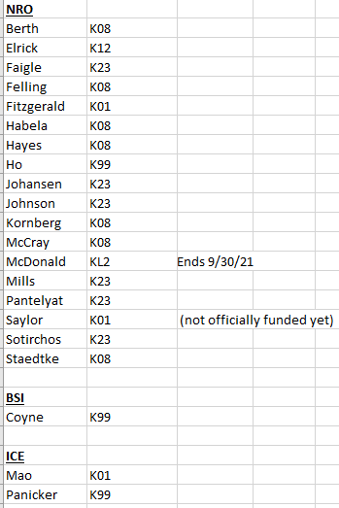
K awards 2021-2022
Departmental
Investment >$500k pa

Slide 13
Congratulations to our graduates

Slide 14
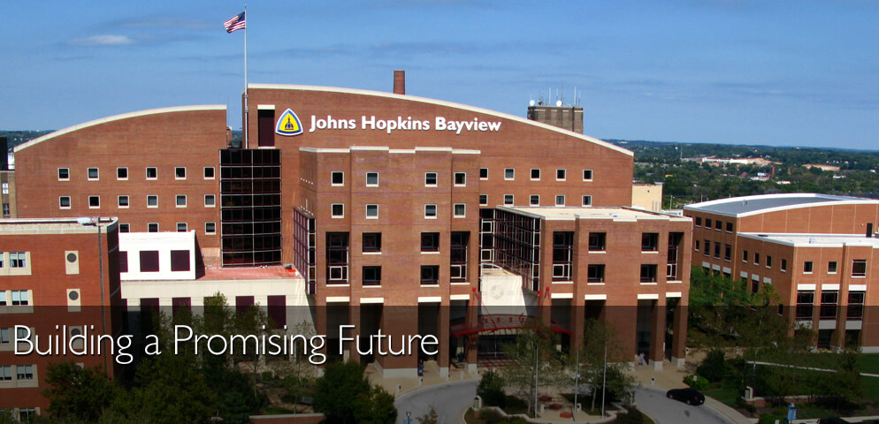
Congratulations on the recognition!
Newsweek recognized Johns Hopkins Bayview Medical Center on both the World's Best Specialized Hospitals and the World's Best Smart Hospitals lists for 2023.

Slide 15
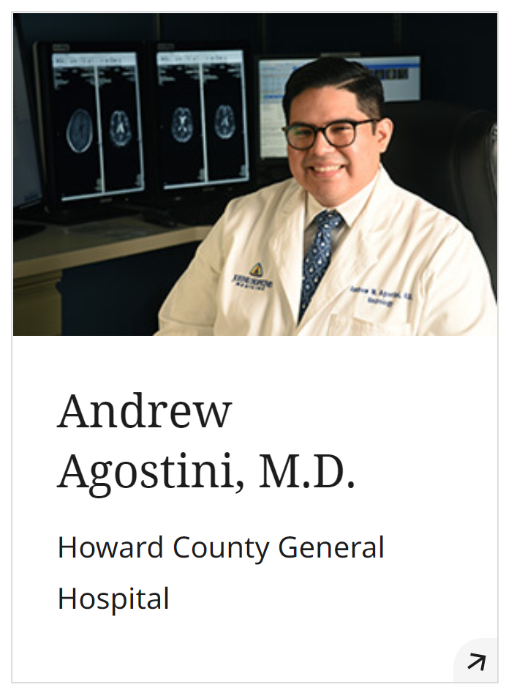
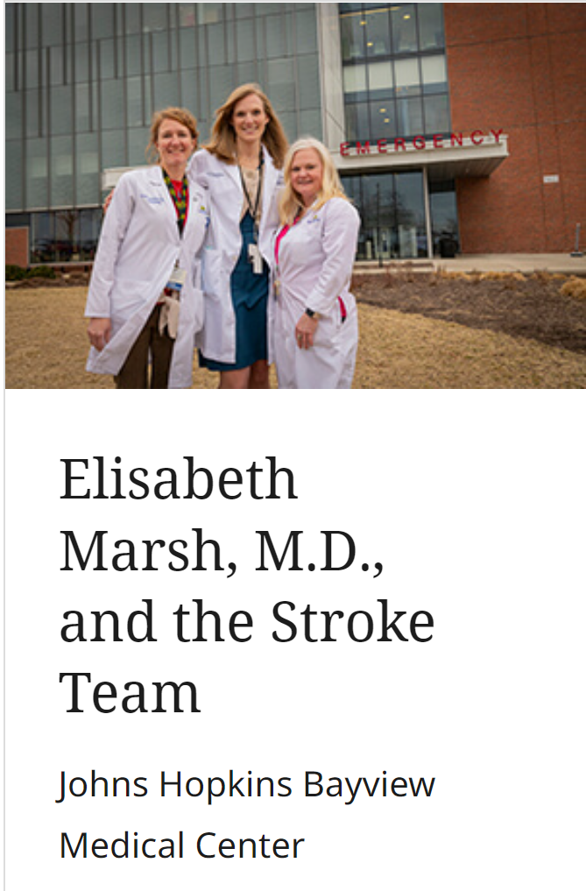
Congratulations to the 2021 winners of the Johns Hopkins Medicine Clinical Awards for Physicians and Care Teams!
Best consulting physician
Armstrong Award for Excellence in Quality and Safety
Innovations in Clinical Care

Slide 16
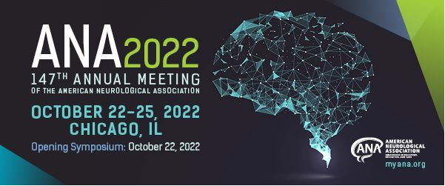
Congratulations to Romer Geocadin and Deanna Saylor
Romer Geocadin ~ 2022 ANA Award for Excellence in the category of Service to the ANA (Discrete Contributions).
Deanna Saylor ~ ANA Distinguished Neurology Teacher Award

Slide 17
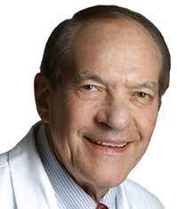
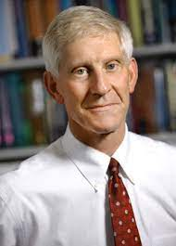
Retirees this year
Daniel Drachman MD David Cornblath MD

Slide 18
Faculty hires this year
Thanks to our admin who makes this happen !
Augustine | Erika | KKI | Asso Prof PAR
Chin | Eric | KKI | Asst Prof
Serra | Carlo | Neuromuscular | Res Asso
Sharp | April | KKI | Asst Prof
Smith | Clay | KKI | Asst Prof
Tallon | Carolyn | BSI | Res Asso
Zhu | Yuxin | Neuro-Visual & Vestibular | Asst Prof
Morris-Berry | Christina | KKI | Asst Prof
Asato | Miya | KKI | Professor PAR
Chua | Jason | Movement Disorders | Asst Prof
Shah | Vishank | NCCU | Asst Prof
Marashly | Ahmad | Pediatric Neurology | Asst Prof
Smith | Matthew | Neuroimmunology | Res Asso
Smith | Derek | Cognitive Nro | Res Asso
Boyce | Danielle | BSI | Asst Prof
Khan | Mohammed | ICE | Res Asso
Stockbridge | Melissa | Cerebrovascular | Res Asso
Deme | Pragney | Neuroimmunology | Res Asso
Ho | Margaret | Sleep Disorders | Res Asso
Rosner | Karli | Neuro-oncology | Asst Prof
Bowen | Meredith | Comprehensive Neurology | Asst Prof
Coyne | Alyssa | BSI | Asst Prof
Galleguillos Caro | Danny | Neuroimmunology | Res Asso
Haridas | Babitha | Epilepsy | Asst Prof
Mohassel | Payam | Neuromuscular | Asso Prof PAR
Mukherjee-Clavin | Bipasha | Neuromuscular | Asst Prof
Murphy | Olwen | Neuroimmunology | Asst Prof
Sung | Hyun | Neuromuscular | Res Asso
Gupta | Siddharth | Epilepsy | Asst Prof
Graley | Christina | Headache | Asst Prof
Zhang | Xi | Neuromuscular | Res Asso
Fisgin | Aysel | Neuromuscular | Res Asso
Paul | Ashley | Movement Disorders | Asst Prof
Gharagozloo | Marjan | Neuroimmunology | Asst Prof
Kamkwalala | Asante | Neuroimmunology | Res Asso

Slide 19
Congratulations to……
Great match results for 10 adult and 4 pediatric residents
Eric Aldrich: AAN AB Baker teaching award
Mohamed Farah received a 4th percentile on an R21 grant
Liz Marsh received her RO1
Marilyn Albert received a score of 10 on her T32 renewal
Kelly Mills received an R21
DNT received a $4m grant
Carlos Pardo received an RO1 for neurosarcoidosis
….and many others !
PS….thanks to our hard-working IGRG !

Slide 20
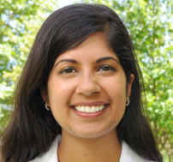
CONGRATULATIONS!
Dr. Ashley Paul has been
NOMINATED to the
Distinguished Teaching Society of JHU School of Medicine

Slide 21
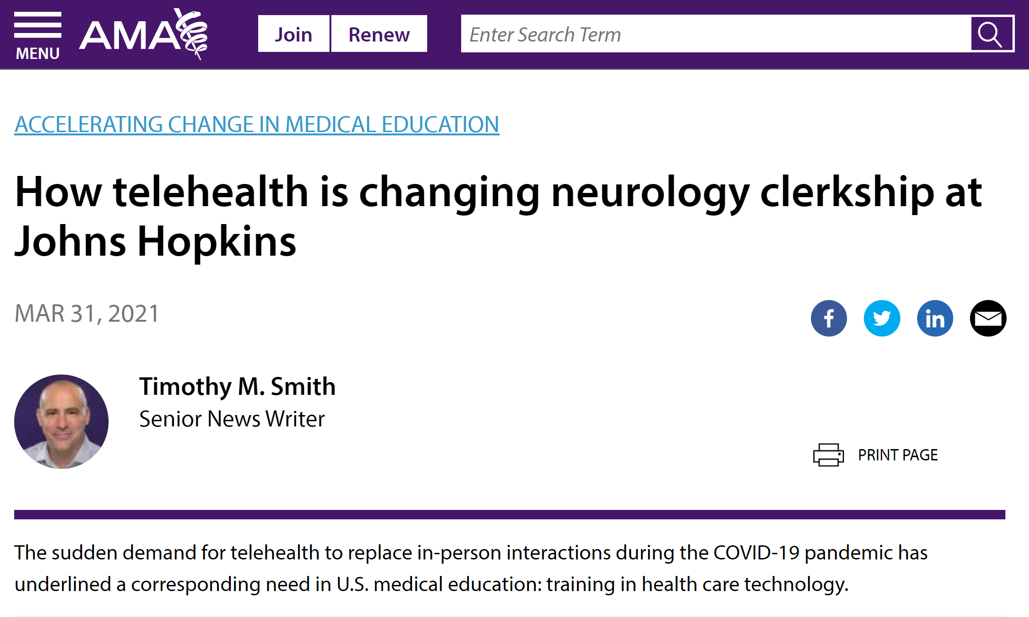
Kori Porosnicu Rodriguez MS3 won an AMA Health Systems Science Trainee Challenge and was invited to be interviewed for a podcast about the Neurology elective we did last year when covid hit.

Slide 22
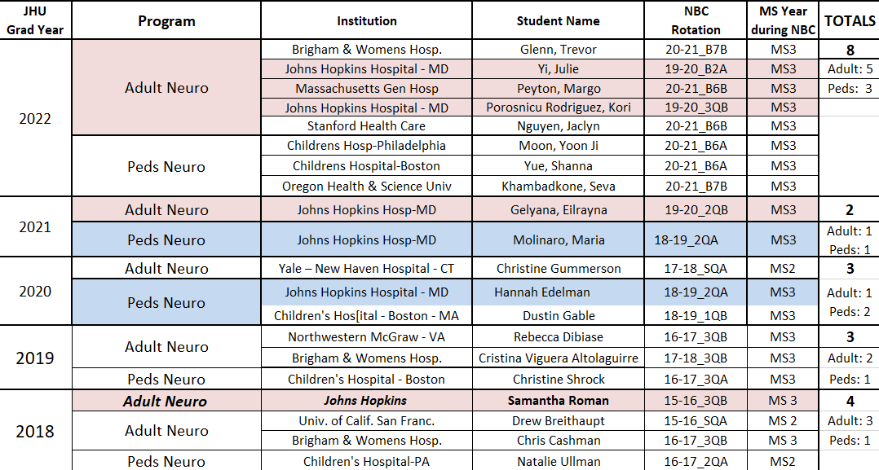
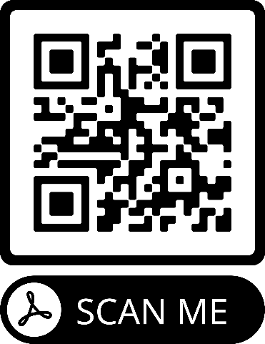
Best Year Ever for Neurology at Hopkins! 2022 SOM Match
We had 8 students (4 of which our Osler Apprentices (OAs) in Neurology) match in Neuro this year. Two of the OAs matched in Hopkins Neuro. Eight is the highest number of matching students in Neurology in the history of the clerkship
JHSOM Grads going into Neurology Residency Programs

Slide 23
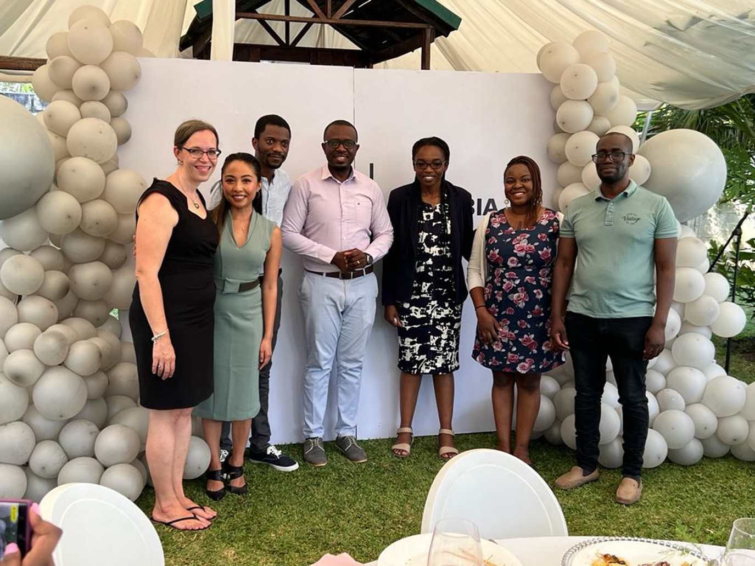
Deanna Saylor and graduating class of residents at UTH, Lusaka

Slide 24
Congratulations !
David Hale and Chris Latimer
Miller Coulson Academy of Clinical Excellence (MCACE) ~ winners of the Frank L. Coulson, Jr. Award for Clinical Excellence.

Slide 25
NAM inductees (10 from JH of 100)
Ted Dawson
Jessica Gill (BDP)
Pablo Celnik (PMR)

Slide 26
Neurology Research Retreat 2022
“Connect and Synergize”
SAVE THE DATE
November 7, 2022
Mountcastle Auditorium
Please join us to reconnect with colleagues IN PERSON!
Interactive voting for best posters and talks!
2022 Organizing Committee
Justin McArthur
Norm Haughey
Charlotte Sumner
Alyssa Coyne
Stay tuned for more information!

Slide 28
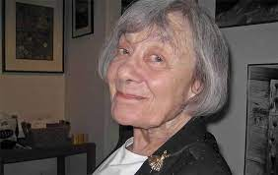
Pamela Talalay PhD in memoriam
Pamela Talalay, a former faculty member in our department, passed away on August 23rd at the age of 93. She was a brilliant editor of grants and manuscripts for innumerable faculty and fellows, and influenced the careers of many. Many patients have benefited from the research work that she played such a pivotal role in developing. She was a true unsung hero and we will forever be in her debt.
On a personal level we all loved interacting with Pamela. She was so kind and had a gentle touch with her editorial red pen.
She was married to the late Paul Talalay from the Department of Pharmacology.

Slide 29
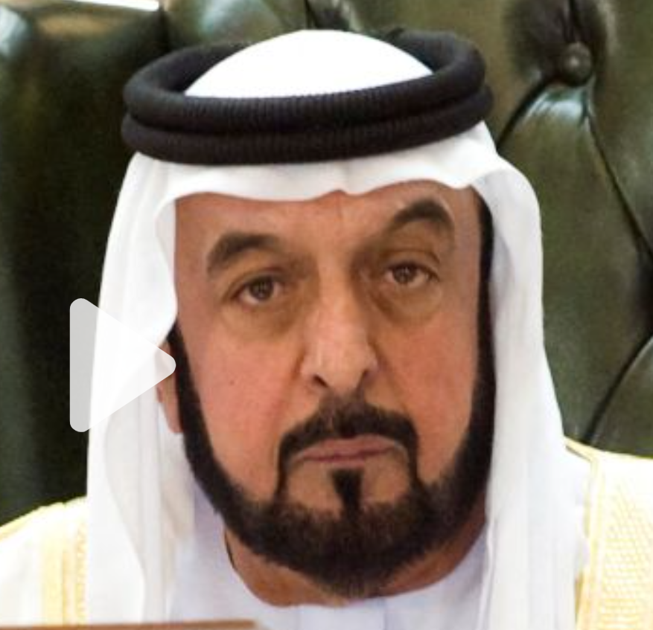
Sheikh Khalifa bin Zayed Al Nahyan, the United Arab Emirates President whose modernization policies helped transform his country into a regional powerhouse, died in May aged 73.
We are grateful for his very generous support of the Sheikh Khalifa Stroke Institute.

Slide 30
https://www.youtube.com/watch?v=OSRTK_-KywE

Slide 31
Time for transformation
At a time when support for basic and translational science needs a strong voice and the burden of neurological disease is growing, the ANA is the champion of neurological research and the ally of all physicians and scientists who strive to make a difference through careers that combine discovery, education, and clinical care……..we are challenging this organization to be the champion for ALL

Slide 32
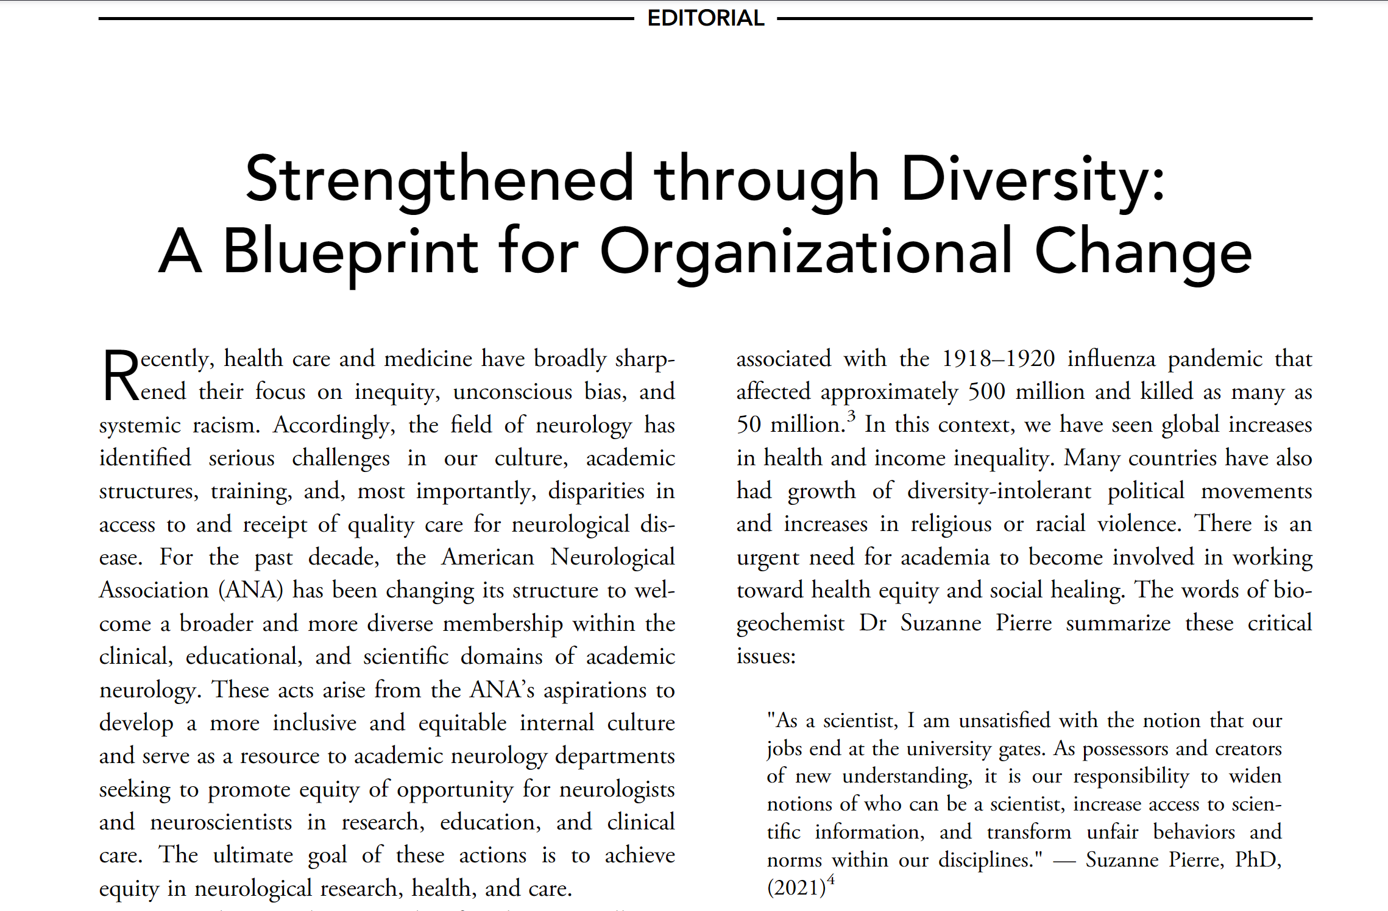

Slide 33
We exceeded our budget target in FY22

Slide 34
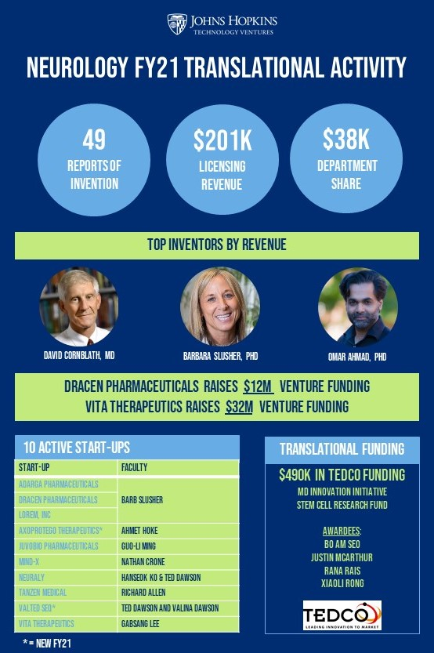

Slide 35
Neurology’s development team

Slide 36
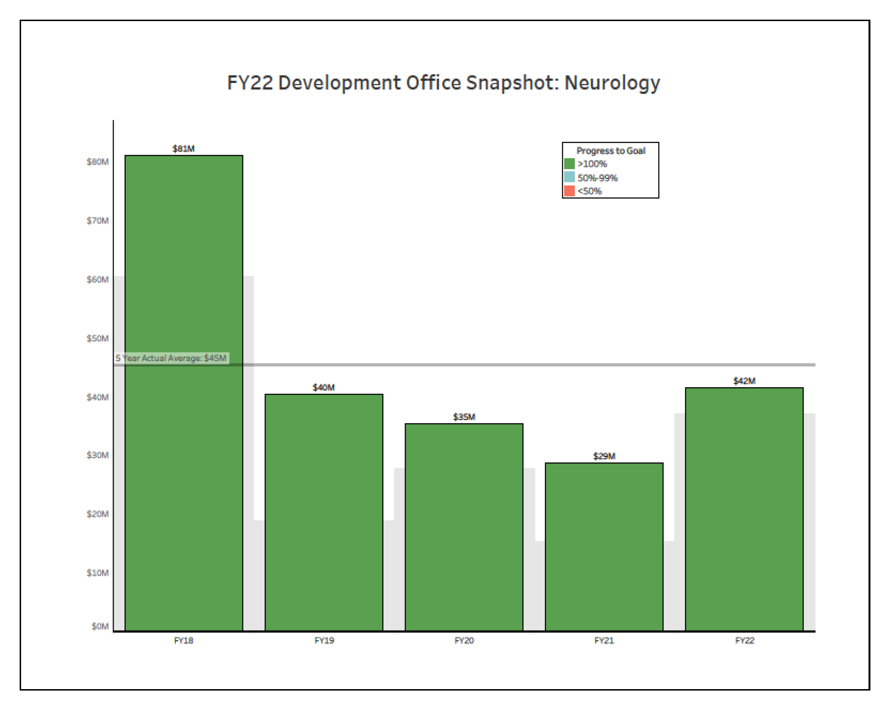
Neurology development: gifts and pledges

Slide 37
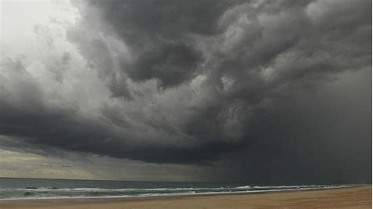
Financial challenges that we face….
Carefirst negotiations
Financial transformation
Funds Flow reboot
Slow ramp-up of clinical services in NCR
Faculty & staff compensation

Slide 38
December 5th is potential date for JHM moving “out of network”

Slide 42
A huge thank you to Carly, Heather S, Heather C, David, and many others
1,000 accounts !

Slide 44
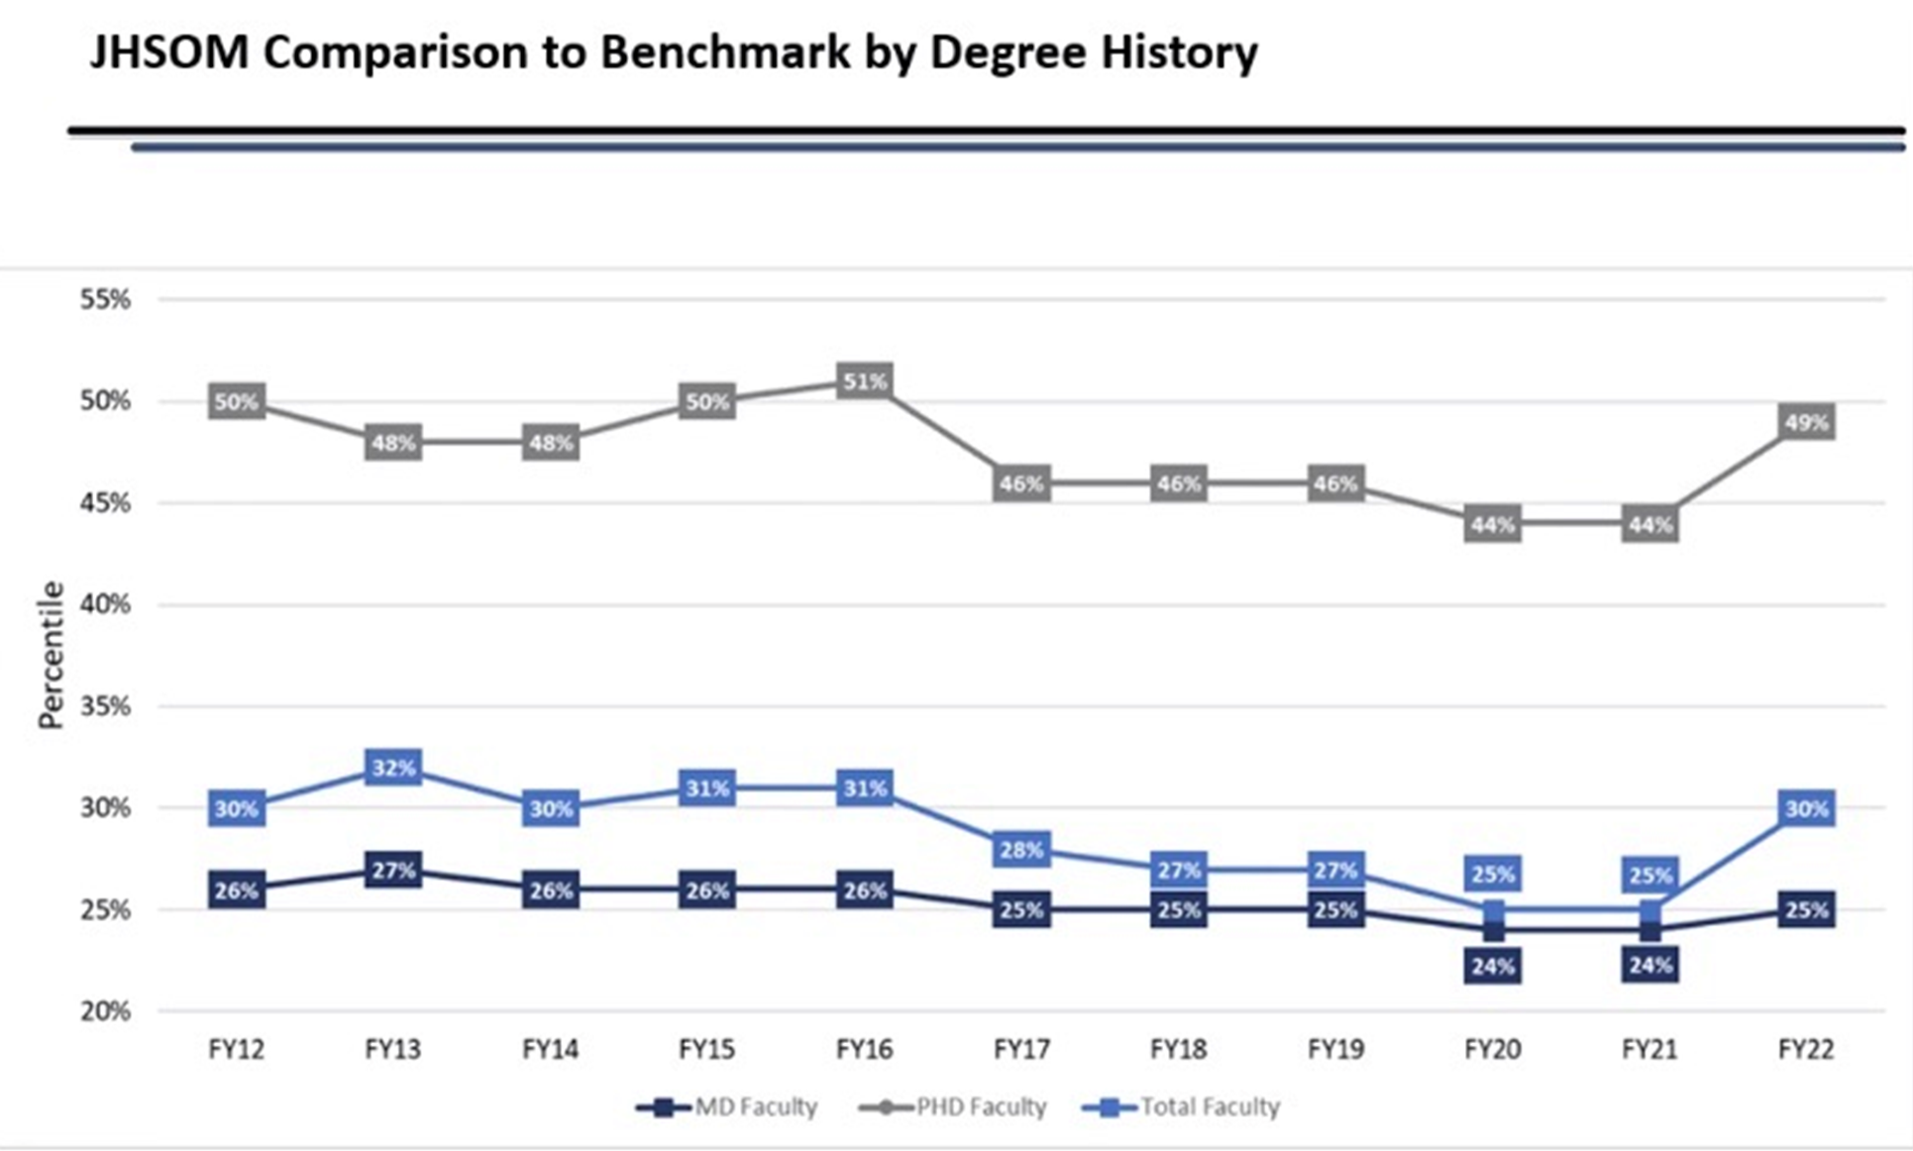

Slide 45
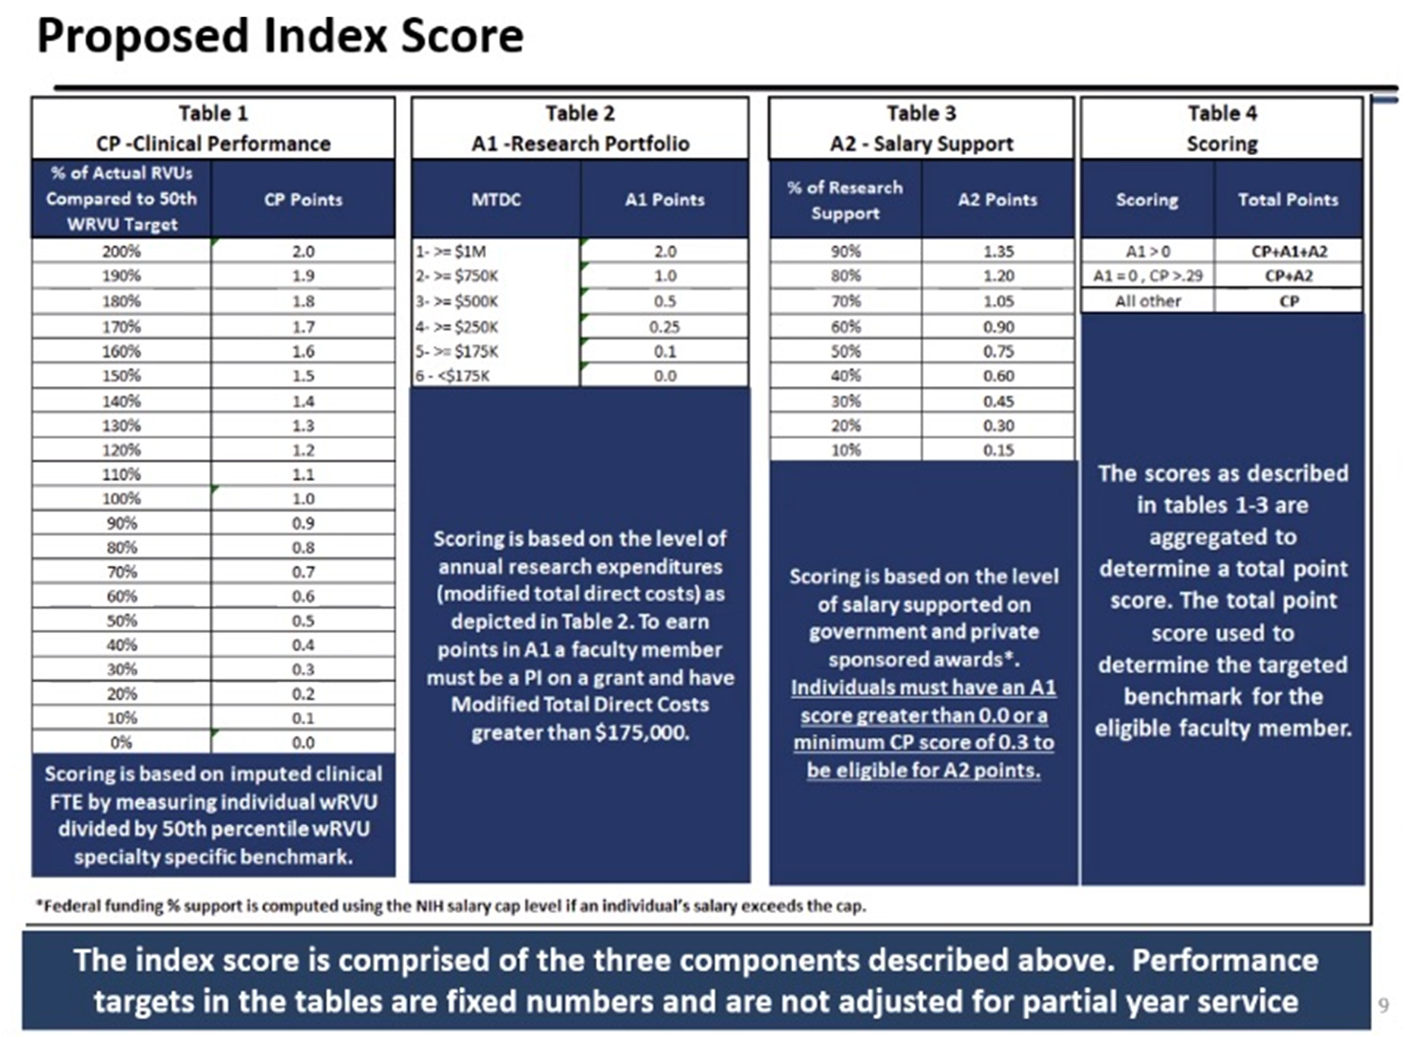
Plans to increase compensation
3% x 3 2022/23
Bring JHU SoM faculty to median 40^{th%} AAMC
Revamp compensation plans for each department
Develop clinical and research “productivity” supplement

Slide 46
SoM financial transformation
Over next few months will audit all accounts across SoM
Working with Huron and Chartis on funds-flow revamp
Various working groups
Working with each department on deficits that roll up to SoM
Continuing plans for revised comp plans + supplemental payments based on clinical/research productivity
Continuing with plans for CMSC renovation

Slide 47
Vision for Neurology

Slide 48
Leadership changes
Vice-chair for physician-scientist development ~ Michael Kornberg
Vice-chair for clinical research ~ Charlotte Sumner

Slide 49
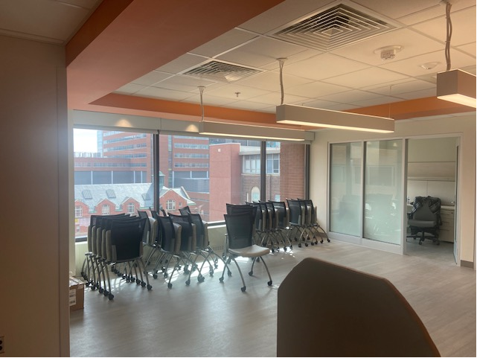
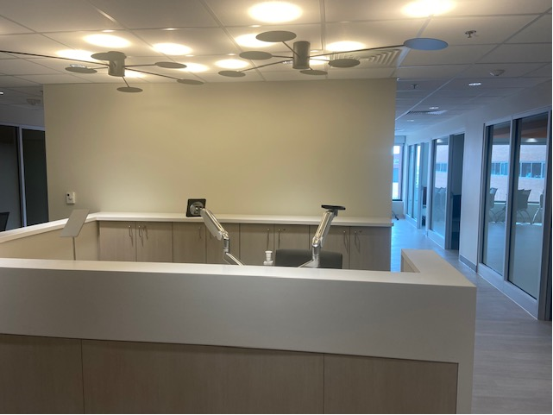
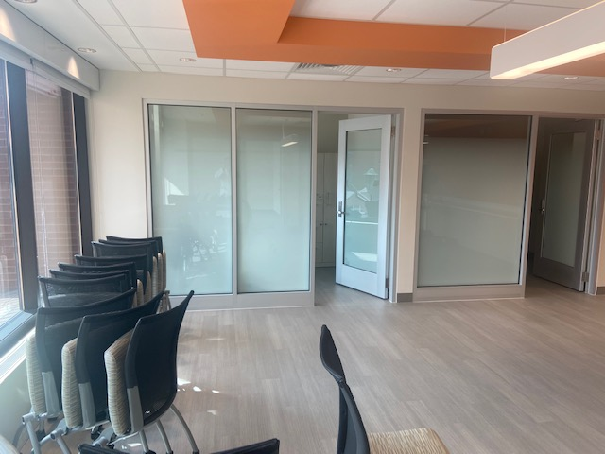
NTAP Center/Neuro-oncology ~ Meyer 8

Slide 50
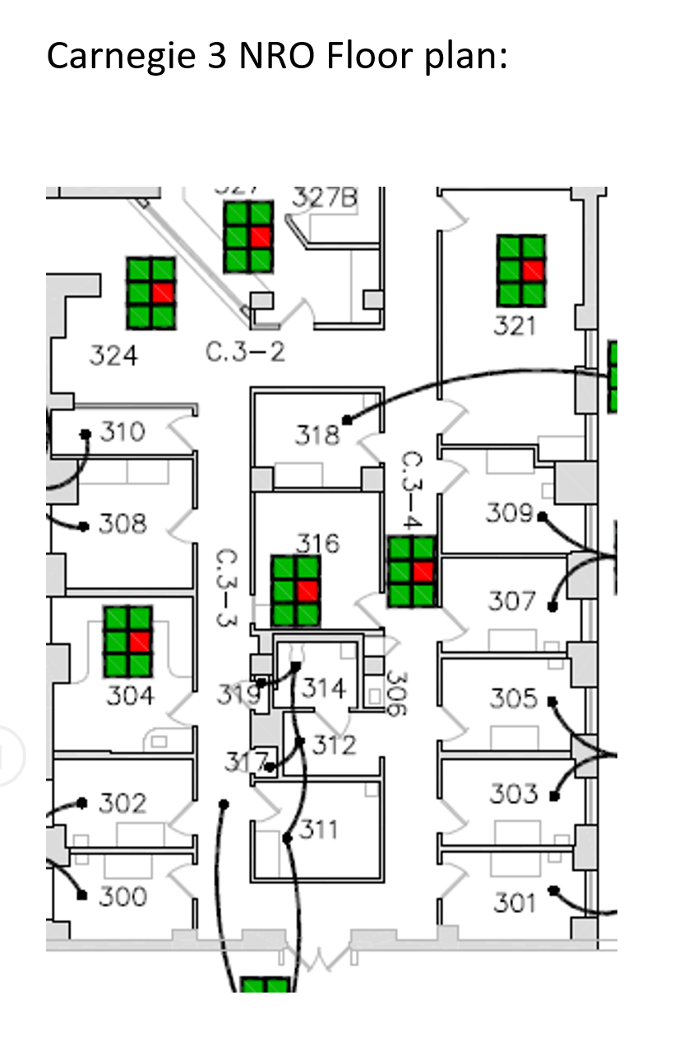
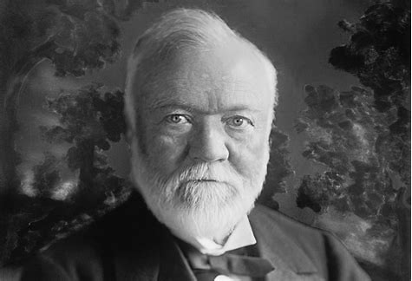
Carnegie 3 space

Slide 51
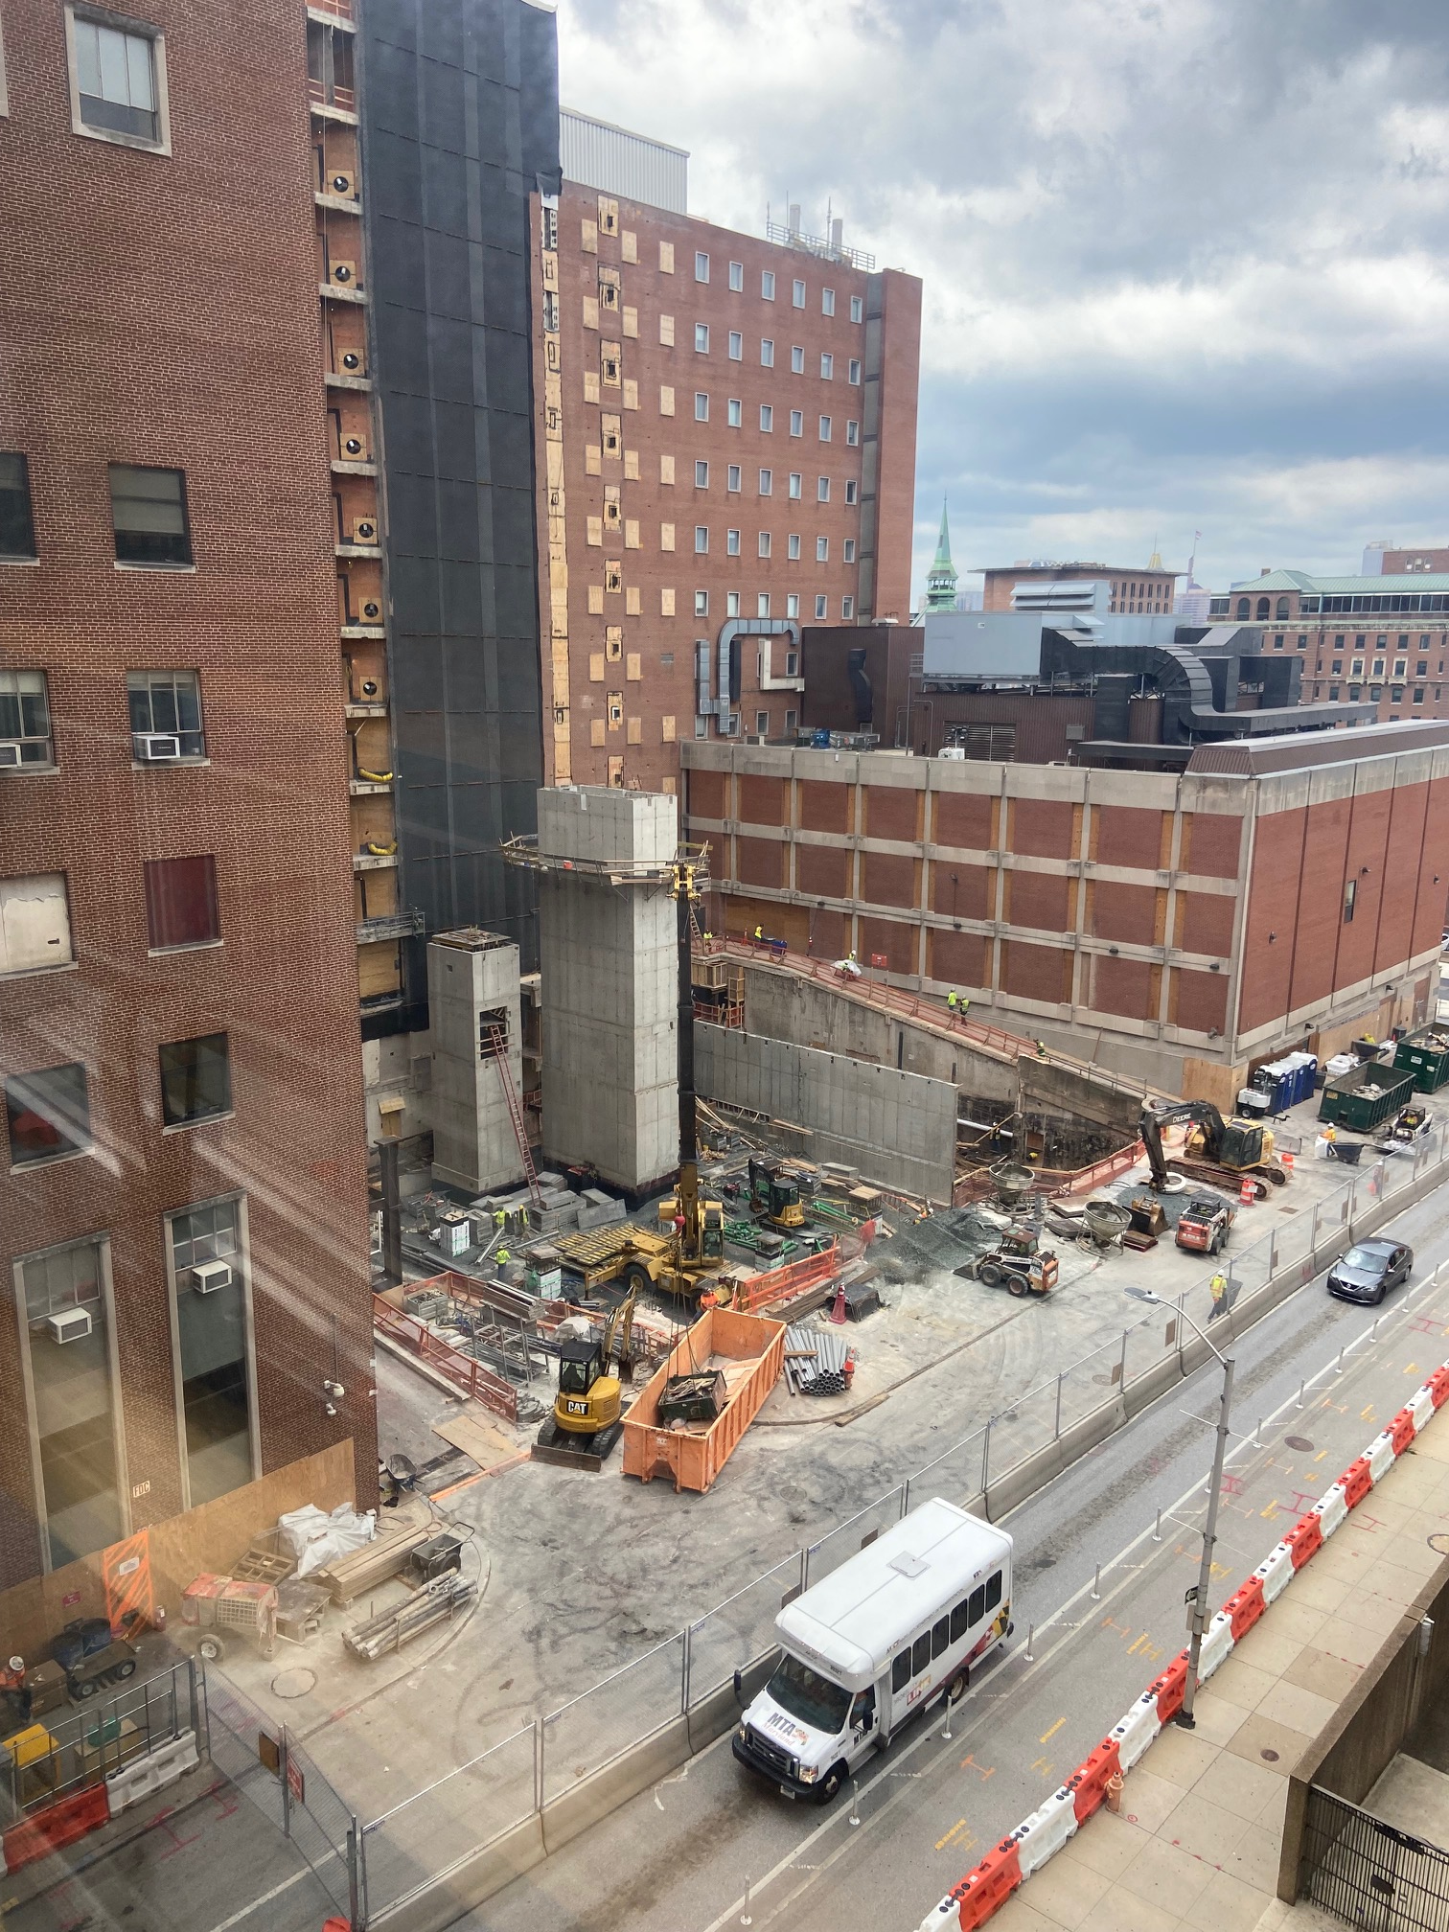
North Tower Addition

Slide 52
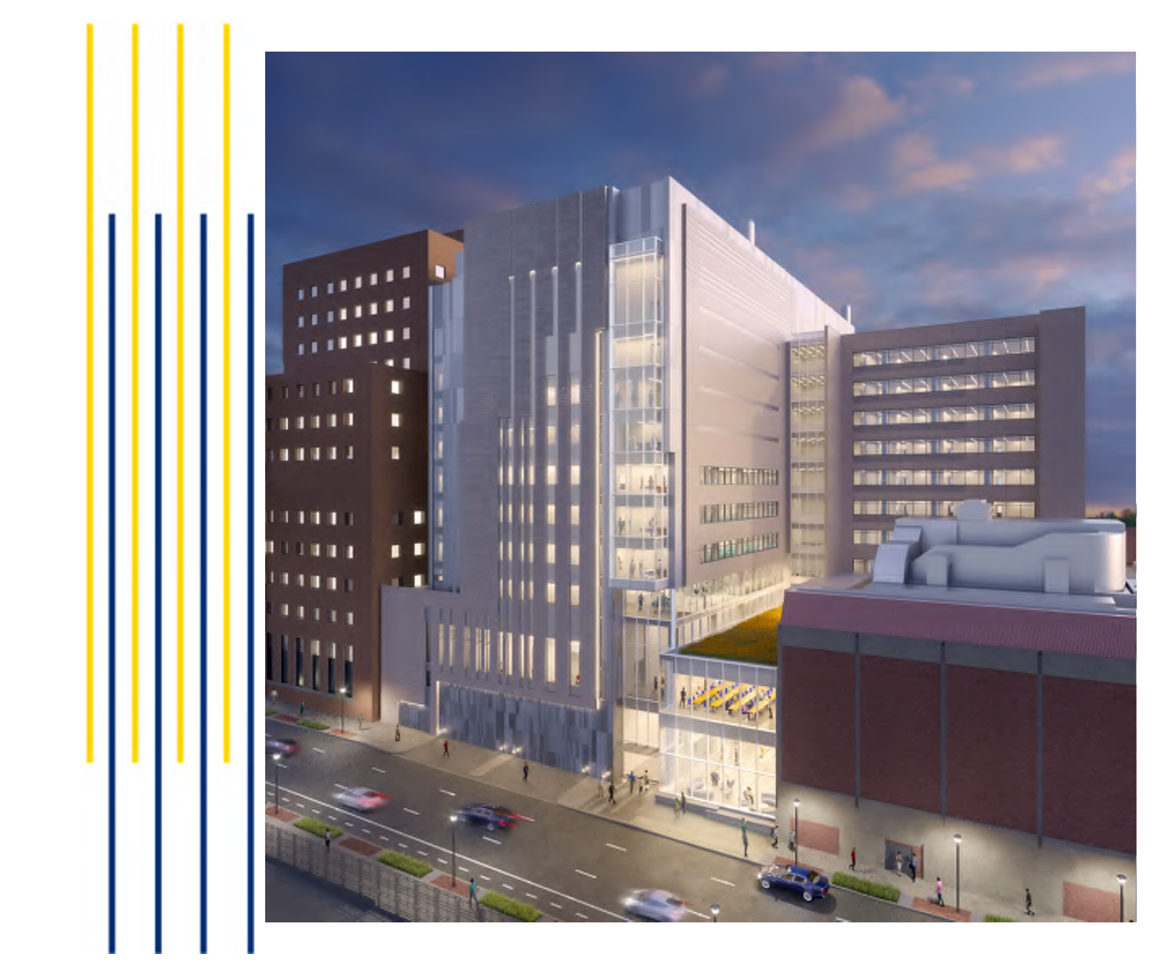

Slide 53
Summary of challenges and view ahead
Grow leadership capability within the department with the aim of effective succession planning.
Push for a realistic compensation plan for faculty and staff.
The development of business plans for faculty must be subsidized from the JHHS and CPA if accessible neurology services are required.
Neurology research space is crowded (we have one of the highest research $ per SF in the SoM). New space in the Precision Medicine building will be programmed in 2022.
Inpatient and outpatient services are constrained by capacity, and planning for expansion of NCCU and IMC beds, and additional outpatient space will be essential. Telemedicine will be expanded.
Research administration and administrative support for our faculty will be improved so that faculty can be freed from some of the regulatory burdens.

Slide 54
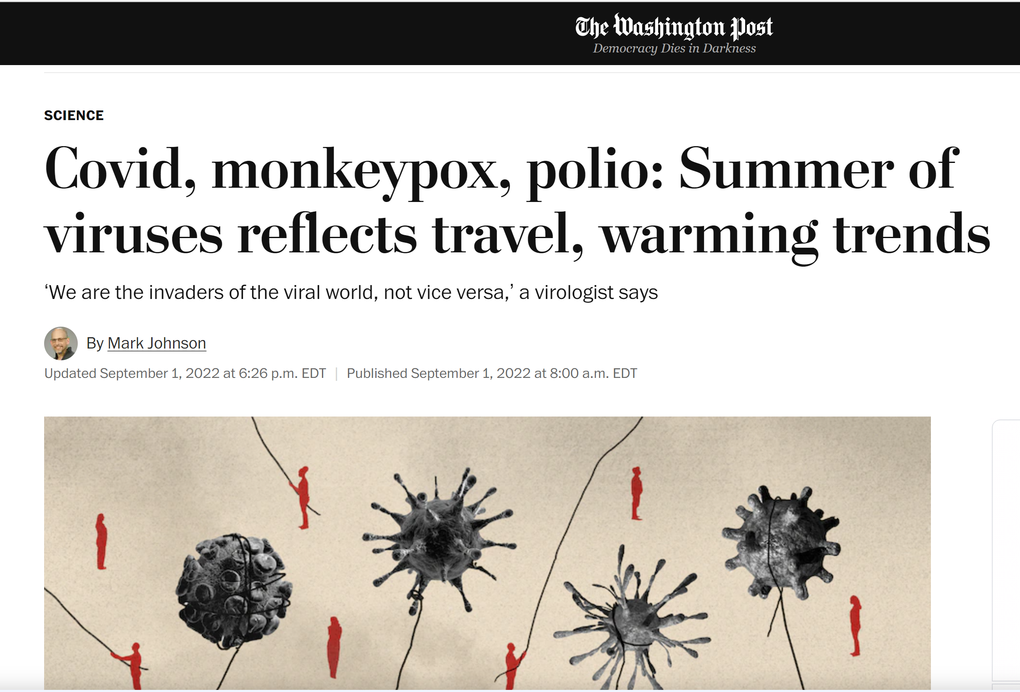

Slide 55
Congratulations !
David Hale and Chris Latimer
Miller Coulson Academy of Clinical Excellence (MCACE) ~ winners of the Frank L. Coulson, Jr. Award for Clinical Excellence.

Slide 56
Humanism in neurology
Donald Berwick, 2009

Slide 57
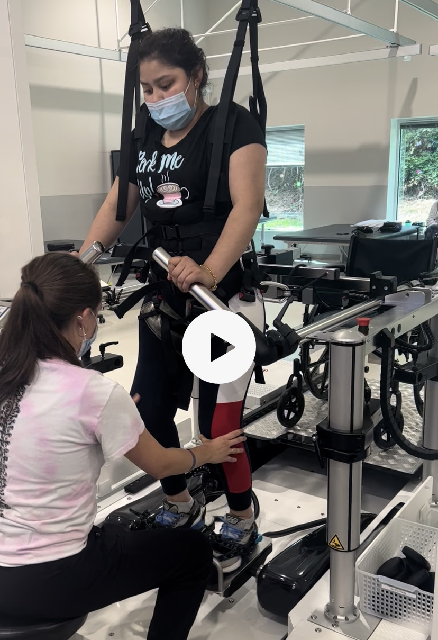
M’s story

Slide 58
Thanks to all of you….
Residents and fellows
Nurses, clinical techs, CMAs, PSCs, MOCs
Research staff
Faculty
Development team
Administration team
Research and finance teams

Slide 59
